Slide 1
Mobile Accessibility (Morning)
http://pz.tt/mobile22-AHG
Wifi: AHEADAHG Password: ahgdenver2022

Slide 2
2.3 Geolocation
Alternatives are provided for geolocation functionality that is mandatory (for example, requiring a specific geolocation before functionality appears), unless the geolocation is essential for legal reasons, or doing so would invalidate the activity. This applies to geolocation via GPS, user statement, IP address or other methods.

Slide 3
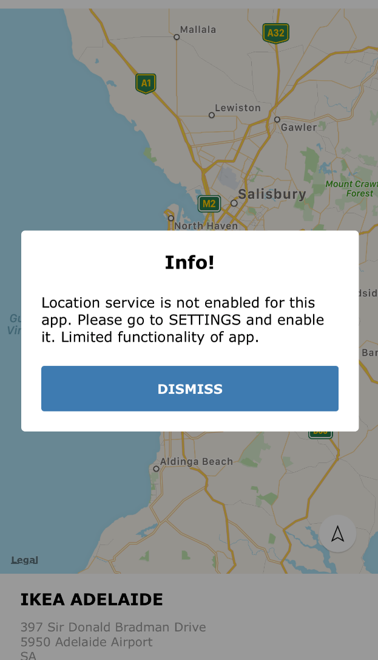
2.3 Geolocation
Fail – Blocking location

Slide 4
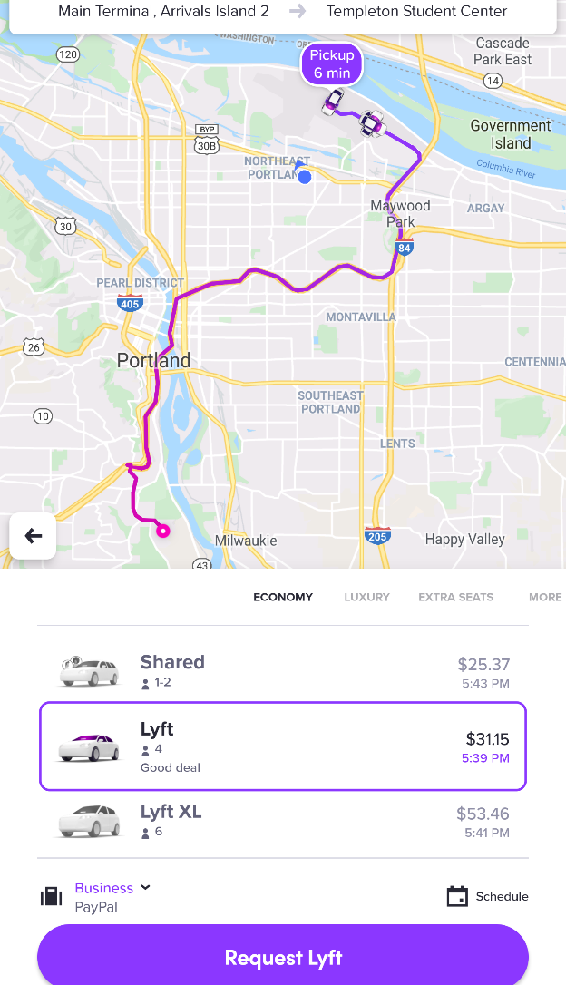
2.3 Geolocation
Pass – Choosing a different location

Slide 5
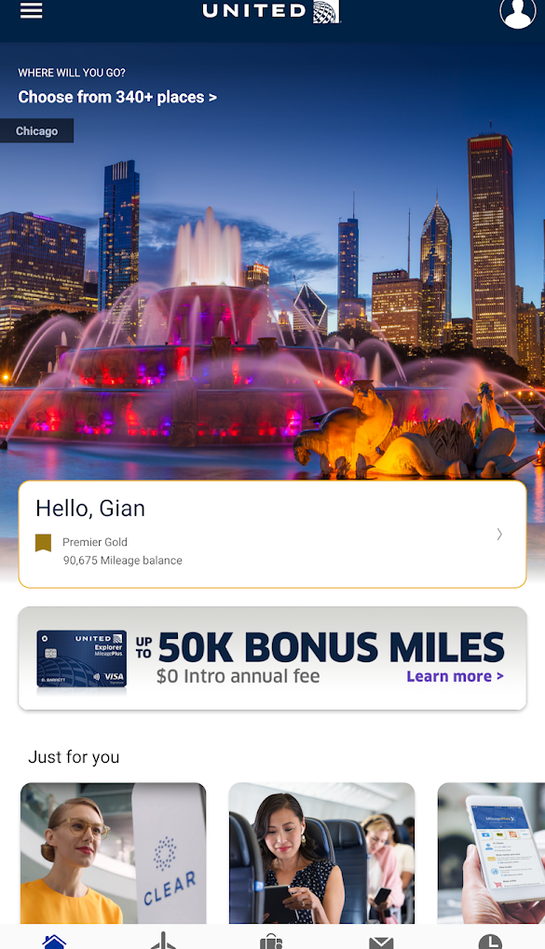
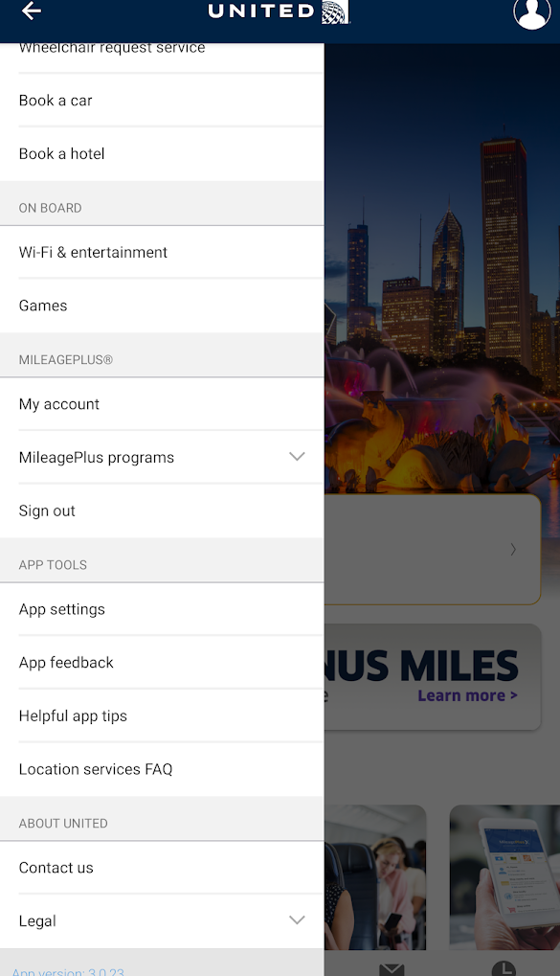
2.3 Geolocation
Changes of state of non-standard controls (e.g. hamburger menu, star ratings) are clearly indicated

Slide 6
2.8 Summary of content
Where the text requires reading ability more advanced than Flesch Kincaid level 8, a summary or description of content is provided (for more information see SC 3.1.5: Reading Level).

Slide 7
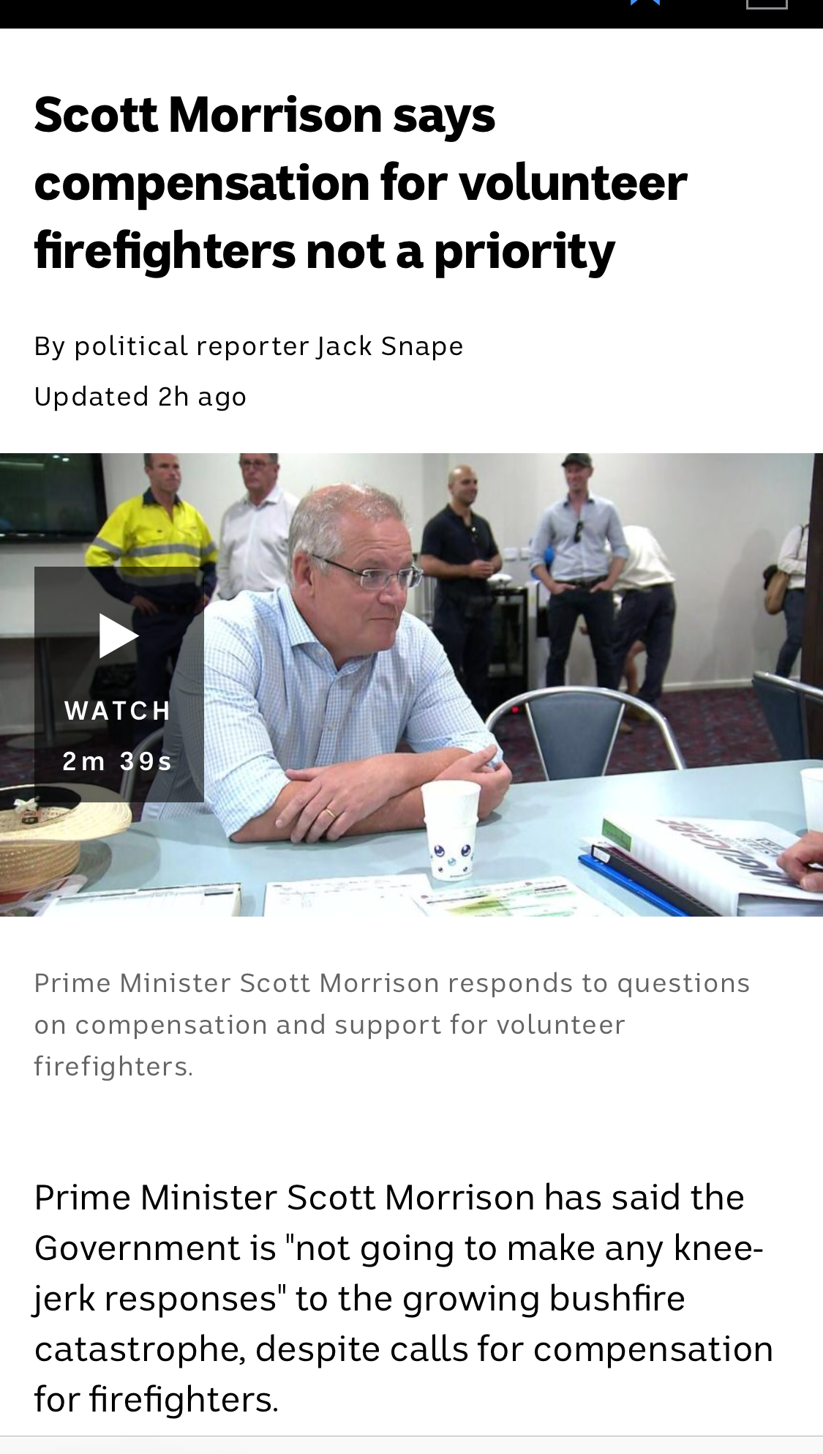
2.8: Summary of content
Fail – No summary provided
Notes:
The article does not provide a summary version.

Slide 8
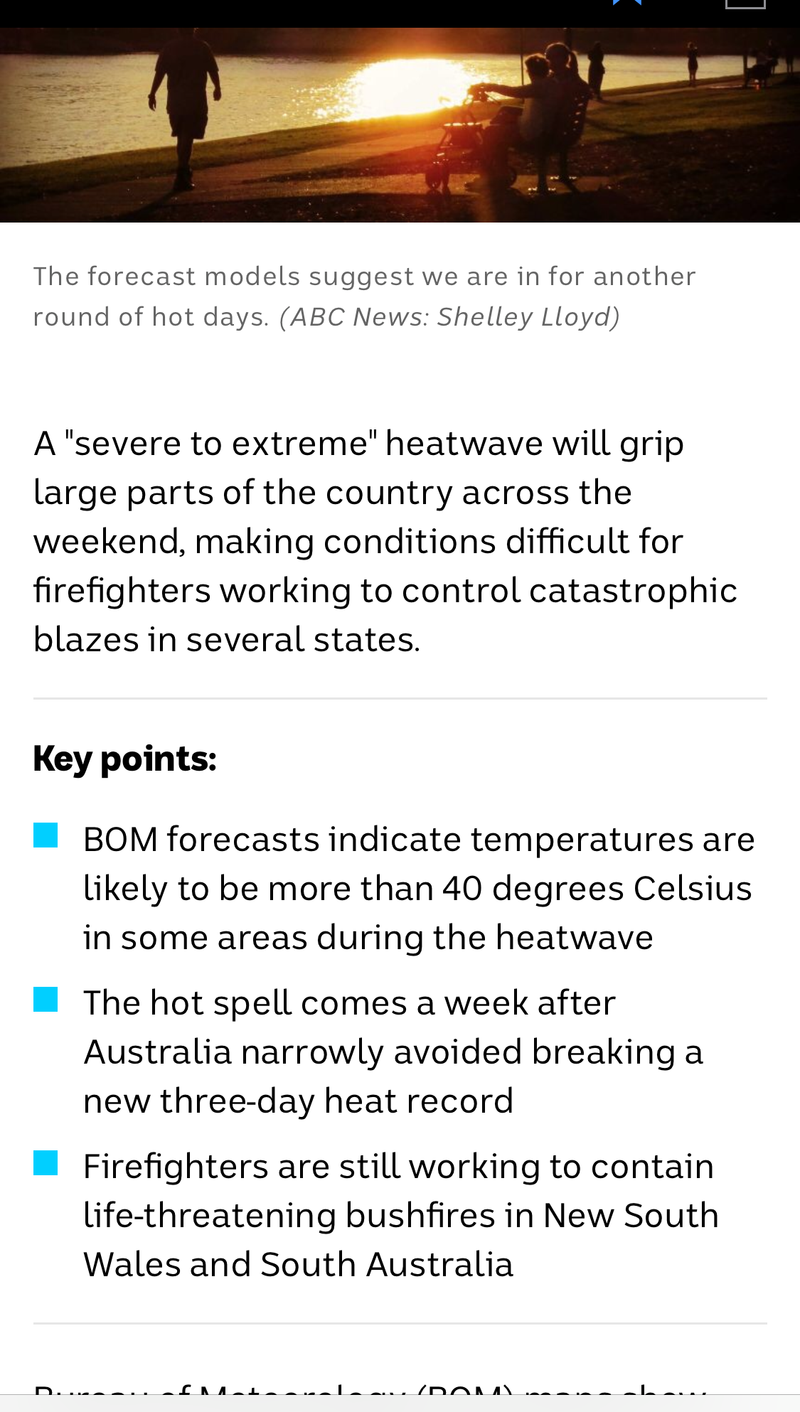
2.8: Summary of content
Fail – Summary does not meet Reading level 8
Notes:
The summary provided requires a Flesch Kincaid Reading Level of 16.4.
The summary reads "A 'severe to extreme' heatwave will grip large parts of the country across the weekend, making conditions difficult for firefighters working to control catastrophic blazes in several states."

Slide 9
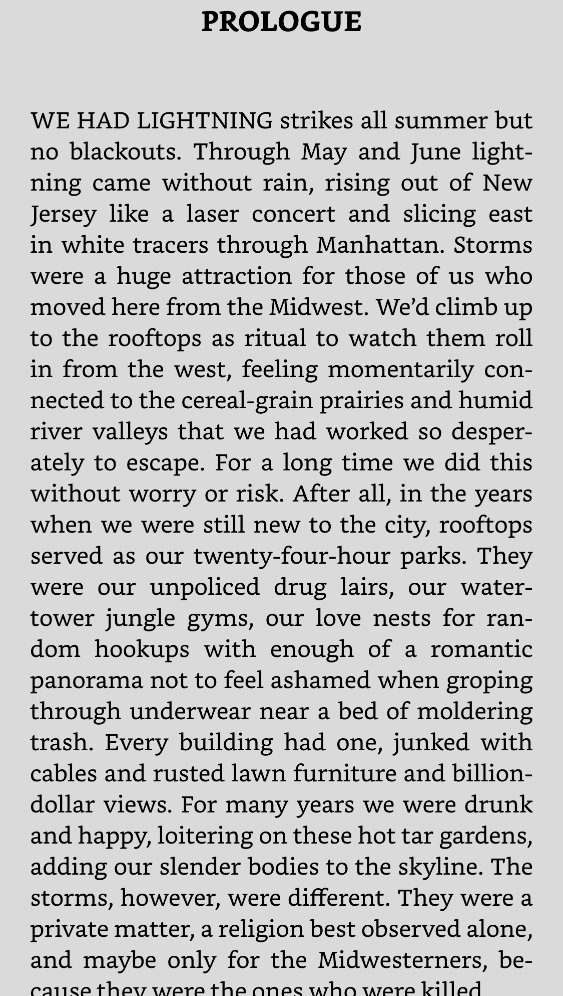
2.8: Summary of content
Pass – (Exclusion - Creative content) – Novel
Notes:
The novel “Lightning People” in the Kindle app does not need to meet the summary requirement.

Slide 10
2.9: Ambiguous text
Controls, primary headings, links, field labels and page titles are not ambiguous when read aloud.
Notes:
About this requirement
Screen reader users hear words spoken aloud. Therefore, there are some words which will be ambiguous to them, such as write / right, aloud / allowed, etc.
There are five types of ambiguous text:
Homonyms
Homophones
Heteronyms / Heterophones
Capitonyms
About homographs and heterographs
Please note there are two other terms that are used in these situations: homographs and heterographs.
Homographs have the same spelling and different meaning and the pronunciation is irrelevant. An example homograph is:
minute (60 in an hour)
minute (take notes)
minute (tiny).
Therefore, homographs are always either homonyms or heteronyms.
Heterographs have different spelling, different meaning and the same pronunciation. An example heterography is:
to (travel)
too (also)
two (one more than one)
Therefore, heterographs are also homophones.
About testing this requirement
This requirement is probably best tested by automation.
Exclusions
Creative content is excluded from this requirement.

Slide 11
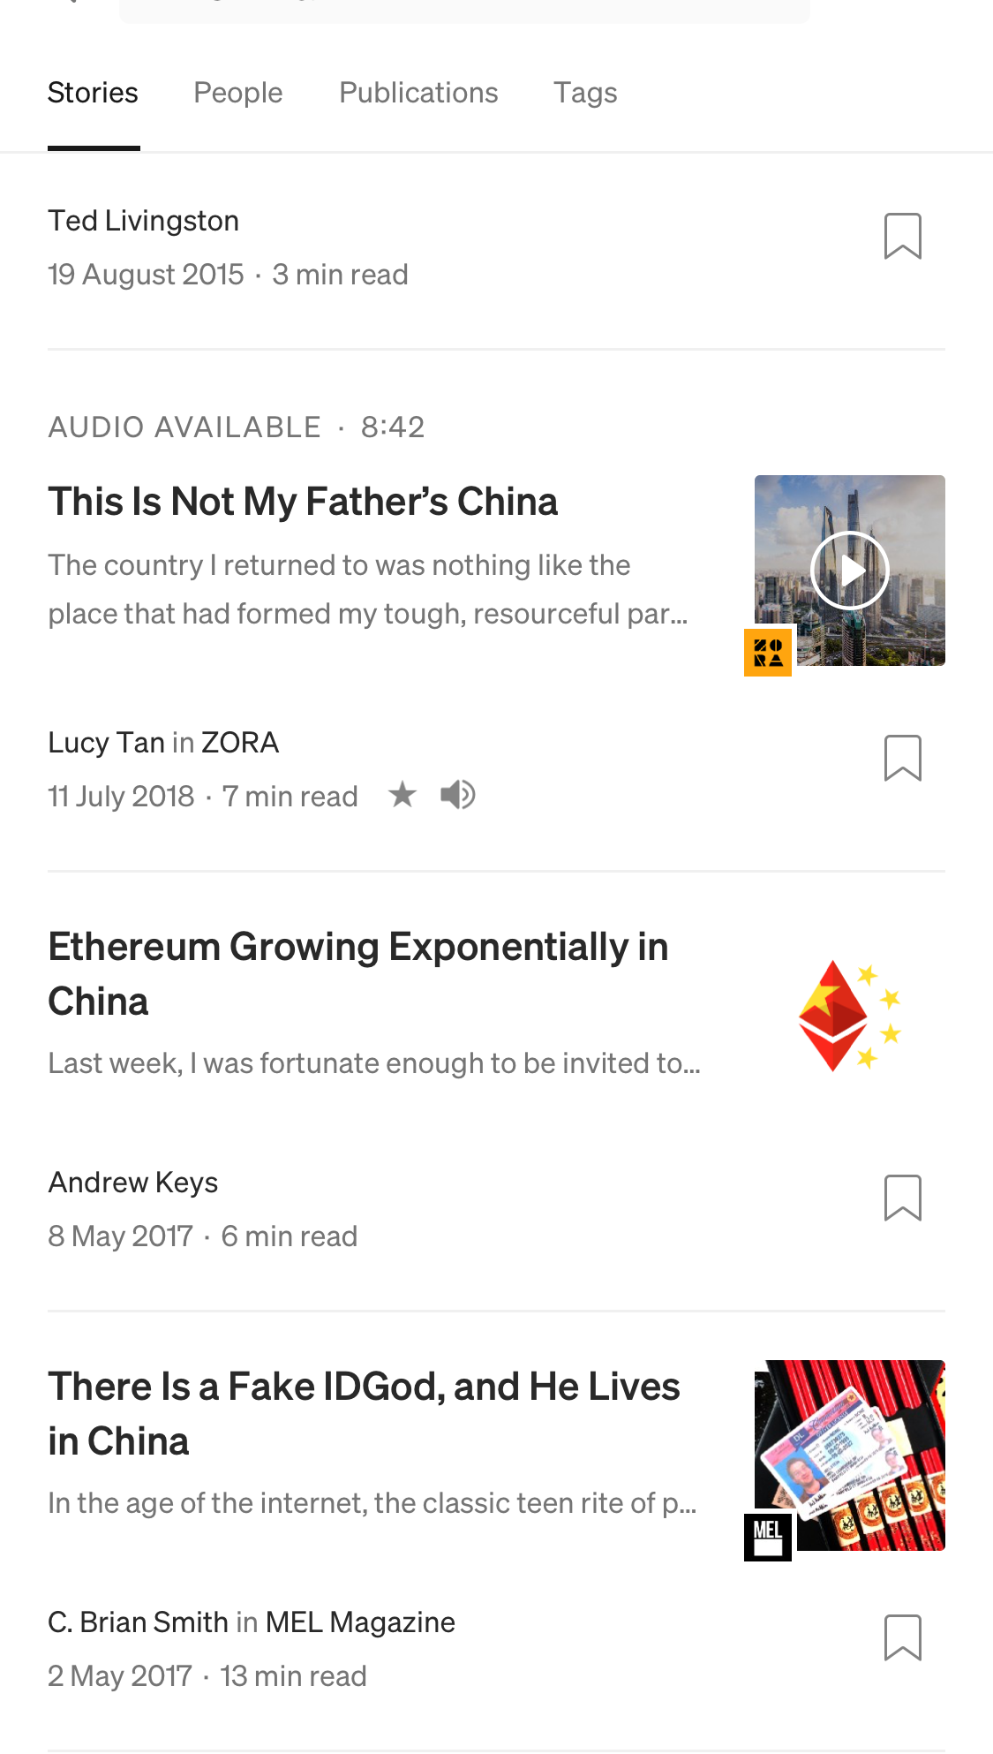
2.9: Ambiguous text
Fail – Ambiguous text - “This Is Not My Father’s China”
Notes:
It is unclear whether this article heading is referring to the country or to table settings.

Slide 12
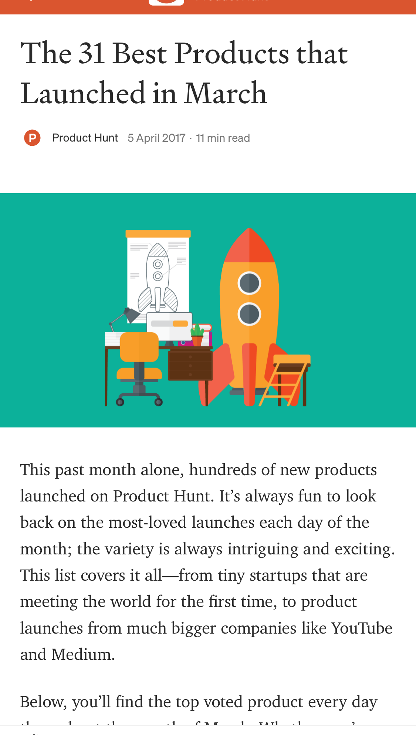
2.9: Ambiguous text
Pass – Unambiguous text - “The 31 Best Products That Launched in March”
Notes:
It is clear that the article refers to the month “March.”

Slide 13
Mobile Accessibility (Afternoon)
http://pz.tt/mobile22-AHG

Slide 14
Navigational aids

Slide 15
Navigational aids
5.1: Visual indicators
5.2: Character key shortcuts
5.3: Descriptive headings
5.4: Inactivity timeout
5.5: Navigation features

Slide 16
5.1: Visual indicators
Visual indicators, (such as arrows, next and previous buttons) have been used to indicate swipe or scroll areas or additional functionality.
Notes:
About this requirement
When using a mobile device there is less feedback presented to the user as to the functionality available. For example, on a desktop or laptop when the mouse hovers over an actionable item the cursor changes. This does not occur on mobile devices as mobiles are reliant on touch and not mouse movement. As a result it is important to appropriately indicate additional content or functionality so users are aware of them.
How to test
Identify all areas of the app where additional content or functionality is added.
Is there a visual indicator that indicates that swipe will show additional content?
Does this visual indicator meet color contrast, touch target size and inactive space requirements?

Slide 17
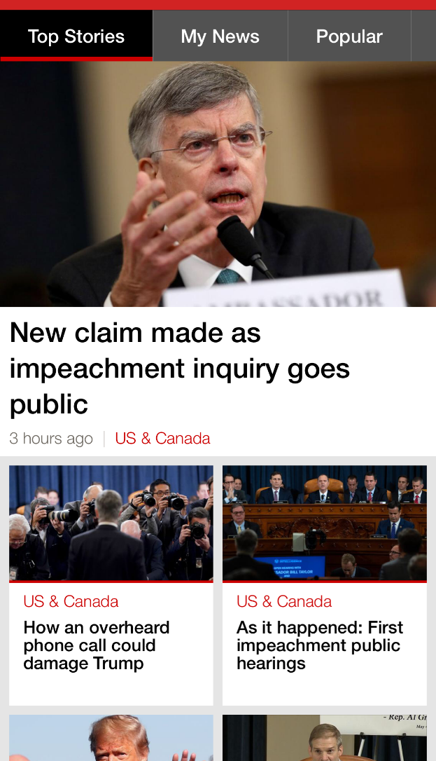

5.1: Visual indicators
Fail – No indicator of horizonal swipe
Notes:
Swiping from left to right moves to the next tab (from Top Stories to My News). This is not visually indicated anywhere on the page.

Slide 18
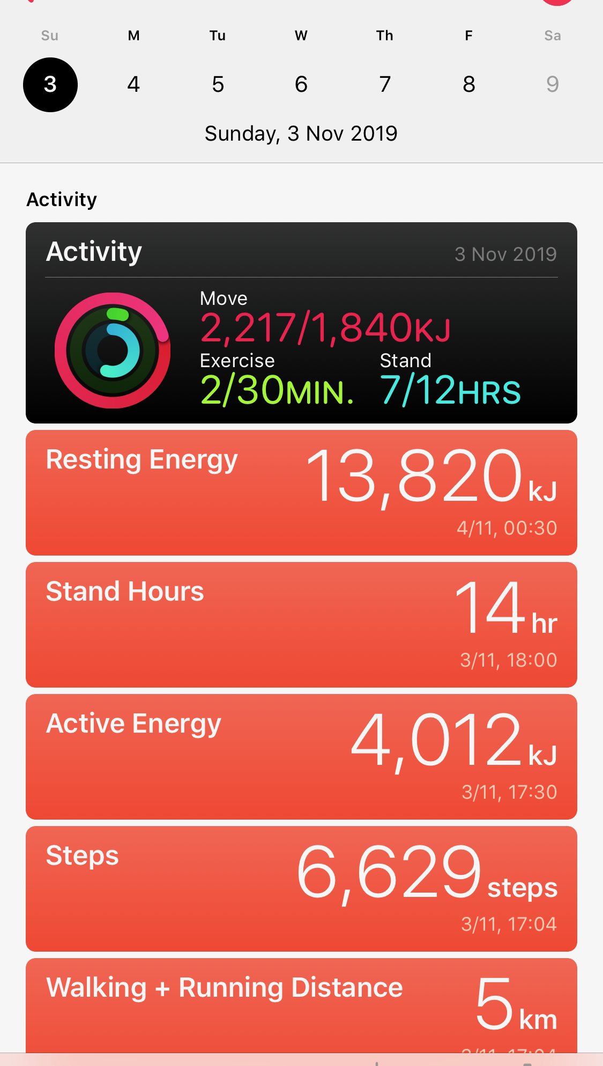
5.1: Visual indicators
Fail – Swipe to move to next week
Notes:
When on a particular week, you can swipe to the left or right to move between weeks. This does not have a visual indicator.

Slide 19
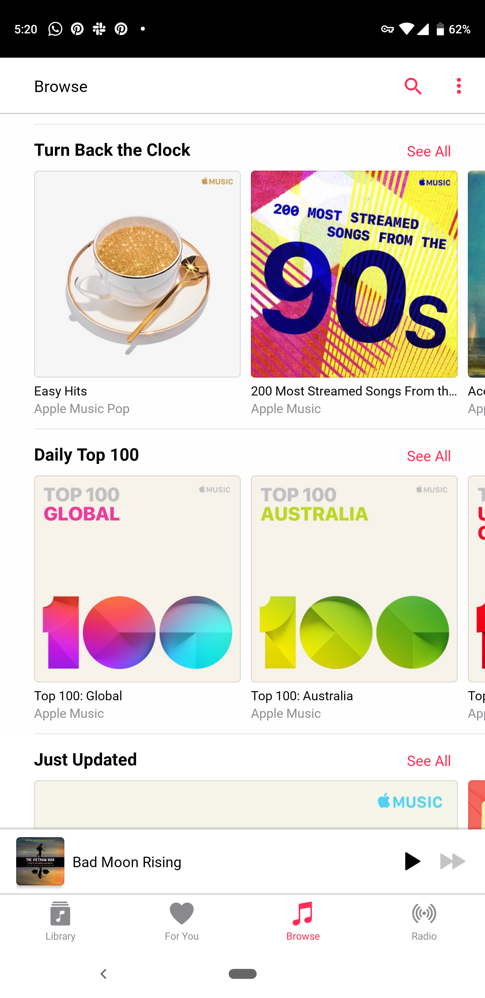
5.1: Visual indicators
Pass – Visual indicator of horizontal swipe
Notes:
Two album covers and a small portion of a third album cover is visible on the page. The fact that the majority of the third album is cut off, indicates that swipe can move through additional albums.

Slide 20
5.3: Descriptive headings
Blocks of content have descriptive headings (for more information see SC 2.4.10: Section Headings).
Notes:
About this requirement
For more information see SC 2.4.10: Section Headings.
Exclusions
Creative content is excluded from this requirement.
How to test
Pull out all the headings in the app.
Are the headings descriptive of their content?

Slide 21
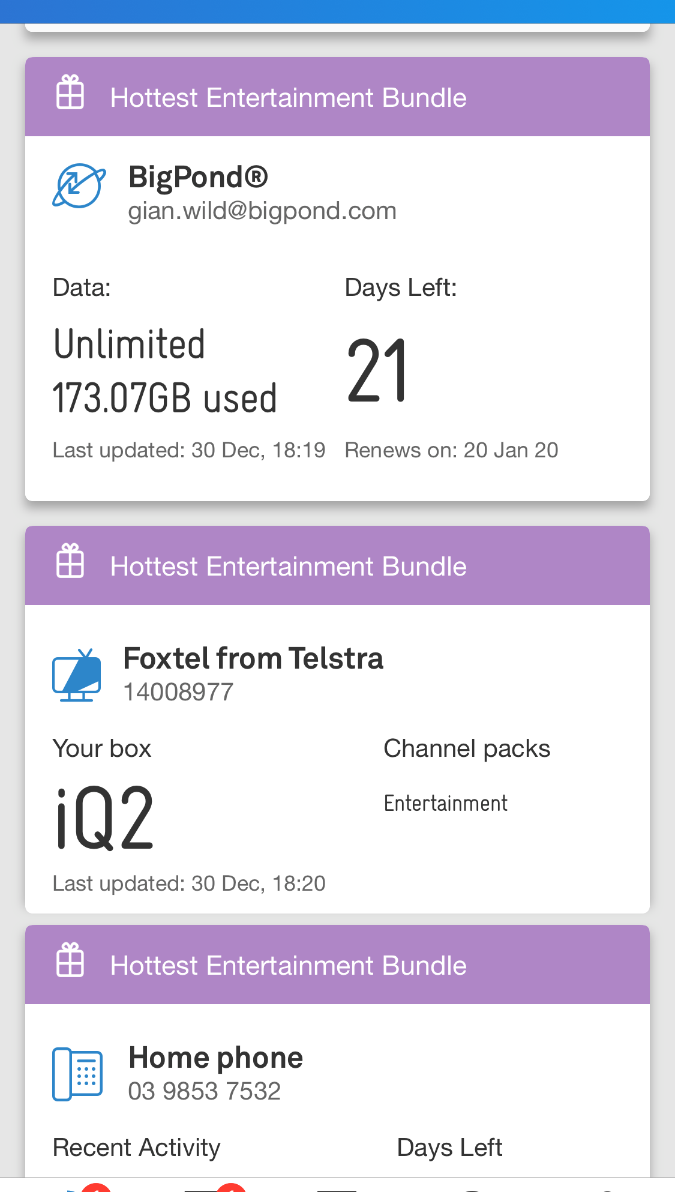
5.3: Descriptive headings
Fail – Nondescriptive headings
Notes:
In this app, the three headings “Hottest Entertainment Bundle” are not descriptive. The sub-headings “Bigpond,” “Foxtel from Telstra” and “Home phone” should be the headings.

Slide 22
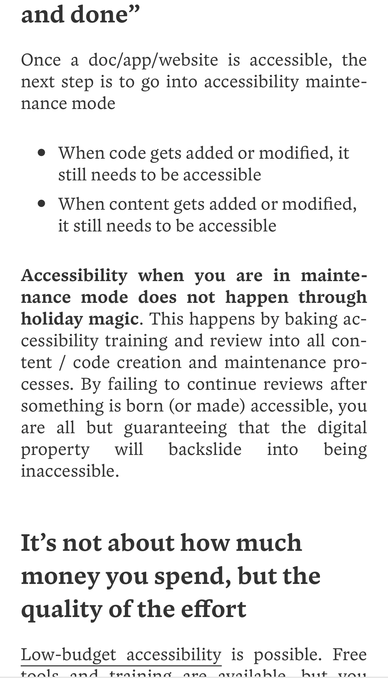
5.3: Descriptive headings
Pass – Descriptive headings
Notes:
In this article, the headings “Accessibility in never ‘one and done’” and “It’s not about how much money you spend, but the quality of the effort” are descriptive headings.

Slide 23
5.5: Navigation features
Navigation features such as back buttons, breadcrumbs, next and previous buttons are provided (for more information see SC 2.4.8: Location).
Notes:
About this requirement
Native apps do not contain standard navigation features that are available on browsers, such as a back button. Therefore, it is important that they are included in all native apps.
For more information see SC 2.4.8: Location.
Navigation features that are recommended on all native apps are:
Back buttons
Menu link on all pages
Breadcrumbs
Sitemap
Indicating the current section in navigation (without using color alone)
Next and previous buttons in features such as image galleries, slideshows and multi-page forms.
How to test
Open the application.
With the screen reader feature off, starting from the landing screen, explore each page of the application.
Look to see whether navigational aids – i.e. elements such as back buttons, breadcrumbs, next and previous buttons are provided as part of the design.
Ensure that these elements, if used repeatedly, are placed consistently on the pages on which they appear. Ensure these elements are also visually consistent. (See SC 3.2.3 Consistent Navigation)
Ensure that each element receives visible focus on touch.
Ensure that each element is operable through swipe gesture and touch activation (double-tapping or other).
Ensure that each element has the same functionality on each page on which it appears.
Ensure that the page, screen or element is the expected destination as defined by the navigational aid.
Ensure that each element on the page that is clearly labelled to indicate the purpose (buttons) and/or is descriptive of its purpose and/or destination (breadcrumb links).

Slide 24

5.5: Navigation features
Fail – No clear navigational aids
Notes:
There are no clear navigation features within the design to allow a user to move through the application. In the iTunes app on Android, when a song is playing there are no navigational aids visible.

Slide 25
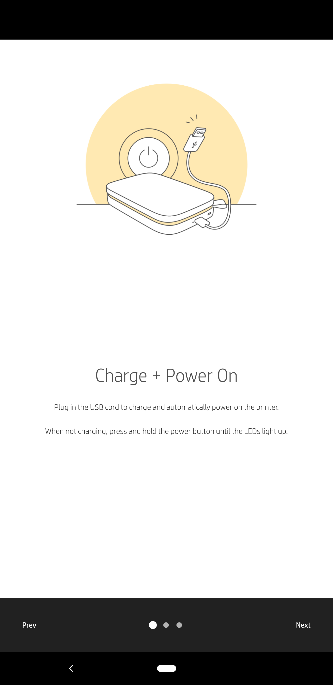
5.5: Navigation features
Fail – Navigation features are not accessible
Notes:
The elements (Prev and Next) are present but not clearly labelled or sufficiently descriptive to indicate clearly their purpose and/or destination. The word “Prev” is not sufficient as a descriptor.

Slide 26
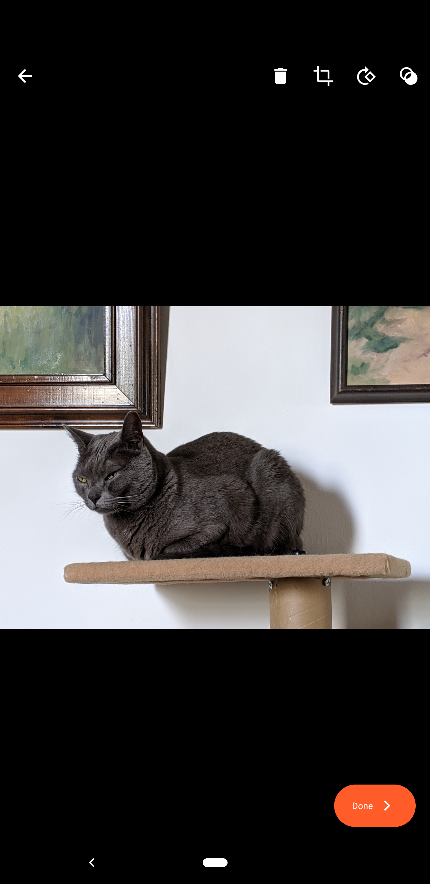
5.5: Navigation features
Pass – Back and Done buttons
Notes:
In the photos app in the Google Pixel, when looking at a photo you can go back (top left arrow) or select the Done option (bottom right)

Slide 27
Audio and video

Slide 28
Audio and video
6.1: Transcript
6.2: Captions
6.3: Live audio and video

Slide 29
6.1: Transcript
All video and audio have an accessible transcript.
Notes:
About this requirement
Although captions are essential to people who are Deaf or hard of hearing and audio descriptions are essential for people with vision impairments, there are users that either cannot interpret these features or are Deaf-Blind. In this case, the only accessible method is to provide a transcript. Please note that the transcript must include both the audio and visual content in the video. It is not sufficient to have a transcript of only speech.
How to test
Open the application.
Navigate to the page(s) that contains – or launches – the video or audio player or file link.
Ensure that there is a textual transcript alternative available on the same page as the video or audio player.
Ideally it is adjacent to the video or audio player, with easy access.
The transcript may be in the form of text on a separate page in the application, or available as a download, or is available on a web page that is launched from the native app.
Access and read the transcript to ensure the textual transcript accurately reflects the content of the video or audio file.
Ensure the transcript is perceivable and operable using the built-in screen reader feature on mobile, whether on a page, webpage or PDF.
Ensure that any links to the transcript, or a title for the transcript document, is descriptive and clearly identifies the transcript as the content.

Slide 30
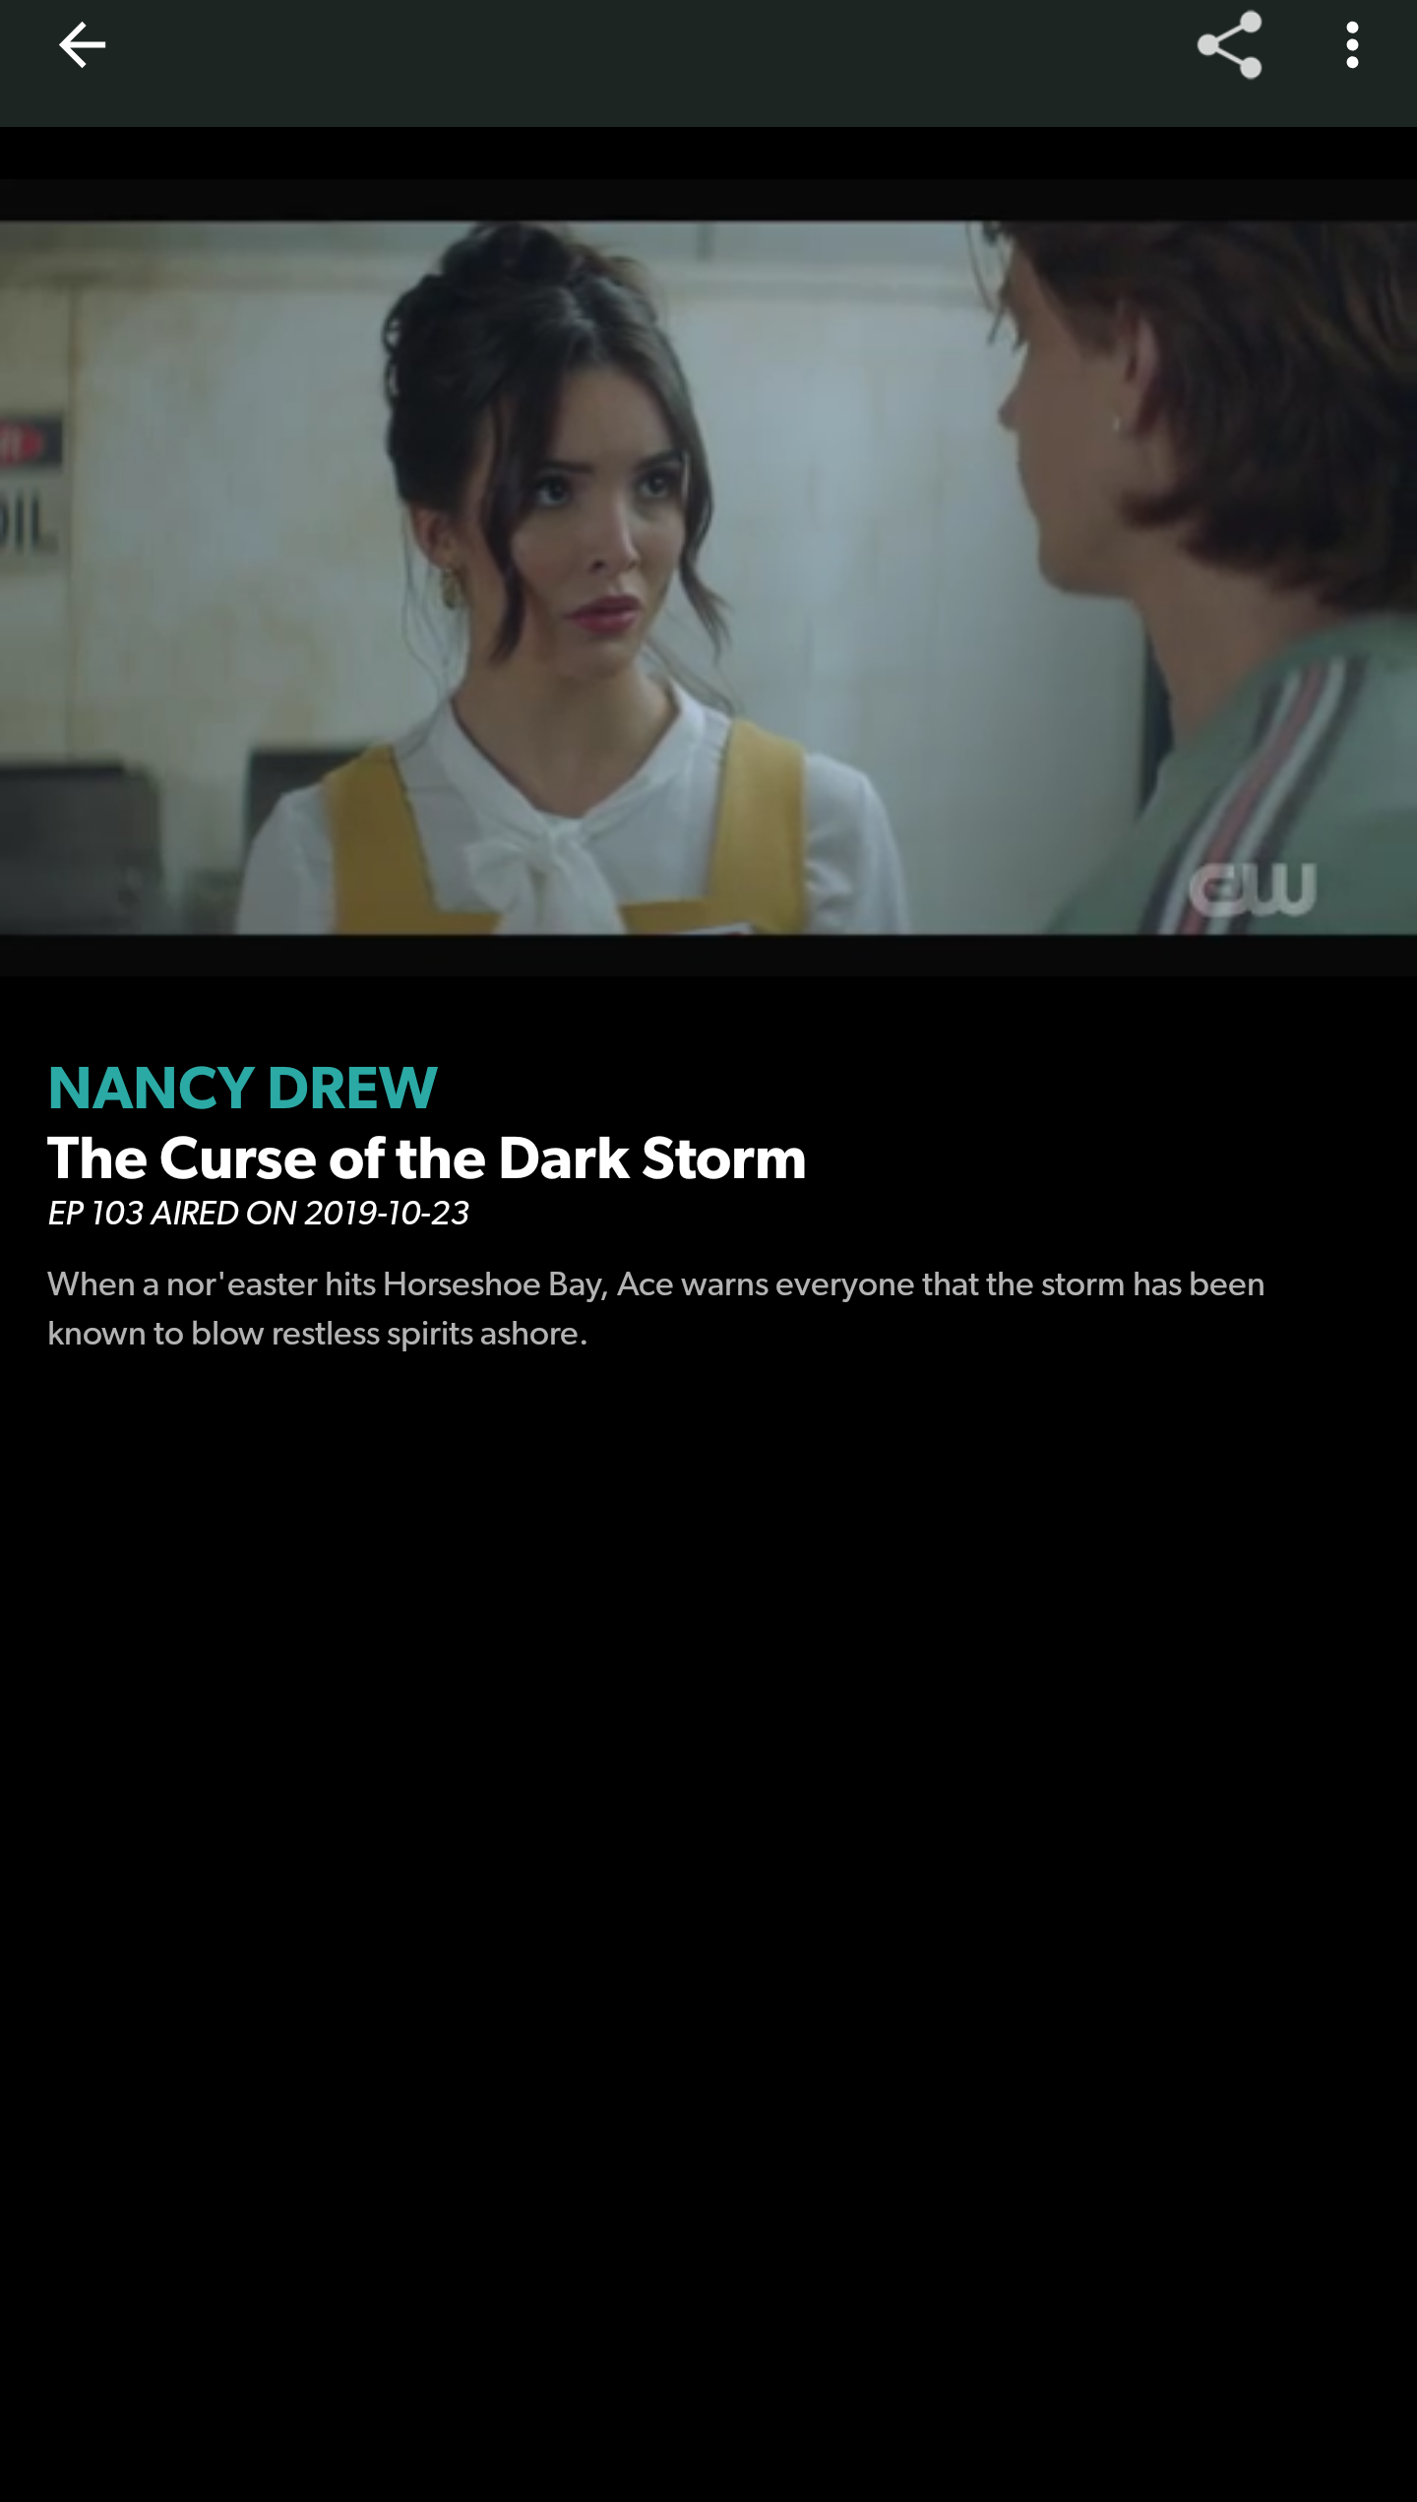
6.1: Transcript
Fail – There is no text transcript alternative to the video or audio file
Notes:
In the CW app, you can watch episodes of different television shows. The episodes do not have a transcript.

Slide 31
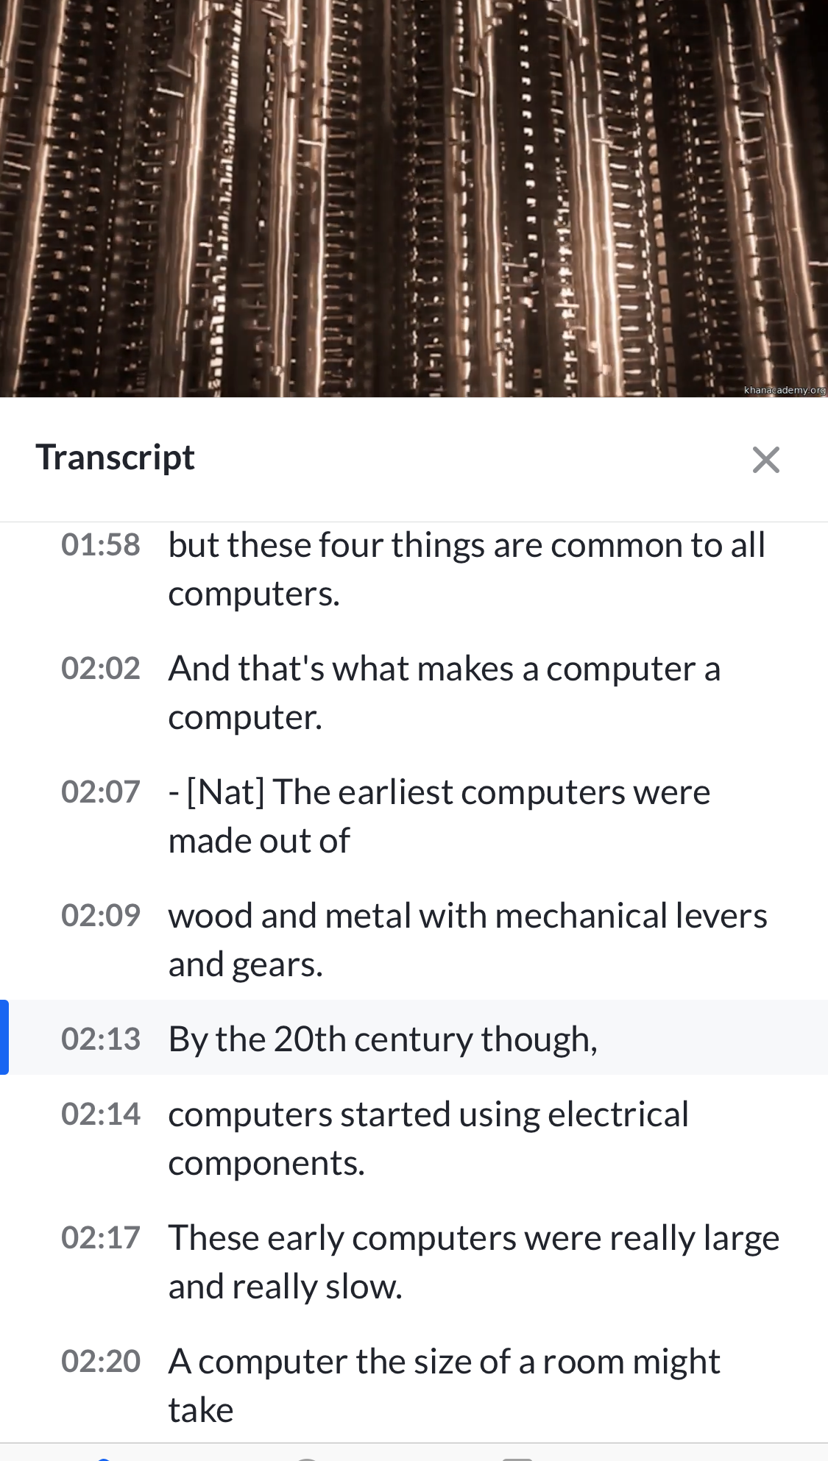
6.1: Transcript
Fail – The transcript is a direct transcription of the captions only
Notes:
In this example the transcript does not include descriptions of the visuals.

Slide 32
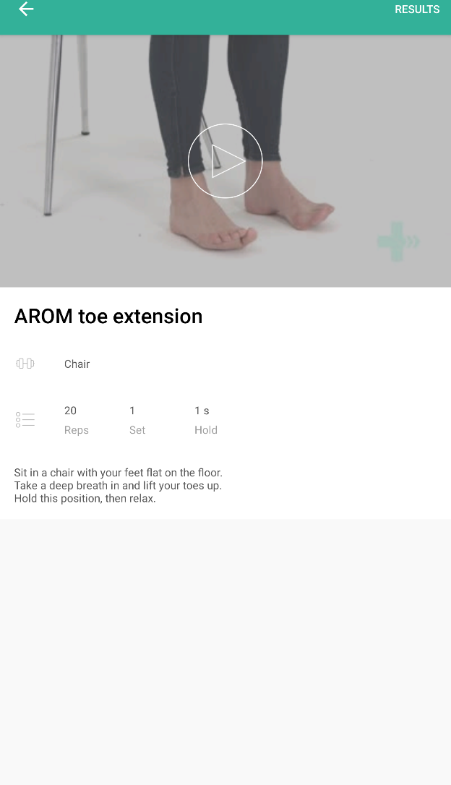
6.1: Transcript
Pass – Transcript is available and accurate
Notes:
A video showing the exercise is accompanied with a text transcript that accurately describes the entire video.

Slide 33
Forms

Slide 34
Forms
7.1: CAPTCHAs
7.2: Context-sensitive help
7.3: Error prevention
7.4: Positioned field labels
7.5: Visible field labels
7.6: Accessible name
7.7: Form and keyboard interaction

Slide 35
7.4: Positioned field labels
Field labels are positioned adjacent to their input field and appear closest to their respective input field in relation to other field labels and other input fields.
Notes:
About this requirement
As a mobile device has a small screen, if field labels are positioned far away from their respective input fields it is possible that they will not appear on the screen at the same time as the field that they describe. In addition, where a field label is positioned close to other input fields it may be unclear to some users which field the field label describes.
How to test
Review the application for form fields
Ensure that all form fields have adjacent field labels
When two or more form fields appear on the same screen, ensure that field labels appear adjacent to their respective form fields and are placed closest to their form field than other form fields
Ensure that field label spacing and layout is consistent between like form fields on the same screen.
Ensure that all form fields and field labels maintain accessible color contrast ratios in all states (e.g. selected/not selected)

Slide 36
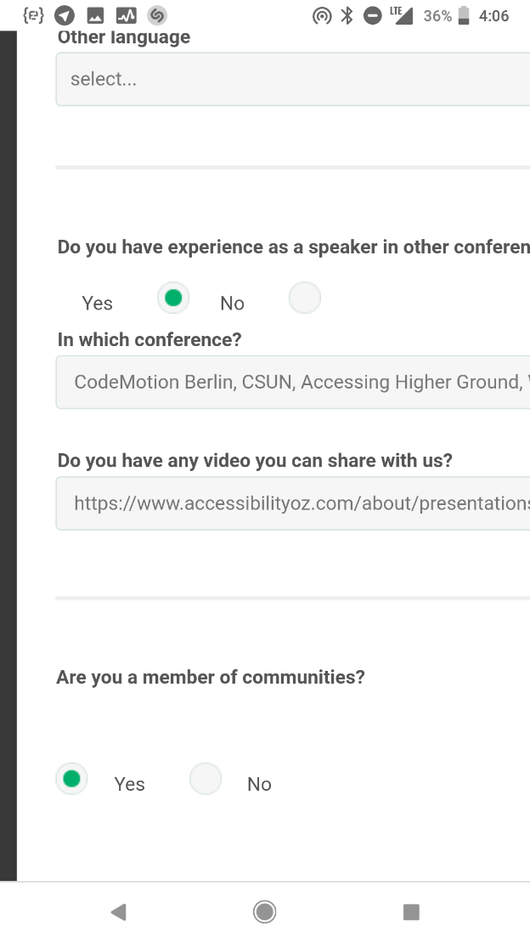
7.4: Positioned field labels
Fail – Input fields equidistant to field labels
Notes:
The radio button is equidistant from the Yes option and the No option. In addition to the unselected radio button not meeting color contrast, it is not clear which option is selected.

Slide 37
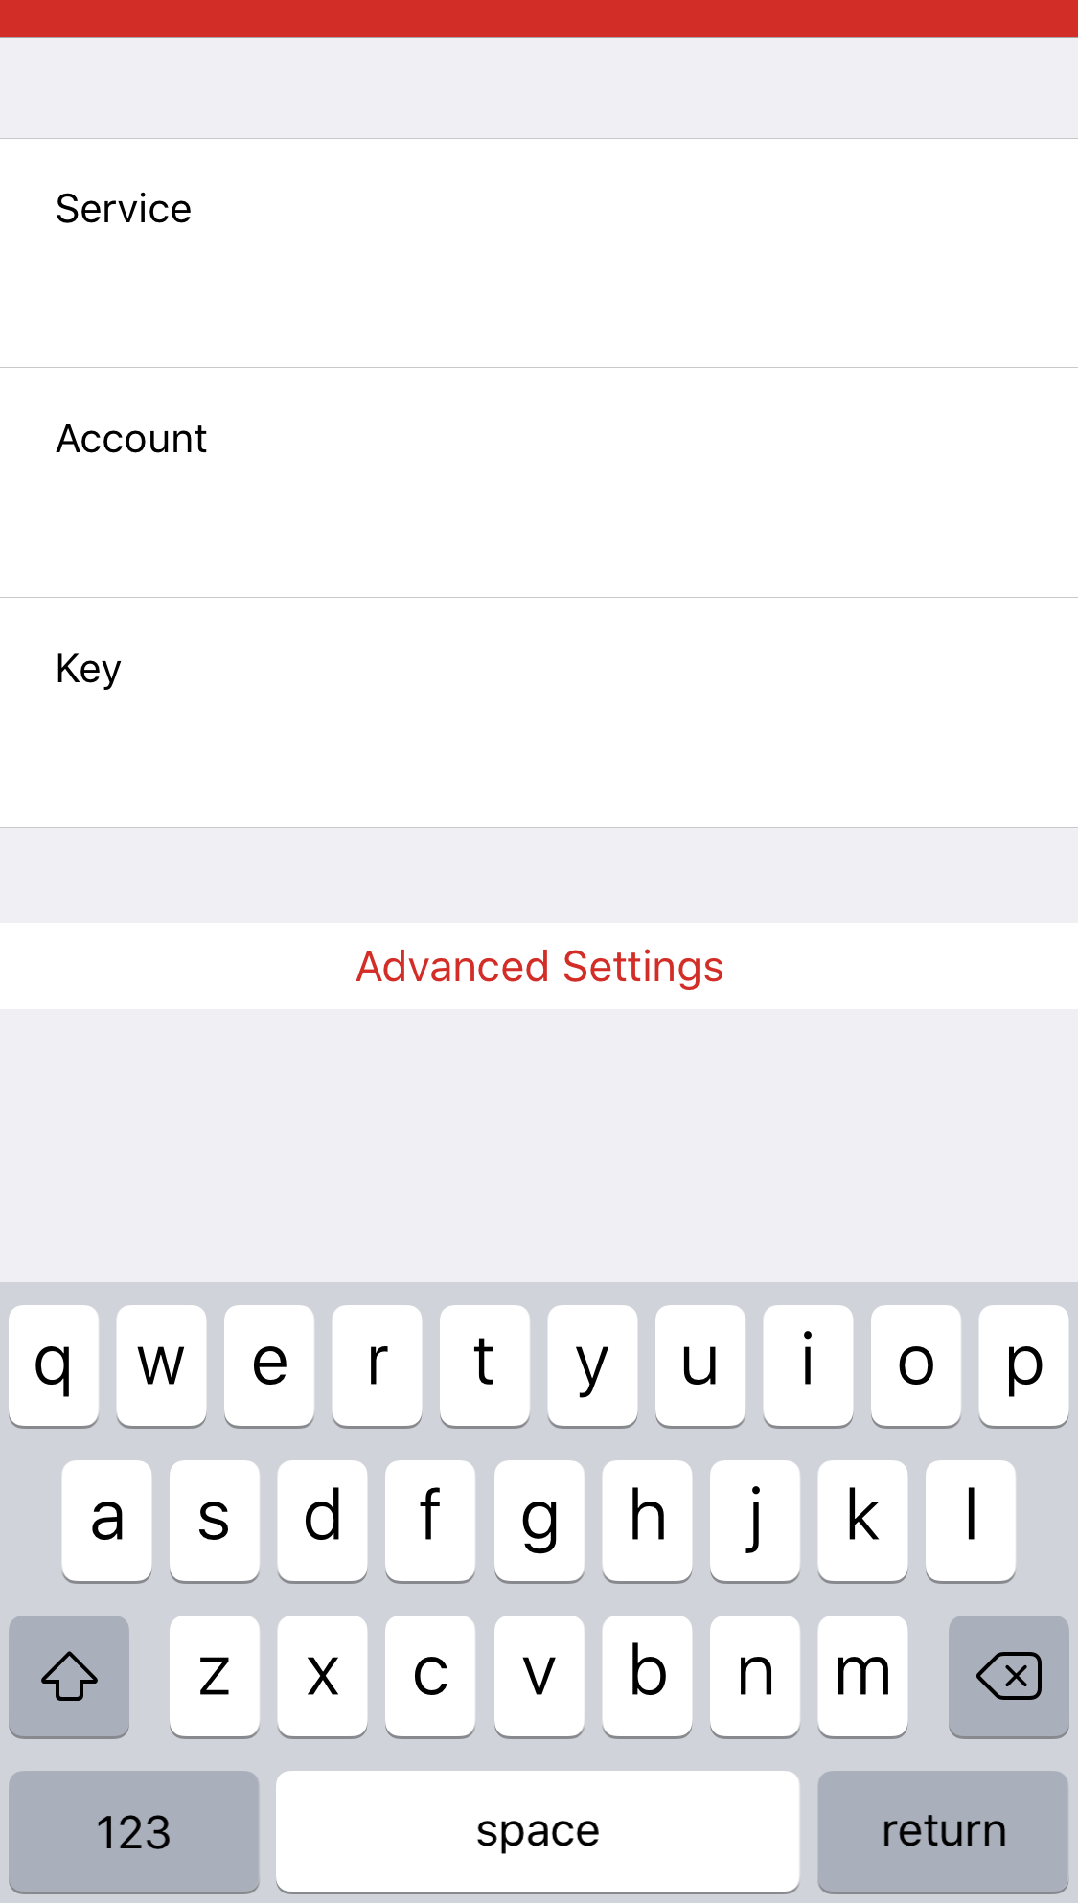
7.4: Positioned field labels
Fail – Differentiation has been provided but it is not sufficient
Notes:
Each field label (Service, Account, Key) is equidistant from the input field above and below the respective field. Although there is a border between one field and another, it does not meet color contrast requirements.

Slide 38
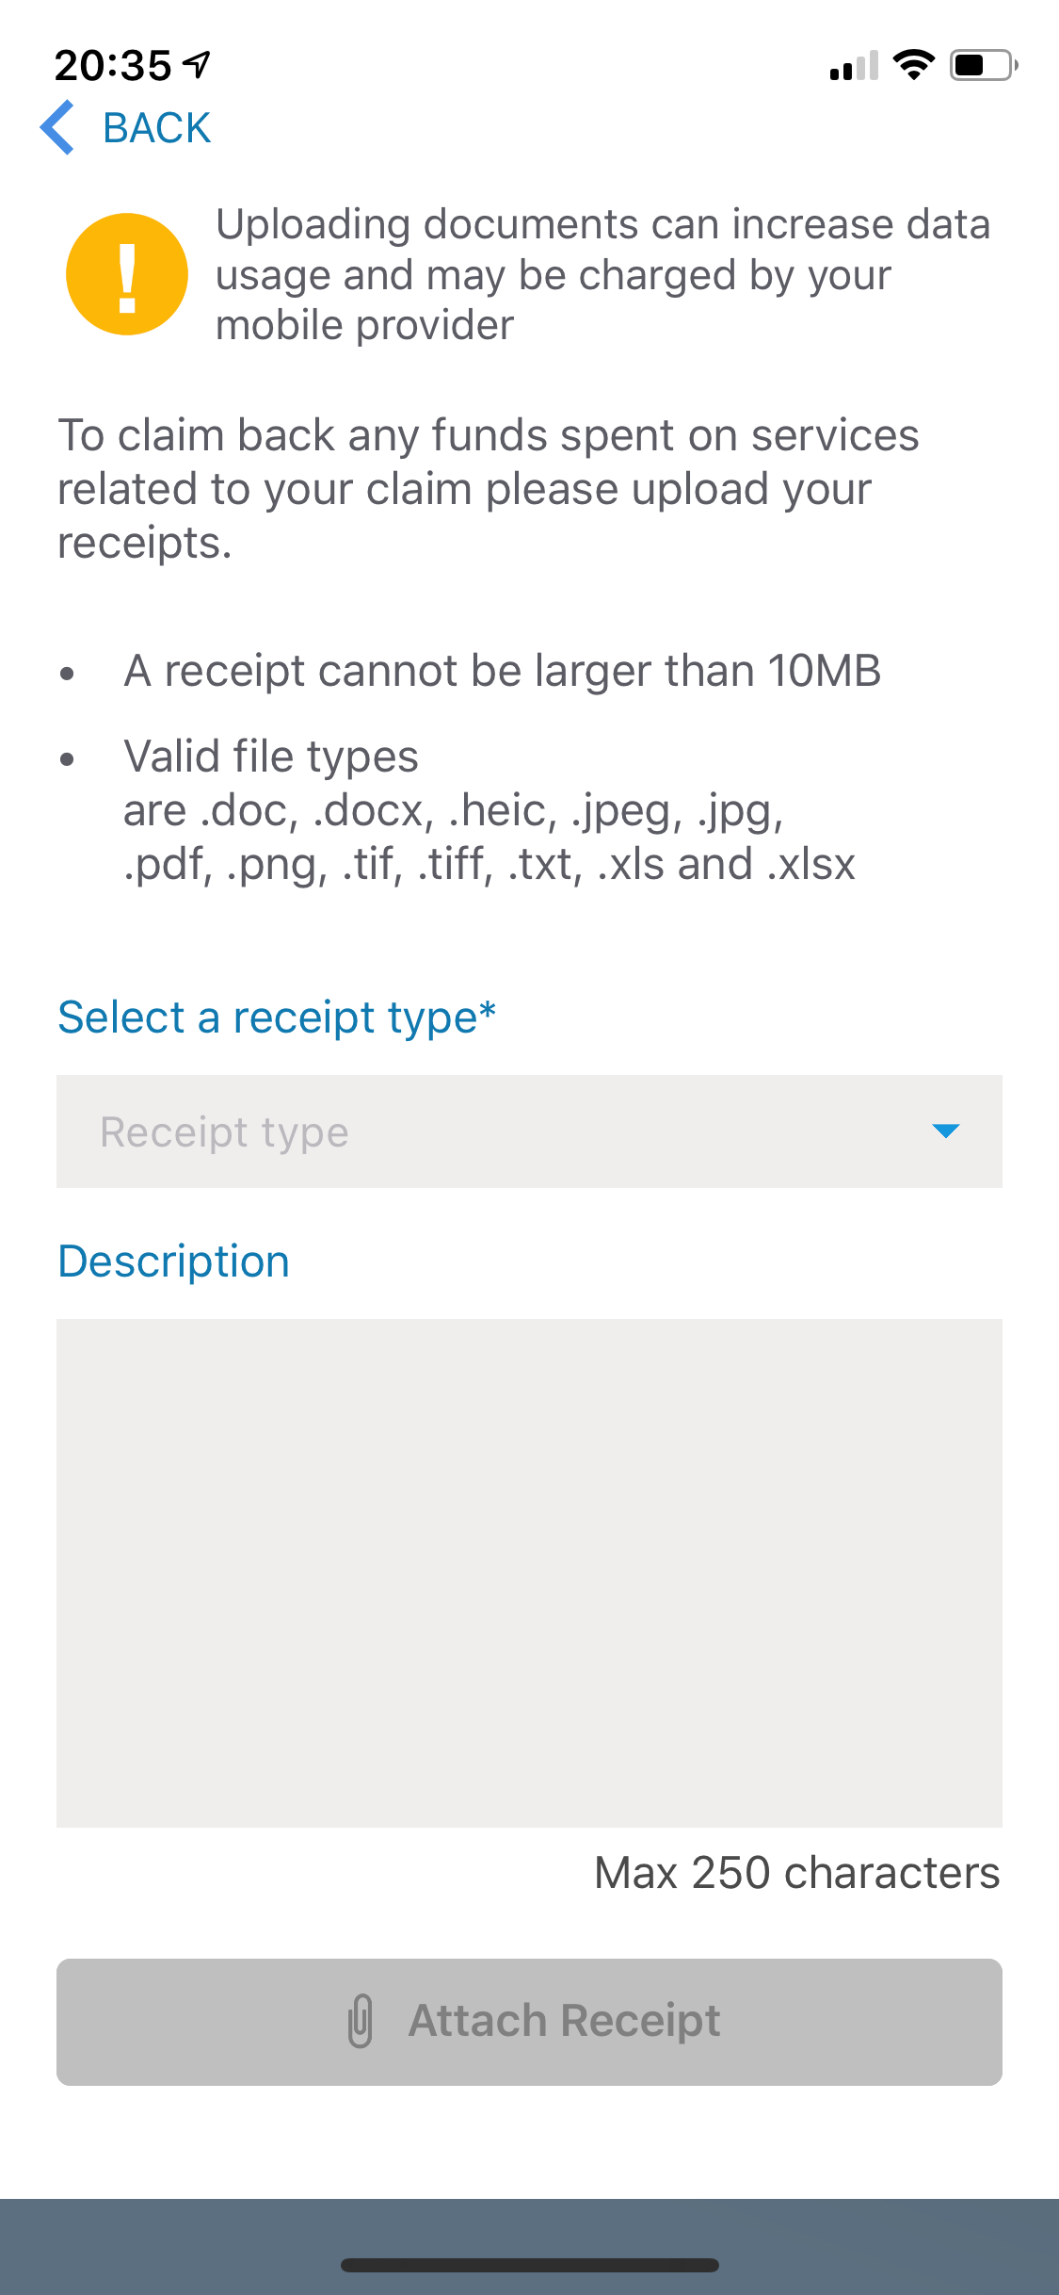
7.4: Positioned field labels
Pass – Input fields are located close to their field labels
Notes:
In this example, the field labels (Select a receipt type and Description) are closer to their respective input fields than to any other input field.

Slide 39
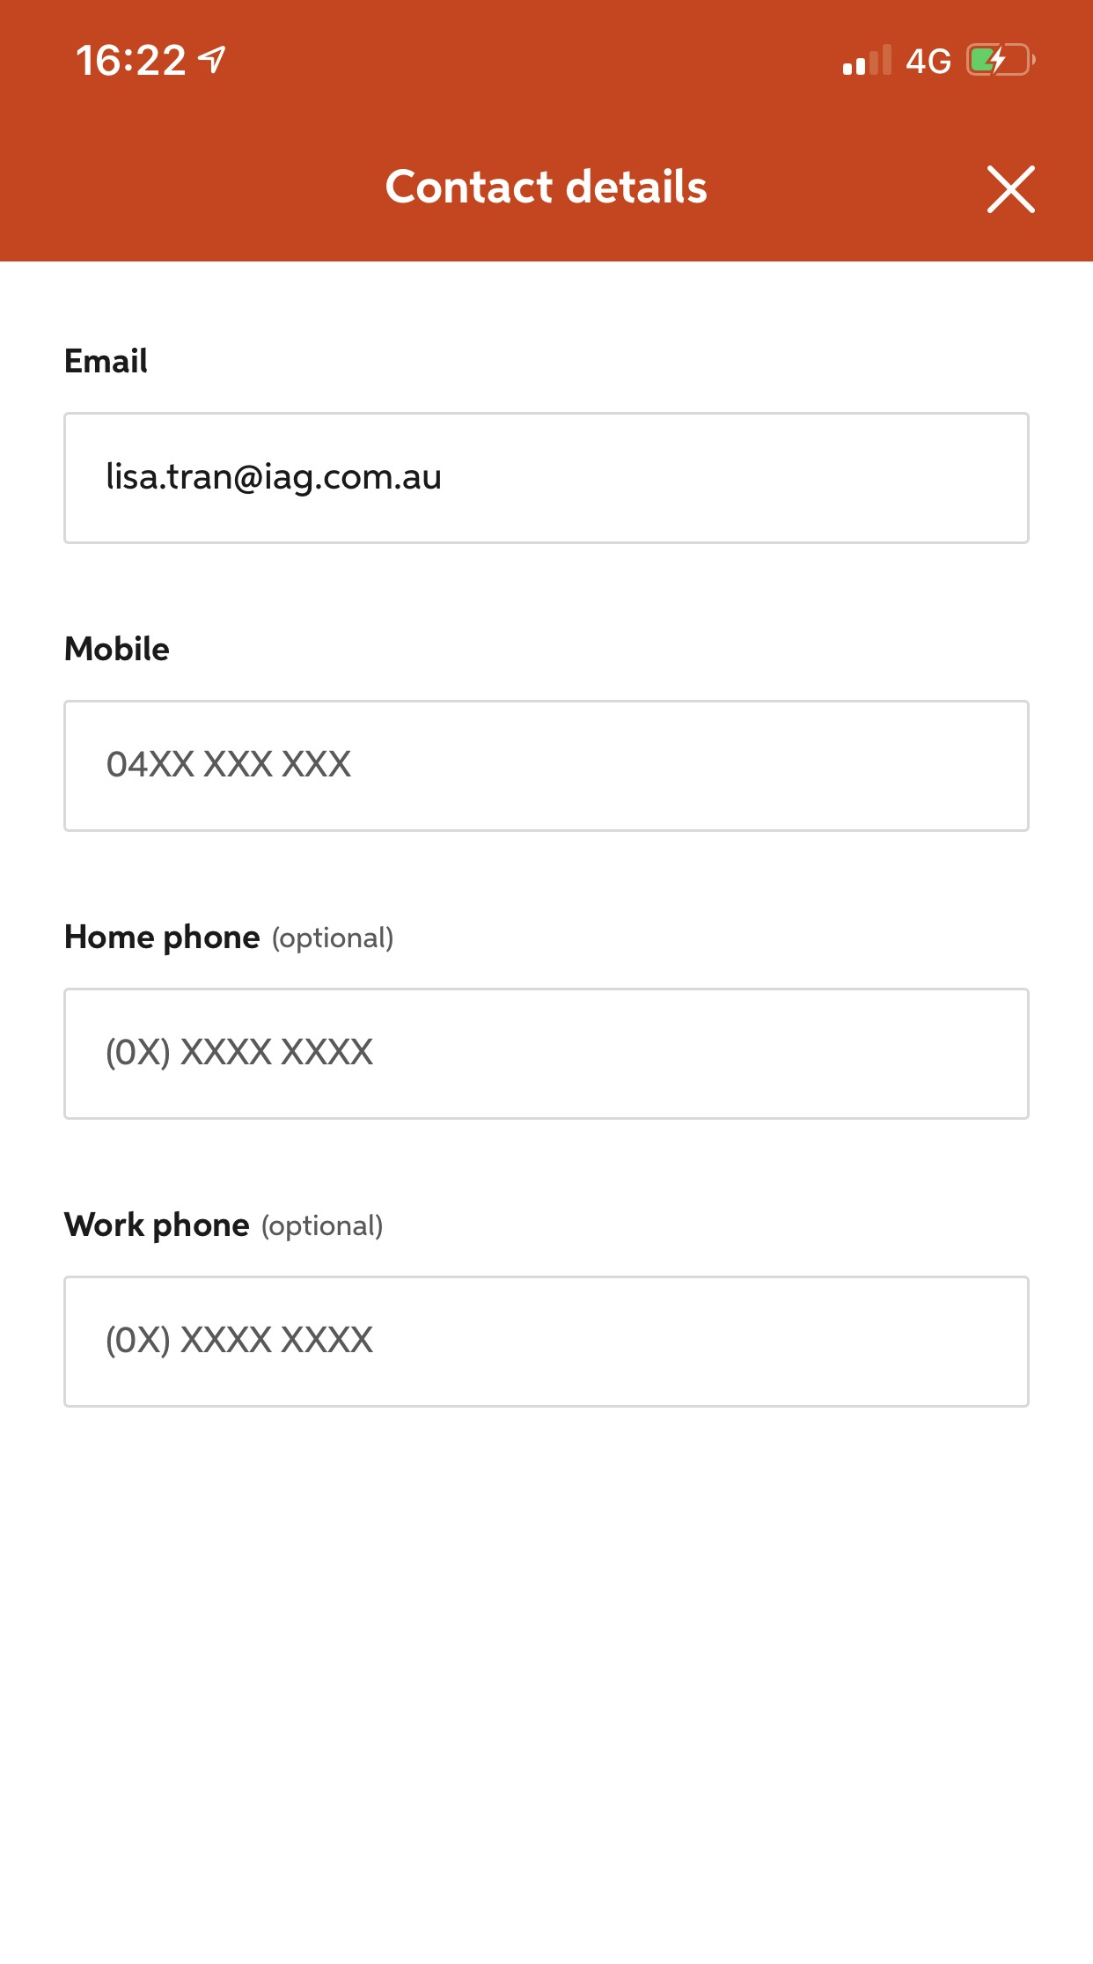
7.4: Positioned field labels
Pass – Input fields are located close to their field labels
Notes:
In this example, the field labels (Select a receipt type and Description) are closer to their respective input fields than to any other input field.

Slide 40
7.5: Visible field labels
Fields must have an associated visible label which is also programmatically associated with the field (please note that placeholding characters do not meet this requirement) (for more information see SC 2.5.3: Label in Name).
Notes:
About this requirement
WCAG2 allows for labelling of input fields by adjacent buttons or other items. As a mobile device has a small screen, if adjacent buttons or items are positioned far away from their respective input fields it is possible that they will not appear on the screen at the same time as the field that they describe. Therefore, this committee believes that all fields should have a visible field label that is also programmatically associated with the field.
What do we mean by “visible field label”?
Although a text label for a field is preferred, this requirement does allow for a visible field label that is an icon or an image. However please note that SC 1.1.1: Non-text Alternatives would still apply.
Are placeholding characters visible field labels?
This committee does not believe that placeholding characters are an appropriate visible label for three reasons:
By default, placeholding characters do not meet color contrast requirements and therefore will not be visible to some users.
Placeholding characters that disappear when a user focuses on a field means the describing label is lost at this point.
Placeholding characters that do not disappear when a user focuses on a field cause multiple problems for users of assistive technologies such as screen readers and often mean they cannot submit the form correctly.
How to test
Review the fields in the form.
Does each field have a visible field label – text or icon?
Is the visible field label accessible (placeholding characters do not meet accessibility requirements)

Slide 41
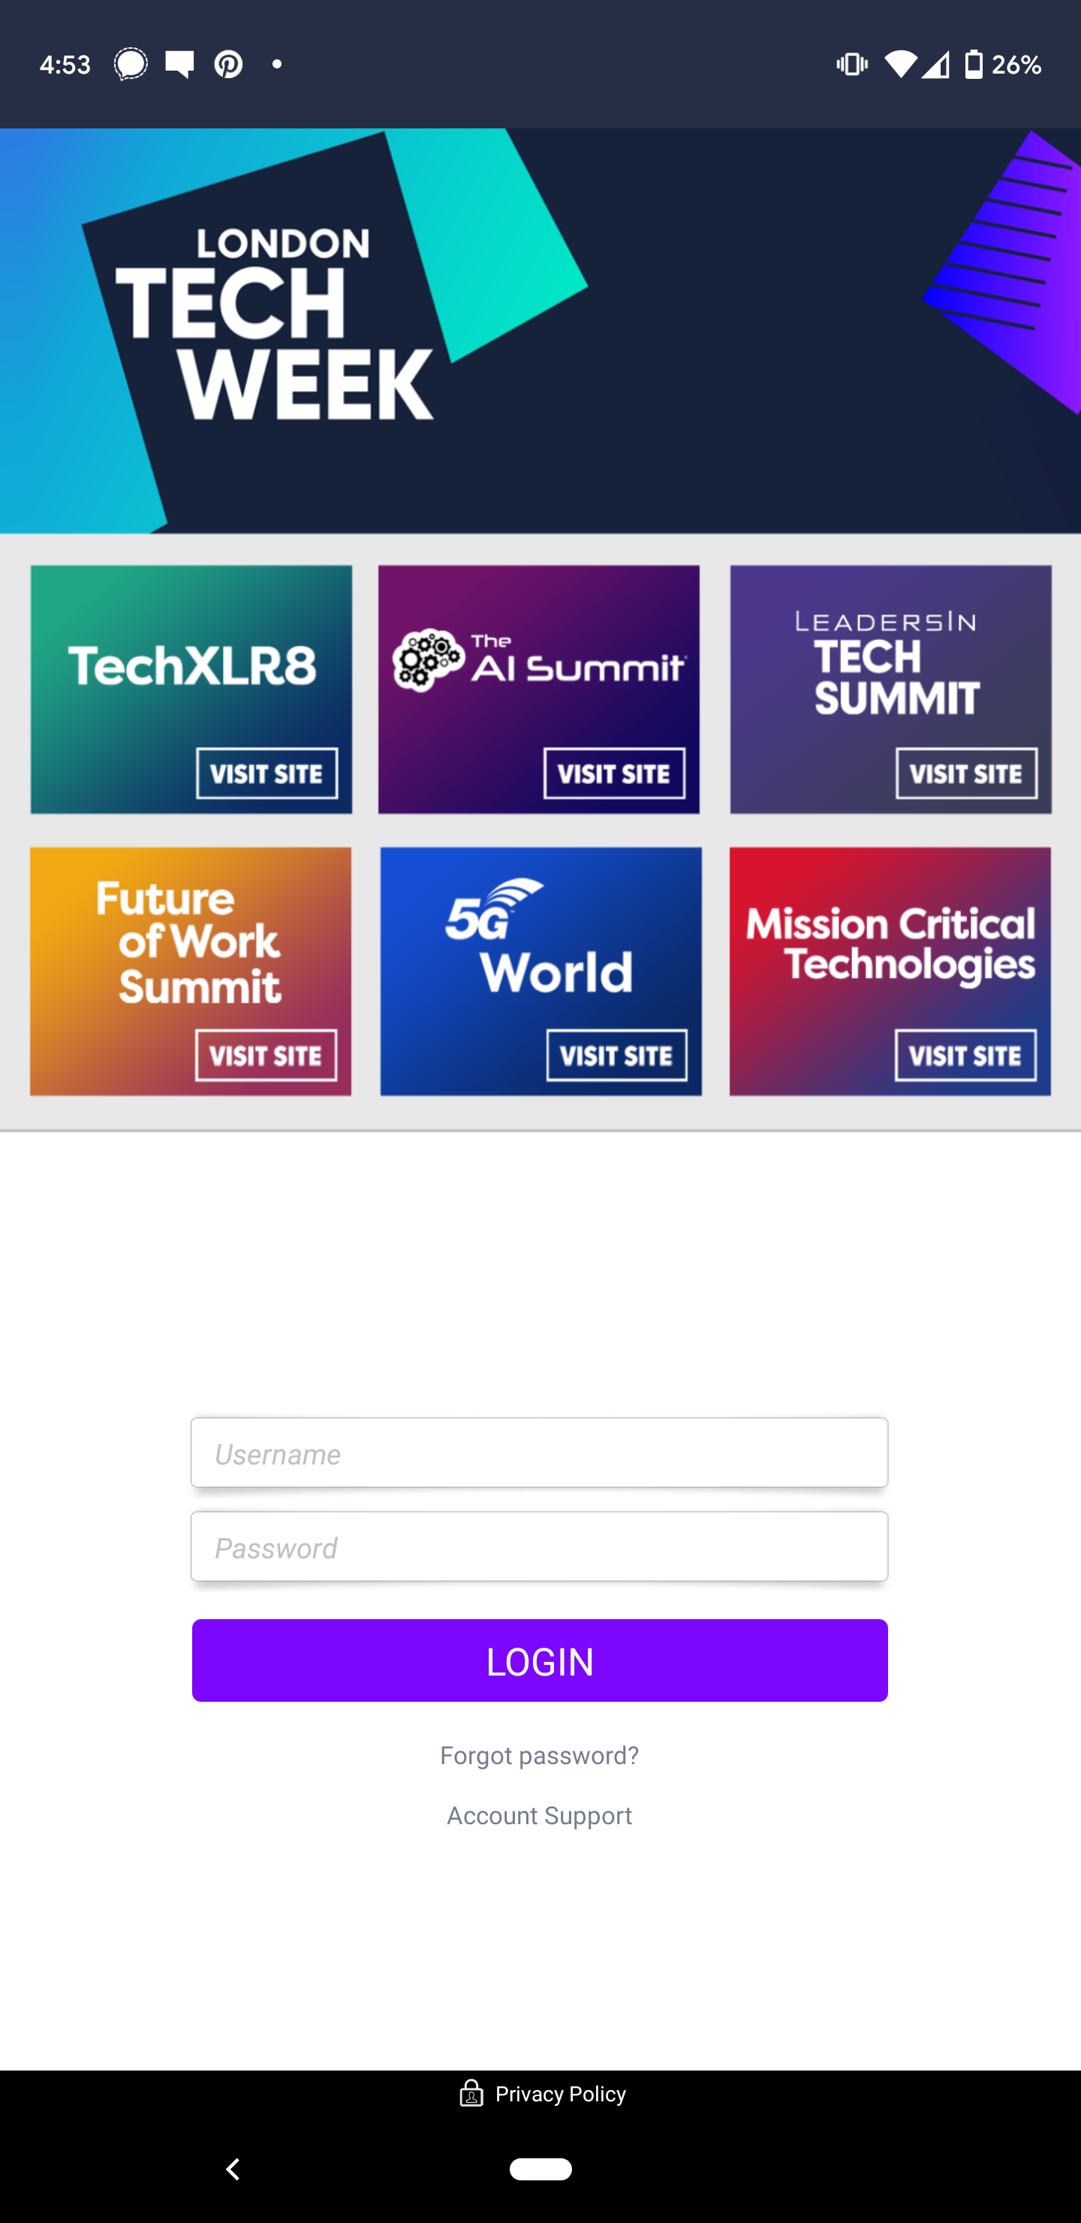
7.5: Visible field labels
Fail – Placeholding characters
Notes:
This app uses placeholding characters as visible field labels.

Slide 42
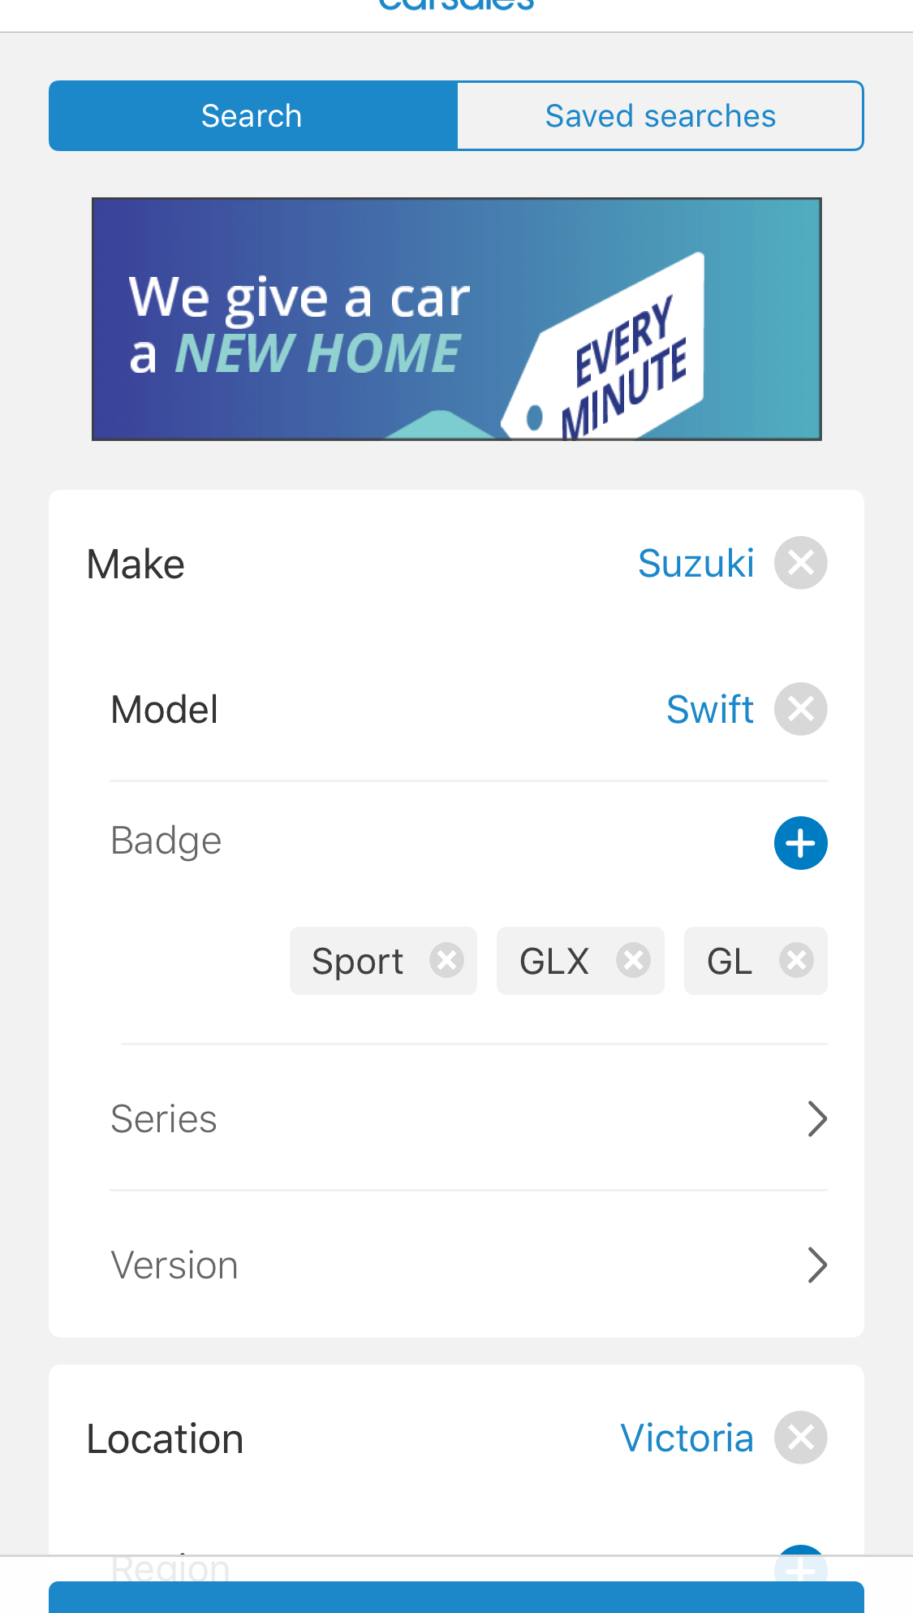
7.5: Visible field labels
Pass – Text field labels
Notes:
CarSales has visible field labels.

Slide 43
Mobile and desktop interaction

Slide 44
Mobile / desktop interaction
8.1: Consistency
8.2: Linking between types of site

Slide 45
8.2: Linking between sites
Links between different types of a site (desktop, m.dot and/or responsive) have been provided, where the site is not solely a responsive site.
Notes:
WCAG2 clearly states that all functionality be available on all different variations of a responsive site. However, in some cases an m.dot site is created specifically to provide limited functionality (for example a map of the campus). In these cases, it is adequate to provide limited functionality on the m.dot site, as long as the user can easily move to the desktop (or responsive) site to access all content and functionality.
It is important that the user can move between both types of sites, for example:
Move from the m.dot site to the desktop / responsive site
Move from the desktop / responsive site to the m.dot site
How to test – identifying multiple sites
Open the site in a desktop.
Open the site on a mobile device.
If the site is the same on both devices then this requirement does not apply and no further testing is required.
How to test – mobile device
Open the site on the mobile device.
Is there a link to the desktop / responsive site?
Activate the link. Does the site change?
Is there a link back to the mobile version of the site?
How to test – desktop
Open the site on the desktop.
Is there a link to the mobile site?
Activate the link. Does the site change?
Is there a link back to the desktop version of the site?

Slide 46
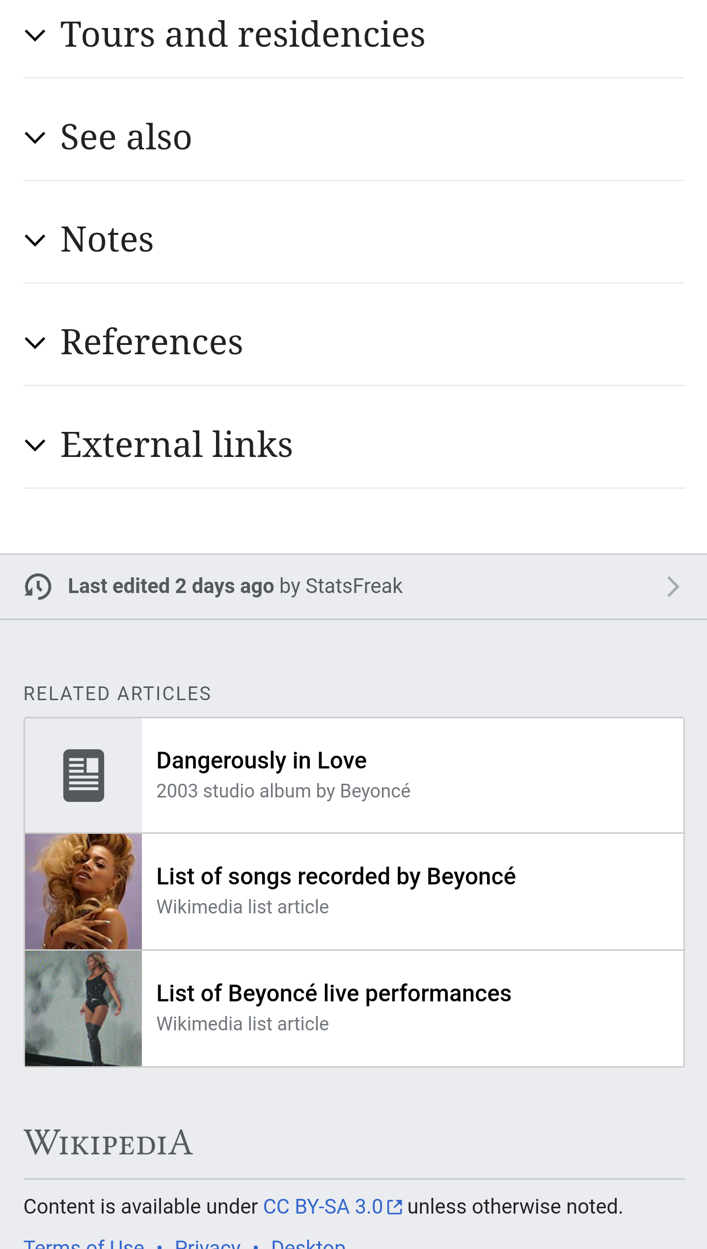
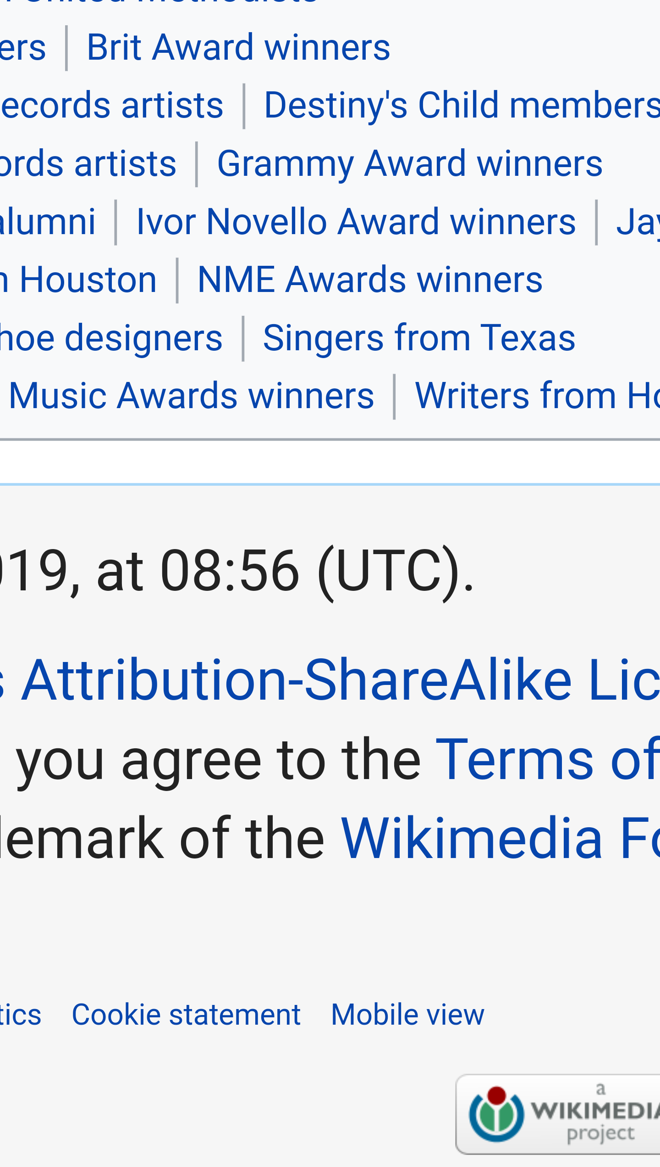
Linking between sites
Pass – Link to desktop / Link to mobile
Notes:
In a Wikipedia page, in the mobile view in the footer there is a link to go to the desktop view and when on the desktop site there is a link to go back to the mobile view.

Slide 47
Exercise
Mobile site only
Monash University (https://www.monash.edu/)
The University of Melbourne (https://www.unimelb.edu.au/)
Griffith University (https://www.griffith.edu.au/)
Charles Darwin University (https://www.cdu.edu.au/)
Open these sites on a mobile device and see if you can find any mobile issues

