Slide 1
Mobile Accessibility (Morning)
http://pz.tt/mobile22-AHG

Slide 2
Mobile Site & Native App Testing Methodologies

Slide 3
Mobile Site Testing Methodology Overview
Step 1: Identify devices
Step 2: Identify site type and variations
Step 3: Test critical issues
Step 4: Test mobile-specific issues
Step 5: Test mobile assistive technology and feature support

Slide 4
Native App Testing Methodology Overview
Step 1: Identify devices
Step 2: Define application functionality
Step 3: Test critical issues
Step 4: Test mobile-specific issues
Step 5: Test mobile assistive technology and feature support

Slide 5
1. Identify devices

Slide 6
Determining which devices to test on
    In the United States, Australia, and other western countries, iOS devices are most popular. In Asia and other eastern countries, Android devices are most popular. To best find which devices to test on, review the Google Analytics or other analytics system for the requisite web site.

Slide 7
Choosing devices
    Due to the popularity of the Android system, there are tens of thousands of Android operating systems and browser combinations available. It is not possible to test on all these systems.
    The “Internet” browser that comes pre-packaged with most Samsung phones is very dependent on the operating system itself and it is a better representation to test with Chrome.

Slide 8
Devices with assistive technologies
    Even if the site is a desktop site, people will still use the site on mobile with various assistive technologies. In some cases, as with VoiceOver, these assistive technologies are also available on desktop, however in most cases, assistive technologies are inherent to the device.

Slide 9
Devices with assistive technologies
    It is important to remember that even assistive technologies that work across desktop and devices may behave differently on each system, and therefore they still need to be tested on mobile and tablet devices.
    For the latest information on screen reader usage, please see the WebAIM Screen Reader Survey.

Slide 10
Additional device screen readers
    Samsung includes an additional screen reader called “Voice Assistant,” however TalkBack is still available as part of the Accessibility Suite. Amazon Fire also utilizes a different screen reader called “Voice View”.

Slide 11
Identify devices
Recommended devices and browser combinations:
iPhone, (Safari)
iPad, (Safari)
Android phone, (Chrome)

Slide 12
Identify devices
Other devices to consider
Android tablet, Chrome
Alternative devices such as a Kindle device

Slide 13
Identify devices
Test on the latest version of iOS and iPadOS.
Test on latest two versions of Android.
When a site is directly aimed at people with a particular kind of disability, consider including assistive devices and/or other assistive technologies used by potential users.

Slide 14
WCAG and this methodology
You need to meet WCAG2 and this mobile testing methodology

Slide 15
2. Identify site type & variations of the page

Slide 16
Identify site type and variations
Is the site:
Desktop
M.dot
Responsive
If the site is responsive, are there variations of the page?

Slide 17
Three types of mobile sites
    Desktop web sites: that have only one display, whether viewed on desktop or mobile or tablet device
    m.dot sites: that have a particular display for mobile and tablet sites. The m.dot site must also be tested against the entirety of WCAG2, in addition to the standard www version of the site.
    Responsive web sites: that change depending on the screen size or other feature as determined by the developer

Slide 18
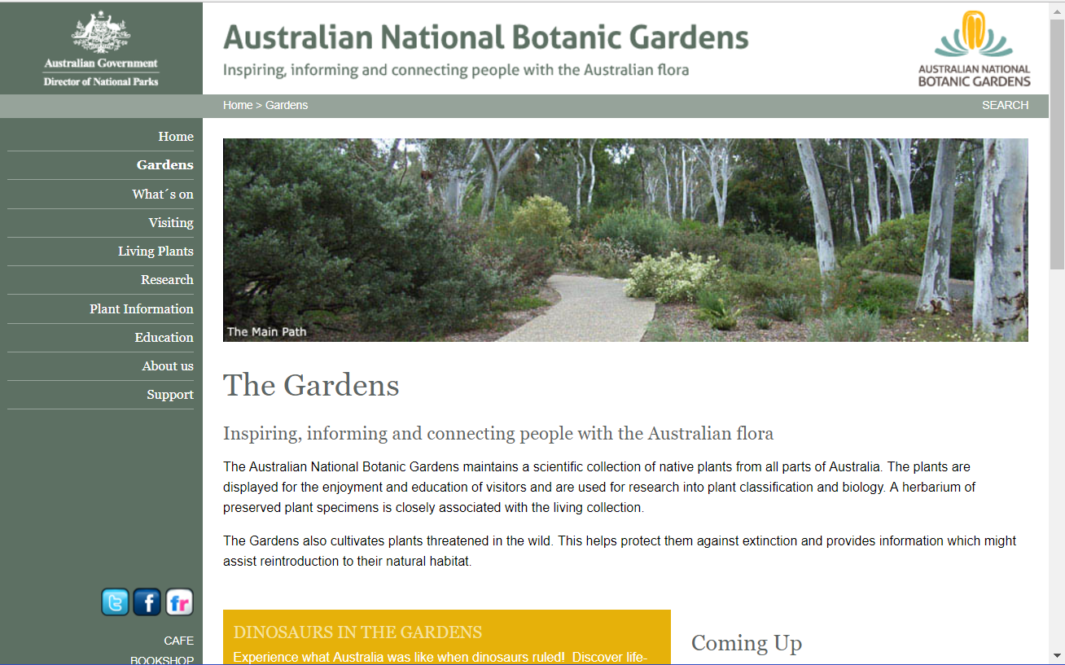
Example of a desktop site

Slide 19
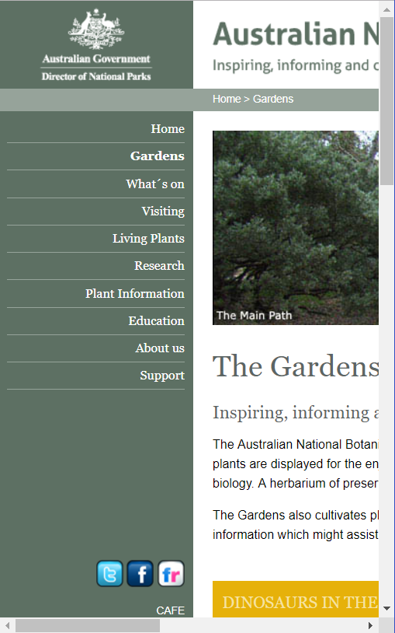
Example of a desktop site
The site is a desktop site if the content does not change as you drag the browser window narrower. In most cases you will see a horizontal scrollbar at the bottom of the page.

Slide 20
Steps to identify m.dot sites
Ask the client
Change the URL to start with “m.” instead of www.
Compare the site on desktop to the site on a mobile device?

Slide 21
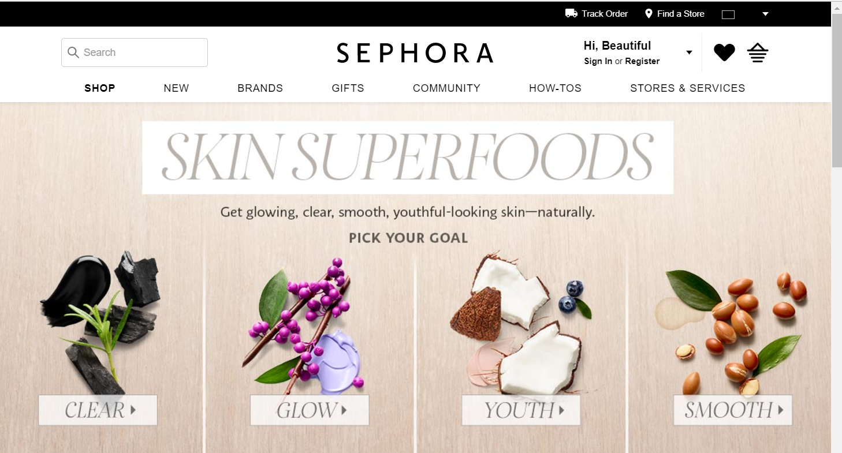
Example desktop site

Slide 22
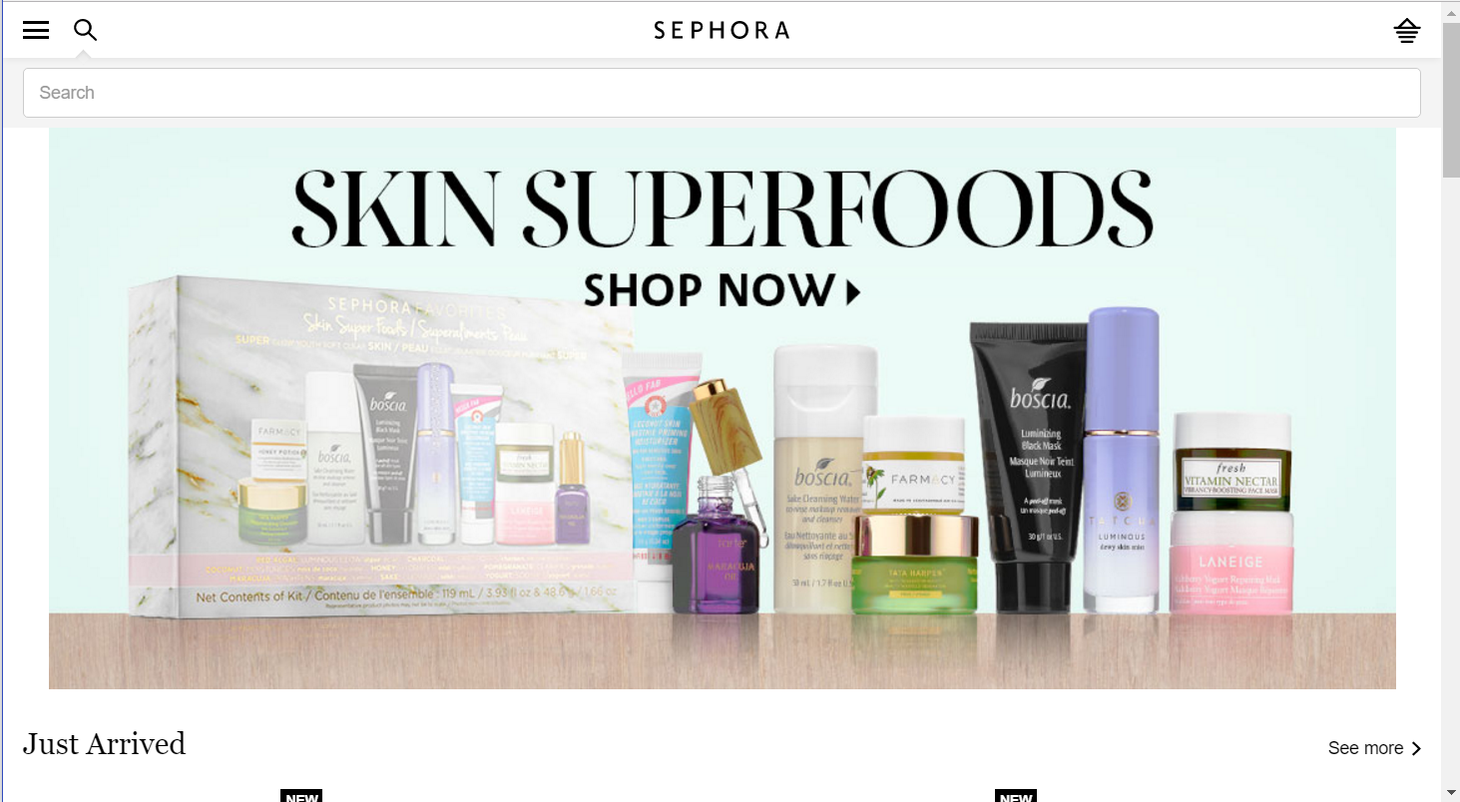
Example m.dot site

Slide 23
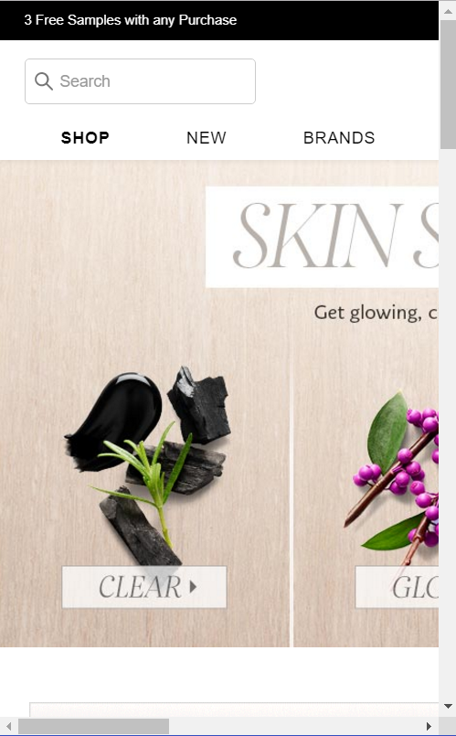
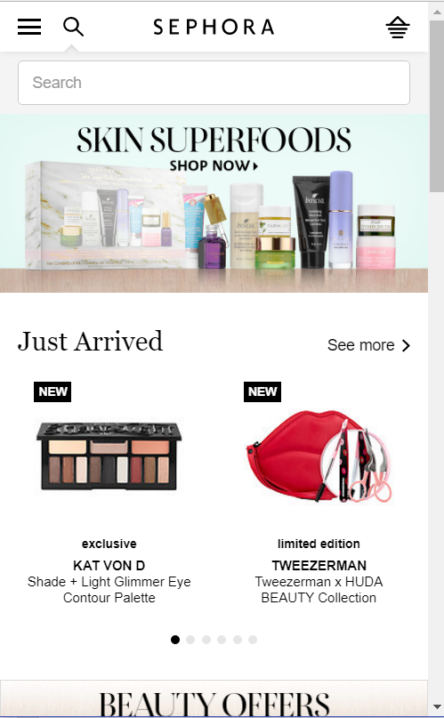
Desktop and m.dot
Desktop
m.dot

Slide 24
Responsive web sites
    Please note that it is most likely that a site is responsive. If a site is responsive, it is definitely not a desktop site. However, it is possible (but very unlikely) that there is also a m.dot web site.

Slide 25
Identifying a responsive web site
    The site is responsive if the layout changes as you change the browser window size. To test this, open the web site in a browser, ensure the window is not maximized, and select the right-hand edge and drag it to the center of the screen.

Slide 26
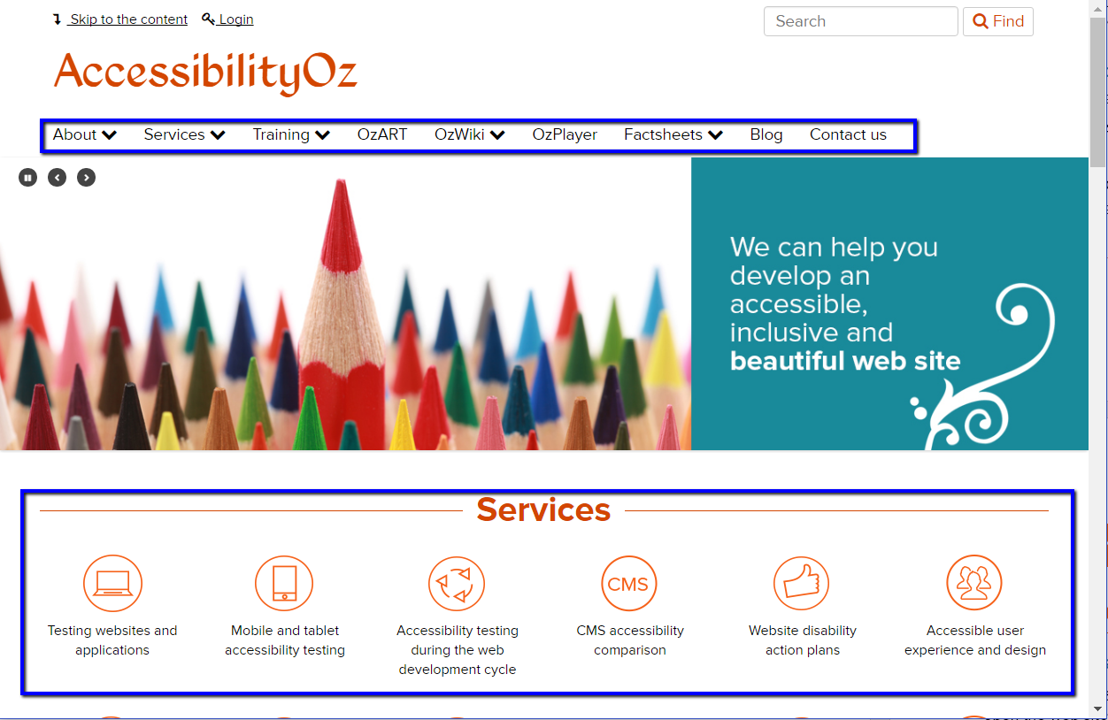
Example of a responsive web site – desktop

Slide 27
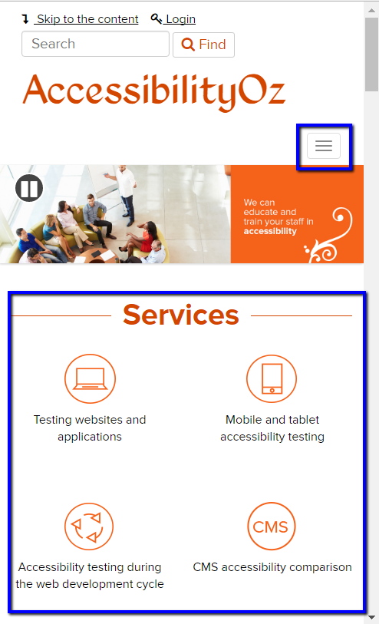
Example of a responsive web site – mobile
If elements in the page move around, then the site is responsive. Another way to tell is if the navigation disappears and is replaced with a hamburger menu.

Slide 28
2. Define application functionality

Slide 29
Define application functionality
Through your understanding of the purpose of the native app, define which functionality is critical to its purpose and use and that must be tested for efficacy, operability, and workflow from a user experience perspective.

Slide 30
Define application functionality
    Ask the question: how would the experience be impacted if the functionality failed, the content could not be reached, and or the experience caused a barrier to the user?
    Prioritise. All functionality should be accessible within the native app; however, it is important to define and include the critical functionality for each individual app to be prioritised in your testing.

Slide 31
Common elements to test
Navigation
Landing screen(s)
Emergency sections
Login flows
Settings
Account and profile
Contact Us
Real-time updates
Privacy policy, Terms and Conditions
Interactional functionality
Help section
Widgets (calendars, etc)
Geo-locational maps
High-traffic areas

Slide 32
Exercise
Mobile site only
Monash University (https://www.monash.edu/)
The University of Melbourne (https://www.unimelb.edu.au/)
Griffith University (https://www.griffith.edu.au/)
Charles Darwin University (https://www.cdu.edu.au/)
Open these sites on desktop and change the window size. Open them on your mobile device. What site types are they? Are there any accessibility issues in the variations?

Slide 33
Find these guidelines
Find these methodologies on the AccessibilityOz web site under the Resources menu item

Slide 34
3. Test critical issues

Slide 35
New features means new traps
Trap: Where a user is trapped within a component and cannot escape without closing the browser or app.
There are many more traps in mobile sites and native apps than on desktop.

Slide 36
Traps identified
Exit trap
Swipe / Scroll trap
Text-to-speech trap
Headset trap
Layer trap

Slide 37
Exit trap
Ensure there is always an accessible actionable item (e.g. a close button that meets color contrast requirements and has an accessible name) that closes any feature that overlays the current page (such as a full-page ad).
Applies to: All users
Methodology: Mobile Site and Native App

Slide 38
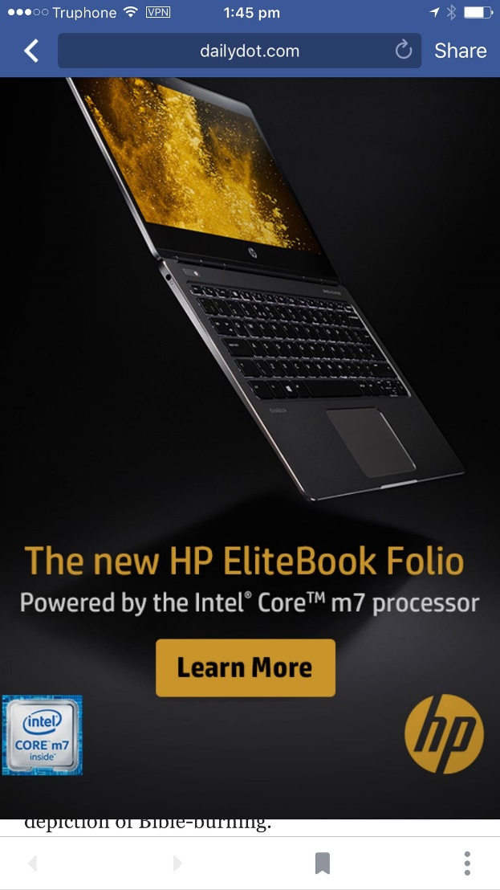
Exit trap
No way to close the feature (usually an ad)

Slide 39
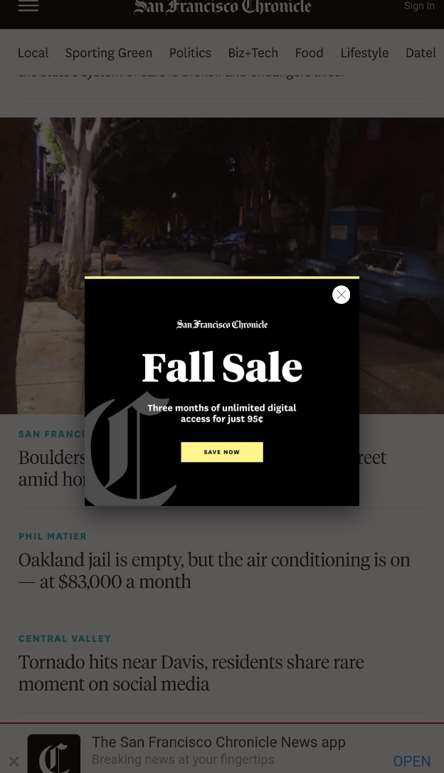
Exit trap
Close button does not meet color contrast or touch target size requirements

Slide 40
Swipe / Scroll trap
Ensure you do not override standard mobile touch functions (swiping, scrolling, etc.) on the majority of the page.
Applies to: Touch users
Methodology: Mobile Site and Native App

Slide 41
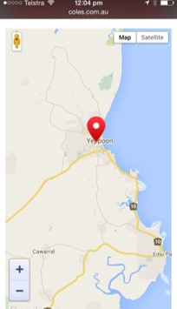
Swipe / Scroll trap
The zoom of doom

Slide 42
Text-to-speech trap
If the app has an ability to provide content via text-to-speech, the screen reader user must be able to pause or stop the app speaking in a simple manner, e.g. by performing a swipe on a screen.
Applies to: Screen reader users
Methodology: Native App

Slide 43
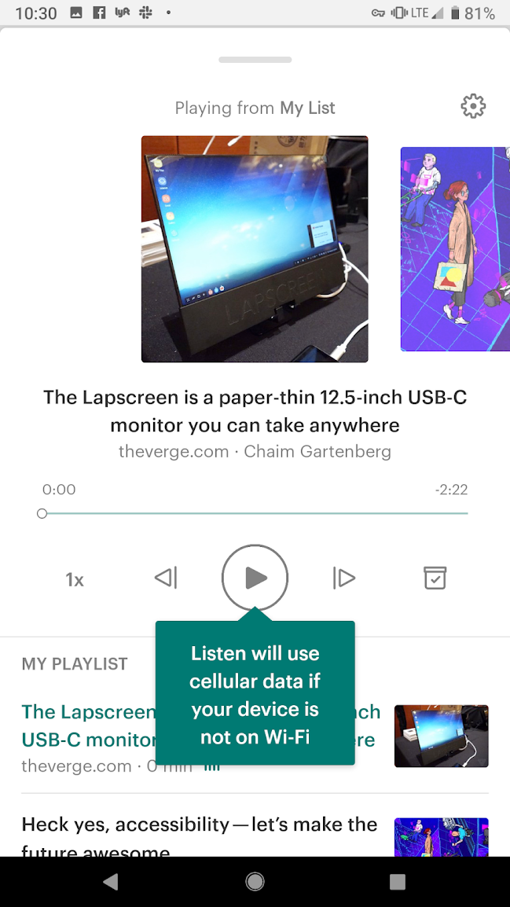
Text-to-speech trap
Once activated, screen reader users cannot stop the TTS

Slide 44
Headset trap
Headset users must always be able to pause media (audio or video) content by using the Pause/Play control on the headset.
Applies to: Screen reader users, Headset users
Methodology: Mobile Site and Native App

Slide 45
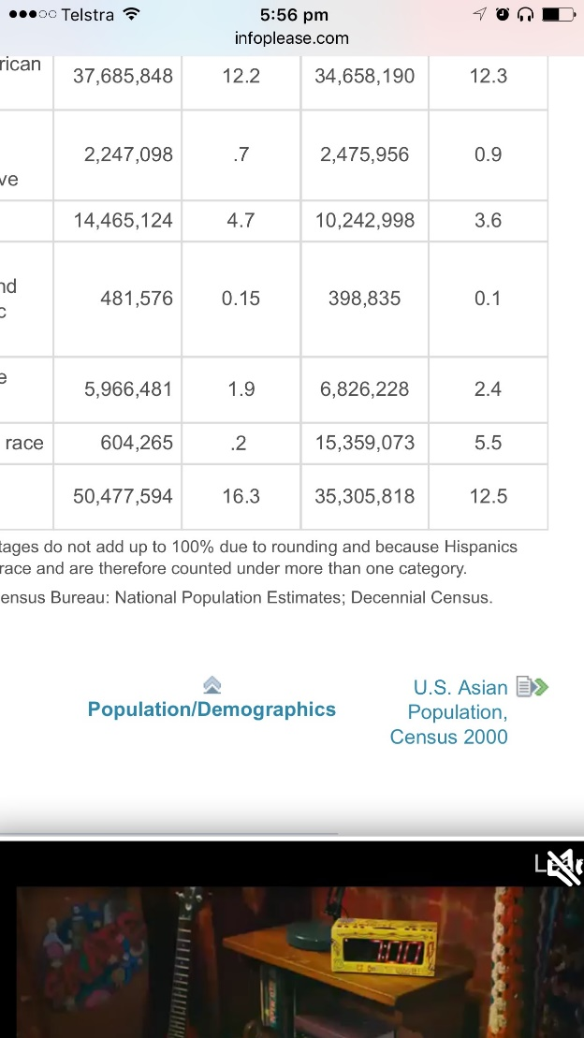
Headset trap
Cannot pause the audio using headset hardware (pause on the headset pauses the screen reader)

Slide 46
Layer trap
The user should not be trapped on a non-visible layer.
Applies to: All users (but mostly encountered by screen reader users and sometimes keyboard users)
Methodology: Mobile Site and Native App

Slide 47
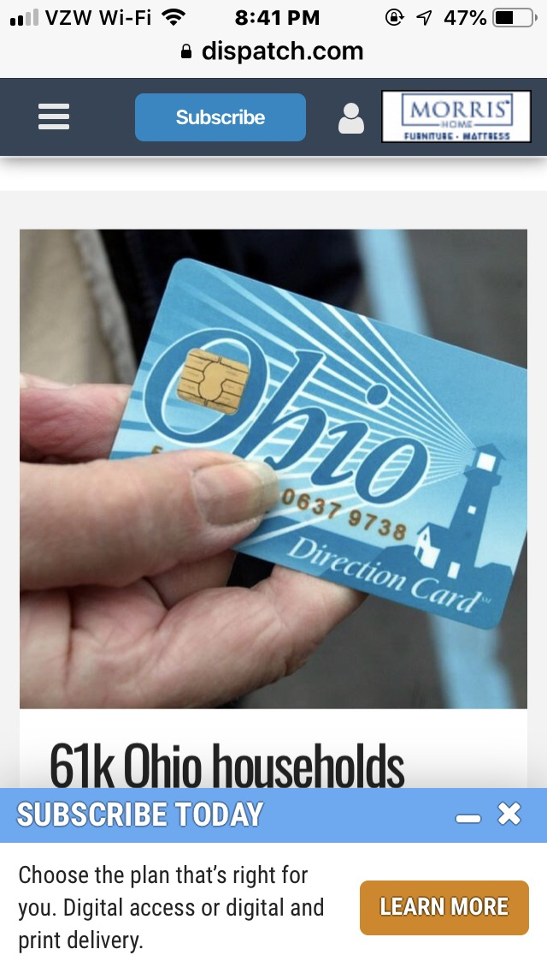
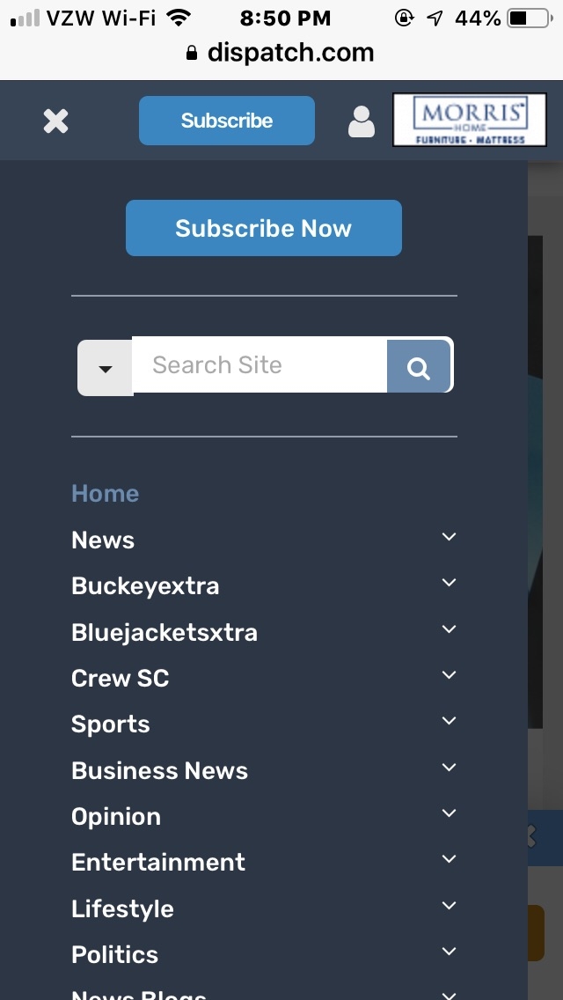
Layer trap
Screen reader user cannot access the menu. Focus stays on the parent layer.

Slide 48
Exercise
Mobile site only
Monash University (https://www.monash.edu/)
The University of Melbourne (https://www.unimelb.edu.au/)
Griffith University (https://www.griffith.edu.au/)
Charles Darwin University (https://www.cdu.edu.au/)
Open these sites on a mobile device and see if you can find any Critical issues
bit.ly/3AdDjjP

Slide 49
Test mobile-specific issues

Slide 50
Alternatives

Slide 51
Alternatives
2.1: Motion, interaction and gesture
2.2: Touch gestures
2.3: Geolocation
2.4: Change of state
2.5: Audio cues
2.6: Status messages
2.7: Abbreviations
2.8: Summary of content
2.9: Ambiguous text

Slide 52
Let’s see an example from the document

Slide 53
2.2 Touch gestures
Any touch gesture must have an alternative, accessible, actionable item (for more information see SC 2.5.1: Pointer Gestures).

Slide 54
Examples of touch gestures
Swiping up and down or left and right
Dragging up and down or left and right
Double-tapping
Tap and hold
Tap and swipe
Two pinch zoom
Press and long hold

Slide 55
Examples of alternative, accessible gestures:
A link
A button
A dropdown
A separate page with the same functionality

Slide 56
About this requirement
This requirement is particularly important for screen reader users. For example, if you require your user to swipe right to complete a purchase, when the screen reader is on, the swipe right gesture moves you to the next focusable item and doesn’t complete the purchase. You must be able to perform the same action, by using a link, an up or down swipe, or some other gesture.

Slide 57
About this requirement
Please note that this requirement is similar to the Exit Trap requirement. A failure of the Exit Trap requirement is that a user cannot escape from content or a page. A failure of the Touch Gestures requirement is that the user cannot choose content or a page (i.e. they are not trapped).

Slide 58
How to test
Identify any site controls. If they require any of the following gestures, is there an accessible actionable item provided as an alternative?
Swiping up and down or left and right or dragging up and down or left and right
Double-tapping or two-pinch zoom
Tap and hold or tap and swipe
Press and long hold

Slide 59
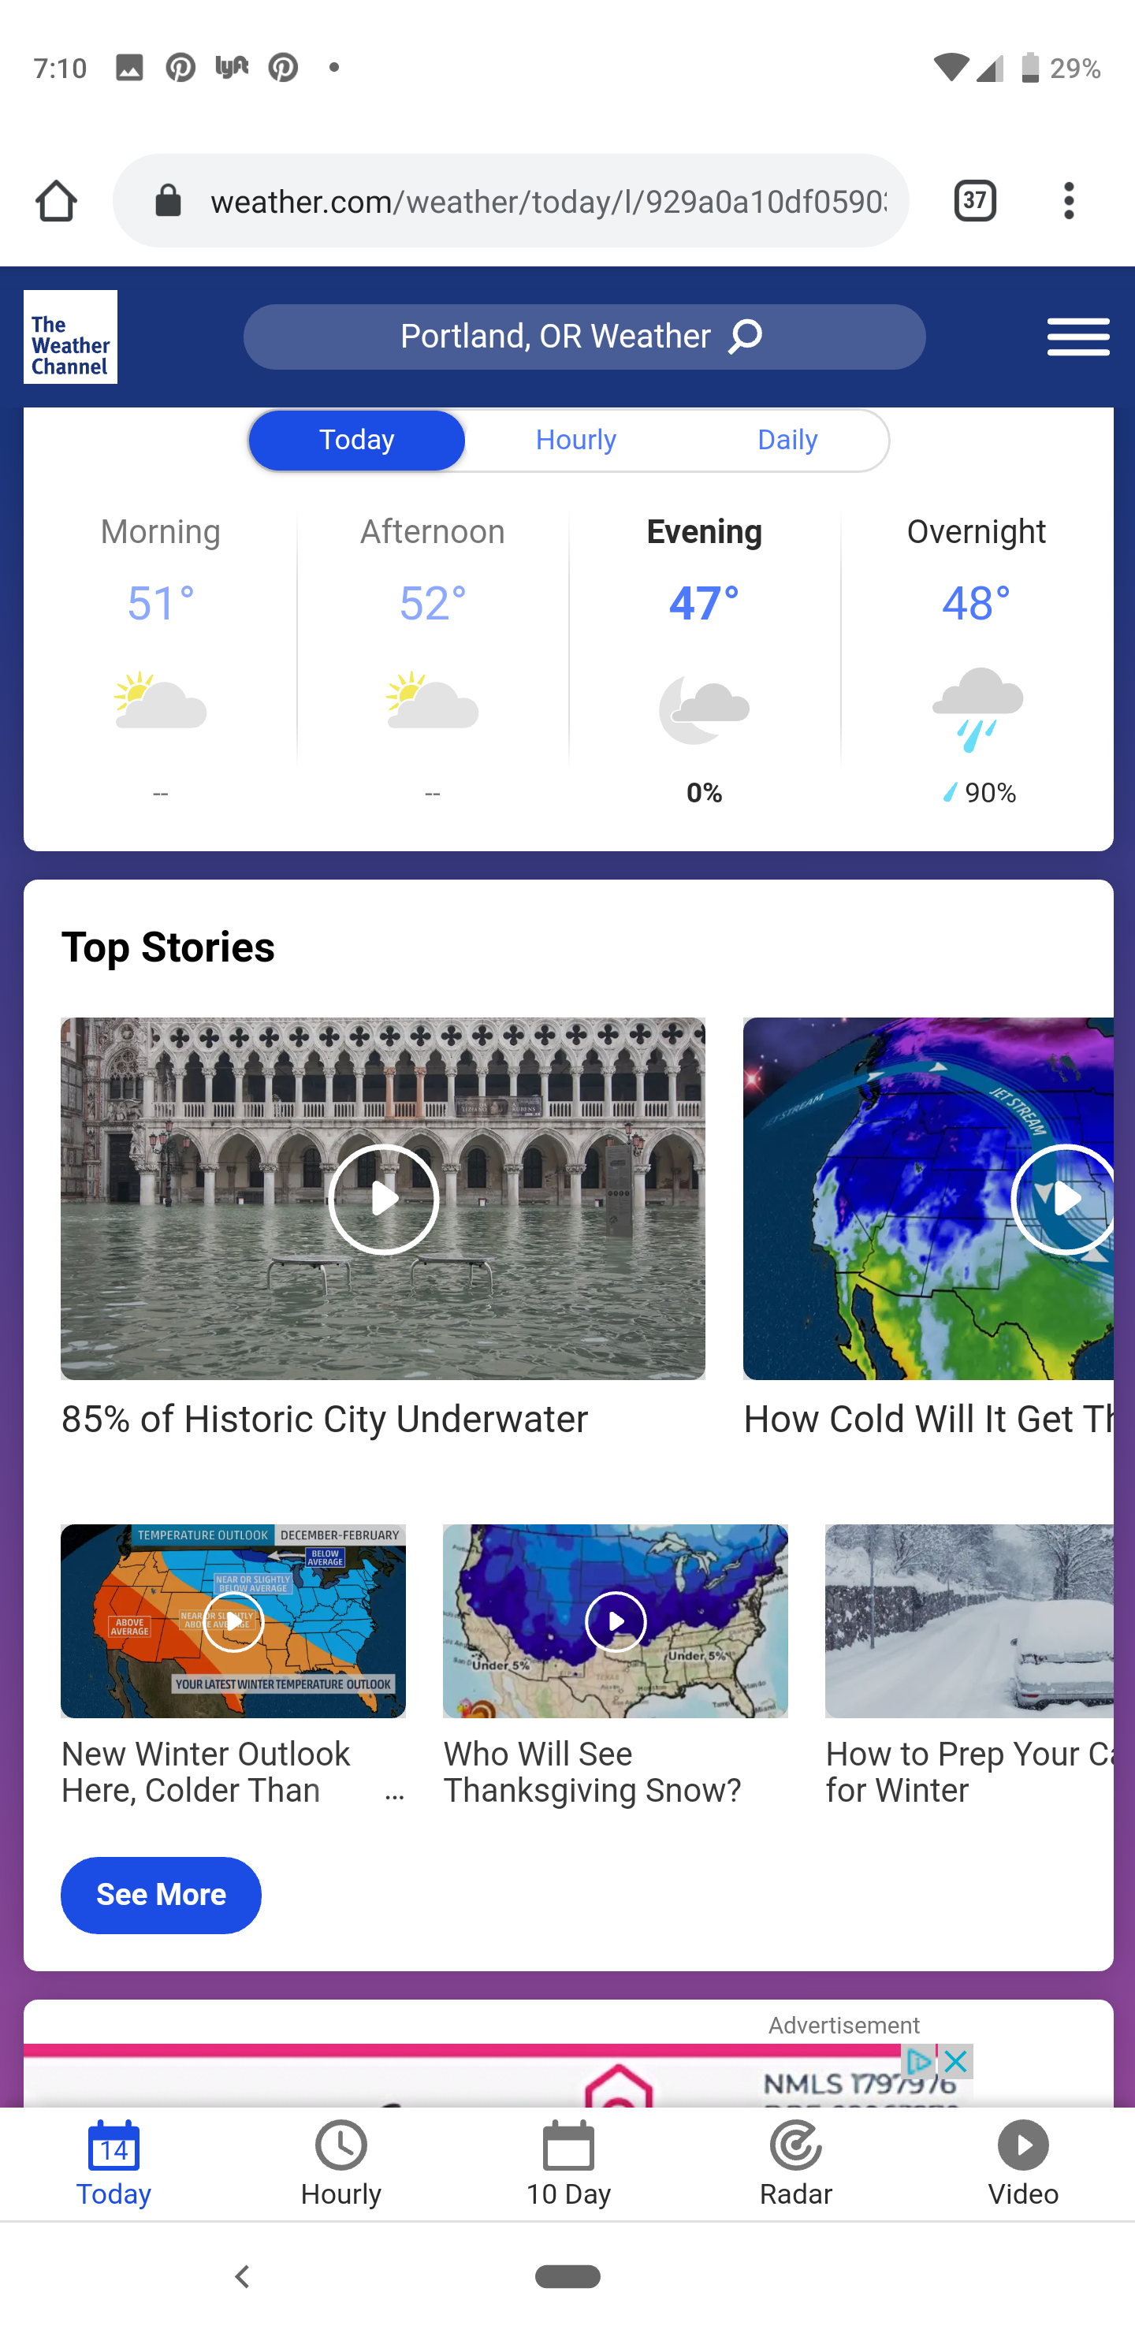
2.2 Touch gestures
Alternative is provided on another page
Notes:
Two rows of content under the “Top Stories” heading indicate that more content is visible on swipe as part of the content is cut off. There is a link labelled “See more” and the same content is shown when this link is activated as the additional content on swipe.

Slide 60
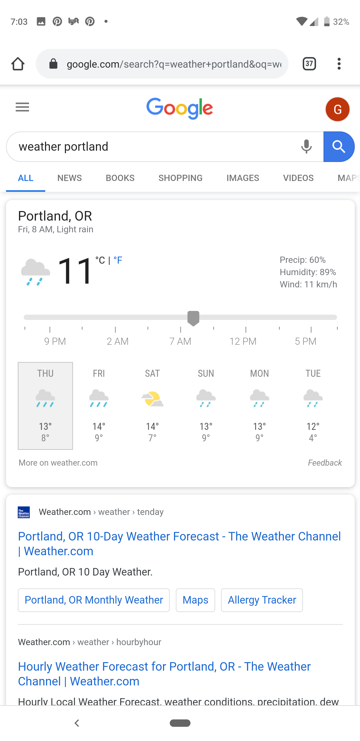
2.2 Touch gestures
Tap alternative is provided instead of drag gesture
Notes:
When viewing the weather on Google you can select and drag the slider to determine the weather at certain times during the day. You can also tap on one of the times to move the slider to that specific time.

Slide 61
Let’s see the documents
Have a look at the documents

Slide 62
2.3 Geolocation
Alternatives are provided for geolocation functionality that is mandatory (for example, requiring a specific geolocation before functionality appears), unless the geolocation is essential for legal reasons, or doing so would invalidate the activity. This applies to geolocation via GPS, user statement, IP address or other methods.

Slide 63
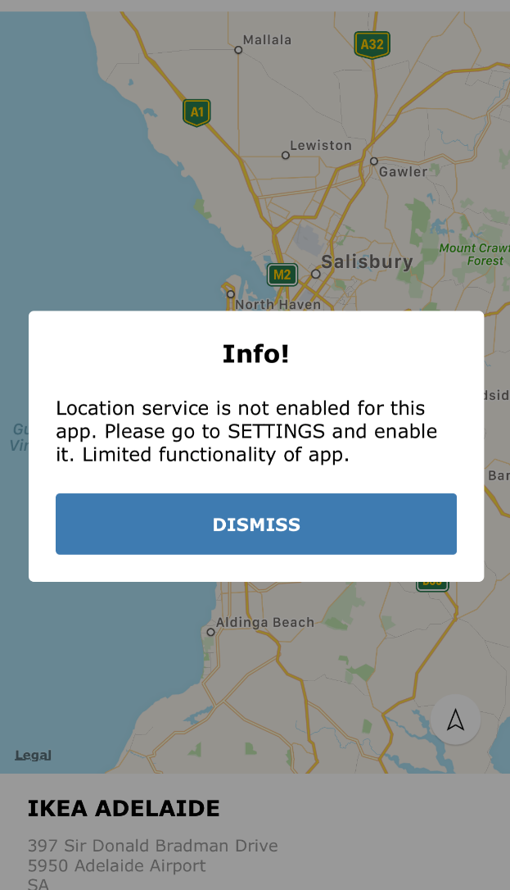
2.3 Geolocation
Fail – Blocking location

Slide 64
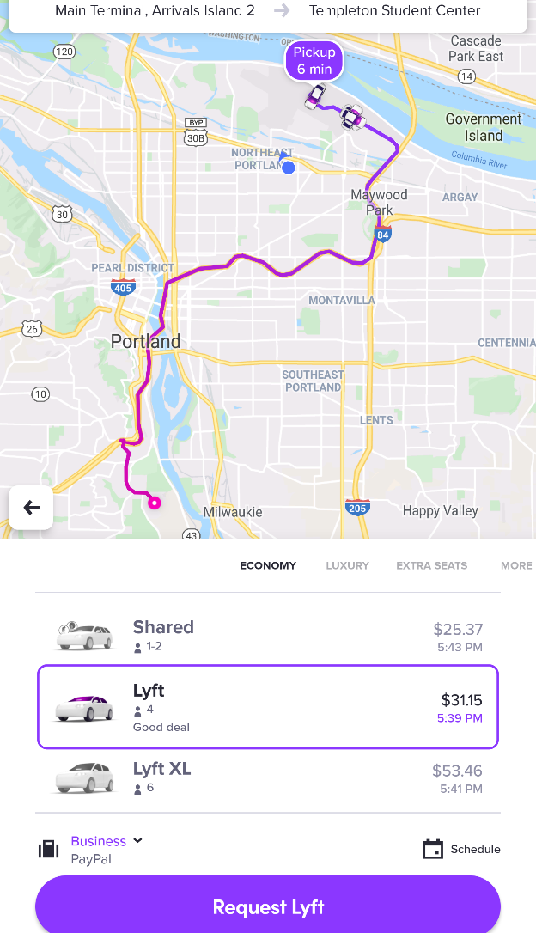
2.3 Geolocation
Pass – Choosing a different location

Slide 65
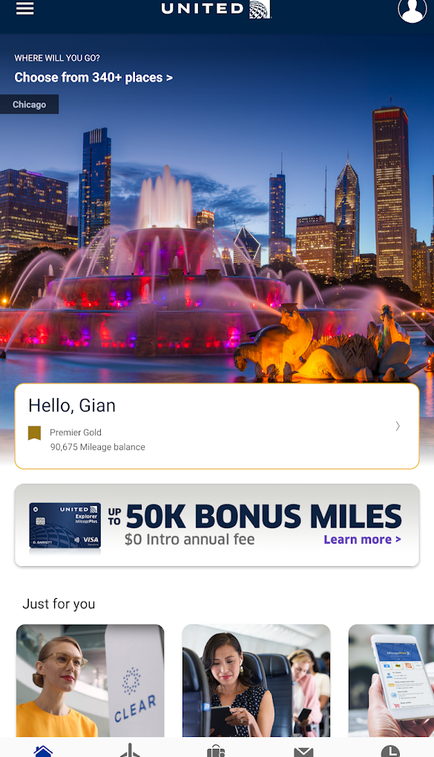
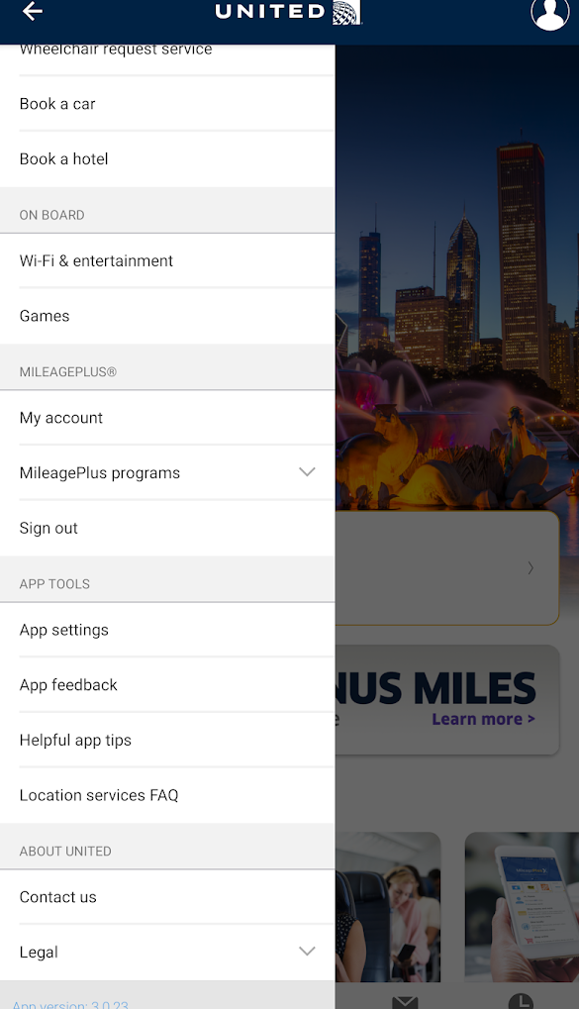
2.3 Geolocation
Changes of state of non-standard controls (e.g. hamburger menu, star ratings) are clearly indicated

Slide 66
2.8 Summary of content
Where the text requires reading ability more advanced than Flesch Kincaid level 8, a summary or description of content is provided (for more information see SC 3.1.5: Reading Level).

Slide 67
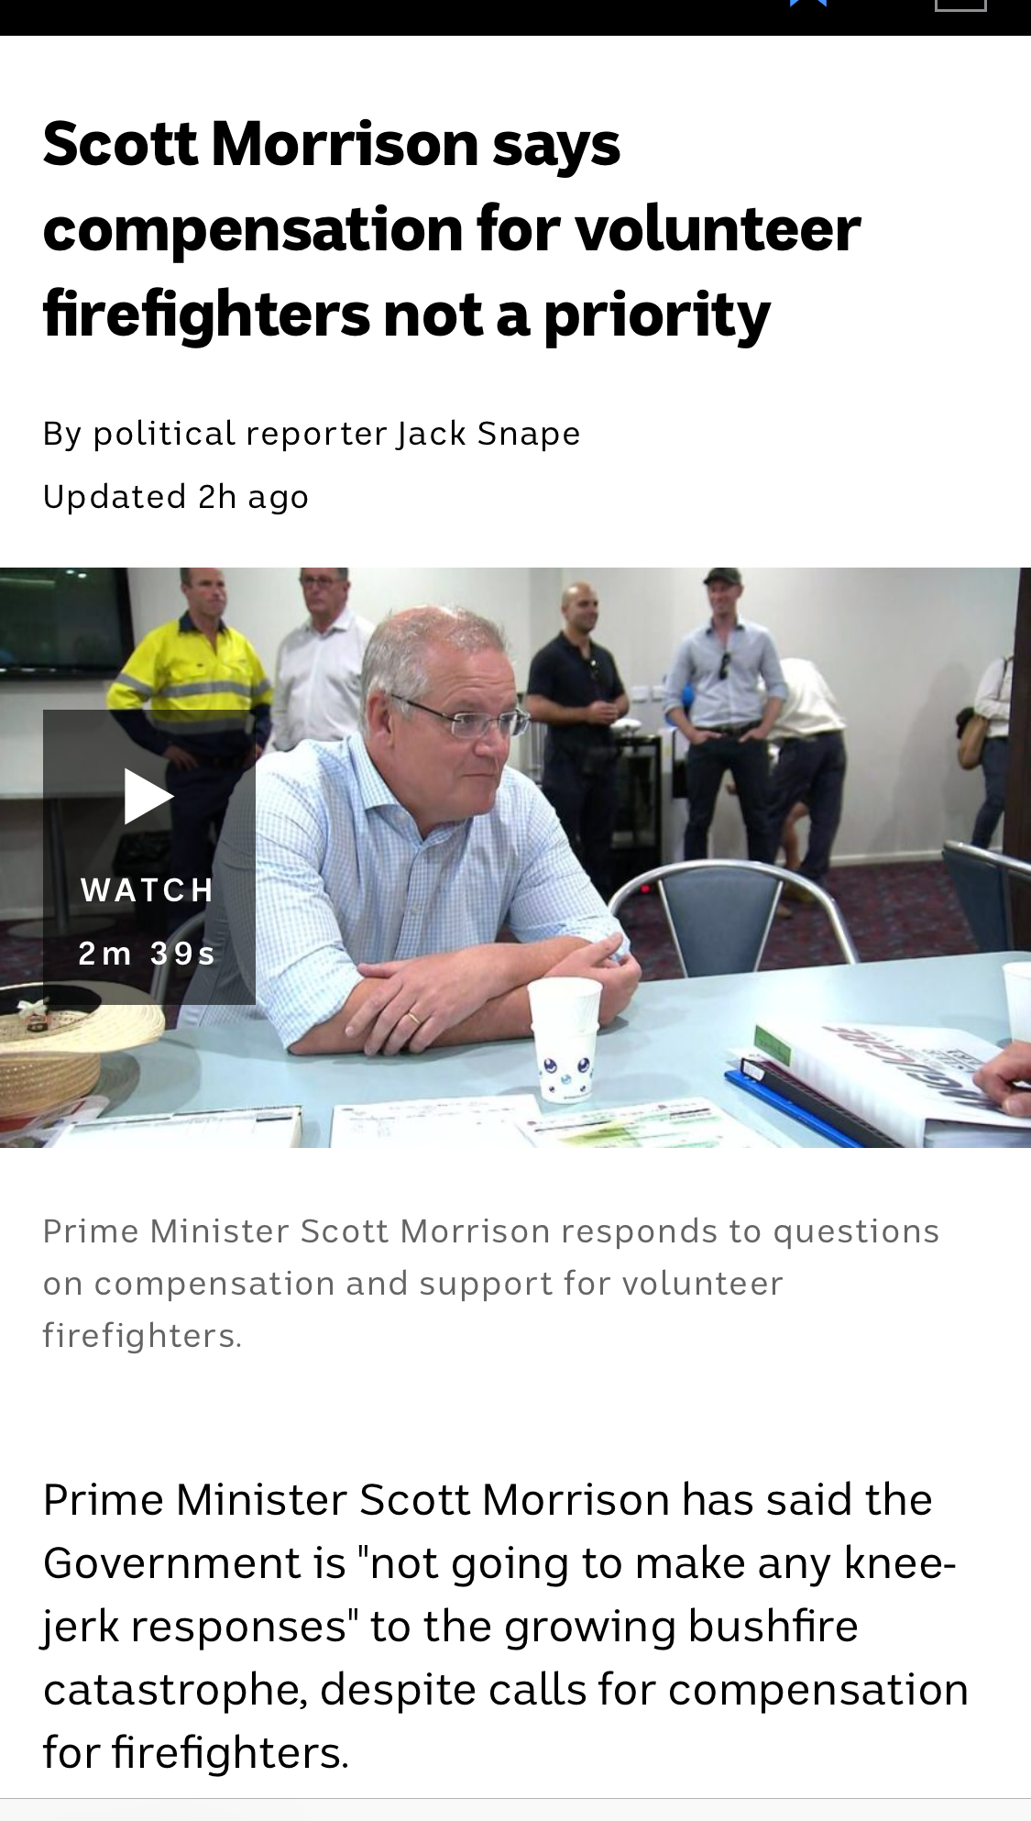
2.8: Summary of content
Fail – No summary provided
Notes:
The article does not provide a summary version.

Slide 68
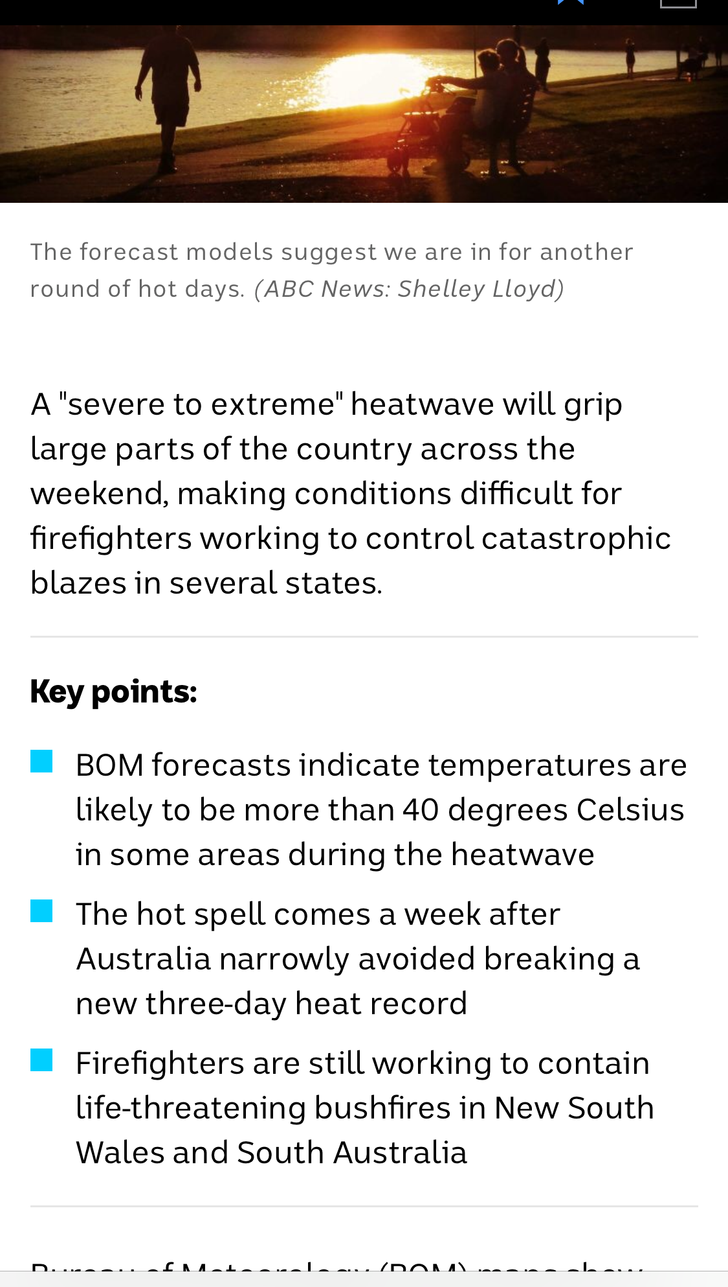
2.8: Summary of content
Fail – Summary does not meet Reading level 8
Notes:
The summary provided requires a Flesch Kincaid Reading Level of 16.4.
The summary reads "A 'severe to extreme' heatwave will grip large parts of the country across the weekend, making conditions difficult for firefighters working to control catastrophic blazes in several states."

Slide 69
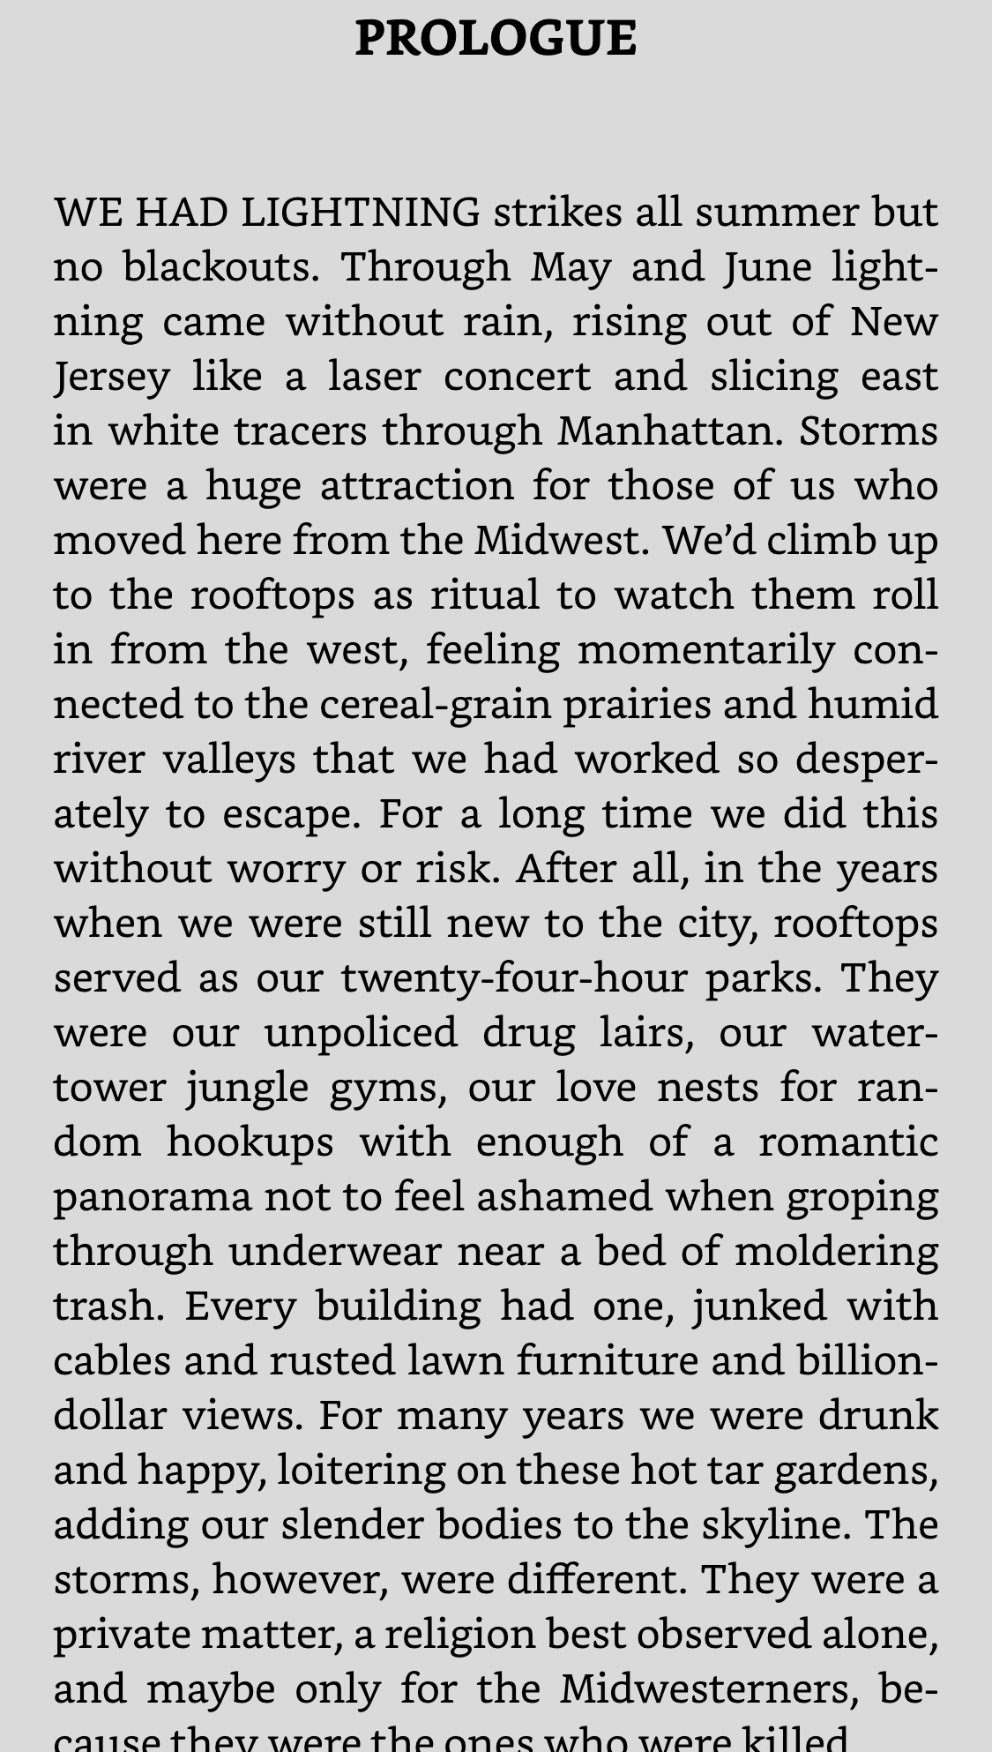
2.8: Summary of content
Pass – (Exclusion - Creative content) – Novel
Notes:
The novel “Lightning People” in the Kindle app does not need to meet the summary requirement.

Slide 70
2.9: Ambiguous text
Controls, primary headings, links, field labels and page titles are not ambiguous when read aloud.
Notes:
About this requirement
Screen reader users hear words spoken aloud. Therefore, there are some words which will be ambiguous to them, such as write / right, aloud / allowed, etc.
There are five types of ambiguous text:
Homonyms
Homophones
Heteronyms / Heterophones
Capitonyms
About homographs and heterographs
Please note there are two other terms that are used in these situations: homographs and heterographs.
Homographs have the same spelling and different meaning and the pronunciation is irrelevant. An example homograph is:
minute (60 in an hour)
minute (take notes)
minute (tiny).
Therefore, homographs are always either homonyms or heteronyms.
Heterographs have different spelling, different meaning and the same pronunciation. An example heterography is:
to (travel)
too (also)
two (one more than one)
Therefore, heterographs are also homophones.
About testing this requirement
This requirement is probably best tested by automation.
Exclusions
Creative content is excluded from this requirement.

Slide 71
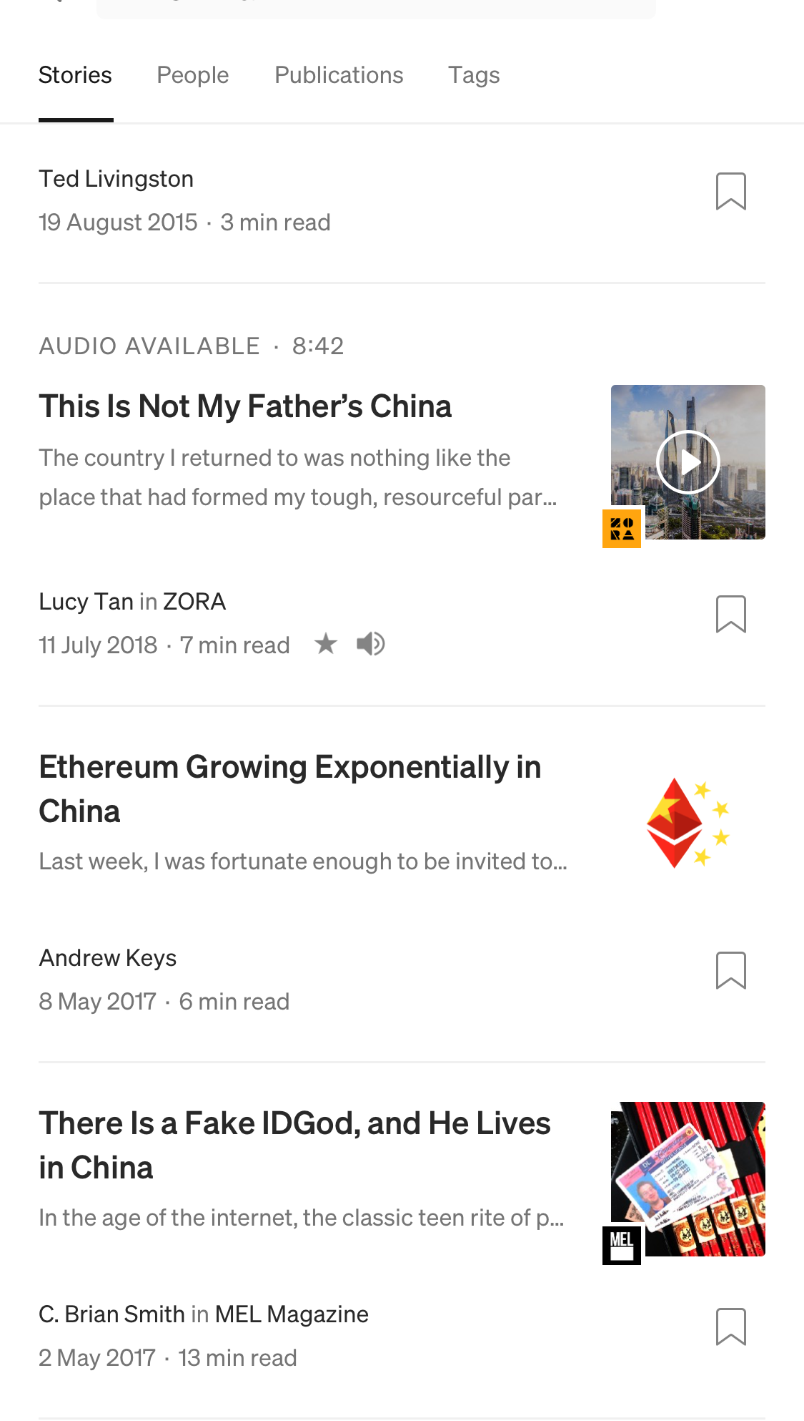
2.9: Ambiguous text
Fail – Ambiguous text - “This Is Not My Father’s China”
Notes:
It is unclear whether this article heading is referring to the country or to table settings.

Slide 72
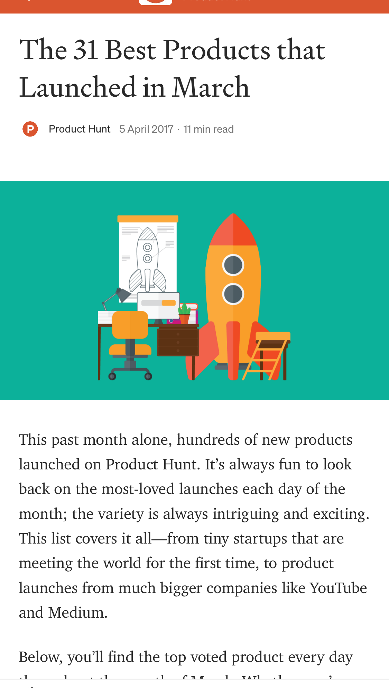
2.9: Ambiguous text
Pass – Unambiguous text - “The 31 Best Products That Launched in March”
Notes:
It is clear that the article refers to the month “March.”

