Slide 1
A Best Practices Model for Providing AT Services and Supports in Higher Education
AHEAD Accessing Higher Ground, 2022
Shannon Lavey, MS, OTR/L, ATP, Student Service Coordinator
Marla Roll, MS, OTR/L
Director, Assistive Technology Resource Center
Assistant Professor, Department of Occupational Therapy
Allison Swanson, MA, AT-IT Coordinator
Notes:
MARLA WILL GET us rolling
Each of us introduce ourselves – share our role at CSU

Slide 2
Agenda
About Colorado State University (CSU) & the Assistive Technology Resource Center (ATRC)
Occupational Therapy (OT) Process
Human, Activity, Assistive Technology (HAAT) Model
Strength-based approach
Initial Meeting
Assessment
Training
Application of AT to Academic Tasks
AT on Campus
Outcome Measures – COPM, Survey
Research
Notes:
Marla

Slide 3
About Colorado State University (CSU)
A Public, Land-grant University
•A Carnegie R1 Research Intensive University
•Institutional Profile (Fall 2020)
32,800 total students
7,491 faculty and staff
4325 online students
•8 colleges
•Located in Ft. Collins, Colorado
Notes:
Marla

Slide 4
About the Assistive Technology Resource Center ( ATRC) at CSU
Housed in the Department of Occupational Therapy at Colorado State University
Our staff: 3 Occupational Therapists, OT graduate students, AT-IT Coordinator, admin assistant, research director.
The ATRC is charged by the VP for IT with ensuring equal access to technology and electronic information.
Notes:
Marla

Slide 5
ATRC Services
Students: AT assessments, training and accommodations for students with disabilities
Implementation of AT across campus from a UD lens/ social model of disability
Employees: AT assessments, trainings and supports for employees with disabilities
OEO and self referral
Electronic Inclusivity:
Training faculty in development of accessible course materials
Assist with accessibility reviews of technology and web sites
Notes:
Marla

Slide 6
Mission, Vision & Philosophy
Mission
Ensures equitable access to technology and electronic information for students and employees with disabilities by fostering a technological climate that is inclusive and welcoming to a diversity of learners and workers
Vision
Offers leadership, direction, and support to build Colorado State University’s capacity at the individual, organizational, and attitudinal levels to create a technological climate that is inclusive and provides electronic access for all its community
Advocates for proactive, inclusive design, and planning concerning access to technology and electronic information
Strives to contribute to and draw from research and evidence-based practice
Elevates best practices for assistive and mainstream technology supports and services in higher education
Philosophy
Sees disability as a facet of diversity and inclusive excellence
Considers a Social Justice approach, focusing on equity of access to opportunities
Follows a Social Model of disability
Values the Occupational Therapy lens
Notes:
Marla

Slide 7
ATRC’s OT Process
Notes:
Shift to shannon!

Slide 8
What is Occupational Therapy (OT)?
What is OT?
Occupational Therapists help people participate in their desired occupations with the therapeutic use of everyday activities, based on the client's personal interests and needs.
OT considers the complex relationship between the client, the activity, and the environment in which the activity takes place (American Occupational Therapy Association, 2022)
Notes:
How we define OT at the ATRC
Give examples of occupations – maybe snf and ADL and then open up to what are common occupations of a student?

Slide 9
OT Values and Process as a Best Practice
Research shows that finding the right match leads to adoption of AT (Cook, Polgar & Encarnacao, 2022)
Take time to match the technology to the client's needs
Client-centered
Building therapeutic rapport
Notes:
OT values and processes that guide/shape our services
Client centered means – client led, empower, focus on priorities/goals/strengths/needs
Rapport – partnership, collaborative
This will be a lead up to discussing the HAAT model

Slide 10
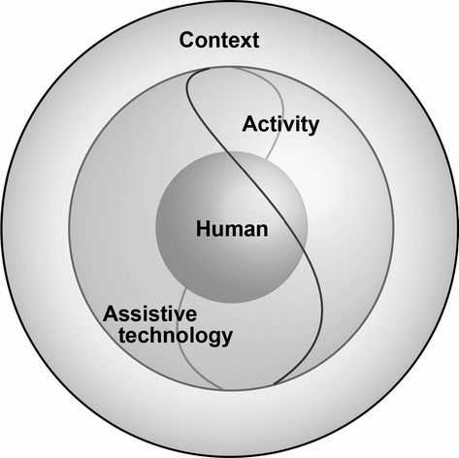
HAAT Model
Human Activity Assistive Technology
Framework describing elements of AT
Human
Activity
AT
Context
Student-driven process
Look at person first, then activity and context, then technology
Notes:
Student drives process, we provide options
The Human Activity Assistive Technology model is an enduring example that has continued to develop by integrating a social model of disability, concepts from occupational therapy theory and principles of assistive technology adoption and abandonment - https://doi.org/10.1111/1440-1630.12054

Slide 11
Strength-Based Approach
Overview and background
Specific examples will be provided in our process
Build on strategies and strengths
Changing language and words
Collaborative
Notes:
Updated forms and documentation, as well as mission, vision & philosophy.
SDC was also looking at this at the same time- reframing our language

Slide 12
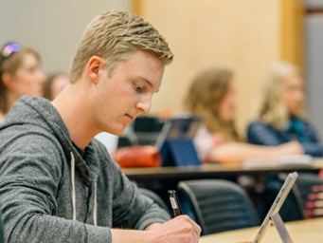
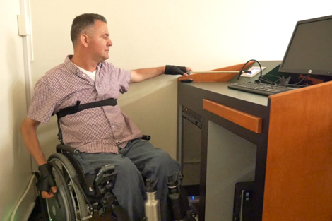
Referral Process
CSU Students
Student Disability Center
Health Network
CSU Employees
Office of Equal Opportunity
Self-referral

Slide 13
Types of appointments offered
In-person
Virtual (Teams or Zoom)
Over the phone

Slide 14
ATRC OT Process - Initial meeting
Begin building rapport
Types of information gathered
Goal for connecting with ATRC
Occupational profile
Strategies and strengths
Barriers
Types of technology
Self-advocacy
Health and well being
Preferences
COPM to prioritize needs
Notes:
Referral info – SDC, CSU HN, employee referrals

Slide 15
ATRC OT Process – Assessment
Introduce supports and resources to find the best match
Focus on academic tasks:
Reading, writing, note-taking, time management, computer access, more
A variety of AT and mainstream tech
Campus and community resources
Notes:
Process takes longer, but evaluation is worth the investment.
Research shows finding the best match leads to better long-term adoption.

Slide 16
ATRC OT Process - Training
Application of AT to Academic Tasks
Train in preferred environment
Examples
Text-to-speech on assigned reading
Writing supports on upcoming paper

Slide 17
ATRC OT Process – Check in
Check in with student to ensure AT and resources are meeting needs
COPM Reassessment
Complete survey
Plan for the next semester
Transition information
Notes:
Transition information – try to help find funding or free options, DVR

Slide 18
AT on Campus
Notes:
Allison takes it away@!

Slide 19
Wide Variety of Technology
Licensed
Free
Mainstream / Built-ins
Mac & PC
Mobile Apps
Browser Extensions
Hardware loans (digital recorders, smart pens, alternative keyboards, mice, braille display, magnifier)
Notes:
Handout of AT by task

Slide 20
Tiers of Tech
Site licenses
Available to everyone
Shared with campus IT to include in their lab images
LMS Delivery
AT Standard Image Build
Available on our computers in various locations around campus
Home installs
Individual needs – classrooms, labs, office, hardware loans
Notes:
Handouts of AT on Campus and AT by task

Slide 21
Variety of Locations – Integrated Model
Full Suite of AT
Library – 6 quiet rooms
Adult learner and veteran services (ALVS)
Academic advancement center (AAC)
Athletics
Alternative testing center
Site Licenses
Labs in ALVS, AAC, Athletics
College labs
Library lab
Classrooms
Checkout laptops & iPads
Personal devices
Canvas (LMS)
… And As Needed Elsewhere
Notes:
OT mindset – participation alongside peers, not a segregated lab. Provide the AT wherever the student is.

Slide 22
Imaging Process & Campus Partners
Standard AT Image
All AT burned in
Slim image with software apps deployed by task sequence
Consistent configuration
Simplify user experience
Installers on network share for Campus IT Pros
Notes:
8 different colleges, additional administrative units – all with decentralized IT

Slide 23
IT Support for AT Service Providers
Minimum requirements checklist
USB / SharePoint installers
Installation instructions (Mac/PC)
Disabling antivirus
Troubleshooting tips
Join appointments (remote & in person)
Troubleshooting student devices (limited)
Troubleshooting document issues (accessibility crossover)

Slide 24
Applying the OT Process
Notes:
Transition to Shannon

Slide 25
HAAT Model Case Study - Thomas
Human | Activity | Context | Assistive Technology
Undergrad student Chemistry Major Work study position on campus Enjoys hiking and camping Strengths include communication, adaptability and tenacity Has an iPad and PC Progressive vision loss Benefits from magnification, high contrast and screen reading | Computer access (Canvas, readings, etc.) | Needs to access material at home, on campus, in labs, and at work Prefers to use iPad for on-the-go access | Fusion installed on several lab computers in the Chem building Fusion installed on work computer Fusion installed on PC laptop Set up with AT Room access in campus library iPad built ins and Voice Dream Reader app

Slide 26
HAAT Model Case Study - John
Human | Activity | Context | Assistive Technology
PhD Student Nutrition Major Lives off campus Works as GTA Enjoys live music and spending time with family and dog Tech savvy – uses Apple products Sustained C5 Spinal Cord Injury Limited UE dexterity Uses manual wheelchair | Note-taking in for Nutrition Seminar course | Lecture hall with 1 main entrance 3rd floor of building Instructor presents with PPT slides John prefers to use iPad with stylus for note-taking | Notability app Text expansion on iPad Adapted stylus in glove Wheelchair accessible desk Added auto door opener to main door Ensured elevator was working

Slide 27
HAAT Model Case Study - Jane
Human | Activity | Context | Assistive Technology
Master’s student Social Work major Commutes 1 hour to campus Busy family life Enjoys travel and art (sculpture, painting) Strengths include organization, dedication, passionate about classes Has a Windows laptop and iPhone Has ADHD and dyslexia | Reading | Tends to read at home and in between classes Ideally would like to read during commute Reviewing readings is also a study strategy | Kurzweil 3000 – desktop and online versions on laptop (text-to-speech and annotation) Kurzweil 3000 online and Natural Reader app for commute Access to AT rooms on campus library – for Kurzweil and being able to move around in room to help with focus

Slide 28
ATRC Outcome Measures/ Research
Notes:
Marla

Slide 29
Issues at hand
1 in 10 college students report they have a disability,¹ although the prevalence is likely higher²
19.4% of college students have a disability³
Post-secondary AT service outcomes & processes are under-reported
Outcome measures specifically designed for AT in post-secondary education are lacking
Disparities in outcomes and AT service utilization must be identified
¹Snyder et al., 2016
²Kurth & Mellard, 2006
³Center for Educational Statistics, 2017

Slide 30
ATRC Process: How have we built measurement into our process?
Intake / Initial meeting
Canadian Occupational Performance Measure (COPM)– as an outcome measure and as a guide to intervention
Assessment - AT or mainstream supports documentation
Applied Training on the accommodation - with the student’s course materials
Follow along/ follow up
Re - administration of COPM and ATRC survey (program evaluation + research)
Re-evaluation as needed
Notes:
Scale down to mainly highlight the survey and the readminration of the COPM

Slide 31
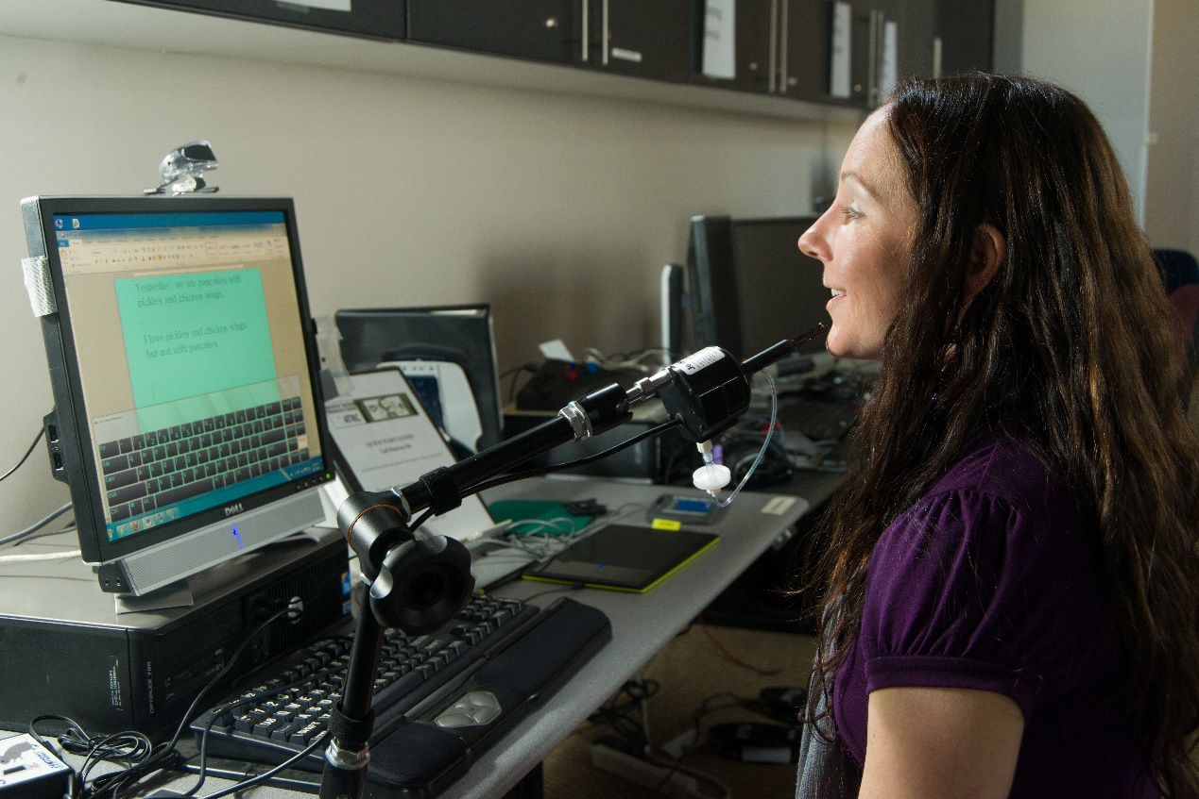
General Methods for our Program Evaluation & Research
Data we collect
Academic skills:
importance, performance & satisfaction ( COPM)
AT use: what, where, when, how
User-preferences
User-characteristics
Data sources
Our own database
CSU Student Disability Center - Clockwork
CSU Institutional Research Office
Notes:
What does outcome measures used here mean? FROM MATT: AGREED…WAS CONFUSING, I REMOVED IT.
Could also use slide 7 here

Slide 32
[Modified] Canadian Occupational Performance Measure (mCOPM)
In our case, occupations are academic skills in post-secondary ed.
Student
Reading
Note-taking
Studying
Org & Time Mgmt
Writing
What is the COPM?
Commonly used assessment in occupational therapy
Semi-structured interview at initiation and end of services
Prioritizes occupations by importance to the client
Notes:
mCOPM has allowed us to tailor measures to our population. Also, the focus is on academic success versus use of the technology….
Term occupation is OT speak but translates to meaningful tasks of a college student

Slide 33
Academic Skills Captured by the mCOPM
Student
Reading
Note-taking
Studying
Org & Time Mgmt
Writing
How important is this skill?
How do you rate your performance?
How satisfied are you with this skill?
Notes:
mCOPM has allowed us to tailor measures to our population. Also, the focus is on academic success versus use of the technology….
Term occupation is OT speak but translates to meaningful tasks of a college student
Should also include the measure of importance? Or is talking about in the prior slide enough

Slide 34
ATRC Survey¹
Assesses:
Student’s awareness of resources
For what tasks/skills student uses AT
Student’s independence in using AT
Training preferences
How well AT works for the student
Academic impacts of AT
How often and where students use their AT
¹Roll et al., 2007
ATRC
survey
Notes:
Also is considered program evaluation
qualtrics

Slide 35
Research at CSU/ ATRC:
Simpson, C. W., Roll, M. C., & Malcolm, M. P. (2022). Predicting Assistive Technology Service Utilization and Grade Point Average for Postsecondary Students with Disabilities. JPED, 35(1), 5–16.
Malcolm, M. P., & Roll, M. C. (2017). Self-reported assistive technology outcomes and personal characteristics in college students with less-apparent disabilities. Assistive Technology, 20, 1-10. DOI: 10.1080/10400435.2017.1406414
Malcolm, M. P., & Roll, M. C. (2017). Assistive technology outcomes in post-secondary students with disabilities: the influence of diagnosis, gender, and class-level. Disability and Rehabilitation: Assistive Technology, 12(8), 857-867. DOI: 10.1080/17483107.2016.1277794
Malcolm, M. P., & Roll, M. C. (2016). The impact of assistive technology services in post-secondary education for students with disabilities: Intervention outcomes, use-profiles, and user-experiences. Assistive Technology. DOI: 10.1080/10400435.2016.1214932
Pinkelman, A., Roll, M., & Greene, D. (2016). Use of a modified Canadian Occupational Performance Measure for assistive technology outcomes in postsecondary education. Occupational Therapy in Health Care, 30(4), 388-401. DOI: 10.1080/07380577.2016.1227893

Slide 36
What we have learned so far:
Study 1:
Use of a modified COPM for assistive technology outcomes in post -secondary education
Study 2:
AT & AT services impact self-ratings of performance & satisfaction
Study 3:
AT & AT services benefit persistence & grades
(by self-rating)
Study 4:
Student characteristic predict service utilization & outcomes
Study 5:
How do AT outcomes relate to academic performance(GPA)

Slide 37
Lessons Learned
Existing AT outcomes did not meet the unique needs of our center
Service should drive research agenda
Research can and should inform service
Changes in service delivery make research a moving target
Plan each step of measuring, collecting, organizing, storing, and analyzing data
Collaboration is the key
Research
Practice
Notes:
Diagram conveys that research feeds into practice and practice feeds back into your research line of inquiry.

Slide 38
Translation to the Larger World
Consider what data are already being collected in your setting
Consider an outcome measure to build into your process
Start small - simple survey regarding user experience with AT and your AT services
Some data is better than no data
Find collaborators who understand measurement, survey development, methodology for interpretation of data
Tell your story - to administration, funders, etc.

Slide 39
House Bill – Data Reporting
Two aims :
Forms a committee to make recommendations to the general assembly and institutions of higher education (IHE) in Colorado aimed at improving outcomes for students with disabilities; and
State institutions of higher education are to begin reporting on data to CDHE for students with disabilities, specifically:
Students who have reported to the institution that they have a disability
Students who are receiving a service or accommodation due to their disability
Benefits:
Requires and standardizes data being collected at each institution
Will allow program evaluation and research across institutions in our state.

Slide 40
Questions / discussion?

Slide 41
Contact Info
Websites:
ATRC Website (atrc.colostate.edu)
Accessibility by Design Website (accessibility.colostate.edu)
Email:
shannon.lavey@colostate.edu
marla.roll@colostate.edu
allison.r.swanson@colostate.edu

