Slide 1
What Grade Did Your Screen Reader Get in Arithmetic?

Slide 2
Presenters
Brian Richwine, CPACC
Senior Accessibility Strategist – Learning Technologies UITS Assistive Technology and Accessibility Centers brichwin@iu.edu
Mary Stores, CPACC
Accessibility Analyst UITS Assistive Technology and Accessibility Centers mstores@iu.edu

Slide 3
Every Good STEM Webinar Starts with a Math Quiz

Slide 4
Demo Math Quiz Question
Included on the next slide are two audio players:
The first is of JAWS reading the entire math quiz question web page.
The second is of only the equation and the answer options
Listen to the audio and determine which answer you would choose.

Slide 5
The Math Quiz as Read by JAWS
Here is the text of what is spoken by JAWS:
Heading level 1 Quiz Question 1
Solve the following question and select from the answers below:
Square root of 4 plus 5 math content.
Choices: 9, 7, 3, 2

Slide 6
The Quiz Question Answer
The correct answer is 3.
If you selected 3, how confident were you that the answer wasn’t 7?
JAWS does not announce where the square root symbol ends.

Slide 7
The Quiz Question Answer (2)
If the square root extended over the quantity 4 plus 5, the answer would be the square root of 9, which is 3.
But, if the square root only extended over the 4, then the square root of 4 is 2 and the answer would be 2 plus 5, which is 7.
Unfortunately, JAWS would read either possibility the same.

Slide 8
Why Special Attention to Spoken Electronic Math Content is Necessary

Slide 9
A Downside of Embossed Braille Materials
A consideration for braille readers is the physical volume of paper required for embossed braille materials

Slide 10
Electronic Braille Has Its Downsides Too
Electronic braille solves the physical space needs problem, but:
Not everyone knows braille and a math braille code
Some may no longer be able to read braille due to neuropathy or diabetes.
Not everyone has a braille display or carries it around everywhere
Electronic braille can be expensive and take a long time to produce
Many programs handle automatic math braille translation poorly

Slide 11
Happily, the W3C Has a Math Standard: MathML
MathML = An XML Mathematical Markup Language
MathML was created to integrate mathematical formulae into World Wide Web pages and other documents
MathML 1.0 was released in April 1998
MathML 3.0 (current) was released April 2014
For more on MathML see: https://www.w3.org/Math/

Slide 12
MathML is easily embedded into HTML5
<h1>Example of MathML embedded in an HTML5 file</h1>
<p>The area of a circle is
<math>
<mi>&pi;</mi>
<mo>&InvisibleTimes;</mo>
<msup>
<mi>r</mi>
<mn>2</mn>
</msup>
</math>.
</p>

Slide 13
We Started Promoting Electronic Math
Began meeting with Instructional Designers and Faculty to promote building born accessible math course materials
The ID’s built a course to help faculty make accessible math content using LaTeX in our Learning Management System (Canvas). Lecture notes, readings, assessments, etc.
Faculty became enthused and found it empowering.
LaTeX for Canvas on “Canvas Commons”
Notes:
https://iu.instructure.com/accounts/98865/external_tools/135244?launch_type=global_navigation

Slide 14
Then the Problems Came
Each combination of technology used has different bugs and limitations:
MathML does not work as part of an accessible name (like a radio button label for a multiple-choice question for an online quiz) as accessibility APIs pass them by straight text
Incorrect math braille output generated by screen readers
Lower case ‘a’s disappearing in speech output from equations due to TTS sonification quirks
And… math simply being read aloud incorrectly or too ambiguously and nothing the author or end user could can do will fix it

Slide 15
Troubleshooting
We made a “torture test” of a diverse set of equations. The equations were coded in MathML in a page in the Canvas LMS.
We had JAWS speak the equations and soon realized a pattern to the mistakes JAWS makes and created a simpler test set.
Notes:
https://brichwin.pages.iu.edu/tests/mathML_speech_text_examples.html

Slide 16
Samples of Potentially Ambiguous MathML
We created a test web page with MathML and two equivalent Word docs; one built with default MathType equations and the second using the Microsoft equation tools.
The test documents are available upon request.
Notes:
https://brichwin.pages.iu.edu/tests/mathML_speech_text_examples.html

Slide 17
Is it Us?
We kept expecting to find someone who knew something we didn’t:
Maybe there is a JAWS support page we missed
Maybe we made our MathML or LaTeX wrong
Maybe there’s something we didn’t know we don’t know….

Slide 18
We Decided to Get a Few Other Opinions…
We reached out to others to help us test. We’d like to thank them here:
Liz Botner: Tested with a MacBook Pro and Safari
Colette Roos: Tested with NVDA and Chrome and Office 365 on Windows 10
Nancy Simpson-Oberhart: Tested with JAWS 2022 and Chrome on a Windows 10
Desiree Sturdevant: Tested with JAWS 2021, Chrome and Microsoft Word
Carlos Taylor: Tested with JAWS 2021 with Windows 10
Melissa Wobschall: Tested with Windows 10, NVDA and Chrome.

Slide 19
How Screen Readers Speak Math

Slide 20
How Should a Screen-Reader Speak Math?
How would you read this bit of mathematics to someone?

Slide 21
How Should a Screen-Reader Speak MathML?
How would you distinguish the following two similar, but algebraically different equations by speech?
or

Slide 22
First Handbook for Spoken Mathematics?
“Larry’s Speakeasy”
Lawrence Chang, Ph.D. October 1983
A goal of the handbook was to establish a standard where no standard has existed
As a blind person he learned mathematics by means of others reading the material to him
The Office of Equal Opportunity of the Lawrence Livermore National Laboratory, the U.S. Department of Energy

Slide 23
Enter the Grammars for Speaking Math
Many assistive technologies use defined grammars like ClearSpeak, MathSpeak and SimpleSpeak to speak math.
Notes:
ClearSpeak: use common ways of speaking math with pauses or words to disambiguate
Ex: “the fraction with numerator 1 and denominator x+1”
Mention MathSpeak (follows braille), SimpleSpeech (make simple things simple)

Slide 24
The MathSpeak Grammar
Developed by Dr. Nemeth (author of the Nemeth braille math code)
Allows speaking math information unambiguously and concisely
Uses a special grammar and lexicon that follows how the Nemeth Code linearizes mathematics:
[Begin math]
x equals StartFraction negative b plus-or-minus StartRoot b squared minus 4 a c EndRoot Over 2 a EndFraction
[End math]

Slide 25
MathSpeak Core Specification
Introduction to MathSpeak Grammar: https://www.seewritehear.com/learn/the-fundamental-problem-of-spoken-mathematics/
MathSpeak Grammar Specification: https://www.seewritehear.com/accessible-mathml/mathspeak/examples/grammar-rules/index.php

Slide 26
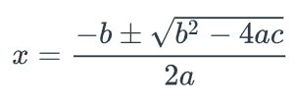
The ClearSpeak Grammar
Developed by:
Lois Frankel and Beth Browstein, Educational Testing Service
Neil Soiffer, Design Science, Inc. (at the time)
Create rules for math expressions typical of high school-level algebra that produce speech like the speech used in typical classrooms.
Designed along with flexible authoring and content-user tools
[Begin math]
x equals the fraction with numerator negative b + or - the square root of b squared minus 4 a c and denominator 2 a
[End math]

Slide 27
ClearSpeak Grammar Spec, Tutorial, History
In the MathType documentation on the Wiris website, you can find a page on ClearSpeak. It used to include early presentations, tutorials, and videos on the thinking behind its development. They described how flexible and customizable it is. Unfortunately, Wiris took much of it down.
https://docs.wiris.com/en/mathtype/office_tools/accessibility/clearspeak
Notes:
https://docs.wiris.com/en/mathtype/office_tools/accessibility/clearspeak

Slide 28
The SimpleSpeak Grammar
Designed by Neil Soiffer to use less words where possible, yet clearly disambiguate math
Speaks common, simple expressions such as 1/x without extra words.
More complicated expressions will have begin/end words to clearly disambiguate where the notation begins and ends. [Begin math]
x equals; fraction, negative b plus or minus;
the square root of b squared minus 4 a c end root;
over, 2 a, end fraction;
[end math]

Slide 29
JAWS - HTML - Case of the missing plus signs
JAWS’s Speech:
the square root of 3 i 2 i MathContent
the square root of 3 i 2 i MathContent
Note that in both examples, the plus operator is not being announced. We discovered that surprisingly the JAWS punctuation verbosity level setting affects how math is read aloud.
Find the source web page at: https://brichwin.pages.iu.edu/tests/mathML_speech_text_examples.html
Notes:
Web page with MathML for testing screen-readers: https://brichwin.pages.iu.edu/tests/mathML_speech_text_examples.html
Web page used for bug report to Freedom Scientific re: JAWS math speech issues: https://brichwin.pages.iu.edu/tests/jaws_Reading_MathML_ambiguously-2021-06-07.html
URL to issue filed with Freedom Scientific: https://github.com/FreedomScientific/VFO-standards-support/issues/539

Slide 30
JAWS – Required Punctuation Setting
The JAWS Punctuation setting in Editing Options controls the amount of punctuation JAWS will speak. Available settings are None, Some, Most, and All. The default setting is Most.
Punctuation must be at least “Some” for the math symbols we tested in math content to be read aloud.

Slide 31
JAWS - HTML – Square Roots
JAWS’s Speech:
the square root of 3 i plus 2 i MathContent
the square root of 3 i plus 2 i MathContent
Note that in the first example, only the 3i is under the square root. In the second example both the 3i and the 2i are under the square root. JAWS is not announcing the end of the root, so the two distinct equations are being read the same. JAWS provides no user settings for its math speech output.
Notes:
https://brichwin.pages.iu.edu/tests/mathML_speech_text_examples.html

Slide 32
JAWS – HTML – Trig Functions
JAWS’s Speech:
sine of 3 i minus 2 i MathContent
sine of 3 i minus 2 i MathContent
Note that JAWS is not reading the parentheses that are present in the two equations. The listener cannot determine that in the first equation, only the 3i is being passed to the sine function but in the second equation the entire quantity 3i minus 2i is being passed to the sine function.

Slide 33
JAWS – HTML – Fractions
JAWS’s Speech:
fraction, x + y, over x minus y. + 5 sevenths MathContent
fraction, x + y, over x minus y. + 5 sevenths MathContent
Note that JAWS is not announcing the end of fractions. The listener cannot determine that in the first equation, the 5 sevenths is part of the denominator of the first fraction while in the second equation only the x minus y is in the denominator and the 5 sevenths is a separate term at the same level as the first fraction.

Slide 34
JAWS – HTML – Superscripts
JAWS’s Speech:
x to the power of n minus 1 MathContent
x to the power of n minus 1 MathContent
Note that JAWS is not the end of exponents. The listener cannot determine that in the first equation, the minus one is part of the exponent while in the second equation only n is in the exponent and the minus one is a separate term at the same level as the x to the power of n.

Slide 35
VoiceOver MacOS - HTML – Square Roots
VoiceOver’s Speech:
square root of 3i, end of root, plus 2i, with 4 items, math
square root of 3i plus 2i, end of root, math
Note that VoiceOver on MacOS is announcing the end of root and putting in a pause before and after that annunciation.
Notes:
https://brichwin.pages.iu.edu/tests/mathML_speech_text_examples.html

Slide 36
VoiceOver MacOS – HTML – Trig Functions
VoiceOver’s Speech:
sine ( 3i ) negative 2i, with 9 items, math
sine ( 3i minus 2i ), with 9 items, math
Note that VO on the Mac is reading the parentheses that are present in the two equations. The listener can detect the differences. Note however how VO said “negative 2i” instead of minus 2i in the first equation.

Slide 37
VoiceOver MacOS – HTML – Fractions
VoiceOver’s Speech:
fraction start, x + y over x – y + fraction start, 5 over 7, end of fraction, end of fraction, math
fraction start, x + y over x – y, end of fraction, + fraction start, 5 over 7, end of fraction, with 3 items, math
Note that VO clearly announces the start, over, and end of each fraction.

Slide 38
VoiceOver MacOS – HTML – Superscripts
VoiceOver’s Speech:
x, superscript n minus 1, math
x, superscript n, minus 1, with 3 items, math
Note that VO is depending upon the pause between the n and the minus one to let listeners know the exponent has ended.

Slide 39
NVDA+MathCAT – HTML – Square Roots
MathCAT’s Speech (ClearSpeak Verbose for Blindness):
[tick] the square root of 3 i end root plus 2 i [tock]
[tick] the square root of 3 i plus 2 i end root [tock]
Note that when setup for Blindness and ClearSpeak Verbose, MathCAT’s speech explicitly indicates where the root ends.
Notes:
https://brichwin.pages.iu.edu/tests/mathML_speech_text_examples.html

Slide 40
NVDA+MathCAT – HTML – Trig Functions
MathCAT’s Speech (ClearSpeak Verbose for Blindness):
[tick] sine of 3 i minus 2 i [tock]
[tick] sine open paren 3 i minus 2 i close paren [tock]
Note that when setup for Blindness and ClearSpeak Verbose, MathCAT’s speech only speaks the parenthesis for the trig function when there is more than one term contained in them.

Slide 41
NVDA+MathCAT – HTML – Fractions
MathCAT’s Speech (ClearSpeak Verbose for Blindness):
[tick] the fraction with numerator; x plus y; and denominator x minus y plus 5 sevenths; end fraction, [tock]
[tick] the fraction with numerator; x plus y; and denominator x minus y; end fraction; plus 5 sevenths [tock]
Note how the use of “end fraction” in both cases makes the math unambiguous.

Slide 42
NVDA+MathCAT – HTML – Superscripts
MathCAT’s Speech (ClearSpeak Verbose for Blindness):
[tick] x raised to the n minus 1 power [tock]
[tick] x to the n-th power, minus 1 [tock]
Note how MathCAT’s natural sounding choice of saying either “raised to the … power” or “to the … power” makes the exponent unambiguous.

Slide 43
How Screen Readers Read Math in Word Documents

Slide 44
JAWS – Word with Microsoft Math Objects
JAWS reads math in Microsoft Word documents if the math was entered using Microsoft Word’s equation tools. JAWS appears to read the math exactly as it read the same equations from MathML on a webpage.

Slide 45
VoiceOver – Word with Microsoft Math Objects
VoiceOver reads math in Microsoft Word documents if the math was entered using Microsoft Word’s equation tools. VoiceOver reads the math differently than the equations from MathML on a webpage. For example, notice it does not speak the “end root” in the first equation as it did on the webpage.
Notes:
VoiceOver only differentiates the two square root equations by using a mix of different timings and intonation. The inconsistency would add to the challenge!

Slide 46
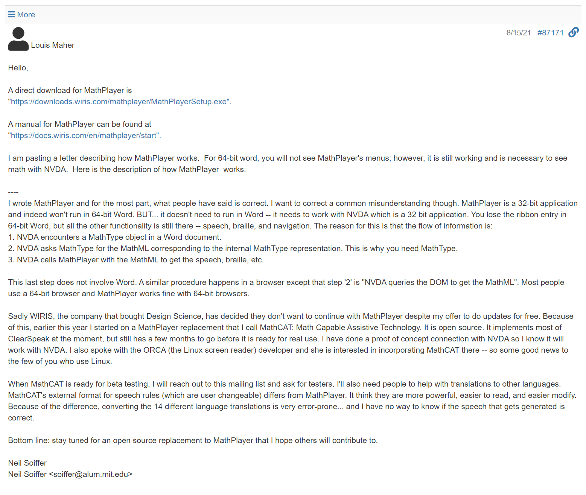
Neil Soiffer on Where MathPlayer Works
Retrieved from: https://nvda.groups.io/g/nvda/topic/84904907 on February 4, 2022
Notes:
https://nvda.groups.io/g/nvda/topic/84904907

Slide 47
NVDA with MathPlayer’s Default Settings
MathPlayer’s default settings use settings for a sighted individual. It assumes the individual can see the equation’s structure thus does not include details necessary for understanding the structure and relationships between the parts. Hearing the speech alone is not enough to understand the content.

Slide 48
Be Aware of MathPlayer’s Default Settings
By default, MathPlayer’s settings are for sighted individuals with print impairments. They need to be changed to generate speech appropriate for individuals with blindness.
https://docs.wiris.com/en/mathplayer/start#mathplayer_settings

Slide 49
NVDA and MathPlayer Set to Read for Blindness
Here MathPlayer has been configured to “generate speech for blindness” and to use MathSpeak Grammar and “Speech amount Full”.
Notice the error NVDA and MathPlayer make reading the last two equations: the ‘x’ is missing from the speech output that should be:
x superscript n minus 1
x superscript n baseline minus 1

Slide 50
MathPlayer’s Future Under Wiris is Uncertain
It appears that Wiris, the company that bought Design Science, has decided they don't want to continue with MathPlayer. They don’t have a time frame for when they will have products that replace MathPlayer’s functionality.
Notes:
https://info.wiris.com/mathplayer-info

Slide 51
Testing Summary

Slide 52
Summaries of Screen Readers and Consuming Math Content - JAWS
Not currently recommended for listening to math content
Supports MathML in Web pages and EPUBs natively
Supports modern Microsoft Math objects in Word docs natively
Does not offer any end user settings to adjust how it speaks math
Does not speak math unambiguously. It leaves out “End Fractions”, “End Roots”, “back to base”, etc. and does not employ pauses or other means to indicate structure.

Slide 53
Summaries of Screen Readers and Consuming Math Content – JAWS (2)
It’s not clear what speech grammar it is using
Overrides MathJax (when present)
Has its own expression explorer (custom version of MathJax expression explorer)

Slide 54
Summaries of Screen Readers and Consuming Math Content – VoiceOver (Mac OS)
Passable only if the user is okay with interpreting pauses
Supports MathML in Web pages and EPUBs natively
Supports modern Microsoft Math objects in Word docs natively
Does not offer any end user settings to adjust how it speaks math
Seemingly randomly switches between speaking end of structure notifications and using pauses.

Slide 55
Summaries of Screen Readers and Consuming Math Content – VoiceOver (Mac OS) (2)
Has a unique math speech grammar
Complex MathML generated very awkward speech output

Slide 56
Summaries of Screen Readers and Consuming Math Content – NVDA (Windows)
Does not support MathML in Web pages or EPUBs natively
Does not support Microsoft Math objects in Word docs natively
Will support MathJax 3 in Web pages natively.
Seemed difficult to get NVDA and MathJax 2.7.7 to work together smoothly
Works with MathJax’s expression explorer

Slide 57
Summaries of Screen Readers and Consuming Math Content – NVDA + MathCAT
Best combination to use for listening to math in Web pages, EPUBs, and documents
Supports MathML in HTML and EPUBs
Supports Microsoft Math objects natively
Supports MathType math objects if MathType is installed and licensed

Slide 58
Summaries of Screen Readers and Consuming Math Content – NVDA + MathCAT (2)
Offers many user settings
Speaks math unambiguously when configured for SimpleSpeak or for Blindness with ClearSpeak Verbose
Has its own expression explorer
Has advanced math navigation features

Slide 59
DAISY Webinars on Accessible Math
The DAISY Consortium produces many great online Webinars
Their Creating and Reading Accessible Math Webinar covers using tools to produce accessible Word, HTML, and EPUB output.
https://daisy.org/news-events/articles/creating-reading-accessible-math-w/
Notes:
https://daisy.org/news-events/articles/creating-reading-accessible-math-w/
28:20 example of navigating math using MathCAT.

Slide 60
Summaries of Screen Readers and Consuming Math Content – MathPlayer
Appears to have been abandoned by Wiris
Requires configuring via a Control Panel app
Defaults to producing speech output for print impairment (sighted users) instead of for users with blindness
Can generally produce unambiguous math if configured for Blindness and MathSpeak grammar or SimpleSpeak grammar. However, it is buggy
Uninstalling MathPlayer can cause difficult to repair issues with office products

Slide 61
Summaries of Screen Readers and Consuming Math Content – MathPlayer (2)
Works with NVDA and JAWS in various contexts
Requires full Windows version of MathType to be installed and licensed to speak MathType math objects in Microsoft Word docs
Good documentation for configuring and using MathPlayer is available on the Wiris website

Slide 62
The MathCAT NVDA Addon
The MathCAT NVDA plug-in is available now by searching for MathCAT NVDA Addon or by visiting:
https://addons.nvda-project.org/addons/MathCAT.en.html
Notes:
https://addons.nvda-project.org/addons/MathCAT.en.html

Slide 63
MathJax Math to Speech Text Converter
We created a tool that leverages MathJax to create math speech for us: https://brichwin.pages.iu.edu/altMediaTools/mathToSpeechTextMathJax3.html

Slide 64
The MathCAT Demo
A demo page is available where MathCAT’s speech and braille output can be explored:
https://nsoiffer.github.io/MathCATDemo/

Slide 65
Linear Math Speech Will Not Always Cut It
What would you prefer? Exploring this equation with your eyes:
or, hearing it read aloud:
“sigma-summation Underscript k equals n 0 Overscript n Endscripts left-parenthesis StartFraction upper A Over StartAbsoluteValue k minus c EndAbsoluteValue plus 1 EndFraction cosine left-parenthesis k dot 2 pi x minus v t right-parenthesis cosine left-parenthesis r dot pi x right-parenthesis plus a right-parenthesis StartFraction 1 Over StartRoot 2 pi s EndRoot EndFraction e Superscript left-parenthesis minus StartFraction left-parenthesis x minus u right-parenthesis squared Over 2 s squared EndFraction right-parenthesis” ?
Notes:
While an alternative text description on an image of a math equation is better than nothing, it still a violation of Success Criterion 1.4.5 Images of Text(link is external).
Presenting an equation as an image denies the non-sighted user to derive the understanding through exploring structure, relationships, and meaningfully render the semantics in their desired form to perceive the math in an equivalent fashion to a sighted user.

Slide 66
Students May Need to Learn to Navigate Math Using Expression Explorers
MathCAT: https://nsoiffer.github.io/MathCAT/nav-commands.html
MathPlayer: https://docs.wiris.com/en/mathplayer/navigation_commands
MathJax: https://speechruleengine.org/www/keybindings.html
JAWS: https://www.freedomscientific.com/training/teachers/accessing-math-content-with-jaws-and-fusion/
Notes:
Solves the problem of linearity also allows piecewise exploration.

Slide 67
Expression Explorer Demo
To follow along, visit this Canvas page:
https://iu.instructure.com/courses/1886472/pages/complex-math-examples or use this shortened URL:
https://go.iu.edu/4Djx
Notes:
This page has MathJax 2.7.7 running on it.

Slide 68
Student Sentiments on Electronic Math
Question:
“Why didn’t you advocate more for accessibility in your math classes?”
Colette’s reply:
“You don’t know where the problem lies. Is it the LMS? Is it the way they programmed the textbook? Is there something wrong with the screen reader? Who do you report the problem to when everyone will say it’s not their problem?”
After discussing how the Math Explorer tools are more effective at allowing discovery of an equation’s structure, Nancy said:
“Why bother doing all these steps in the math explorer when it may not read correctly?”

Slide 69
Some take aways
There are a lot of subtle complexities to providing effective communication of mathematical content through speech text.
Speech grammars were designed with specific goals and contexts in mind
The wrong choice of speech grammar and speech grammar settings could lead to miscommunication and misunderstanding of math content.
Users dependent on speech should be informed consumers and get training on how to correctly interpret what they are hearing
Some tools do not give you a choice in math grammar and may not offer any customization
Some tools simply do a poor job of converting MathML into speech

Slide 70
Tools Should Be Better – Let’s Raise the Bar
More and more STEM content is being “Born Digital”
We need reliable tools of production and consumption so those born digital STEM materials can truly be “Born Accessible” for the widest audience possible
AT vendors need to hear that supporting STEM content is important
AT Vendors, eText platform developers, and content creators need to hear that they need to have qualified people that understand the space they are working in
Notes:
Apple’s response to math speech bugs (2016 – is the sentiment expressed still held by Apple today?): https://discussions.apple.com/thread/7475266
A committee of guidance should be formed to tackle problems of why STEM content is working. Screen reader developers and subject matter experts can collaborate to ensure math content will be accessible in the future.

Slide 71
Reported the issue to Vispero
Please feel free to pile on comments to the issue: https://github.com/FreedomScientific/VFO-standards-support/issues/539
Notes:
Reported in June of 2021. Asked for an update in June of 2022. Did not get a reply.

Slide 72
Thoughts… Discussion… Ideas???
Notes:
Seed the discussion

