Slide 1
Video and accessibility
pz.tt/AHG22-video

Slide 2
Video statistics

Slide 3
About video numbers
  Three billion internet users watching video at least once a month (244.4 million viewers in the US) – 92% of internet users
  Average video consumption is 84 minutes a day
  15% of millennials watch 10 to 20 hours of video a week
  One-third of all online activity is watching video

Slide 4
About video traffic
  82% of all internet traffic is video
  More video content is being uploaded in 30 days than what major TV networks have produced in the past 30 years
  62% of searches on Google include a video, with 80% coming from YouTube

Slide 5
About video - mobile
  90% of consumers watch video using mobile
  70% of YouTube consumption is from mobile
  More than 75% of all video content is viewed on mobile (up from 50% in 2019) and 90% of Twitter video

Slide 6
About video uploads and views
  500 hours of video content is uploaded every minute to YouTube
  Facebook has more than 8 billion video views per day, Twitter has more than 2 billion, TikTok: 1 billion
  Video posts on LinkedIn are shared 20 times more than other formats
  Video posts on social media get 48% more views
  Video advertising in the US was estimated at $55 billion per year

Slide 7
About video captions and transcripts
  92% of consumers watch videos with the sound off, with 50% relying on captions
  85% of videos on Facebook and 80% of videos on LinkedIn are watched without sound
  80% of people that use captions are not Deaf or Hard Of Hearing

Slide 8
About video captions and transcripts
  Captioned videos are watched to the end 40% more than uncaptioned videos
  Videos with transcripts earned 16% more revenue than videos without transcripts

Slide 9
Creating accessible video

Slide 10
Common accessibility issues for video
  Inadequate keyboard access
  Insufficient control and operation
  Incorrect implementation
  Inaccessible content
  Lack of transcript, captions or audio descriptions

Slide 11
Quote about video for blind people
“Video is a very important source of information and is remarkable of culture now. Blind individuals must not be excluded from access to data provided in video content. You can’t see, but you can understand.”

Slide 12
So, how do you create an accessible video experience?

Slide 13
Accessible video
  No flashing content
  Never auto-play
  Accessible video player
  Accessible content in the video
  Accessible transcript
  Accessible captions
  Accessible audio descriptions

Slide 14
Step One
No flashing content

Slide 15
No flashing
  Flashing images, especially those with red, should not flicker faster than three times per second. If the image does not have red, it still should not flicker faster than five times per second.
  Flashing images should not be displayed for a total duration of more than two seconds.
  Stripes, whirls and concentric circles should not take up a large part of the screen.

Slide 16
Pokémon Shock
  Electric Soldier Porygon is the 38th episode of the Pokémon's Anime series. It was broadcast in Japan on December 16, 1997 on 37 stations to 4.6 million households.
  There were repetitive visual effects (flashing red and blue lights) – effectively strobe lights at a rate of 12 Hz for six seconds

Slide 17
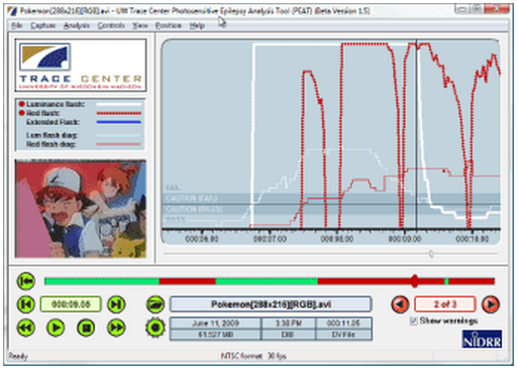
Flickering
  Use the PEAT (Photosensitive Epilepsy Analysis Tool) tool:
  https://trace.umd.edu/peat

Slide 18
Step Two
Never auto-play

Slide 19
Impact: Auto-play
  Some video players will automatically start when a page opens.
  Video audio clashes with the user’s screen reader audio (both run at the same time)
  Screen reader users and keyboard users have to manually search through the page until they find the video and stop it using the player controls

Slide 20
There may not be a website mechanism to pause or stop the video.

Slide 21
No global setting to stop autoplay on YouTube

Slide 22
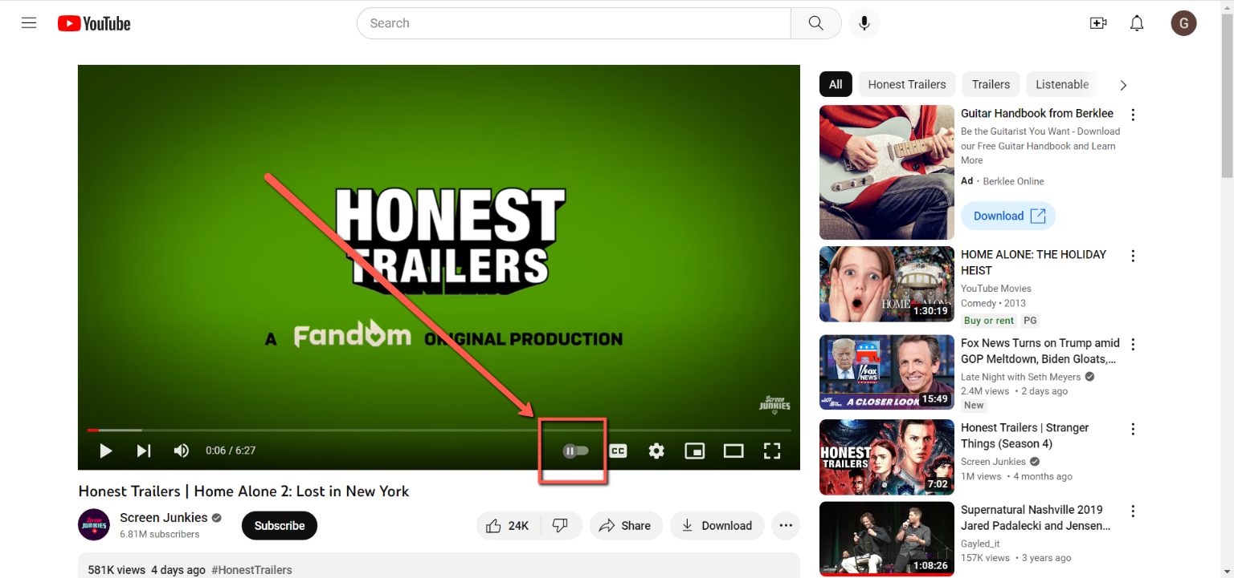
Auto-play

Slide 23
Step Three
Accessible video player

Slide 24
Accessible media player
  Must address the common issues by providing:
  Adequate keyboard access
  Sufficient control and operation
  Correct implementation

Slide 25
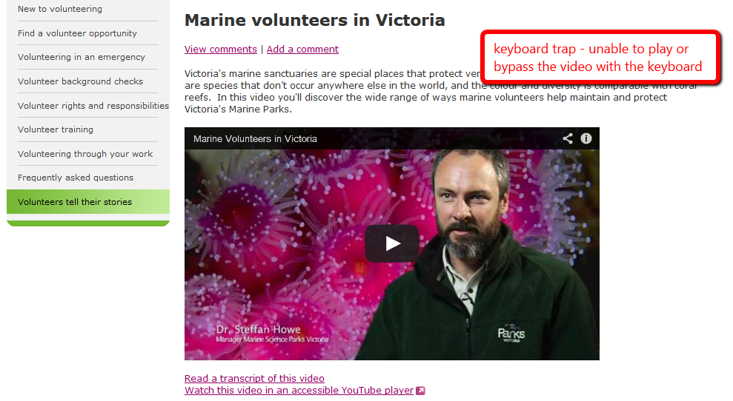
Keyboard trap

Slide 26
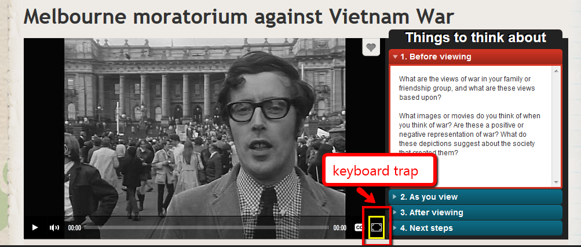
Keyboard trap

Slide 27
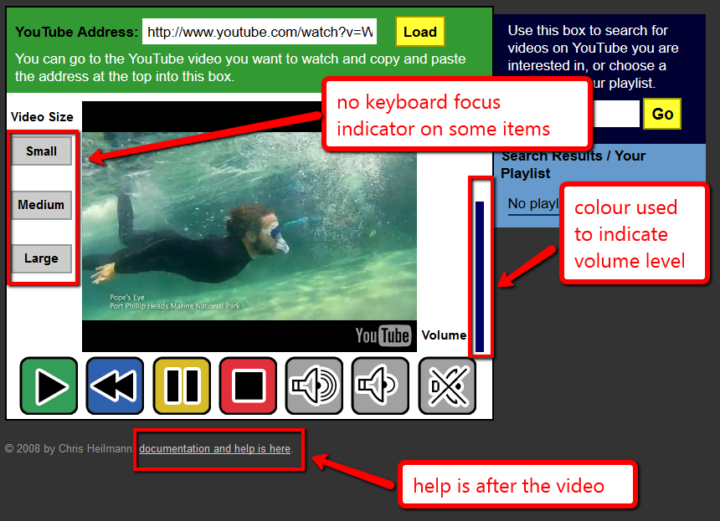
Keyboard focus missing

Slide 28

So we built…
www.oz-player.com

Slide 29
OzPlayer features
  Skip links
    Skip video entirely
    Skip to transcript
  Access to help information before the video
  Fully keyboard accessible
  Highly visible keyboard focus indicator on all controls

Slide 30
YouTube is accessible, right?
Notes:
Infinite scrolling and lack of audio descriptions

Slide 31
Access Able Player and OzPlayer
Able Player:
https://ableplayer.github.io/ableplayer/
OzPlayer
https://www.accessibilityoz.com/ozplayer/
Code generator: https://www.accessibilityoz.com/ozplayer/ozplayer-code-generator/

Slide 32
Step Four
Accessible content

Slide 33
Accessible content
  Use high contrast colors for any text overlaying video content
  Do not convey information with color alone
  Avoid patterned backgrounds

Slide 34
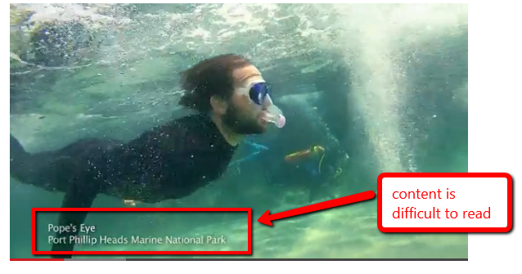
Low color contrast

Slide 35
Step Five
Accessible transcripts

Slide 36
Who are transcripts for?

Slide 37
Accessible transcript
  Be in an accessible format
  Identify the speakers and include all speech
  Include relevant information about the speech
  Include relevant non-speech audio information
  Include any textual or graphical information

Slide 38
Accessible transcript
  Include a description of on-screen events and important changes of scene
  Indicate the end of the transcript if on the same page as the video or provide a mechanism to return to the video if on another page.

Slide 39
Step Six
Accessible captions

Slide 40
Who are captions for?

Slide 41
Accessible captions
  Synchronized to appear at the same time as the sound they are captioning
  Include all important audio information
  Can be read
    Sufficient color contrast between background and caption text
    Appear on the screen for enough time

Slide 42
Accessible captions
  There are no periods without captions
  Attribute speech to a particular speaker and identify all changes in speaker
  Do not contain important information not included in the video

Slide 43
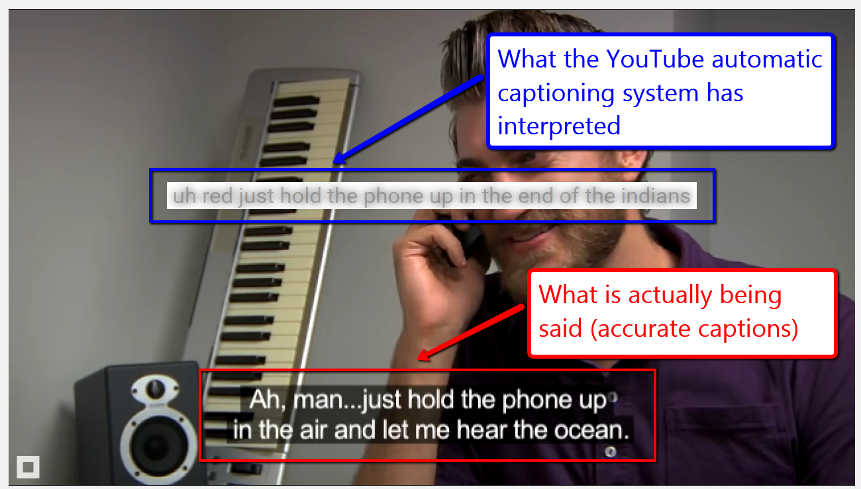
YouTube captioning

Slide 44
Step Seven
Accessible audio descriptions

Slide 45
Who are audio descriptions for?

Slide 46
Accessible audio descriptions
  Adequately describes all important visual information
  Does not impact on other speech or important sounds
    May need to create an alternative video which includes pauses to allow sufficient time for information to be delivered at the appropriate point (extended audio description)

Slide 47
Accessible audio descriptions
  Can be heard
    Is distinguishable from the audio content in the video itself
  Contains only information included in the video

Slide 48
Examples
Example extended Audio Descriptions:
a11yoz.com/ead
Example automated captions: a11yoz.com/captionfail

Slide 49
Resources
AccessibilityOz – Resources – Articles
8 steps to creating accessible video
Video Accessibility Principles
Accessible videos are your friend
AccessibilityOz – Resources – Webinars
Video and Accessibility webinar
AccessibilityOz – Factsheets
Video accessibility principles, impact on users, testing checklist

Slide 50
What’s needed for full accessibility?
To enjoy online materials you need to have three browsers, three screen readers and a smartphone with accessibility features, and extreme patience, and still satisfaction is not guaranteed.

Slide 51
Questions?

