Slide 1
Texthelp Tools to Support and Simplify Your Entire Alt Format Process
AHG Conference - 2022

Slide 2
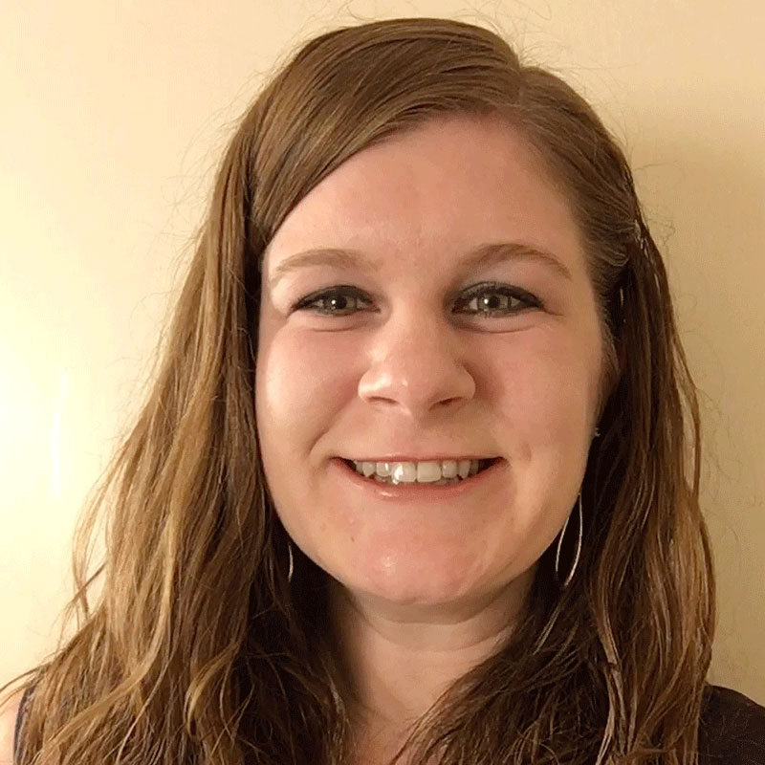
Hello There!
Rachel Kruzel
Higher Education Specialist
Texthelp
Email: r.kruzel@texthelp.com
Phone: 651-245-3128
Twitter: @TH_RachelK

Slide 3
Learn More About Texthelp tools
Find out more about us and learn more about our products
text.help/ALTFORMAT

Slide 4
Today’s Agenda
Accessible Course Materials
Tools of Support
Questions & Discussion
Creation & Consumption
Through the Eyes of…

Slide 5
Accessible Course Materials

Slide 6
Then

Slide 7
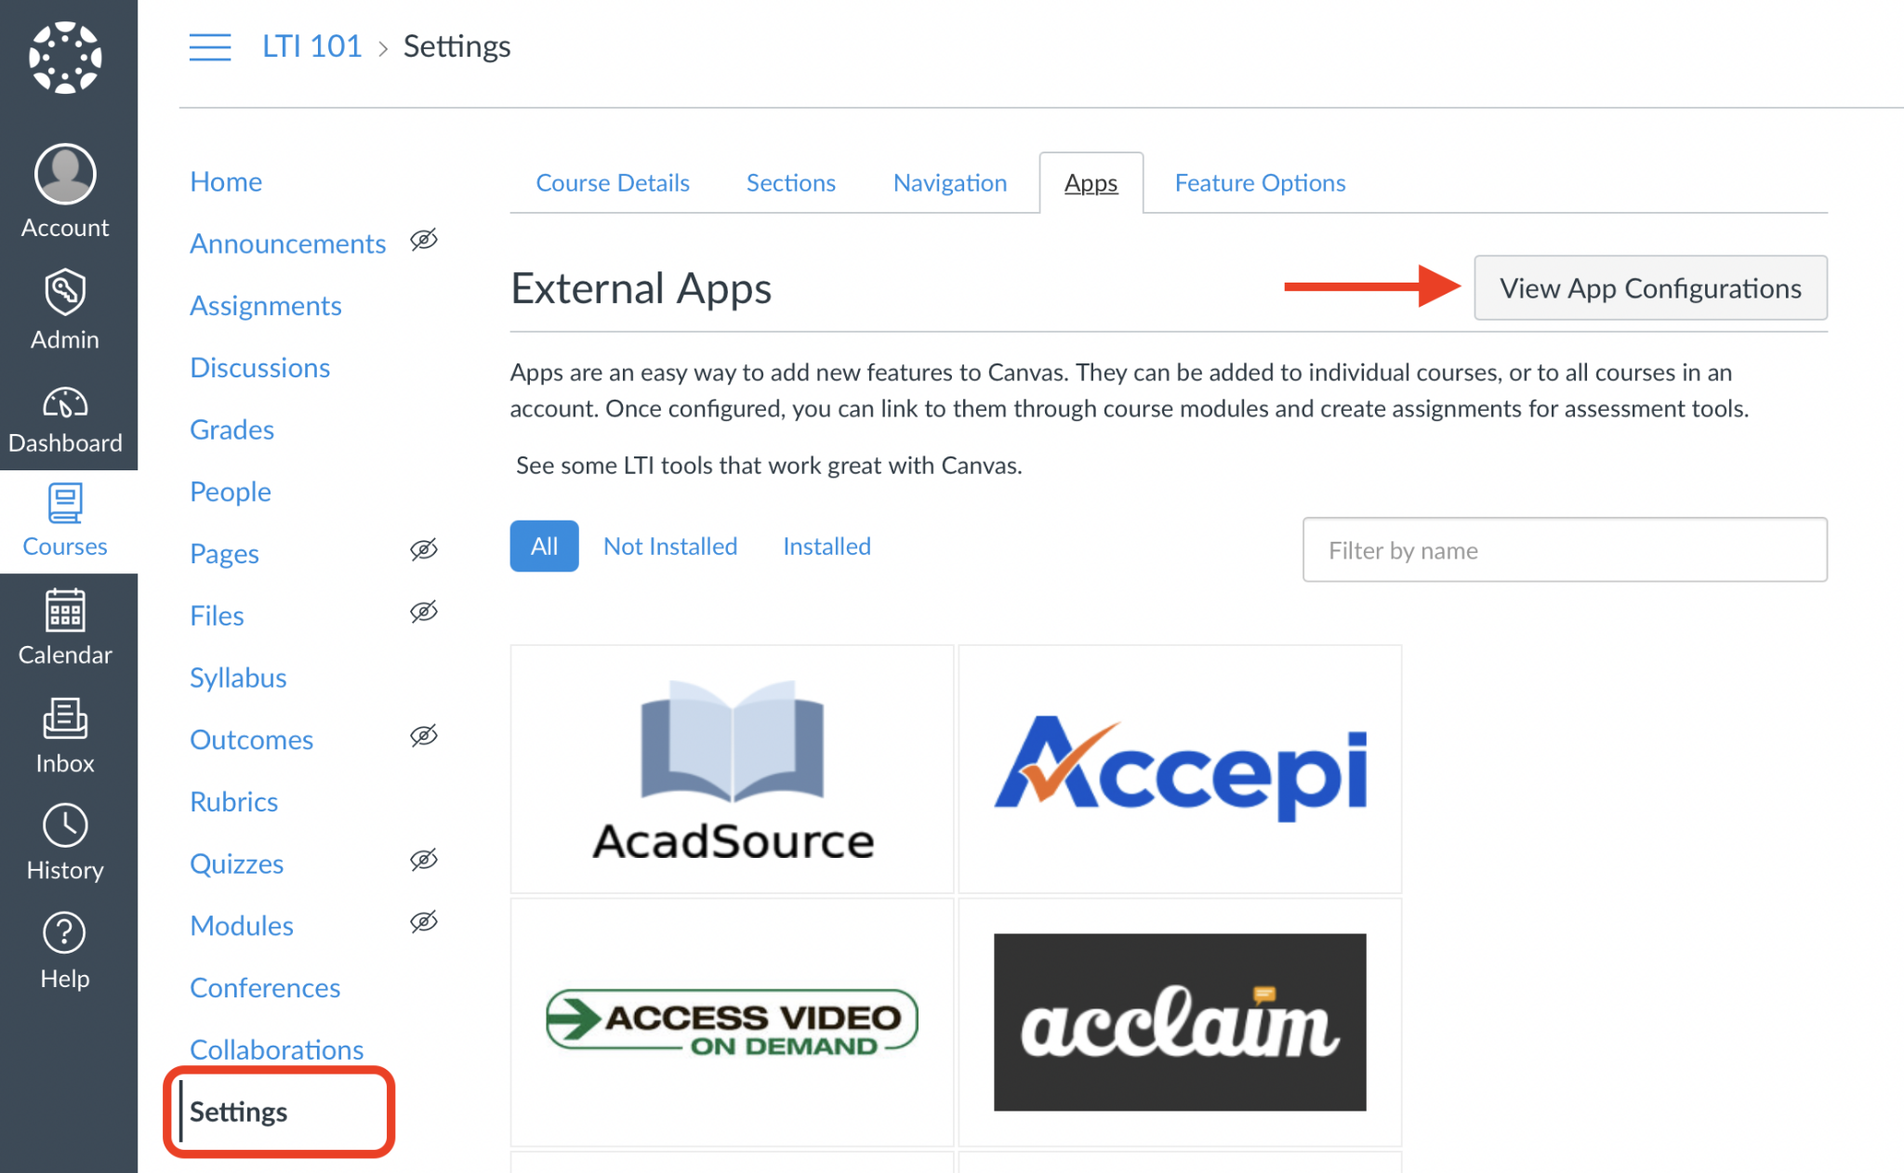
Now

Slide 8
Evolution of Course Materials
Textbook readings
PDFs, journal articles, and files
LMS pages
Websites
3rd Party content and programs
More…

Slide 9
Perpetuation of Practice
Why do some schools perpetuate the practice that only some of the varied types of course materials of today are considered and provided to students as part of the accessible course materials conversion and distribution process?

Slide 10
Limitations & Challenges We Encounter
Budgetary
Staffing
Expertise
Bandwidth
Buy-in
Impact of disability versus diagnosis

Slide 11
Meeting People Where They Are At
Finding a tool or suite of tools that meets our institutions, our students and our staff where they are at based on the limitations and challenges we are all facing is key for sustainable practice and support moving forward.

Slide 12
Global, Holistic & Nimble Support
360 degree support for all subjects
Single group of tools that connect and interface with one another
Tools that follow and support learners
Easy to use, low cognitive load for use

Slide 13
True Accessibility & Access
Scope of all content
Breadth of all content
Depth of all content
Access to all content

Slide 14
Reading & Writing Interplay
If a student struggles with reading, they likely struggle with writing
If a student struggles with writing, they likely struggle with reading
Many professionals, don’t dive in deep enough to determine the barriers of writing
Necessary to assume impacts to both key areas of literacy

Slide 15
Adjusting Our Mindsets
Holistic support around literacy - not just reading
Writing support tools and support reaching and creating content
Disability categories with executive functioning impacts

Slide 16
Creation & Consumption

Slide 17
Necessary Components - Creation
Optical Character Recognition
Staff/professional/faculty
Student
Basic PDF editing
Remediation of STEM Content

Slide 18
Necessary Components - Consumption
Read text based content
Variability of content types
STEM content
Create written content
Ability to create/interact with STEM content

Slide 19
Tools of Support

Slide 20
Read&Write
Help students understand, engage and express themselves
Read&Write is a literacy support tool that offers help with everyday tasks like reading text out loud, understanding unfamiliar words, researching assignments and proofing written work.

Slide 21
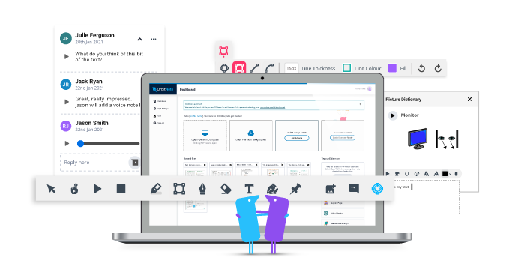
OrbitNote
Create, convert, connect:
Take your documents to the next level
OrbitNote allows you to transform and interact with documents in a completely different way. Create an accessible, dynamic and collaborative space that works for everyone.

Slide 22
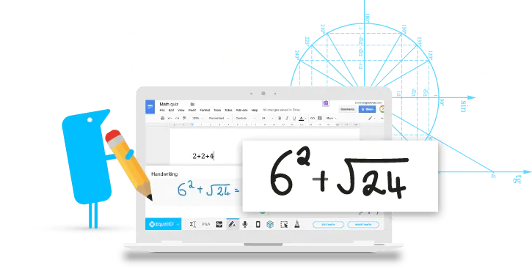
Equatio
Make math digital
EquatIO allows you to create equations, formulas, and more, digitally. Helping to make math and STEM classes more accessible and engaging for every student.

Slide 23
Through the Eyes Of

Slide 24
A Student
Read&Write to read all text based content in variety of places
Reads STEM content created with Equatio
Read PDF files with OrbitNote
Independent OCR capability
Ability to write text based content with Read&Write
Ability to create STEM based content with Equatio

Slide 25
Let’s Take a Peek - Student

Slide 26
Staff - Remediation, Alt. Format, DS
Independent access to course content
Ease of distribution of remediated files using Google Drive or OneDrive
OCR & basic PDF editing with OrbitNote
Creation and remediation of STEM content with Equatio

Slide 27
Let’s Take a Peek - Staff

Slide 28
A Faculty Member
Independent access to OCR tool with OrbitNote
Creation and remediation of STEM content with Equatio
Feedback and collaboration with OrbitNote

Slide 29
Let’s Take a Peek - Faculty

Slide 30
Questions & Discussion

Slide 31
Learn More About Texthelp Tools - 2
Find out more about us and learn more about our products
text.help/ALTFORMAT

Slide 32
Let’s Connect!
Rachel Kruzel
Higher Education Specialist
Texthelp
Email: r.kruzel@texthelp.com
Phone: 651-245-3128
Twitter: @TH_RachelK

