Slide 1
Math & STEM Content Made Accessible in an eLearning World
Louis Shanafelt

Slide 2
Presenter Introduction
Hello, I’m Louis.
Louis Shanafelt
Product Manager
Texthelp
@LouisShanafelt
L.Shanafelt@texthelp.com
Notes:
My name is________ and I work for Texthelp.

Slide 3
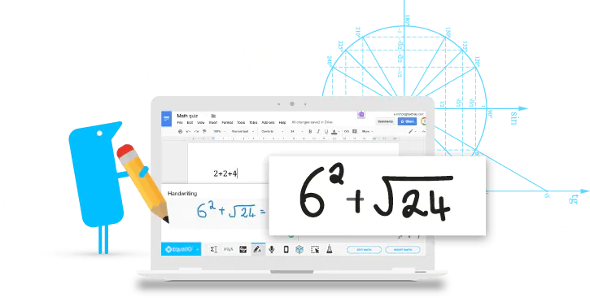
An Introduction To The Product I Will Be Utilizing To Make Math Digital and Accessible
Make math digital
Equatio allows you to create equations, formulas, and more, digitally. Helping to make math and STEM classes more accessible and engaging for every student.

Slide 4
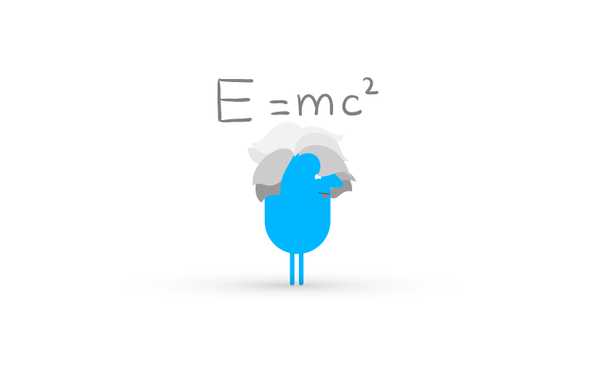
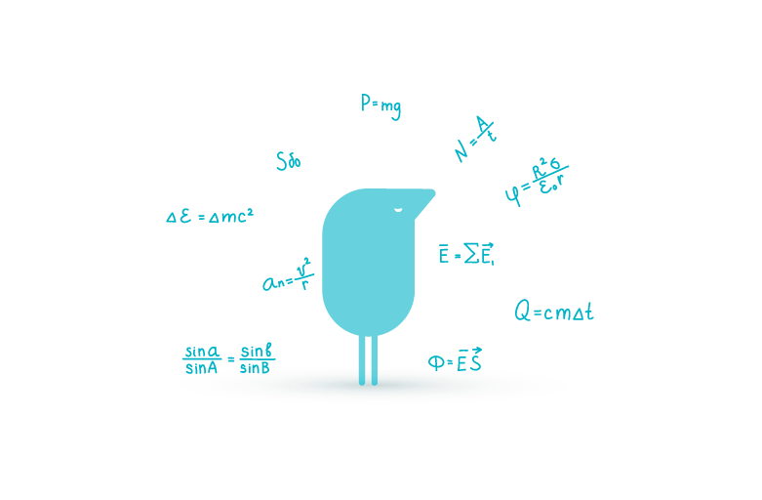
This Is The Vision For Equatio
VISION:
To disrupt how math is both taught and learned.
We do this by making it easy to create digital and accessible math to work with any learning style or environment.
We are the math editor of choice for schools and content creators

Slide 5
Texthelp Has A Robust Portfolio Of Accessibility Tools
Notes:
And Texthelp is the company that produces Equatio as well as its flagship product Read and Write as well as Fluency Tutor, OrbitNote, and WriQ.

Slide 6
First Learning Objective:
Participants will be able to demonstrate at least 3 ways of creating digital and accessible math.
Notes:
This is an accessibility conference, so we do expect your content to be accessible. But we think it’s good to state our minimum expectations

Slide 7
Second Learning Objective:
Participants will be able to describe a process for converting physical print-based documents to digital.

Slide 8
Third Learning Objective:
Participants are able to describe 2 challenges of providing equitable math instruction in today's classroom.

Slide 9
A Description Of Math Through The Years
Math hasn’t changed.
Little to no collaboration with current classroom structure
Worksheets don’t allow for critical thinking or math manipulation.
Notes:
Look of a traditional classroom
Students Are In Rows
Facing Forward
Little To No Collaboration
Minimal Conversation
Teacher Is The Primary Source Of Information
Students Passively Receive Content
Learning Is Very Linear And Offers No Student Choice
Current drill & practice activities
Work That Is Typically Created At A Copy Machine And Involves Passing Out Worksheets
Students Find This Method Of Learning Boring And Monotonous
Used For Acquiring Basic Knowledge But Doesn’t Invoke Critical Thinking

Slide 10
Has Teaching & Learning Changed Recently?
teaching and learning
have changed a lot
Notes:
This is an accessibility conference, so we do expect your content to be accessible. But we think it’s good to state our minimum expectations

Slide 11
Many Students Struggle With STEM Curriculum
score below proficient in math
60%
67%
of 4th graders
of 8th graders
Source: Nation’s Report Card

Slide 12
Most Who Struggle Early, Struggle Late Also
kids with persistent math problems in elementary school are...
13%
29%
less likely to graduate high school
less likely to attend college
Source: PhysOrg.com

Slide 13
Attitudes Are Formed Early On…
attitudes formed as early as middle school have the ability to influence whether students want to pursue careers in STEM
Source: MDPI

Slide 14
Many Jobs Will Be Available In The STEM Field
need to build a STEM workforce
there are 26 million STEM jobs in the US 20% of all US jobs are STEM-based
Source: Bureau of Labor Statistics

Slide 15
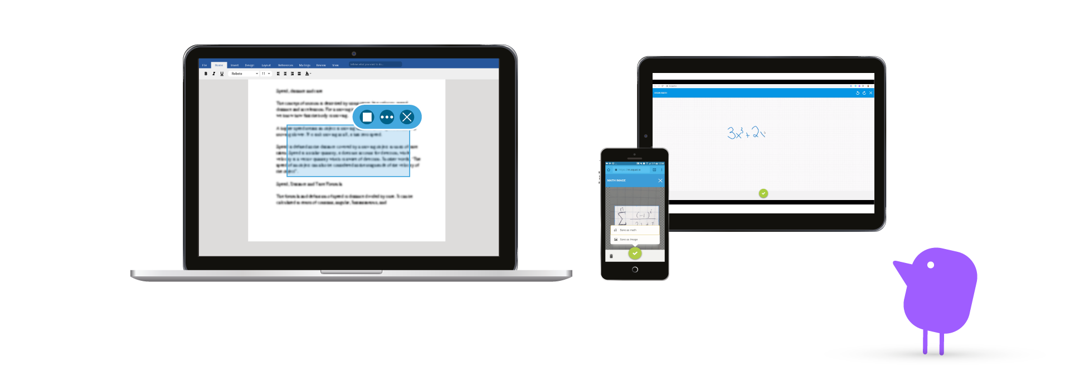
Demo Time
Demo time

Slide 16
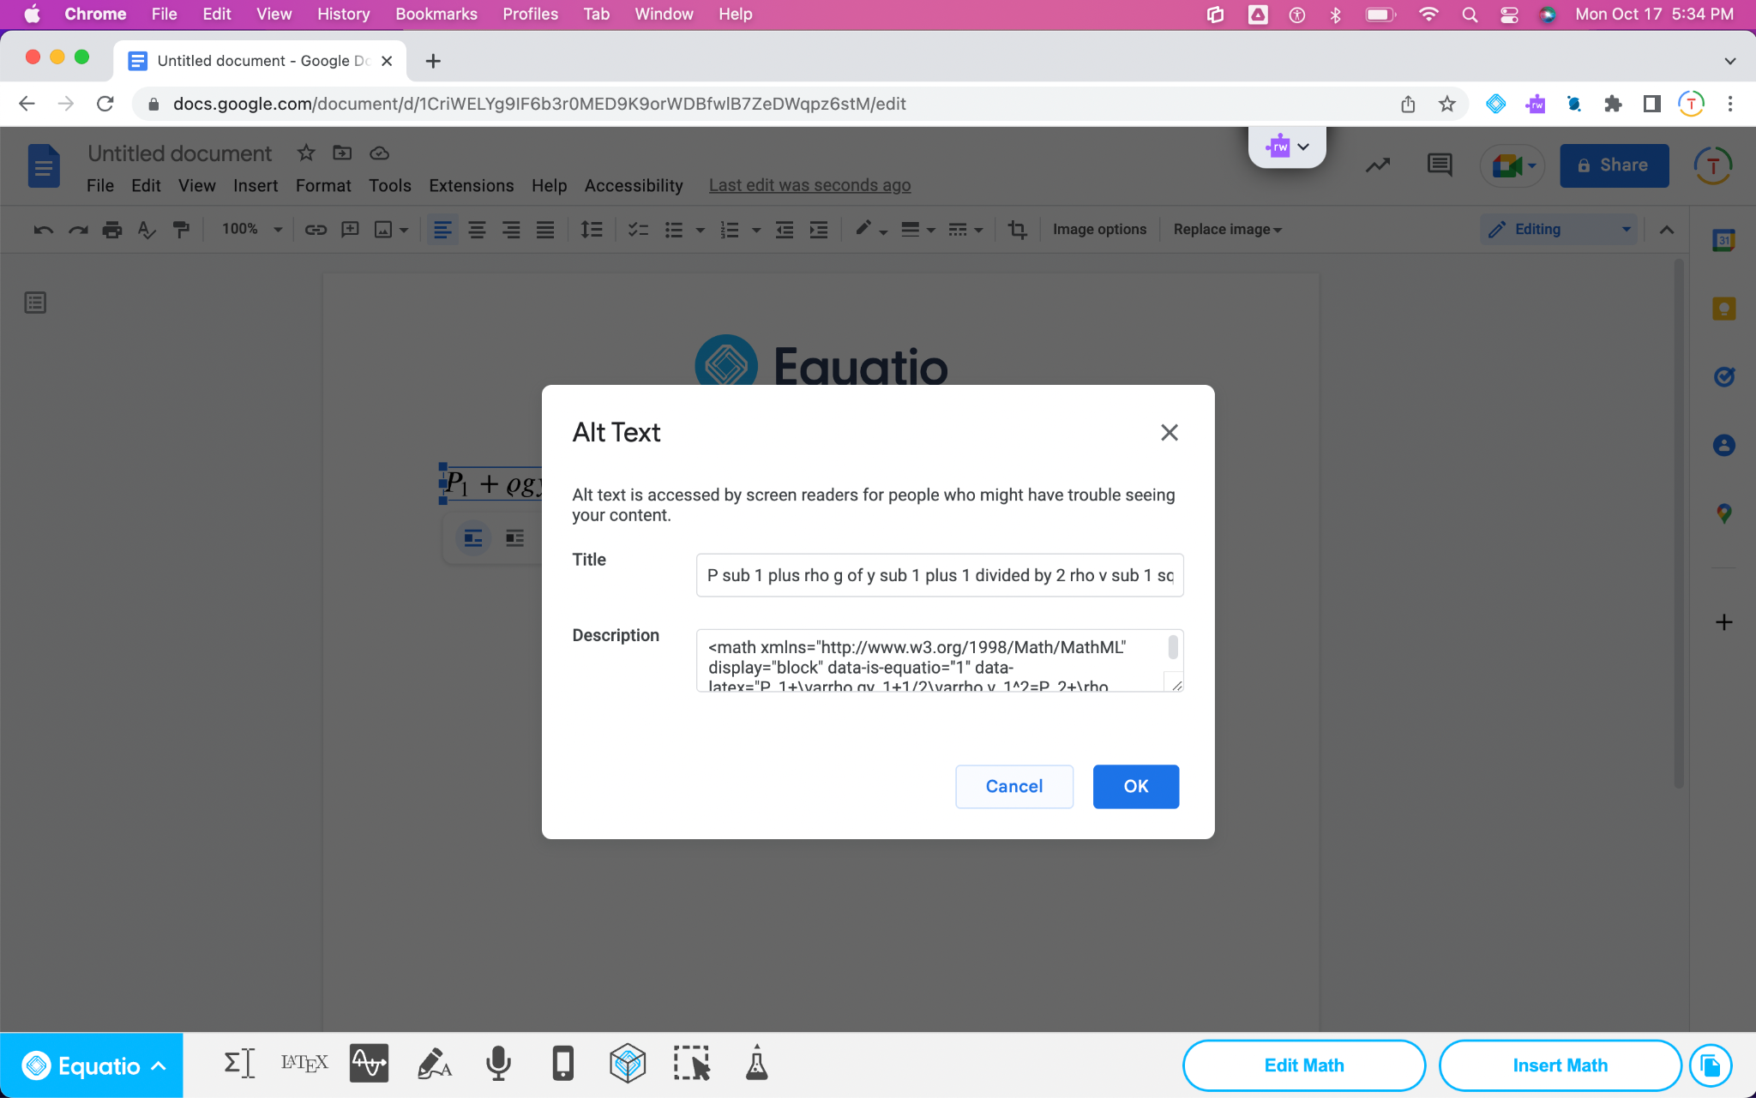
Creating Digital & Accessible Math
Creating Digital & Accessible Math
Each Math Insert Created By Equatio Carries With It Alt Text & MathML
Alt Text Is Supported By Collaborative Platforms Such As Google & Microsoft
Commonly Used LMS Providers Also Support Alt Text

Slide 17
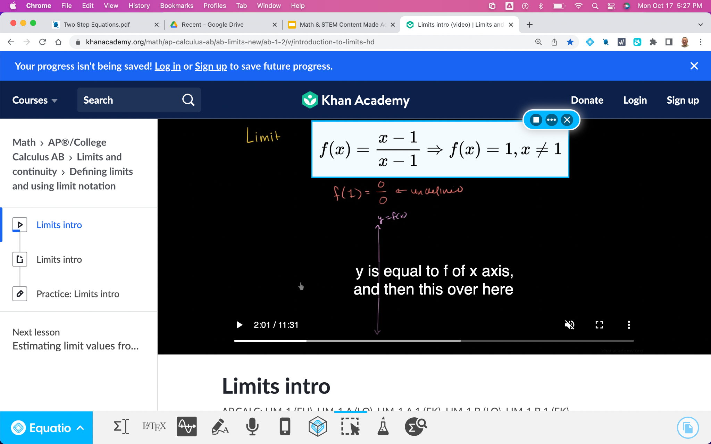
Using The Screenshot Reader To Read Math Aloud
Creating Digital & Accessible Math
Use the Screenshot Reader To Pull A Box Around Math & STEM To Hear The Math Played Aloud.
Then Copy The LaTex & Bring It Into Equatio To Convert It Into Accessible Math

Slide 18
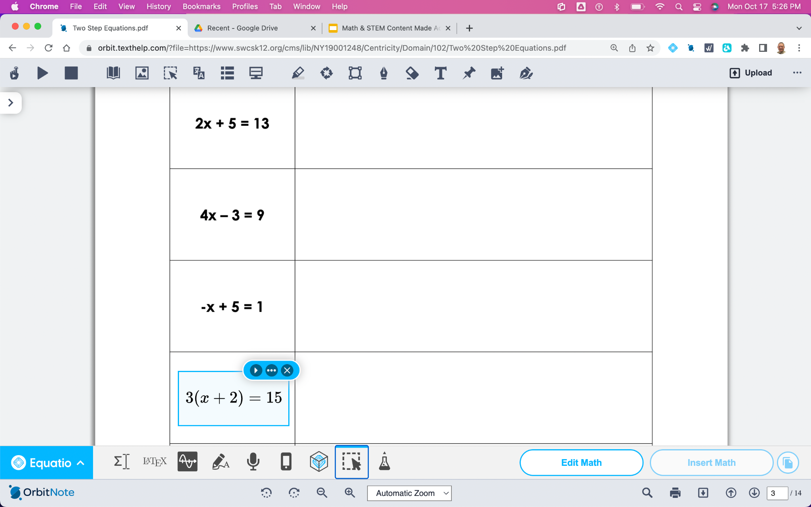
Using OCR Technology On PDFs
Creating Digital & Accessible Math
Use The Equatio Screenshot Reader On PDFs To Read Math Aloud
Click On Edit Math With Equatio To Pull Content Into Your Math Editor

Slide 19
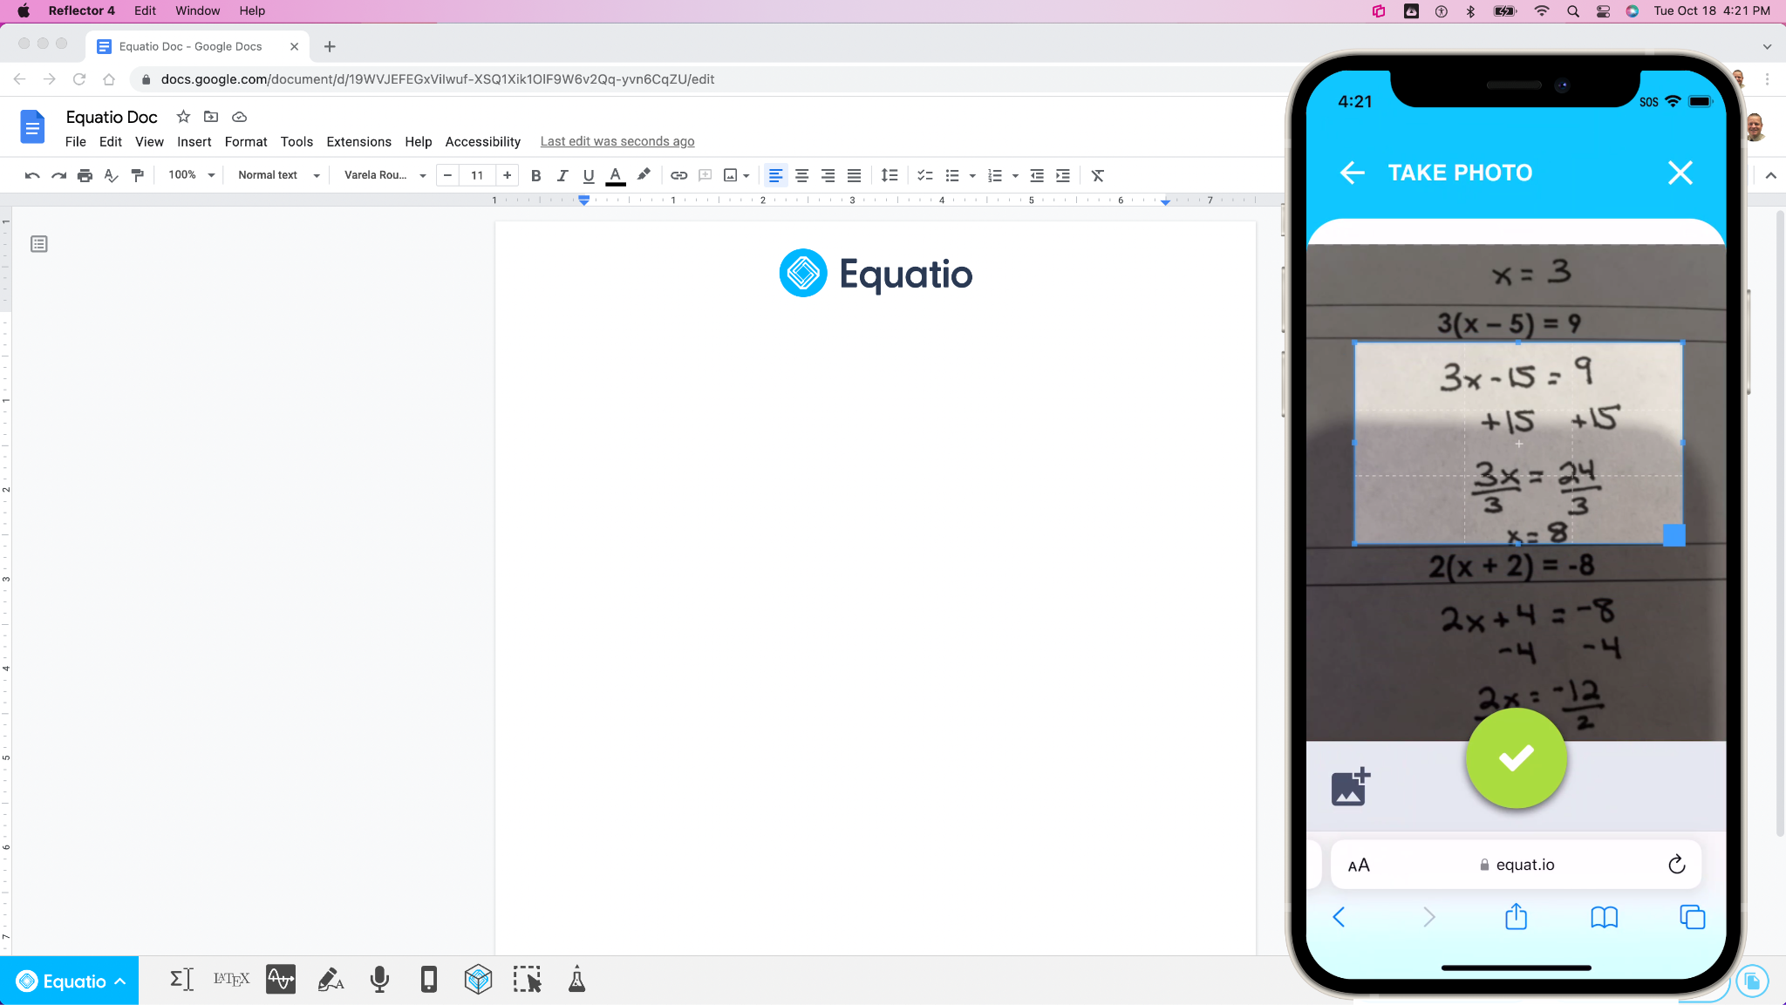
Converting Physical Print-Based Documents To Digital
Converting Physical Print-Based Documents To Digital
Use Equatio Mobile To Scan Handwritten Math & Turn It Into Digital Accessible Math
Send That Scanned Math Into An Active Document

Slide 20
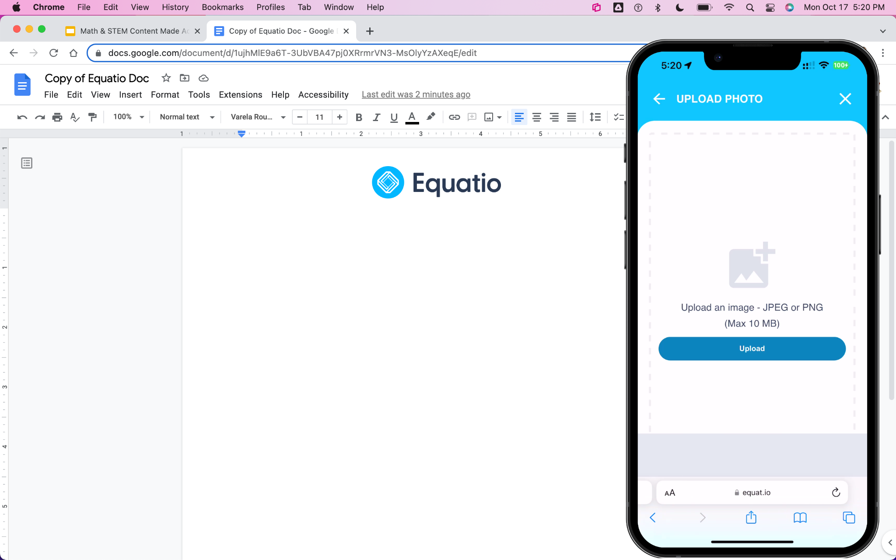
Using Equatio Mobile To Scan Full Page Documents
Converting Physical Print-Based Documents To Digital
Use Equatio Mobile To Scan Physical Documents To Pull A Box Around Multiple Problems & Text
Send That Scanned Math Into A Mathspace Where All Problems Will Be Digital & Accessible

Slide 21
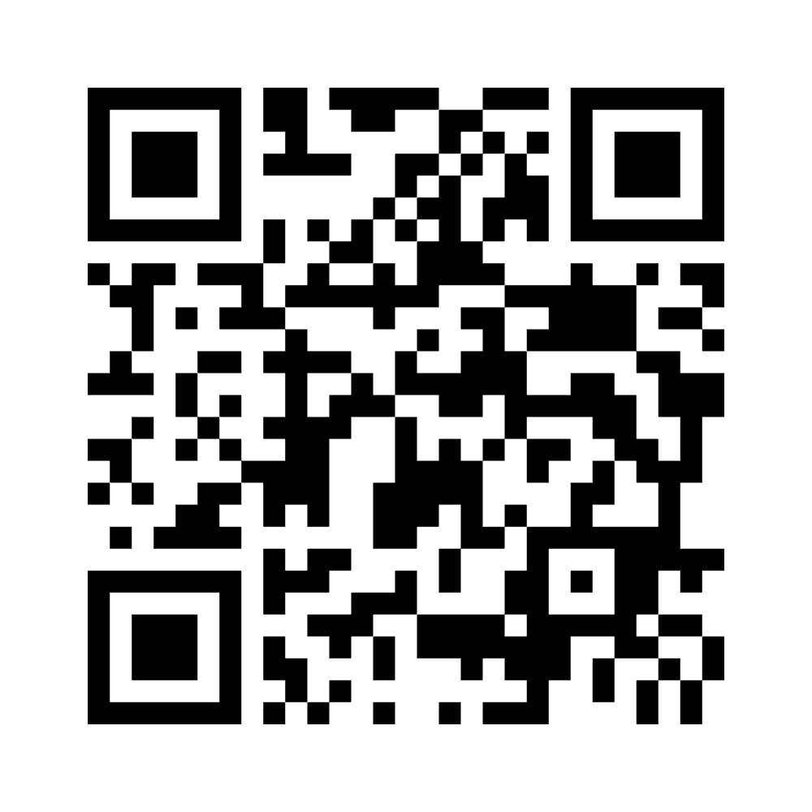
An Activity About Providing Equitable Math Instruction
2 Challenges Of Providing Equitable Math Instruction
Scan the QR code from your mobile device
Think about your answer and then input a challenge or two that comes to mind when providing instruction
Notes:
https://www.menti.com/
https://www.mentimeter.com/accessibility
https://www.mentimeter.com/
https://www.menti.com/alu3nr3sus2n

Slide 22
Why Should You Consider Equatio?
Why Equatio?
Makes digital math possible
Makes digital math easy
Enables blended learning in math/STEM
Allows for collaboration in math
Makes math accessible
Incorporates Desmos digital graphing tool
Reads all math content aloud

Slide 23
Why Should You Consider Equatio?
Why Equatio?
Based on UDL principles
Reduces paper costs
Measures student progress
Live monitoring in formative assessment
Contributes to differentiated instruction
Provides avenues for teacher creativity
Students can create using manipulatives

Slide 24
Why Should You Consider Equatio?
Why Equatio?
Students demonstrate mastery in many ways
Offers multiple methods of representation
Student choice = empowers learners
Allows for active learning (versus passive)

Slide 25
Any Feedback or Questions By The Audience?
Feedback or questions?

Slide 26
Interested In Next Steps, Please Let Us Know
Next steps
You have 30-day access to premium features for students
Domain pilots are currently available to any school district interested
Online Texthelp Learning Academy
Webinars / Demonstrations can be scheduled
Licensing Quote

Slide 27
Contact Information
For more information please contact:
Louis Shanafelt
Product Manager / Evangelist for Equatio
l.shanafelt@texthelp.com

