Slide 1
Does it STEM? A look at technologies for accessible math and science notation
Notes:
Note: An accessible word version of this presentation is available on the AHG site and in the resources. Ask the presenters for it if you cannot find it. This PowerPoint file was designed with accessibility in mind. The slides contain open URLs (usually at the bottom) so sighted viewers can see the URL to reproduce it if desired. The word version contains more accessible links with descriptive text.

Slide 2
Available Resources

Slide 3
Presenters
Brian Richwine
Senior Accessibility Strategist – Learning Technologies UITS Assistive Technology and Accessibility Centers brichwin@iu.edu
Mary Stores
Accessibility Analyst UITS Assistive Technology and Accessibility Centers mstores@iu.edu

Slide 4
Who is Here? Participant Introductions
Name
Affiliation
What brought you to this session?
What are you most looking forward to at the conference?

Slide 5
Today’s Agenda
Schedule: 9 – Noon, 1:30 – 4:30
Overview of STEM materials. Where you find it, the formats and technologies used, and how they can be accessed.
We invite group discussion
We’ll provide demos, hands-on activities, and even a pop quiz.
We will not focus on production details, because that is covered copiously elsewhere.
We will focus on how STEM is consumed, and the challenges involved.
Notes:
A significant amount of science, technology, engineering and mathematics (STEM) information is presented visually, from graphs and tables to diagrams and math equations. Students and professionals in the STEM fields who are blind or have low vision must find methods of accessing, working with, and publishing STEM content.
In many cases, they rely on assistants to read and describe images in order to stay current with content in their fields of study.
Access to text through electronic files and assistive technologies has the promise to make possible a great deal of independence for these individuals.

Slide 6
Group Discussion: A Scenario
A senior recently became blind with no usable vision and has just started learning literary braille. Unfortunately, they held off on taking their Gen Ed math requirement until now. It’s an in-person Finite Mathematics course covering set theory, probability, and matrix algebra.
The instructor is concerned and wants to meet with you because students do a lot of manual homework and must show their work in the assignments and assessments.
You’re tasked with determining how to accommodate the course materials and support the student with assistive technology:
What would you ask of the instructor?
What would you ask of the student?
If you get stuck, let the presenters know what you’ve discussed so far.

Slide 7
Understanding Needs: User Personas
Students with physical limitations:
Writing / manipulating STEM content via speech
Students with cognitive impairments:
Reading & perceiving STEM content
Writing / manipulating STEM content
Students with visual impairments:
Total blindness knows braille & a math braille standard
Total blindness does not know braille
Total blindness with loss of feeling in fingers
Low vision and not a screen reader user

Slide 8
Where Does it STEM from?
Places where STEM content is found includes:
Textbooks and/or Digital Learning Tools (DLTs)
Handwritten notes
Chalk boards / whiteboards
Google Docs, Microsoft Word, PPTs
Slide Presentations (PowerPoints etc.)
Web pages, LMS content
Notes:
Places where STEM content is found.

Slide 9
It’s Also Working With STEM Content
Working through math other STEM problems
Sharing STEM content and collaborating with others
Turning in STEM homework in traditional print formats
Being able to show your work

Slide 10
What Are Some Examples of Challenges Your Students Have Encountered?

Slide 11
Braille
Notes:
We often hear that if a student with blindness wants to study technical materials, that they need to learn braille. So, what are the braille math formats?

Slide 12
Nemeth Braille Code for Mathematics and Science Notation
Created by Dr. Abraham Nemeth in 1946 so he could complete his PhD in mathematics
First accepted as a standard for representing math and science in braille in1952 and updated several times since
It was originally designed to blend with the surrounding nontechnical text written in English Braille American Edition (EBAE)

Slide 13
The Nemeth “Green Book”
“The Nemeth Braille Code for Mathematics and Sciences, 1972 Revision” became known as the "Green Book“
This is what the PDF of the 1972 document is a scan of

Slide 14
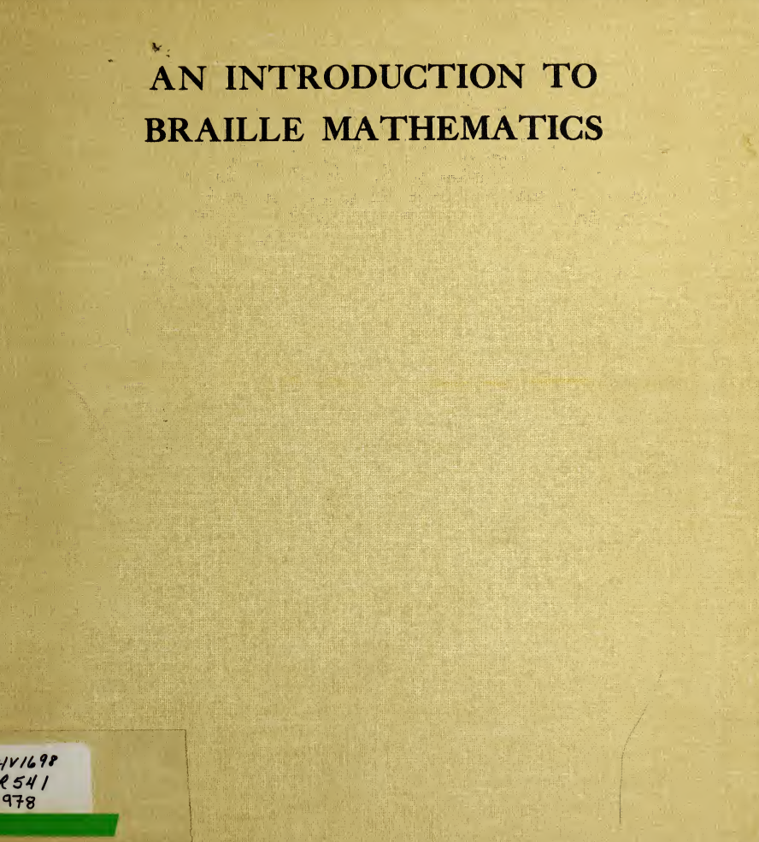
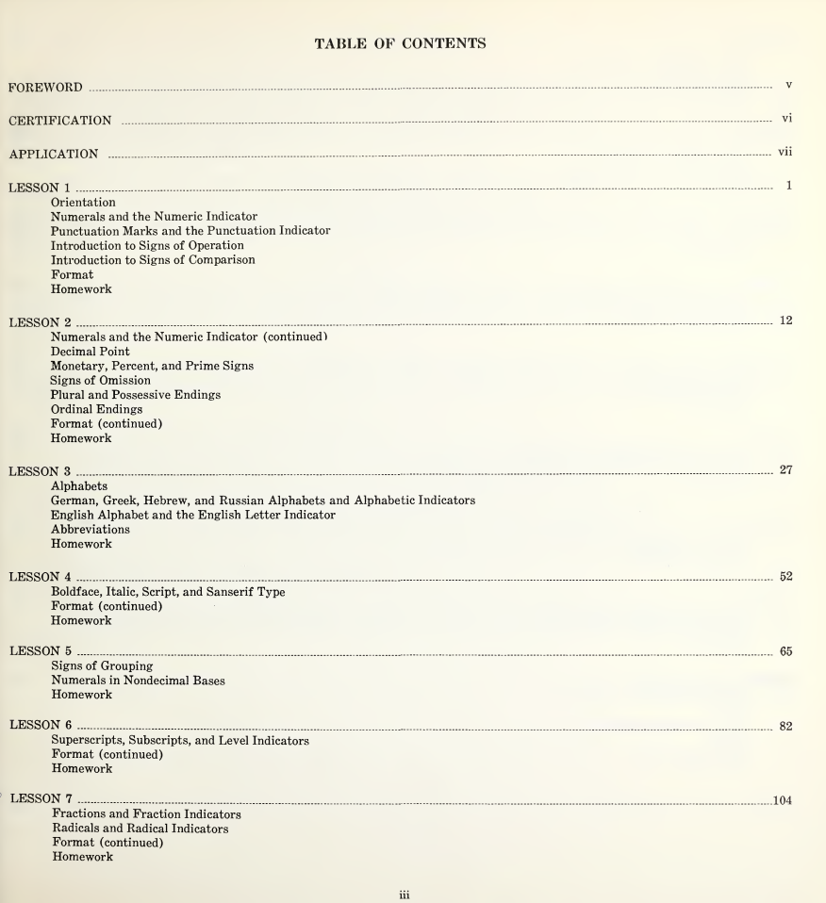
Yellow Book
Many learned the Nemeth Code from the 1978 “An Introduction to Braille Mathematics” by Helen Roberts, Bernard Krebs, and Barbara Taffet.
It became known as the “Yellow Book”
Notes:
See: An Introduction to Braille Mathematics: Based on The Nemeth Braille Code for Mathematics and Science Notation, 1972 (archive.org)
https://ia801301.us.archive.org/34/items/introductiontobr00byhe/introductiontobr00byhe.pdf

Slide 15
Braille Codes for Math and Science Notations
It’s important to note the distinction between:
Nemeth Braille Code within English Braille American Edition (EBAE)
Nemeth Code within Unified English Braille (UEB)
Unified English Braille (UEB)

Slide 16
Unified English Braille
UEB is a complete code for both literary and technical content in braille.
This is a major change from the previous code used in the United States, English Braille American Edition (EBAE), which could only be used for literary materials.
References to "Math UEB" or "UEB math code" may reinforce the misconception that there are two UEB codes.
Notes:
However, the Board of BANA could not reach consensus regarding the establishment of a single standard code for technical materials for braille in the United States. BANA both adopted UEB as a complete code and the Nemeth Code within UEB context.

Slide 17
It’s No Longer One Math Braille Code
The Braille Authority of North America (BANA) voted to adopt Unified English Braille (UEB) in 2012 and to implement it January 2016.
BANA both adopted UEB as a complete code and the Nemeth Code within UEB context.
Notes:
However, the Board of BANA could not reach consensus regarding the establishment of a single standard code for technical materials for braille in the United States. BANA both adopted UEB as a complete code and the Nemeth Code within UEB context.

Slide 18
UEB with Nemeth
The switch to Unified English Braille (UEB) required a shift in how surrounding “nontechnical text” is written with Nemeth because EBAE is no longer one of the official codes.
BANA developed guidelines for use of the Nemeth Code embedded within UEB text. Code switching indicators are employed to prevent any ambiguity or conflict between UEB and Nemeth symbols.
The text surrounding math expressions or chemical formulae are in UEB while the technical content itself is transcribed in the Nemeth Code.
In other words, Nemeth Code is used within UEB contexts.

Slide 19
To UEB or Nemeth Be?
You need to clearly specify the desired braille code
The name "Nemeth" alone no longer provides adequate distinction
BANA recommends technical materials should be referred to as “UEB Math/Science” or as “UEB with Nemeth”
All new transcriptions of math and science materials should be produced in one of these two codes
Notes:
See: Terminology: UEB Math/Science and UEB with Nemeth | Braille Authority of North America

Slide 20
To UEB or Nemeth Be? So, Which One?
BANA states: “The decision to use UEB or the Nemeth Code within UEB context for technical materials should be made based on braille reader’s individual needs.”
The student needs to be consulted as to which they know and prefer
For details, see: https://www.brailleauthority.org/terminology-ueb-mathscience-and-ueb-nemeth
Notes:
See: Terminology: UEB Math/Science and UEB with Nemeth | Braille Authority of North America

Slide 21
Learning Nemeth Braille

Slide 22
Project INSPIRE
Project INSPIRE (Increasing the STEM Potential of Individuals Who Read Braille)
Six-week online courses for teachers of students with visual impairments, braille transcribers, adult service providers, and university disability resource center personnel
Courses in development for higher grades and for UEB Math/Science
https://www.pathstoliteracy.org/resource/project-inspire/
Notes:
https://www.pathstoliteracy.org/resource/project-inspire/

Slide 23
The TSBVI UEB With Nemeth Course
Online course from the Texas School for the Blind and Visually Impaired (TSBVI) aimed at instructors, paraeducators, families, etc. that are working with students learning the Nemeth Code
Participants can drop into any level to find the specific symbols and examples needed
Modules introduce symbols and contain multiple samples of using Nemeth within UEB contexts and include optional quizzes.
https://www.tsbvi.edu/statewide-resources/professional-development/online-learning?t=261
Notes:
https://www.tsbvi.edu/statewide-resources/professional-development/online-learning?t=261

Slide 24
NFB Nemeth Code Transcribing Course
The NFB’s Nemeth Code transcribing course was recently updated for UEB with Nemeth
Lessons are available in printable PDFs, PDFs with links, and BRF files
https://nfb.org/programs-services/braille-certification/mathematics-braille-transcribing
Notes:
https://nfb.org/programs-services/braille-certification/mathematics-braille-transcribing

Slide 25
The Pearson Nemeth Curriculum
Students of any age may learn from the lessons, especially if they need a refresher or additional practice with Nemeth symbols:
The Nemeth Braille Code Curriculum (Pre-K through 2nd Grade)
The Nemeth Braille Code Focused Lessons (3rd Grade through 8th Grade)
https://accessibility.pearson.com/resources/nemeth-curriculum/

Slide 26
The Pearson Nemeth Symbol Library
A searchable glossary of terms used in math that are linked to a description of how to write Nemeth Code related to that content.
Provides examples in:
Nemeth in EBAE as a Braille Ready File (.brf) file
Nemeth within UEB Contexts as a .brf file
Nemeth in print and sim-braille

Slide 27
The Online APH Nemeth Tutorial
American Printing House’s Nemeth Tutorial was designed with screen reader users in mind.
Covers first grade through Calculus
https://nemeth.aphtech.org/

Slide 28
Nemeth References Aids
Many references and learning aids are available for purchase that can support the student learner and the transcribers as well.
Usually available in braille and tactile forms as well as large print.

Slide 29
Sources for Nemeth Reference Aids
National Braille Press: https://www.nbp.org/ic/nbp/NEMETH.html
TSBVI: https://www.tsbvi.edu/store/nemeth-at-a-glance-a-math-resource-grade-level-chart-and-evaluation-tool
APH
Nemeth Reference Booklet: https://www.aph.org/product/math-symbol-reference-booklets-large-print-version/
All APH Math/Nemeth resources: https://www.aph.org/search-results/?fwp_search_term=nemeth

Slide 30
Images

Slide 31
Some images can be described using text:
[begin figure description]
This figure has two illustrations one left and one right, each with a top and bottom part.
Left illustration – no violation of doctrine. Evidence is admissible:
Top: A police officer stands next to a wall and there are plants behind the wall. The officer is tall enough to be able to see over the wall.
Bottom: A police officer stands next to the driver’s side of a car. The officer shines a flashlight into the car and at the driver of the car.
Right illustration – violation of doctrine. Evidence is inadmissible:
Top: A police officer stands on a ladder next to a wall and there are plants behind the wall. The officer needs the ladder to see over the wall.
Bottom: A person looks through binoculars and sees another person in a ski-mask who seems to be in the process of picking a lock.
[end figure description]

Slide 32
Resources for Describing STEM Images
WGBH’s Effective Practices for Description of Science Content within Digital Talking Books
DIAGRAM Center:
Image Description Guidelines
Image Sorting Tool Decision Tree
Accessible Image Sample Book
Poet Training Tool
Notes:
https://www.wgbh.org/foundation/ncam/guidelines/effective-practices-for-description-of-science-content-within-digital-talking-books

Slide 33
General Image Description Concepts
Validity: Determine if the image should be described
Context:
Survey the text surrounding an image to understand how it fits into the bigger picture.
Be sure the description highlights the role the image plays.
Brevity:
Avoid long descriptions of non-essential info that put greater demands on short-term memory.
Do not repeat what was described in the surrounding text.
Clarity: Make the description as clear and straightforward as possible

Slide 34
General Image Description Concepts (2)
Language
Use grade appropriate / subject-related language using the same writing style and terminology as the surrounding text
Avoid visual dependent language. Reference examples and details that the reader will understand
Use active verbs in the present tense
Avoid identity language unless necessary or appropriate
Drill-Down Organization
Start with a brief summary of the image, then move into specifics
Consistency- Be consistent in structure, organization, and language

Slide 35
Guidelines for Describing Images for Assessments
There are unique challenges when describing images for assessments to maintain the fairness and integrity of the assessment
Make descriptions contain the key points required to answer related questions
Make sure the description doesn’t unfairly hint or give away the answer
Make sure the description includes any original distractors
Be aware of images with visual bias (contain information that are students blind or visually impaired would not know)
Notes:
NWEA image description guidelines are based on our 5 description principles: validity, brevity, clarity, language complexity, and drill-down organization. The guidelines review concepts such as item integrity, fairness, and the unique challenges image description writers face in the context of assessment. Additionally, the document discusses common difficulties with making assessment materials accessible, including issues of visual bias and cueing the correct response. The guidelines are written in a reference format, to best enable users to find guidelines for the specific type of image they are describing.

Slide 36
Image Description for Assessments Resources
WGBH’s Guidelines for Describing Images for Assessments
NWEA Image Description Guidelines for Assessments (PDF)
Notes:
https://www.wgbh.org/foundation/ncam/guidelines/guidelines-for-describing-images-for-assessments

Slide 37
However, some images really do “say a million words”

Slide 38
BANA’s Produce Tactile Graphic Decision Flow Chart
Notes:
https://www.brailleauthority.org/tg/web-manual/index.html

Slide 39
BANA’s Produce Tactile Graphic Decision Flow Chart (2)
If the answer to any of these three questions is yes, do not produce:
Is the information a repeat of facts in the text?
Would the information be more meaningful in text form?
Does the graphic require the reader to use visual discrimination or visual perception?
(the flow chart description is continued on the next slide)

Slide 40
BANA’s Produce Tactile Graphic Decision Flow Chart (3)
If the answer to either of these questions is yes, produce the tactile:
Is the actual object unavailable, too small, too large, or too dangerous to examine by touch and perceive details?
Does the reader need the information from a map, figure, or graph to participate in discussions, answer questions, complete a task?
The flow chart ends with otherwise, do not produce the tactile.

Slide 41
Tactile Graphic for the Previous Image

Slide 42
So, What Are Tactile Graphics?
An alternate media format where students with visual impairments may use their fingers to perceive information by exploring raised tactile features that sighted students would perceive visually.

Slide 43
Exploring Tactile Graphics by Touch Only (without eyesight)

Slide 44
The “No Peeking!” Tactile Graphic Challenge
Try not to look inside at the image
Slip your hand inside the envelope and…
Explore!
What is the symbol? (Don’t spoil it for others!)
Hints to follow…

Slide 45
Hints for the Tactile Challenge
Envelope #1: You might wish upon it
Envelope #2: Love it!
Envelope #3: You can catch this (as in contagious)
Envelope #4: Brooding superhero of the night
Envelope #5: Common symbol in this presentation
Envelope #6: Happy
Envelope #7: Semaphore “N” and “D”; could have been a dove
Envelope #8: Save the environment

Slide 46
Answers: Images Used as Tactile Graphics

Slide 47
The Problem with Tactile Graphics
Graphics used in higher education are often complex, full of small details, and deal with new and unfamiliar ideas
Resulting tactile graphics, even if well designed, could not be used independently by students with visual impairment
Student feedback described tactile graphics as confusing, stressful, and exhausting

Slide 48
Research Confirms Tactile Graphics Are Problematic
Audible Image Description as an Accommodation in Statewide Assessments for Students with Visual and Print Disabilities
Journal of Visual Impairment & Blindness, July-August 2017, pages 325-339

Slide 49
Research Confirms Tactile Graphics Are Problematic (2)
From Results, Students with Visual Disabilities, page 334:
The results of this analysis indicated that students with visual disabilities who read braille were 1.2040 times more likely to respond correctly in the audible image description condition (1.2040, p = .0277, E.S. = .6638)
The odds of responding correctly to mathematics questions in the tactile graphics only condition (baseline) were significantly poorer (-.9163, p = .0285, E.S. = .5052)
https://core.ac.uk/download/pdf/304664963.pdf

Slide 50
Found inspiration in two works:
Hinton, Ron (1996) Tactile Graphics in Education, Moray House Publications, ISBN: 0901580775, “6.4 Audio scripts for use with diagrams”
Ricker, K S (1981) Writing Audio Scripts for Use with Blind Persons, Journal of Visual Impairment and Blindness, 75 (7), 297-9.

Slide 51
Our Answer: Tactile Tours A Specialized Text-based Image Description
A “Tactile Tour” is a guided introduction to the features on the tactile that a reader would need to be aware of and look out for
Like a guided introduction to a museum or a location’s notable landmarks and the identifying features of those landmarks

Slide 52
Goals for a Tactile Tour
Allow the reader to conceptualize the information prior to using their fingertips
Reduce confusion by describing design techniques used
Enable the reader to strategically explore the tactile by locating and describing features in the tour
Facilitate perception of each prominent detail

Slide 53
Not just a Legend or Typical Transcriber’s Note
Example typical transcriber’s note found in Guidelines and Standards for Tactile Graphics, (2010) APH, 3.10-3.11

Slide 54
Example Calculus Tactile Graphic
Note the possible sources of confusion in the tactile graphic pictured here:
Multiple line types even for the same features (x-axis, function curve)
Braille labels in Nemeth Code
High density of features (curve, axis numbering, axis/domain line, axis tick marks)

Slide 55
The Corresponding Original Image
For reference, here is the original image.
Note the use of the green, red, blue, and black colors that might be referenced in the text, problems, or in the lecture.
Image credit:
Figure 1.51, Briggs, William L., Lyle Cochran, and Bernard Gillett (2015), Calculus, p. 29

Slide 56
Corresponding Tactile Tour
Function plot of $y=x^{2}−x^{4}$ on a Cartesian graph with the origin centered at the middle of the graph. The x-y axes are marked with medium-width solid lines and are drawn from negative 3 to 3 with tick marks in increments of 1. The axes are labeled at $y=2$, $x=−1$, and at $x=1$. The x-axis and the function’s curve are highlighted in four colors that represent four different domains of $x$. For each domain, listed from left to right, the x-axis line and function curve’s share the same line style:
For the green domain $x=(−∞, −1]$, a thick dashed line is used.
For the red domain $x=[−1, 0]$, a thin solid line is used.
For the blue domain $x=[0,1]$, a thin dashed line is used.
For the black domain $x=[1,∞)$, a thick solid line is used.
In the positive x-axis domain, the function goes through the origin rising exponentially to $y=1$ at $x=1$, and then drops exponentially towards negative infinity passing $y=−3$ around $x=1.75$. The function’s curve is mirrored around the y-axis.
Notes:
These notes contain the tactile tour using MathSpeak Grammar for the math content:
[Begin tactile tour]
Function plot of [Begin math] y equals 2 x squared minus x Superscript 4 [End math] on a Cartesian graph with the origin centered at the middle of the graph. The x-y axes are marked with medium-width solid lines and are drawn from negative 3 to 3 with tick marks in increments of 1. The axes are labeled at y equals 2, x equals negative 1, and at x equals 1. The x-axis and the function’s curve are highlighted in four colors that represent four different domains of x. For each domain, listed from left to right, the x-axis line and function curve’s share the same line style:
Bullet: For the green domain x equals left-parenthesis negative infinity comma negative 1 right-bracket, a thick dashed line is used.
Bullet: For the red domain x equals left-bracket negative 1 comma 0 right bracket, a thin solid line is used.
Bullet: For the blue domain x equals left-bracket 0 comma 1 right-bracket, a thin dashed line is used.
Bullet: For the black domain x equals left-bracket 1 comma infinity right-parenthesis, a thick solid line is used.
In the positive x-axis domain, the function goes through the origin rising exponentially to y equals 1 at x equals 1 and then drops exponentially towards negative infinity passing y equals negative 3 around x equals 1.75. The function’s curve is mirrored around the y-axis.
[End tactile tour]

Slide 57
Creating Tactile Tours

Slide 58
Tactile Tours = Carefully Designed Briefings
Be concise!
The goal is to enable the reader to conceptualize the information and diagram structure as best as possible prior to when they use their fingertips.

Slide 59
Tactile Tours = Carefully Designed Briefing
Provide only enough information to:
Form a mental image of what features are contained in the diagram and how those features are represented
Layout details to enable confident exploration of the tactile
Understand how the tactile graphic differs from the original image

Slide 60
First: Briefly Set the Context
Start with a brief description of what’s in the image or diagram.
For example, is it a:
Bar graph
Cross section
Histogram
Line graph
Map
Scatter plot
Etc.

Slide 61
Describe the Features and Their Design Techniques
Examples:
Let readers know of how features in the graphic are labeled (Is a key used? How are braille labels placed relative to objects?)
Explain if leader lines or arrows are used to connect labels to features as the added lines can create confusion
Describe other potentially confusing or distracting features (large areas of fill textures with parallel lines, tight spacing, uncommon use of line types, etc.)

Slide 62
Use Consistent Terms
Line widths: “thin”, “medium”, “thick”
Line types: “solid”, “dashed”, “dotted”, “dot-dashed”, etc.
Points or dots: “solid circle”, “hollow circle”, “small cross”, etc.
Textures:
It’s best to provide a key. Mention that a feature is textured, and then be sure to refer to the key.
Otherwise, be sure to develop standard texture fills and consistently use descriptive names for how they feel (horizontal line pattern, vertical line pattern, dot pattern, etc.)

Slide 63
Make Design Details Obvious
For example:
If two different circle types (solid vs. hollow, etc.) were used to distinguish two data sets then make that explicit.

Slide 64
Ensure Important Features Are Not Overlooked
Don’t assume the student has a systematic approach for reading tactile graphics
Provide clues on how to approach the tactile graphic if the reader may benefit from exploring the diagram via a particular approach
Be sure to cover each prominent feature to assist the reader in perceiving the entire diagram:
Locate it
Describe it
Discuss its role in the image

Slide 65
Describe How the Design Differs from the Original
Was the image broken up into multiple tactile graphics?
Were textures or line types used to represent what was originally conveyed by color or other visual attribute?
Was a 3D image converted into a cross section?
What details were removed? Were two trains on a railroad track rendered as two rectangles placed above a dashed line?

Slide 66
The Usual Image Description Cautions
Be as concise as possible!
Avoid jargon outside of the material’s domain
Be careful when choosing to include identity information
Include all relevant details and avoid biasing the reader
Check for accuracy!

Slide 67
Overall Benefits
Increases reader confidence and independence – Less need for sighted assistance
Speeds the perception of tactile graphics
Helps to ensure all prominent features are discovered and understood
Helps keep reader motivated – decreases cognitive burden, reduces confusion, stress, and exhaustion
Maintains investment made in production of the tactile graphic

Slide 68
When Are Tactile Tours Helpful?
Given the benefits of tactile tours, we feel they are always needed in order to fulfill the ADA’s standard of providing “substantially equivalent ease of use”.
Think of how easily sighted users can take in an image at a glance vs. the challenge in perceiving abstracted tactile representations.

