Slide 1
AUDIO DESCRIPTION WITH 3PLAY MEDIA
Type questions in the Q&A window during the presentation
This webinar is being recorded & will be available for replay
To view live captions, please click the CC icon www.3playmedia.com l @3playmedia l #a11y

Slide 2
HELLO!
Let’s get to know each other.
Rebecca Klein
Content Marketing Specialist Email: rebecca@3playmedia.com

Slide 3
AGENDA
What is audio description?
Who is 3Play Media?
Q&A

Slide 4
What is Audio Description?
Let's define the basics.

Slide 5
THE BASICS
Narrates relevant visual information
Plays in addition to the main audio track.
Accommodation for blind and low-vision viewers
Paints a picture for those who can’t see the screen.
Represented by an “AD” icon
Let’s watch an example.
More audio description examples

Slide 6
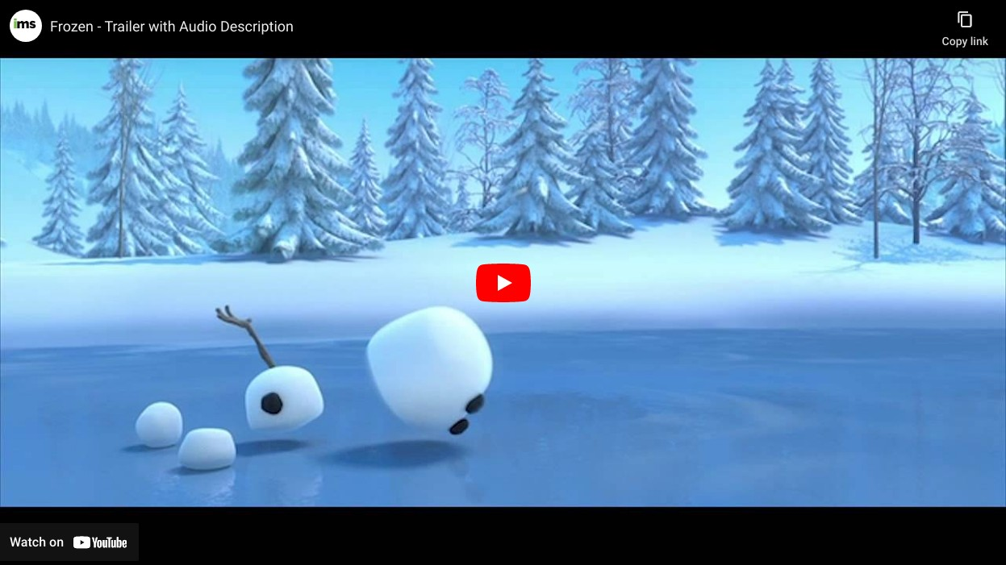
Audio Description Example

Slide 7
STANDARD VS. EXTENDED
Standard audio description fits into the natural pauses of a video.
Extended audio description pauses the video as needed to the video to make room for descriptions.

Slide 8
CREATING AUDIO DESCRIPTIONS
Narrate
Narrate the visuals at the time of the recording
Record and Merge
Record voiced description and merge with source audio
Outsource
Outsource for professional description

Slide 9
QUALITY MATTERS
DCMP
Described and Captioned Media Program
What, When, How
Best practices for audio description
Reference for Creating AD

Slide 10
WHAT MAKES A QUALITY DESCRIPTION?
Accurate
Equal
Consistent
No errors in pronunciation, word selection, and diction
The intended meaning of the program is conveyed
Matches the style, tone, and pace of the program
Prioritized
Appropriate
No errors in pronunciation, word selection, and diction
No errors in pronunciation, word selection, and diction

Slide 11
PUBLISHING AD
Upload AD Track
Upload audio-described .mp4’s to your hosted video platform
Publish Second Video
Publish a second video with the audio track
Share AD Track
Download .mp4 files & share directly on your site
3Play Media's ACCESS Player
Full accessible media player that works with your existing media player (ex: YouTube) of choice

Slide 12
BENEFITS OF DESCRIPTION
Accessibility
AD is imperative for accessibility for blind and low-vision viewers.
Flexibility
Brand
View videos in eyes-free environments
Inclusive design and equal access won’t go unnoticed by consumers
An estimated 32.2 million Americans (13%) have trouble seeing (AFB)
Focus
Legal Compliance
Failing to recognize visuals that are important for context
AD may be required by law

Slide 13
ACCESSIBILITY LAWS
Rehabilitation Act of 1973
Section 504 and Section 508
Americans with Disabilities Act
Title II and Title III
CVAA
21st Century Communications & Video Accessibility Act
FCC
Mandates audio description requirements for broadcast

Slide 14
WEB CONTENT ACCESSIBILITY GUIDELINES
Level A
Choice to provide either an audio description track or a full-text alternative.
Level AA
Audio description is provided for all pre- recorded video content in synchronized media.
Level AAA
Must also provide an extended text description.

Slide 15
WHO IS
3PLAY MEDIA?
More than just captioning.

Slide 16
OUR SERVICES
Closed Captioning & Transcription
99% accuracy guaranteed; flexible workflows
Live Captioning
Display in any video player
Subtitling, Dubbing, and Translation
40+ language to choose from
Audio Description
Innovative, cost-effective solution
Synthetic voice and professional voice artists

Slide 17
FUTURE-PROOF SOLUTION
Scalability
We have a deadline compliance 99.9% and can process large quantities of files
Upgrade Anytime Easily request new services to ensure your content stays compliant
Account Management Your dedicated account manager can help review your goals and keep you up-to-date with accessibility news
Flexibility
We can accommodate numerous workflows, formats, and turnaround times to match your needs

Slide 18
BROWSE OUR FREE RESOURCES
Resource Portal
Monthly Webinars
Allied Podcast
Weekly blogs, free ebooks, checklists, research studies
Taught by accessibility experts
Monthly podcast all about accessibility

Slide 19
Ask us anything.
Q&A

