Slide 1
Alternative Text
Showdown
Presented by: Christine Foushi
Content Industries LLC
Notes:
https://www.youtube.com/watch?v=13tnjh3dZw4

Slide 2
Who is Content Industries?
A software consulting company providing support and solutions for the education technology industry.
Working with content since 1999
Involved in the W3C ePub Standard Development

Slide 4
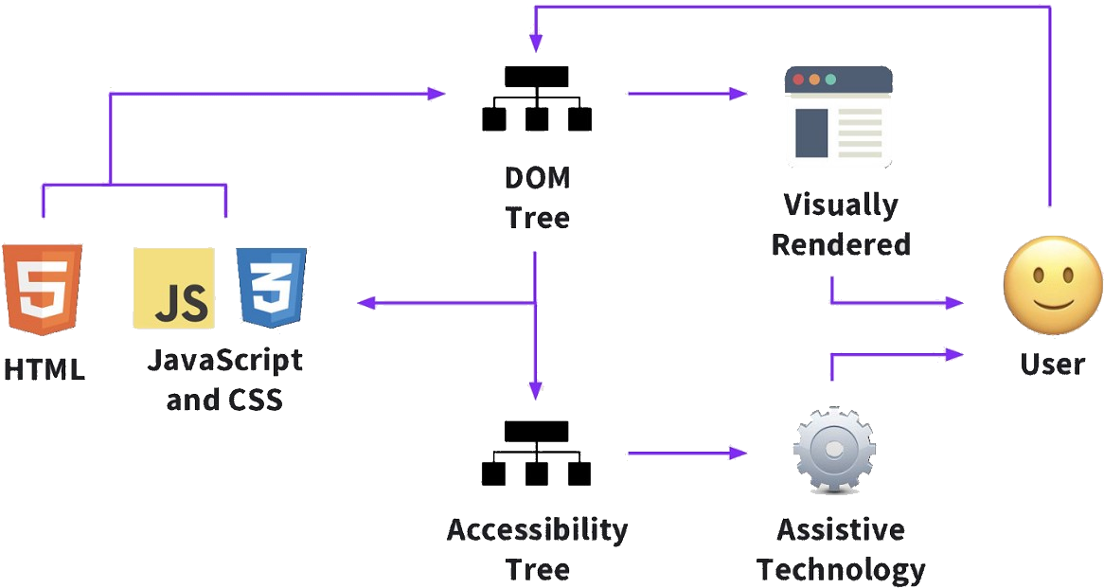
‘Alt Text’ and the Accessibility Tree
The Accessibility Tree: a tree of accessibility objects that assistive technology can query for attributes and properties and perform actions on.
Web developers shape and manipulate the accessibility tree primarily through DOM properties such as ARIA attributes for HTML.
Screen Readers and some other Assistive Technologies are primarily dependent on the accessibility tree to communicate to the end user what is happening on the screen.
This can and does have a direct impact on the user experience!

Slide 5
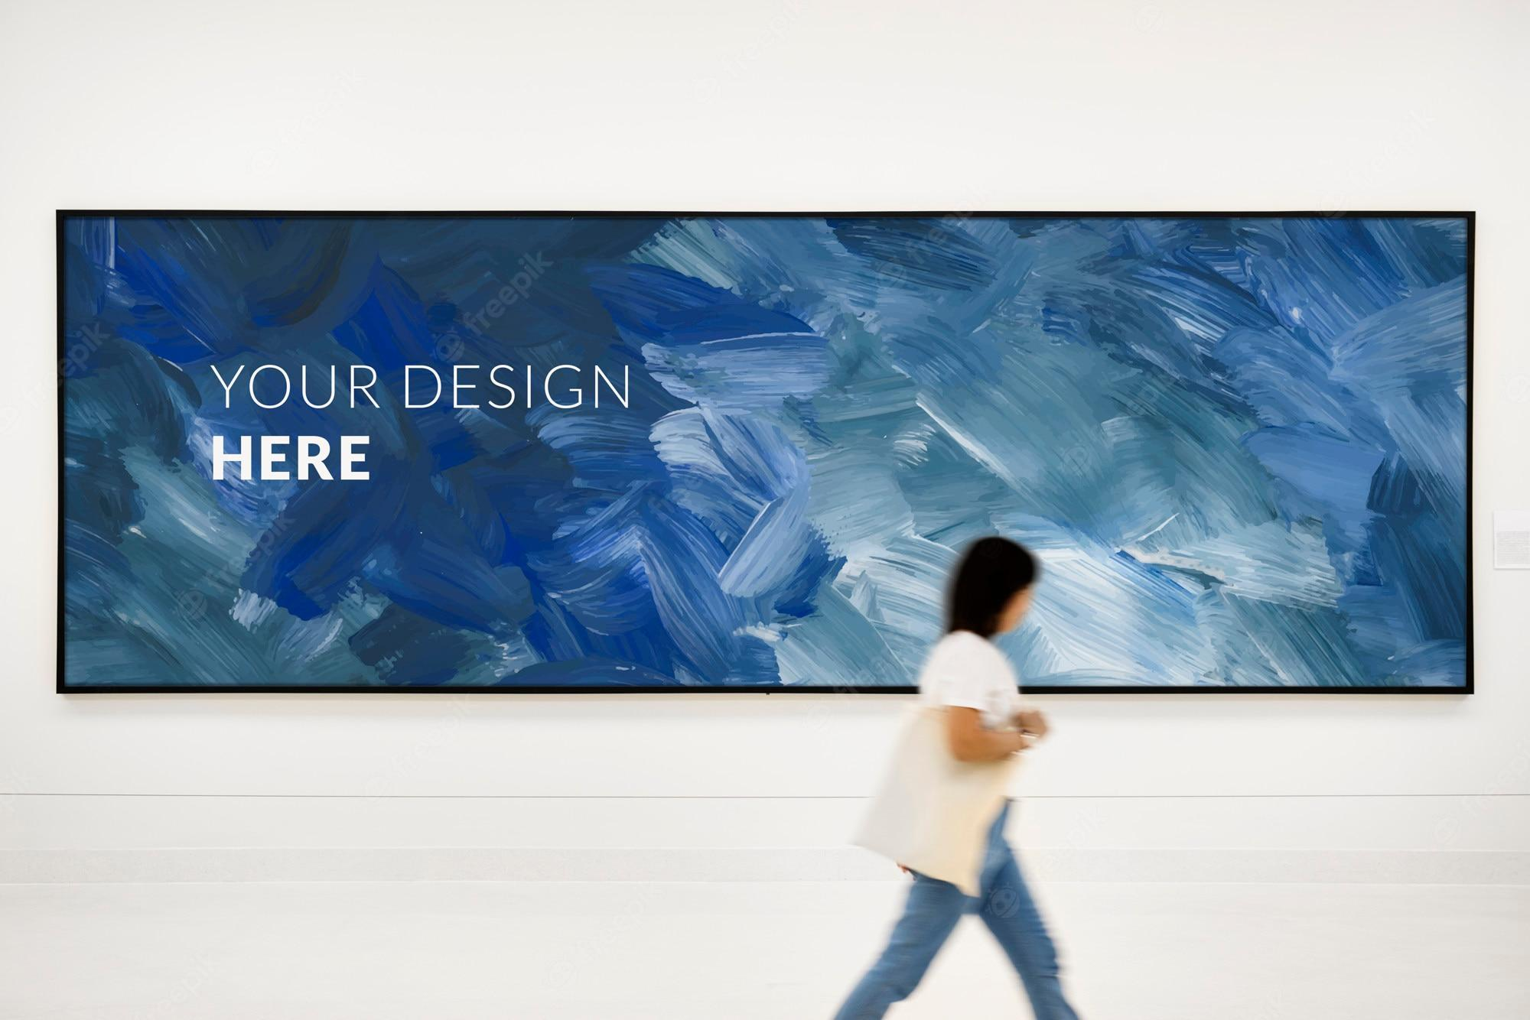
Accessible Name
Sometimes all you do is glance at an image…
Hint: aria-labeledby

Slide 6
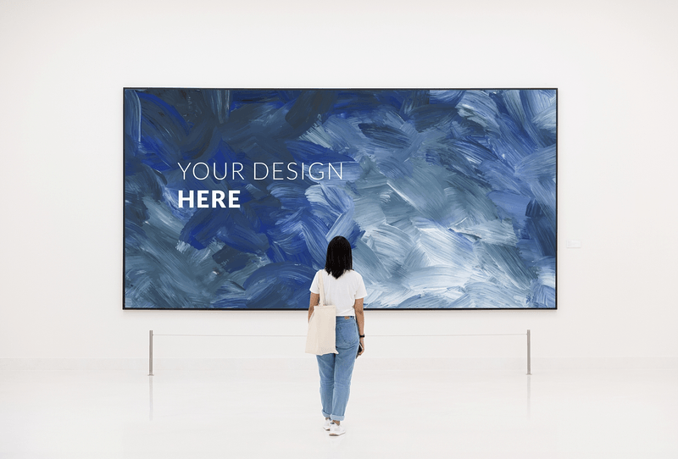
Accessible Description
Other times however you might want to study the image.
Hint: aria-describedby

Slide 7
Alt Text vs. Textual Alternatives
Effectively, all alt texts are textual alternatives, but not all textual alternatives are “alt text”: there is the text required, and the mechanism for providing that text.

Slide 8
Mechanisms for Adding Text Alternatives
If You are Glancing
(aka the Accessible Name / label)
@aria-label
@aria-labeledby
@alt
@title
If You are Studying
(aka the Accessible Description)
@aria-describedby
@aria-describedat
<figcaption>
<details>
<caption>
@longdesc (does not work in Apple products)

Slide 9
“Text Alternatives should…
be succinct – it’s an ALTernative, and NOT a description (think “Label”).
be accurate and equivalent in representing content and function.
not be redundant, or provide the same information as text near the image.
not include phrases like "image of ..." or "graphic of ...", etc. (Screen readers already announce "graphic" when encountering an <img> and then announce the alt text.)
SVG graphics:
SVG graphics can be referenced in the src attribute of an <img> element like other image formats (PNG, JPEG, GIF). In this case, the examples of this tutorial can be used with SVG as well.
As SVG images consist of tags like HTML, their code can also be used in HTML5 directly. In this case you can provide a text alternative in a <title> element within the SVG image. To improve accessibility support, that title should be referenced from an aria-labelledby attribute of the <svg> element, for example:
<svg aria-labelledby="svgtitle1"> <title id="svgtitle1">Settings</title> [other svg code] </svg>

Slide 10
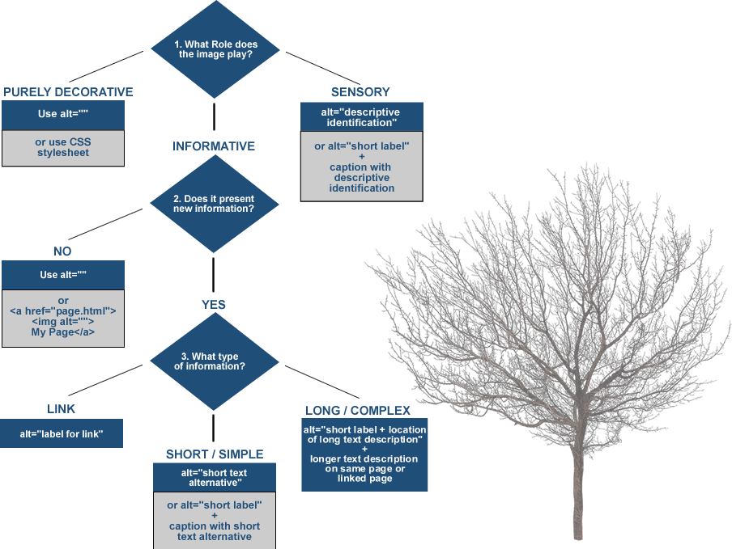
Textual Alternative Decision Tree
source: https://4syllables.com.au

Slide 11
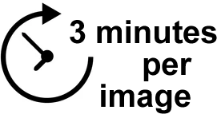
The Challenge – How are your alt text skills?
Break into groups of 5 or less
You will be shown 4 images for 3 minutes each
Work with your team to craft the best text alternatives you can for each image

Slide 12
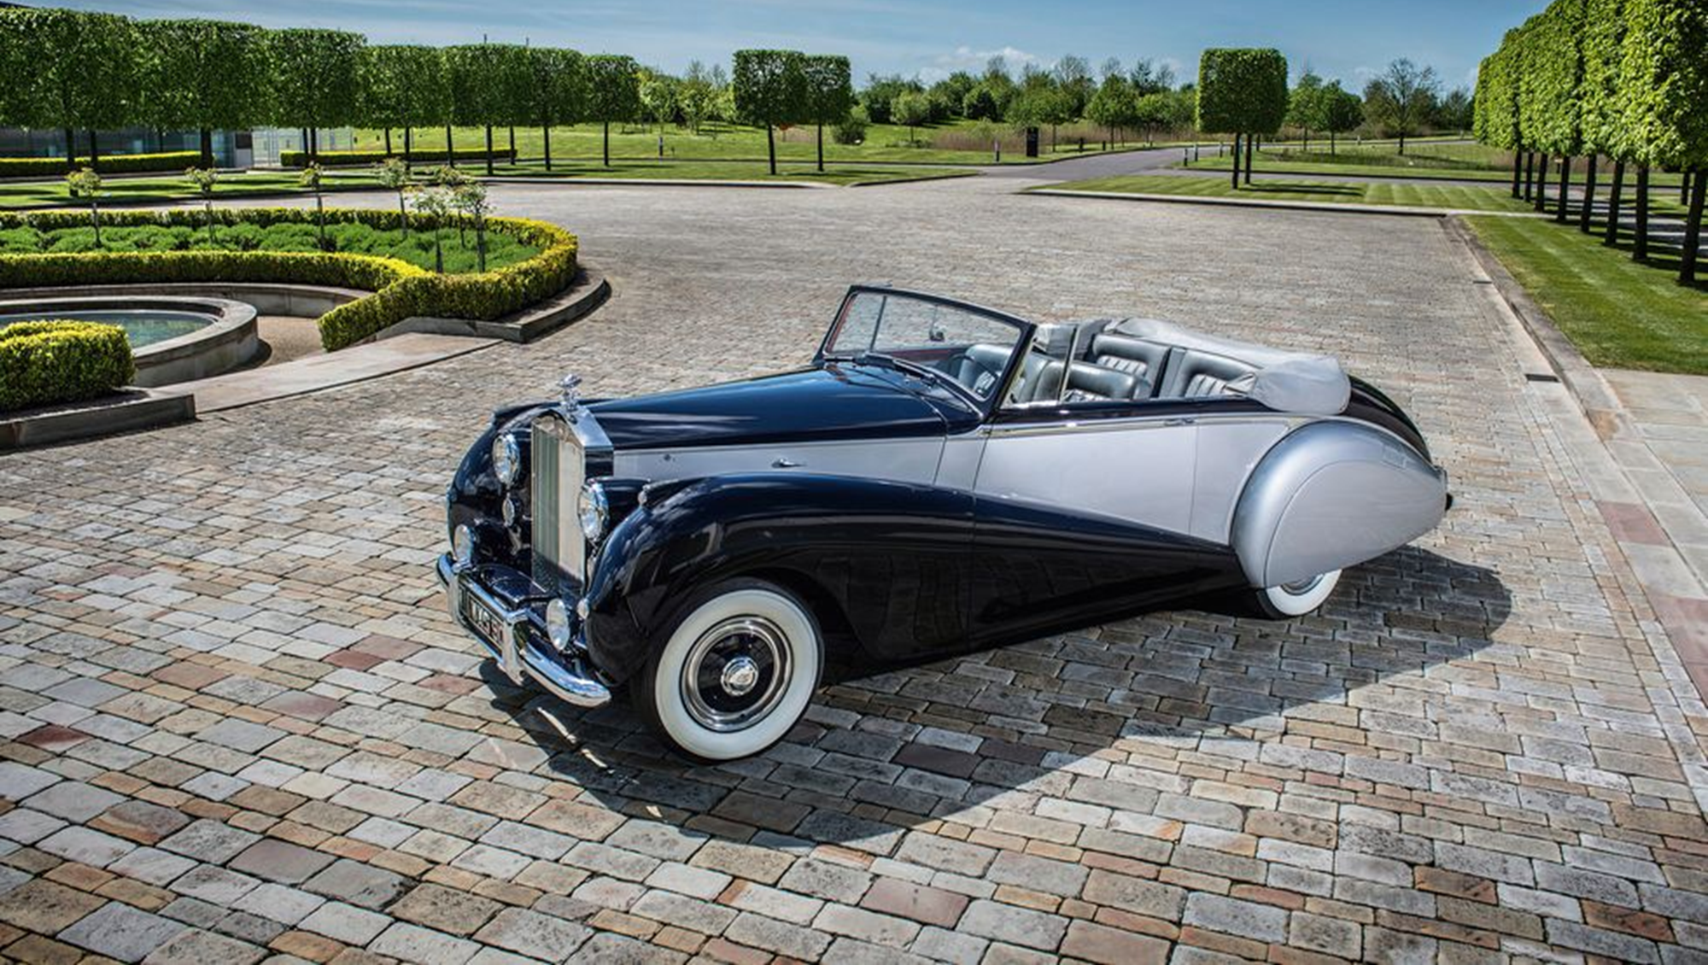
Example 1
Time’s Up
Notes:
https://www.youtube.com/watch?v=DykZEOV5wD4

Slide 13
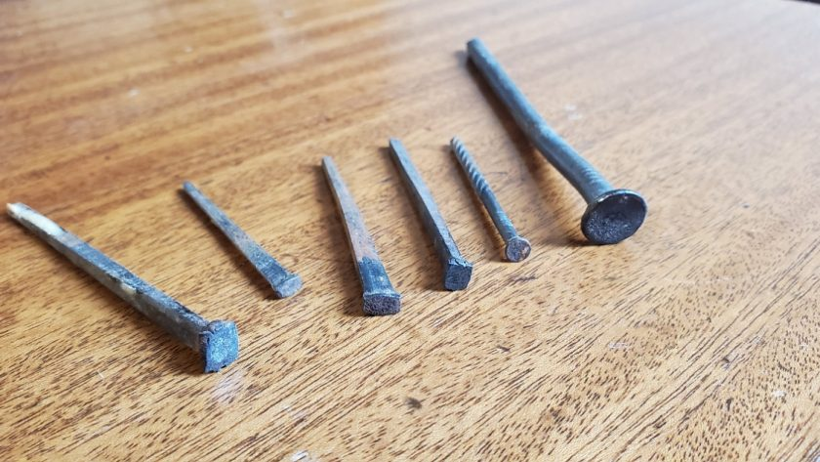
Example 2
Time’s Up

Slide 14
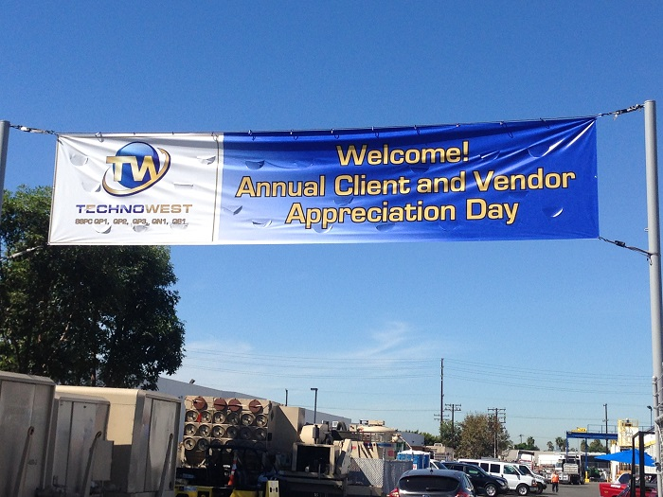
Example 3
Time’s Up

Slide 15
Example 4
Time’s Up

Slide 16
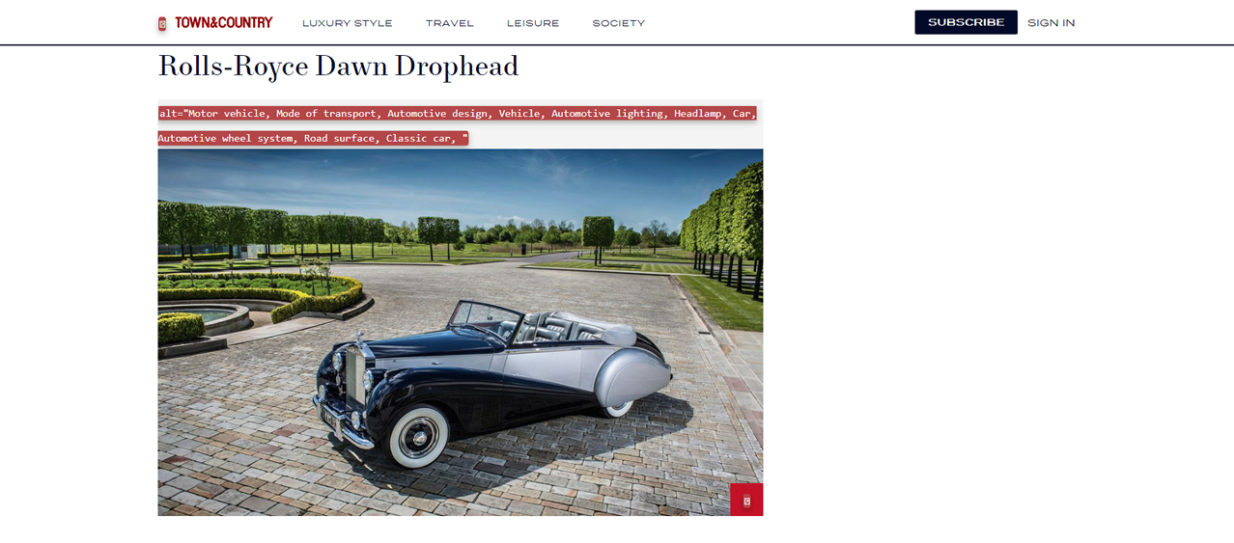
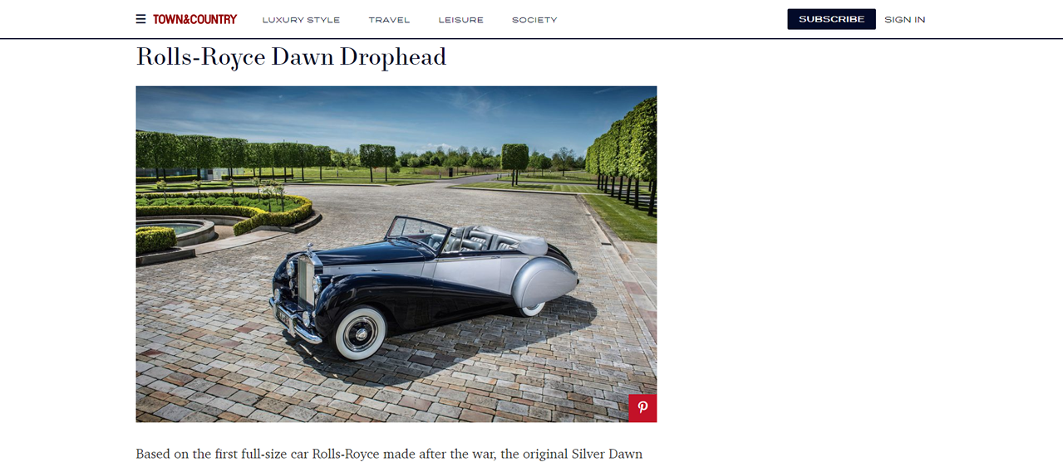
Example 1: Town and Country Magazine
https://www.townandcountrymag.com/leisure/sporting/news/g2165/best-vintage-cars/

Slide 17
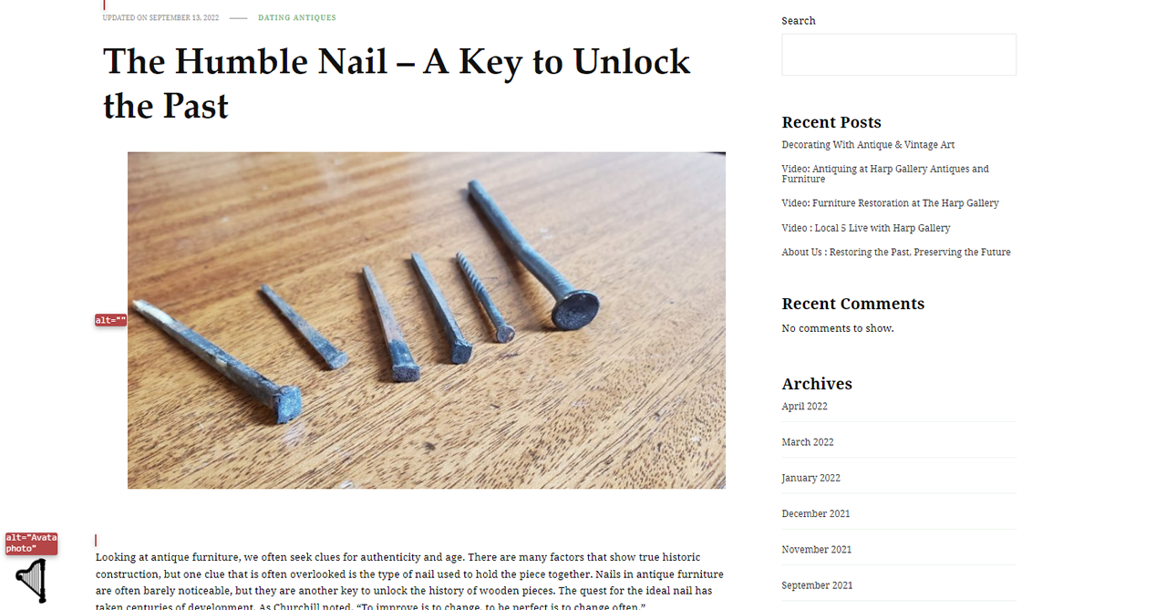
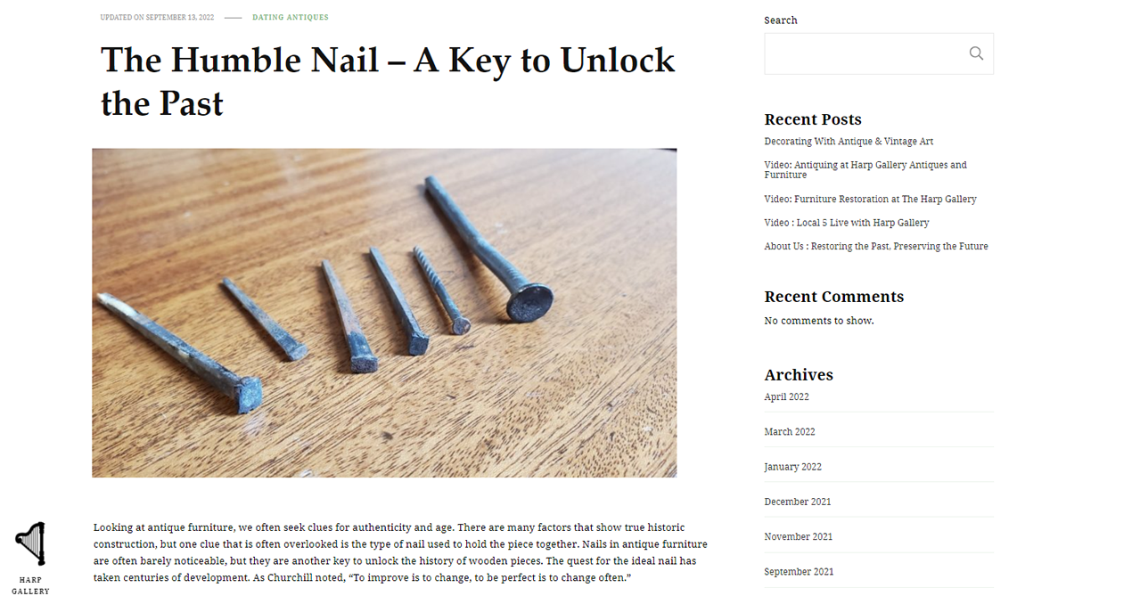
Example 2: Harp Gallery Antique Furniture
https://www.harpgallery.com/blog/the-humble-nail-a-key-to-unlock-the-past/

Slide 18
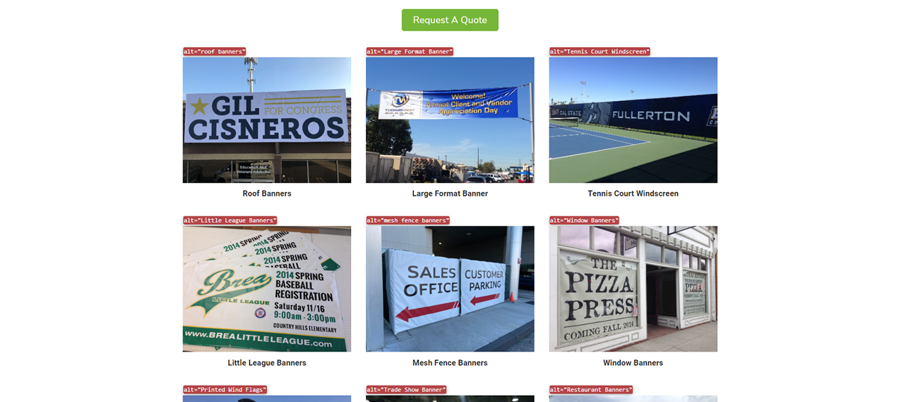
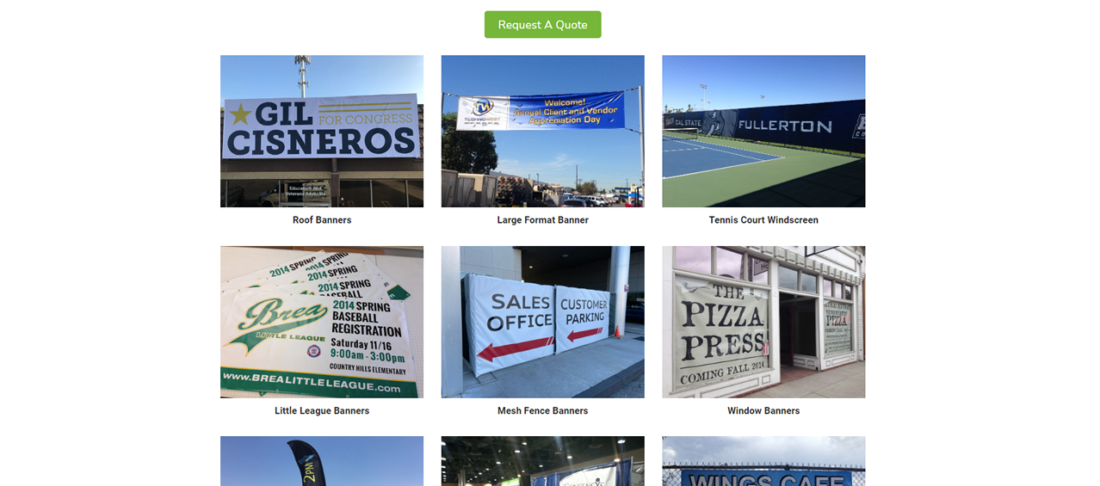
Example 3: Superior Signs and Graphics
https://superiorsignsandgraphics.com/products_services/banners/

Slide 19
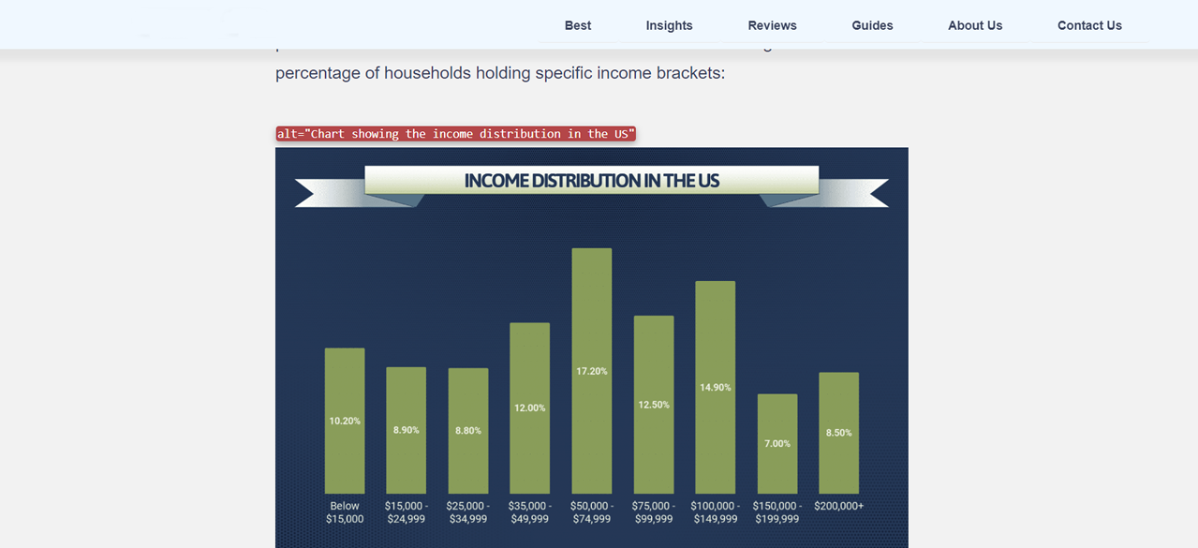
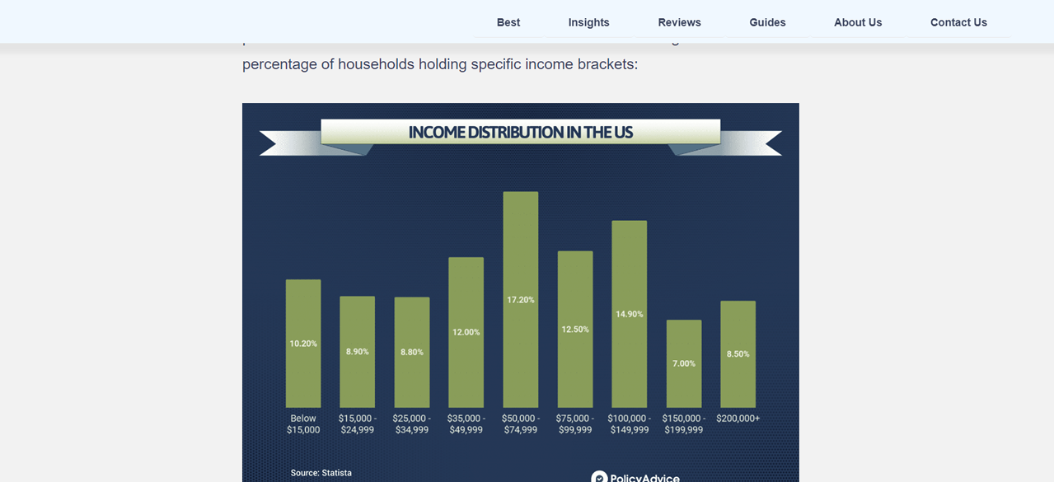
Example 4: policyadvice.net
https://policyadvice.net/insurance/insights/average-american-income/

Slide 20
The Results
Who found this exercise hard? (hands up)
Why was it hard?
What was missing?

Slide 21
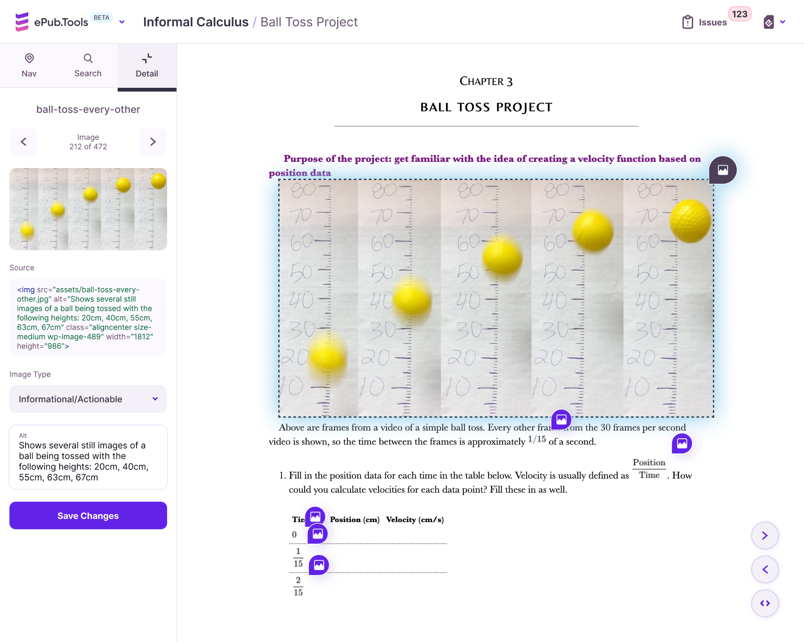
Text
Alternatives

Slide 22
QUESTIONS?
Thank you for joining us for this
fun exercise!
hello@content.industries

