Slide 1
Fighting Fires or Changing Culture: Prioritizing Accessibility in Peer Developed Courses - Changing How Faculty Approach Course Design
https://bit.ly/AHG22fires

Slide 2
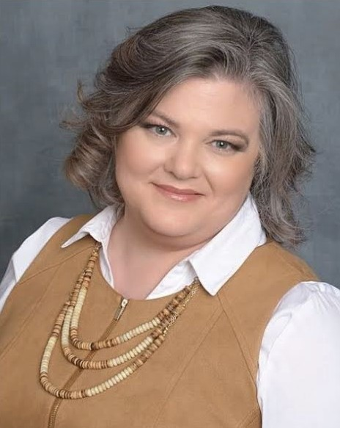
Presenter
Lindsay Nichols Foster
eLearning Instructional Designer
Focus: Accessibility and RSI
lindsay.nicholsfoster@tccd.edu
@LFTechTeach
@LFosterTechTeach
https://bit.ly/AHG22fires

Slide 3
Outline
Peer Developed Courses (PDC)
Timeline of building accessibility culture
Instructor/faculty focused efforts
Instructor/faculty feedback
Lessons learned
https://bit.ly/AHG22fires

Slide 4
Rating
Number | 1 | 2 | 3 | 4
How you feel about helping faculty with accessibility.
https://bit.ly/AHG22fires

Slide 5
Peer Developed Courses (PDC)

Slide 6
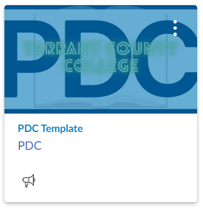
TCC Connect Peer Developed Courses (PDC)
Currently 35 courses available
2 course updated in 2017
1 course updated in 2020
32 courses updated 2021
3 in development

Slide 7
Timeline

Slide 8
TCC Accessibility Action Timeline
Course Accessibility Review
PSA Contractor Program Implemented
ID - Accessibility Position Created/Hired
PDC Template Development
Accessibility
Roadmap Developing

Slide 9
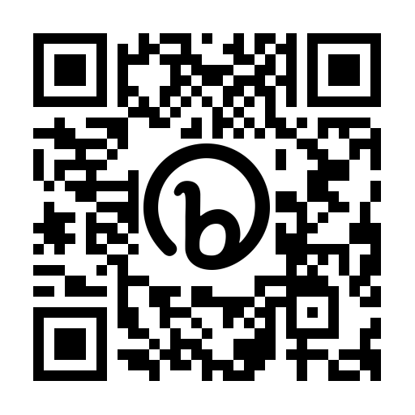
If you would like a copy of our road map when the public facing version becomes available, complete this survey.
bit.ly/TCCroadmap

Slide 10
Instructor/Faculty Focused Efforts

Slide 11
Our Focused Efforts
“Accessibility is the law.”
“It’s accessible because it’s the right thing to do.”
“Here are the humans who benefit from providing accessible materials.”

Slide 12
Instructor/Faculty Feedback

Slide 13
Feedback Instructor 1
Most Impactful or Valuable Instructional Module: Accessibility was really helpful. I need to work on this in my classes, and I was not aware of a lot of the tools available to help.

Slide 14
Feedback Instructor 2
Most Impactful or Valuable Instructional Module: Building Access. I didn't know that canvas had an accessibility checker built in.

Slide 15
Feedback Instructor 3
Something That Was Reinforced: A focus on accessibility. This is easier to do in a face-to-face classroom setting as the issues are noticeable. There are many challenges that can arise from distance learning that need to be considered for all students to have success.

Slide 16
Feedback Instructor 4
This was a good reminder about some of the accessibility issues that are not always at the forefront of our course planning.

Slide 17
Feedback Instructor 5
I didn't realize how dynamic Canvas is and how many resources are available to help make courses accessible.

Slide 18
Feedback Instructor 6
…really good and helped me realize I need to take a look at accessibility in all my courses. I already feel like I am consistent and organized, but lots of the color coding needed to go. I am still interested to know more about accessibility some of the handwritten drawings and class notes that I do in my math classes and then post them later. I always feel like math is always more complicated to make accessible but it shouldn't be.

Slide 19
Feedback Instructor 7
I benefitted greatly from the "little guy" who checked accessibility. I had no idea that my own listing may not display properly for other users. Now, I am constantly clicking the "little man" to ensure I'm compliant. This is a great feature and I appreciate that it was discussed and demonstrated.

Slide 20
Feedback Instructor 8
This was a great module because it brought my attention to accessibility issues in my current virtual classrooms. With the help of the instructors, I now have the means to create accessible and responsive pages that look great on multiple screen sizes and will not prove to be a problem with screen readers. This is great because I like to use navigational images and I didn't want to abandon those for accessibility. I can now replace all my formatting tables with bootstrap grids.

Slide 21
Lessons Learned

Slide 22
Lessons Learned Basics
Bottom up method versus top down method; “Jaws of Life” method
Start small
Start somewhere
Identify and prioritize needs
Choose one thing (focus)
Do it well
Get “good” at it
Assimilate into the culture
Intentional movement and progress (road map)
Monitor impact and progress
“What is expected must be inspected.”
#AllMeansAll

Slide 23
More Lessons Learned
Staffing
Centrally localized department/unit within the organization for consistency and support through training and resources
Student facing vs. Faculty/Staff facing
Budget for:
Staffing
Resources
Materials
Procedures
Software
Hardware
Training
Unplanned items

Slide 24
Questions?
Lindsay Nichols Foster
eLearning Instructional Designer
Focus: Accessibility and RSI
lindsay.nicholsfoster@tccd.edu
@LFTechTeach
@LFosterTechTeach
https://bit.ly/AHG22fires

Slide 25
“Do the best that you can until you know better. Then when you know better, do better.”
Maya Angelou

