Slide 1
Leading from the Center
Digital Accessibility Efforts Through the Library
Rebecca.Oling@Purchase.edu
Notes:
While I generally speak of accessibility in universal terms, I will occasionally use person first language throughout referring to SWD or PWD as a shorthand for Students with Disabilities or People with Disabilities. Person first language is appropriate in this case because of the universal approach we take to accessibility at Purchase College, but I recognize that the preference itself is not by any means universal.

Slide 2
Slido Library Website Accessibility Information
To what extent does your campus library address physical or digital accessibility on its website?
ⓘ Start presenting to display the poll results on this slide.
Notes:
📣 This is Slido interaction slide, please don't delete it. ✅ Click on 'Present with Slido' and the poll will launch automatically when you get to this slide.
“only 14% of responding libraries had a formal accessibility policy for content acquisition according to Jasmine Clark in College and Undergraduate Librariesin 2020

Slide 3
Why the Library?
Librarians = Sharing
potential ties to area public libraries
Strong existing consortial relationships
ILL potential
The collection is sometimes unwieldy
Advocacy = key skill
“Neutral” grounding and position Core
Competencies of Librarianship (2021)
Photo by Valeria Lo Iacono on Pixabay
Notes:
According to LYRASIS Accessibility Survey Report (2019), only 14% of libraries had formal accessibility policy for content acquisition (Clark 266) Libraries can avoid purchasing inaccessible products and can design alternate access plans in advance. Clark notes “True change takes collaboration”

Slide 4
Purchase College
EITA Policy
Accessibility Committee
IDEA Committee
Lip Service
System human network
3446 undergrad, 83 grad
Liberal Arts and Sciences
15.7% incoming first generation
Office of Disability Resources
25% total identified disability
Budgetary issues
Staffing issues
https://www.purchase.edu/accessibility/library-initiatives-and-updates/
Notes:
who are we? 6 faculty librarians, small staff

Slide 5
Laying the Foundation: 2002-2017
Training Begins
Library Staff Mobility Training
Universal Design for Learning (UDL)
UDL Checklist
Ebooks (begin collecting in earnest)
Teaching Learning Technology Center Online Course Redesign
stipend for faculty
full peer workshop format
Notes:
where were we?

Slide 6
The Shift
OCR Complaint
EITA Policy created 2018
SUNY EITA 2019
Creation of Director of Digital Accessibility Role
new relationship with Learning Center
one-on-one training
Collection of VPATS
Adoption of Blackboard Ally
Vendor Advocacy begins
Homegrown workflows
Curricular considerations
2018 to 2020
Notes:
What happened/shifted?

Slide 7
Five-Prong Approach: The Landscape
ODR Identified Courses with PWD
High Risk Courses (Over 75 students)
Online/Hybrid Courses
Lowest Ally Scores
Referred Courses
Photo by Alexander Grey on Unsplash
Notes:
Ally & The documentation

Slide 8
Slido Point Person
Does your campus library have a point person for accessibility?
ⓘ Start presenting to display the poll results on this slide.
Notes:
📣 This is Slido interaction slide, please don't delete it. ✅ Click on 'Present with Slido' and the poll will launch automatically when you get to this slide.

Slide 9
Existing Collections & Services
What do we already have/do?
Ebooks
Films with Captioning and Audio Description
Journal Articles and Databases
Advocacy Opportunities
Faculty
Vendors
Administration
Students, Interns, Ambassadors, Government, Clubs, Classes
Advocacy Opportunities & Content Advisory
Notes:
How can we push, become more transparent, advocate

Slide 10
Crisis into Leadership 2020-2022
Library Accessibility Cohort
using our SUNY systemness
Procurement Toolkit
Vendor Communication
Community of Practice
Topical Presentations
Small Tweaks–Inch Forward
Photo by cottonbro: https://www.pexels.com/photo/woman-holding-sign-3951615/
Notes:
https://slcny.libguides.com/slss-accessibility/procurement-toolkit

Slide 11
More questions than answers
What have we done?
What do we do?
Where are we?
Who can we reach?
What can we improve?
How can we prove it?

Slide 12
Leveraging InterLibrary Loan and Ally Data
What’s being requested? By Whom?
Can it impact collection development? What’s being scanned/used? By how many? Can we acquire ebook? Is there an OER that fits?
Ally Environmental Scan: what are users doing? Are there patterns to what they are downloading that becomes UX info? What “fix” features are faculty using or not using? How can that impact messaging and training.
What numbers should we be watching?
copyright violations and money “saving” practices also lead to inaccessible content
How does that information change collection development?

Slide 13
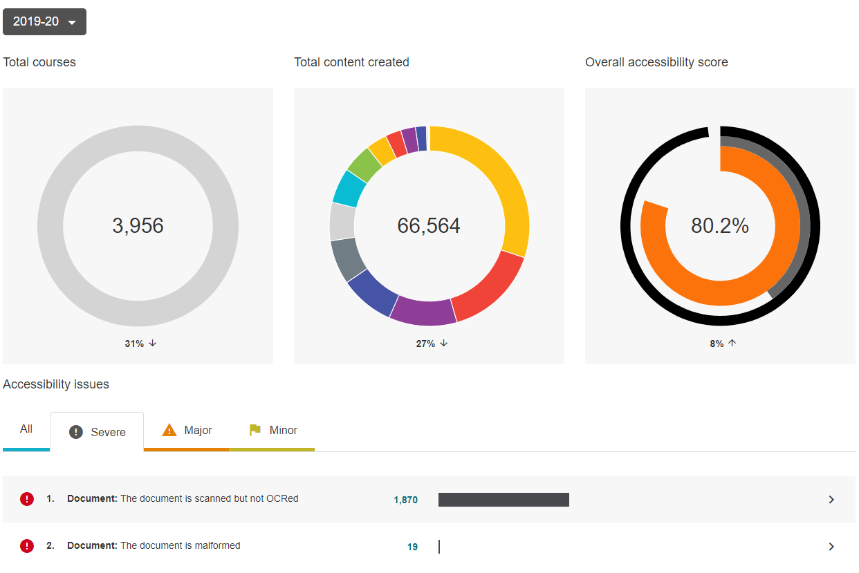
2019-2020 Global Distribution & Severe Issues

Slide 14
Centering the Library
Be Transparent, State Goals & Accomplishments
Physical Spaces & Digital Efforts
Lead Training v Lead Nudge
Especially Content like Basics, Customer Service, Ebooks, OER, etc.
Best Practices (Scanning)
teach departmental staff to say “No” & slow down
can we eschew scanning? PDFs?
Relationship with Public Libraries, Consortia, Systems, Organizations, Vendors, etc. Opportunities
“An informed citizenry is at the heart of a dynamic democracy” (Jefferson)
Notes:
He didn’t say “an informed and abled citizenry”

Slide 15
Being
Buoyant
People Aren’t Always Ready (Primed)
Money isn’t always “on cycle”
be ready with themed collections
Diversity, Equity, Inclusion Efforts
Gap taskforce
Statements
Ongoing Displays
Running list of tasks for assistants and interns
LibGuide, Checking works, measuring spaces, mocking up pages, working with groups, testing Blu-Ray for AD and CC

Slide 16
Consortia and Special “pots”
Consortial renewals = time to shape ebook collections with DEIC
Small DEIC grants opportunities to cover promotion, events, certification,, consultingetc.
ebooks and print bought with “last minute, end of year funds”
consultant for DEIC

Slide 17
Ruthless Rejiggering
Homegrown system for DA data
not scalable
can’t attach notes
not helpful with OCR complaint
Research “Free” alternatives
each has more labor
NOW, we can talk about ODR application “Accommodate”

Slide 18
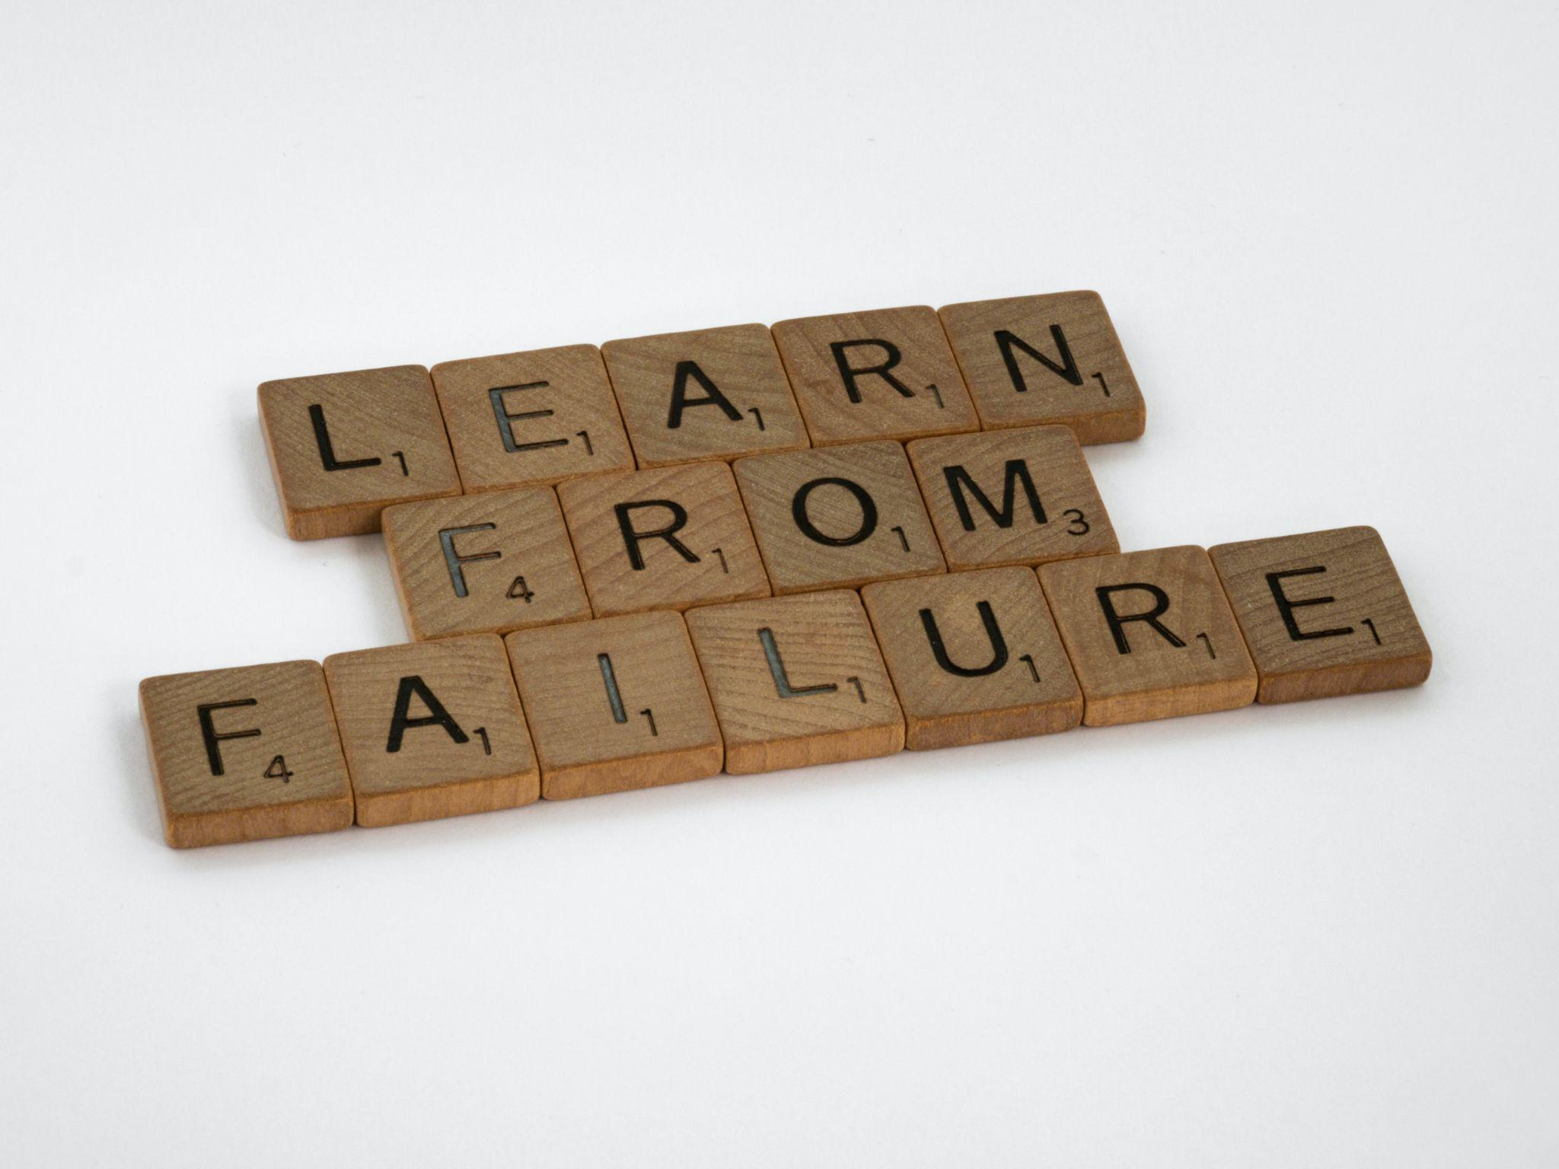
If you never know failure, you cannot know success.
Be willing to:
Detach with Love
Begin again
Consult Others
Share the narrative
Engage Assistance
Promote accomplishments
Photo by Brett Jordan on Unsplash

Slide 19
So where does your library fit in your plan?
unexpected curricular ties– Faculty requiring “Check Accessibility” for Word
new OER or accessible materials
potential partnerships
campus leadership opportunities
increased awareness
What else on your campuses?

Slide 20
Questions and Discussion
Rebecca.Oling@Purchase.edu
@RebeccaOling Twitter
www.linkedin.com/in/rebeccaoling
https://www.purchase.edu/accessibility/library-initiatives-and-updates

