Slide 1
Engaging Teams Across Campus
Lessons learned from working with higher education institutions
tinyurl.com/ahg22
Mark Pope
Pope Tech, LLC

Slide 2
Introduction

Slide 3
Lesson 1
Don’t assume…

Slide 4
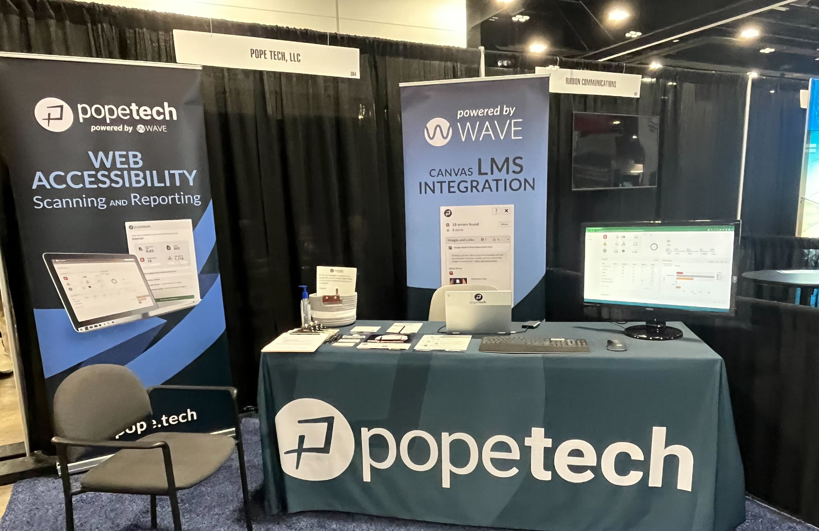

Slide 5
Are your websites and Canvas courses accessible to students with disabilities?

Slide 6
Lesson 2
The power of leadership buy-in
(Executive sponsor)

Slide 7
Benefits of an Executive sponsor
When the executive leaderships of the institution has chosen to embrace digital accessibility as part of their culture, things are much easier
Champion campus-wide policy and initiatives
Help get resources, tools, and personnel
Make introduction
Put accessibility on agendas
Approve trainings (internal and external)
Rally and enforce

Slide 8
Lesson 3
Have someone designated to “herd” the efforts

Slide 9
Lesson 4
Think about partnerships/stakeholders across campus
(involve everyone!)

Slide 10
EDUCAUSE IT Accessibility Community Group (Presentation, EDUCAUSE 2022)
Partnerships for building successful accessibility initiatives on campus:
Executive sponsor
Legal
Technology (IT)
Procurement
Academic Leadership
Diversity (DEI) Office
Disability Services
Human Resources
Teaching & Learning Centers
Communications
Audit Services

Slide 11
Bonus strategy!
Leaders can make introductions facilitate conversations

Slide 12
Lesson 5
Network with other like-minded people across different campus

Slide 13
What if your campus doesn’t have supports like this?
Keep doing what you can for accessibility in your position/role
Keep Advocating and Educating
Create your own network (institutionally & cross institutions)
Keep thinking what’s the next thing
Take Home:
Be the type of person who they will come to when they are ready.

Slide 14
What are things you do or have seen that non-executive admins can do to increase/promote digital accessibility?

Slide 15
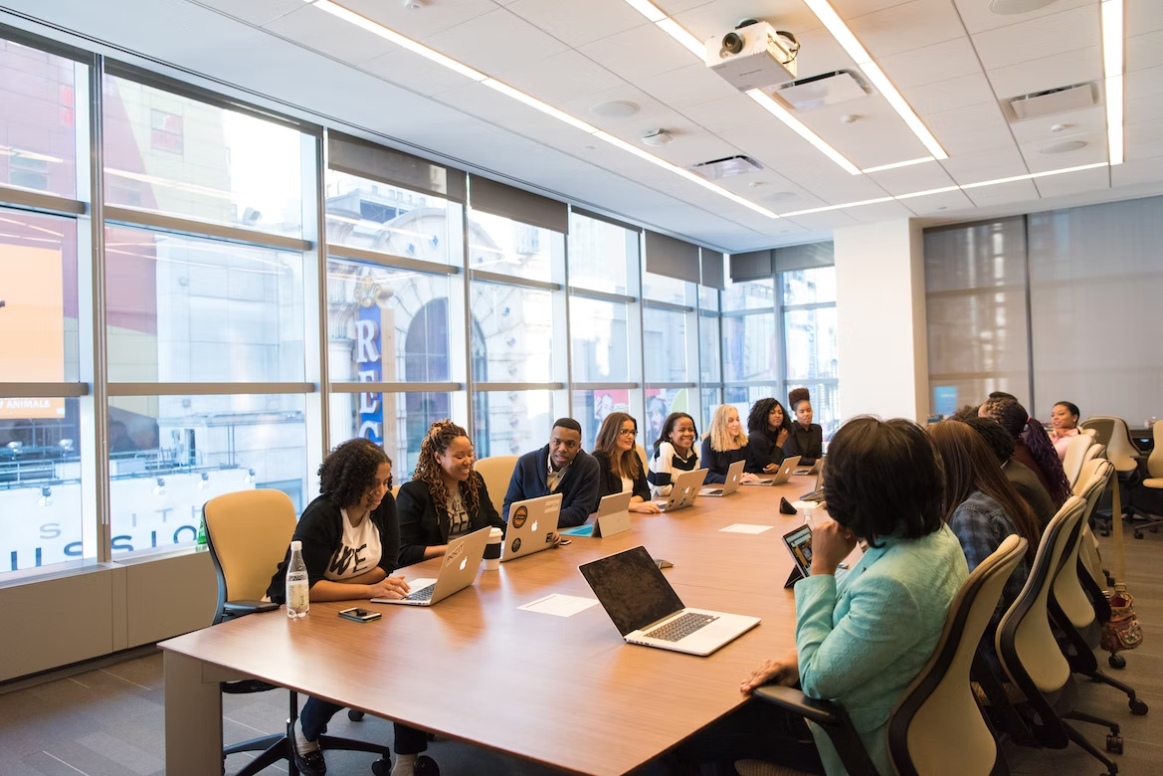
Lesson 6
Take Action!
(Planning is important, but always take some concrete action that improves accessibility)

Slide 16
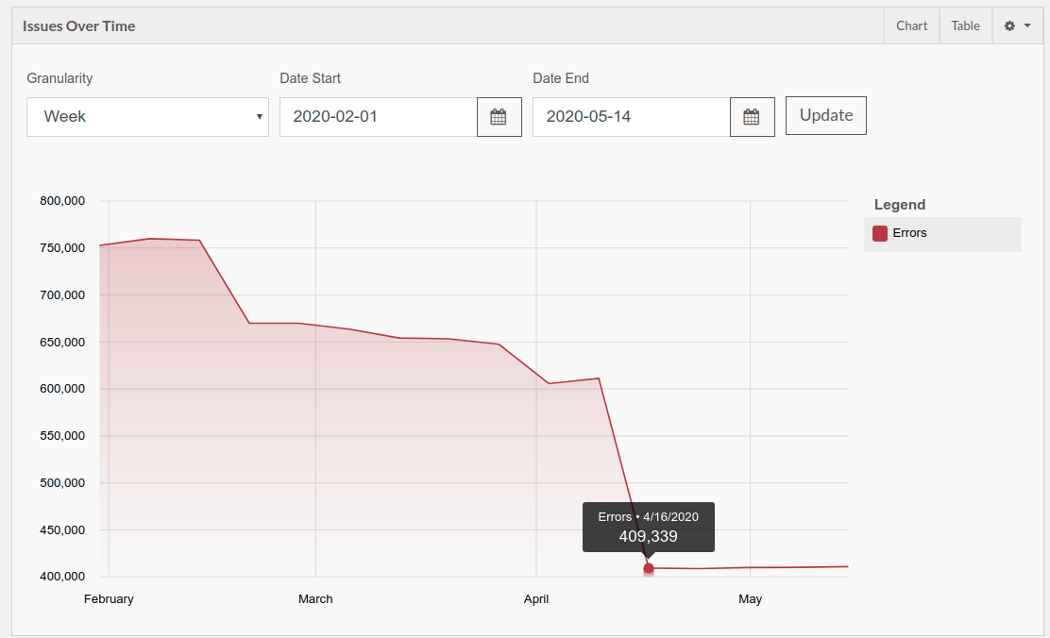

Slide 17
Consistency is the secret sauce of web accessibility
Some fun consistent activities I have seen in action

Slide 18
Brown Bag Lunch Sessions
Scheduled time to meet up and chat about accessibility

Slide 19
Monthly Accessibility Focus
need some ideas for topics? (blog.pope.tech)

Slide 20
Annual PDF Purge

Slide 21
Annual Accessibility Competition
See how many of the fully automatically detectable errors you can get down to zero.
Start of month get baseline data. End of the month get result data.

Slide 22
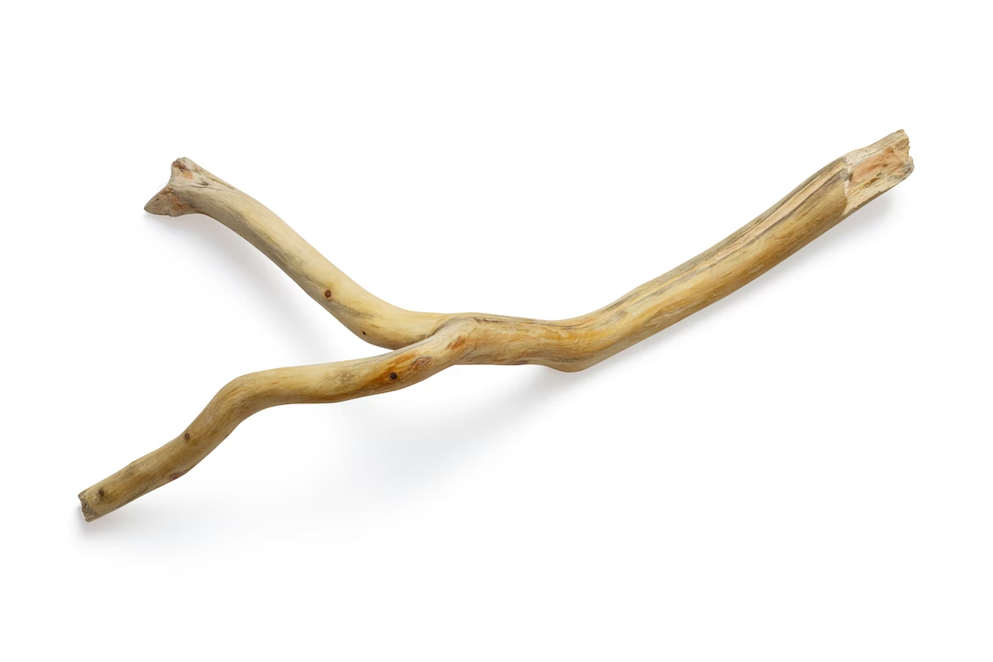
Think Carrots first!
… but make sure people do understand 508 compliance is the law

Slide 23
What have other suggestions do you have?

Slide 24
Lesson (last)
Always thinking what can I/we do next

Slide 25
Final Thoughts
Be committed to accessibility
Be consistent & keep moving forward
Involve others
Look for what is next
Honor the journey

