Slide 1
Audio Description Associates, LLC and
the American Council of the Blind’s Audio Description Project
presents
AUDIO DESCRIPTION: AN AID TO LITERACY
with
Joel Snyder, Ph.D.
President, Audio Description Associates, LLC
Founder/Senior Consultant, Audio Description Project, ACB
Jason Stark
CEO, Described and Captioned Media Program
Susan Glass
Writer, retired English professor and
Chair, BADIE sub-committee, Audio Description Project
Accessing Higher Ground Conference
November 17, 2022 – 11:30 am-12:30 pm MST
American Audio Description Symbol

Slide 4
ANNOTATED AUDIO DESCRIPTION SCRIPT FOR THE COLOR OF PARADISE
Cues in CAPS; descriptions preceded by “>>.”
Annotations are in bold at right, keyed to numerals in description text.
Note: The appearance of the character “Mohammed” is described earlier in the film.
1 01:01:36:12 00:00:10:26 --:--:--:--
>> Mohammed kneels and taps his hands
through the thick ground cover of brown 1. 1 – Color has been shown to be
curled leaves. important to people with low vision, even people who are con-
01:01:46:16 00:00:00:23 --:--:--:-- genitally blind.
.
..[CHIRPING/RUSTLING :02]
3 01:01:48:16 00:00:04:04 --:--:--:--
>> A scrawny nestling struggles on
the ground near Mohammed's hand.
4 1:01:52:19 00:00:00:23 --:--:--:--
...[GASP/CHIRPING :02] 2. 2 – Timing is critical in the
crafting of description. We
5 01:01:54:19 00:00:15:00 --:--:--:-- weave descriptive language
>> His palm hovers above the around a film’s sound elements.
baby bird. He lays his hand lightly
over the tiny creature. Smiling,
Mohammed curls his fingers
around the chick and scoops 3. it into 3. – Vivid verbs help conjure
his hands. He stands and strokes images in the mind’s eye.
its nearly featherless head with
a fingertip.

Slide 5
6 01:02:08:12 00:00:00:23 --:--:--:--
...[CHIRPING/RUSTLE :01]
7 01:02:09:12 00:00:17:19 --:--:--:--
>> Mohammed starts as the bird
nips his finger. He taps 4. his
finger on the chick's gaping
beak. He tilts 4. his head back, 4. – Description, like much
then drops it forward. Mohammed poetry, is written to be heard.
tips 4. the chick into his front Alliteration adds variety and
shirt pocket. Wrapping his legs helps to maintain interest.
and arms around a tree trunk,
Mohammed climbs.
8 01:02:28:10 00:00:01:04 --:--:--:--
...[HEAVY BREATHING/CLIMBING :11]
9 01:02:39:10 00:00:17:19 --:--:--:--
>> He latches onto a tangle of
thin, upper branches. His legs
flail for a foothold. Mohammed stretches
an arm between a fork in the trunk of the
tree and wedges in his head and shoulder.
His shoes slip on the rough bark.
Note: Throughout this excerpt, for the most part, descriptions are written to be read “in real time,” i.e., as the action being described occurs on screen. However, in many films descriptions may precede the action on occasion. This is a useful convention – it accommodates timing required in films with a great deal of dialogue and allows description users the opportunity to know “what happened” moments before the action occurs.

Slide 6
10 01:02:55:11 00:00:00:23 --:--:--:--
...[SCRAPING :03]
11 01:02:58:11 00:00:16:04 --:--:--:--
>> He wraps his legs around the
lower trunk, then uses his arms
to pull himself higher. He
rises into thicker foliage and
holds onto tangles of smaller
branches. Gaining his footing,
Mohammed stands upright and
cocks his head to one side.
12 01:03:13:20 00:00:01:04 --:--:--:--
...[CHIRPING/FLUTTER]
13 01:03:18:15 00:00:10:15 --:--:--:--
>> An adult bird flies from a nearby branch. 5. 5 – What to include? This
Mohammed extends an open hand. He image is important – the
touches a branch and runs his fingers adult bird returns in the
over wide, green leaves. next scene.
14 01:03:27:11 00:00:00:23 --:--:--:--
...[RUSTLING :03]
15 01:03:30:11 00:00:14:08 --:--:--:--
>> He pats his hand down the
length of the branch. His fingers trace the
smooth bark of the upper branches,
search the network of connecting tree
limbs, and discover their joints.

Slide 7
16 01:03:43:20 00:00:00:23 --:--:--:--
...[RUSTLE :02]
17 01:03:45:20 00:00:05:06 01:03:50:26
>> Above his head, Mohammed's
fingers find a dense mass of
woven twigs--a bird's nest.
18 01:03:50:26 00:00:00:23 --:--:--:--
...[CHIRPING :03]
19 01:03:53:26 00:00:07:15 --:--:--:--
>> Smiling, he removes the chick
from his shirt pocket and drops
it gently into the nest beside
another fledgling.
20 01:04:01:00 00:00:00:23 --:--:--:--
...[CHIRPING :03]
21 01:04:03:04 00:00:13:04 --:--:--:--
>> He rubs the top of the
chick's head with his index 6. 6 – Be specific-- precision
finger. Mohammed wiggles his creates images!
finger like a worm 7. and taps a
chick's open beak. Smiling, he 7 – Similes paint pictures!
slowly lowers his hand.

Slide 8
“SEE THE BALL”

Slide 9
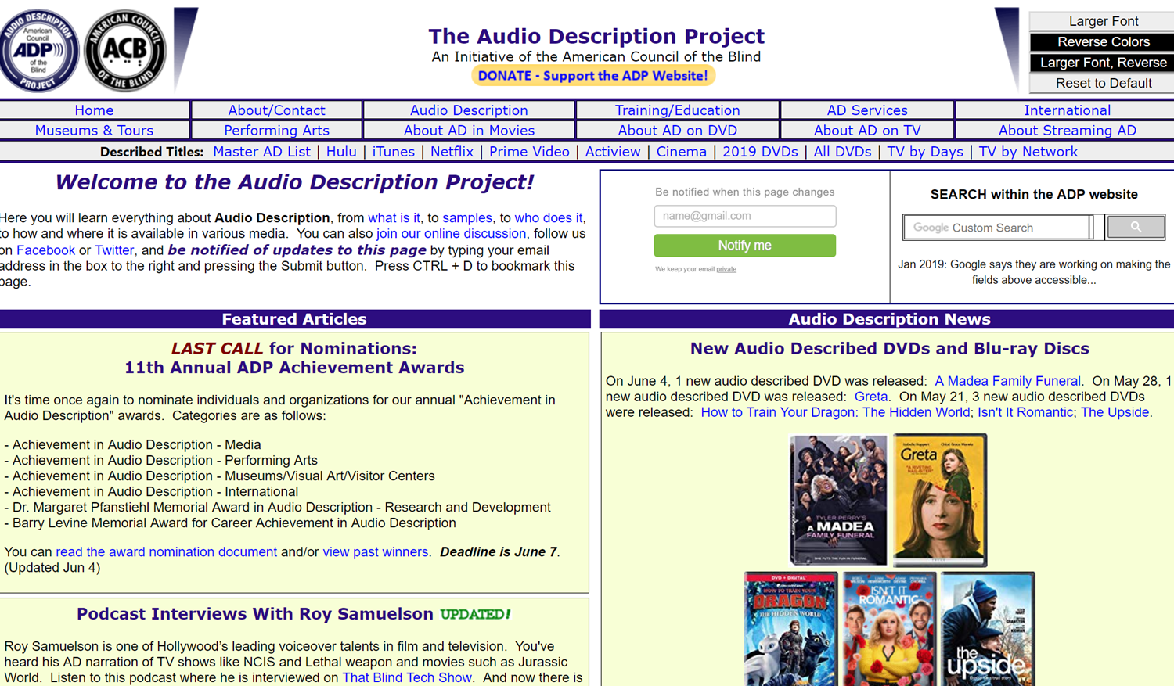

Slide 10
American Council of the Blind’s
Audio Description Project
https://adp.acb.org

Slide 12
JOEL SNYDER, Ph.D.
Audio Description Associates, LLC
www.audiodescribe.com - jsnyder@audiodescribe.com
https://adp.acb.org - jsnyder@acb.org
JASON STARK
Described and Captioned Media Program
www.dcmp.org – jstark@dcmp.org
SUSAN GLASS
susancglass@att.net
American Council of the Blind’s Audio Description Project (ADP)—
21st ADP AD Institute – virtual: March 2022
Visit https://adp.acb.org for updates

