Slide 1
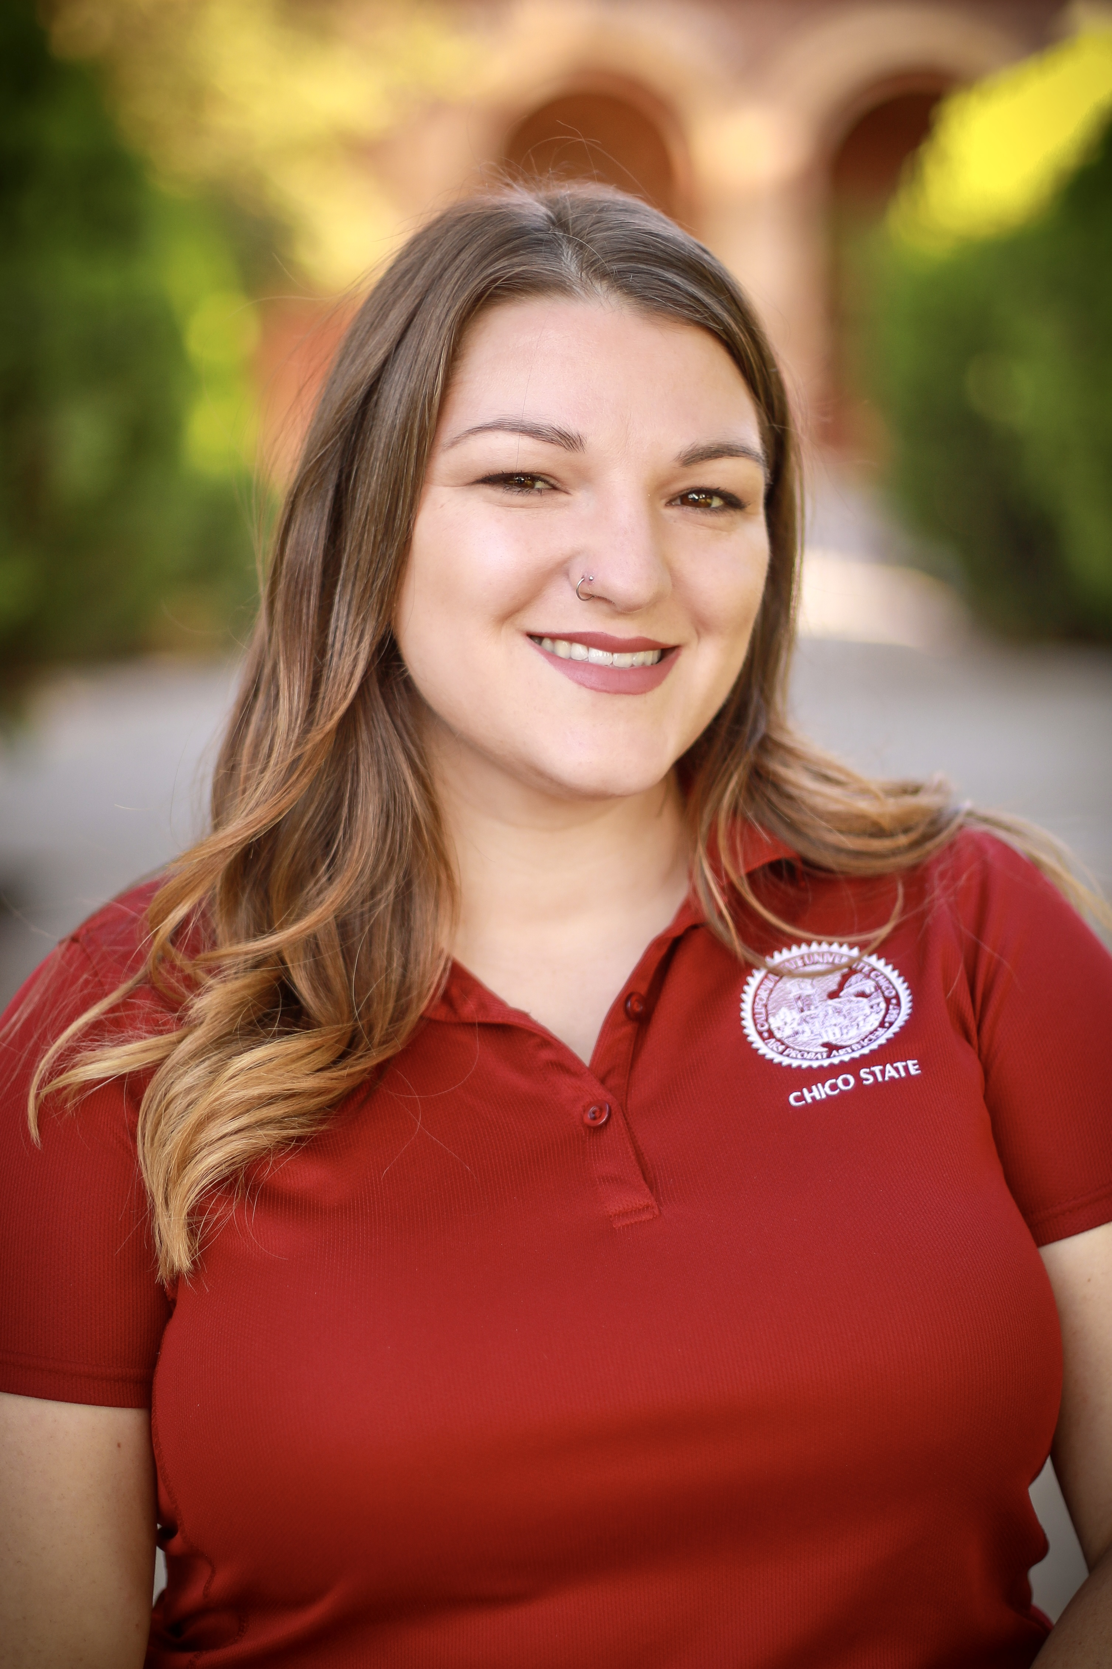
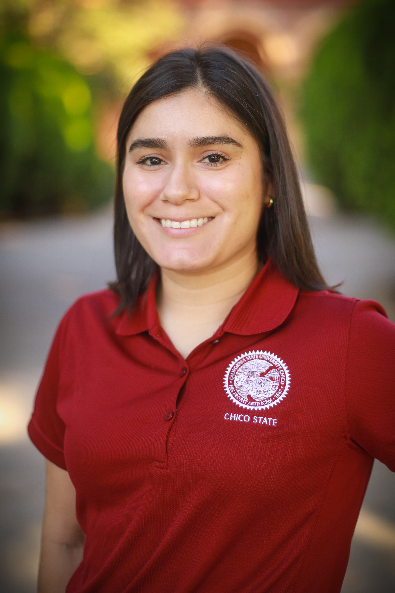
Session Presenters
Allyson Bartley (she/her)
Accessible Content Specialist
Brandy Cervantes (she/her)
Instructional Support Assistant

Slide 2
Land Acknowledgment
We acknowledge and are mindful that Chico State stands on lands that were originally occupied by the first people of this area, and we recognize the Mechoopda and their distinctive spiritual relationship with this land and the waters that run through campus. We are humbled that our campus resides upon sacred lands that once sustained the Mechoopda people for centuries.

Slide 3
Campus-wide Development and Practices of an Independent Accessible Technology Office
November 2021 Accessing Higher Ground

Slide 4
Session Outcomes
Strategies and implementation of a stand-alone accessible technology office.
How project management should adapt to cater to each unique goal.
And how the heck to get student assistants to learn and love content remediation.

Slide 5
How It All Started
2011- Alternate Media department lived in the Accessibility Resource Center (ARC).
2014- Branched out to become our own department.
2016- Took on additional roles on campus.
2017- HUGE year for OATS! Implementation of campus-wide web initiative & Blackboard Ally.
Notes:
2011-
The Alt Media Coordinator at the time came into ARC in 2011
Inherited Alt media team of 3
Only editing books for Kez and only had 7 students with alt media accommodation
2014-
Exponential growth from 27 students, 46. 72. etc.
Began to grow and starting thinking through the lens of inclusivity versus accessibility
Accommodations always come first, but we starting thinking, we are putting in the same amount of work for one student when we could simultaneously supporting 100 students, or 200, or more.
Many students don’t identify with their disability, know they have one, and so many different learning styles who fight their way through college
Alt Media Coordinator came to the director of ARC with a business plan of how we can get materials back to faculty as well as students with documented disabilities.
Course Readers were all the rage during this time- run PDFs and Word docs through checker and auto tag and send back to faculty to replace in the LMS. (too small of a team at this point)
This hit users of all abilities and continuously advocated and assisted in our efforts toward universal design
We become OATS
2016-
We took on more and more responsibilities- captioning for courses, more students with alt media as accommodations, clean docs became more popular and wanted by professors
2017-
Beginning of 2017 Kez editing got better by itself freeing up time for OATS to take on more content outside of books
HIRED ME! 2 staff 12 SA’s-- The old Alternate Media Coordinator became Director of OATS and I became the new Alternate Media Coordinator
Good thing because Web Services transitioned to Cascade 3.0 meaning it was time to clean house on the web bringing in a HUGE influx of content remediation
Then implemented BB Ally- This made a huge name for us on the Academic Affairs side, which I will get into in a little.
2020-
HIRED BRANDY, huge for our office because our registered students with disabilities went from 5% of the population to 9% so my Assistive Technology Assessments grew exponentially and roles were able to be distributed for more efficiency in the office workflow. 17 student assistants and 3 staff members

Slide 6
Funding
2011- $22,000 for 3 SA’s from VP of Student Affairs.
2016- $60,000 just for SA’s (outside of Staff salaries) from VPSA.
Been our base pay since 2016 with an additional $10,000 for outside costs as well as an additional $5,000 for professional development.
2017- received an additional $50,000 from the Graduate Initiative 2025 funding.
Today- $130,000 total: $60,000 from VPSA, $50,000 from GI 2025, and an additional $20,000 for other operating costs.
Notes:
FUNDING:
VP of Student Affairs kicked over $22,000 for 3 SA’s at the beginning. Once we grew in 2016 they gave us $60,000 just for SA’s (outside of Staff salaries).
Been our base pay since 2016 with an additional 10,000 for outside materials and costs as well as an additional $5,000 for professional development.
During that huge boom in 2017/2018, since we took over all of campus’s content, we received $50,000 additionally from the Graduate Initiative 2025 funding.
Total currently, we get $60,000 from VPSA, $50,000 from GI 2025, and an additional $20,000 for other operating costs. $130,000

Slide 7
Web Content Remediation
Department Site Maintainers to avoid long return times.
IMMEDIATELY. SO. MANY. PDFS. Now what?
Cascade Training for 3.0 Site Maintainers
Notes:
Cascade Server is a web content management system that Chico State has used for years, then we upgraded to the Cascade 3.0 template, which included some structural accessibility changes.
During this transition we knew it was time to really start implementing more of a emphasis on web/web content accessibility, again always with the lens of inclusivity for all who visit our sites.
Each department has an appointed site maintainer who can only have access after training for site accessibility (web only no content)
This was our first BIG project for PDF remediation- over 5,500 documents for remediation in a 8 month span, including video captioning
This process helped us build a great collaborative team with Web Services, we began the Accessible Technology Initiative Committee on campus to continue to promote web/content accessibility
Accessibility Bootcamp- Web finds it “biggest offenders” and contacts them directly with a score and walks them through the process of submitting tickets to us.
These have been good band-aids for the bigger goals and a good way to gauge the outcome our outreach efforts
By December, we will be constructing a site-wide shut down to no longer allow any document uploads onto any sites without coming through OATS first.

Slide 8
Blackboard Ally
Who knows what Blackboard Ally is?
Another opportunity for education and put us in the spotlight on the Academic Affairs side.
Notes:
Raise hands who knows BB Ally? (explain BB Ally)- cut down a lot people know it already
The Cascade 3.0 transition got us the spotlight in the Student Affairs side and BB Ally got us the spotlight on the Academic Affairs side
ALLY presented us with an opportunity for educational based accessibility practices vs editing post creation- taught faculty how to edit word and PPT, Alt text, headers, scanned documents, and overall importance of this being for ALL students.
This was a great opportunity to bring accessibility into the conversation- We demonstrated this at numerous department meetings, brought to department chairs, workshops for new faculty, Tipping Point (opportunity to learn from other departments in mini-presentations), word-of-mouth from SA’s and ourselves, etc.

Slide 9
Our “Ecosystem” of Tools
“How can we continue to approach new or current technology with a Universal Design mindset?”
Kurzweil campus-wide, Otter.ai, Microsoft Translate.
Gave new life to accessibility/UDL practices campus-wide.
Notes:
After ALLY we became credible and resourceful on campus helping us more gain funding and acknowledgment across campus
“How can we continue to approach new or current technology with a Universal Design mindset?”
Rolled out Kez for ALL and Otter.ai (explain) for all as well- first campus with SSO Kurzweil
We started demoing and distributing Kurzweil to large lecture halls every semester, departments such as Educational Opportunity Program (EOP), Speech and Debate team, Athletics department, staff members and faculty for personal use and course use, etc.
Example: Mahally’s course- Kurzweil for all students, PPT uploaded onto BB with voice recordings of her explaining each slide
Microsoft Translate became widely used for large presentations on campus, such as Welcome Week, Orientation, larger lecture halls, etc. which again, promoted the practice of inclusivity versus accessibility, including those whose first language may not be English.
Now Otter.ai (using today) which has almost completely taken over for peer note-taking as accommodations for students with disabilities and is widely used amongst campus
Huge boom during virtual learning
We get creative in the ways that we can promote the use of these tools across campus!

Slide 10
Remediation Tools
Kaltura/Otter.ai
Adobe Acrobat Pro
Microsoft Office & Google Workspace
Blackboard Ally (score & HTML)
JAWS
Notes:
Kaltura- campus media repository and Otter
Adobe for PDF
Office and Google for slides and docx
BB Ally as part of our three-part accessibility check– in the process of exploring new tools like PDF/UA
JAWS and VoiceOver for screen reading sites and documents (forms especially)- used to test new software products for campus, existing software, and highly visible documents for campus

Slide 11
“Ecosystem” of Project Management Tools
TeamDynamix
Where staff and faculty submit.
Remediation/captioning/screen testing tickets.
Shows new, in progress, and closed statuses of tickets.
Trello
Separate boards for Web Services, ALLY courses, accommodation requests, and procurement/ screen reading testing.
Viewed amongst OATS only.
Box
Used for larger ticket files (5 or more).
Notes:
NOTES: Include links or process of linking out to TD and Trello and Box Inventory
Now, you may be thinking to yourself at this moment. How on earth are these people able to keep track of all the tasks they need to do? Well, let me breakdown the project management tools we use.
Our influx of remediation services grows every single year and now that we have implemented workflows, organization for all projects is vital.
Three tools we use for our project management are TeamDynamix, Trello and Box.
One of my main tasks within my position is to oversee workflow that comes in and out of the office and to delegate these tasks out to our student assistants.
Work VERY Closely with TeamDynamix and Trello every day
TeamDynamix: This tool is our main support ticket tracking system for our office and it’s where all staff and faculty submit support tickets for content remediation
This is also the way we communicate with the faculty and staff when we are working on their tickets
TeamDynamix shows us all statuses of support tickets such as New tickets that have not been opened yet, in progress and closed statuses of support tickets
TeamDynamix also helps us look at overall workflow and see how fast tickets are coming in and being sent out.
Influx of captioning ticket within last year
Once we receive a support ticket through TeamDynamix, we transfer it to Trello.
. For anyone who has never used or heard of Trello, it is a very diverse tool that can be used as an agenda or a tasks and to do list.
Different boards- started with just alternate media board and have added three more on
Helps me with delegation for the student assistants- able to see who is working on what ticket, who needs help finishing
I can create labels for each board such as a priority label (needs to be done first before anything else)
The student assistants also work very closely with Trello. They can see what tickets haven’t been grabbed from the New Ticket pile etc.
Box - file storing system
Used for large ticket files (4 or more)
Inventory, Unedited, In Progress, and Edited folders
We inventory anything that is not LMS related

Slide 12
Workflow for LMS Remediation
TLP does initial outreach and creates the ticket and inventory.
OATS remediates documents and captions all videos.
OATS keeps notes on common accessibility errors in the document.
Ticket is reassigned back to TLP and TLP connects with faculty.
Notes:
Now that we have broke down our project management tools, let’s go over one of our workflows to see our tools put in action.
We have collaborated with our Technology and Learning Program, commonly referred to as TLP on our campus, to create a workflow for course remediation.
The TLP office consists of a team of instructional designers that provide support for our faculty and help create and advise in instructional materials.
This office works with faculty and their course content every single day. Most beneficial to partner with this office to improve LMS accessibility scores.
The way we have constructed our TLP-OATS workflow is TLP is the only office to communicate with the faculty.
In previous workflows, both OATS and TLP created course remediation tickets.
Caused inconsistencies and miscommunication
Through multiple evolutions of this workflow, OATS is no longer in communication with faculty and are working on the backend of the course to make all content accessible
The first step of this workflow is for instructional designer to meet directly with the faculty member and assess and inventory the course.
Because this is a LMS ticket, the instructional designers will create the inventory, not OATS
A course remediation ticket will be created and it will be reassigned to OATS so that it appears in our TeamDynamix workflow.
We will go ahead and follow the process I mentioned in the previous slide which is just transferring the ticket to Trello so that our student assistants can begin to remediate the course.
As our office moves through all of this course content, we are writing down in a separate note column any common accessibility errors for each document.
Describe image.
This box note gives us the opportunity to relay educational information on what the accessibility of a document is, and some steps for faculty to think of when creating any future documents instead of doing a post content remediation.
Once all content has been made accessible or checked for accessibility, OATS will send all accessible content back to the instructional designer in a Box folder and reassign the ticket back to them as well.

Slide 13
Student Assistants-The Backbone of OATS
A main reason for our success in campus wide accessibility is our team of student assistants.
Strength in numbers.
Most Important: create a positive and welcoming environment.
Hiring system- through referral and small cohorts.
Notes:
We have reached many milestones within our office and have made significant impacts in our strive for campus accessibility.
Yes, we have a lot of tools and workflows that have helped us reach this point, but none of this would have been possible without our team of student assistants.
The term strength in numbers absolutely applies to our situation here
As we expand our efforts every year and our intake of remediation services and captioning services grows, we need a large team to balance this
Just as a reminder, we have grown from a team of 3 student assistants to a current total of 17.
How were we able to grow a student assistant team this big?
Our key is to create a positive and family environment within the office.
Remediation and captioning work is very rarely someone’s cup of tea
What keeps all of our student assistants engaged within our office is this environment we have created.
Open dialogue
Interactive and informal team meetings
Hiring System- Referral
Led to a diverse team. ranging from international students to athletes to Greek life community and now students in the Masters of Computer Science program.
Basically we’re a 21st century Breakfast Club.
What we have found to be most effective in terms of training is through small cohorts
We typically hire 1-3 student assistants each semester depending on our numbers.
New hires has someone to collaborate and learn alongside with- connection starts from there

Slide 14
Summary
Shifting our lens from accessibility to inclusivity helped us stay on track.
With the support of our campus partnerships, VPSA, and our incredible student assistants, we are able to keep up with the influx of material and have the flexibility to take on new roles and evolutions to our workflows.
Notes:
To wrap up this presentation, let’s first review our why.
Why did we decide to create an independent accessible technology office? The answer is because of the students.
If we were to combine with our accessibility center, our only service would be to Chico State students registered with a disability.
We wouldn’t be reaching students who cannot register with our accessibly center because they are not fully eligible, we cannot reach out to a student who has a disability, but is not registered with our accessibility center because they are uncomfortable or unable to connect with our office.
Separating ourselves from our accessibility center allows us to reach those students registered with a disability and more. We are no longer reaching just one student, but reaching hundreds all with creating accessible and inclusive web services material and accessible course material. We are also able to reach and provide alternative formats for students with different learning styles.
How are we able to sustain a successful independent accessible technology office?
Now, our second part. How are we able to create an inclusive environment for our campus?
This is through partnerships with neighboring offices, such as our Technology and Learning Program, providing assistive technology tools to all Chico State students,
to name a few are Otter.ai and Kurzweil, not just those registered with our accessibility services.
And to accomplish our why and how, we use a variety of project management tools such as Trello and TeamDynamix and a killer army of student assistants.
Our office has come a long way in just these seven years. To say we are proud of being a part of this office and this inclusive campus initiative would be an understatement. We hope we have provided you all with a thorough insight to our journey and we want to thank you once again for participating in our presentation and we would now like to take the time to answer any questions.

Slide 15
About The Office of Accessible Technology and Services Awards & Accomplishments
2020 Blackboard ALLY Global Accessibility Day Champions (most remediated documents in 24 hours).
First campus to introduce Kurzweil 3000 as an SSO campus-wide application.
CSU, Chico Student Affairs Technology Initiative award 2018.
California Public Higher Ed Innovation Honors award for Transforming Accessibility into Inclusivity at Chico State.

Slide 16
Questions?
Allyson Bartley: abartley1@csuchico.edu
Brandy Cervantes: Bcervantes10@csuchico.edu

