Slide 1
25 Million Requests for Greater Access: a Review of Student Preferences for Course Accessibility
November 2021
Notes:
David or Andrew to announce 3 minutes before start time then 30 seconds to start time

Slide 2
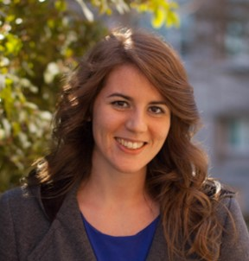
Meet the Presenter
Krista Greear
Senior Accessibility Strategist
Global Client Experience
Vice President
Access Technology Higher Education Network
(ATHEN)
Notes:
Walk through the agenda for the meeting
Will ask Tim Atkin and Viki Hucke-McCright, our integration co-leads, will talk about the next steps in our integration

Slide 3
Agenda
What are Ally’s Alternative Formats?
Who is using the Alternative Formats?
What does the data show?
So what?
Bonus: What are top global accessibility issues in the LMS?
What are additional resources?
Notes:
Walk through the agenda for the meeting
Will ask Tim Atkin and Viki Hucke-McCright, our integration co-leads, will talk about the next steps in our integration

Slide 4
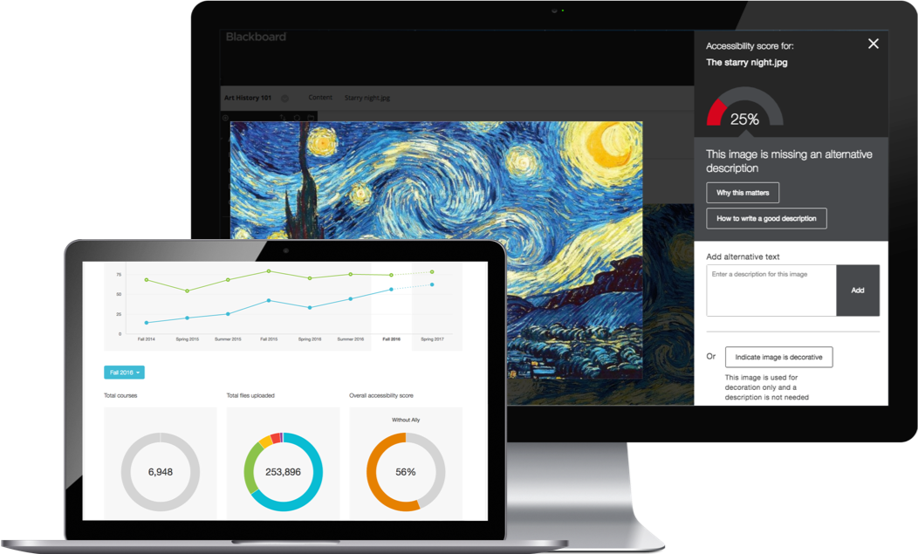
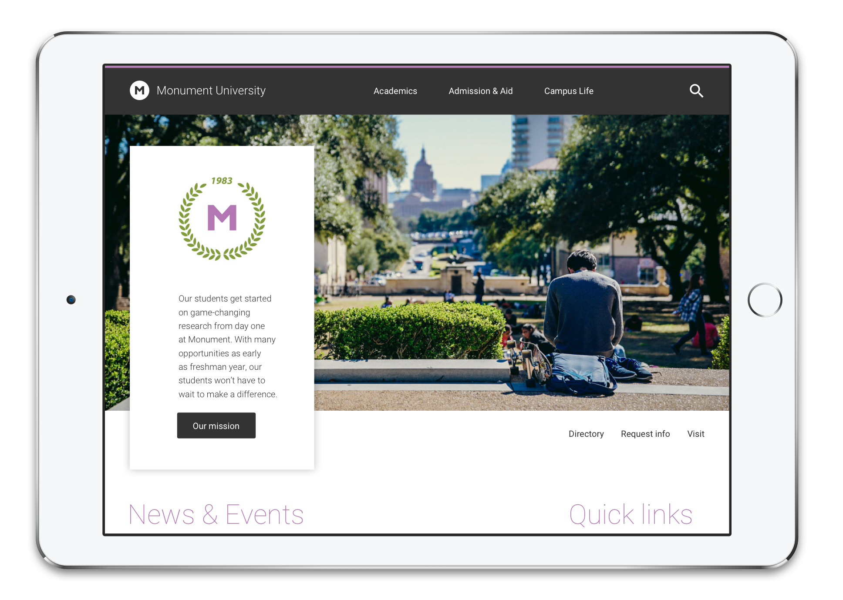
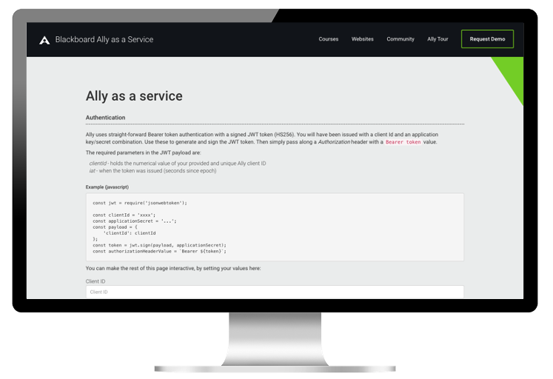
Ally Solutions: One Consistent Approach
Ally LMS
Ally Web
Ally as
a Service

Slide 5
Diverse 21st Century Learners
Visible disability
Invisible disability
International
students
Professionals Seeking Education (i.e. non-traditional)
First in family
(i.e. first-generation)
Temporary
disability
Lifestyle
Parents
Mobile

Slide 6
Factors in Learning
Interaction Desires
See it
Hear it
Write it
Annotate it
Highlight it
Complete it
Speak it
Environments
Office
Home
Personal Vehicle
Public Transportation
Library
Gym
Devices
Type of device
Laptop
Phone
Tablet
Public vs private

Slide 7
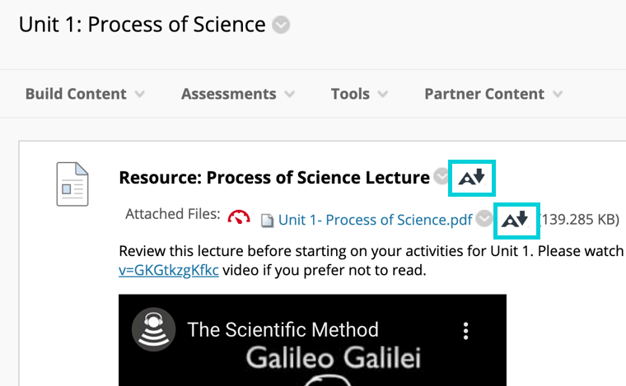
Alt Format Options in Learn

Slide 8
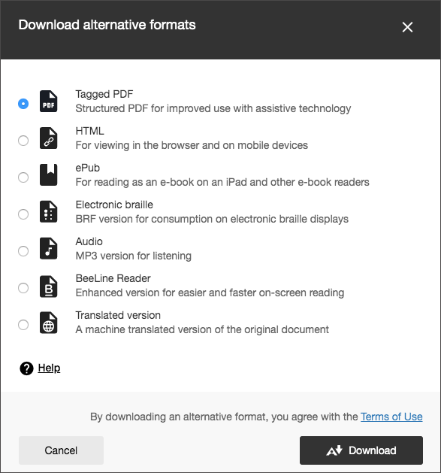
Alternative Format Options
http://bit.ly/BbAltFormats
Brief demo

Slide 9
What does the data show?
August 1st 2020 to June 30th 2021
Notes:
Good morning, good afternoon or evening, depending on from where you are joining us around the globe.
Today is a really, really exciting day! As you know, the merger of Anthology and Blackboard is now closed.
We wanted to take this opportunity to gather with all of you to share more about our vision for our combined company and the opportunity we have before us to make a significant impact on the global education community and literally transform millions of lives.
I want to mention from the outset that going forward, we’ll be using Blackboard Collaborate as our meeting tool.
Because of the large size of our combined team – 3600-strong people! – and the fact that this is day 1, we wanted to be sure to roll out Collaborate to our full organization the right way. So, we decided to use this Go To Webinar platform just for today.
I realize it doesn’t have the interactive chat features that we would have liked, but you still have the ability to ask questions using the ask question feature and I’ll get to as many as I can at the end.
Also, those we don’t get to, we’ll be sure to post on BbCentral and The Library.
I’d like to start out by sharing a little bit about myself for those of you who don’t know me. I have served as CEO of Anthology since its inception 15 months ago, and before that I was CEO of Campus Management for 6 years.
Prior to joining Campus Management, I served as CEO of two publicly traded technology companies.
After graduating from the University of Waterloo in Canada in 1983 with a BMath and Computer Science and Economics majors, I spent 21 years with HP, Compaq and Digital Equipment, managing organizations as large as 15,000 people and revenues of $20B.
I work out of our Boca Raton, Florida office, although I am originally from Toronto. I have 3 kids, 1 grandchild and 1 dog!
And, now, I consider it a privilege and honor to serve as the Chairman and CEO of our newly combined company.
But, enough about me.

Slide 10
Regions
APAC
Southeast Asia
Asia Pacific
EMEA
Europe
Middle East
~1300 total clients
US+LAC
United States
Latin America
CAN
Canada

Slide 11
Total Downloads by Type by Region
Alt Format | APAC | EMEA | US+LAC | CAN | Total
Beeline | 38,827 | 158,618 | 613,320 | 23,304 | 834,069
Braille | 12,933 | 69,326 | 186,397 | 6,719 | 275,375
ePub | 190,708 | 927,967 | 3,181,420 | 104,969 | 4,405,064
HTML | 268,065 | 1,593,214 | 3,213,189 | 101,650 | 5,176,118
OCRed PDF | 21,014 | 125,289 | 419,705 | 7,701 | 537,709
PDF | 501,801 | 3,762,036 | 8,580,995 | 192,589 | 13,037,421
Translation | 2,348 | 62,440 | 63,581 | 5,280 | 133,649
Audio | 32,888 | 165,695 | 538,728 | 15,910 | 753,221
Total | 1,068,584 | 6,864,585 | 16,797,335 | 458,122 | 25,188,626

Slide 12
PDFs are the most downloaded alternative format.

Slide 13
Regions and Top 3 Most Popular Alt Formats
APAC
PDF (501k)
HTML (268k)
ePub (190k)
EMEA
PDF (3.7 mil)
HTML (1.5 mil)
ePub (927k)
US+LAC
PDF (8.5 mil)
HTML (3.2 mil)
ePub (3.1 mil)
CAN
PDF (192k)
ePub (104k)
HTML (101k)

Slide 14
Desired Alt Formats by Original File Type
Original File Type | 1st Most Popular | 2nd Most Popular | 3rd Most Popular
PDF | HTML (3.8 mil) | OCRed PDF (573k) | ePub (334k)
PowerPoint | PDF (6.3 mil) | HTML (567k) | Audio (92k)
Document | PDF (6.6 mil) | HTML (740k) | ePub (64k)
HTML | ePub (3.8 mil) | Beeline (600k) | Audio (418k)

Slide 15
The original file type may influence the preferred alternative format.

Slide 16
Downloads by Role by Region
Region | Students | Instructors | Admins | Total
APAC | 204,927 (98%) | 4,166 | 299 | 209,392
EMEA | 877,847 (97%) | 24,179 | 600 | 902,626
US+LAC | 3,076,677 (98%) | 75,445 | 1,816 | 3,153,938
CAN | 54,070 (98%) | 1,201 | 18 | 55,289
Total | 4,213,521 | 104,991 | 2,733 | 4,321,245

Slide 17
4.2 million students world-wide have proven the need for access, flexibility, and choice.

Slide 18
Avg Downloads Per Student Per Region
Region | Downloads by Students | Total Students | Average Per Student
APAC | 1,056,425 | 204,927 | 5.16
EMEA | 6,790,094 | 877,847 | 7.73
US+LAC | 16,591,684 | 3,076,677 | 5.39
CAN | 453,803 | 54,070 | 8.39
Total | 24,892,006 | 4,213,521 | 5.91

Slide 19
Frequency of students downloading the alternative formats may be influenced by region.

Slide 20
So What?
Notes:
Good morning, good afternoon or evening, depending on from where you are joining us around the globe.
Today is a really, really exciting day! As you know, the merger of Anthology and Blackboard is now closed.
We wanted to take this opportunity to gather with all of you to share more about our vision for our combined company and the opportunity we have before us to make a significant impact on the global education community and literally transform millions of lives.
I want to mention from the outset that going forward, we’ll be using Blackboard Collaborate as our meeting tool.
Because of the large size of our combined team – 3600-strong people! – and the fact that this is day 1, we wanted to be sure to roll out Collaborate to our full organization the right way. So, we decided to use this Go To Webinar platform just for today.
I realize it doesn’t have the interactive chat features that we would have liked, but you still have the ability to ask questions using the ask question feature and I’ll get to as many as I can at the end.
Also, those we don’t get to, we’ll be sure to post on BbCentral and The Library.
I’d like to start out by sharing a little bit about myself for those of you who don’t know me. I have served as CEO of Anthology since its inception 15 months ago, and before that I was CEO of Campus Management for 6 years.
Prior to joining Campus Management, I served as CEO of two publicly traded technology companies.
After graduating from the University of Waterloo in Canada in 1983 with a BMath and Computer Science and Economics majors, I spent 21 years with HP, Compaq and Digital Equipment, managing organizations as large as 15,000 people and revenues of $20B.
I work out of our Boca Raton, Florida office, although I am originally from Toronto. I have 3 kids, 1 grandchild and 1 dog!
And, now, I consider it a privilege and honor to serve as the Chairman and CEO of our newly combined company.
But, enough about me.

Slide 21
Lessons Learned
Ally’s data demonstrates student need for flexibility and choice.
Knowing what students choose could impact course design.
More analysis is needed to understand the user experience as to why certain alt formats are chosen.
Emphasize access over accessibility.

Slide 22
Bonus! Top Accessibility Issues
Global Data from August 1st 2020 to June 6th 2021
Notes:
Good morning, good afternoon or evening, depending on from where you are joining us around the globe.
Today is a really, really exciting day! As you know, the merger of Anthology and Blackboard is now closed.
We wanted to take this opportunity to gather with all of you to share more about our vision for our combined company and the opportunity we have before us to make a significant impact on the global education community and literally transform millions of lives.
I want to mention from the outset that going forward, we’ll be using Blackboard Collaborate as our meeting tool.
Because of the large size of our combined team – 3600-strong people! – and the fact that this is day 1, we wanted to be sure to roll out Collaborate to our full organization the right way. So, we decided to use this Go To Webinar platform just for today.
I realize it doesn’t have the interactive chat features that we would have liked, but you still have the ability to ask questions using the ask question feature and I’ll get to as many as I can at the end.
Also, those we don’t get to, we’ll be sure to post on BbCentral and The Library.
I’d like to start out by sharing a little bit about myself for those of you who don’t know me. I have served as CEO of Anthology since its inception 15 months ago, and before that I was CEO of Campus Management for 6 years.
Prior to joining Campus Management, I served as CEO of two publicly traded technology companies.
After graduating from the University of Waterloo in Canada in 1983 with a BMath and Computer Science and Economics majors, I spent 21 years with HP, Compaq and Digital Equipment, managing organizations as large as 15,000 people and revenues of $20B.
I work out of our Boca Raton, Florida office, although I am originally from Toronto. I have 3 kids, 1 grandchild and 1 dog!
And, now, I consider it a privilege and honor to serve as the Chairman and CEO of our newly combined company.
But, enough about me.

Slide 23
2020-2021 Global Data for 11,882,120 courses
File Type | Total | Accessibility Issue | Total of Issue | Percentage
PDFs | 90,520,490 | Scanned PDFs | 11,794,161 | 13.03% of all PDFs
PDFs | 90,520,490 | Untagged PDFs | 38,902,470 | 42.98% of all PDFs
Images | 203,328,757 | Images Missing a Description | 168,119,522 | 82.68% of all Images
PDFs, Word Docs, PPTX | 172,309,728 | Color Contrast | 61,524,578 | 35.71% of all PDFs, Word Docs, PPTX
PDFs, Word Docs, PPTX | 172,309,728 | Missing Headings | 40,759,304 | 23.65% of all PDFs, Word Docs, PPTX

Slide 24
Additional Resources
Notes:
Good morning, good afternoon or evening, depending on from where you are joining us around the globe.
Today is a really, really exciting day! As you know, the merger of Anthology and Blackboard is now closed.
We wanted to take this opportunity to gather with all of you to share more about our vision for our combined company and the opportunity we have before us to make a significant impact on the global education community and literally transform millions of lives.
I want to mention from the outset that going forward, we’ll be using Blackboard Collaborate as our meeting tool.
Because of the large size of our combined team – 3600-strong people! – and the fact that this is day 1, we wanted to be sure to roll out Collaborate to our full organization the right way. So, we decided to use this Go To Webinar platform just for today.
I realize it doesn’t have the interactive chat features that we would have liked, but you still have the ability to ask questions using the ask question feature and I’ll get to as many as I can at the end.
Also, those we don’t get to, we’ll be sure to post on BbCentral and The Library.
I’d like to start out by sharing a little bit about myself for those of you who don’t know me. I have served as CEO of Anthology since its inception 15 months ago, and before that I was CEO of Campus Management for 6 years.
Prior to joining Campus Management, I served as CEO of two publicly traded technology companies.
After graduating from the University of Waterloo in Canada in 1983 with a BMath and Computer Science and Economics majors, I spent 21 years with HP, Compaq and Digital Equipment, managing organizations as large as 15,000 people and revenues of $20B.
I work out of our Boca Raton, Florida office, although I am originally from Toronto. I have 3 kids, 1 grandchild and 1 dog!
And, now, I consider it a privilege and honor to serve as the Chairman and CEO of our newly combined company.
But, enough about me.

Slide 25
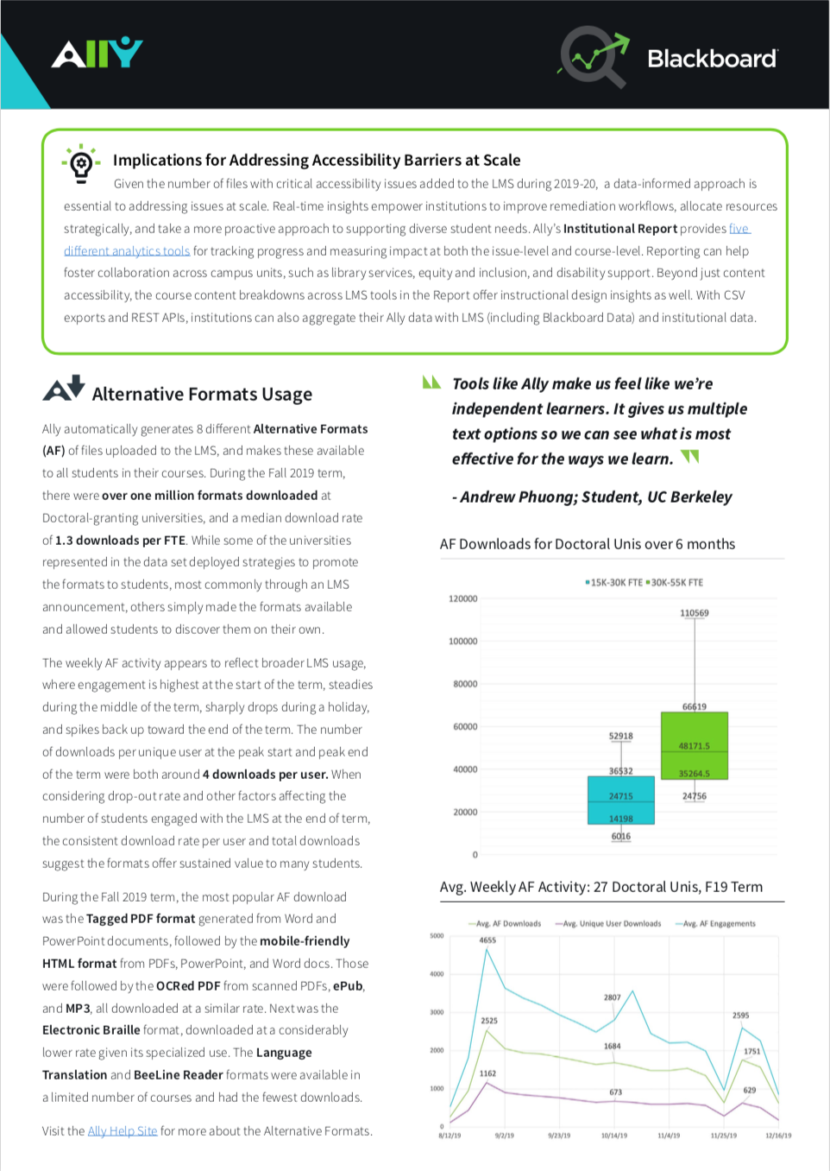
Research and Impact
Ally has a wealth of course content and accessibility data
Continued focus on new data studies, whitepapers and other research
https://ally.ac/research

Slide 26
Course + Book of Ally
tinyurl.com/bballycourse
https://go.blackboard.com/book-of-ally

Slide 27
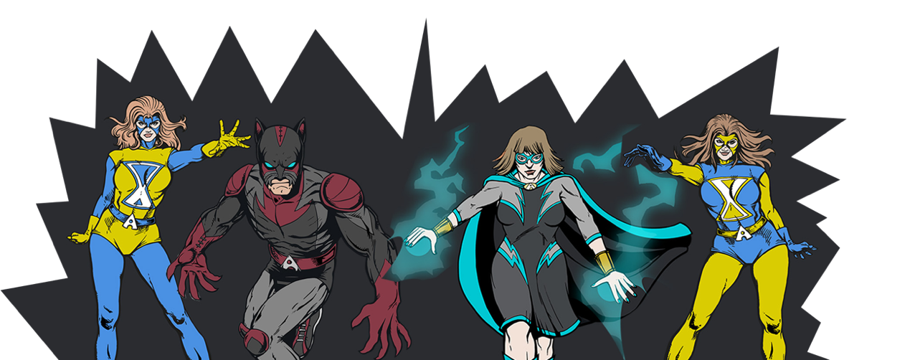
Join the Ally Community of Accessibility Heroes
usergroup.ally.ac

