Slide 1
The online accessibility hub: What makes a great institutional accessibility website?
David Sloan
Principal Accessibility Engineer, Research and Strategy Lead, TPGi

Slide 2
Goals of this session
Defining an online accessibility hub and its role in an institutional accessibility strategy
Identifying key audiences and meeting their needs
Exploring strategies for building and maintaining the accessibility hub
Learn from each other about achievements and challenges
Notes:
Some institutions have well-established accessibility programs, with extensive web sites.
Others may be at a less mature stage, unsure what to prioritize, and how to manage an online presence with minimal resources. The goal of this session is to help you plan and manage an online accessibility hub that can grow and reflect your institution’s commitment to accessibility.

Slide 3
What is an accessibility hub?

Slide 4
Your experience
Does your institution have an accessibility web site?
Who owns it?
What is its URL?
What content does it offer?

Slide 5
The online presence of the institution’s accessibility efforts
The focal point of the accessibility program — a central place for all stakeholders to find the information they need
A visible demonstration of a shared commitment to accessibility
An open communication channel focused on digital accessibility
A connection between digital accessibility and other related services

Slide 6
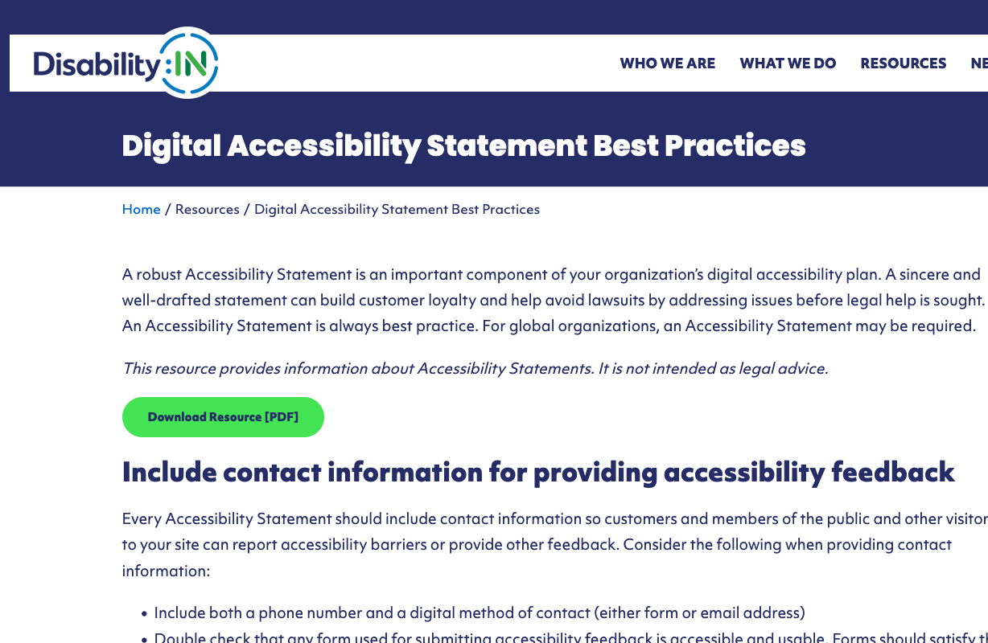
Accessibility statement vs accessibility hub
An accessibility statement has more limited scope, focused on identifying and mitigating known issues:
What the institution is doing to improve accessibility
Where accessibility issues exist in a web site or digital product digital
How you can get in touch if you encounter an accessibility barrier
May be a legal requirement in some cases
Digital accessibility statement best practices (Disability:IN)
Notes:
Note: in the EU, there are legal requirements for public sector organizations including universities to provide an accessibility statement, with defined sections of content

Slide 7
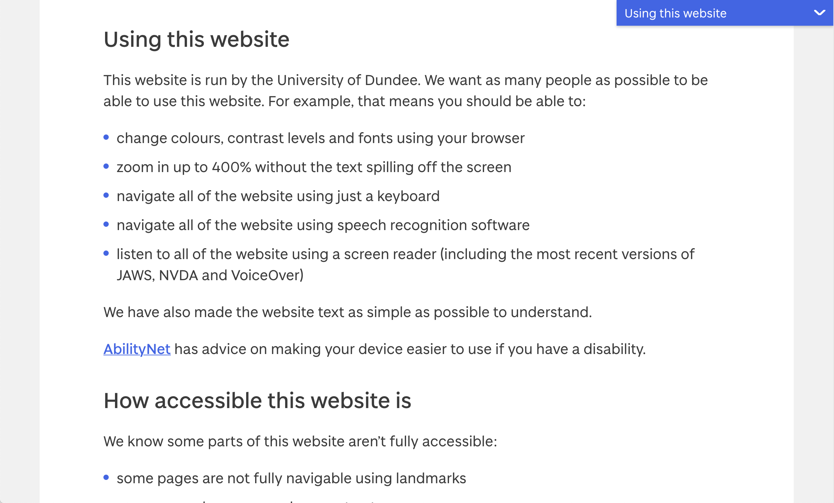
The University of Dundee’s accessibility statement
Notes:
The University of Dundee's Accessibility Statement follows the standard EU Public Sector accessibility statement structure.
It includes a section on Using this website, outlining accessibility support for the site, and a How accessible this web site section listing known accessibility problems.
There are also sections for what to do when encountering accessibility problems, technical information on barriers and the testing that was conducted on the site, and plans for improving the site’s accessibility.

Slide 8
The hub’s primary audiences and their needs
Faculty: “I need help providing accessible learning resources”
Staff: “I need help creating accessible web sites, documents and media”
Current employees and students with disabilities: “I need to know what to do if I encounter digital accessibility barriers”
Prospective employees and students with disabilities: “I need to see evidence this institution is committed to digital accessibility”
Vendors: “I need to know what accessibility requirements exist in the institution’s procurement policy”

Slide 9
Meeting the needs of the accessibility hub’s audiences

Slide 10
Introduce the institution’s accessibility program/initiative
Communicate the institution’s commitment to digital accessibility in simple and credible terms
Articulate accessibility responsibilities of stakeholders
Explain what support the program offers to help stakeholders meet their responsibilities
Link to key service and support offerings
Example: University of Colorado at Boulder

Slide 11
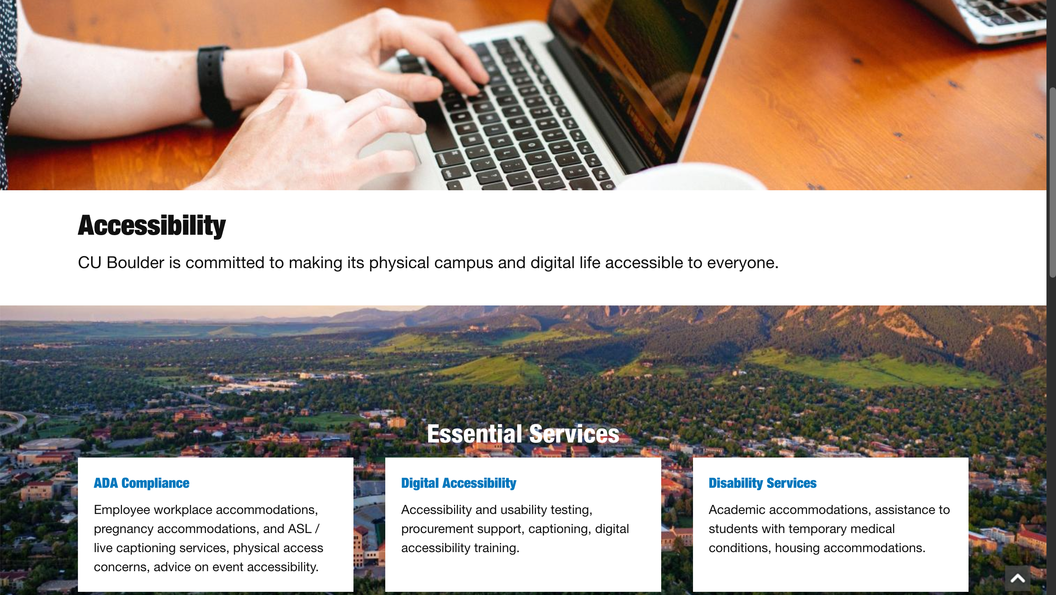
CU Boulder’s commitment to accessibility
Notes:
CU Boulder's Accessibility Program home page is introduced with the text: Accessibility. CU Boulder is committed to making its physical campus and digital life accessible for everyone.
Under Essential services, are descriptions of ADA Compliance, Digital Accessibility and Disability Services.

Slide 12
Provide ways to ask for accessibility help and report issues
Provide multiple ways for people to report accessibility concerns and get help
Online form (simple, and accessible)
Dedicated email address (ideally something like accessibility@foo.edu)
Phone number
Campus units dedicated to accommodations/assisting people with disabilities
Make sure there is capacity to escalate and respond to feedback
Example: University of Nevada at Reno
Notes:
What you offer should reflect what you’re capable of staffing

Slide 13
University of Nevada at Reno’s Accessibility Assistance options
Notes:
The University of Nevada, Reno's Accessibility Assistance page has advice on assistance for different audience including academics, administrative staff, students and the public.
There is a menu of Assistance options including Ask a question, File a help request, Report an accessibility issue, File a complaint, and a link for vendors.

Slide 14
Help content providers evaluate accessibility of their content
Accessibility evaluation can be intimidating and stressful, so simplify the process:
Lists of key things to check
Guidance appropriate to format or software being used
Links to tools that can help
Advice on how to address barriers identified in an evaluation, including EEAAP support
Examples: Penn State and University of Maine

Slide 15
Penn State’s support for testing and triage
Notes:
Penn State's Accessibility program page on Testing Tools and Triage has links to triage and protocol for testing, testing tools, a sample inaccessible page for people to practice testing on, and advice for using screen readers in testing

Slide 16
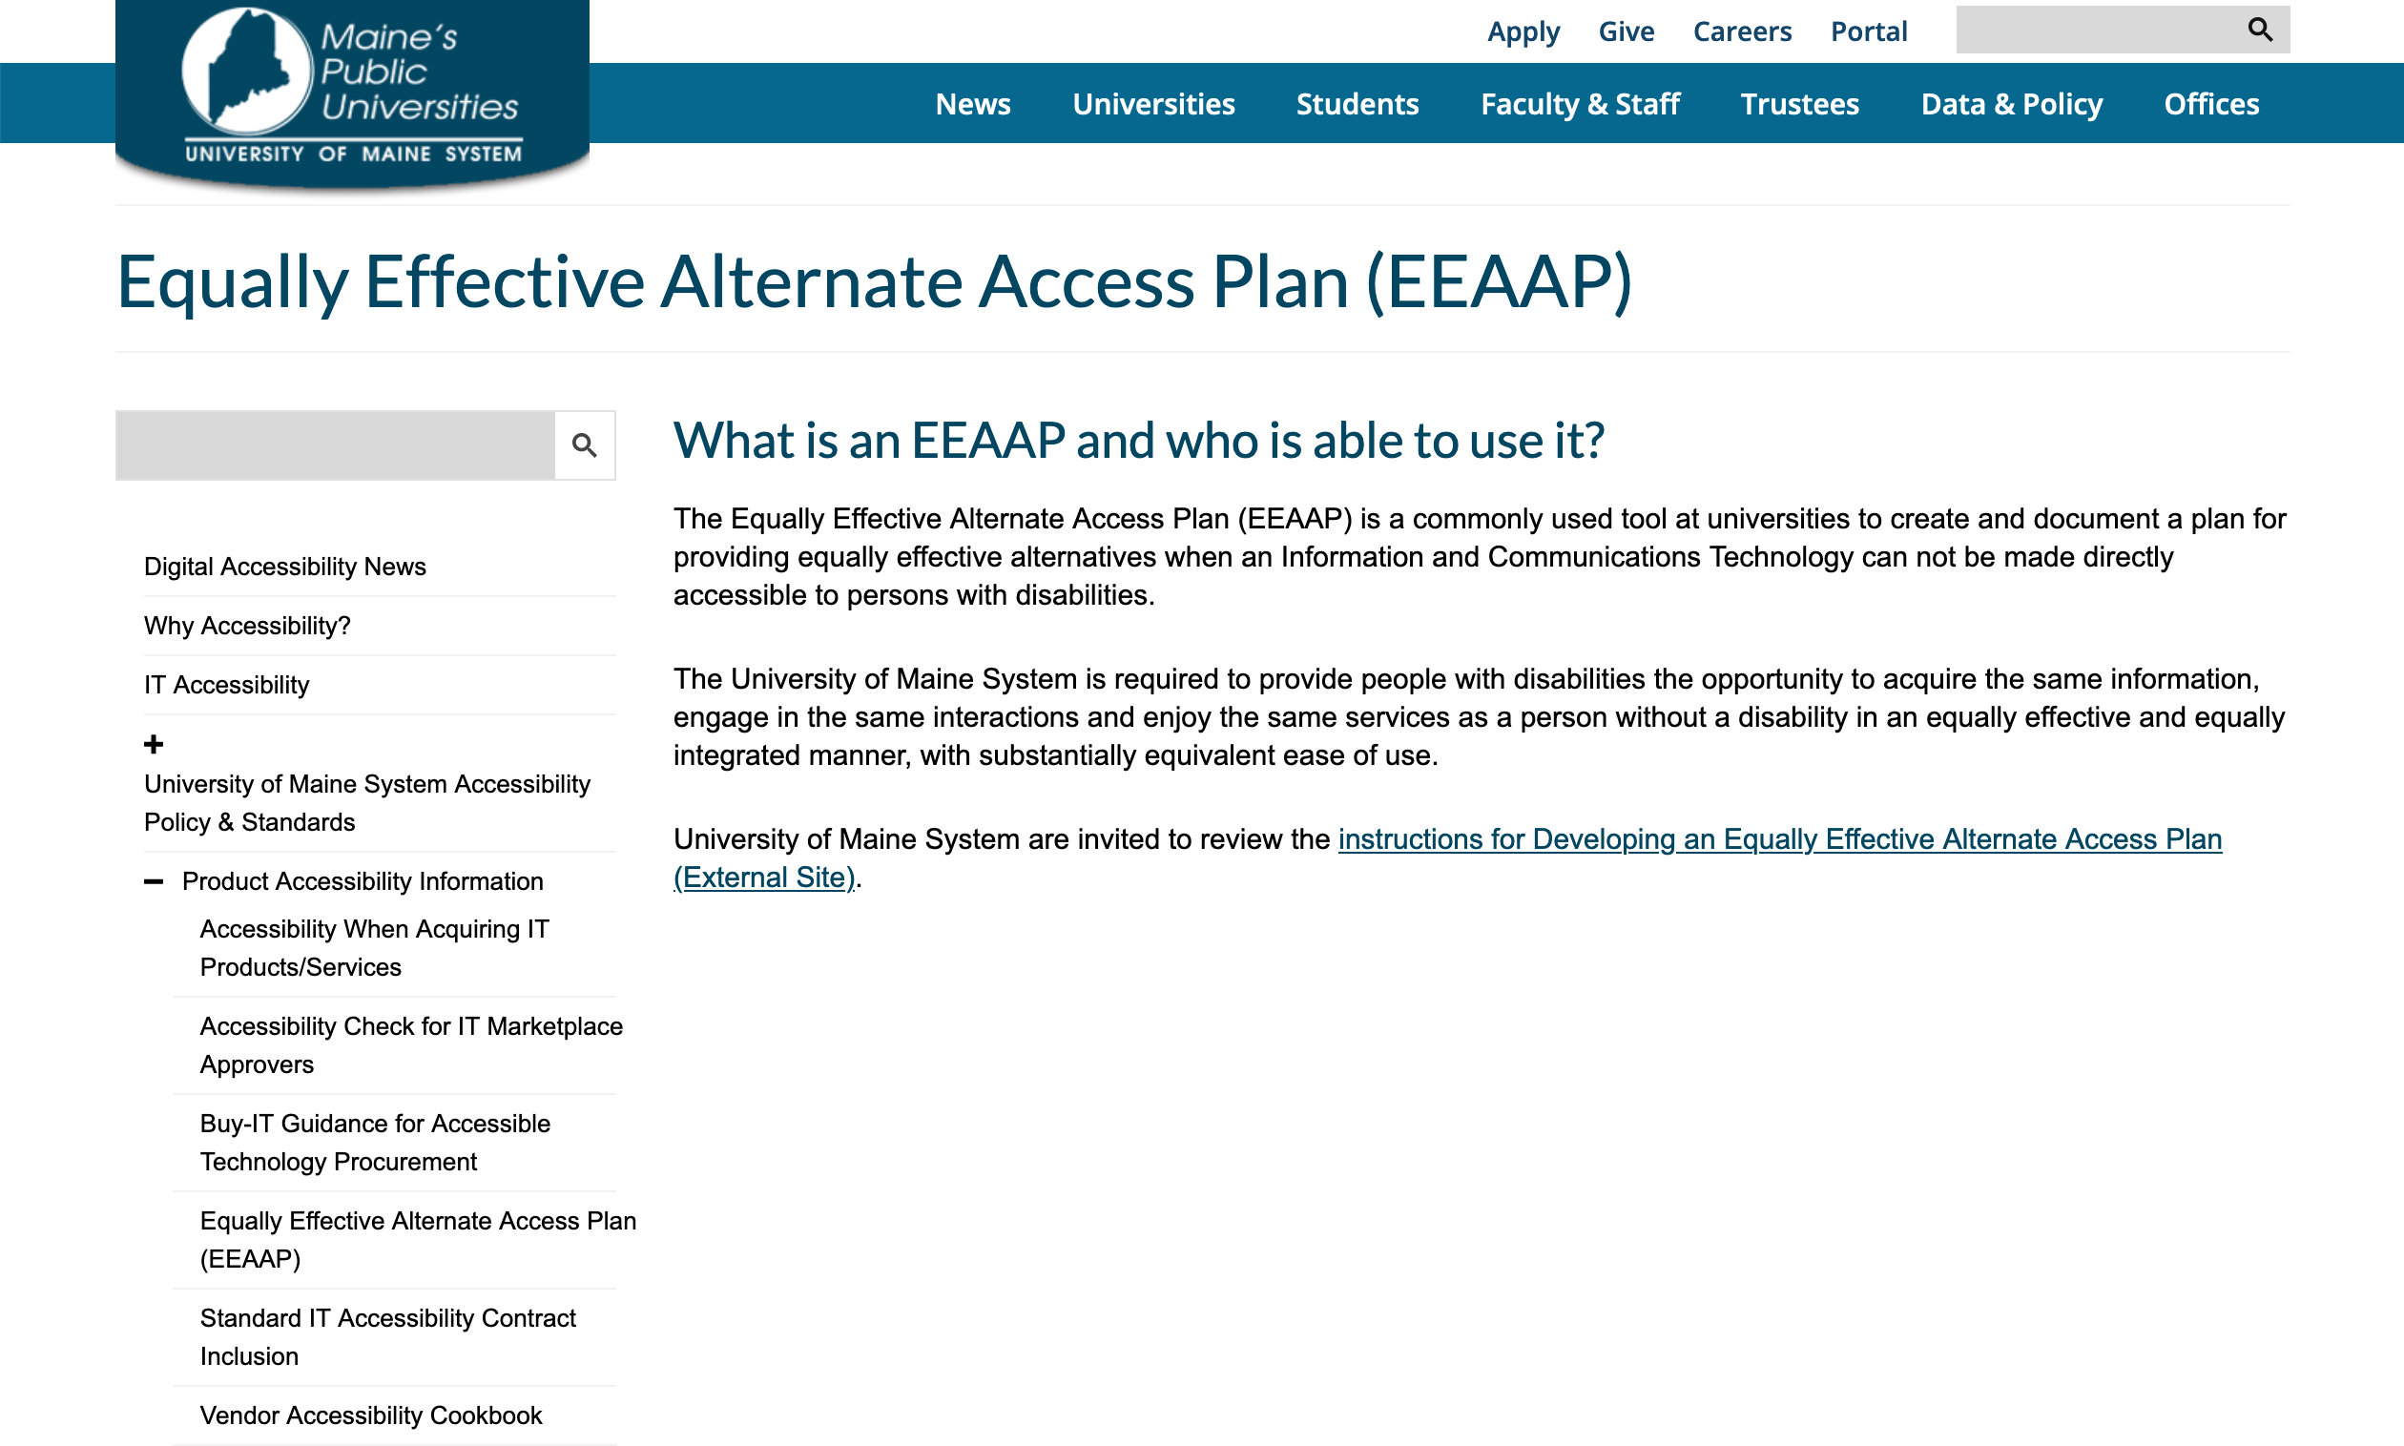
University of Maine’s introduction to Equally Effective Alternate Access Plans
Notes:
The University of Maine System's digital accessibility hub's Equally Effective Alternate Access Plan (EEAAP) page. It describes the purpose of the EEAAP approach, with a link to instructions for developing a plan for a specific situation.

Slide 17
Help people create accessible content
Articulate key principles
Carefully introduce WCAG as a guiding resource
Techniques for key content formats
Web, documents, multimedia
Inclusive teaching best practices
Examples: University of Arizona

Slide 18
University of Arizona’s Inclusive Teaching and Accessibility Strategies
Notes:
The University of Arizona's Inclusive Teaching and Accessibility Strategies page has information and details of resources and tools to support creating on accessible course design and content.

Slide 19
List support services for content providers
Training, webinars (example: Harvard)
Tools
Accessible document checkers/converters; automated accessibility monitoring tools
Services
Captioning
Accessibility evaluation and remediation services, usability testing with people with disabilities
Community support — email groups, Slack channel, lunch-and-learns
Notes:
The accessibility hub should clearly communicate what support services are available to help people create accessible content. This is not an exhaustive list, neither is it a required list. Share what your institution is able to offer now, and consider what it could offer

Slide 20
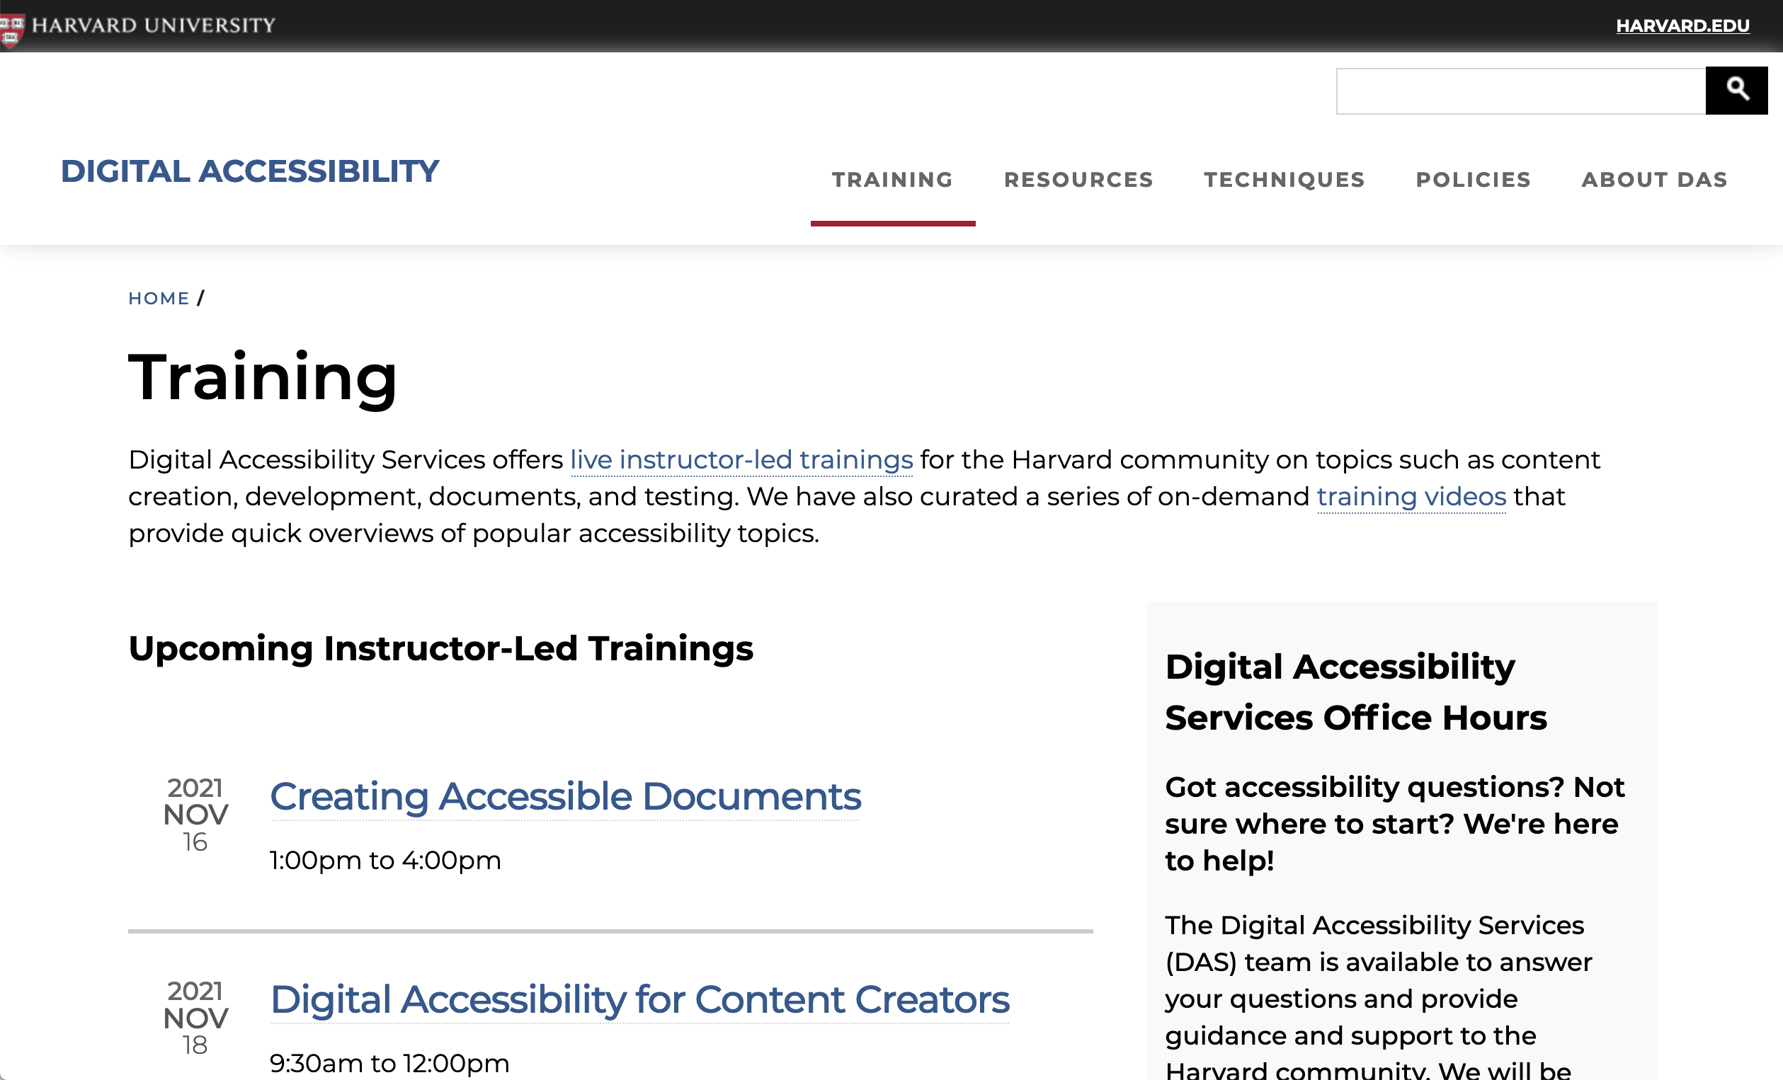
Harvard University’s training resources
Notes:
Harvard University's Digital Accessibility Training page lists upcoming instructor-led trainings on accessibility, links to on-demand training videos, and details the Digital Accessibility Services office hours.

Slide 21
Support digital resource procurement
For staff and faculty, provide:
Policy and process to follow for ensuring that accessibility requirements and vendor accessibility capacity assessment influence procurement decisions
For vendors, provide:
Your expectations for accessibility and your approach to partnership to improve and maintain product/service accessibility
Example: University of Washington

Slide 22
University of Washington’s procurement guidance
Notes:
The University of Washington's Accessible Technology site includes a page on Procuring Accessible IT, communicating accessibility responsibilities for people procuring IT.
There’s a link to the University's Procuring Accessible IT policy.

Slide 23
Promote the institution as an inclusive place to work or study
The Accessibility Hub is an opportunity to demonstrate your institution is progressive about digital accessibility
Link to Diversity, Equity and Inclusion efforts
Links to hiring processes for people with disabilities
Links to case studies of students with disabilities
Example: Arizona State University

Slide 24
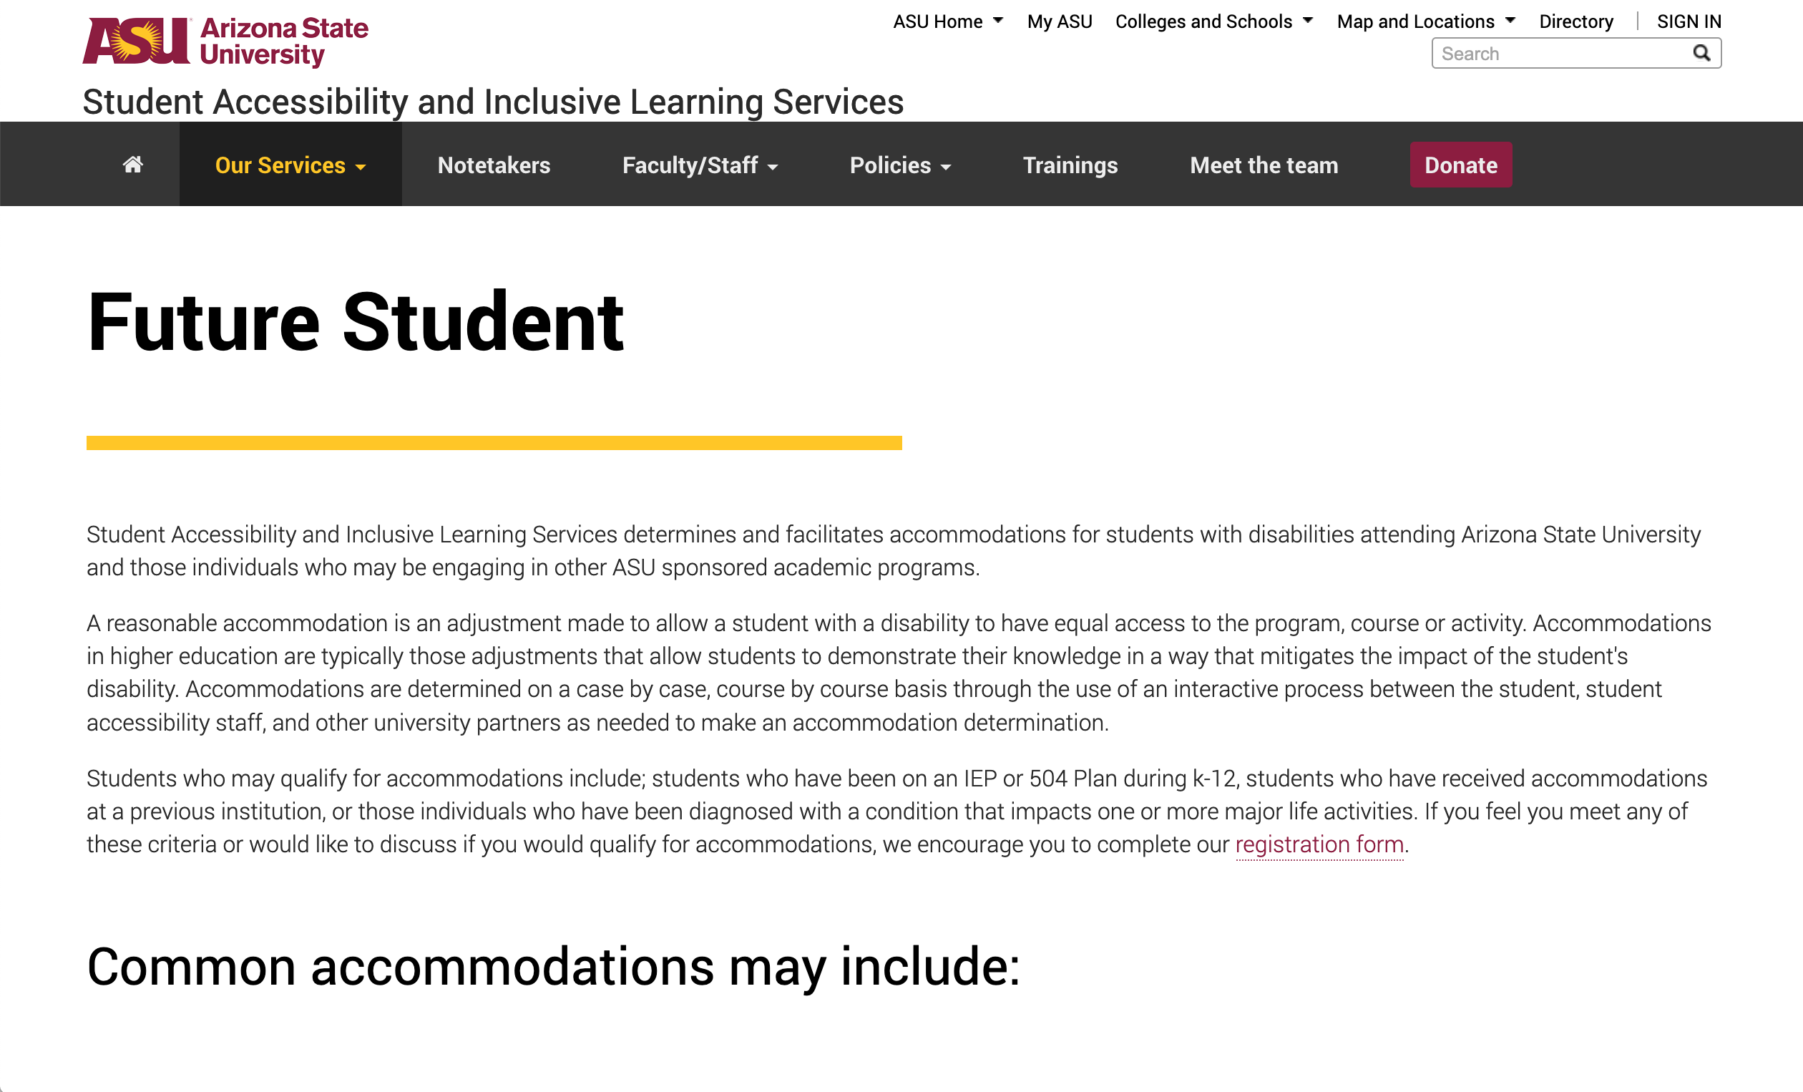
Arizona State University’s accessibility information for future students
Notes:
Arizona State University's Student Accessibility and Inclusive Learning Services site has a page for Future Students, describing accommodations available for students with disabilities.

Slide 25
Policy, process and governance
Internal policy, links to external standards
Governance
Who is accountable and responsible for accessibility?
How is quality overseen?
Reporting on plans and progress
Accessibility goals for the institution, and achievements so far
Examples: University of Nevada at Reno, and University of Washington

Slide 26
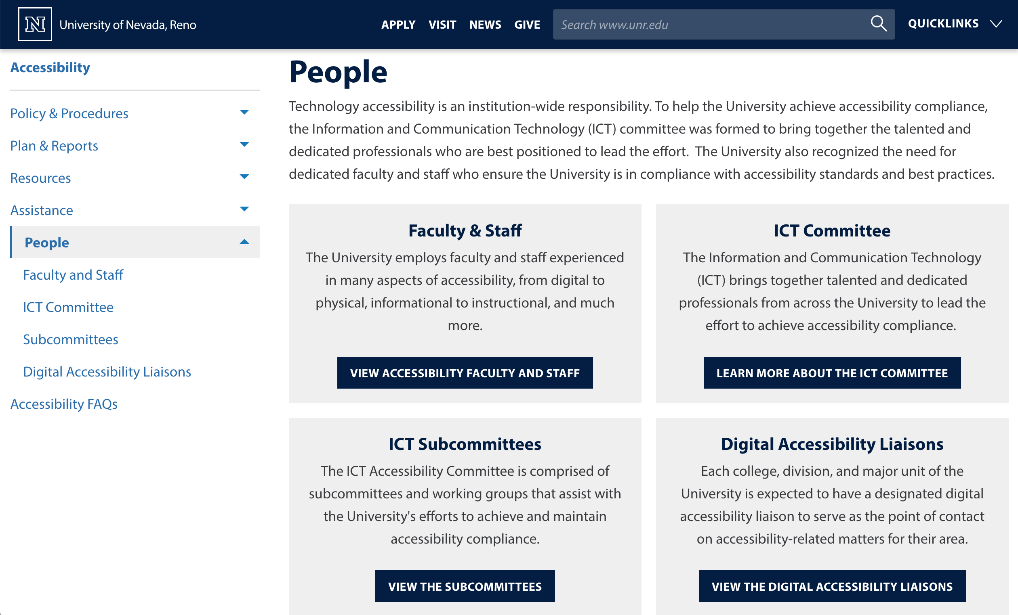
University of Nevada at Reno’s list of people and committees supporting accessibility
Notes:
University of Nevada, Reno's People page lists Faculty and Staff employed to support accessibility, describes the function of the ICT committee, ICT subcommittees and campus Digital Accessibility Liaisons in helping the university meet its accessibility goals

Slide 27
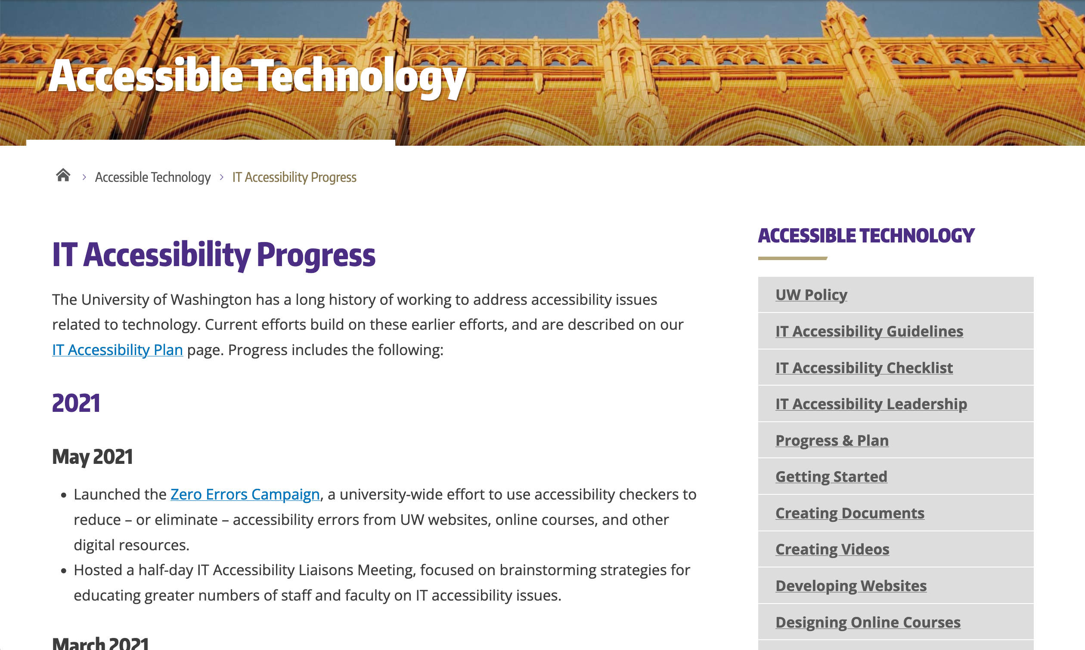
University of Washington’s accessibility progress and plans
Notes:
University of Washington's IT Accessibility Progress page lists, in chronological order most recent first, events and achievements in advancing accessibility.
There’s s also a link to the university's IT Accessibility Plan.

Slide 28
Strategy for building your accessibility hub
Notes:
If your institution is starting from scratch, or in the early stages of building an accessibility program, what should you prioritize? How can you build up a hub with limited resources?

Slide 29
Key priorities for building the hub
Make the hub easy to find
Make content easy to find and follow for the target audiences
Prioritize institution-specific content; make use of third-party informative resources
Have a plan for managing content

Slide 30
1. Make the hub easy to find
A URL that communicates the hub’s importance
Ideal: institution.edu/accessibility or accessibility.institution.edu
Link to it from a consistent place on other site pages
“Accessibility” is simple and effective as link text
A header link is more findable than the footer
Link to it from key web and non-web locations

Slide 31
2. Make content easy to find and follow
Organize content to be findable by reluctant or stressed people
Multiple ways to locate content for a specific audience or purpose
Clearly distinguish help for content creators and help for people who encounter accessibility barriers
Focus on a writing style that encourages rather than intimidates
Prioritize essential guidance
Celebrate achievements, help build a community of practice

Slide 32
3. Prioritize institution-specific content
Prioritize creating content that reflects the support your institution offers
Institutional commitment
Communication channels
Policy and processes
Services and tools
For content supporting learning, make use of quality third party content
Example: W3C WAI, WebAIM

Slide 33
W3C WAI’s Accessibility Fundamentals
Notes:
The W3C Web Accessibility Initiative Accessibility Fundamentals Overview page lists a set of resources introducing key accessibility concepts, including key accessibility principles, how people with disabilities use the web, and how accessibility, usability and inclusion interconnect.

Slide 34
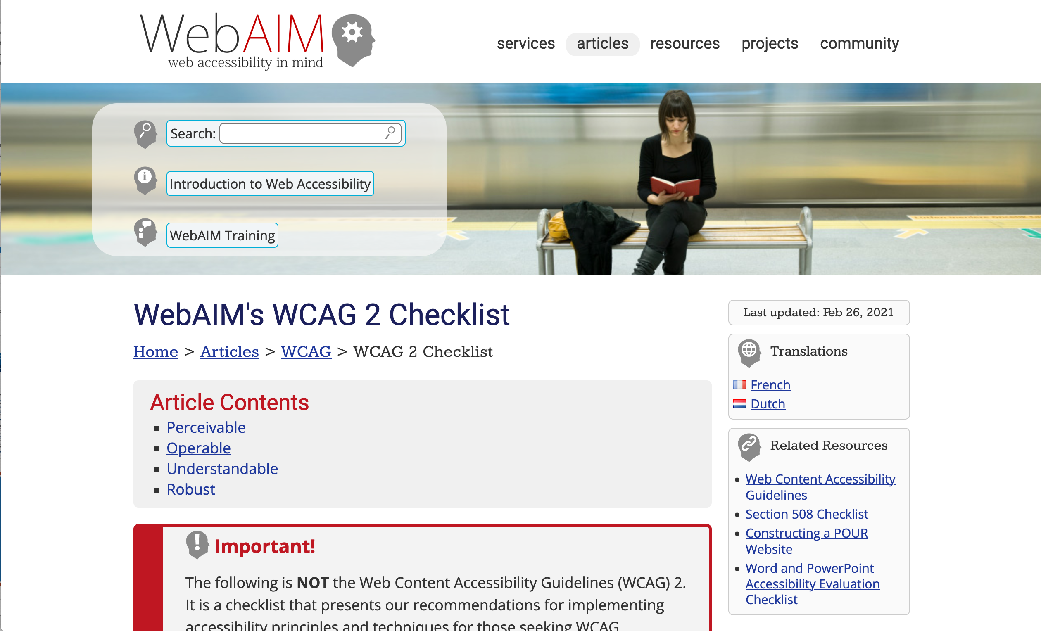
WebAIM’s WCAG 2 Checklist
Notes:
WebAIM's WCAG 2 Checklist breaks down WCAG 2 into a simplified set of checks organized by WCAG principle (Perceivable, Operable, Understandable and Robust)

Slide 35
4. Have a plan for managing content
Identify what content’s most likely to change over time:
Reporting on institutional progress
New/updated services, tools, policy
Links to helpful external resources
Blog posts, news items, events
Identify and assign responsibility for reviewing and updating content

Slide 36
Reflecting on your own experience
How does your institution’s accessibility hub compare?
What challenges do you identify or have you encountered when building an accessibility hub?
What successes have you achieved in meeting the accessibility needs of different audiences?

Slide 37
Summary
The accessibility hub is an opportunity to help advance digital accessibility at your institution in a sustainable way, through:
Enabling communication
Providing guidance and support
Reporting progress

Slide 38
Thank you!
David Sloan
Email: dsloan@tpgi.com
LinkedIn: https://www.linkedin.com/in/sloandr/
Twitter: @sloandr

