Slide 1
Low cost, high impact user research with people with disabilities
David Sloan
Principal Accessibility Engineer, Research and Strategy Lead, TPGi

Slide 2
Agenda
Why involve people with disabilities in user research?
Challenges to conducting user research with people with disabilities
Ways to address challenges of research cost and impact

Slide 3
Why involve people with disabilities in user research?

Slide 4
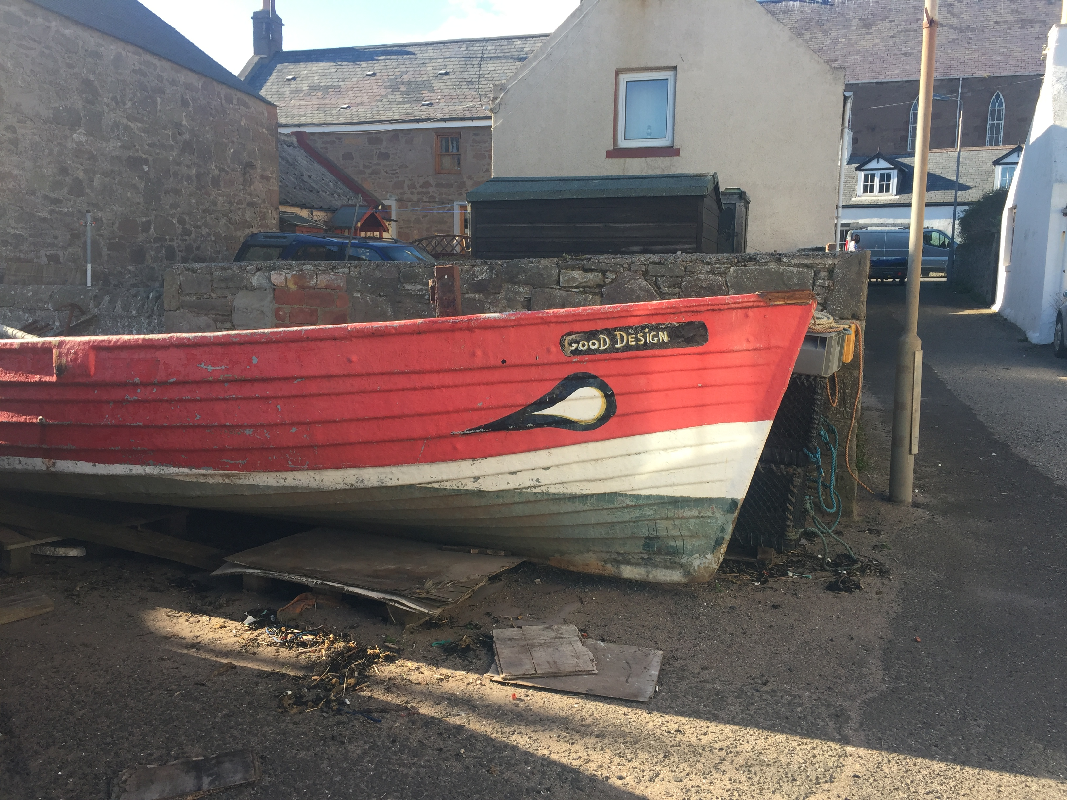
User research with people with disabilities helps make digital products and services that people can use

Slide 5
People with disabilities are people
If a digital product has users, it’s almost certain those users will include people with disabilities
People with disabilities have needs, wants, and experiences just like any other current or potential user
Technology has particular potential to reduce exclusion for people with disabilities
So when perspectives of people with disabilities are ignored or misunderstood, technology can increase exclusion

Slide 6
Accessibility standards are not enough
Using accessibility standards like WCAG to guide design and development of a digital product is an essential part of an effective accessibility strategy.
But:
Accessibility standards are generic. Product teams need expertise to apply a standard effectively to a product’s specific design objectives and constraints, in order to design for a desired user experience.
Standards are technology-focused. They can’t give you the first-hand, contextual experience of people with disabilities.

Slide 7
User-centered design and disability
User-centered design is an iterative product design approach that involves:
learning as much as possible about a design problem from users’ perspectives to inform product requirements
evaluating potential solutions for areas where they work well and where they could be improved.
For user-centered design to be inclusive, we need to involve people with diverse capabilities and characteristics, including people with disabilities.
Involving people with disabilities in the design process helps you gain a richer understanding of a design problem, design a solution that is sensitive to diverse user needs, and validate your efforts with the people you’re designing for.

Slide 8
Tim Brown quote on the importance of looking beyond the center of a population’s bell curve
By concentrating solely on the bulge at the center of the bell curve we are more likely to confirm what we already know than learn something new and surprising.
Tim Brown, Change by Design

Slide 9
User research in an inclusive design process

Slide 10
David Travis’ quote on the importance of observation as a research technique
The best way of gaining actionable and testable insights is not to ask, but to observe. Your aim is to observe for long enough so that you can make a decent guess about what’s going on…
…What people say is not as useful as what people do, because people are unreliable witnesses.
David Travis
The 7 Deadly Sins of User Research
https://medium.com/@userfocus/the-7-deadly-sins-of-user-research-22857c5a971b

Slide 11
The two key phases of research
1: Research for discovery — to help you understand more about a challenge or a problem from the user’s perspective, in order to identify the requirements for a solution
2: Research for evaluation — to help you understand how well your solution meets user needs
Research as part of an iterative process:
Find out what works, and what doesn’t; adjust the design and evaluate again

Slide 12
When the objective is to discover
Involve people with disabilities when you want to learn more about a new design problem or opportunity:
Do this as early as possible in development of a new product/service or redesign of an existing product/service
The focus is on understanding current experiences and behavior, so you don’t need a product to evaluate

Slide 13
When the objective is to validate
Involve people with disabilities when you have something you want to validate:
During development of a product, ideally with functional prototypes, to enable iterative improvement
For mature or live products, testing can help identify areas to improve or benchmark against competitors/previous versions

Slide 14
Opportunities for user research with people with disabilities
Any initiative to review and improve a key user journey
Web, mobile app or software design or redesign projects
Strategic technology transformation initiatives
Procurement processes for significant IT purchases

Slide 15
Distinguishing UX research from accessibility testing
Our focus is on engaging people with disabilities in UX research
This goes beyond accessibility testing to focus on the user’s experience
Preferably find and fix accessibility barriers before evaluating a design with users with disabilities
Or design the study to avoid users encountering known barriers

Slide 16
Addressing the challenges of doing user research with people with disabilities

Slide 17
It costs too much
“We don’t have budget to do it”
“We don’t have time to do it”
“We don’t have the people or resources to do it”

Slide 18
It has insufficient impact
“This research data isn’t what we need at this time”
“This research data isn’t credible”
“This research data isn’t going to make us change our minds”

Slide 19
Reducing the cost of user research
Find data that’s freely available
Reduce time and effort required to conduct a research activity
Involve more people, transfer skills

Slide 20
Look for data that people with disabilities have already provided you
Helpdesk
Disability services
Social media
Github, product review sites
Word-of-mouth

Slide 21
Reducing time and effort
Recruit fewer participants for an activity—consider focusing on one accessibility profile
Focus on shorter, less complex research activities—focus on one specific question
Then, try to increase frequency of repeatable studies
Look at partnership opportunities with academic departments that specialize in UX/design

Slide 22
Build a pool of participants
Reduce recruitment effort by growing a pool of participants with disabilities who may be able to provide input on a regular or ad-hoc basis
With participant permission, record details of accessibility profile to help with targeted recruitment

Slide 23
“Critical friends”
Some participants may become ”expert evaluators” and therefore less representative of users, and their role may need to transition:
Providing expert evaluations on a regular or ad-hoc basis
Becoming members of technology product design teams
Participating in decision-making groups affecting technology strategy or procurement

Slide 24
Research methods that require less time or effort
Remote moderated research studies, where you and participants don’t have to travel to the same place
Unmoderated research studies, where participants provide feedback on an activity without being observed
Opportunistic evaluation, where you go to where people are:
Seek rapid feedback on very specific topics
Do so sensitively, when you have a relationship with a facility or organization that people with disabilities frequent

Slide 25
Build capacity for inclusive research
Make research activities participatory so more people develop skills to be able to run them:
Involve multiple stakeholders in research activity design and delivery, and discussion of implications
Jared Spool’s concept of “exposure hours”
Embed practices of inclusive research as standard — recruitment, accessible activity material design

Slide 26
Increasing impact of user research
Reduce bias, increase confidence in research output
Communicate results in a timely, actionable way

Slide 27
Reliability and usefulness of results
Address and communicate limitations to research findings
Any observed issue is likely to be a valid issue for (some) people with disabilities
But consider how representative an observation is, especially if the corresponding action required is substantial
Timing: conduct research activities so that they deliver results when they’re most needed

Slide 28
Format research output to be actionable
Best: have decision-makers observe the research; discuss findings as soon after as possible
Prioritize output as easy-to-digest summaries
Capture and share video highlights
In-depth data if people ask for it
Anticipate and answer the question “so what?”

Slide 29
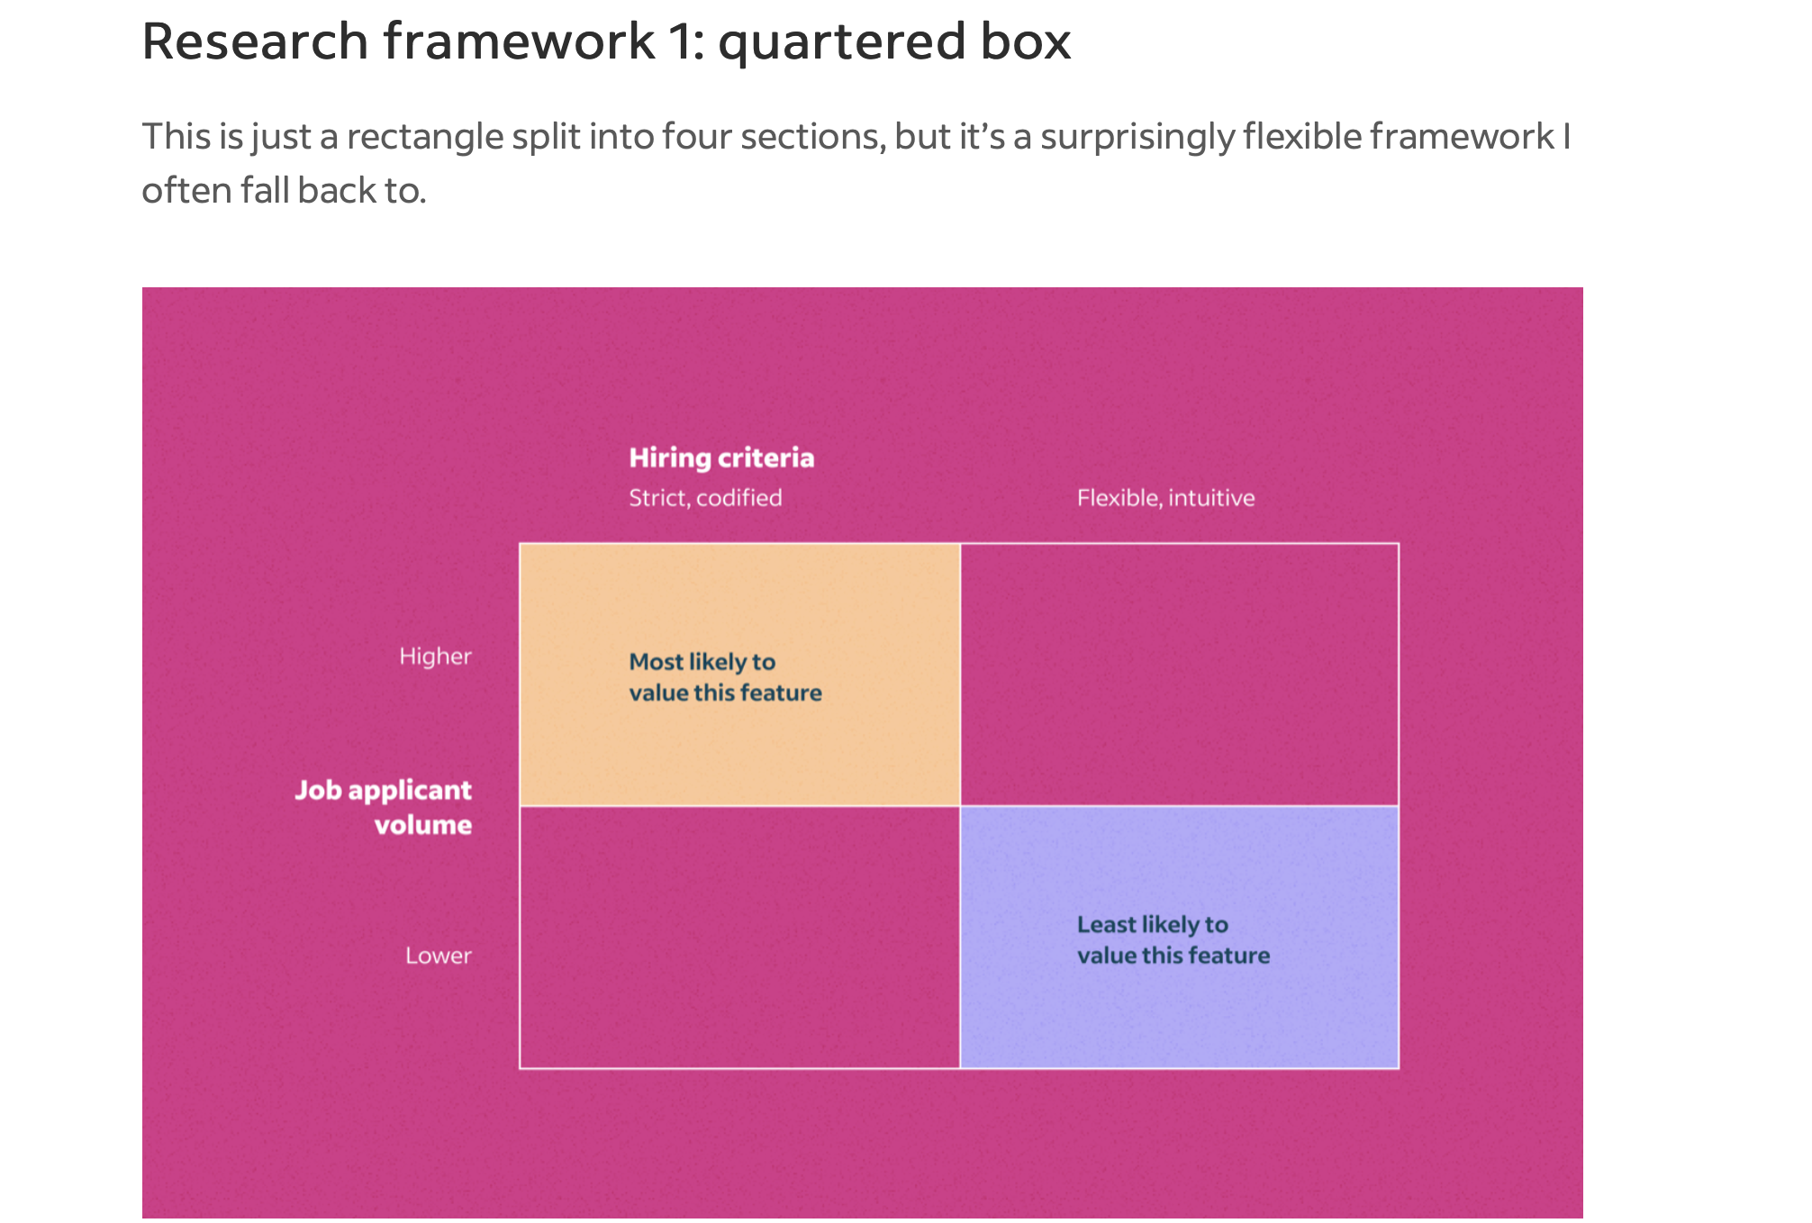
Visualizing research discovery: example
Use These Frameworks to Make Your UX Research Results Stick: Eli Goldberg https://indeed.design/article/frameworks-for-presenting-ux-research-results

Slide 30
What experiences have you had in user research with people with disabilities?
What challenges have you encountered?
How have you addressed those challenges?

Slide 31
Further reading

Slide 32
Specific research focus on disability
Just Ask, by Shawn Henry. Focuses on involving people with disabilities throughout the UX design process. Published 2007, the text of the book is now freely available online: http://www.uiaccess.com/accessucd/
Doing Accessible Social Research: A Practical Guide, by Danielle Aidley and Kriss Fearon (2021). Not specifically UX-focused, but valuable advice on including people with disabilities in research activity.
TPGi’s UX blog: https://www.tpgi.com/ux/
The UK’s Government Data Service (GDS) has a number of useful blog posts on the practicalities of including people with disabilities in user research: https://userresearch.blog.gov.uk/

Slide 33
General user research books with occasional focus on disability
Interviewing Users: Steve Portigal. Rosenfeld Media.
User Research: A Practical Guide to Designing Better Products and Services: Stephanie Marsh. Kogan Page.
Think Like a UX Researcher: How to Observe Users, Influence Design, and Shape Business Strategy: David Travis and Philip Hodgson. CRC Press.
Research Methods in Human-Computer Interaction: Jonathan Lazar, Jinjuang Heidi Feng and Harry Hochheiser. Morgan Kaufman.

Slide 34
Thank you!
David Sloan
Email: dsloan@tpgi.com
LinkedIn: https://www.linkedin.com/in/sloandr/
Twitter: @sloandr

