Slide 1
ePub Accessibility Testing and Remediation
No Experience Required.

Slide 2
Who is Logictran?
A software consulting company providing support and solutions for the education technology industry.
Working with content since 1999
Helped create the EDUPUB Format
Involved in the W3C ePub Standard Development

Slide 3
Who We Work With?
Some of the largest Education Technology companies in the world.
And More!

Slide 4
What is ePub.Tools?
An ePub validation and remediation platform with a focus on Accessibility.
Easy for anyone to run powerful, industry standard ePub and Accessibility tests on ePubs.
Perform both manual and automated fixes on their ePub content.
SaaS model with a free version available to everyone.

Slide 5
Why Is This Important?
Remove technical barriers from testing and remediation
If more people can test and remediate ePubs for Accessibility, there will be more Accessible ePubs!

Slide 6
What Are The Challenges Associated with ePub Accessibility Testing and Remediation?
Available tests don’t display issues inline
Process currently requires multiple tools (reader, IDE, automated tests, etc.)
Many common accessibility fixes require users to manually alter tagging.
Issues will often be repeated throughout content, sometimes hundreds of times.

Slide 7
Let’s look at some of the features of ePub.Tools….

Slide 8
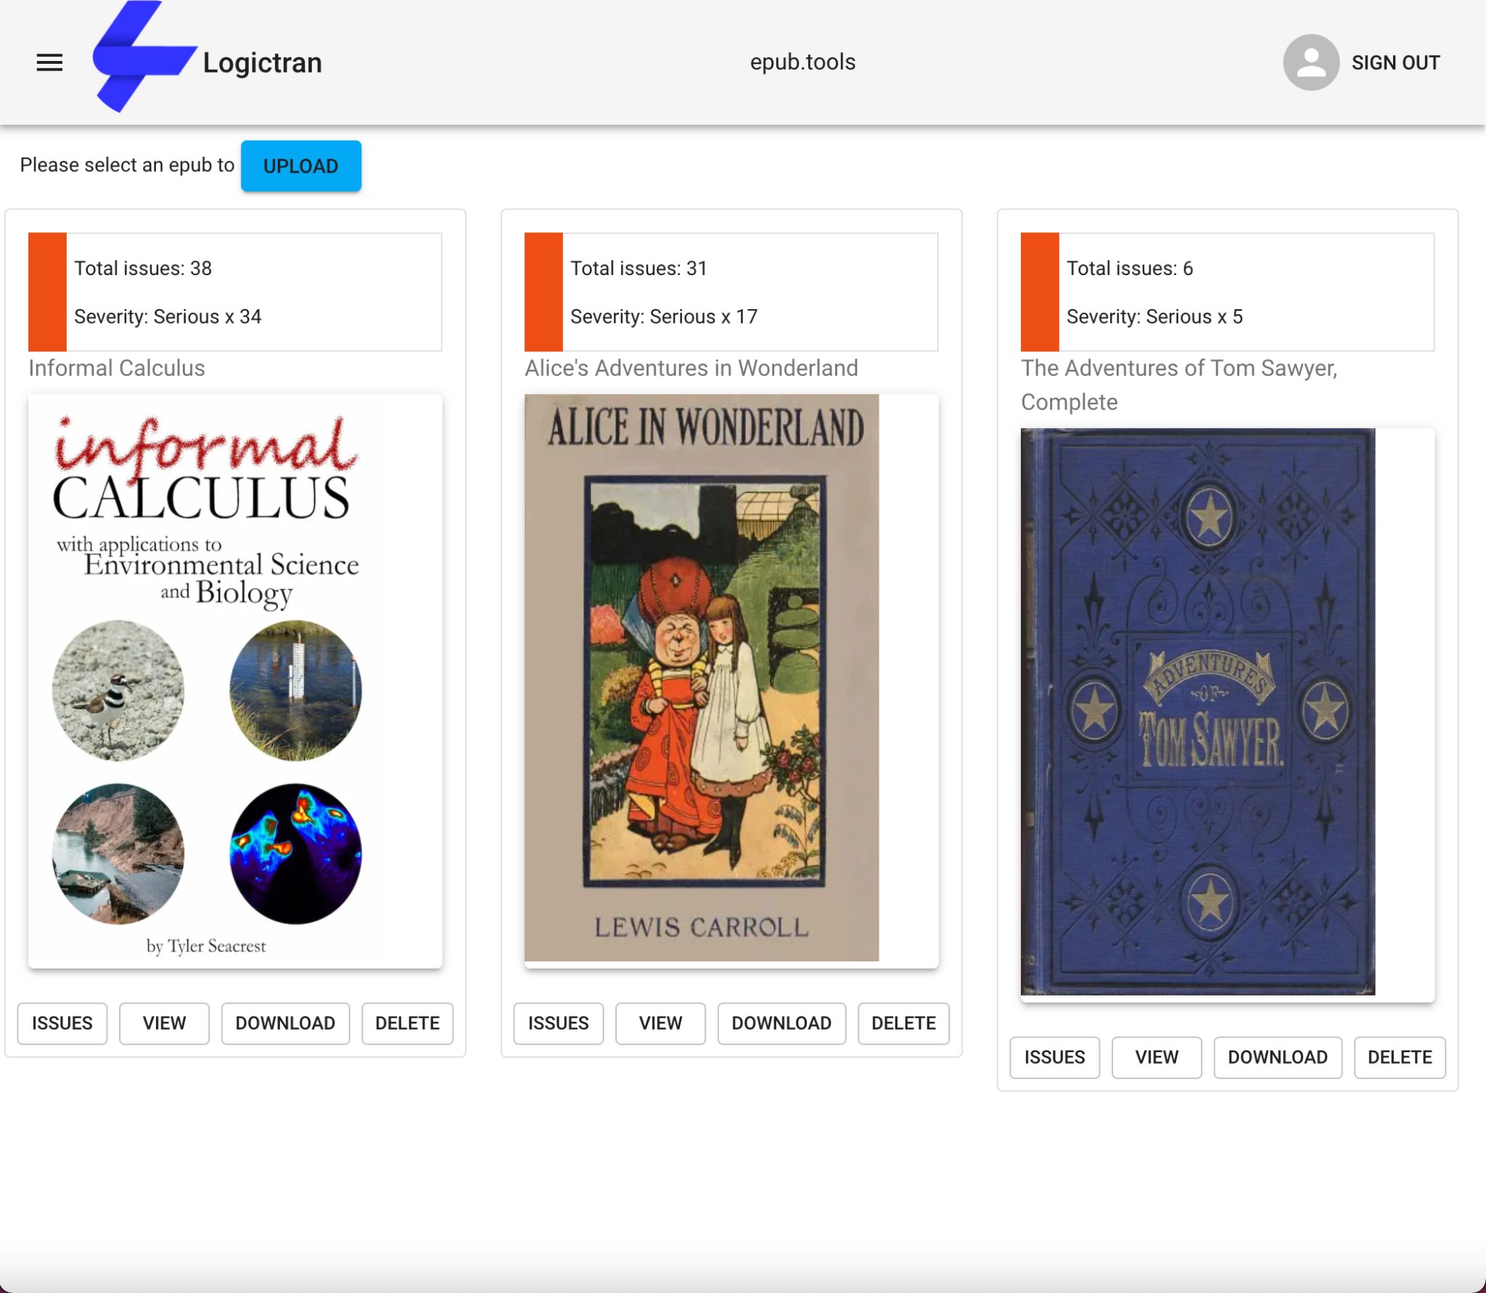
The Upload Screen
Upload new ePubs.
View all uploaded ePubs.
Get quick information about your ePubs.
*Informal Calculus by Tyler Seacrest

Slide 9
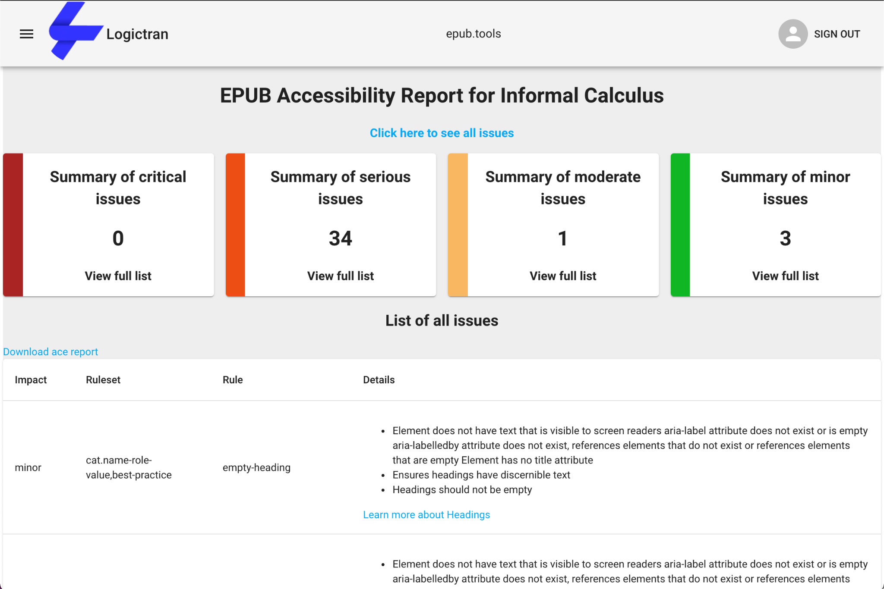
The Reporting Screen
List of all issues: Ace, ePubcheck & LT issues.
Detailed view with links to more information.
Downloadable reports.

Slide 10
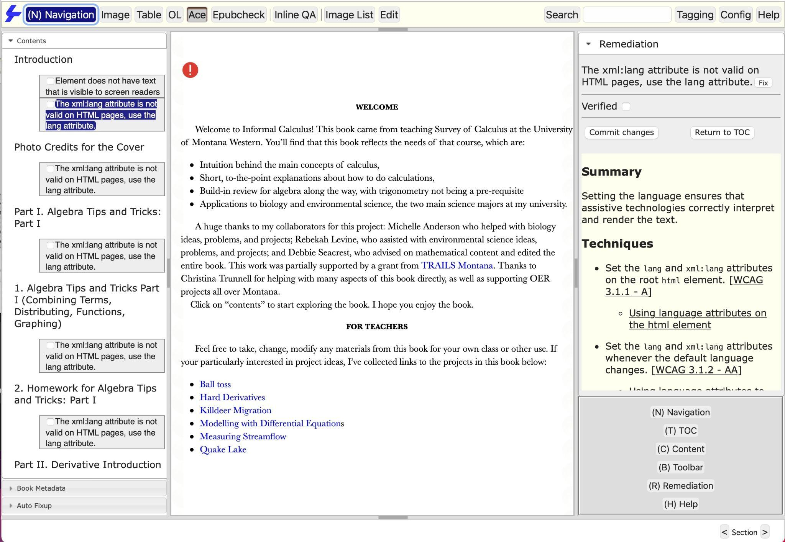
Full Keyboard Navigation
Tab once reveals a hidden (N) Navigation Element
Users can use keyboard shortcuts to navigate.

Slide 11
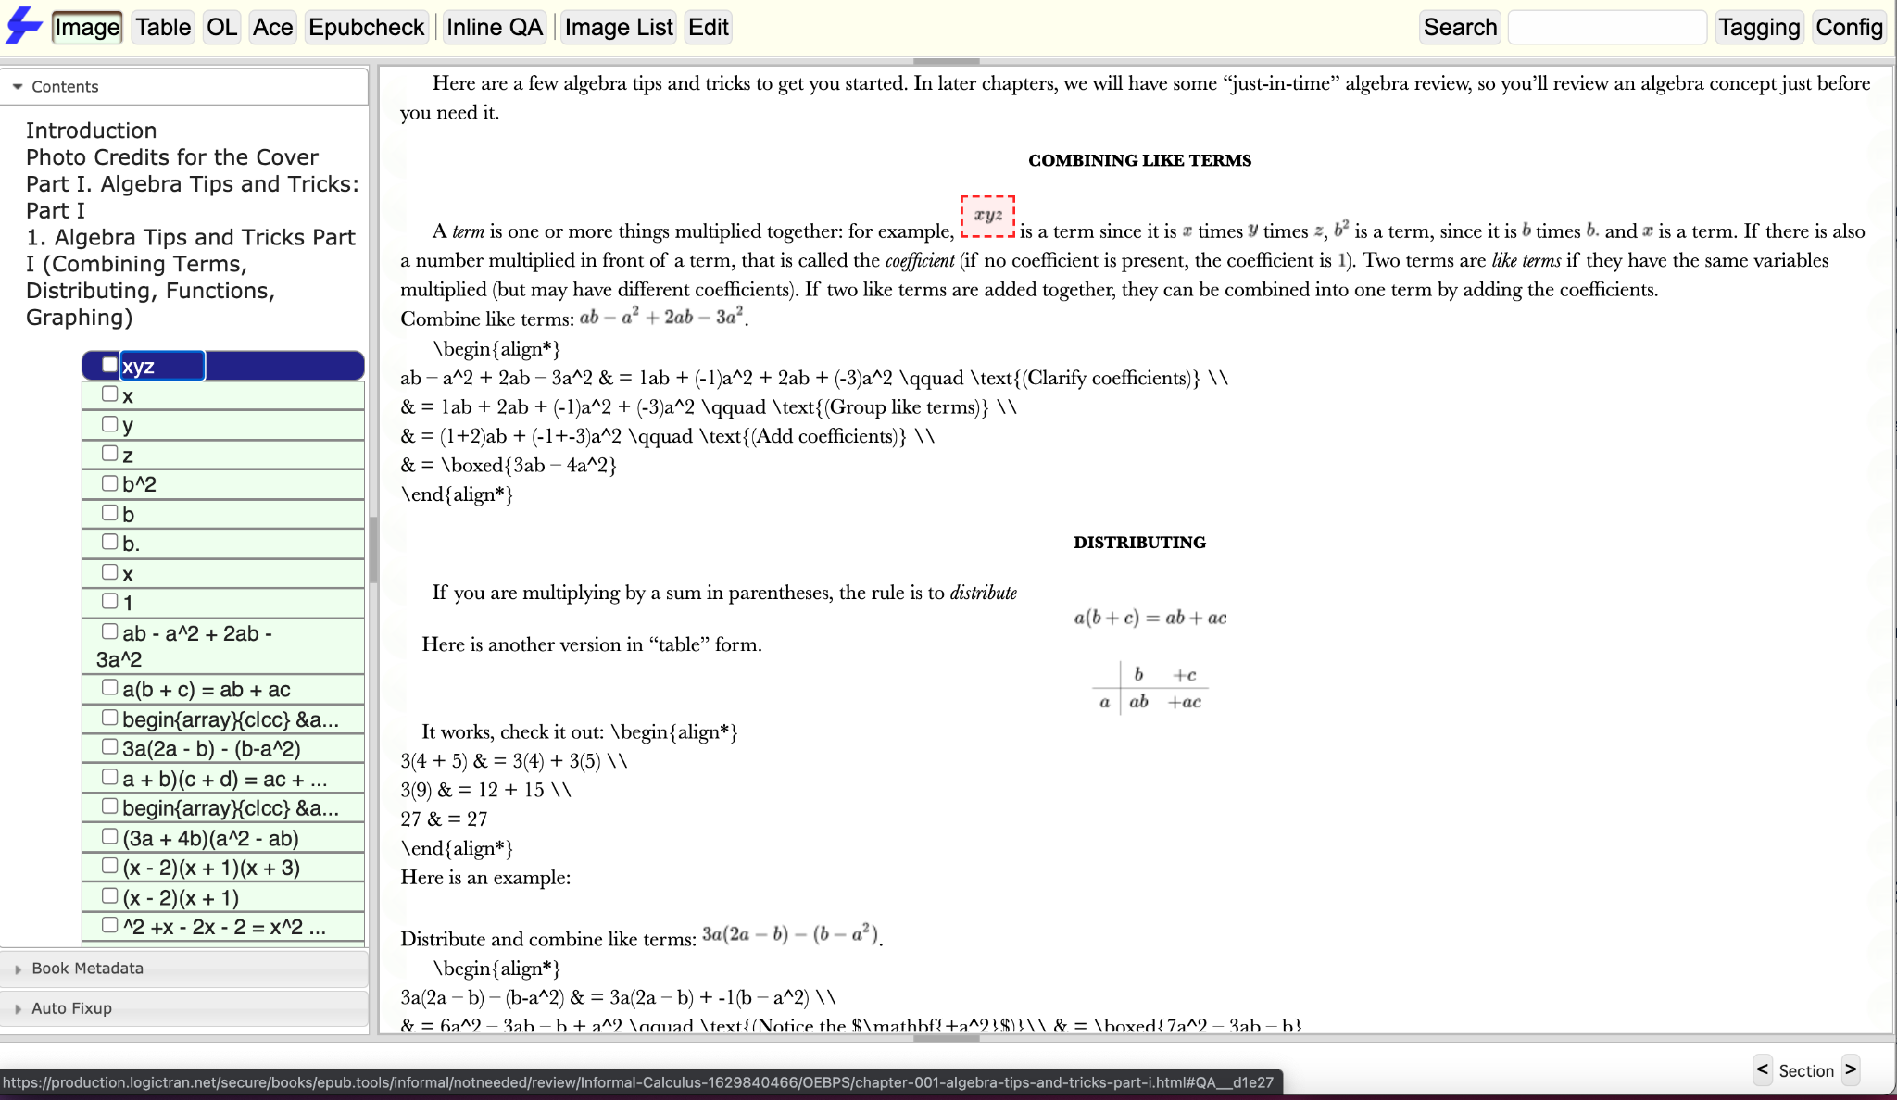
The Image Tool
Locates all of the Images within the content.
Displays in the TOC by their Alt Text.
Clicking on an Image will highlight it in the Content panel.

Slide 12
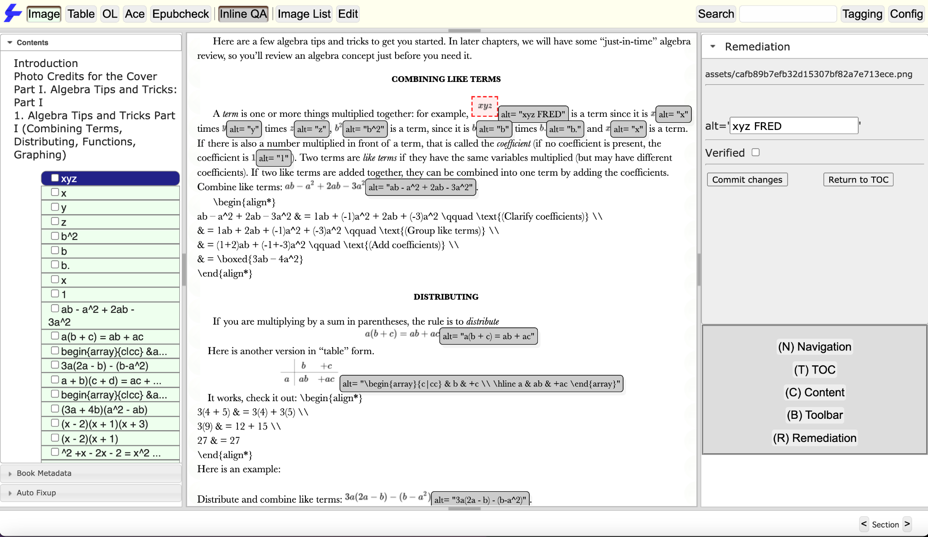
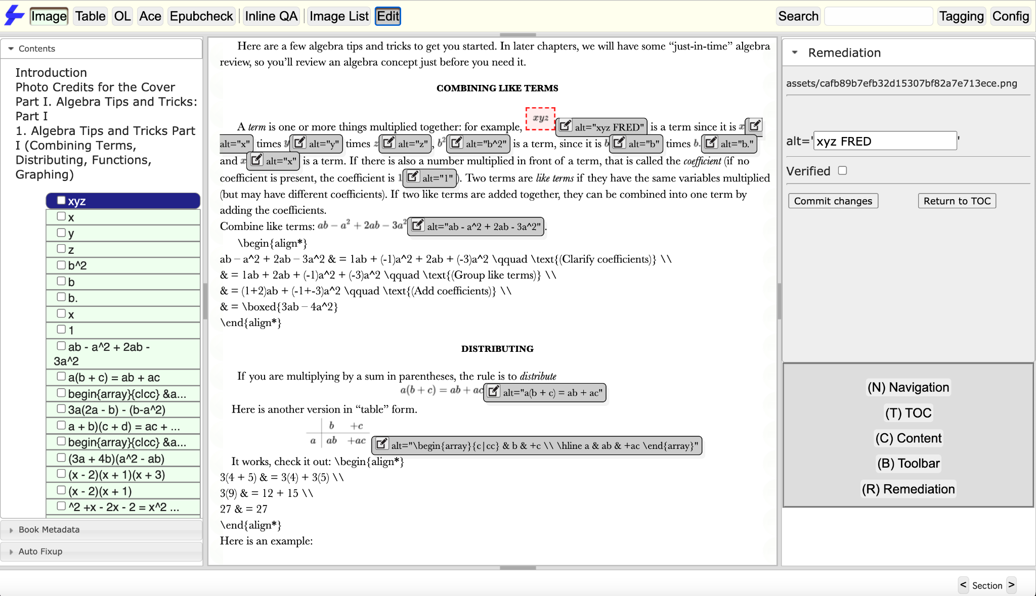
The Inline QA, Edit and Checkbox Tools
Inline QA (left) reveals important tagging information, inline with the Content.
Edit (right) reveals the same tagging information, but will let you edit it within the Content.
Checkboxes allow you to generate a QA Checklist that can be exported later.

Slide 13
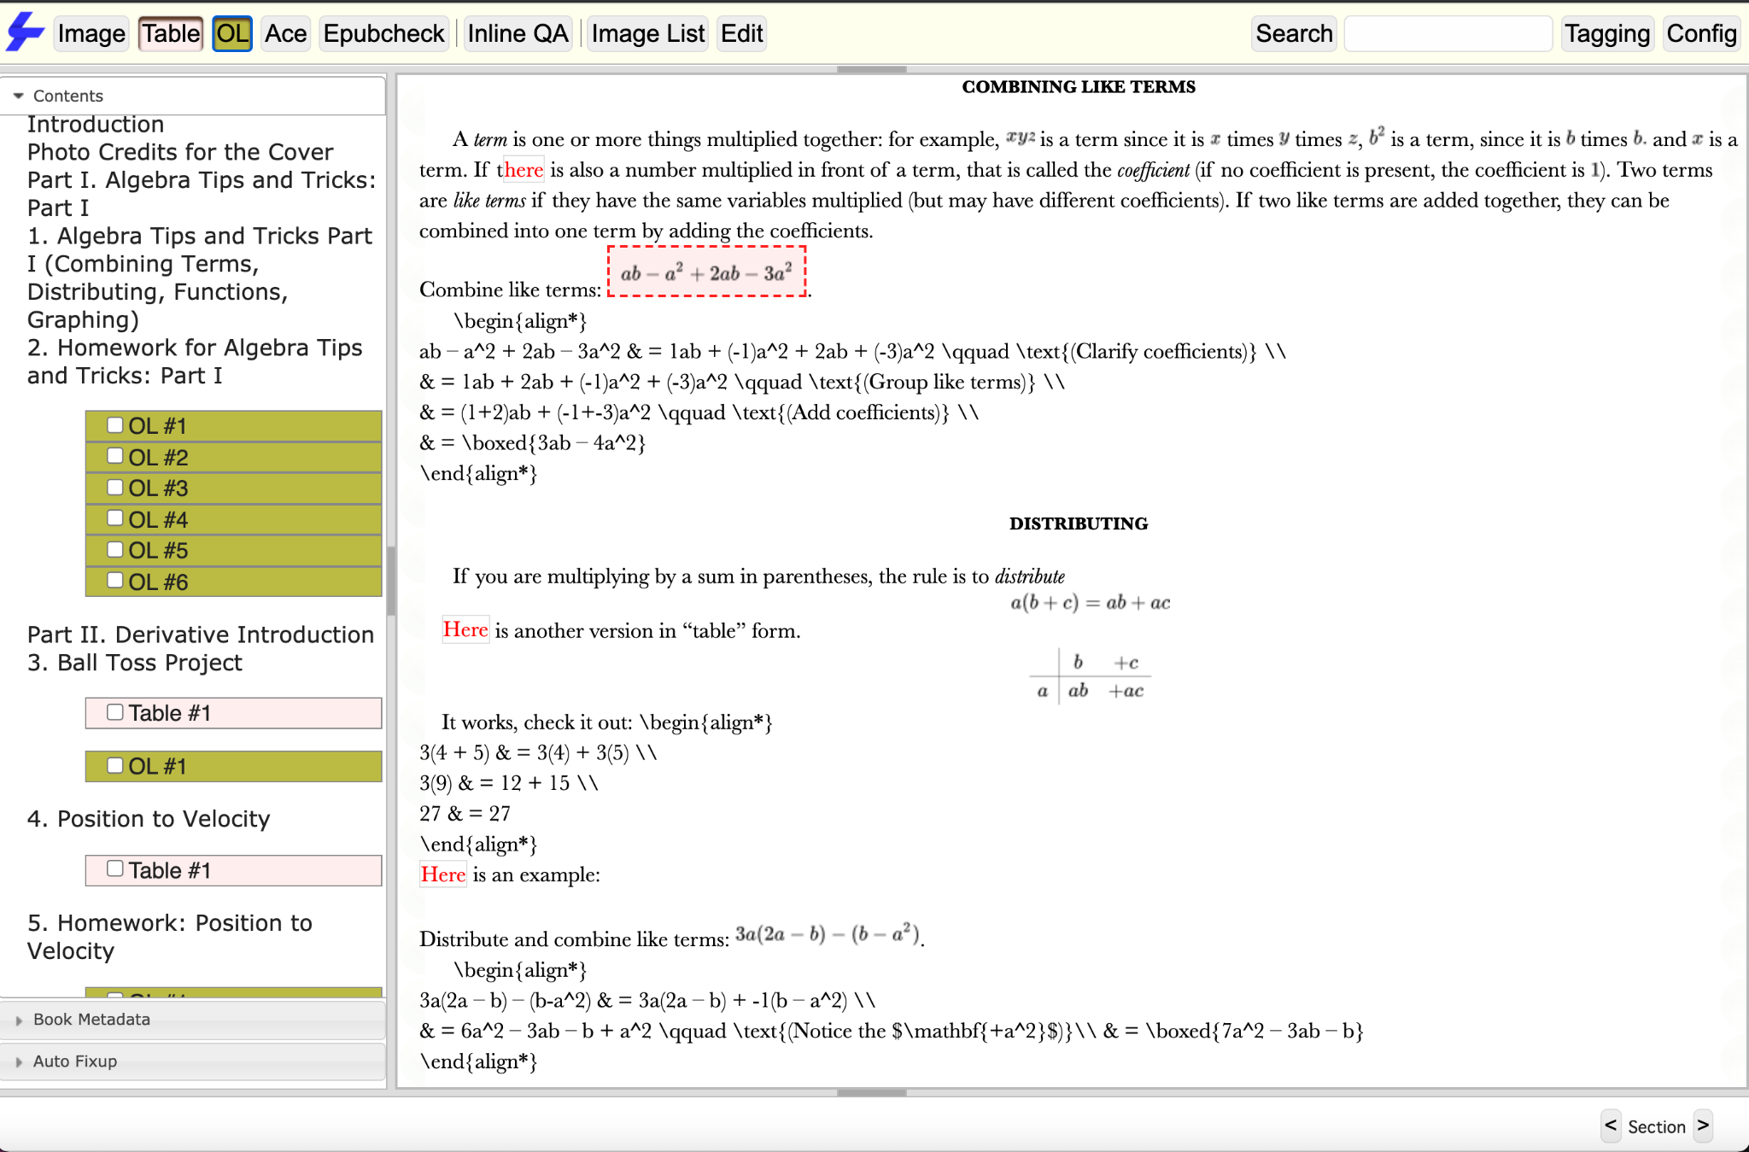
Semantic Views
ePub.Tools will offer different views based on your content.
Table brings up a numbered list of Tables in the TOC.
Lists works on Unordered and Ordered Lists in the same way.

Slide 14
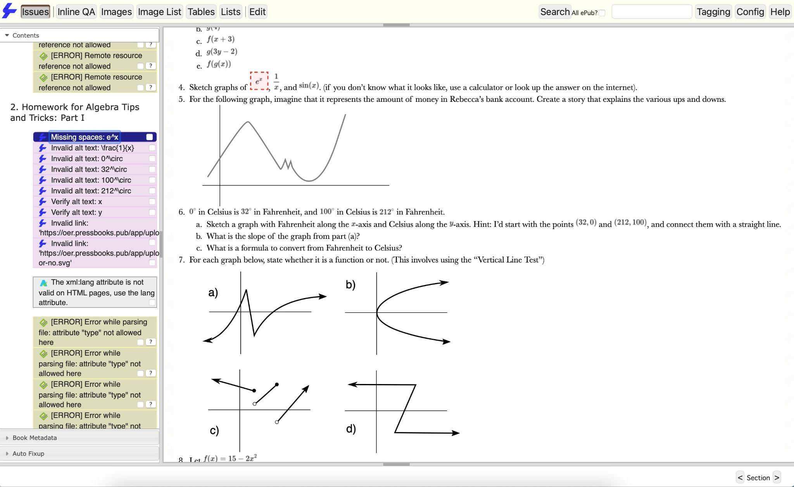
The Issues Tool
Displays all of the Issues in the TOC, organized by ruleset.
For some issues, you can click on the “Fix” button to automatically fix the issue.

Slide 15
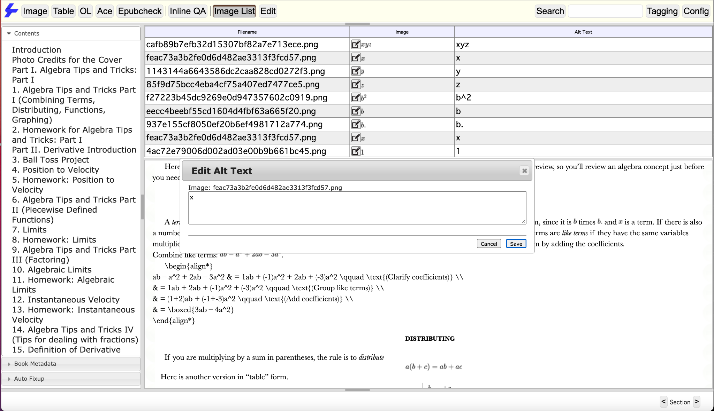
The Image List Tool
Brings up a tab with a list view of all the images, Alt Text and Filenames.
Attributes displayed are based on content.
Attributes can be edited.

Slide 16
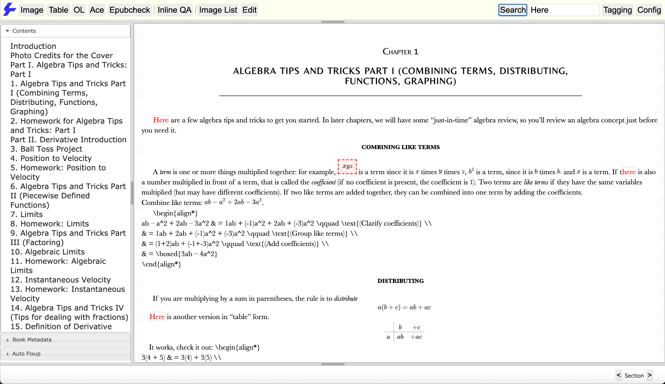
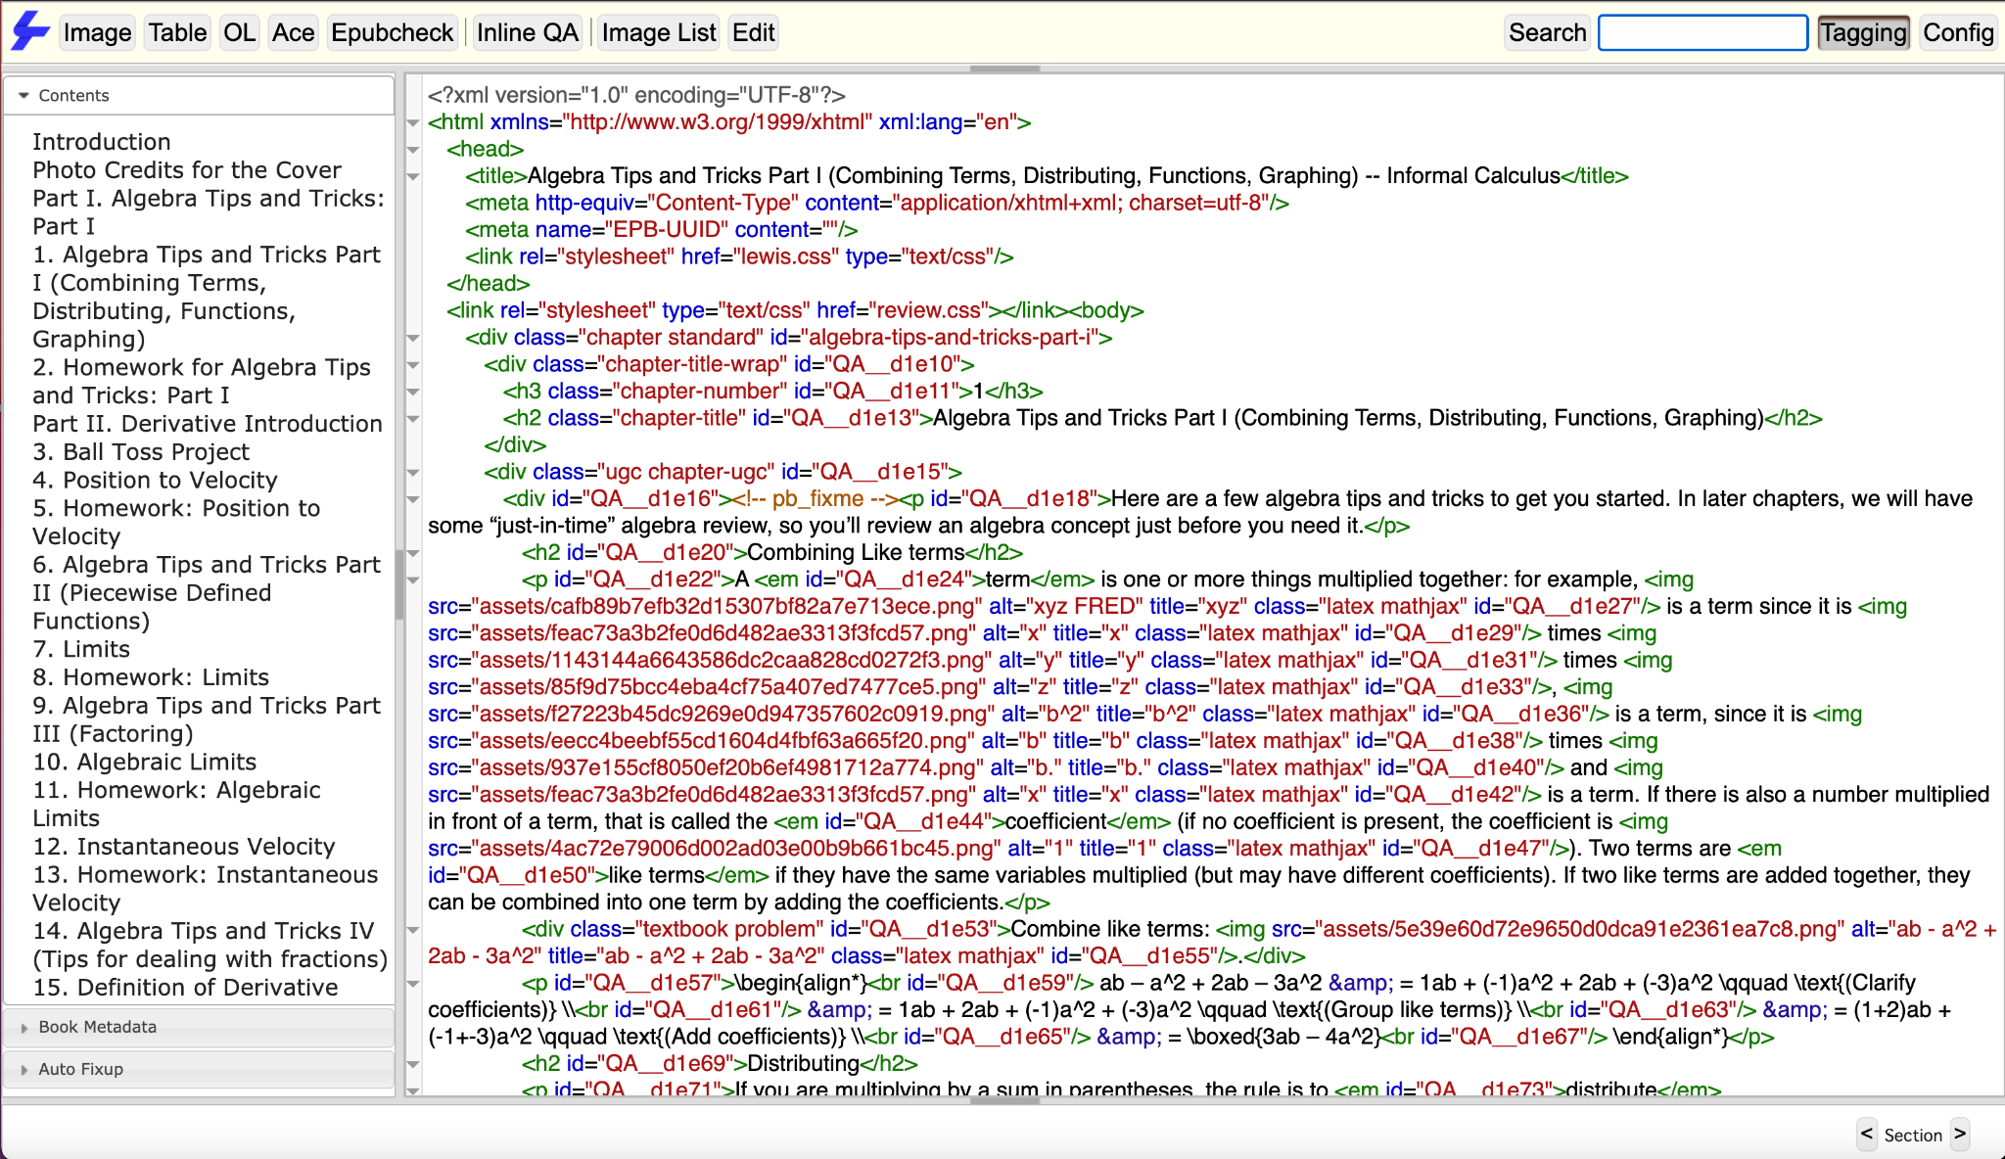
The Search and Tagging Tools
Search for text within the content.
Tagging reveals formatted tagging beneath your content.

Slide 17
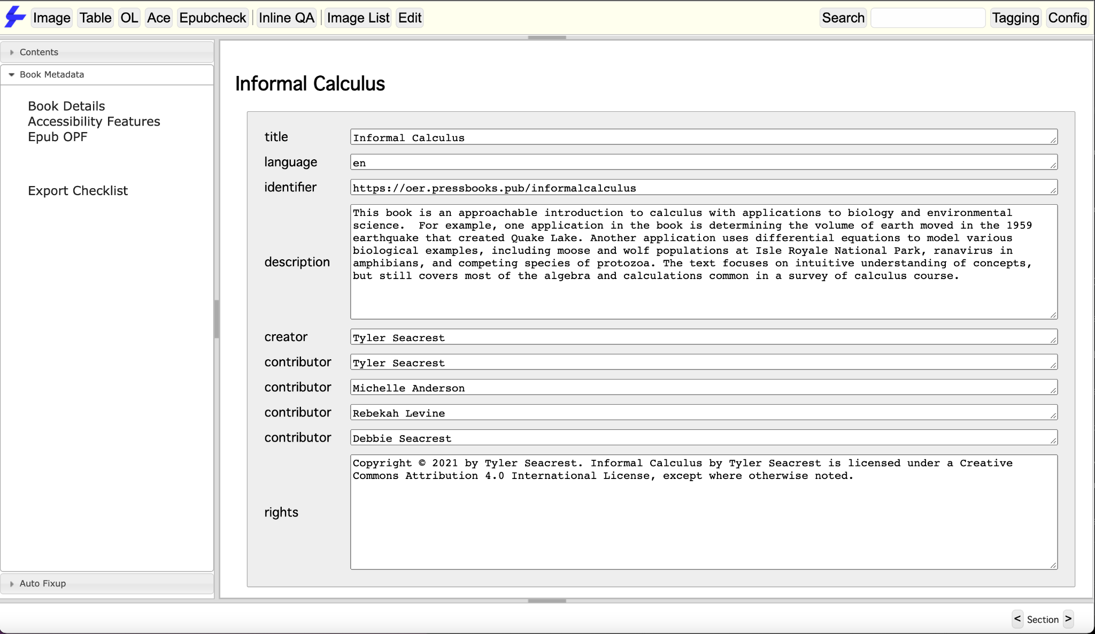
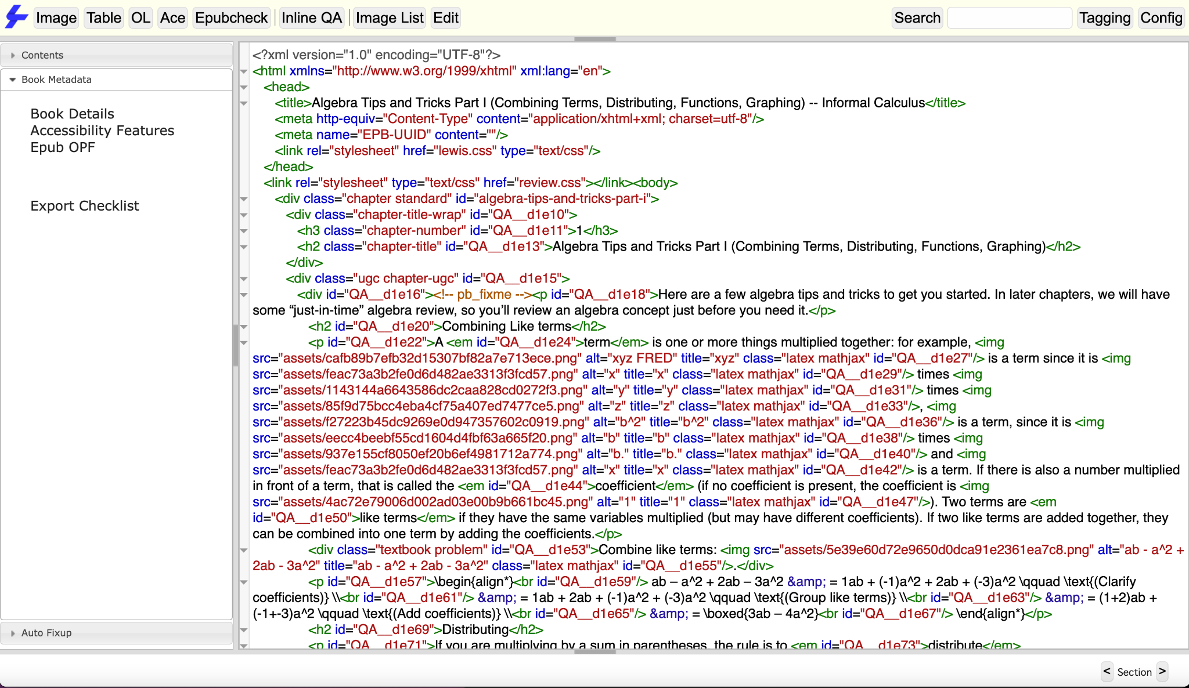
The Metadata Views
Book Details option (left) allows you to view and edit book details.
Epub OPF option (right) allows you to directly view the tagging contained in the book’s OPF file.
Issues will also be displayed in these Book Metadata views.

Slide 18
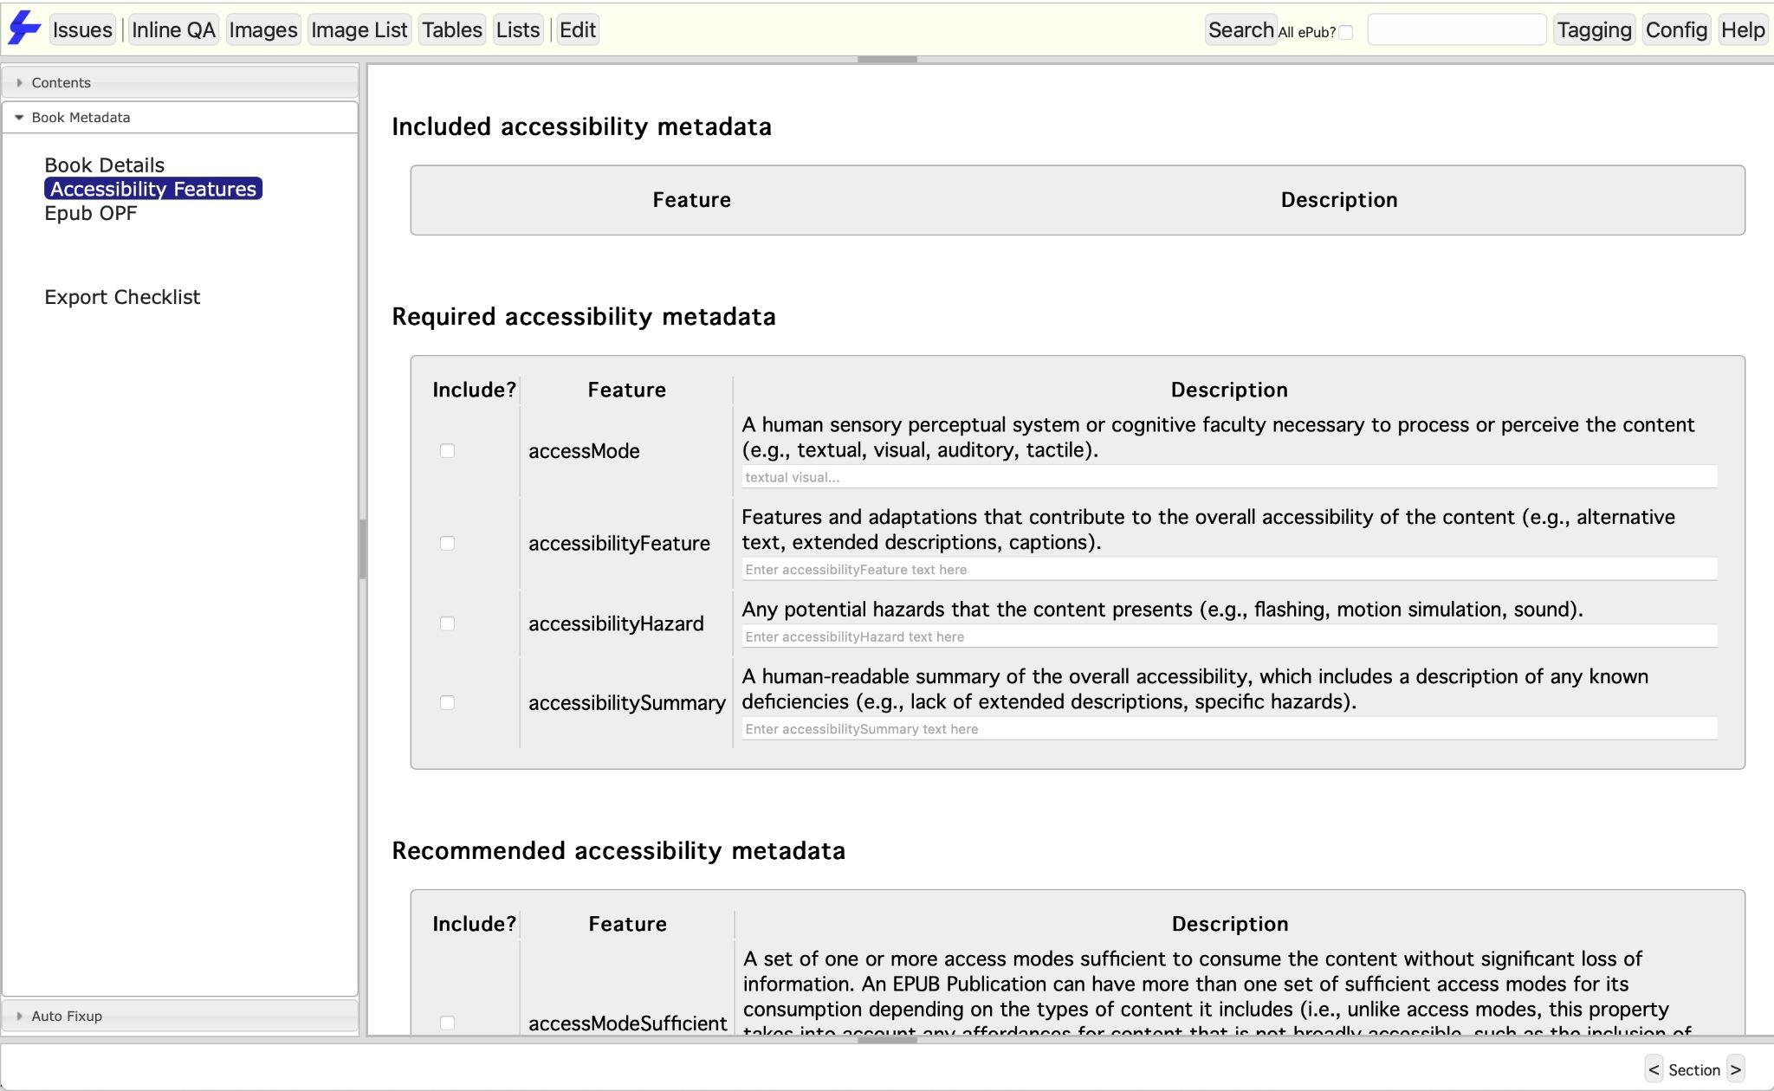
The Accessibility Features Tool
Lists accessibility features.
Gives option to add to metadata.
Gives info on these features.

Slide 19
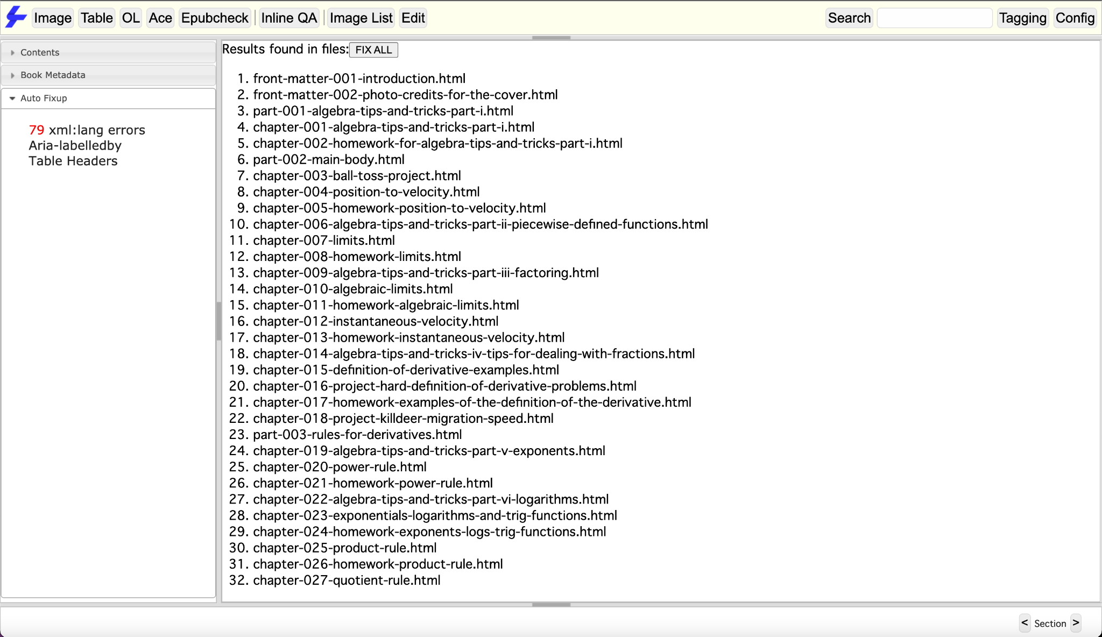
The Auto Fixup Tab
Lists all available automatic remediation options.
Displays the number of fixable issues.
The FIX ALL button will apply the fix.

Slide 20
Let’s Begin Our Tech Demo...
epub.tools

Slide 21
Any Questions?

