Slide 1
Cross Departmental Accessibility Focus: College-Wide Student Success and Online Courses
Steven Bianco, Coordinator, Accessibility and LMS Administration
Dr. Rozalind Jester, Assistant Vice Provost, Online Learning

Slide 2
Key Points
Create a culture of collaboration and awareness training for compliance.
Identify campus stakeholders and develop strategic partnerships with Academic Affairs, Library, Information Technology, and ADAptive Services.
Inter-departmental collaboration to ensure students, faculty, and staff are directed to appropriate resources.

Slide 3
The Point of this Talk is to…
Establish connections in your institution for accessibility collaboration.

Slide 4
Why Care?
Making relationships and connections within your institution impact student success.

Slide 5
FSW’s Accessibility Journey

Slide 6
Create a Position
The job description at FSW focused on collaboration and training.
Training for FSW IT through Online Learning Consortium (OLC) workshops.
Fundamentals: ADA & Web Accessibility
Strategic Planning for Web Accessibility
Designing with Accessibility in Mind
Notes:
The Electronic Information Technology (EIT) Accessibility Specialist was created and approved May 22, 2018, and under the Office of Information Technology.
Developed by the College’s CIO and Director of eLearning.
The position was placed under Web Services with deep relationships to eLearning.
This position was tasked with collaboration between the Office of Information Technology, General Counsel, ADAptive Services, Library Services, and other areas of the College.

Slide 7
Rekindling the Accessibility Working Committee
We developed a list of stakeholders for the revived committee and an action plan.
Designated the EIT position as chair of the Accessibility Committee.
Meetings are an open forum for discussion.
Notes:
As we learned through the OLC workshop, Strategic Planning for Web Accessibility we developed a list of stakeholders for the revived committee and an action plan.
We had an Accessibility Committee that was active from 2016-2017, which stopped meeting due to a central leader not being present.
The EIT Accessibility Specialist rekindled the Committee in 2019, bringing in the stakeholders from across the College as we outlined in our planning from OLC.

Slide 8
The Accessibility Working Committee
The committee meets every two months
30+ members
Members plan for both electronic and physical accessibility.
Benchmark Progress through the areas each meeting.
Notes:
The Provost’s Office, CIO, eLearning and eLearning coordinators, ADAptive Services, College Deans, Library Services, General Counsel, Procurement, Team AASPIRE (Institutional Research and planning), and others.

Slide 9
Office of Information Technology Example
Weekly Professional Development Session on accessibility topics through the Teaching and Learning Center.
Other formal workshops on accessibility tools like Blackboard Ally.
Universal Design and Access workshop as part of the DEV 101 course design certification process.
Notes:
Using cloud-based tools in the Canvas Learning Management System we have metrics to help see improvements:
Blackboard Ally
UDOIT
For website accessibility we monitor our scores using Siteimprove.

Slide 10
eLearning Example
Course reviews based on accommodations.
Notifying instructors about who to contact for questions.

Slide 11
Inter-Departmental Referrals
Through awareness training the point of contact information is available to faculty and staff.
Referrals are made between eLearning, Information Technology, ADAptive Services, and the Equity Office.
Notes:
Through the awareness training point of contact information is available to faculty and staff. If someone is contacted who does not work directly in an area an inter-departmental referral is made.
How should I setup my class for interpreters?
How do I make my videos more accessible?
A student is asking for more than what was on the Letter of Accommodation.
What assistive technology will benefit my students?

Slide 12
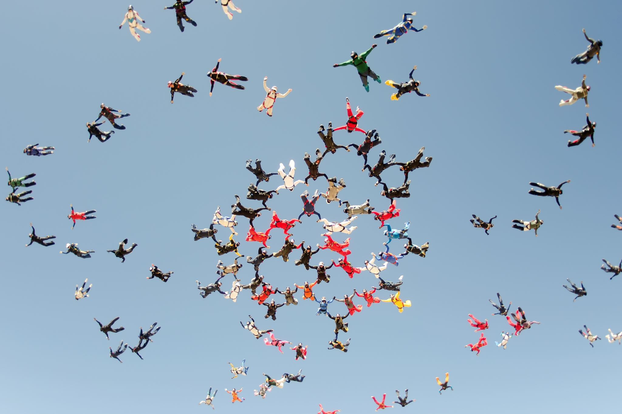
Building Relationships

Slide 13
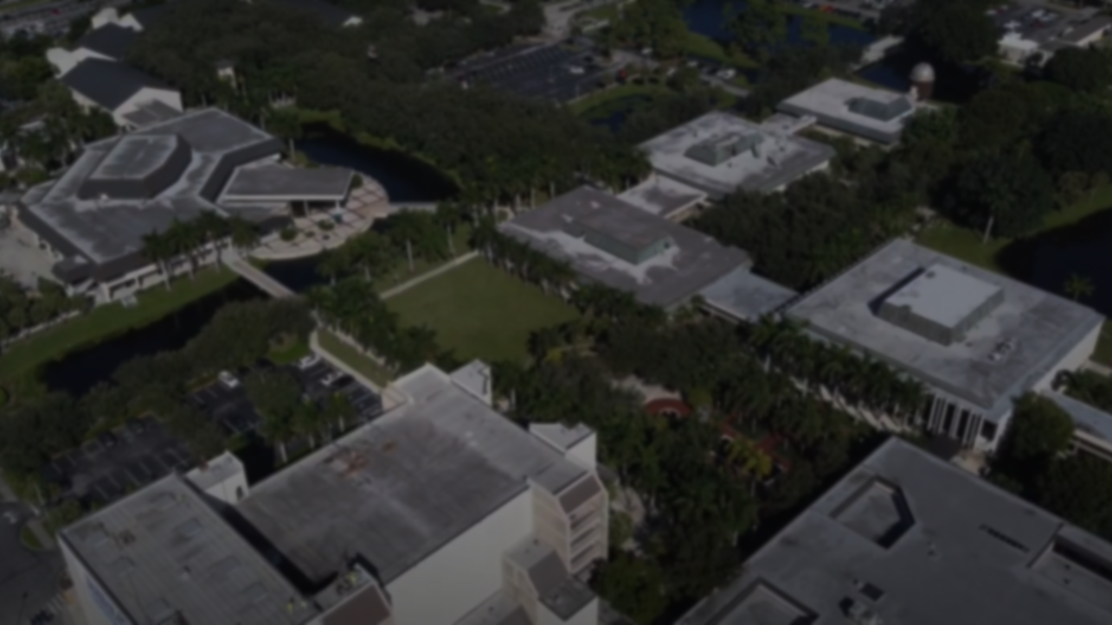
College-Wide Collaborations
Cabinet Level Support
Provost
Office of Information Technology
Instructional Design Team
Academic Affairs
Student Affairs
ADAptive Services
CIO
Electronic Information Technology (EIT) Accessibility
Technology Support Center
Equity Office
Online Learning
Teaching and Learning Center
Faculty Champions
Academic Administrators

Slide 14
The Data
DEV 101
Blackboard Ally
Institutional Goals

Slide 15
The Data – DEV 101
21% Average Improvement in course accessibility where the faculty developer completed DEV 101.
Based on Blackboard Ally Data.
Notes:
Compared the scores for 6 courses, 3 in the School of Arts, Humanities, and Social Sciences and 3 in the School of Pure and Applied Sciences. The most dramatic score improvements were in the newly designed MAT 1100, PHI 2600, and PHY 2053L the score increase ranged from 22-38% improvement, with original accessibility scores of those courses ranging from 60-76%, with final scores in the 98-99% range. Mid-range for these values were the newly designed masters for SLS 1515 and SPC 2608 with an increase of 16% and 17%, respectively, original scores 78-81%, and final scores of 94-98%. The minor improvement was from CHM 2046 with a 3% increase, originally scoring at 40% with an end score of 43%.

Slide 16
The Data – DEV 101 Survey
Notes:
The data represents participants within DEV 101 who took both the pre- and post- workshop survey within the DEV 101 Canvas course.

Slide 17
The Data - Blackboard Ally
Notes:
Blackboard Ally was enabled in all past, current, and future courses on August 5, 2021.

Slide 18
The Data - Institutional Goals
Among those adopting accessibility as a goal, the most popular were:
All [department] staff will attend accessibility training sessions on an accessibility topic of disability awareness and/or accessible document creation.
All [department] webpages will meet best practices of accessible design.
Notes:
[#/%] staff will attend a training session on an accessibility topic.
Make accessible [#/%] of documents posted to the College’s Document Manager.
Check videos on [unit’s] web presence, including social media, for accurate captioning.
Work with EIT Accessibility Specialist to improve public facing website content’s accessibility by [#/%].
Educate [#/%] staff and student assistants on where individuals can receive accommodation information.
Make accessible documents for email, web, Document Manager, and courses/workshops/presentations.

Slide 19
Questions?
20 Minutes, ask away!

Slide 20
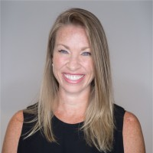
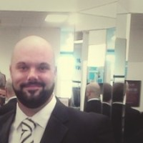
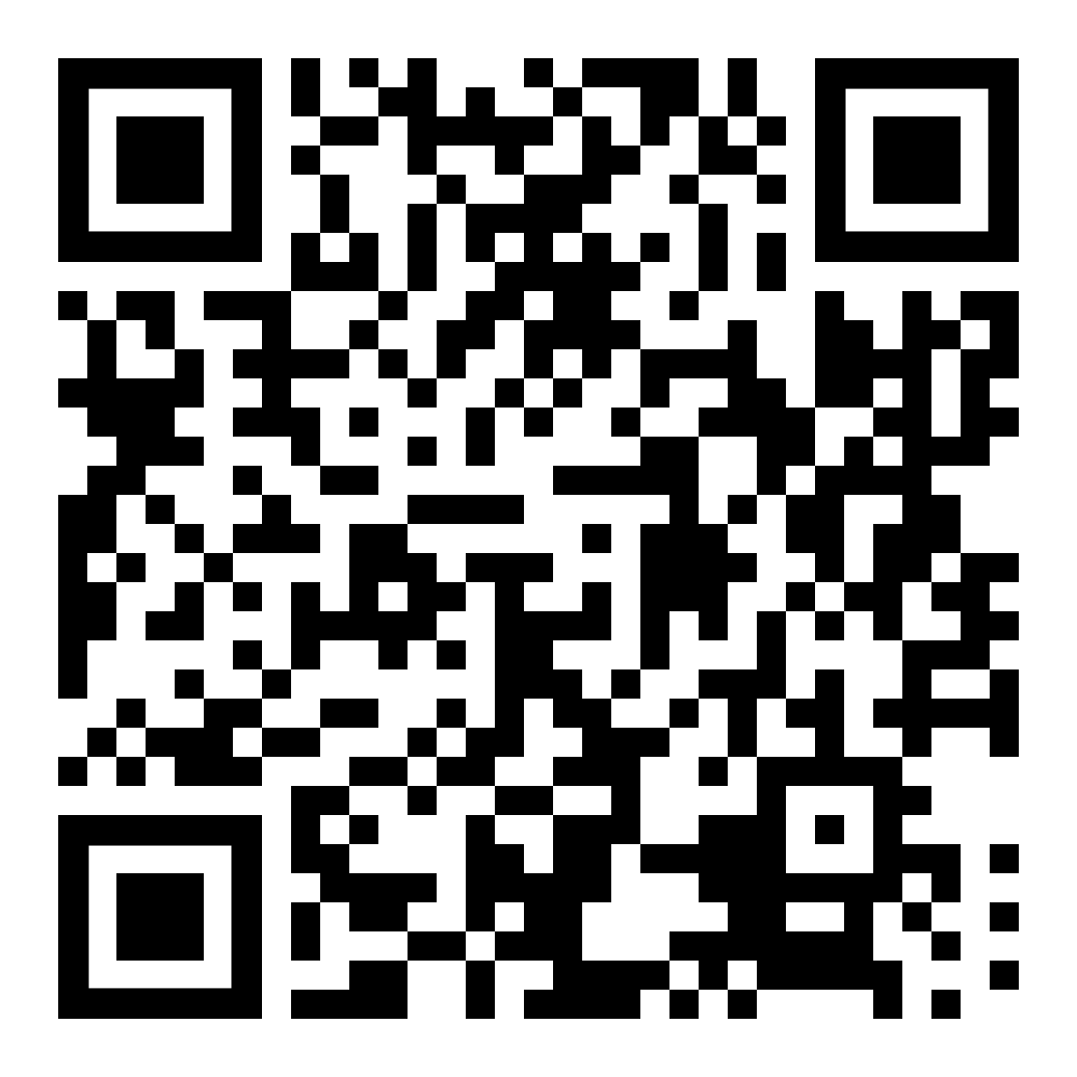
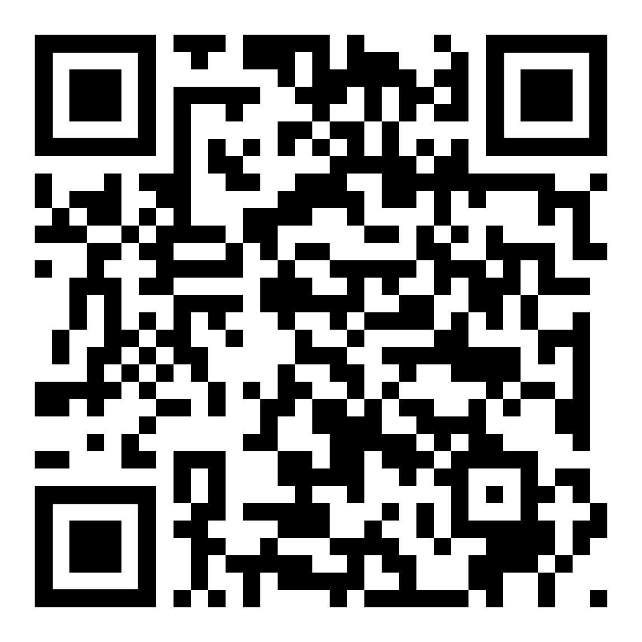
Thank You!
Steven Bianco (sbianco@fsw.edu)
Dr. Rozalind Jester (rjester@fsw.edu)

