Slide 1
Annotations for All
Creating accessible and understandable annotated and marked-up content
Laura Ciporen
11/17/2021

Slide 2
Agenda
The goal of today’s presentation
About the annotated and marked up text project
Our steps to creating accessible, visually complex content
Final tips

Slide 3
Content In This Presentation Does Not Represent Real Content
Samples for illustrative purposes only

Slide 4
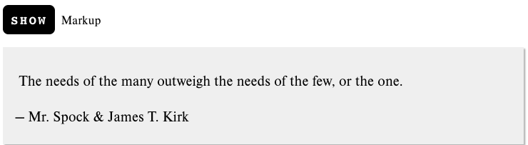
The Needs of the Many
Accessing Higher Ground 2021 - Ciporen

Slide 5
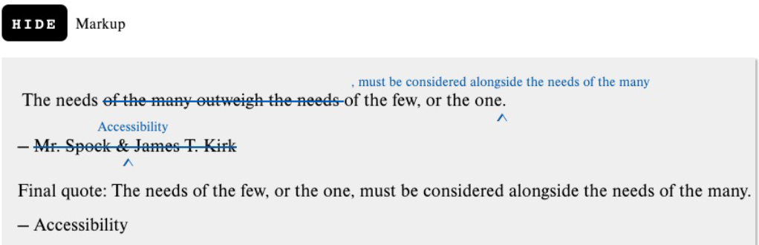
The Needs of the Many, With Markup

Slide 6
Goal of Today’s Presentation
I present our approach to thinking- and working through the a11y challenges of our annotated and marked-up content project
You come away with ideas on how to apply the approach to making your own highly complex and visual content presentations more accessible

Slide 7
About Me
Certified Professional in Accessibility Core Competencies (CPACC)
Masters in Educational Communication and Technology from NYU
Started at McGraw Hill Higher Ed. focused on instructional design in 2009
Moved to Content Accessibility exclusively in 2015
I’m short, white, female, left-handed, and pretty smiley

Slide 8
About the Annotated and Marked-Up Content Project
Annotated writings: Writing samples with commentary pointing out key features within the content that exemplify what is described in the main text.
Marked up content: Sample sentences, paragraphs, and citations with features called out and content changed.
  Proofreading marks
  Arrows connecting ideas
  Highlights and brackets grouping phrases
  Text added to identify the function of other text
  Etc.

Slide 9
The Problem
Due to the complex layout needs, it was all done as images

Slide 10
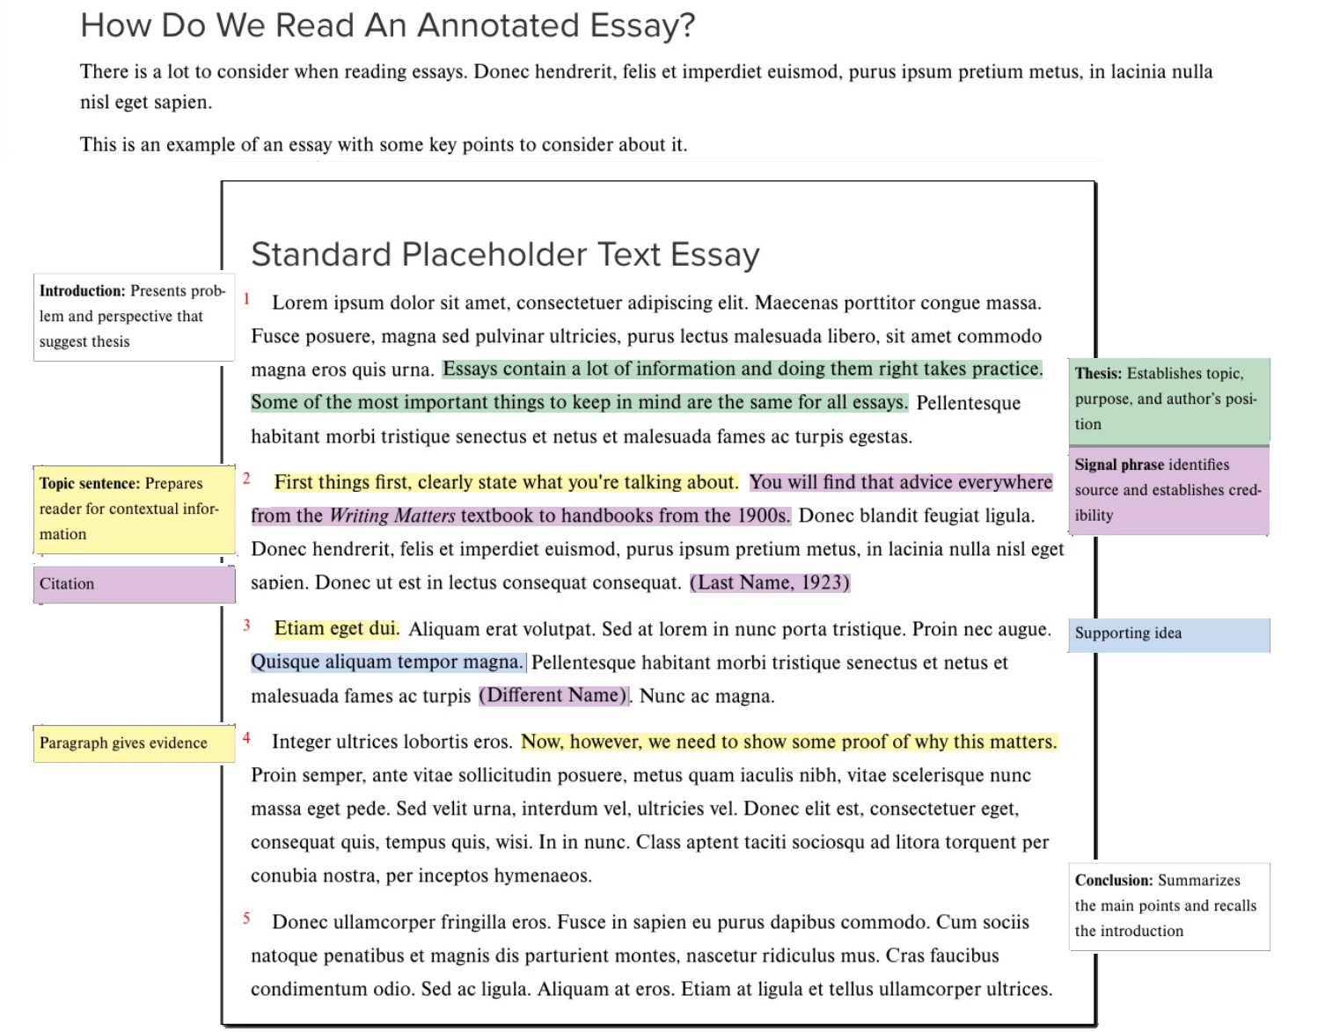
Annotated Essay As Image

Slide 11
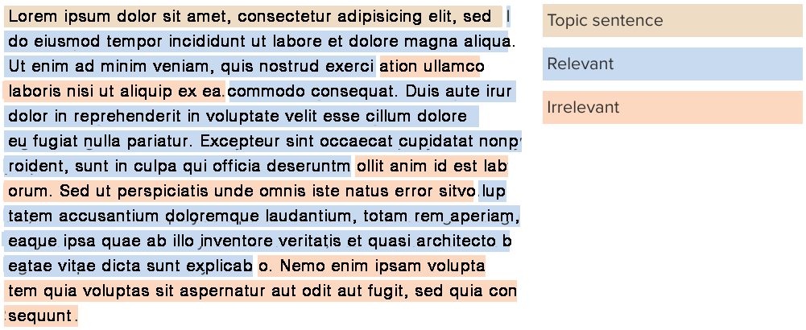
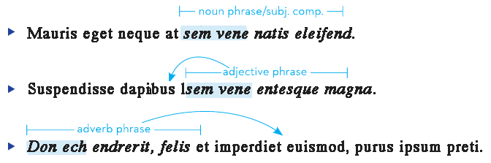
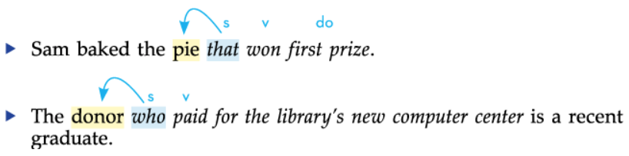
Marked-Up Content Examples 1

Slide 12
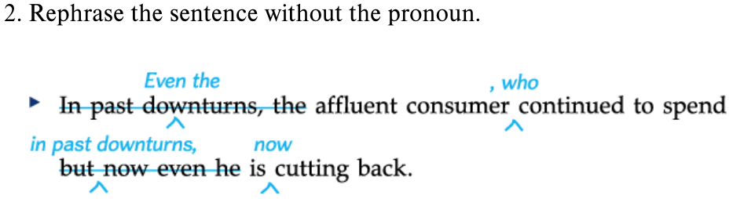
Marked-Up Content Examples 2

Slide 13
Steps to Making Visually Complex Content Accessible
Gather your Team
Define the Project
Question Absolutely Everything About the Current Approach
Evaluate A11y Concerns
Come Up With Possible Solutions
Test with Users
Revise and Finalize
Take Pride in Your Accomplishment

Slide 14

Step 1. Gather Your Team
Required perspectives:
Content
Accessibility
Instructional design / design
Coding / implementing
End users

Slide 15

Step 2. Define the Project
What broad criteria does your solution NEED to meet?
Come back to your core requirements throughout the project
Identify, as best you can, the full scope of content you need to solve for
Decide where the work will be implemented first

Slide 16

Our Initial Success Criteria
Readable text
Preserve current visual presentation
Reading order logical and flexible to match alternate visual reading paths
Identify components non-visually in addition to visual cues
Easy to use and understand
Reflowable (like all other eBook content)
Technologically simple (no new authoring system, just a lot of very creative styling)
Improve the experience for all students

Slide 17

Step 3.
Question Absolutely Everything About the Current Approach

Slide 18
Be Mindful, Ask Questions
What are students able to do with the current format?
What are we expecting them to understand from the visual presentation?
What meaning is signaled by the look of every element?
How will students know the meaning implied by how something looks?
Does the look have to stay or just the meaning?
Why does this look different than that?
Why THIS spacing / positioning, color, shape / symbol / icon?
Content creation and design decisions are often made INSTINCTIVELY but to make things accessible, all decisions must be MINDFUL
Dig into every little example

Slide 19
Reading Paths

Slide 20
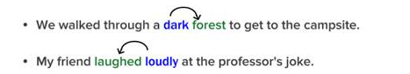
Arrows - Meaning
Pedagogical purpose:
Arrows show relationships between words in a sample text.
Different colored words indicate different types of words or phrases or parts of sentences.

Slide 21
Arrows - Detailed Questions
Will this ever need to be interactive? Toggle display of text on/off
Where should the arrows point at? Letter, Word, Phrase Where (left. right, center)?
Should the arrow's start and end be colored automatically or do they need to be colored individually?
Will arrows ever be used without coloring the words?
Will there ever be text between the text the arrow connects?
Does the arrow always mean one thing? Does the arrow explanation need to be custom authored? Will the arrow explanation be best in situ or with flexible placement?

Slide 22
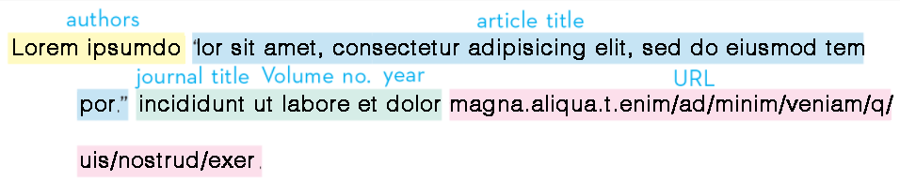
Highlights Meaning And Key Needs
Pedagogical purpose:
Adds emphasis or focus to specific type of text.
Conventions and Pedagogical Requirements:
Need a palette of highlight colors to use consistently.
Text formatting cannot be changed because it is according to APA/MLA style. Convention is to highlight this type of text.
Highlighting can appear in basal text as well as in features such as student papers, images of source facsimiles, etc.

Slide 23
Highlights - Detailed Questions
Why are highlights used?
How is this different from other forms of signaling?
Is a highlight with an annotation the same as a highlight without or with text above?
What is the difference between use for APA/MLA and basal text?
Do highlights use course colors exclusively?

Slide 24
Step 4. Evaluate A11y Concerns
Evaluate content from multiple user perspectives
Brainstorm and prototype alternate solutions for each obstacle
Evaluate each solution for a11y concerns
Review original project goals to ensure you stay within that framework
For a starter guide to accessibility user perspectives, see my set of persona pairs on LinkedIn

Slide 25
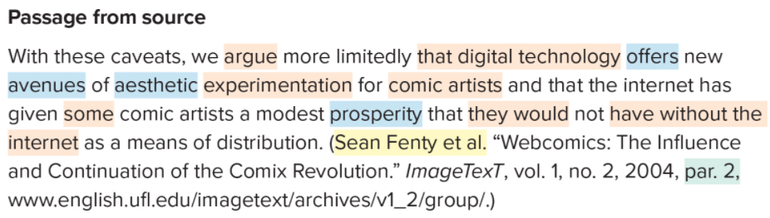
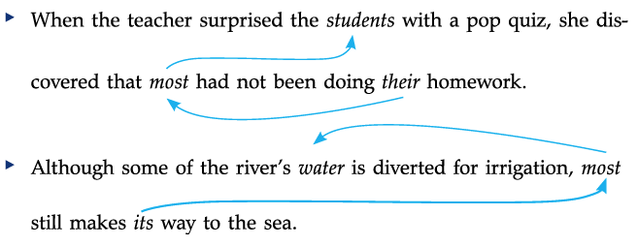
Sampling of Accessibility Concerns 1

Slide 26
Sampling of Accessibility Concerns 2

Slide 27
A Sampling of A11y Concerns About Original Presentation
A lot of information to process
Distinguishing highlights from each other and the background
Reliance on color coding
Much of the meaning is purely visual signaling
Connecting anno correct highlight
Losing annos that are on the right
Using the content non-visually with just as much flexibility as the visual presentation affords

Slide 28
Step 5. Come Up With Possible Solutions
Prototype various solutions to issues
Use as wide a variety of realistic content as possible.
Rely on input from real users with disabilities for formative assessment before deciding on the final solutions.

Slide 29
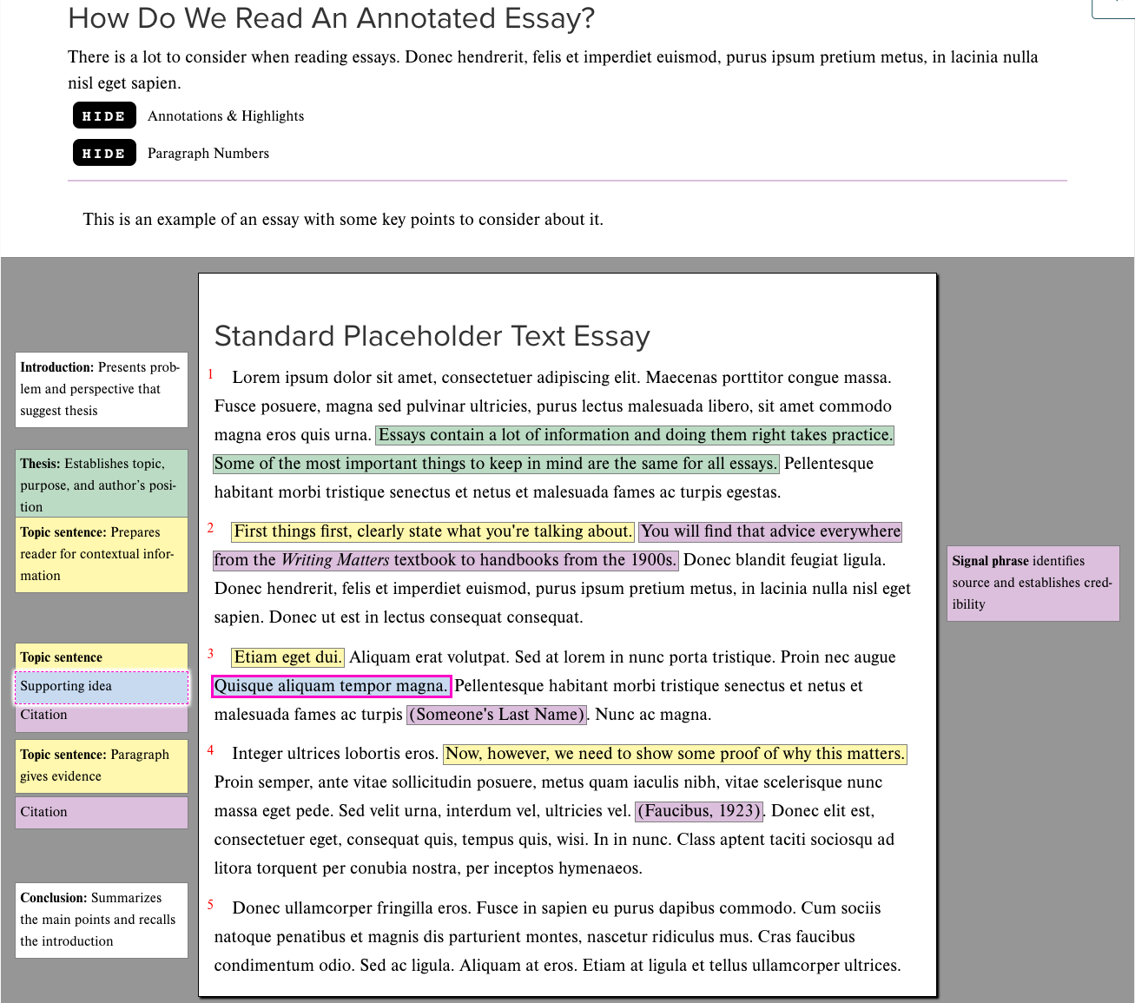
Annotated Essay Now

Slide 30

Step 6.
Test With Users

Slide 31
Formative User Testing Is Essential
Test with realistic content; some particularly complex outliers, most typical
Plan to talk one-on-one or in small groups; do not rely on surveys
Let the students try it out for themselves first to see what is intuitive and what less so, then explain
Take advantage of your DSS office’s existence!
Involve users with as many different disabilities / impairments as possible AND different assistive technologies

Slide 32
Our Student Testers
We had them read a few pages of a mock eBook on their own and answer a survey about preferences, clarity, and overall impressions.
Each page was the same content but with slightly different ways of presenting it.
22 Students
5 magnification
The rest a mixture of JAWS and NVDA
All took survey
About half were available for in depth discussion

Slide 33

Matthew, four-year college student, screen reader user
I enjoyed the layout and the presentation of information. It was easy to consume, understand and I did not feel stuck at any point. … I feel very strong about reading through this material and putting it into practice.
Image not really Matthew

Slide 34

Nikhil, two-year community college student, screen reader user
This experience would be excellent for me reading an English composition book because of the amount of feedback given to the user, and how the user can choose what feedback he or she wants to hear. I really like the level of detail put into the annotations, highlights, and callouts that the average sited [sic] person could just see by scanning a page.
Image not really Nikhil

Slide 35

Sebastian, screen reader user
I was an ESL student and this kind of material would have helped me a lot to learn the content and interact with my class eBook. I really like the amount of options you guys implemented to make the content easier to understand. Paragraph numbers, annotation and highlight announcers are extremely helpful for me as a blind person.
Image not really Sebastian

Slide 36

Demetria, four-year college student, screen magnifier user
I am very familiar to the eBook format so these were very great quality.
Image not really Demetria

Slide 37
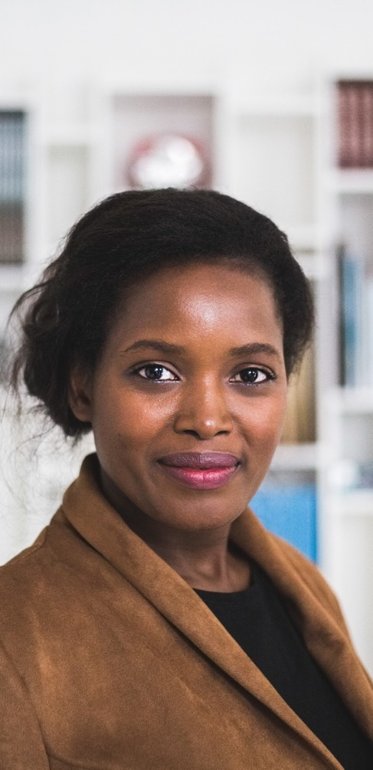
A screen magnifier user
The layout of the content will be helpful to students using screen magnifiers [they] might find this more enjoyable to read from having these accessibility features. However, for me specifically as I am a STEM student I don't personally get excited about doing a lot of reading. But … I would find it manageable to take a reading comprehension course using a software layout like the ones shown in this study.
Image not really anonymous student

Slide 38
Significant Changes Made from Feedback
For the more complex corrections examples, authors will write the “final result” visible for everyone
Change from “Toggle Markup Off/On” to “Hide/Show Markup”
The hide/shows were extremely popular; students wanted even more granularity on what to turn off and on (which is part of Phase 2)…but also worried about having too many buttons
Overall, this new approach requires a tour. Students understood it much better after a brief discussion.

Slide 39
Step 7. Revise and Finalize…this Phase
When finalizing solutions, also be sure to balance:
Level of benefit for those it helps
Added inconvenience level for those it doesn’t help
Technological support required
Ease of authoring
Acceptance by the intended audience (such as professors who will be using it in class)
What is essential for your first release to be truly usable and what needs to be scheduled for a second round

Slide 40
Review: Steps to Making Visually Complex Content Accessible
Gather your Team
Define the Project
Question Absolutely Everything About the Current Approach
Evaluate A11y Concerns
Come Up With Possible Solutions
Test with Users
Revise and Finalize
Take Pride in Your Accomplishment

Slide 41
Tips
Give yourself far, far more time than you think you need
Put the Solutions into Limited Use First, if Possible
Plan based on first-use content but ALSO next use and future use
Avoid hard-coding in project specific terminology
Ideally, retest with (new) users
Plan from the beginning for iterations

Slide 42
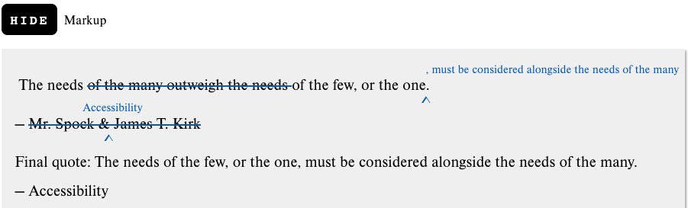
Remember…
Start example. Hide Markup, button.
  The needs
  Start strikethrough
  of the many outweigh the needs
  Strikethrough ended
  of the few, or the one
  Start insert
  , must be considered alongside the needs of the many.
  Insert ended
  — mdash
  Start strikethrough
  Mr. Spock & James T. Kirk
  Strikethrough ended
  Start insert
  Accessibility
  Insert ended
  Example ended.

Slide 43

Thank you!
Laura Ciporen
laura.ciporen@mheducation.com
https://www.linkedin.com/in/lauraciporen/
www.mheducation.com

