Slide 1
Global Certified Accessible™ Third-party Certification for EPUBs
Charles LaPierre
Michael Johnson

Slide 2
Overview
Overview of the GCA process itself
Benefits of certification including keeping publishers up-to-date with the latest requirements and innovations
Our domestic as well as international clients
Accessibility becoming standard in purchasing agreements
Several accessible library projects are underway
Retailers providing accessibility metadata
Contact Information
Useful Resources
Notes:
CL

Slide 3
Why Do Accessible Books Matter?
Over 1 billion people worldwide has a disability or access need
Accessibility is about making sure that everyone has access to the same book, at the same time, and can consume the entire book and all information contained within.
Everyone at some point will be situationally disabled and will need the affordances provided by an accessible EPUB.
Benetech's Global Certified Accessible initiative helps publishers create truly born accessible EPUBs, "Every book, Every Reader, Every Day".
Notes:
CL

Slide 4
Finding, Buying, Reading Accessible Books
Very Personal Experience
How can you find these accessible books
Will I be able to read this book with my assistive technology
Notes:
CL: Finding, buying, and finally reading a book is a very personal experience. For most of us this is routine where we go to a bookstore search for the title we are interested in or perhaps browse the best sellers list, then purchase and start reading the book.
Now consider you are blind and rely on assistive technology to read this book. Will my screen reader work with this title? Are there image descriptions describing these images? Are there page numbers which are accessible? Is the reading order correct so I don't hear chapter 4 before chapter 3? These are just a few of the accessibility concerns consumers have when trying to purchase and ultimately read electronic publication.
The good news is more and more publishers are creating Born Accessible publications and getting the accessibility validation or audit done by independent organizations.
These accessible publications need to be easily found and a user-friendly way to highlight all the accessibility features and potential short comings it has.

Slide 5
GCA Overall Process
Publisher sends an EPUB
Automatic & Manual Checks
Detailed Reports given back to Publisher
Publisher Remediates EPUB & Pipeline
Publisher resubmits EPUB for review
Repeat (until passes WCAG-AA & +80% Born Accessible Score) for 3 EPUB files
Yearly Spot-checks
Quarterly Technical Bulletins
Notes:
CL

Slide 6
GCA Process Review (Workflow)
Validate EPUB with EPUBCheck Utility
Quick Review of EPUB using a Reading System
Looking for potential accessibility issues
Validate accessibility with ACE by DAISY
Conformance Checking with SMART
Explore EPUB internal code using Sigil
Check Images with text for proper contrast
Produce Various Reports for Publisher
Notes:
CL

Slide 7
Global Certified Accessible Stamp
Notes:
[Charles – 15 seconds]
Total time: 6:00

Slide 8
GCA Certified Publishers

Slide 9
GCA Vendor Partnerships

Slide 10
Benefits of Certification
IDEA
An accessible EPUB is better for both findability and readability
One file for all readers
Available for 20%+ of the world's potential readers
Helps mitigate legal risks
Notes:
MJ

Slide 11
Domestic & International Partners
There are over 60 organizations participating
8 different countries
3 continents
Growing week-by-week
Pearson, McGraw-Hill, Cengage, Macmillan, Wiley, and T&F
EBound Canada, NCBI, CELIA
Notes:
MJ

Slide 12
Accessible library Projects
These are happening all over
Three most interesting
U of Michigan
Southern New Hampshire
U of VA
NLS library support via Bookshare
Notes:
MJ

Slide 13
Retailers Providing Accessibility Metadata
W3C has Published new guidelines: User Experience Guide for Displaying Accessibility Metadata​
Vital Source and Red Shelf
Displaying this accessibility metadata in a user-friendly way
Notes:
CL

Slide 14
RedShelf Providing Accessibility Metadata

Slide 15
VitalSource Providing Accessibility Metadata

Slide 16
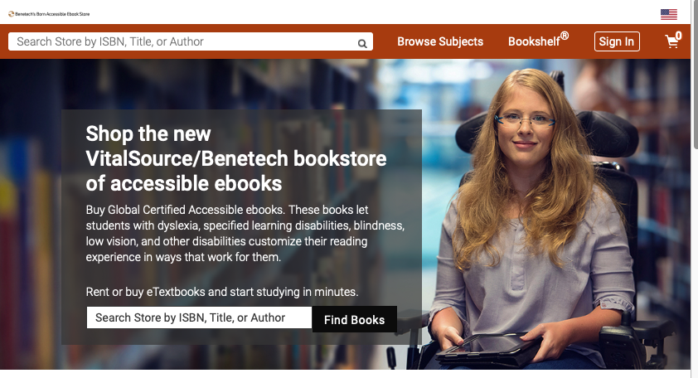
Benetech's Accessible Bookstore - Vitalsource

Slide 17
Contact Information
Charles LaPierre Technical Lead Born Accessible, Benetech charlesl@benetech.org
Michael Johnson Director of Content Partnerships, Benetech michaelj@benetech.org
Contact GCA https://bornaccessible.benetech.org/contact/

Slide 18
Resources: GCA & Tools
GCA™ Website https://bornaccessible.benetech.org/global-certified-accessible/
Certified Publishers https://bornaccessible.benetech.org/certified-publishers/
Benetech Approved Vendors https://bornaccessible.benetech.org/certified-vendors/
Benetech's Accessible Bookstore https://benetechaccessiblebooks.vitalsource.com
DAISY’s Accessible Checker for EPUB (Ace) https://github.com/daisy/ace-gui/releases
DAISY's SMART Tool https://smart.daisy.org

Slide 19
Resources: Accessibility Metadata
User Experience Guide for Displaying Accessibility Metadata
https://www.w3.org/2021/09/UX-Guide-metadata-1.0/principles/
Display Techniques for EPUB Accessibility Metadata https://www.w3.org/publishing/a11y/UX-Guide-metadata/techniques/epub-metadata/index.html
Display Techniques for ONIX Accessibility Metadata https://www.w3.org/publishing/a11y/UX-Guide-metadata/techniques/onix-metadata/index.html
W3C Accessibility Metadata Video https://www.w3.org/2021/09/publishing-seminar/talk/metadata

