Slide 1
How can campus-wide digital technologies (such as wayfinding, digital signage & self-service kiosks) be made accessible?
Laura Boniello Miller
Corporate Business Development Manager, Vispero

Slide 2
Agenda
Examples of Existing Self Service Campus Technologies
Discuss: Are existing technologies accessible?
What makes self service kiosks accessible?
When and who is responsible for self service accessibility?

Slide 3
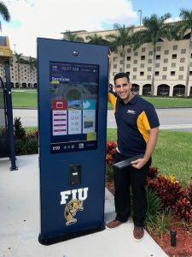
Wayfinding, Interactive Information Kiosks
Notes:
https://intermediatouch.com/portfolio-posts/florida-international-university-installs-outdoor-interactive-kiosks-with-a-custom-wayfinding-solution-to-guide-and-inform-their-students-and-faculty-members/

Slide 4
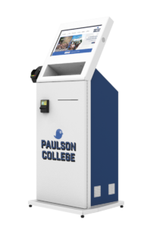
Tuition Payment Kiosks

Slide 5
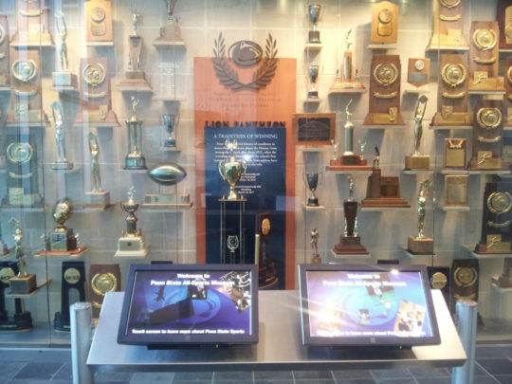
Athletic Hall of Fame Kiosk

Slide 6
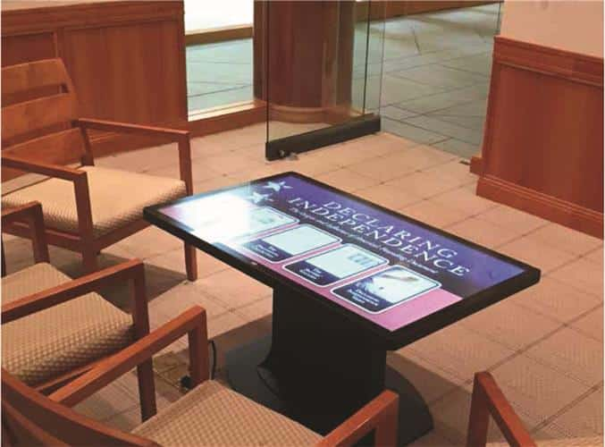
Museum Kiosk
Notes:
Declaration of independence museum table top kiosk at the University of Virginia

Slide 7
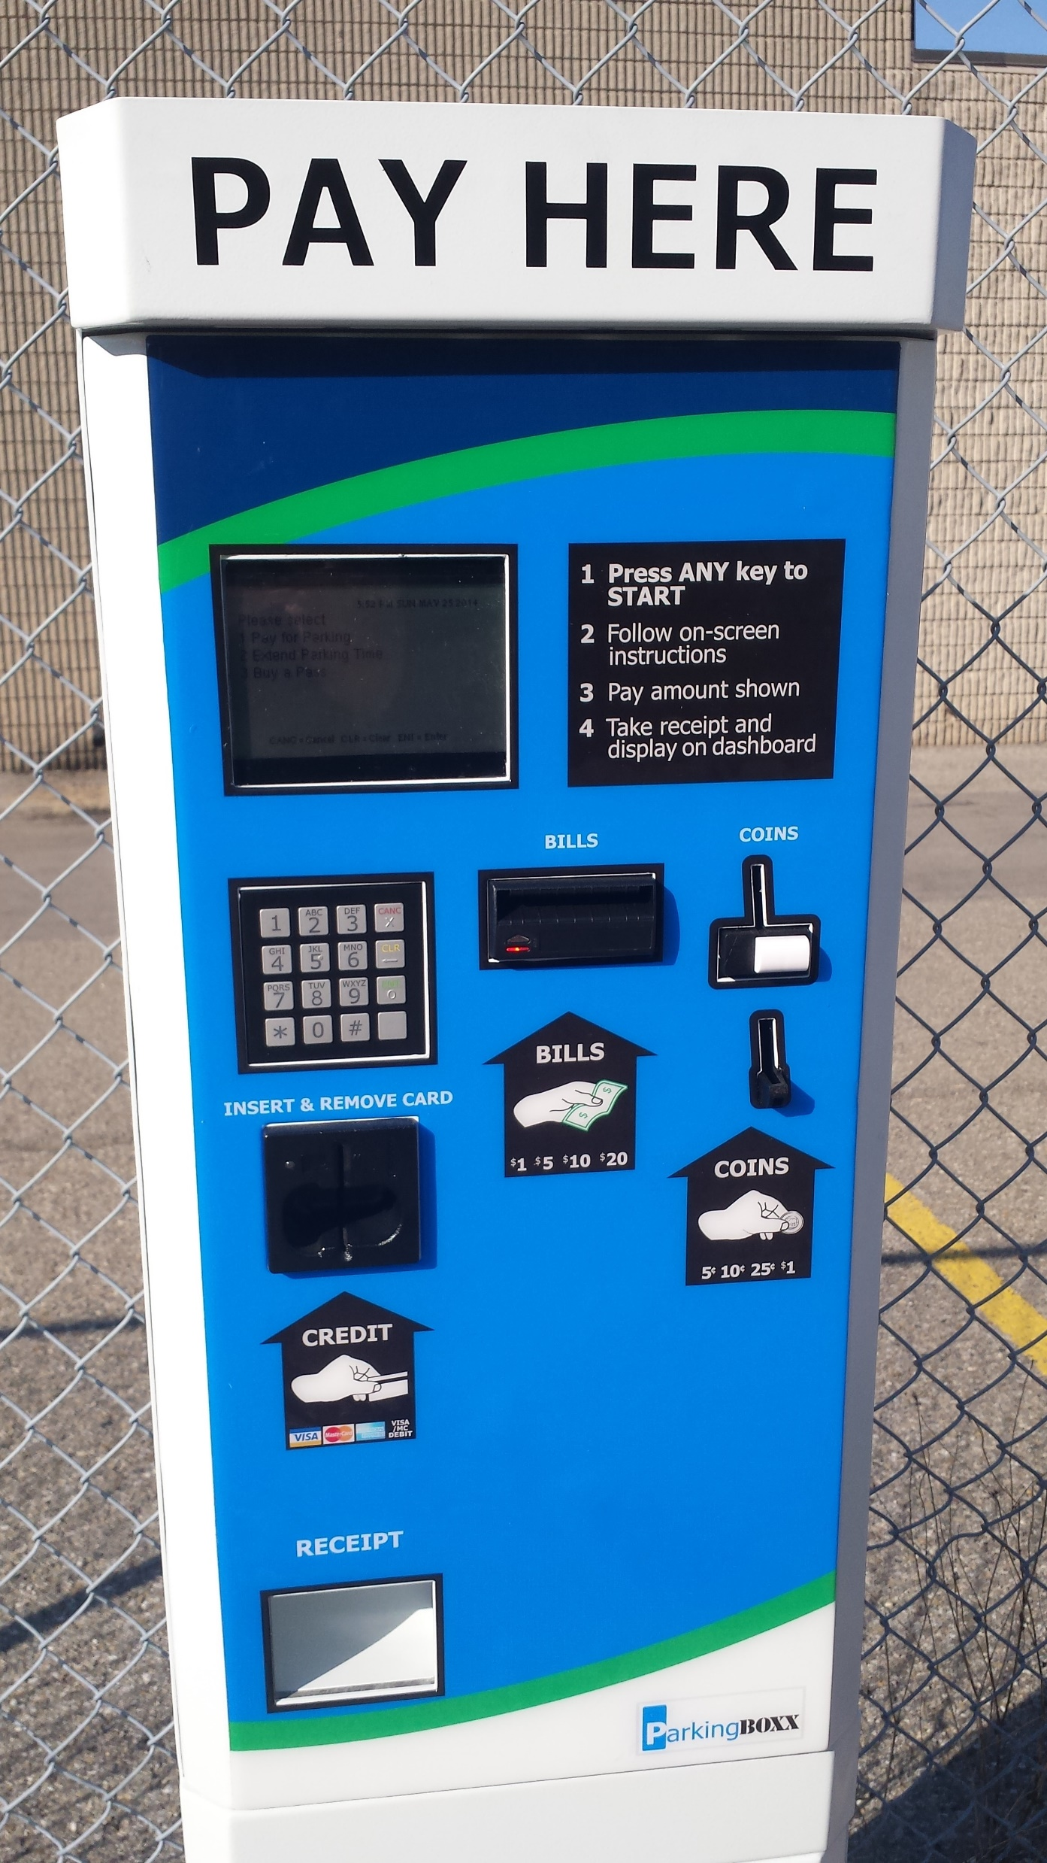
Parking Kiosk

Slide 8
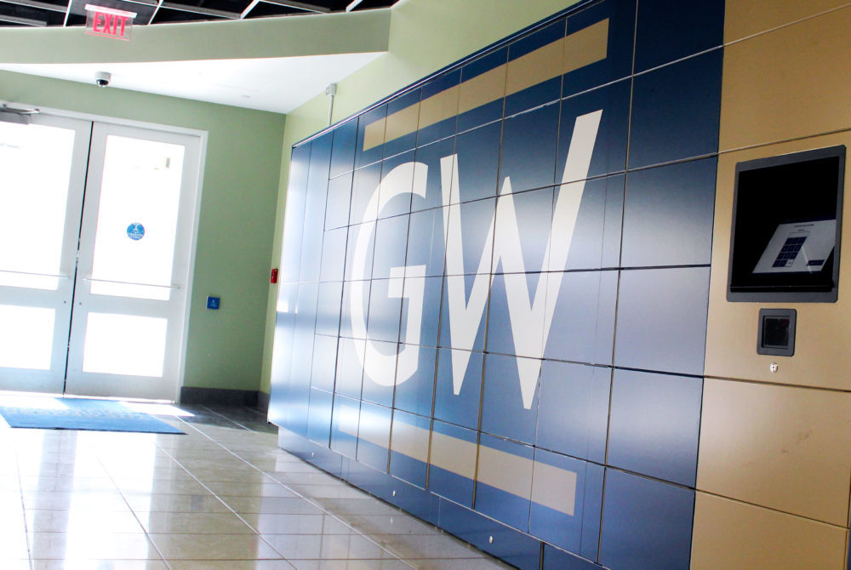
Locker Kiosk for Deliveries (Amazon)

Slide 9
Laptop dispensing kiosk

Slide 10
Vending kiosks

Slide 11
Dining services kiosks
Notes:
Virginia tech food services touch screen kiosk

Slide 12
Library Checkout Kiosks

Slide 13
What makes a closed system accessible?
Standards
Usability/Accessibility
Hardware/Enclosure
Kiosk Application/Software
Input Devices (Card Reader, Tactile Input)
Auxiliary Aids (Screen Reader)
Braille

Slide 14
Understand What Matters Most
Accessible modes should:
Perform the same functions
Provide an equivalent experience
Providing an attendant as a replacement for a kiosk is not an adequate accommodation
There is a wide range between sufficient and advisory. Aim for advisory.

Slide 15
Kiosk Accessibility
Location
Approach, Glare, Noise, and Privacy
Speech
Captions and Plain Language
Software
Contrast and Zoom
Navigation, Input and Output
Labeling
Hardware
Height and Reach
Notes:
The image on this page shows three areas in which the kiosk deployment must consider accessibility.
Location (and the built environment). This includes approach, glare, noise, and privacy. Software (the kiosk application) with speech output, captions and plain language, and contrast and zoom.
There are features in which software and hardware are both involved, and that is navigation, input and output.
Hardware considerations include labeling, height, and reach.

Slide 16
The Built Environment
A piece of hardware may be fully accessible in the showroom but moved to a site may be:
too big for the space
inaccessible to wheelchair access due to the placement of ramps
have too much glare for viewing the screen

Slide 17
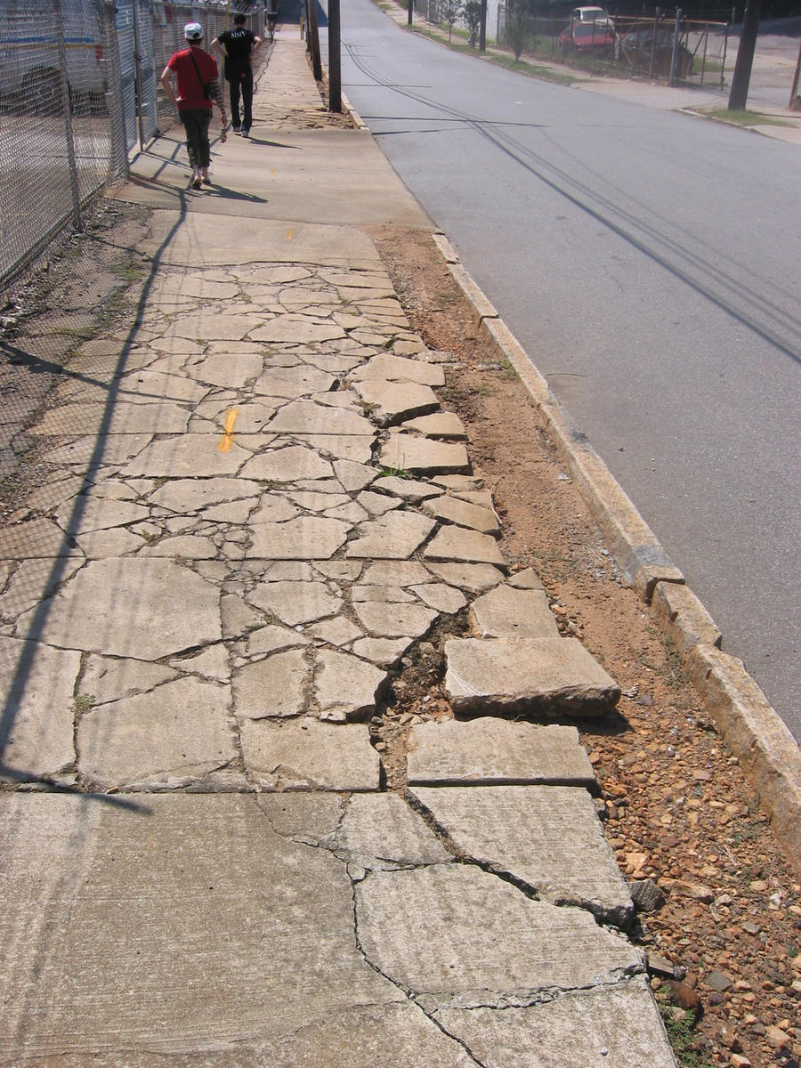
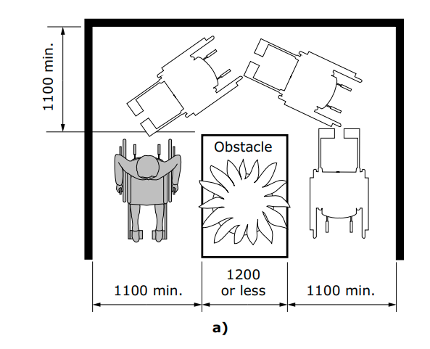
Kiosk placement/ environment

Slide 18
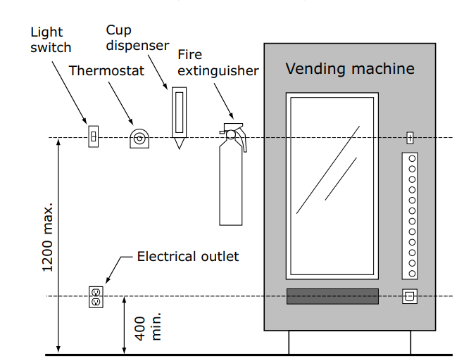
Accessibility Considerations: Reach, depth, and height requirements to enable someone in a wheelchair to interact with and view the kiosk screen and controls.

Slide 19
Assistive Technology such as (JAWS) Screen reader, Headphone Jack, Tactile input device.

Slide 20
Software Accessibility (WCAG)
WCAG 2.0 or 2.1 AA compliant
Usable Design and Usability Testing
Designing for the blind, low vision, and mobility-impaired user experience
Can the user accomplish the original task and perform the same functions?
Is it an equal or comparable experience?
Is the task completion time comparable?
Alternate Solutions
Exploring low-cost solutions during transitions
JAWS Scripting when changes to the application are not available/possible

Slide 21
JAWS Kiosk, TPGi, Vispero
Services offered include:
Review of Hardware Accessibility
Review of Software Accessibility
Design Review for Accessibility
User Testing/Usability Research
Solution Accessibility Review
Screen Reader & Tactile Device Integration

Slide 22
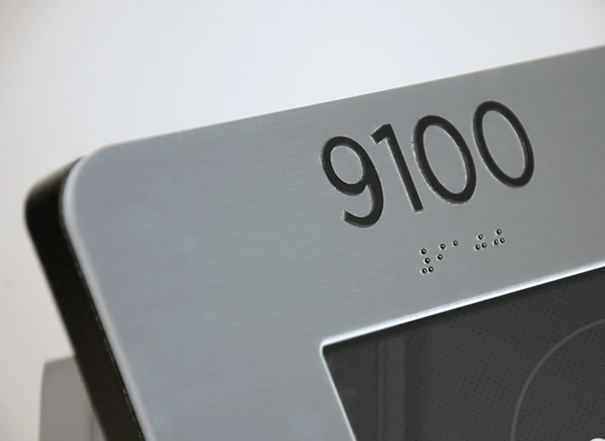
Braille Labels

Slide 23
Discussion
Questions for the audience:
Who owns accessibility of kiosks & closed systems?
Making sure turnkey solutions are accessible prior to purchase
Adding accessibility into an RFP
Requiring third party verification of accessibility prior to purchase

Slide 24
Thank you!
Questions?
Laura Boniello Miller: lmiller@vispero.com

