Slide 1
Automatic accessibility checks on online courses Supporting teachers in getting their homework done
Prof. Dr. Gottfried Zimmermann gzimmermann@hdm-stuttgart.de
Stuttgart Media University
Notes:
Happy to meet you all virtually.
Of course, we would all like to be at the lovely city of Denver.
This pandemic has really had an impact on our lives.
But not all is bad – there are also good things.
As humans, we have been given the capability to adapt and be creative. Let‘s use this capability!

Slide 2
Competence Center on Digital Accessibility
Current situation
Team of 7 persons (as of today)
Strategy: Support universities to become proficient in digital accessibility
Services: Consulting and checking of websites / documents / mobile apps
Webinars, Newsletter
URL: https://barrierefreiheit.hdm-stuttgart.de/
Notes:
Gottfried Zimmermann
White male in the age of 53, blond hair.
At Stuttgart Media University for 9 years
Working in digital accessibility for over 30 years
Lots of research has happened – but where have things really changed.
Let‘s put research into practice!

Slide 3
“Students with Impairment” in Germany
Source: Deutsches Studentenwerk. (2018, September 20). Beeinträchtigt studieren – best2. Deutsches Studentenwerk. https://www.studentenwerke.de/de/content/beeintr%C3%A4chtigt-studieren-%E2%80%93-best2
Notes:
11% Studierende mit studienrelevanter Beeinträchtigung
89% Sonstige Studierende

Slide 4
Study-Relevant Impairments
Source: Deutsches Studentenwerk. (2018, September 20). Beeinträchtigt studieren – best2. Deutsches Studentenwerk. https://www.studentenwerke.de/de/content/beeintr%C3%A4chtigt-studieren-%E2%80%93-best2
Notes:
53% Psychische Erkrankungen
20% Chronisch-somatische Erkrankungen
10% Bewegungs- und Sinnesbeeinträchtigungen
4% Legasthenie und andere Teilleistungsstörungen
6% Sonstige Beeinträchtigungen
7% Mehrere gleich starke Beeinträchtigungen
https://de.wikipedia.org/wiki/Teilleistungsschw%C3%A4che
Unter Teilleistungsschwächen oder Teilleistungsstörungen versteht man Leistungsdefizite in begrenzten Teilbereichen wie Rechnen, Lesen, Rechtschreiben, Sprechen oder der Motorik.

Slide 5
“Side Effects” of Digital Accessibility
Accessible Design is good design for all
Better learning for all
Competencies in digital accessibility for students
Legally correct
Notes:
Wir designen digitale Medien für höchste Ansprüche.
Wie beim Auto: Wenn es auch auf unwegsamem Gelände durchhält, wird es auch auf ebener Straße nicht so schnell kaputt gehen.
Barrierefreies Design ist gutes Design für alle
Struktur
Durchsuchbarkeit
Bessere Lehre für alle
Universal Design for all
Kompetenzen in digitaler Barrierefreiheit für Studierende
Bessere Karrierechancen
Gesetzeskonform
Man spart sich Abmahnungen und ggf. Prozesse

Slide 6
Research Project SHUFFLE
SHUFFLE = “Higher Education Initiative Digital Accessibility for All”
Development and evaluation of digital accessibility measures in HE
Aug 2021 – July 2024
Cooperation partners
Stuttgart Media University
Bielefeld University
Heidelberg University of Education
Freiburg University of Education
Funding from “Stiftung Innovation in der Hochschullehre”
3 Mill. €, 11 FTE

Slide 7
12 Measures for Digital Inclusion in Higher Education
SHUFFLE Makes It Work
Notes:
It is a journey that never ends.
We will never be perfect.
Accessibility is not black-and-white. There are lots of grey tones as well.

Slide 8
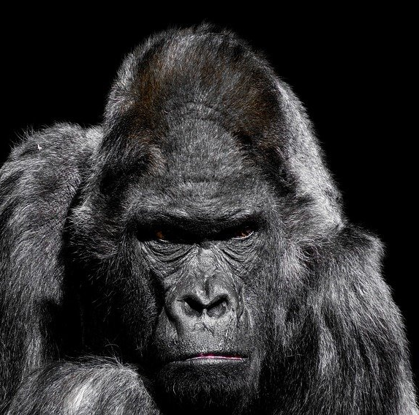
Accessible learning materials
Slides
Scripts
Learning Management System (Moodle, ILIAS, etc.)
Students as e-tutors
Accessible docs benefit all students!
Notes:
Start with your homework!
Gorilla looks grumpy.
Good for all students:
Good structure in documents
Titles for slides
Searchable slides
Text can be copied from slides

Slide 9
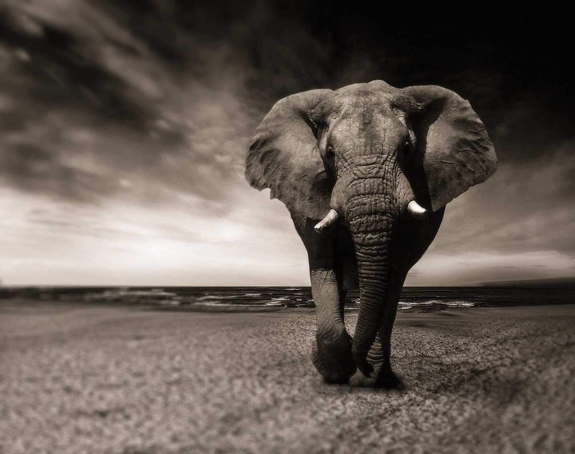
Video Recordings
Make up for a missed lecture
Rehearse for exam
Replay in any speed
Video recordings benefit all students!
Notes:
Elephants don‘t forget anything.

Slide 10
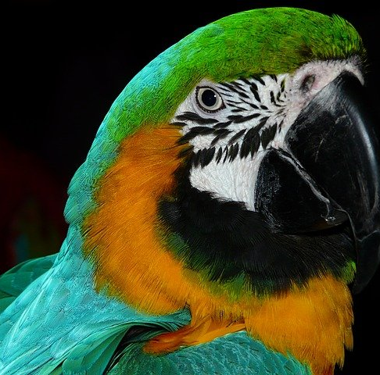
Verbal Descriptions (a.k.a. audio descriptions)
Describe diagrams and screenshots as part of the presentation
All students benefit from good explanations!
Notes:
Parrots are gossipy, long-tongued.

Slide 11
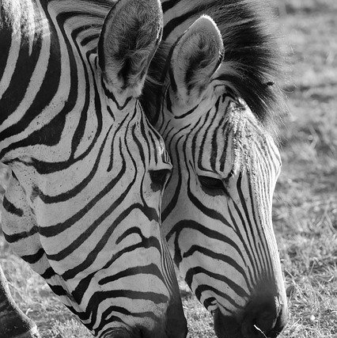
Live Captions & Translation
Automatic speech recognition (AI) achieves usable results
Manual edits can improve quality
Editing = learning?
Automatic translation into other languages (easy language?)
Many students benefit from captions and translations!
Notes:
Zebras have lines on their fur, like captions.

Slide 12
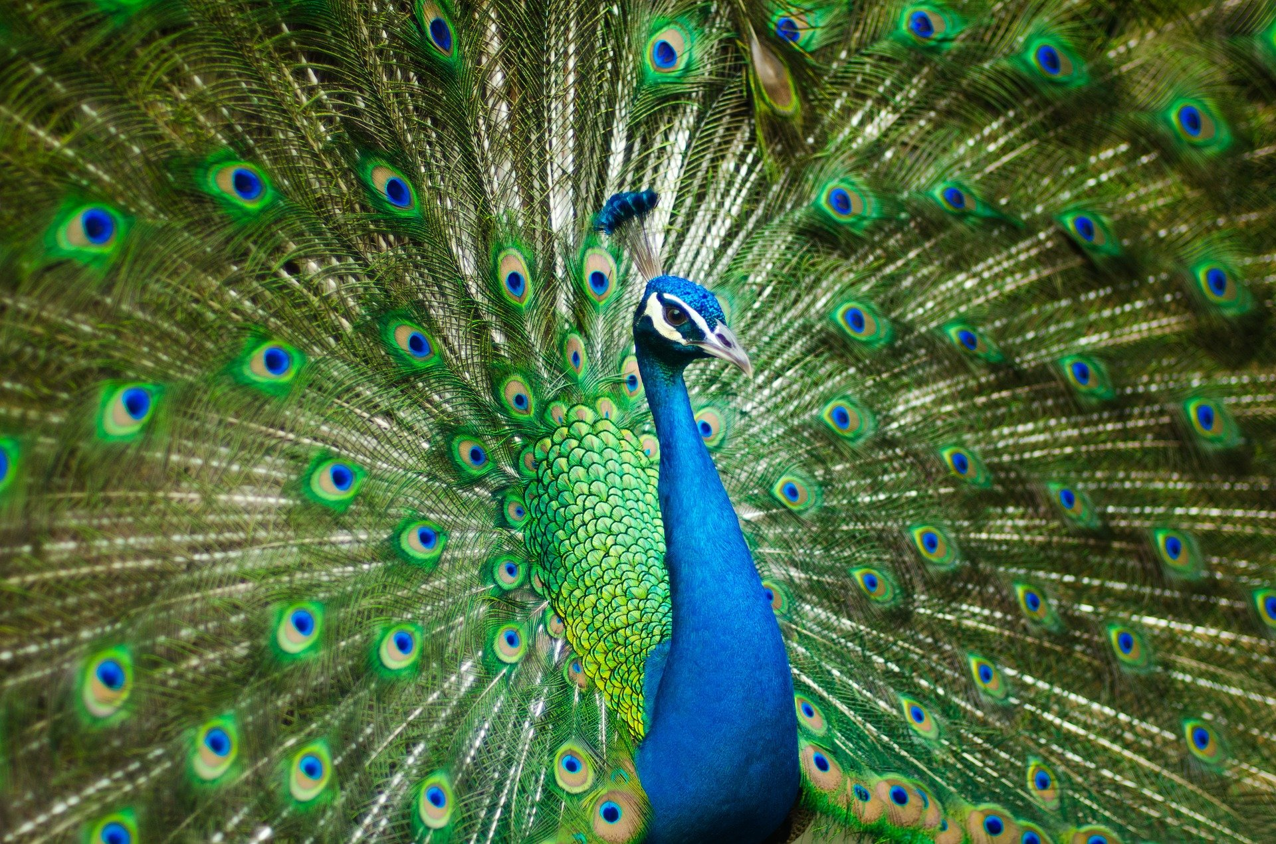
Interactive Learning Script
Multimodal script in multiple tracks, mutually cross-linked:
Video (including AD)
Slides
Captions
Translations
Learning as dialog (cf. Google Duplex)
All students benefit!
Notes:
A peacock has a complex structure of feathers. The „eyes“ are arranged in relation to each other.
Digital speech assistant, chatbots,
- E.g. Google Duplex, https://www.googlewatchblog.de/2018/11/google-duplex-der-assistent-2/, 2018-12-19

Slide 13
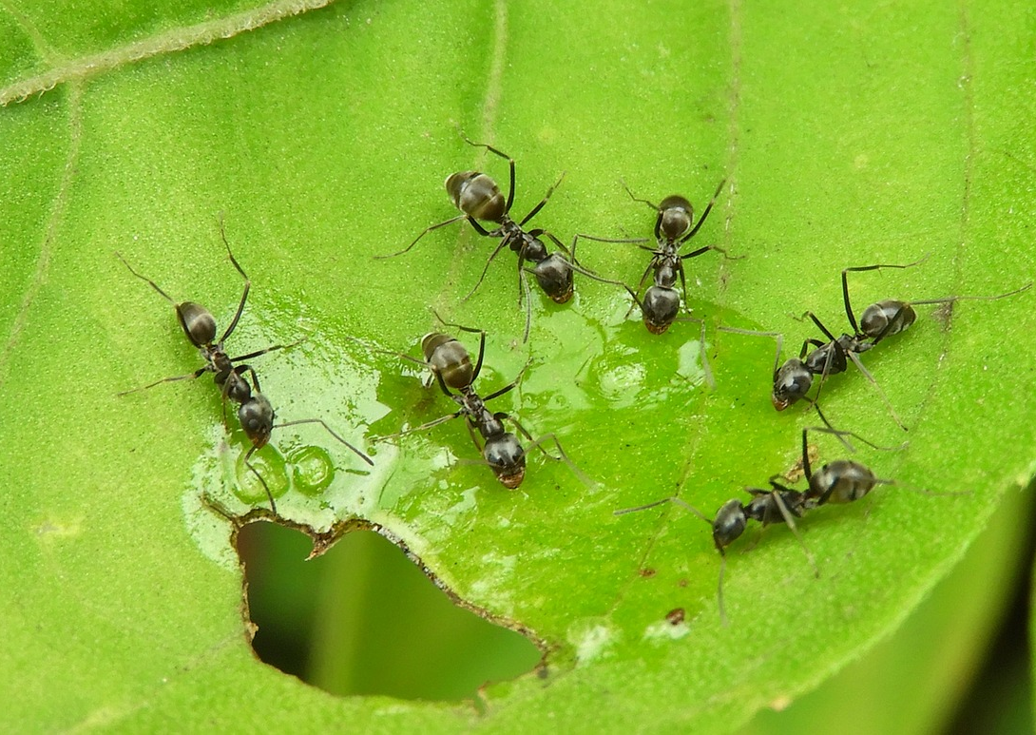
Learning Analytics
Teachers can identify problem areas and sweet spots
Learners get recommendations on learning strategies (e.g., personalization, regular breaks)
Watch out for privacy issues wrt pwds!
In particular, weak learners benefit
Notes:
Ants gather small items from different places and carry them to their heap.

Slide 14
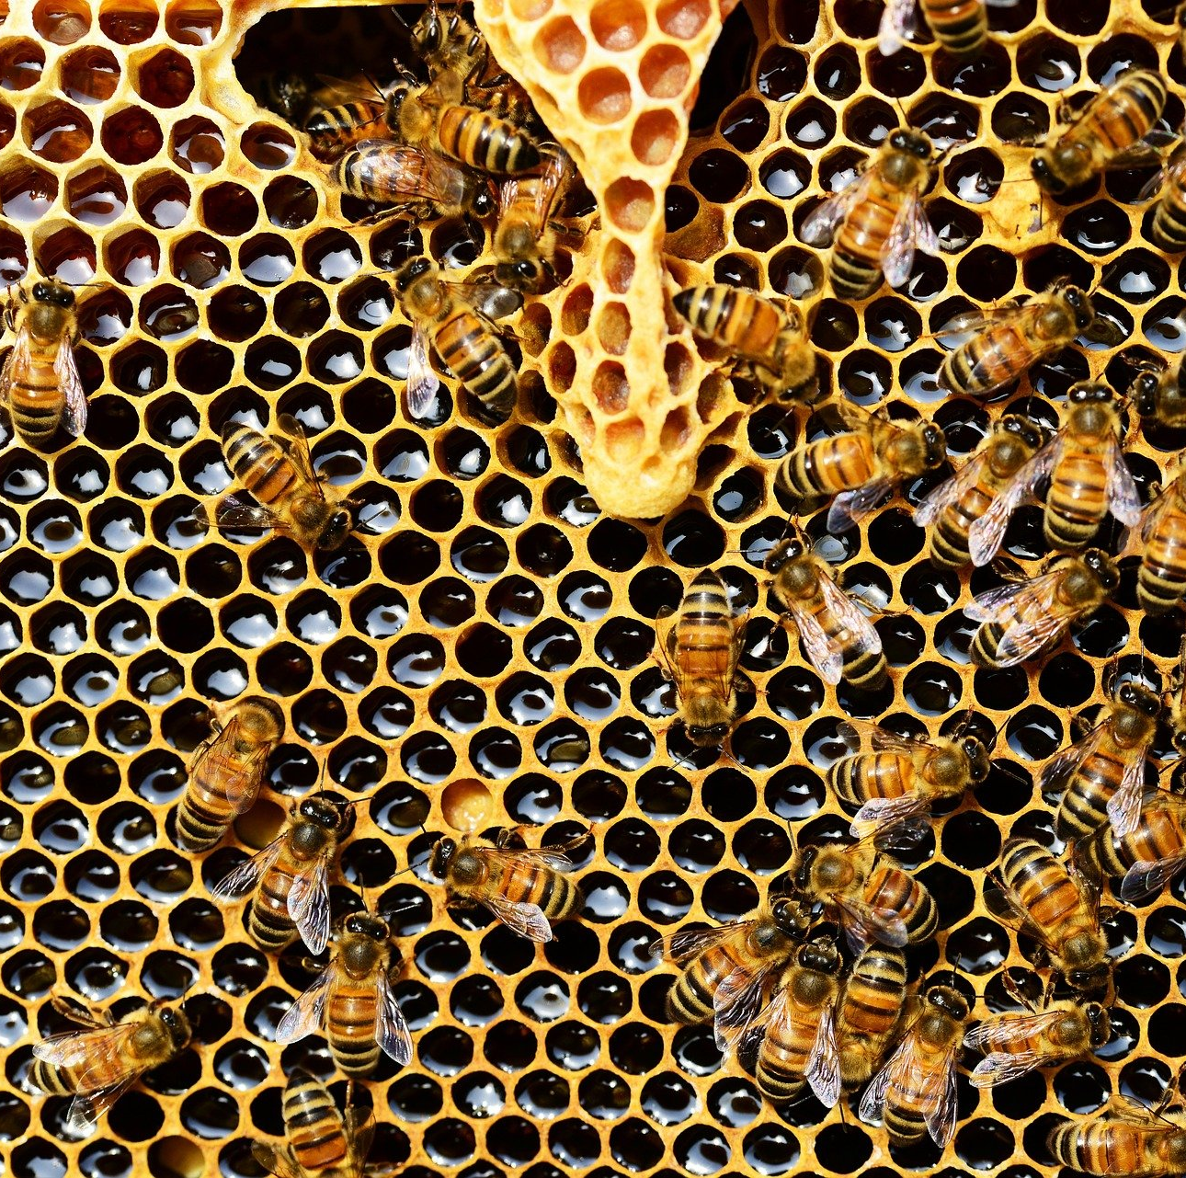
Automatic Checking of Learning Materials
Regular monitoring for online courses, including documents
Automatic tools can discover 30-40% of all error types [1]
Many students benefit from accessible learning materials
[1] Burkard, A., Zimmermann, G., & Schwarzer, B. (2021). Monitoring Systems for Checking Websites on Accessibility. Frontiers in Computer Science, 3, 1–17. https://doi.org/10.3389/fcomp.2021.628770
Notes:
Bees are diligent workers in filling honey combs. Humans rely on their work when enjoying honey.
Of course, we will need to accompany automatic tools with manual training measures.

Slide 15
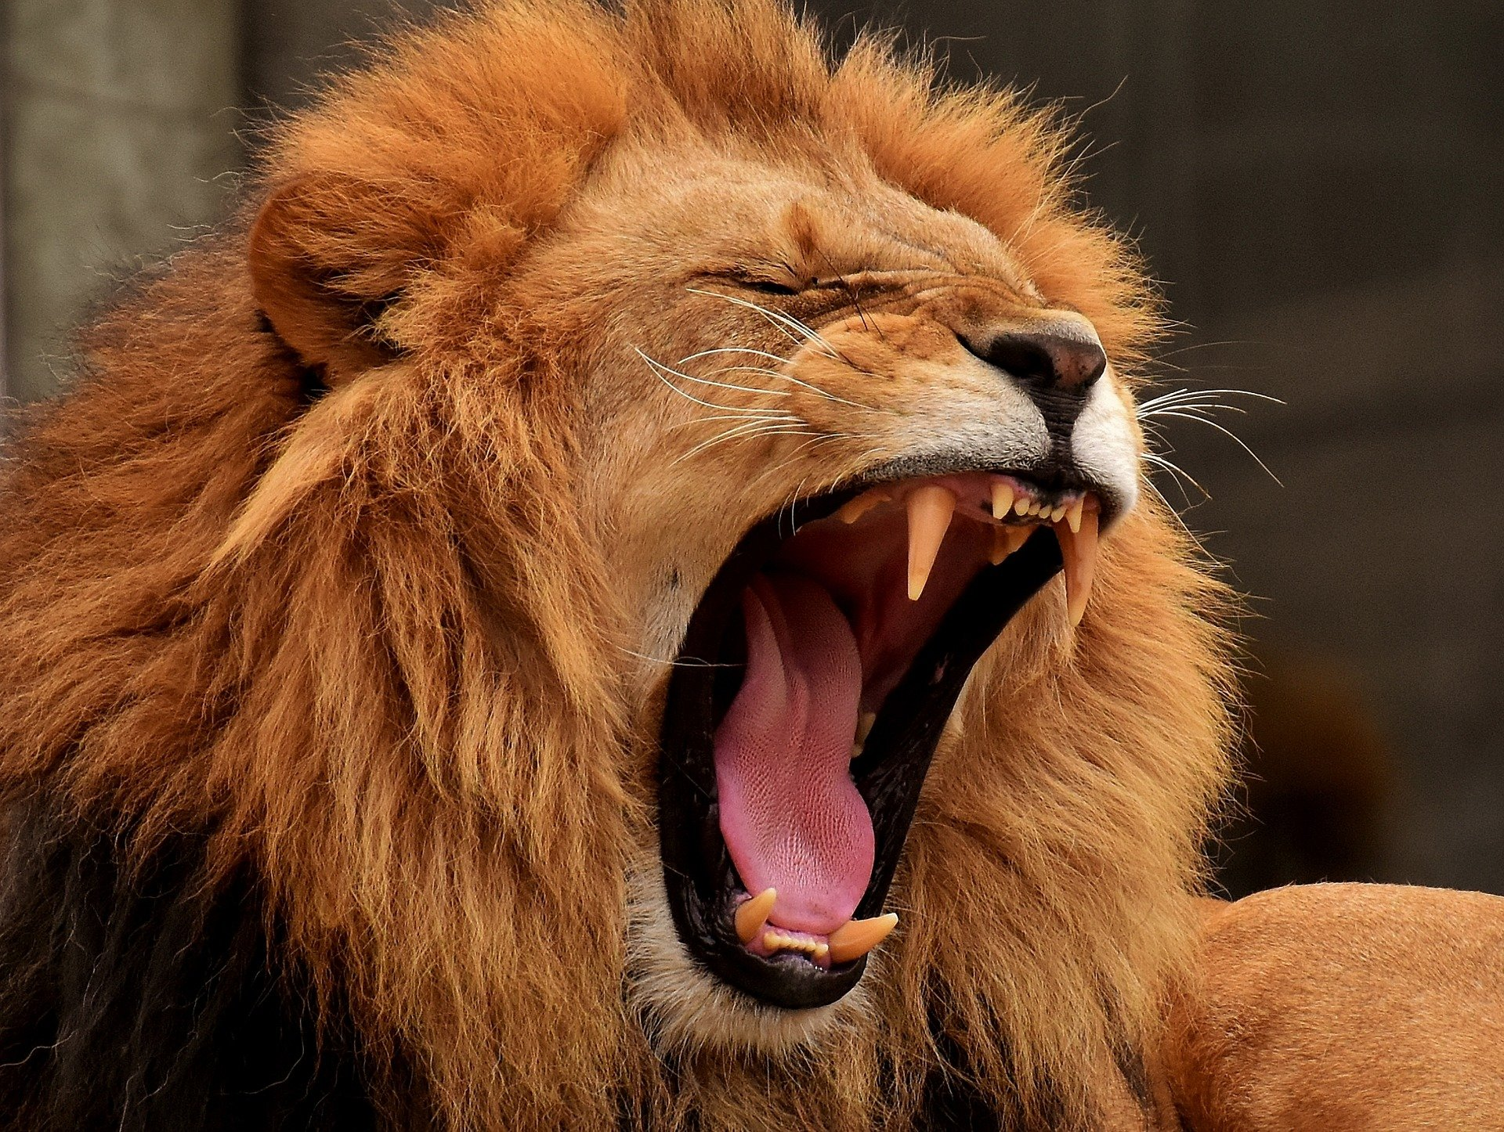
Accessibility Policy
Top-down strategy
University-wide strategy
Public announcements
Beneficial for those who care about a11y
Notes:
Lions are to be respected – otherwise it can become harmful.

Slide 16
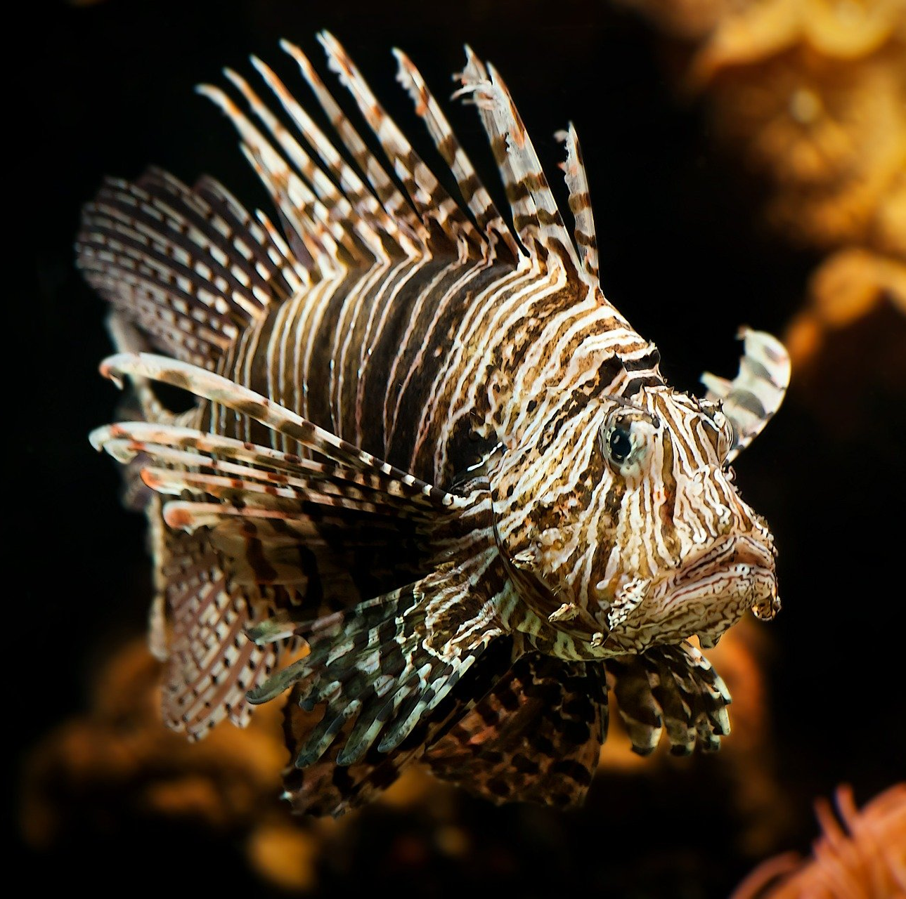
Accessibility Maturity Model
Continuous measurements
Set (intermediate) goals
Identify and target weak spots
Report to management
Beneficial for students and employees with disabilities
Notes:
The lion fish has a complex body structure, with many fins and decorations. It looks beautiful and ugly at the same time.

Slide 17
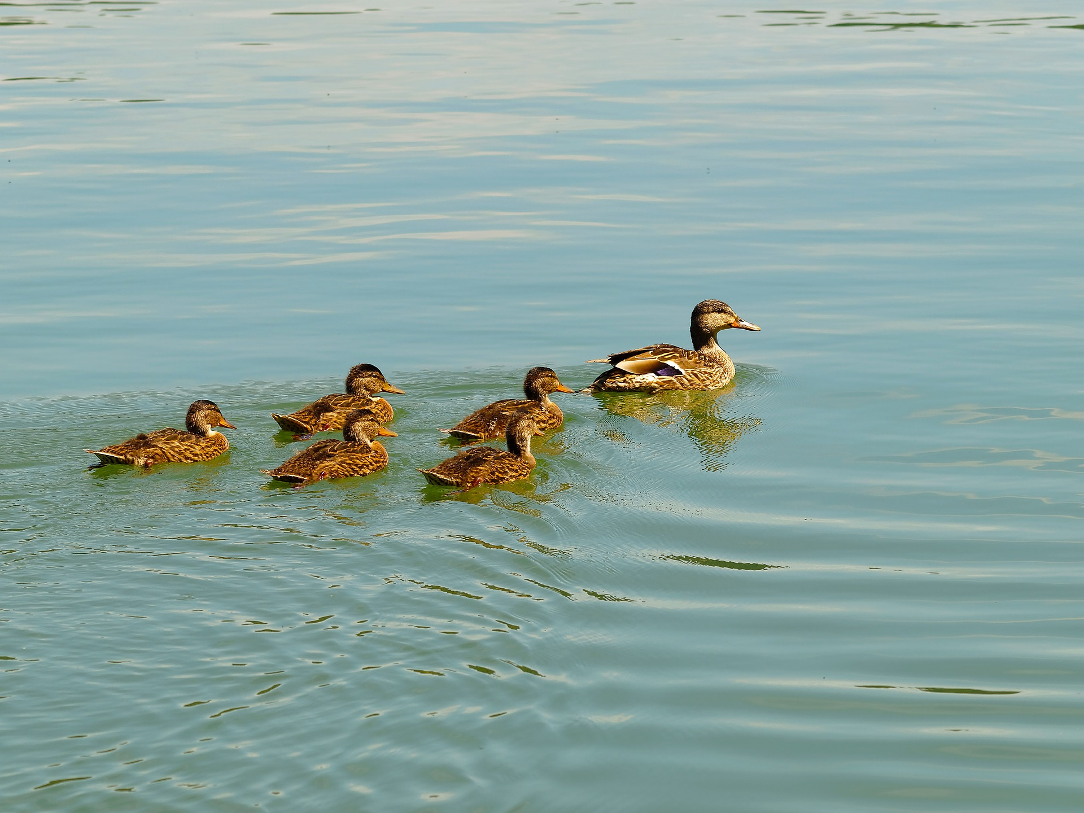
Teaching on Digital Accessibility
Include topics of digital accessibility in the curricula
Offer certificates to students and teachers (e.g., IAAP)
Good for all students to acquire skills in digital accessibility
Notes:
Ducklings follow their mother and thus get their lessons for live.

Slide 18
Interaction Spaces with Pwds
Goal: Invoke empathy and understanding
Ideal: Conversation with real pwds
Second ideal: Meet interactive virtual pwds
Beneficial for all students (“know your user”)
Notes:
A cat and a puppy are looking curiosly at each other like they have never seen each other before.

Slide 19
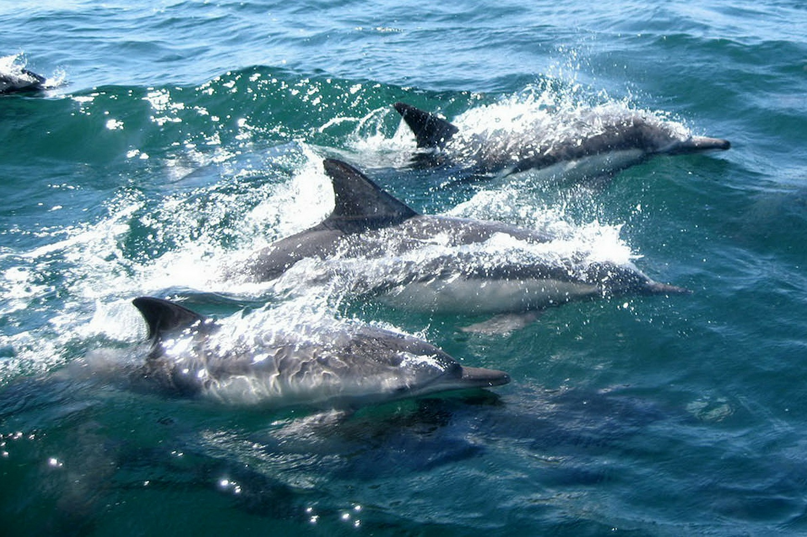
Networking
Exchange between universities
Share experiences
Share learning materials
Share tools & platforms
Notes:
Dolphins are known for their communication between each other and their swarm hunting strategy.

Slide 20
Support For Teachers
Online courses
Slides, documents, assignments, etc.
Constantly changing
Errors happen by ignorance and by accident

Slide 21
Idea: Use automatic checking tools
Automatic tools do NOT detect all errors!

Slide 22
Overall detectable errors by Criteria
Notes:
Overall possible errors 90 100%
Automatically detectable 23 26%
Only manually detectable 67 74%

Slide 23
Criteria By Categories
(1) Structure & semantics
(2) Navigation & orientation
(3) Keyboard input
(4) Text alternatives for images & non-text content
(5) Videos: captions, audio description & sign language
(6) Colors & text design
(7) Animations, distrations, flickering, timeouts & interruptions
(8) Support for form input
(9) Touch, hand & finger operation
(10) Communication by text, audio & video
(11) Support, documentations & generated content
(12) Personalisation

Slide 24
Any Online Course: Overall Detectable Errors (Categories)
Notes:
Detectable errors by siteimprove Automatically detectable Total Only manually detectable
(1) Structure & semantics 1 4 7 3
(2) Navigation & orientation 2 2 8 6
(3) Keyboard input 3 2 8 6
(4) Text alternatives 4 1 1 0
(5) Videos: Captions & AD 5 4 14 10
(6) Colors & text design 6 6 9 3
(7) Animations et al. 7 2 4 2
(8) Support for form input 8 1 5 4
(9) Touch, hand & finger operation 9 1 5 4
(10) Comm. by text, audio & video 10 0 16 16
(11) Support, doc. & gen. content 11 0 11 11
(12) Personalisation 12 0 2 2

Slide 25
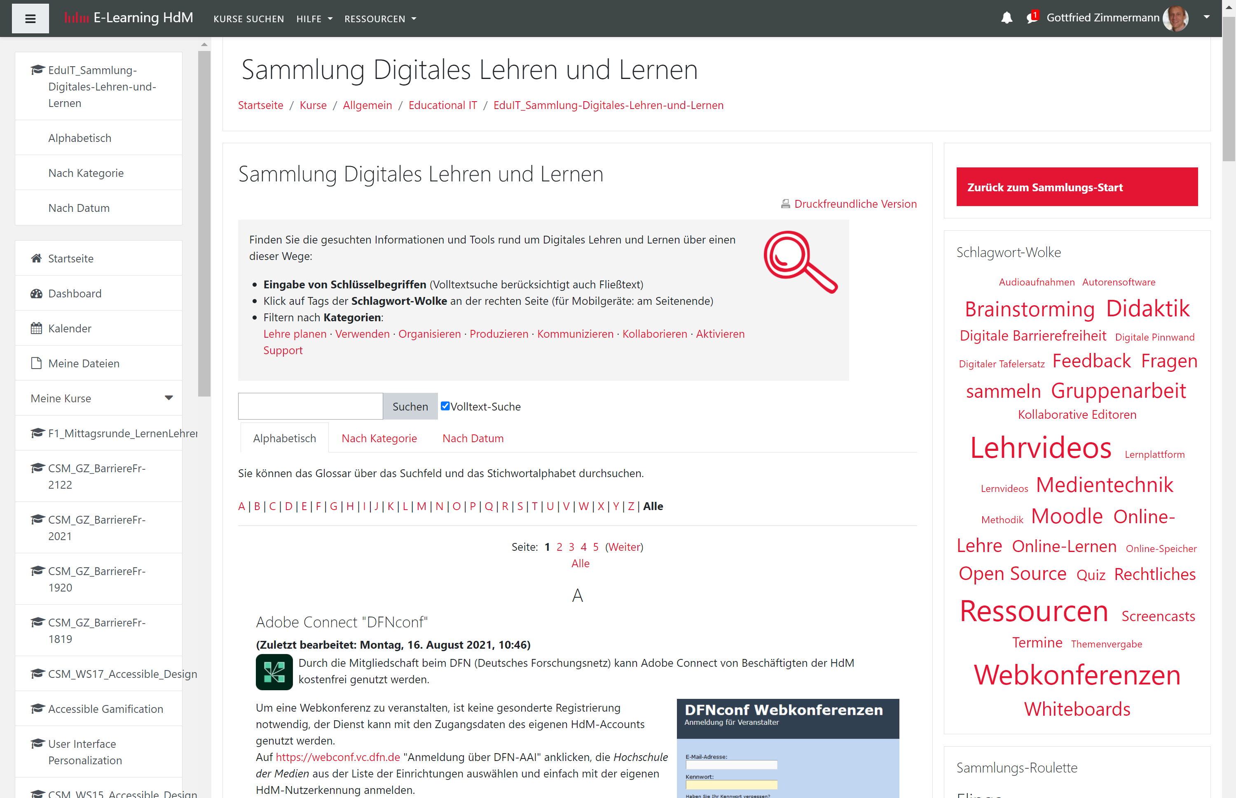
Sample Moodle Course

Slide 26
Sample Moodle Course: Error Instances
Notes:
Manually detected errors 332 100%
Caused by Author 29 9%
Caused by Platform 303 91%
Automatically detected errors 57 100%
Caused by Author 4 7%
Caused by Platform 53 93%

Slide 27
Sample Moodle Course: Distribution of Errors (Instances)
Notes:
Automatically detected (author) Automatically detected (platform) Only manually detected (author) Only manually detected (platform)
(1) Structure & semantics 1 2 51 7 189
(2) Navigation & orientation 2 0 0 0 6
(3) Keyboard input 3 0 0 0 12
(4) Text alternatives 4 2 1 0 20
(5) Videos: Captions & AD 5 0 0 0 2
(6) Colors & text design 6 0 0 17 15
(7) Animations et al. 7 0 0 1 0
(8) Support for form input 8 0 1 0 5
(9) Touch, hand & finger operation 9 0 0 0 0
(10) Comm. by text, audio & video 10 0 0 0 0
(11) Support, doc. & gen. content 11 0 0 0 0
(12) Personalisation 12 0 0 0 1

Slide 28
Sample Moodle Course: Error Criteria
Notes:
Manually detected errors 25 100%
Caused by Author 7 28%
Caused by Platform 18 72%
Automatically detected errors 8 100%
Caused by Author 2 25%
Caused by Platform 6 75%

Slide 29
Sample Moodle Course: Distribution of Errors (Categories)
Notes:
Category Automatically detected (author) Automatically detected (platform) Only manually detected (author) Only manually detected (platform)
(1) Structure & semantics 2 18 7 5
(2) Navigation & orientation 0 0 0 7
(3) Keyboard input 0 0 0 13
(4) Text alternatives 2 2 0 5
(5) Videos: Captions & AD 0 0 0 4
(6) Colors & text design 0 0 9 13
(7) Animations et al. 0 0 2 0
(8) Support for form input 0 2 0 5
(9) Touch, hand & finger operation 0 0 0 0
(10) Comm. by text, audio & video 0 0 0 0
(11) Support, doc. & gen. content 0 0 0 0
(12) Personalisation 0 0 0 2

Slide 30
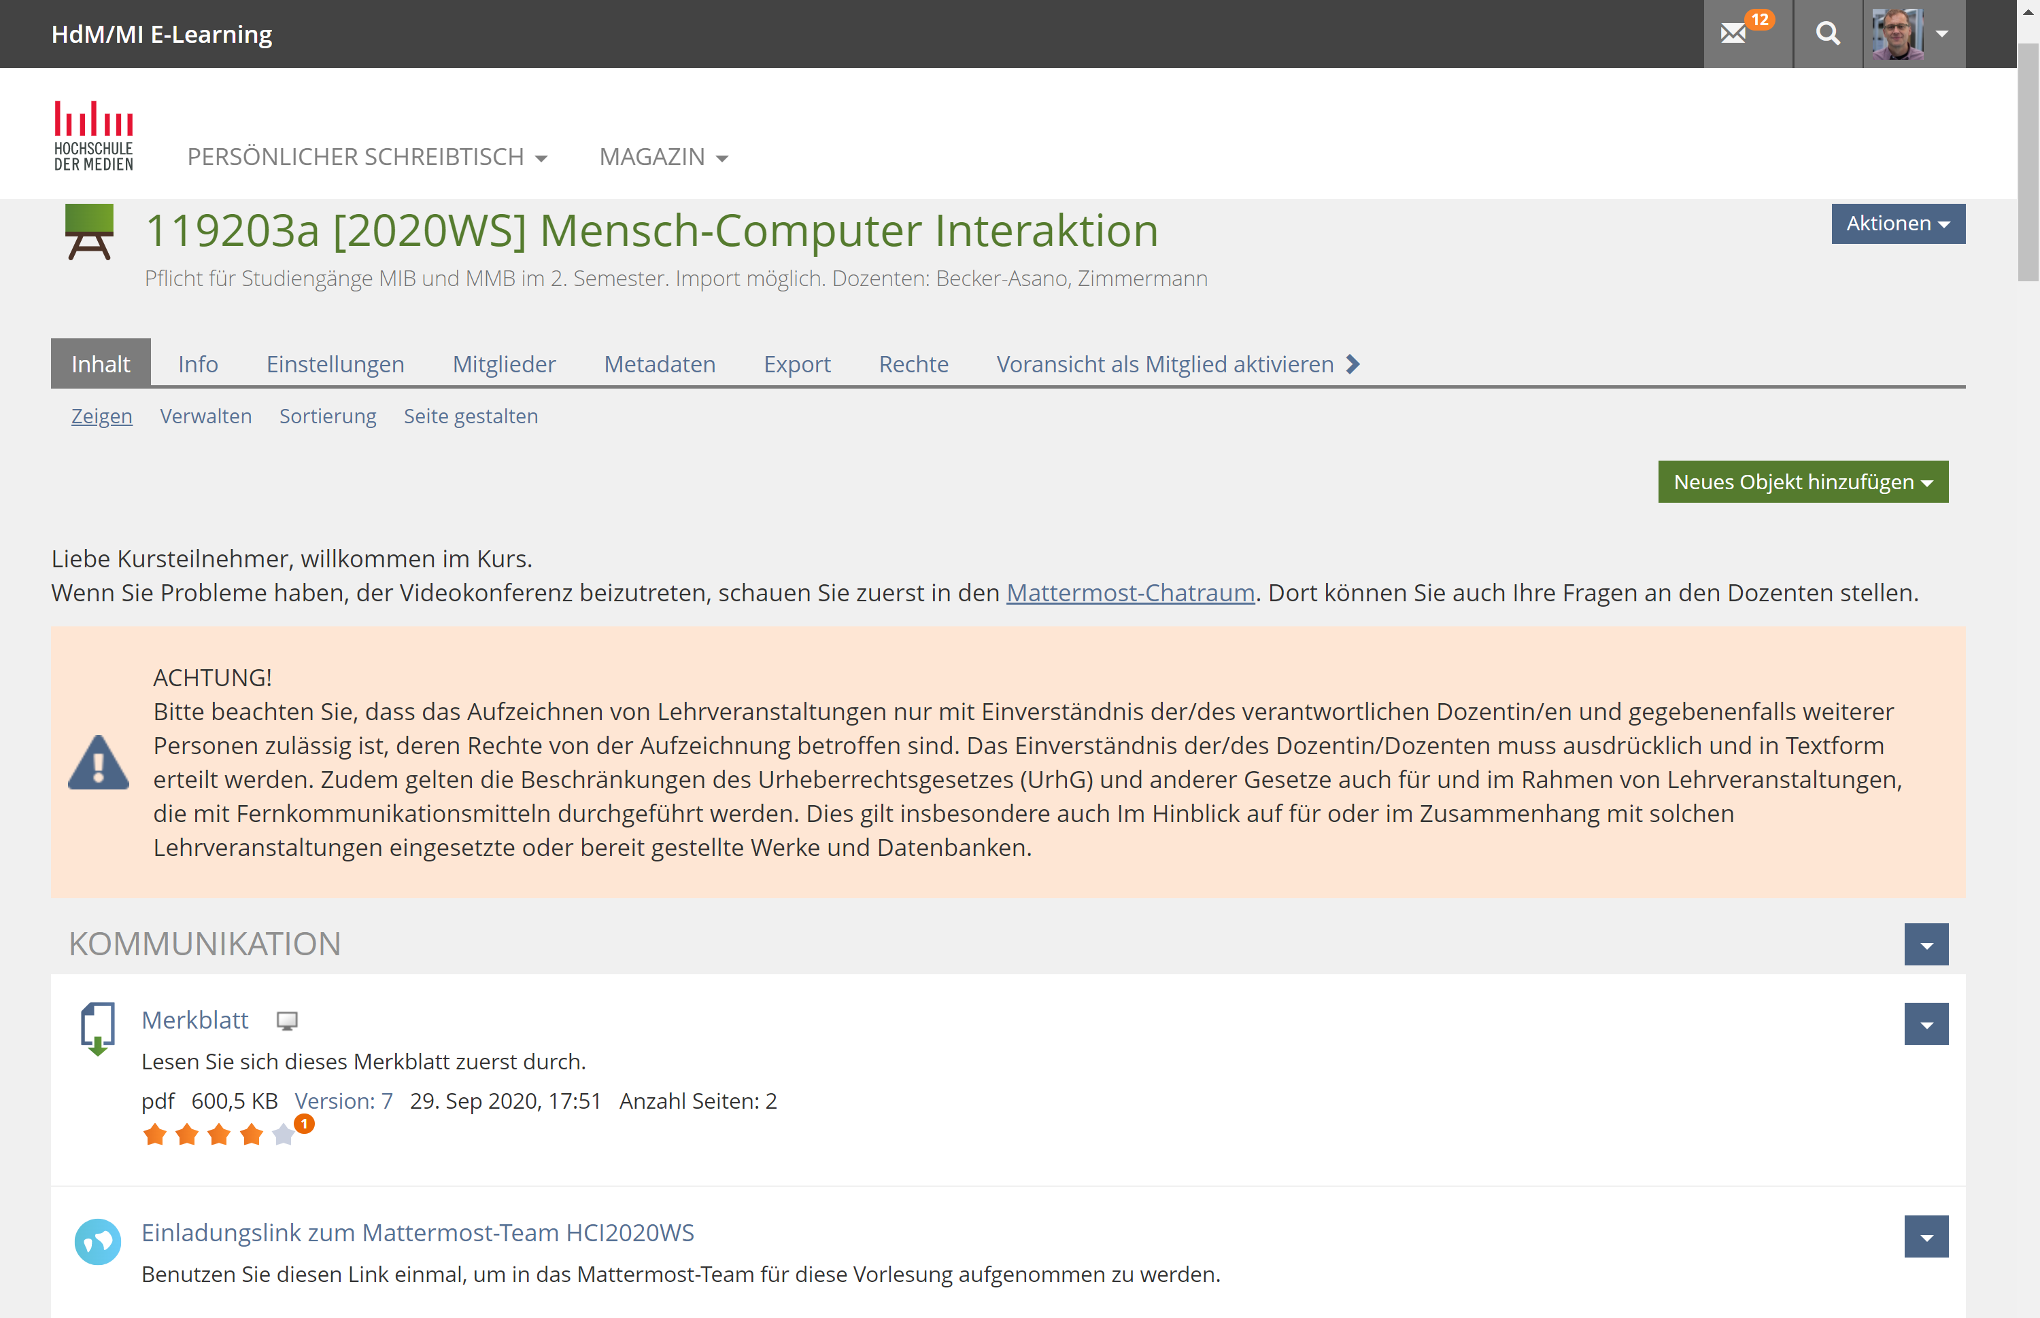
Sample ILIAS Course

Slide 31
Sample ILIAS Course: Error Instances
Notes:
Manually detected errors 292 100%
Caused by Author 1 0%
Caused by Platform 291 100%
Automatically detected errors 106 100%
Caused by Author 0 0%
Caused by Platform 106 100%

Slide 32
Sample ILIAS Course: Distribution of Errors (Instances)
Notes:
Category Automatically detected (author) Automatically detected (platform) Only manually detected (author) Only manually detected (platform)
(1) Structure & semantics 1 0 54 1 85
(2) Navigation & orientation 2 0 6 0 3
(3) Keyboard input 3 0 6 0 1
(4) Text alternatives 4 0 0 0 32
(5) Videos: Captions & AD 5 0 0 0 2
(6) Colors & text design 6 0 40 0 62
(7) Animations et al. 7 0 0 0 0
(8) Support for form input 8 0 0 0 0
(9) Touch, hand & finger operation 9 0 0 0 0
(10) Comm. by text, audio & video 10 0 0 0 0
(11) Support, doc. & gen. content 11 0 0 0 0
(12) Personalisation 12 0 0 0 0

Slide 33
Sample ILIAS Course: Error Criteria
Notes:
Manually detected errors 14 100%
Caused by Author 1 7%
Caused by Platform 13 93%
Automatically detected errors 4 100%
Caused by Author 0 0%
Caused by Platform 4 100%

Slide 34
Sample ILIAS Course: Distribution of Errors (Categories)
Notes:
Category Automatically detected (author) Automatically detected (platform) Only manually detected (author) Only manually detected (platform)
(1) Structure & semantics 0 1 1 1
(2) Navigation & orientation 0 1 0 2
(3) Keyboard input 0 1 0 1
(4) Text alternatives 0 0 0 1
(5) Videos: Captions & AD 0 0 0 2
(6) Colors & text design 0 1 0 2
(7) Animations et al. 0 0 0 0
(8) Support for form input 0 0 0 0
(9) Touch, hand & finger operation 0 0 0 0
(10) Comm. by text, audio & video 0 0 0 0
(11) Support, doc. & gen. content 0 0 0 0
(12) Personalisation 0 0 0 0

Slide 35
Outlook
“Worst-case” courses in Moodle & ILIAS
If needed re-arrange error categories
Provide error-free templates in Moodle & ILIAS
Conduct study with volunteer teachers
Bi-weekly siteimprove reports
Interventions: Monthly training, based on occurring error categories
Measure success

Slide 36
Questions?
Gottfried Zimmermann
Stuttgart Media University
gzimmermann@acm.org
Subscribe to our newsletter

