Slide 1
Notetaking Strategies
Additional Resources

Slide 2

QuickTime Audio Recorder
Open QuickTime Player
Windows: Select File > New Audio Recording
MAC iOS may need 3rd party application to record system audio.

Slide 3
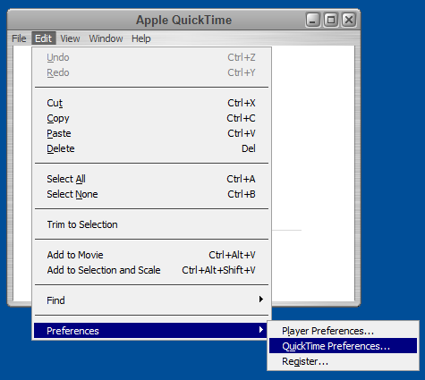
QuickTime Audio recorder: Preferences
Set recording preferences
Edit > Preferences > QuickTime Preferences
MAC iOS may need 3rd party application to record system audio.

Slide 4
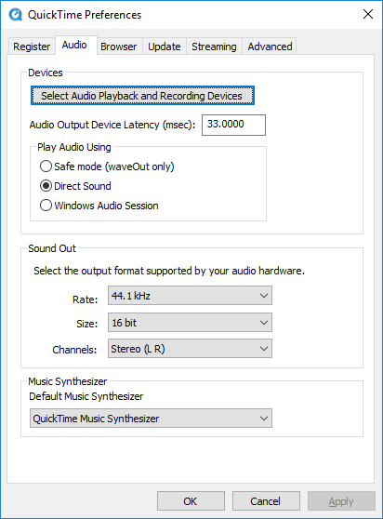
QuickTime Audio recorder: Playback & Recording Devices
Audio Playback and Recording Devices
Windows Audio Session

Slide 5
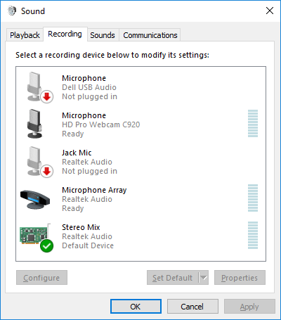
QuickTime Audio Recorder
Audio Playback and Recording Devices
Select internal system audio card
Notes:
Your devices available to record audio will be listed here. Select the internal sound device (usually a sound card).

Slide 6
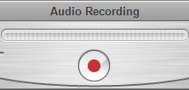
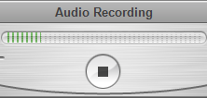
QuickTime Audio recorder
QuickTime: start recording
QuickTime: Stop Recording
You may need to set your QuickTime player preferences to select the internal system audio as the recording source.
The recorded file can be either a .mov or .m4a format.
Notes:
You may need to set your QuickTime player preferences to select the internal system audio as the recording source.
The recorded file can be either a .mov or .m4a format.

Slide 7

Windows 10 Recording
Open the application you want to record
Press the Windows key + G to open the Game Bar dialog
Check the "Yes, this is a game" checkbox
Notes:
Windows 10 has a screen recording utility called the Xbox Game Bar. With it, you can record a video of your actions in just about any Windows app on your laptop.
The video recording tool is part of the Xbox app that comes installed by default in Windows 10. Xbox Game Bar recently received some major updates to make it more useful, so you can now take screenshots and even make memes.
How to Record Video of an App in Windows 10
1. Open the app you want to record. Unfortunately, the tool can't capture some programs, such as File Manager, or the entire desktop, but it does work in regular apps, whether from the Windows Store or desktop apps.
2. Press the Windows key and the letter G at the same time to open the Game Bar dialog.
3. Check the "Yes, this is a game" checkbox to load the Game Bar. This is the procedure whether you are recording a game or another kind of app.
4. Select the Start Recording button (or Win + Alt + R) to begin capturing video.
5. Stop the recording by selecting the red recording bar that will be on the top right of the program window. (If it disappears on you, press Win + G again to bring the Game Bar back.)
That's it! You'll find your recorded videos, which are MP4 files, under the Videos folder in a subfolder called Captures.

Slide 8

Windows 10 Recording
Select the Start Recording button (or Win + Alt + R) to capture video/audio
Stop recording: select red recording bar in the top right of the program window. (Press Win + G again to bring the Game Bar back.)

