Slide 1
Inclusive Presentations Reaching your Entire Audience
Becky Gibson
Sr. Accessibility Strategist

Slide 2
Becky Gibson
30+ year career at IBM as a developer
15+ years focusing on Accessibility
W3C contributor – WCAG, ARIA, APA
Passionate about making Web usable for all
Notes:
W3C – World Wide Web Consortium
WCAG – Web Content Accessibility Guidelines
ARIA - Accessibile Rich Internet Applicatins
APA – Accessible Platform Architectures

Slide 3
Knowbility’s mission is to create a more inclusive digital world for all.
Austin, TX based non-profit organization
Founded in 1999
W3c Member

Slide 4
Agenda
Audience
Description
Plain Language
Contrast & colors
Multimedia
Materials

Slide 5
Don’t Make Assumptions about your Audience

Slide 6
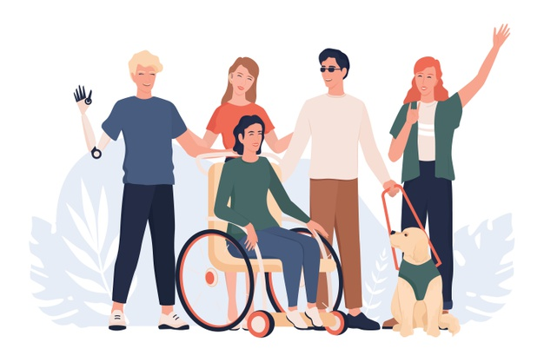
Your Audience is Varied
Notes:
Or This?

Slide 7
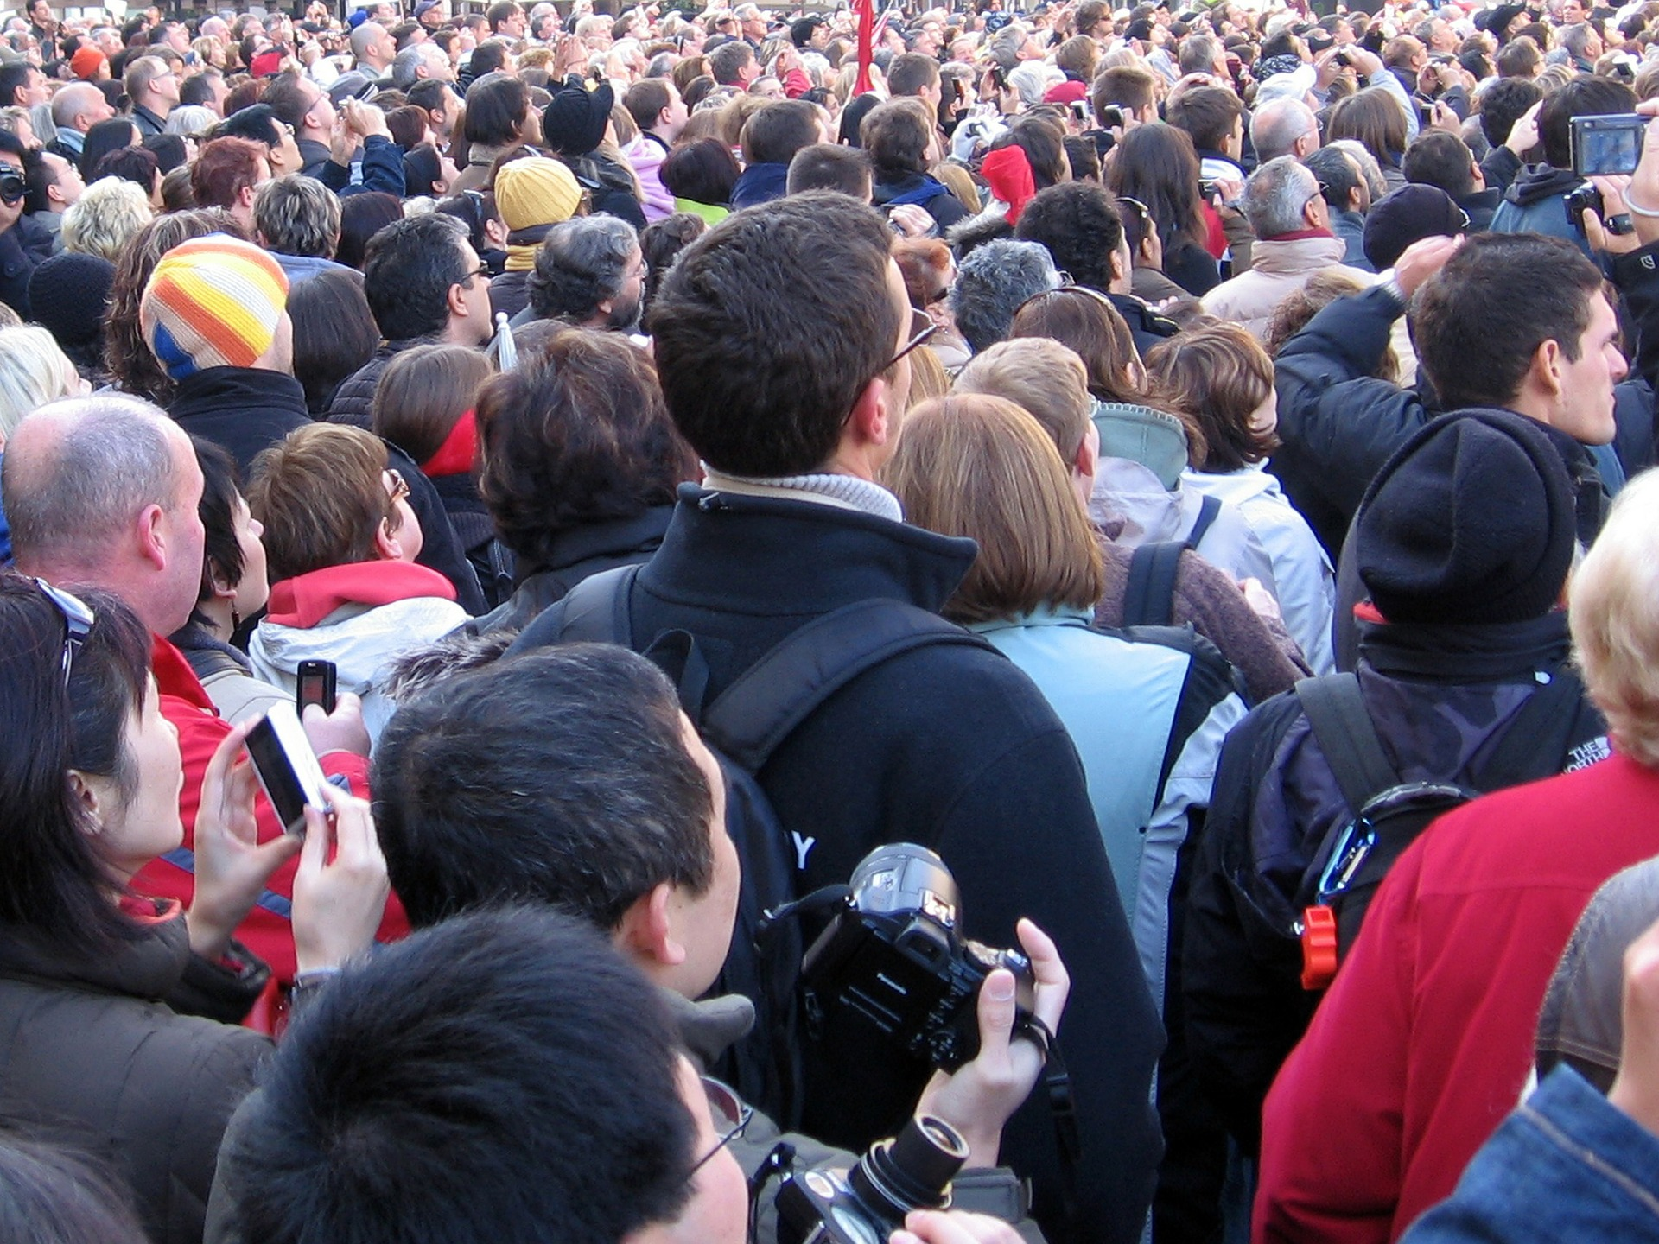
May have a Situational Disability
Add attribution
Image by AI Leinop at Pixabay
Image by Efes Kitap at Pixabay
Notes:
Maybe you are in the back of the room, off to the side, have a column blocking your view, your hearing aid or glasses broke, …

Slide 8
Describe your Materials

Slide 9
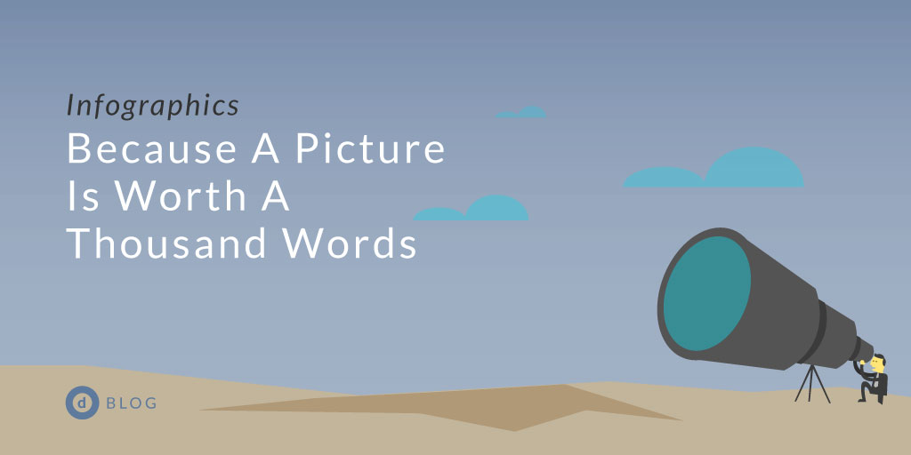
A picture is worth a 1000 words
Only if you can see it

Slide 10
A picture is worth a 1000 words
Only if you can see it
Image source: design-works.com blog post

Slide 11
Sales by Payment Method Chart

Slide 12
Color & Contrast

Slide 13
Low Contrast Bar Chart

Slide 14
Better Contrast

Slide 15
Better Contrast, Pattern, and Data

Slide 16
Text over images can be hard to read
Image by ktphotography at Pixabay

Slide 17
Add a Solid Background
Image by ktphotography at Pixabay

Slide 18
Plain Language & Acronyms

Slide 19
Accessibility Precepts
1990 ADA
1999 WCAG 1.0
2006 CRPD
2008 WCAG 2.0
2016 WAD
2018 WCAG 2.1
2019 EAA
Notes:
Don’t use advanced vocabulary, spell out acronyms

Slide 20
Accessibility Policies -1
1990 Americans with Disabilities Act (ADA)
1999 W3C Web Content Accessibility Guidelines (WCAG) 1.0
2006 Convention on the Rights of Persons with Disabilities (CRPD)

Slide 21
Accessibility Policies - 2
2008 W3C Web Content Accessibility Guidelines (WCAG) 2.0
2016 EU Web Accessibility Directive (WAD)
2018 W3C Web Content Accessibility Guidelines (WCAG) 2.1
2019 European Accessibility Act (EAA)

Slide 22
Multimedia

Slide 23
Add Captions!

Slide 24
Media
Example on youTube
Notes:
https://youtu.be/33krnU_juFE?t=17
Captions are also useful for people learning a new language, who learn better by seeing, noisy settings, quiet settings (library, shared office space, etc)

Slide 25
Captions
Notes:
Add captions for pre-recorded media, describe what is happening and locations on the screen for live demos

Slide 26
Live Demos
Demo adapted from Nicolas Hoffmanm Simple Tooltip example
Notes:
This video shows a styled button with a tooltip to demonstrate WCAG 2.1 Success Criterion 1.4.13 – Content on Hover and Focus. The button is the trigger element. The tooltip displays when the button receives focus and disappears when focus is removed. When the mouse moves over the button, the tooltip displays. When the mouse moves off of the button the tooltip disappears. The tooltip also stays visible as the mouse is moved over it. The tooltip disappears when the mouse is moved off of it.

Slide 27
Use Movement Wisely
Notes:
Make sure it is not continuous.
Give example of presenters that had a moving gif in the background of their slide while they continued talking – very distracting.

Slide 28
Moving Content & Animations
Warning: moving content

Slide 29
Shared Materials

Slide 30
Add Alt Text

Slide 31
Is the artwork important for understanding?
Why
Here?
Is
This
Photo by Chona Kasinger
The Disabled and Here Project
Notes:
https://affecttheverb.com/gallery/disabledandhere/streetprotest/

Slide 32
Make your Shared Materials Accessible
Slides
use available accessibility checkers
Documents
PDF, Word, etc
Other resources
Video, audio, exercises

Slide 33
Be inclusive in all things you do!

Slide 34
Questions?

