Slide 1
Trending Tech Tools 2020 Edition
What’s New, What’s Improved, & What’s on the Horizon for AT & Accessibility Tools
Accessing Higher Ground - 2020
Rachel Kruzel - Texthelp

Slide 2
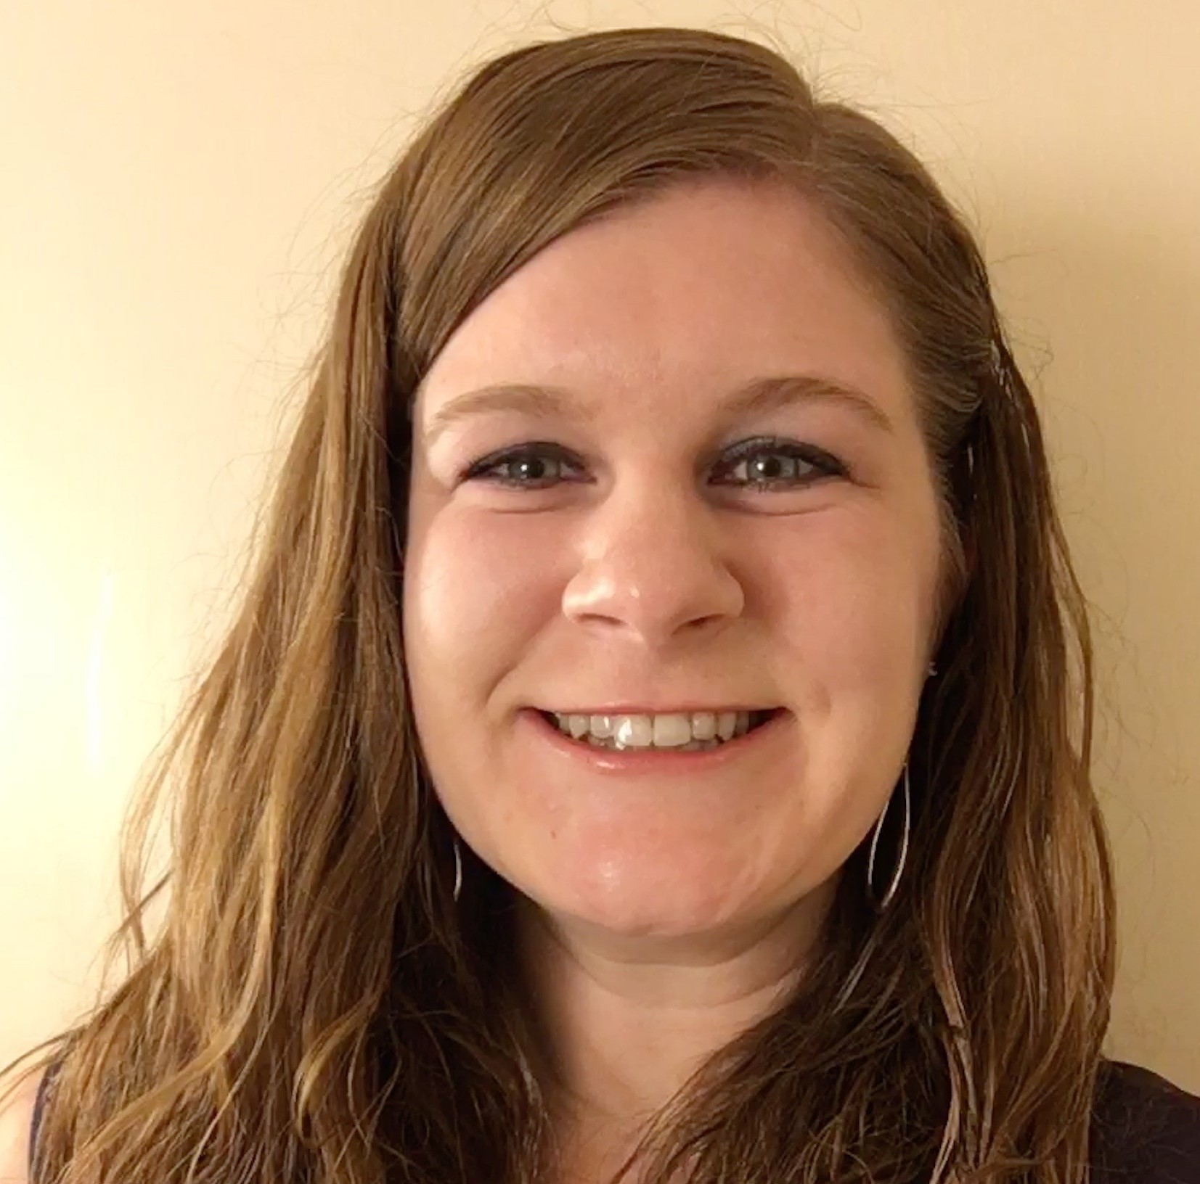
hello, I’m rachel.
Rachel Kruzel
Territory Sales Director
(MN, MO, IA, IL, WI)
Texthelp
r.kruzel@texthelp.com
651-245-3128
@TH_RachelK

Slide 3
Looking for more Information?
Visit us at our AHG AT site to request more information or type the following into your address bar: text.help/AHG20-AT

Slide 4
Today’s Agenda
What’s Trending?
What Are the Updates?
What’s Coming Our Way?

Slide 5
What’s Trending?
Notes:
HigherEd

Slide 6
Past Sessions
Notes:
HigherEd

Slide 7
This Session
Notes:
HigherEd

Slide 8
Shift to Online Learning
Image from: HBR Staff/ Apple/ Getty ccourtesy of:https://hbr.org/2020/03/what-the-shift-to-virtual-learning-could-mean-for-the-future-of-higher-ed

Slide 9
Tools to Support Online Learning
Lockdown Testing Browsers
Student Pushback
Struggles around AT integration
Video Conferencing Platforms
Learning Management Systems
Must have
Underlying Question:
How do we make these accessible?

Slide 10
“Techquity”
Technology + Equity = Techquity
Do individuals have equitable access to the technology needed to:
Learn
Work
Live
Spotlight on the techquity divide

Slide 11
Shortages of Live Captioners
Exponential increase in requests
AI/Machine Learning/Automatic Captioning Solutions
Built-In & Company Integration Solutions
Long-term cost of live captioners

Slide 12
Publishers and Organizations doubling down
Whitepaper on ePub Adoption:
It’s Time to Use the Modern Digital Publishing Format for Your Organization’s Documents
AT companies following suit
Wider ePub Adoption?

Slide 13
What’s Are the Updates?
Notes:
HigherEd

Slide 14
Updates to Support Online Learning
Underlying theme for most tech companies
Many updates, ease of use, user experience, accessibility, features to help support the transition
Notes:
Automatic captions are coming to Zoom

Slide 15
Built-In Speech Recognition Integration
Zoom - available for K12; not yet for higher ed or individual accounts
Paid Zoom Account Beta Program
Google Hangouts
Notes:
Automatic captions are coming to Zoom

Slide 16
AT/Access Company Integration
Otter.AI
Ava
Rev
Verbit
Notes:
Automatic captions are coming to Zoom

Slide 17
WebCaptioner
WebCaptioner (website link)
Free
Chrome Browser; save captions
Zoom Integration
Notes:
“This would still need some work from IT staff, there are API keys to add to the zoom account by an admin” from Neal

Slide 18
Read&Write
New Talk&Type for Windows
Development for New PDF Reader & Rebuild of Read&Write toolbar

Slide 19
EquatIO
O365 Access
Windows PowerPoint
D2L Brightspace Integration
STEM Tools
“Copy As Math” Button
Alt Text in GSuite
MathML Addition

Slide 20
AT Support in Lockdown Browsers
Read&Write for Lockdown Browsers
ReadSpeaker - Respondus
Kurzweil - Respondus
Dragon
Dual Screens

Slide 21
Does the Tool...
Meet students in all the educational environments students are working within?
Addressing all the needs/problems issues you need support around?
Are you just greasing the squeaky wheel?
Systemic, holistic support for students?

Slide 22
Increase In Publisher Accessibility?
NFB/Pearson Agreement
Enhance access of products and courses, culture, accessibility efforts
Kurzweil collaboration?
Will this push the envelope?
Will private companies start to turn the corner?

Slide 23
Notetaking
Sonocent:
Glean Mobile
Features that support online learning
Livescribe Echos are not going away
Continued rumor
Livescribe Symphony release
Transcriptions apps are huge!

Slide 24
Other Notables
Inspiration version 10
What’s New In Version 10?
iOS 14
Sound recognition, Headphone accommodations, Back Tap, updates to VoiceOver, FaceTime detects sign language
Notes:
Replace screen gesture so easier for those with motor or cognitive disabilities
Adjusts sound frequency based on what you are listening to
VoiceOver recognize more on the page, text in images, photos

Slide 25
What’s Coming My Way?
Notes:
HigherEd

Slide 26
Budget Strain
Decrease in enrollment + Covid Costs = projected 5 years of budget strain
Data Driven Decision Making is Key
Notes:
“Show me the data!”

Slide 27
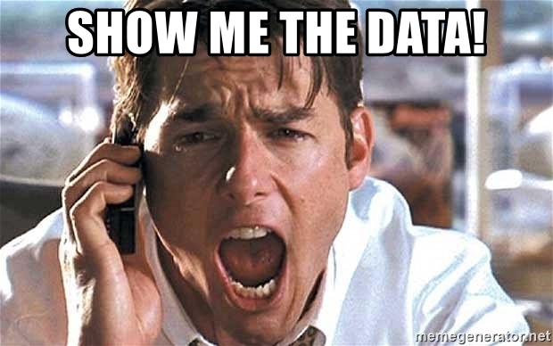
Show Me the Data!

Slide 28
Budget Strain Musts
Proactive Advocacy of Tool Benefit
Backup Plan for funding/long-term solutions
Non-negotiable tools
Don’t let momentum slow
Notes:
“Show me the data!”
Live captioning is suck budgets

Slide 29
Rapid Development of AT Tools
Quickest development we’ve seen in years
High competition
Notes:
“Show me the data!”

Slide 30
Rapid Adoption of EdTech Tools
Has the tool been fully vetted for accessibility?
Is the tool accessible?
Retroactive accommodations
Notes:
“Show me the data!”

Slide 31
Questions

Slide 32
Thank you!
Rachel Kruzel
Territory Sales Director
(MN, MO, IA, IL, WI)
Texthelp
r.kruzel@texthelp.com
651-245-3128
@TH_RachelK

