Slide 1
Accessing Higher Ground, Westminster, CO
Campus Transition To EPUB
November 17, 2020

Slide 2
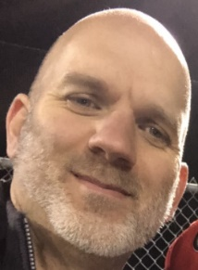
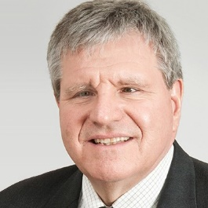
Presenters
Teressa Keenan
Joseph Polizzotto
George Kerscher

Slide 3
How We Got Involved
Joseph’s experience:
Joining a DAISY workgroup
Joseph learned about the rich accessibility features of “born accessible” eBooks
Teressa’s experience:
Campus Digital Accessibility Committee
Joined EPUB in Higher Education Workgroup

Slide 4
Stakeholders
Students
DSO Staff
Faculty/Instructors
Support staff
Librarians
University bookstores and publishers

Slide 5
Steps for Reaching Your Campus
Joseph’s tips:
Inform DSO staff about EPUB
Train students on EPUB reading systems
Learn how to create and remediate EPUBs

Slide 6
Steps for Reaching Your Campus continued
Teressa’s tips:
Inform faculty and support staff about EPUB
Provide support for creation / conversion to EPUB
Provide incentives for EPUB use by faculty
Encourage publishers and vendors to provide accessible EPUB
Highlight EPUB options to students

Slide 7
Conclusion
Access professionals play a key role in informing stakeholders and developing a plan.
The promotion of EPUB depends on students, DSO staff, and faculty viewing EPUB as a desirable format.

Slide 8
Resources
Community:
Join the EPUB for Higher Education Group
Training:
See the DAISY Consortium YouTube Channel
More Information:
See our EPUB Resources Guide

