Slide 1

Reading Systems Face Off
Accessing Higher Ground
Accessible Media, Web and Technology Conference
November 9-19, 2020
How to access EPUB reading systems and how you can know which are the best

Slide 2

Introductions
Joseph Polizzotto
Alternate Media Supervisor
UC Berkeley

Slide 3

Introductions
George Kerscher
Chief Innovations Officer
DAISY Consortium

Slide 4

Introductions
Richard Orme
Chief Executive
DAISY Consortium

Slide 5

Overview
Which EPUB reading systems support the features found in accessible EPUBs and provide the greatest support for users of assistive technology?
In this session we will present a systematic method for testing the accessibility of EPUB reading systems and share the results of our tests. In the process, attendees will learn which EPUB reading systems currently offer the best reading experience for learners.

Slide 6

Quick poll
What devices are learners with print disabilities using?
iPhone / iPad
Android phone / tablet
Macbook
Windows PC
Chromebook
Other
Tell us in the Q&A

Slide 7

Methodology
Standardized test files
http://www.epubtest.org/test-books
Specific tests based on what users say are the most important criteria
Evaluator determines ‘pass’ or ‘fail’, and adds useful notes
Developer has the chance to review (and fix issues!)
Anyone can repeat the tests
Test results are published
http://www.epubtest.org/results

Slide 8

What do we look at?
Basic Functionality
Non-Visual Reading
Visual Adjustments
Read Aloud
Extended Descriptions
Mathematics

Slide 9

Navigation, structure & page numbers
Table of contents (comment on ease of use and features)
Print page navigation (go to page, what page am I on?)
Search
Bookmarking
Other navigation (Bookshelf has figures, Thorium has landmarks etc.)
Browse and select from bookshelf (find recent, search, tag)

Slide 10


Screen reader support
Assessments based on results from Basic Features
and Non-visual reading
Students studying STEM will also be especially interested in results from the Extended descriptions and Mathematics tests
Notes:
George

Slide 11

Visual adjustments
Text size
Colors
Brightness
Support for high contrast
Fonts
Enlarging images
Compatibility with magnification utilities
Also: spacing and margins, justification
Notes:
Richard

Slide 12

Read aloud
Start stop pause resume
Control reading position
Continuous reading
Punctuation and phrasing
Visual highlighting
Reading speed
Also: change voices, language switching, correct pronunciation
Notes:
Joseph

Slide 13

Reading systems under the microscope
Online:
EBSCO eBook reader Edge Windows
RedShelf Chrome Windows
VitalSource Bookshelf Online Chrome Windows
Apps:
Bookshelf for Windows and macOS
EasyReader for Windows, iOS and Android
Kindle for Windows
Texthelp EPUB reader
Thorium Windows and macOS

Slide 14

And the top picks are…

Slide 15


Blind Windows user
Thorium Reader
  results with NVDA
  results with JAWS
RedShelf with Firefox
  results with NVDA
  results with JAWS

Slide 16
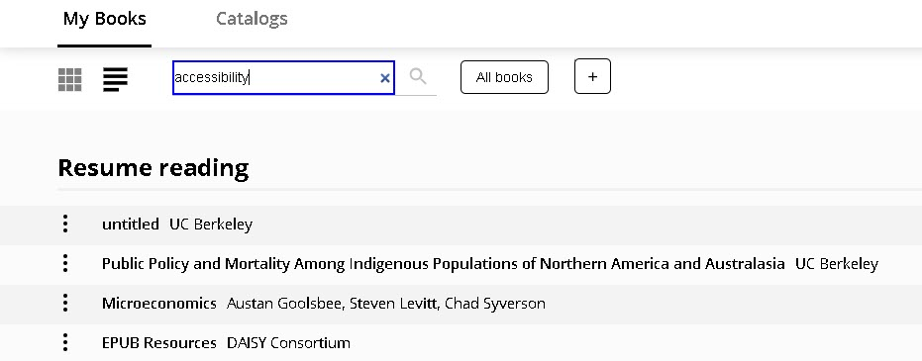
Thorium Reader – My Books

Slide 17


Blind mobile user
EasyReader iOS
  evaluation results
Bookshelf iOS
  evaluation results

Slide 18
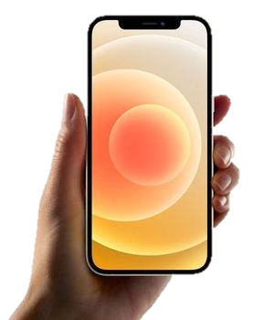
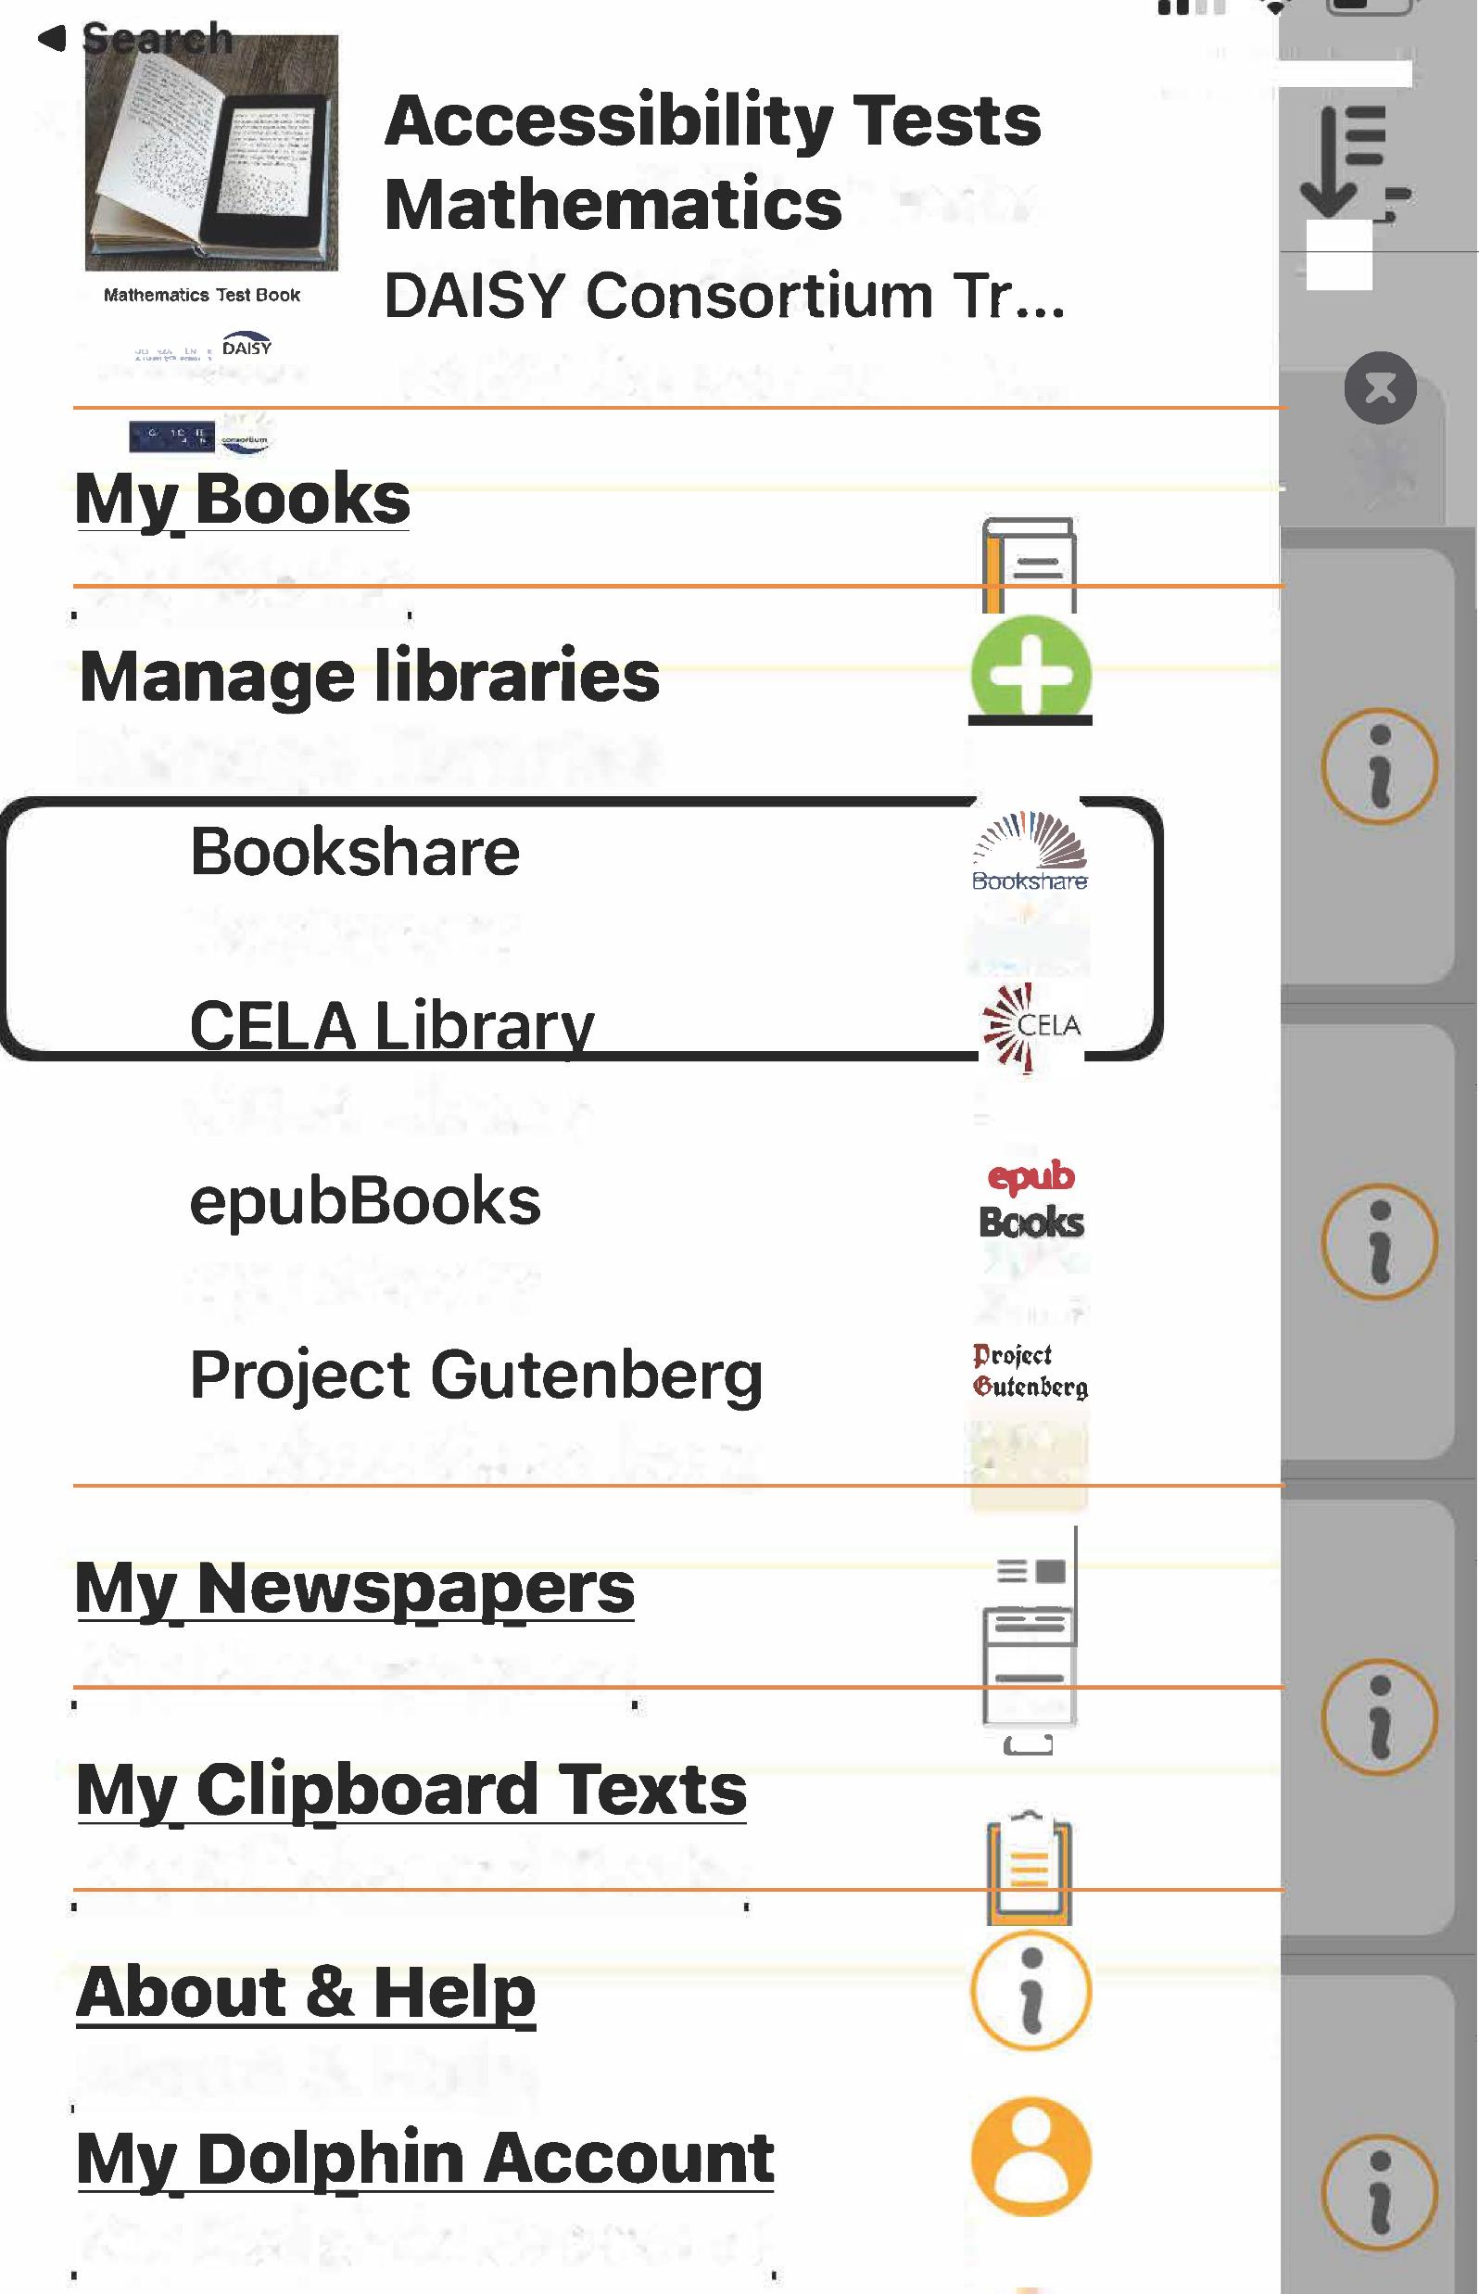
Easy Reader iOS –
Manage Libraries

Slide 19
Blind macOS user
Bookshelf
  results with VoiceOver
Thorium Reader
  results with VoiceOver

Slide 20
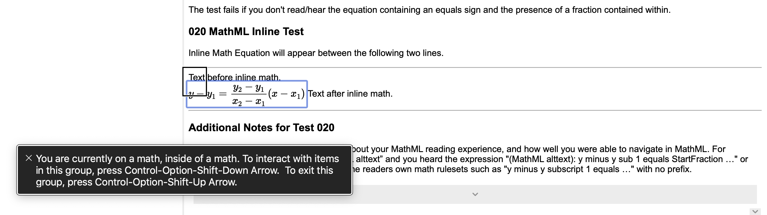
Bookshelf for macOS – Math Accessibility

Slide 21

Low vision user
Yay! Lots of choice:
Bookshelf
RedShelf
Thorium
EasyReader
… and they all have read aloud
Notes:
Mention the webinar recording of

Slide 22
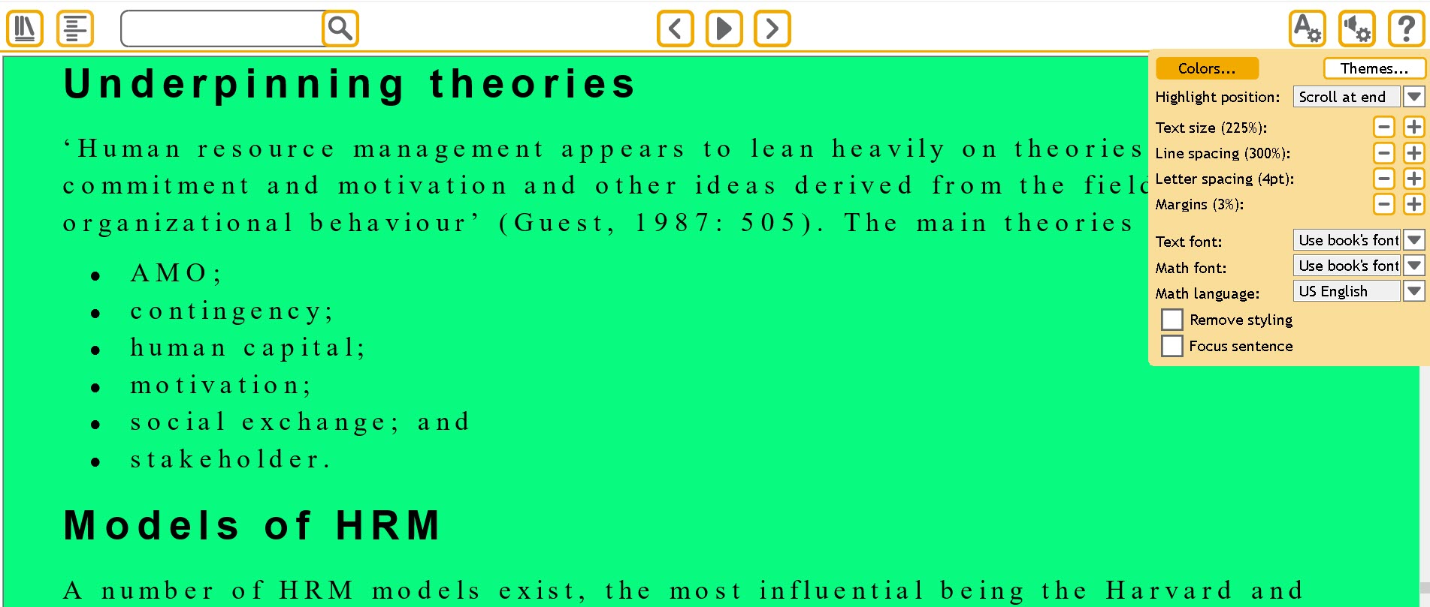
EasyReader for Windows– Visual Adjustments

Slide 23
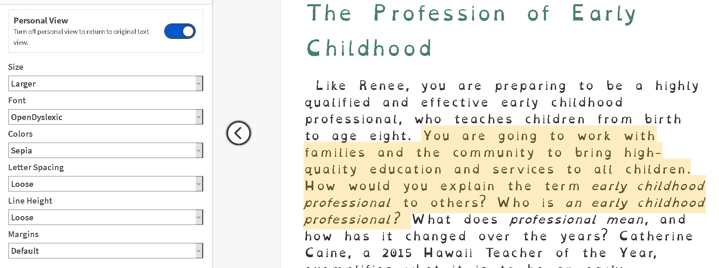
RedShelf – Visual Adjustments

Slide 24
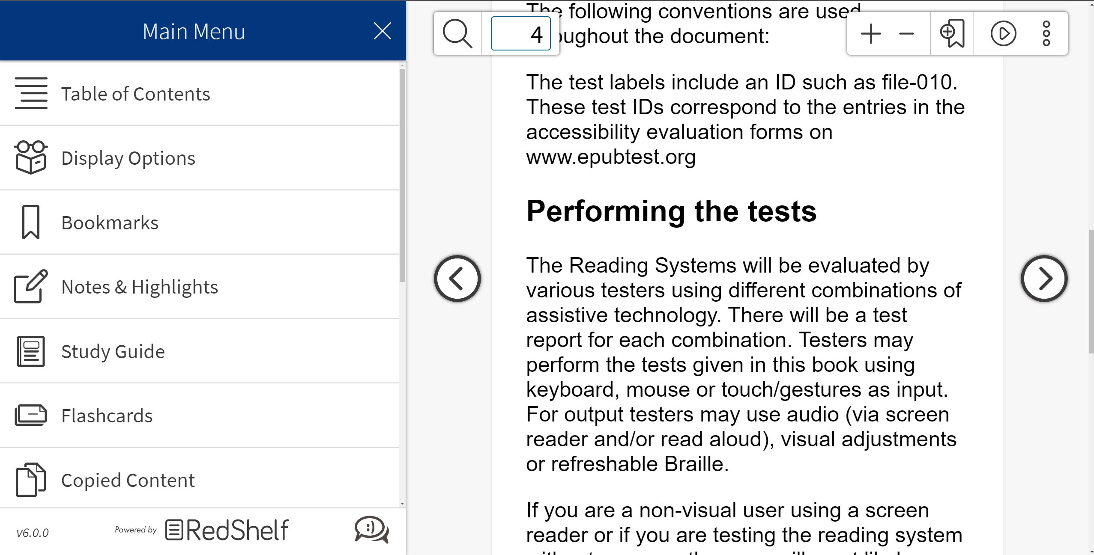
RedShelf – browser zoom
Example of a browser based EPUB reader, and how the UI controls can be magnified using the browser zoom feature
Notes:
On most reading systems the user would use a magnification utility to increase the UI. Interesting that in a well designed EPUB reader accessed through the browser, the browser’s zoom feature can be used to increase both the contents and the user interface.

Slide 25
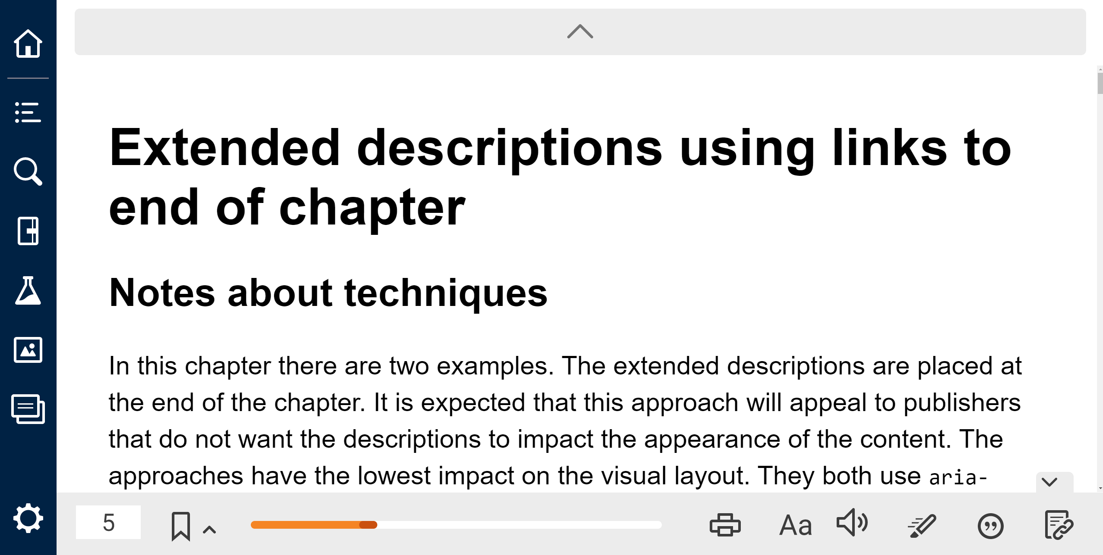
Bookshelf– browser zoom
Example of a browser based EPUB reader, and how the UI controls can be magnified using the browser zoom feature
Notes:
On most reading systems the user would use a magnification utility to increase the UI. Interesting that in a well designed EPUB reader accessed through the browser, the browser’s zoom feature can be used to increase both the contents and the user interface.

Slide 26

Students with LD
Bookshelf
  results with Chrome
RedShelf
  results with Chrome
Texthelp EPUB reader
  results with Edge
Notes:
Joseph

Slide 27
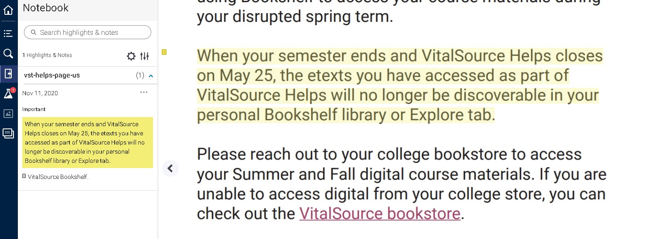
Bookshelf Online – Highlighting and Notes

Slide 28
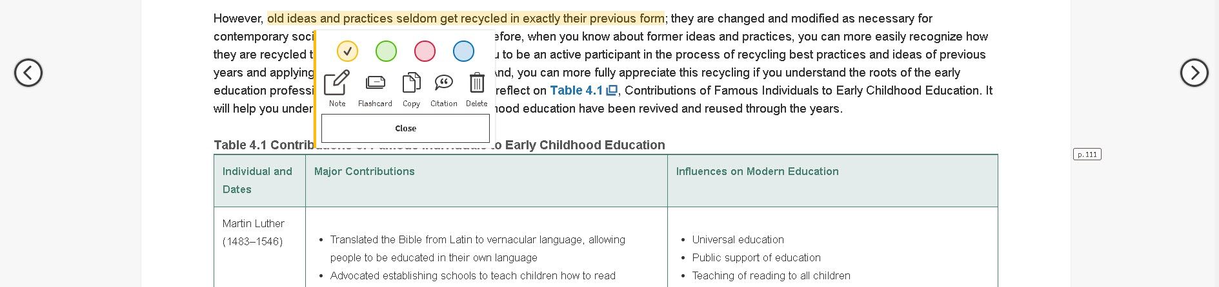
RedShelf – Highlighting and Notes

Slide 29
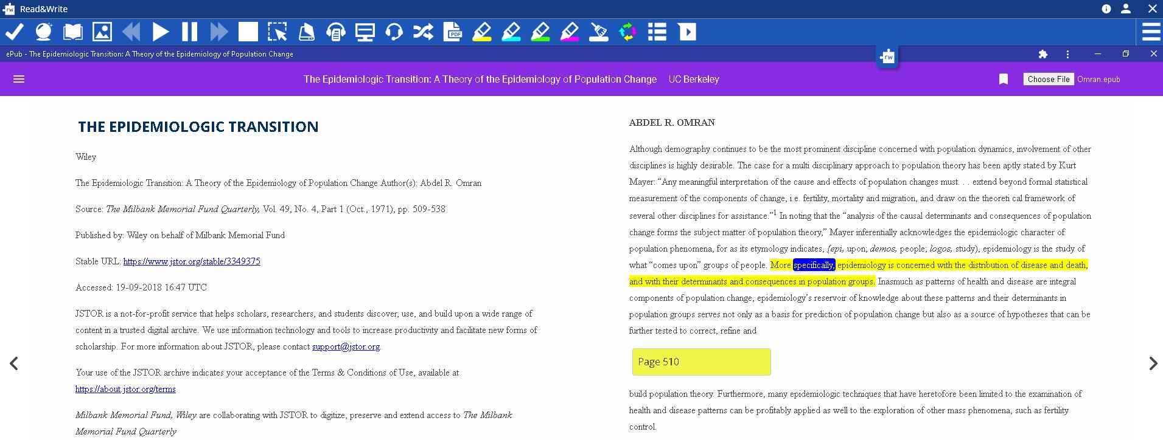
TextHelp EPUB Reader – Read Aloud

Slide 30



STEM student
Bookshelf on macOS with Voiceover
Bookshelf Online via Firefox or Chrome on Windows using NVDA
RedShelf via Firefox on Windows with JAWS or NVDA
Thorium Reader on Windows with NVDA
Bookshelf app on iOS with Voiceover

Slide 31

Updated apps
VitalSource Bookshelf (emojis and more coming)
Thorium Reader (voices, fonts)
EasyReader mobile (alt text display, finger reading, lines visible)
VoiceDream Reader (improved Bookshare interface with sorting, filtering and more, speed reading)
Notes:
VitalSource Bookshelf- installer for custom scripts to improve the reading experience for learners using the JAWS screen reader, emojis, reviser user interface and more coming in version 10.
Thorium Reader- two releases since AHG- TTS synthetic speech voice selection, faster speed option, use any of the installed system fonts, added keyboard navigation (goto page, beginning, end of publication) improvements in the PDF reading
EasyReader mobile (alt text display, finger reading, lines visible). EasyReader can be used on Android, iOS, Amazon Fire tablets, Chromebooks, and on Humanware Braille displays. Free version of the Windows app will be released in Q4, and macOS after the end of the year.
VoiceDream Reader (improved Bookshare interface with sorting, filtering and more, speed reading)

Slide 32

Trends
Journal platforms offer EPUB as a download option
Students using digital resources from publishers
Emphasis on built in accessibility/personalization features
Students downloading EPUB from Learning Management System (LMS)

Slide 33

What next?
For top line results visit the Reading system round up
For detailed results visit the shiny new EPUB test grid
To share and learn join the EPUB in Higher Ed working group
Roll up your sleeves in the reading system testing group
Advocate with app developers for improvements that you value
Find getting started guides and videos at daisy.org

