Slide 1
Lansing Community College Accessibility Initiative
Best Practices in Getting it Right the First Time
Andy George

Slide 2

First, a question
Notes:
How many of you are at institutions who have implemented an initiative or push toward improving digital accessibility?

Slide 3
Origins of LCC’s Accessibility Initiative
Began with Accessing Higher Ground
Brought together Accessibility Initiative Committee in the Spring of 2017
Identified concerns
Set goals and developed a plan to meet them

Slide 4
The Goal
Make all courses, services, and processes accessible by the Summer of 2019.

Slide 5
Accessibility Initiative Committee
Executive Leadership
Center for Student Access
eLearning
Faculty Senate Leadership
IT/Web Development Staff
Human Resources
Records Management
Center for Teaching Excellence
Marketing and Internal Communications
Media Services

Slide 6

Understanding Scope
Developing inventories of digital and physical forms and documents
Examining our website for potential accessibility issues
Reviewing internal and student-facing processes

Slide 7
Challenge: Securing Buy-in
Executive leadership
Specialists who can aid in the work
Champions for accessibility
Content creators on the ground

Slide 8
Spreading the Word
Communicating about the initiative through every avenue available
Offering training in multiple formats at a variety of locations and times
Working with departments to help identify the scope of the work to be done

Slide 9

Some Additional Questions
Notes:
How many of you felt this change was successful?
How many of you encountered significant resistance to this change?

Slide 10
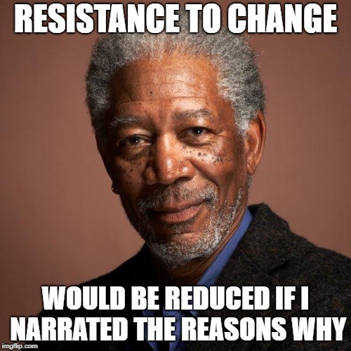
Pushback
Pushback is inevitable when undergoing large-scale change
Helping others overcome the anxiety that comes with change
  Listen and be empathetic
  Help others understand their situation and what needs to be done
  Provide the resources necessary to doing the work
  Help others to understand the reason why change is occurring

Slide 11
Understanding the “Why”
Connecting the work to the needs of people with disabilities and the mission of the institution
Giving students the chance to share their stories
Helping faculty and staff champions to connect with their peers about their experiences

Slide 12
Ensuring Compliance
Creating a committee to evaluate whether we have met and continue to meet our goal
Maintaining and updating document and form inventories
  Working with departments to organize this process
  Employing tools (like ALLY)
Developing a system to periodically conduct accessibility “spot checks”

Slide 13

Where We Are Now

Slide 14
Moving Forward
Digital accessibility is still crucial at LCC
Ongoing theoretical and practical training on accessibility
Establishing and maintaining structures for compliance
Continuing to have conversations about the “why” of accessibility

Slide 15

Questions?

Slide 16
Contact
Andy George
Access Consultant
Center for Student Access
Lansing Community College
georga14@lcc.edu

