Slide 1
Trending Tech Tools 2020 Edition
What’s New, What’s Improved, & What’s on the Horizon for AT & Accessibility Tools
Update
Accessing Higher Ground - 2021 (Feb)
Rachel Kruzel - Texthelp

Slide 2
Looking for more Information?
Visit us at our AHG Watch Party site to request more information or visit us at text.help/9bp3qg

Slide 3
Today’s Agenda
Noteworthy Updates
Education Landscape for spring and beyond
Budgets & Funding
Technological updates

Slide 4
Education Landscape Update

Slide 5
Where Are We Going?
Notes:
We’re turning a corner!
We’re all ready for smooth sailing

Slide 6
Some Bumps Along the Way
Notes:
High uphill battle
Lots of bumps

Slide 7
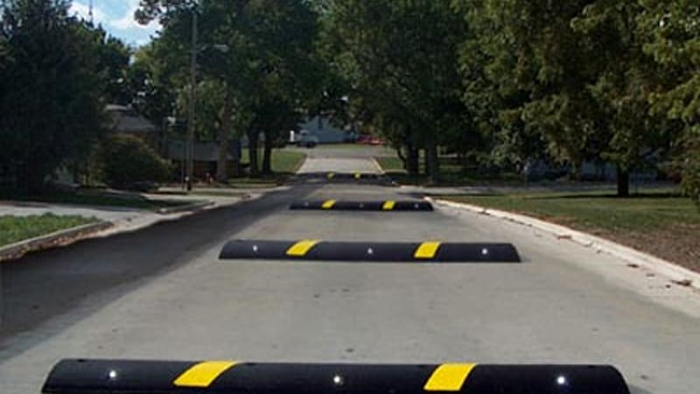
Hopefully We’re Moving Towards This Instead
Notes:
Less of an uphill battle
Less speed bumps
Hopefully you’ll be able to see them and predict them better

Slide 8
“Techquity”
Technology + Equity = Techquity
Rumbles but not as central as earlier
Funding? Action towards access?
Will this be addressed systematically at some point?
Notes:
Do individuals have equitable access to the technology needed to: Learn, Work, Live
Spotlight on the techquity divide

Slide 9
Learning Loss
Has there and to what degree has there been learning loss over the last year?
Content taught online is not the same?
Techquity divide responsible?
True for higher ed students?
To what amount/level?
Notes:
Talked about a lot for K12 but is it as relevant in higher ed?

Slide 10
Budgets & Funding
Notes:
HigherEd

Slide 11
Budgets in Higher Ed
Budgets are continuing to be squeezed
Cuts are projected for FY22
Budgeting for next year has already been underway and may be set
Decreases, cuts, and tough decisions

Slide 12
CRRSAA Funds (New CARES Act)
~$22.7 Billion (but not enough)
At least the same amount of direct aid to students during the last round is required to go to them again
Remaining funds - little to no limitations on guidelines

Slide 13
Getting a Piece of the Pie
What is the money going towards?
Who on campus is overseeing the spending?
Can you tie department priorities (AT) to this funding (if it’s slated to get cut)?
Replace budget?
Equity and online learning?
Accessibility?

Slide 14
More Funds Coming?
Biden’s $1.9 Trillion package
Proposes $35 Billion more for HE (nearly $40B)
Allocated to:
Public institutions, Community colleges, Public & Private HBCUs, minority serving institutions
No mention of Private institutions
Use for health initiatives and supports, distance learning, emergency grants to students
Half emergency financial aid grants to students

Slide 15
Technological Updates
Notes:
HigherEd

Slide 16
Lockdown Browsers
The heat is coming their way!
Schools have recognized accessibility and equity issues
Less need for these tools in the fall
But online learning is not going away
What will be done/used instead?
How do we ensure this doesn’t happen again?
Notes:
Mass adoption on campus without thought to accessibility?

Slide 17
Echo Smartpens
Despite reassurance… Echo Smartpen has been discontinued
Livescribe will continue to support until…
Echo 2 is launched
Release is rumored to be March - April
Limited information available
Notes:
Outreach directly to Livescribe

Slide 18
Read&Write & Brightspace D2L Update
Continued work around rewrite of Read&Write and PDF Reader
Read&Write update in response to D2L content
Cross Frames
Toolbar embeds in each frame of content
Increased functionality online

Slide 19
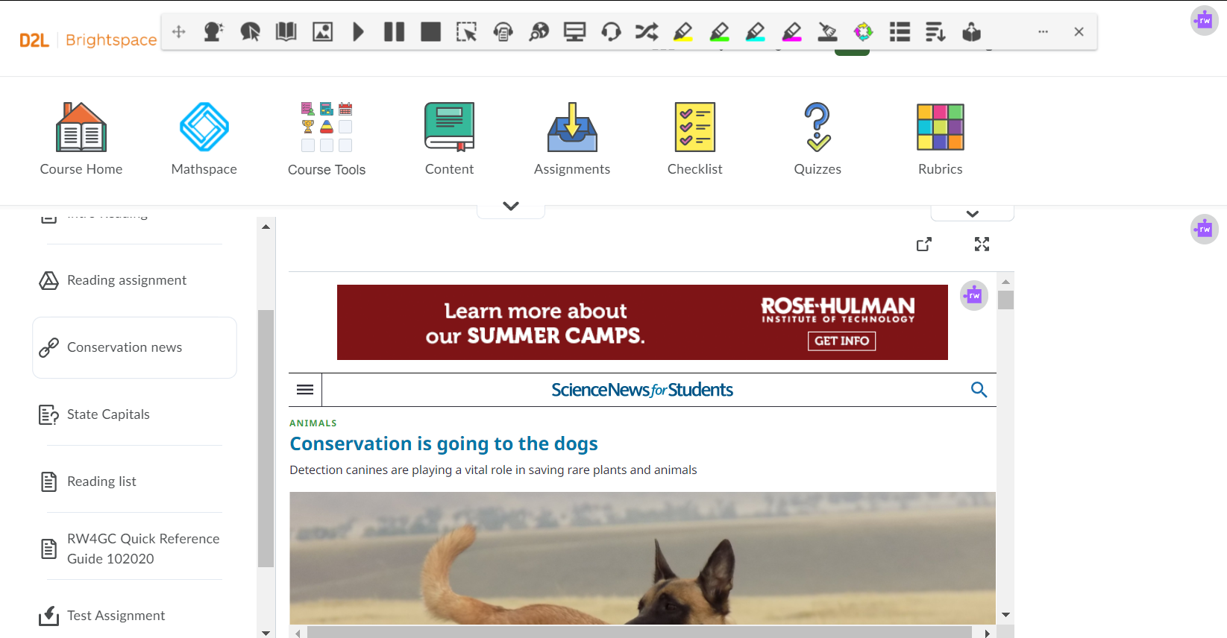
Brightspace Read&Write Update
Notes:
HigherEd

Slide 20
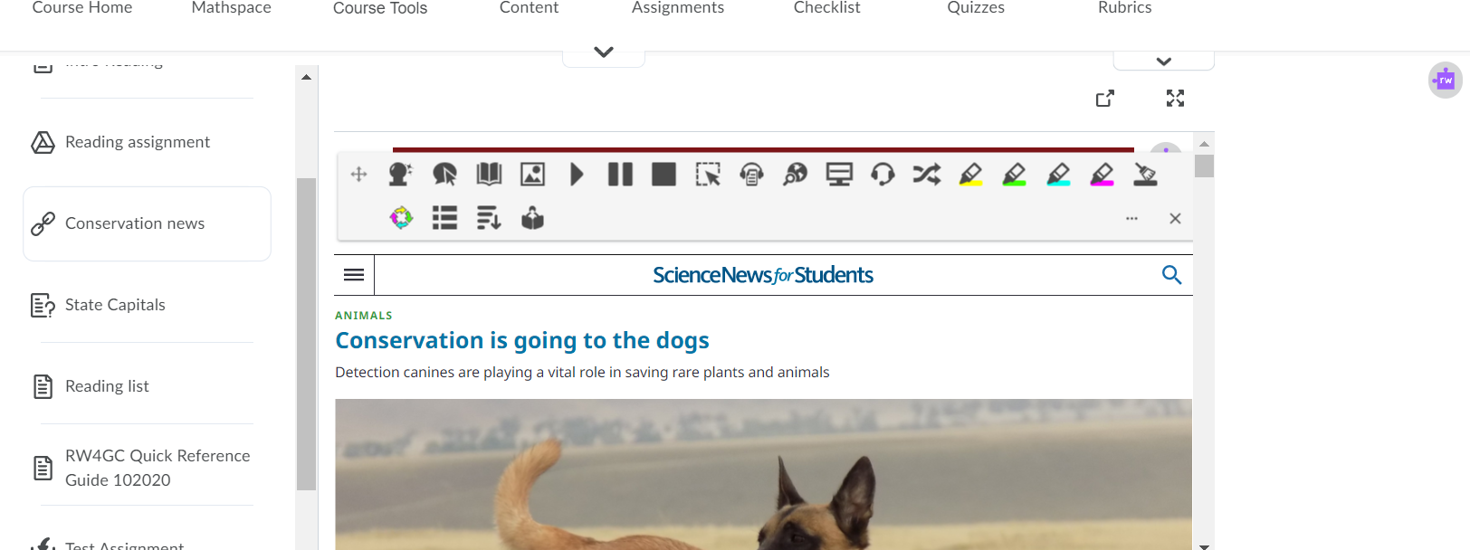
Content in Cross Frames
Notes:
HigherEd

Slide 21
EquatIO Web Toolbar
Released late January
Full toolbar in many websites
Make content in more places online with EquatIO
More EdTech sites faculty may be using
LMS’s where the tool didn’t work as easily before

Slide 22
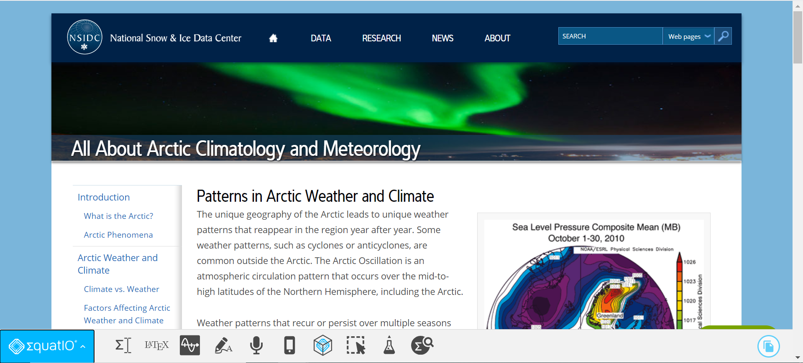
New EquatIO Toolbar Online
Notes:
HigherEd

Slide 23
Dragon Changes
Dragon Professional Individual (DPI) price increase is still “a go”
Increased operational costs and development
~$300 to ~$500
Not being discontinued and continues to be developed
Great news!

Slide 24
Dragon Changes cont.
Focus is moving to Dragon Professional Anywhere (DPA) subscription
~$40/mon or ~$500/year
Pricing for academic and those with a disability not finalized
Less features, less robust
“Lightweight recognition product”
Different user group
Nuance continues to work with our field and advocates

Slide 25
Zoom Built-In Captioning
Automatic, built-in captions/live transcripts for higher ed are live
Zoom Admins/ITS may need to enable it within the settings
Health care and free accounts - not included

Slide 26
Voice Dream Reader for Mac
Voice Dream Reader is coming to Mac
No longer just iPad and iPhone
Soon to be released for laptop/desktop
TBD

Slide 27
Otter.AI with Google Hangouts
Live Notes and Captions within Google Meet
Chrome Extension
Transcript saves to your Otter account
Add highlights, images, and notes to transcript search by keyword and share
Available on all plans

Slide 28
HATHI Trust - Emergency Temporary Access Service
“Member libraries that suffer an unexpected or involuntary, temporary disruption to normal operations”
“Member library patrons [can] obtain lawful access to specific digital materials in HathiTrust that correspond to physical books held by their own library”

Slide 29
Questions

Slide 30
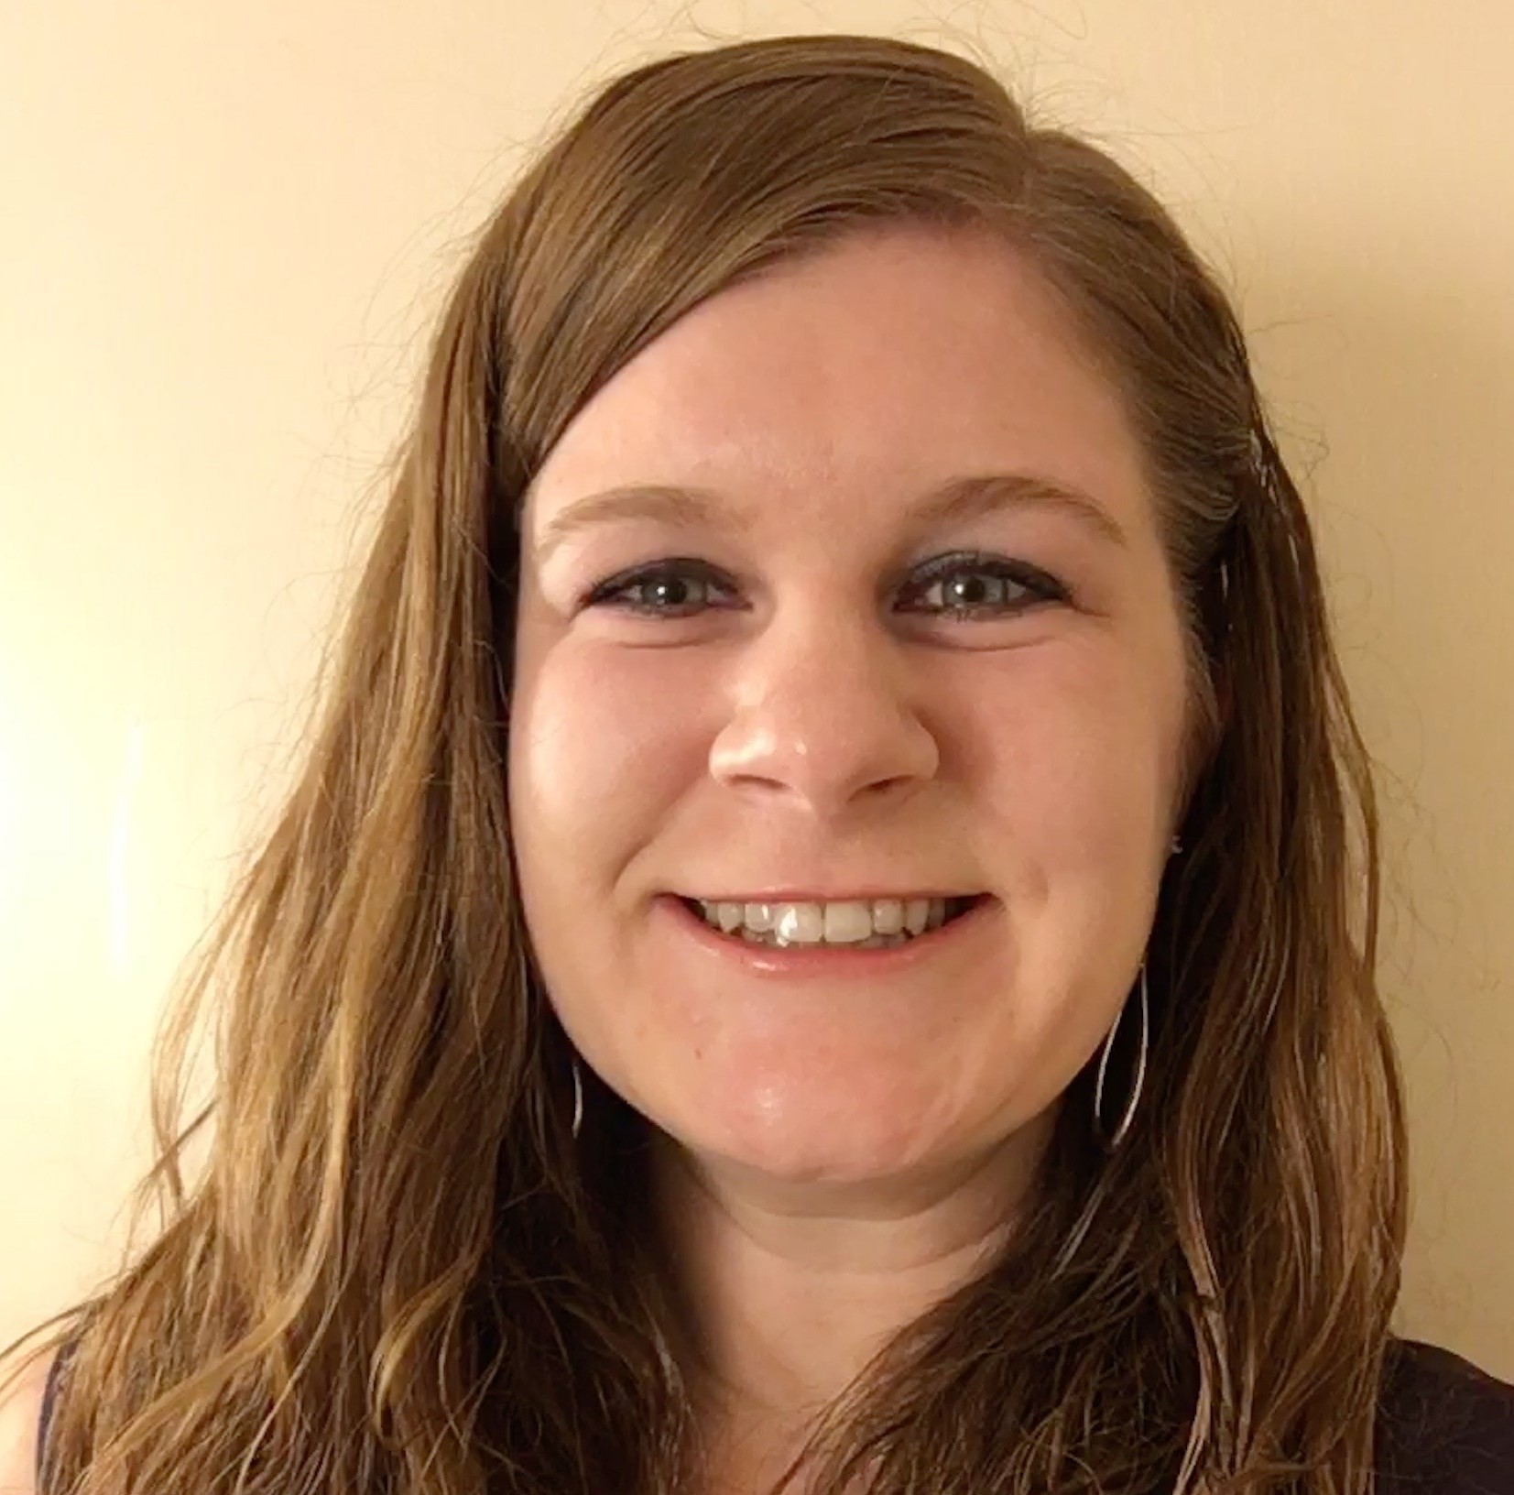
Thank you!
Rachel Kruzel
Territory Sales Director
(MN, MO, IA, IL, WI)
Texthelp
r.kruzel@texthelp.com
651-245-3128
@TH_RachelK

