Slide 1


Creating and Supporting Digital and Accessible Math Instruction in an Online Learning Environment
Rachel Kruzel - Texthelp
Susan Kelmer - University of Colorado Boulder
Jennifer Pedersen - University of Alaska Fairbanks

Slide 2


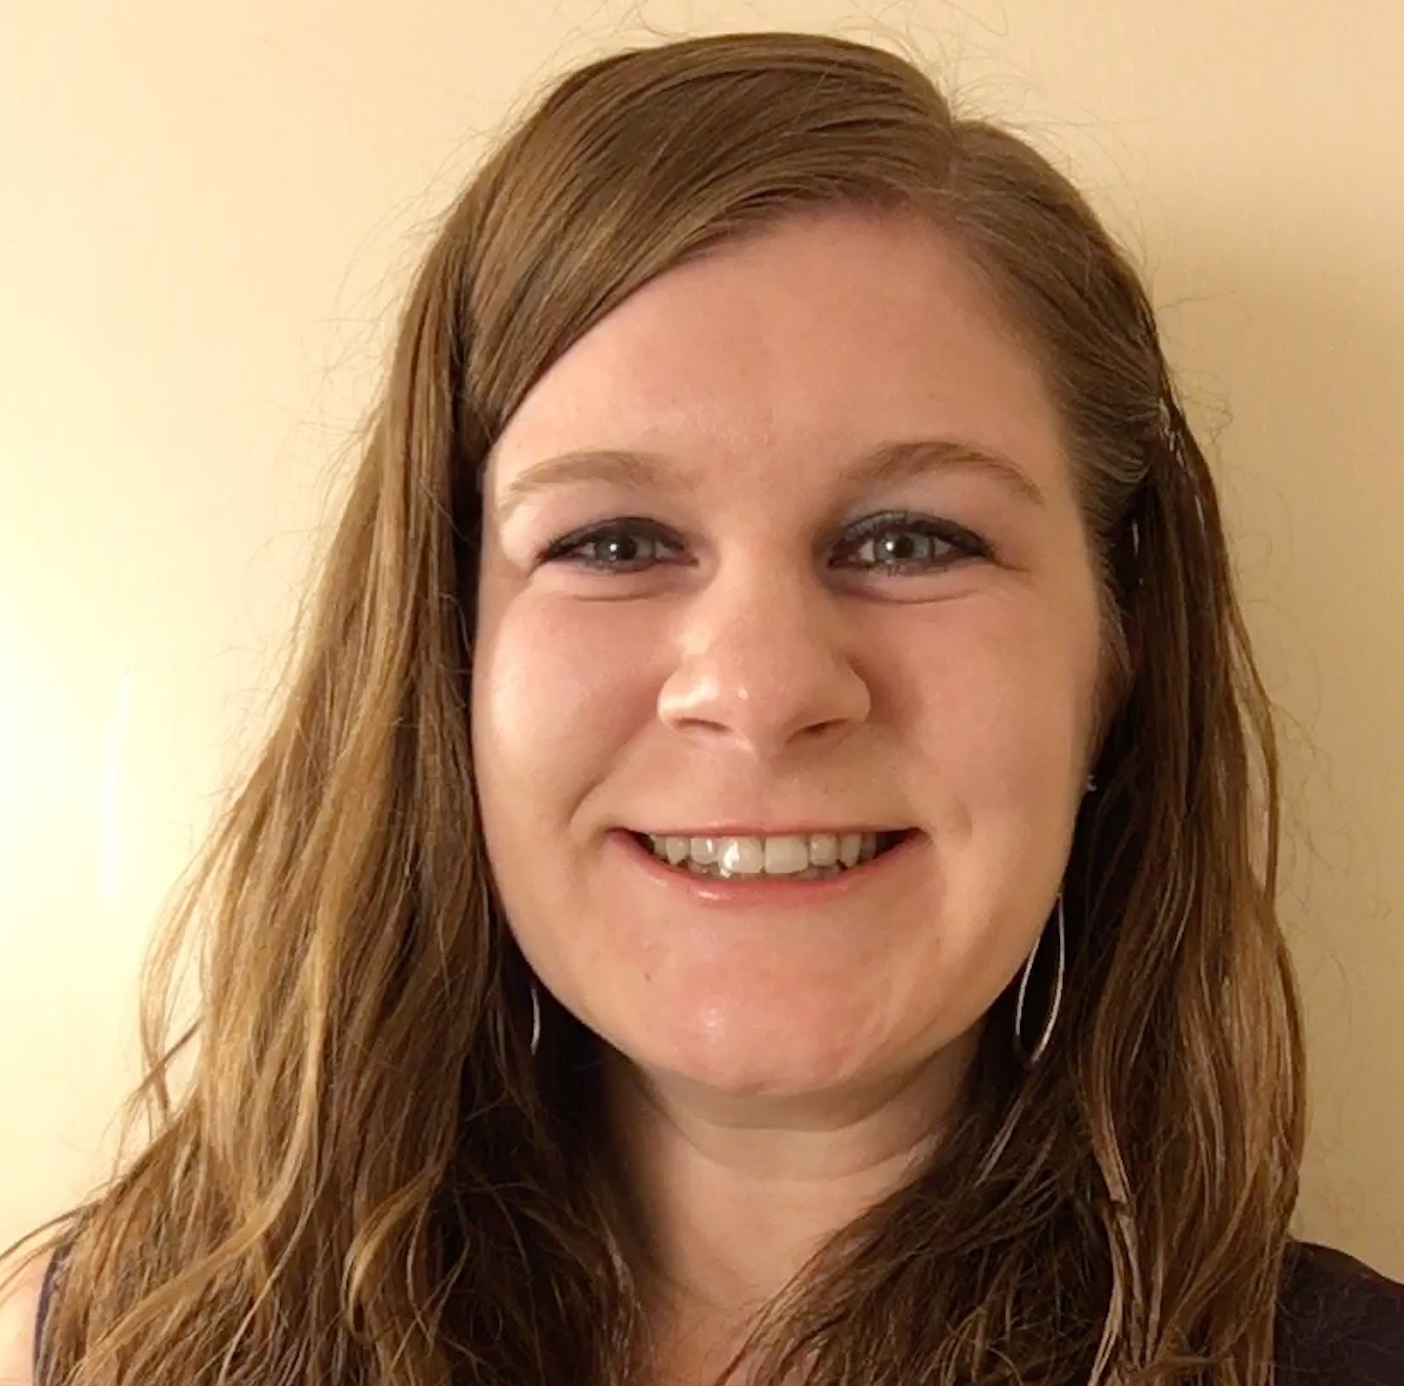
hello, I’m rachel.
Rachel Kruzel
Territory Sales Director
Texthelp
r.kruzel@texthelp.com
651-245-3128
@TH_RachelK

Slide 3
Looking for more Information?
Visit us at our AHG Math site to request more information or type the follow address in your address bar: text.help/AHG20-Math

Slide 4



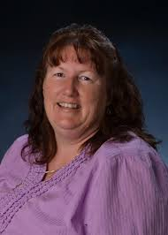
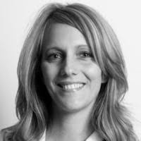
Texthelp Friends Joining In
hello, I’m susan.
Susan Kelmer
Alternate Format Production Program Manager
University of Colorado Boulder
Susan.Kelmer@colorado.edu
hello, I’m jennifer.
Jennifer Pedersen
Course and Program Manager
University of Alaska Fairbanks
jpedersen@alaska.edu
Notes:
HigherEd

Slide 5
Today’s Agenda
What is EquatIO?
EquatIO and Online Teaching
EquatIO and Accessibility

Slide 6

The classrooms of our past are not the classrooms of today, or the classrooms of our future in higher education.

Slide 7

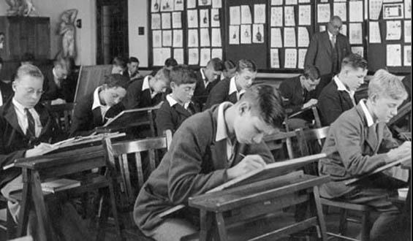
The state of Math

Slide 8
How do we get from there to where we are today?
What tools can help us get from there to where we are today?

Slide 9
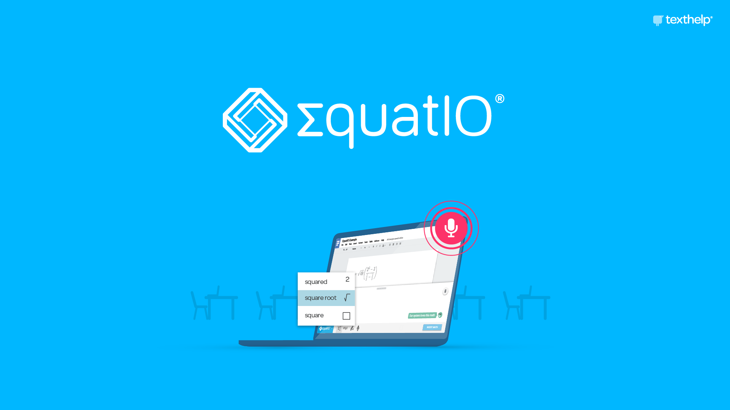
EquatIO

Slide 10
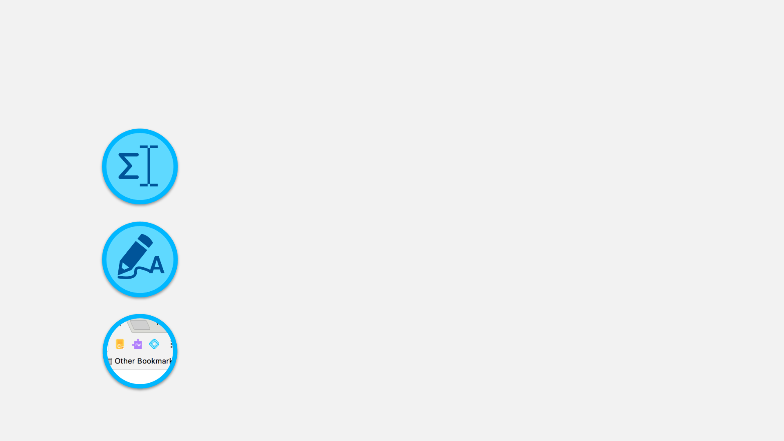
What’s EquatIO?
An easy-to-use math and STEM editor - no math code or programming languages required
Built on Universal Design for Learning (UDL) principles - increases accessibility and engagement across campus
Integrates seamlessly with Read&Write and integrates in the common learning environments student engage with

Slide 11



Three Ways It Supports Campuses
Accommodation Facilitation
Creating Accessible Content
Platform for Teaching Math & STEM Content Digitally

Slide 12

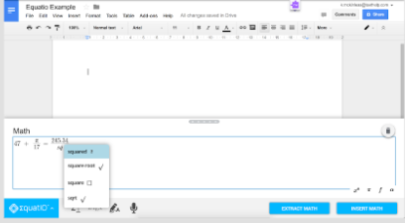
Accommodation Facilitation
Reading STEM Content
Creating STEM Content
Proctors
  Readers
  Writers

Slide 13
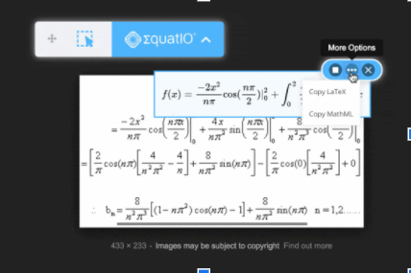
Creating Accessible Content
Textbooks
  Assessments
  Assignments
Proactive and Retroactive
Remediation
UDL

Slide 14
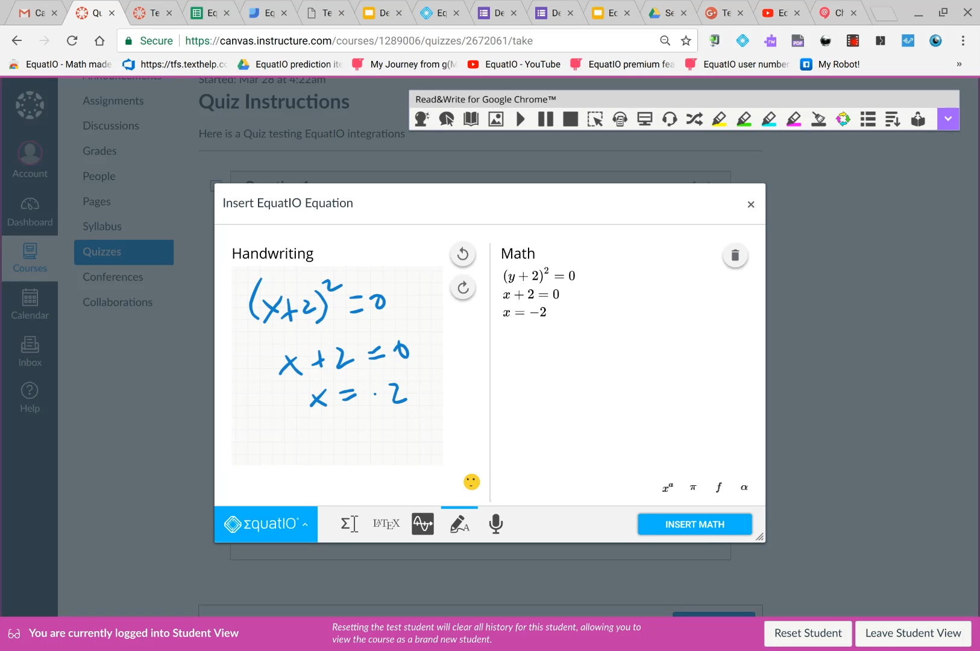
Teaching STEM Content
Google
Microsoft/O365
LMSs
  Canvas &D2L Brightspace
Other EdTech Platforms

Slide 15
EquatIO and Online Teaching

Slide 16

Not everybody speaks “Math”
Notes:
First introduction to EquatIO was 2 years ago at AHG-where I was specifically looking for a way to help faculty make math classes accessible.
Not everyone speaks math-didn’t apply to just instructional designers-not all of our math professors were proficient with math languages like LaTex etc. I needed an easy way for faculty to make math accessible for their students. EquatIO made this possible-it was easy for faculty and for students.

Slide 17

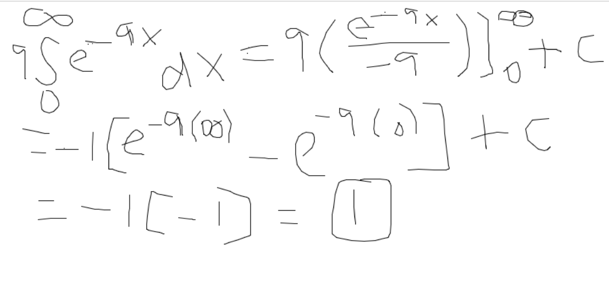
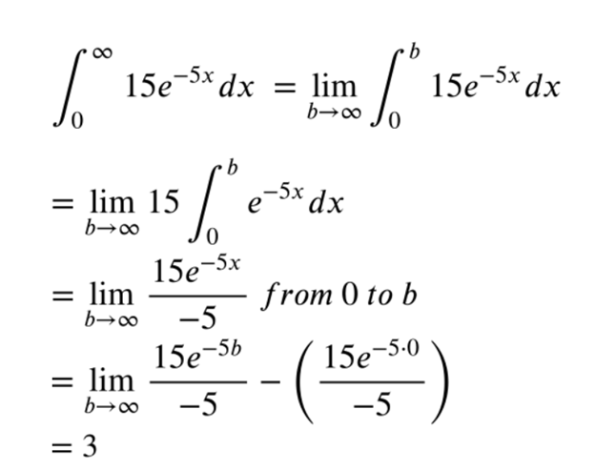
Ease of Use
Math concepts
Vs.
Tools to put math online
Take a Tour with Clair Kochis,
Assistant Math Professor at KPC
Notes:
At the time, I was in charge of the dept. who piloted tech and specifically looked for tech to help with accessibility. EquatIO fit the accessibility bill, but with budget constraints I had to make a hard sell for every purchase.
With EquatIO, I could speak to accessibility easily enough, but I could also speak to retention, particularly in remedial math courses: by using EquatIO, students could focus on learning math, versus having to learn tools. Being able to focus on math itself reduces the number of times students need to take the course.

Slide 18

Grass Roots Approach
Math Department Chair
  Incorporate into class
  Demos for other departments
  Incorporate into math labs
Instructional Designers
  Demos for other departments & statewide committees
  Gather testimonials from students and faculty

Slide 19

Benefits
Remove Barriers in STEM Courses
Read and respond to math content easily and naturally
Students create math content in MathML, LaTeX etc without needing to learn the language
Faculty review submissions quickly to close feedback loop
Provide equal access to math and STEM content for all learners
Notes:
The inability of students to use digital tools to produce mathematical equations has been a barrier for many students in STEM courses-resulting in many who have to still use paper and pencil for exams and homework-think back to the image a couple screens back and imagine how time consuming it is for students to not only write it out, but then try to get it to their professors, and how time consuming it is for faculty to read through all the hand written submissions make notations on them and return them to students. It adds an additional layer if students are allowed to make changes and resubmit! The ability to digitize work using EquatIO reduces the time and effort required for both students and faculty to read and respond to math content easily and naturally.

Slide 20
Breaking News!
UAA now has institutional licenses for EquatIO!
All 3 Universities collaborating to get a statewide license
Letters of support
Faculty and Student Testimonials
Notes:
Chair demo-ing “up” from our community college to the math department at UAA-
Got DSS on board with how it makes online math accessible
DSS departments work together on committees and the word is out! EquatIO makes online math accessible and ‘easier’ for faculty and students

Slide 21
Using Equatio for Alternate Format Production
Susan Kelmer,
University of Colorado Boulder

Slide 22

The Old Way:

Slide 23
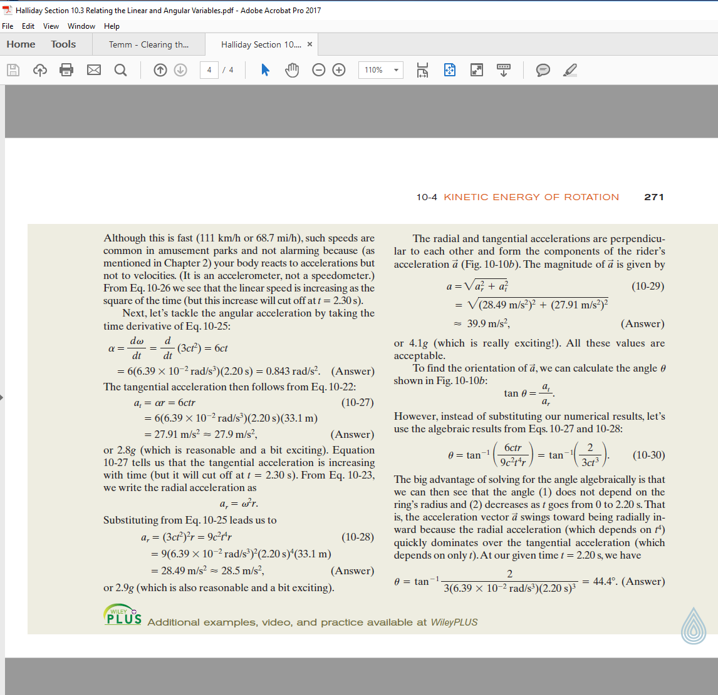
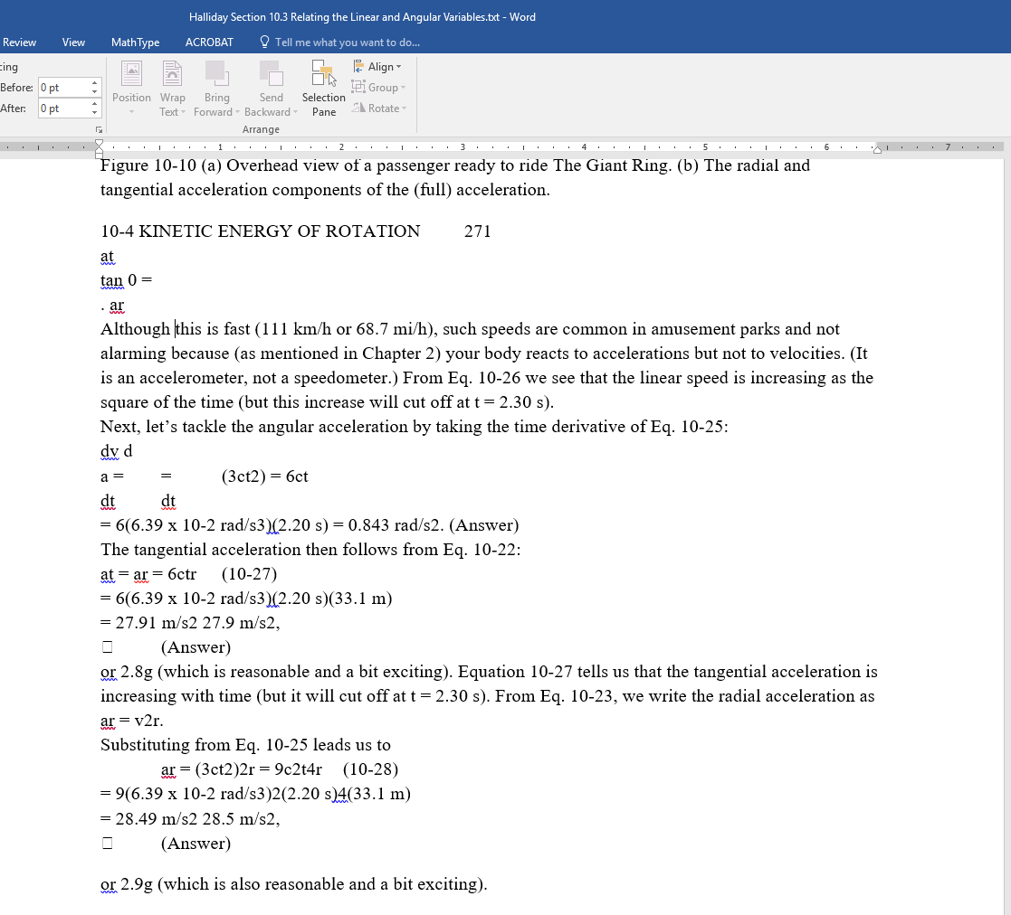
PDF to Word File
Original PDF
Extracted Word File

Slide 24
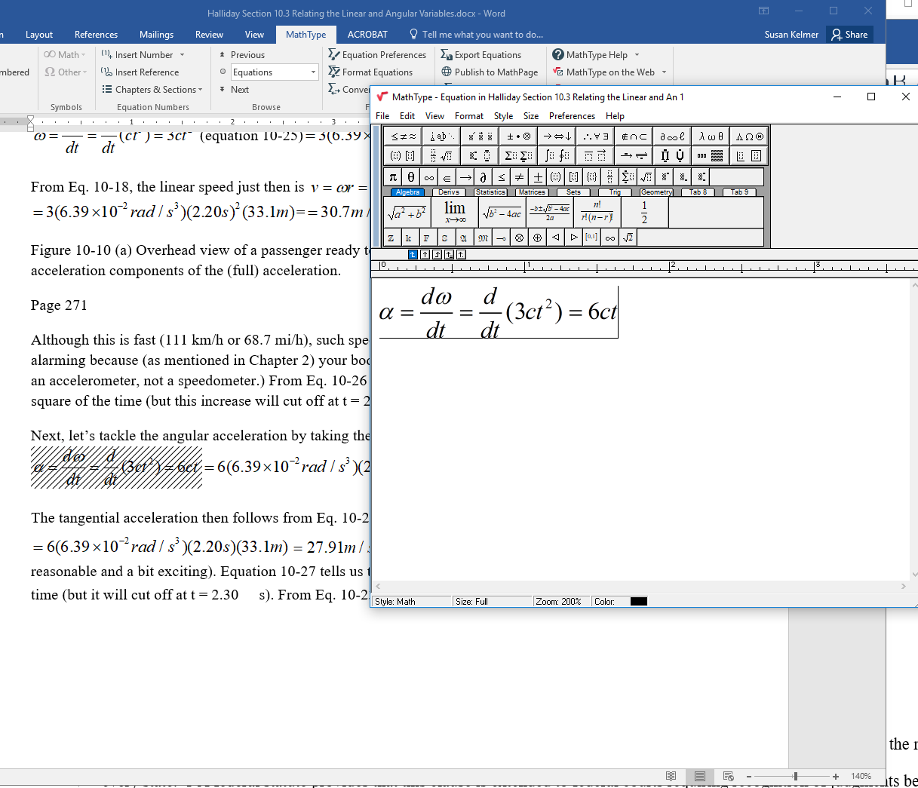
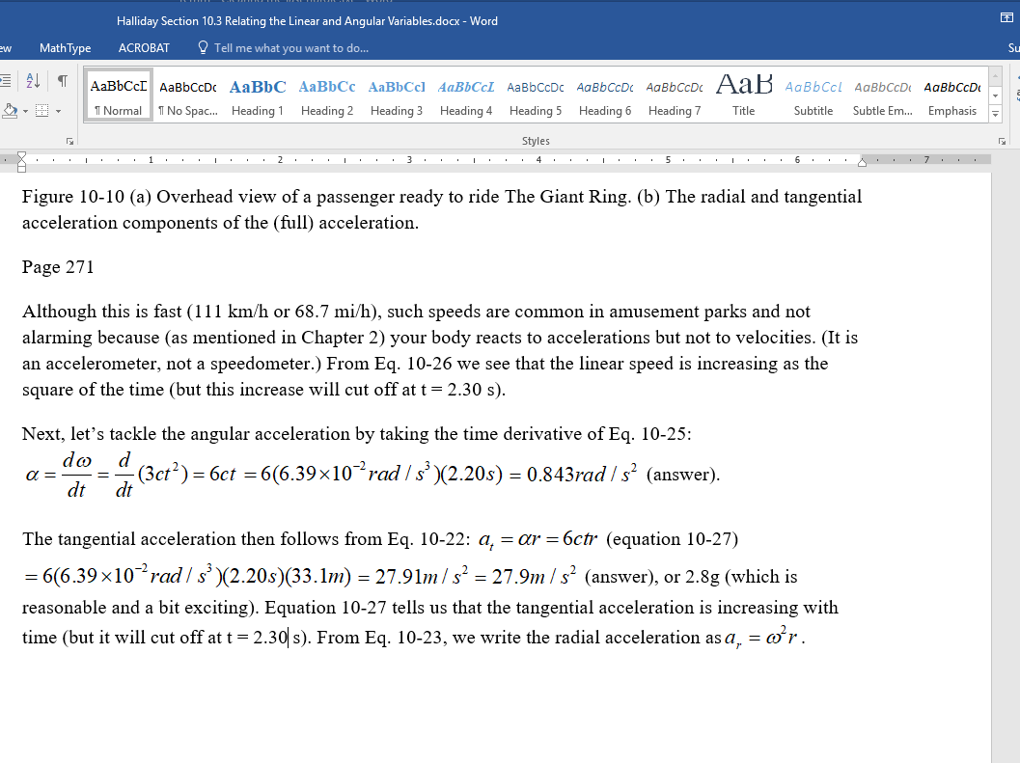
MathML Edits with MathType
MathType Equations Completed
☑ Time-consuming
☑ Human error

Slide 25

The New Way:

Slide 26
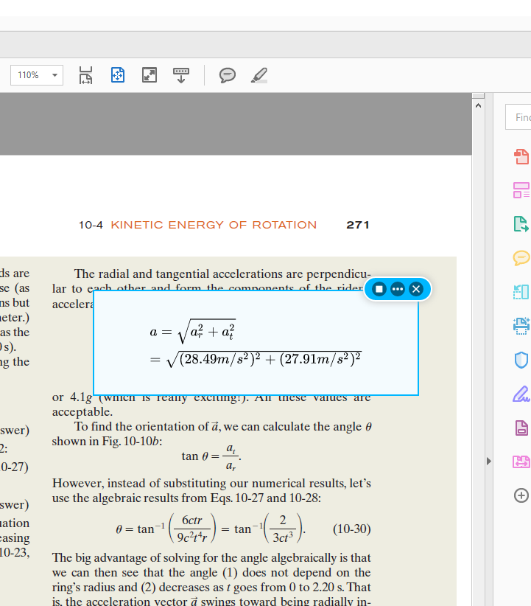
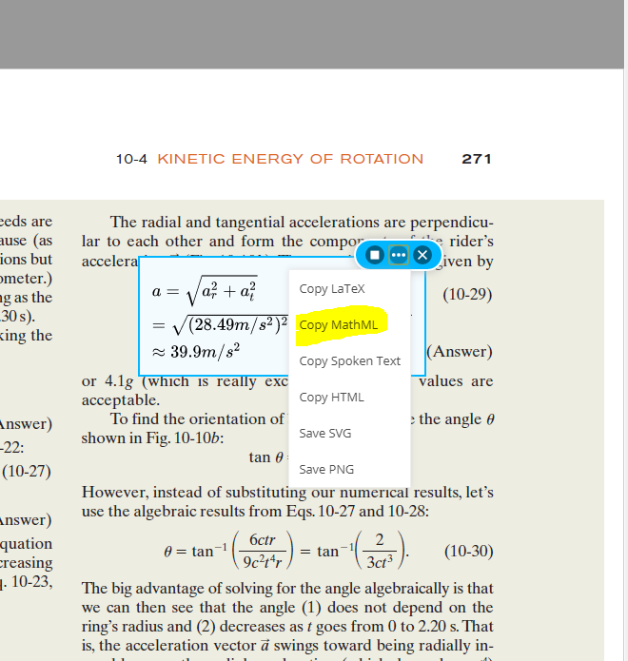
PDF and MathML
Original PDF
Copy MathML Instantly

Slide 27
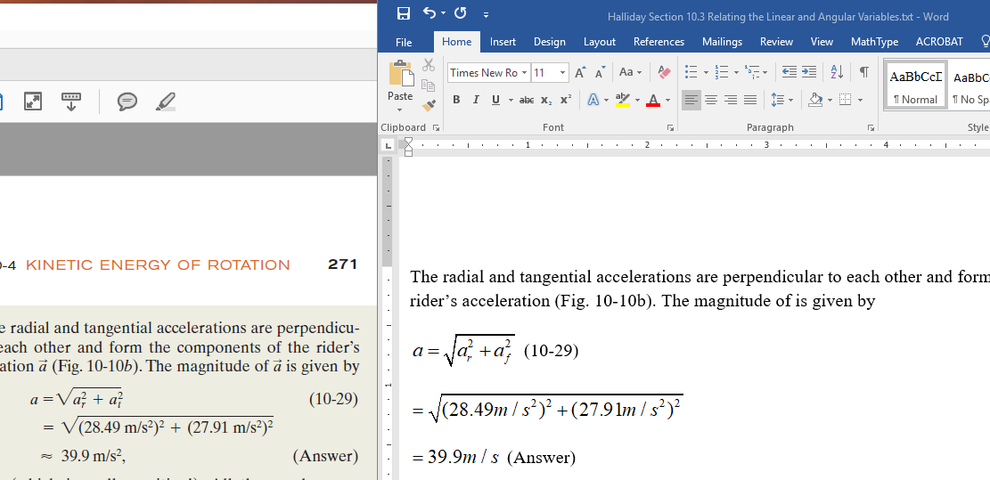
Paste into Word = DONE

Slide 28

Textbook Conversion:
150 hours
$9,000 student worker time

Slide 29

Savings with EquatIO
50
150 hours
$9,000 student worker time
$3,000
Savings: $6,000!

Slide 30
Questions?
Notes:
First introduction to EquatIO was 2 years ago at AHG-where I was specifically looking for a way to help faculty make math classes accessible.
Not everyone speaks math-didn’t apply to just instructional designers-not all of our math professors were proficient with math languages like LaTex etc. I needed an easy way for faculty to make math accessible for their students. EquatIO made this possible-it was easy for faculty and for students.

Slide 31
Thanks for Joining Us!
Jennifer Pedersen
Course and Program Manager
University of Alaska Fairbanks
jpedersen@alaska.edu
Susan Kelmer
Senior Product Manager
University of Colorado Boulder
Susan.Kelmer@colorado.edu
Rachel Kruzel
Territory Sales Director
Texthelp
rlkruzel@texthelp.com
Notes:
HigherEd

