Slide 1
Universal Design of Lecture Capture Using Illinois ClassTranscribe
Accessing Higher Ground Conference 2020
Jon Gunderson, Coordinator of IT Accessibility
Lawrence Angrave, Teaching Professor Computer Science
John Tubbs, Director of Digital Media

Slide 2
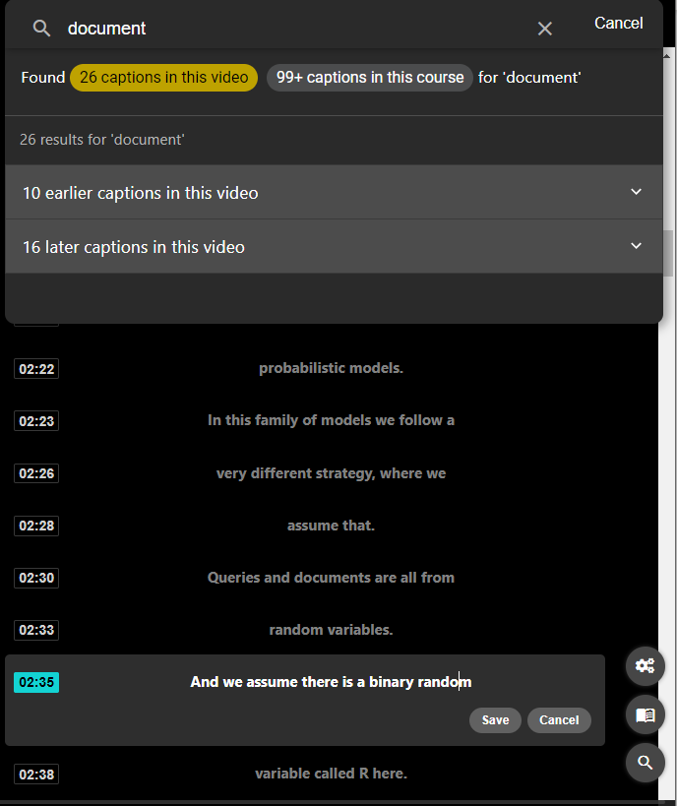
A student asked, “What if ”

Slide 3
What is ClassTranscribe?

Slide 4
What is ClassTranscribe?
Uses low-cost cloud AI to create captions.
Transcriptions include punctuation.
Crowd sourcing to fix errors.

Slide 5
What is ClassTranscribe?
Universal Design inspired video player has led to:
Improved exam performance
Happy students in Illinois classes

Slide 6
What is ClassTranscribe?
Authoring of accessible ePub with the captioned videos and associated educational materials.

Slide 7
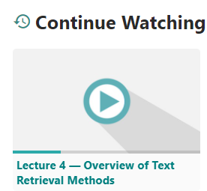
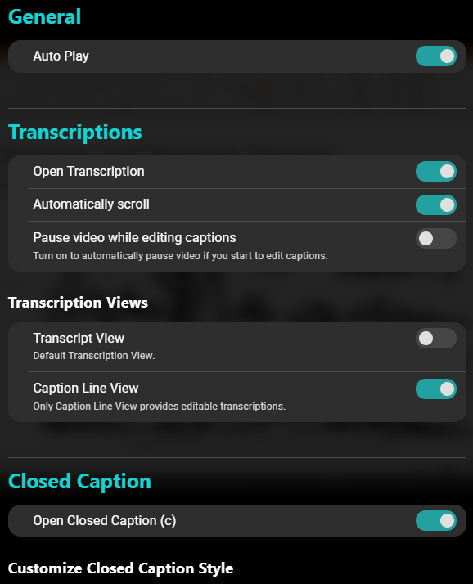
A Better Video Player
Accessible & configurable
Search both within video & across course
Break-and-continue
High concentration, low distraction
Mobile & tablet friendly
Learning analytics
Notes:
Lawrence, Is this your take on AblePlayer? It may be worth mentioning your rebuild from the ground up.

Slide 8
Educational outcomes (UDL ?)

Slide 9
Educational outcomes (UDL ?)
Supports Researcher & instructor friendly: Per-student detailed interactions & engagement reports
American Society of Engineering Education (ASEE) 2019, 2020, 2021.
Special Interest Group on Computer Science Education (SIGCSE) 2020.
EDUCAUSE Accessibility Workshop 2019.

Slide 10
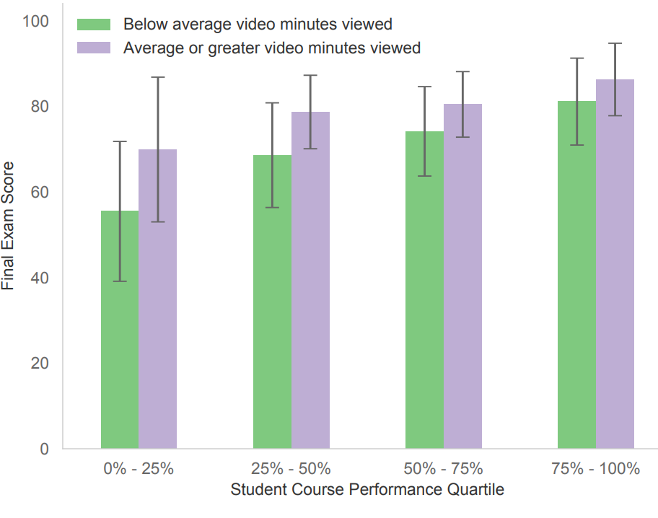
Educational outcomes (UDL ✓)
Statistically significant (p<0.03) outcomes at all performance levels.
Enthusiastic responses on scales & free-response.
Reduce digital distance between instructor & online students.
“Who Benefits? Positive Learner Outcomes from Behavioral Analytics of Online Lecture Video Viewing Using ClassTranscribe” Angrave et al, SIGCSE2020

Slide 11
ClassTranscribe
How it Works:
Crowd-source editing
Searching
Video to EPUB (Structure, Image & Text Content)

Slide 12
Semantic Transformation & ePub
Rethinking how we can use and REUSE transcription

Slide 13
Semantic Transformation
Use data-driven semantic transformation within “real” production & educational contexts to develop new models of authoring, learning, engagement, & publishing pipelines.

Slide 15
Live, Transformable, Semantic Data
Caption Data to:
Editable Closed-Captions & transcriptions
Regenerate open standard caption files (.srt .vtt)
Full text indices, text mining & Computer science/AI
Editable ePub creation: Markdown to ePub, html, pdf.

Slide 16
Semantic Transformation
Extract and Store related semantic chunks:
Video, Audio, Images, Captions, Transcripts, Marked-up text, Related files, Tables, Screenshots, Equations
“Relations” based on time (video is the source)

Slide 17
Semantic Transformation
Reassemble related semantic chunks into new media types:
HTML, ePubs, PDFs, .docx, .pptx, etc…

Slide 18
Semantic Transformation
Reassembled Forms
Goal: User-driven reassembly based on users’ needs
Users: teacher, learner, general reader/viewer
Needs: pedagogical, cognitive, physical, technical

Slide 19
ClassTranscribe Future

Slide 20
Active R&D
Visual data
Audio data
Scene detection
Translation
Searching & learning
Active learning

Slide 21
Acknowledgements
Gies College of Business; Department of Computer Science; Center for Innovation in Teaching & Learning; National Center for Supercomputing Applications & National Petascale Computing Facility; Office of the Provost.
Microsoft Inc. (Lighthouse Accessibility Partner Initiative) & Institute of Educational Sciences (R305A180211)

Slide 22
Contact us:
tubbs@illinois.edu (ePub) angrave@illinois.edu (ClassTranscribe)

