Slide 1
AHG 2020 Discovering and Buying Born Accessible EPUB
Charles LaPierre, Technical Lead, DIAGRAM and Born Accessible
Benetech
Email: charlesl@benetech.org
George Kerscher, Chief Innovations Officer
DAISY Consortium
Email: Kerscher@montana.com
Teressa Keenan, Head Bibliographic Management Services and Accessibility Liaison
Maureen & Mike Mansfield Library, University of Montana
Email: teressa.keenan@mso.umt.edu

Slide 2
We will answer the following…
Accessibility (A11Y) Metadata
What is it?
Where Can I Find it?
How Can it be Used?
3rd Party Certification
Buying Accessible EPUBs
A Libraries Perspective
Useful Links

Slide 3
What is Accessibility Metadata
Information meant to be read by a computer about how accessible or inaccessible the EPUB really is
Can Provide information on
Accessibility Features
Accessibility Hazards (if any)
Accessibility Accommodations for reading
Conformance to WCAG
Certification
Overall Human Readable Summary of accessibility

Slide 4
Where Can it be Found?
Inside the EPUB
OPF File contains the a11y metadata
ONIX
Separate metadata file
but doesn’t yet have a 1:1 mapping
MARC Records
Separate metadata file
but doesn’t yet have a 1:1 mapping

Slide 5
How Can it be Used?
Publishers
Disclosing the accessibility of their publications
School / Library
Used to make informed purchasing decisions
End User
Ensures what you are about to read or buy will meet your needs

Slide 6
3rd Party Certification
Conforms To: EPUB 1.0 Specification WCAG - AA
Certified By: Benetech
Certifier Credential: GCA™
GCA Partners receives Technical Bulletins
Once per quarter
Reviewed and Harmonized with the DAISY Knowledge Base
Alignment with ACE

Slide 7
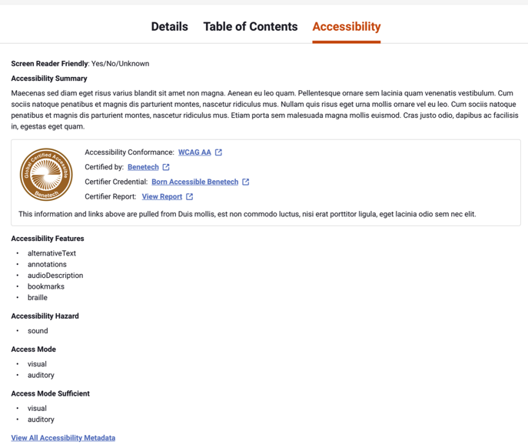
Buying Accessible EPUBs: VitalSource

Slide 8
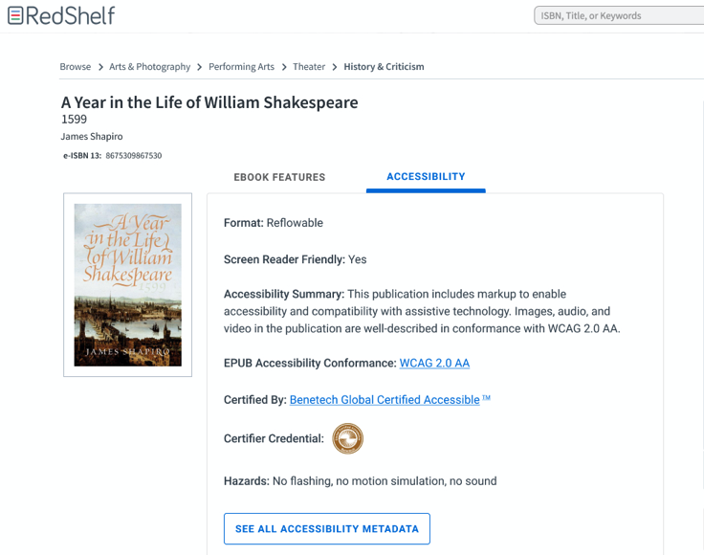
Buying Accessible EPUBs: RedShelf

Slide 9
Library Perspective
Metadata is important
Purchasing decisions
Students and instructors need to find accessible resources
MARC
Separate metadata file
Accessibility features elements added in 2018

Slide 10
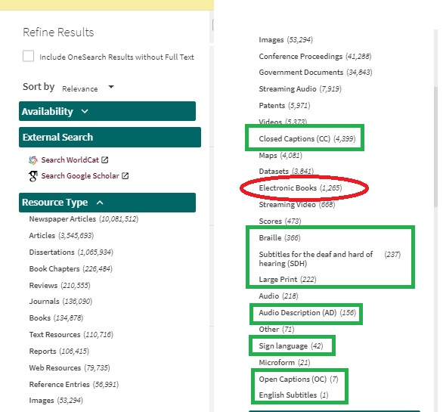
Refining Search Results

Slide 11
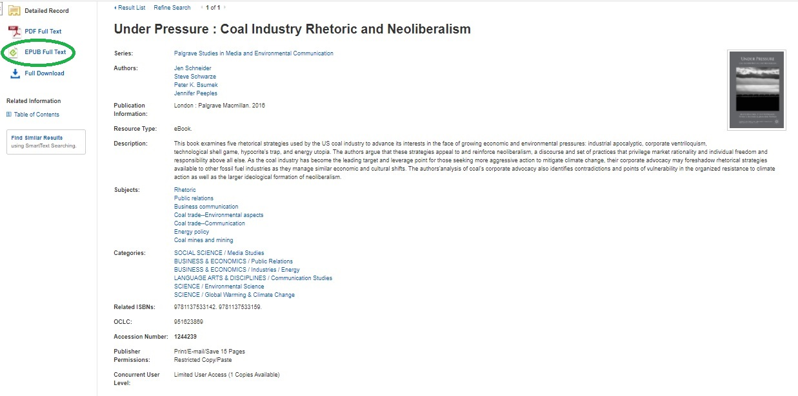
Example: EBSCOhost

Slide 12
What You Can Do
Publishers, aggregators, bookstores and vendors
Add metadata
Display metadata
Share metadata
Libraries
Establish collection policies
Request accessible EPUB with metadata
Individuals
Request the best

Slide 13
Useful Links
Accessibility 1.0 Specification
https://www.w3.org/Submission/epub-a11y/
User Experience Guide for Displaying Accessibility metadata for EPUB
https://w3c.github.io/publ-a11y/UX-Guide-Metadata/principles/
Vital Source / Benetech Accessible Bookstore
https://benetechaccessiblebooks.vitalsource.com
GCA™ Certified Publishers
https://bornaccessible.benetech.org/certified-publishers/
DAISY’s SMART tool
https://smart.daisy.org
DAISY’s ACE tool
https://daisy.org/activities/software/ace/

Slide 14
Thank You & Questions
George Kerscher
DAISY / Benetech
Kerscher@montana.com
Charles LaPierre
Benetech
charlesl@benetech.org
Teressa Keenan
University of Montana
teressa.keenan@mso.umt.edu
?

