Slide 1
Making Math Accessible, One Step at a Time
Lisa Wadors Verne, PhD
Director of Education Research and Development

Slide 2
Math Learning Issues
1 in 5 children have specific disabilities around learning, processing and attention (NCLD, BDA)
Mathematics for students with disabilities. Geary (2011) estimates that approximately 7% of students have a mathematics LD and an additional 10% of students would qualify as having mathematics difficulties (i.e., persistent low achievement in mathematics).
These students are significantly more likely than their peers to repeat a grade or drop out of school.
Impact of learning disabilities can continue into college with lower number of disabled students studying STEM subjects.
Notes:
2. Experts estimate that for every two years of school, children with math disabilities acquire about one year of mathematical proficiency.
Children with math disabilities often reach a learning plateau in seventh grade, and acquire only one year’s worth of mathematical proficiency in grades seven through twelve.
Thirty-five percent of children with learning disabilities drop out of high school.
Seventeen-year-olds with math disabilities have, on average, a fifth-grade level of math knowledge.
Fourteen percent of students with learning disabilities (compared to 53 percent of students in general population) attend post-secondary school within two years of leaving high school.
3. These trends present an enormous challenge for the 7.1 million students with disabilities in the United States (National Center for Education Statistics [NCES], 2020) because most digital mathematics problem- solving tools have limited accessibility.”

Slide 3
Struggles Learning Math
Good maths skills requires executive functioning skills in particular
Working memory
Organisation
Reading skills
Attention
Spatial and sequential processing skill
Key developmental math concepts rely on solid number sense, such as the coexistence between parts of a number and its whole, which is necessary for understanding abstract division, ratios, and fractions.
Notes:
1. They experience challenges such as organizing their work and staying focused. These challenges are even more pronounced for students with learning differences such as dyslexia, dyscalculia, and dysgraphia, who may not be able to practice or learn mathematics due to limited accessibility of curriculum and mathematics tools. These students may experience difficulties with mathematics computations due to misreading symbols or transposing numbers. Mathematics learning requires visualizing, fine motor control, and cognitive processing that can be challenging for many students.”

Slide 4
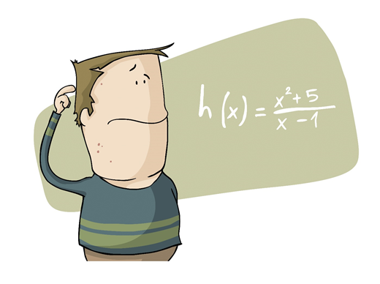
Reading Math
Accessible maths that provides support with decoding can help with problem solving and accuracy
But limited assistive technology support
“H x equals x 2 plus 5 slash x dash 1”
“H of x, equals, x squared plus 5, over, x minus 1”
“H of x, equals, start fraction, x power of 2, plus 5, all over, x minus 1, end fraction”

Slide 5
Educators
Educators are often underprepared to help these students succeed
Parents, teachers, and tutors may not be aware of the different tools and strategies

Slide 6
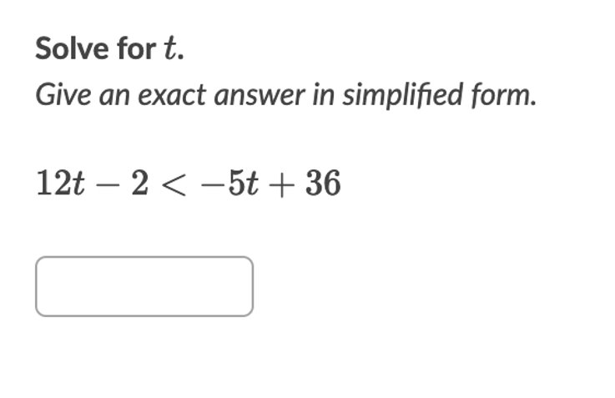
Showing Work
One of the most meaningful ways to improve student learning is through day-to-day formative assessment.
However, most online math editors don't allow students to show work
Notes:
This makes it difficult to track students’ actual understanding of problems and concepts, and can lead to frustration and decreased confidence.

Slide 7
Online Math
Notes:
The math EdTech market is quite large, with hundreds of tools designed to support students learning in a variety of ways. There are math games developed to help kids k-12 increase their time on task and master more complex skills.
These games can be used either as a supplementary tool (Prodigy, Splash Math) or can incorporate teacher’s problem sets in a fun interactive way (AdaptiveMind, Edgenuity).
There are math tutoring tools that can increase student engagement and confidence by giving academic help, enrichment, and strategies to solve equations (IXL, Mathspace, VirtualNerd) as well as tools that will solve the equation for a student (Photomath, QuickMath).
There are tools that focus on specific disciplines like Algebra (Algebra Touch, Graspable Math, Get the Math) or Geometry (Geogebra, Sketchometry, Geometrypad) and tools that provide teachers with tools to help them create math curriculum (Stepping Stones 2.0) as well as grade students’ work (FreeMath).
One of the biggest problems is that most of these tools are not accessible to students with disabilities to be able to interact with math in the ways that work for them.

Slide 8
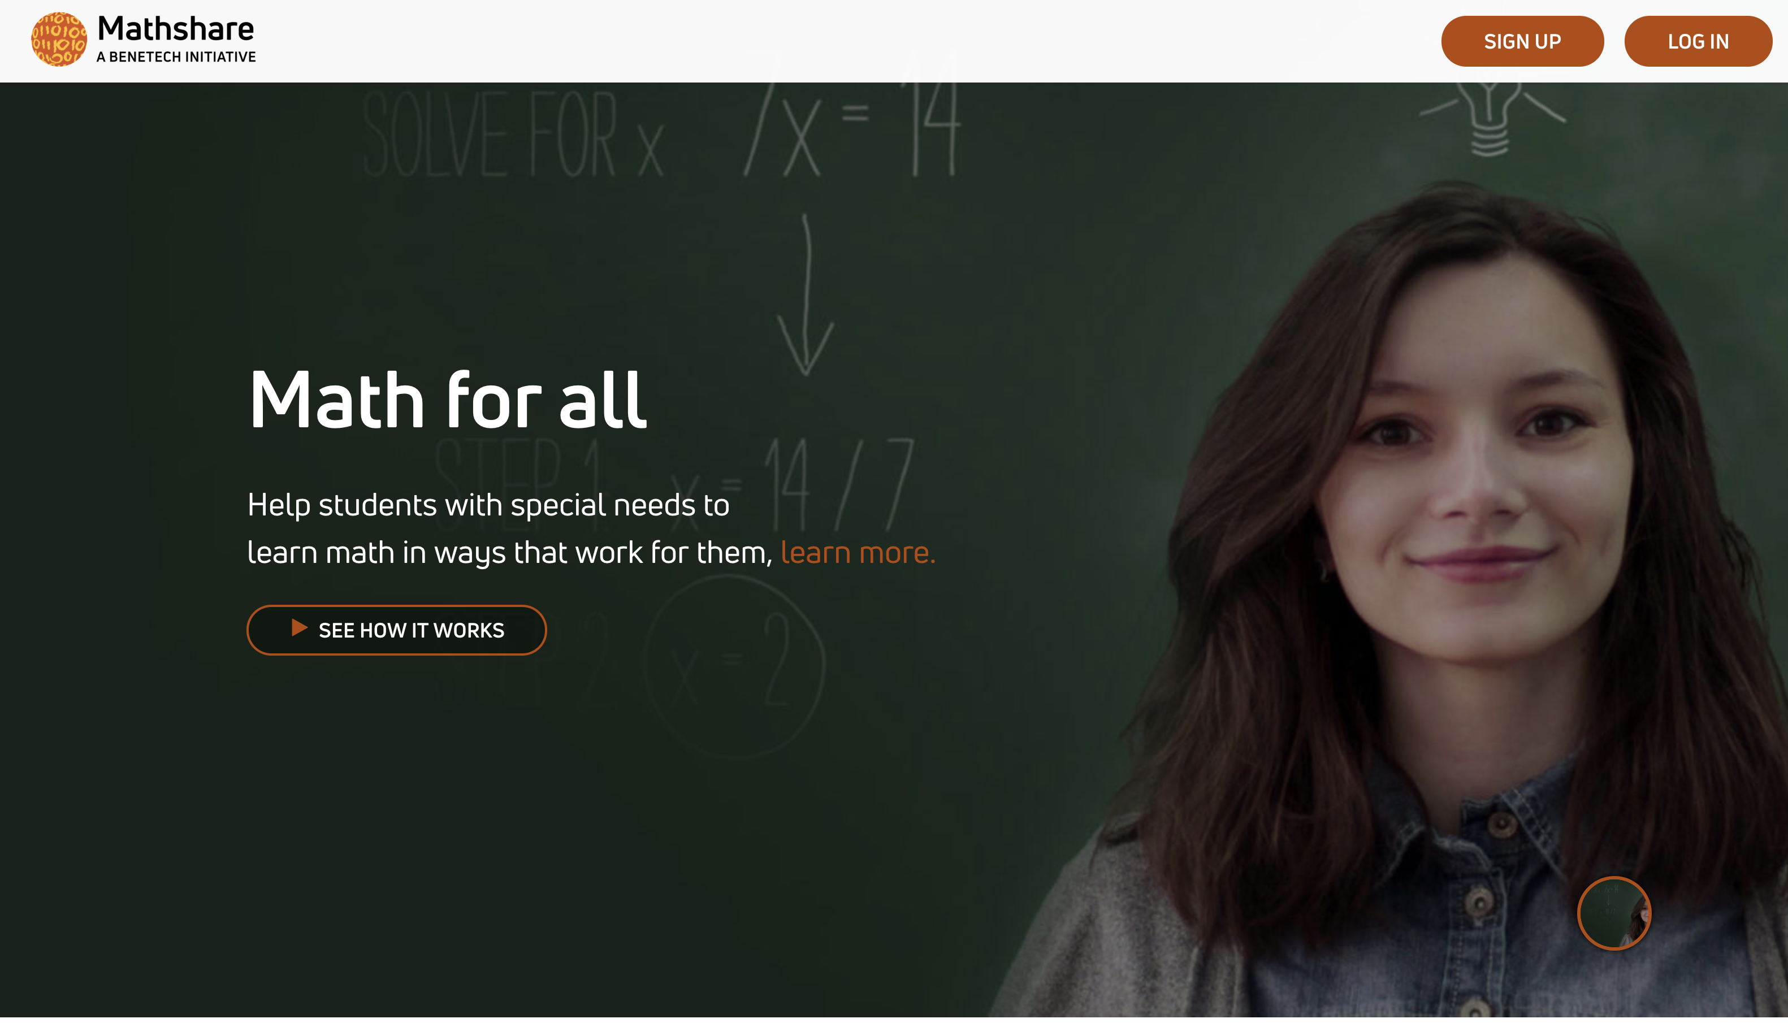

Slide 10
For Students Who Struggle With Math
Seeing math
highly visual
Writing math
requires fine visual-motor skills
Auditory learners
limited options (input & output)
Cognitive processing
Working memory,
Attention required
Coherent thinking & organization skills
Mathshare makes math accessible

Slide 11
Source: https://www.pinterest.com/pin/147844800242181041/

Slide 12
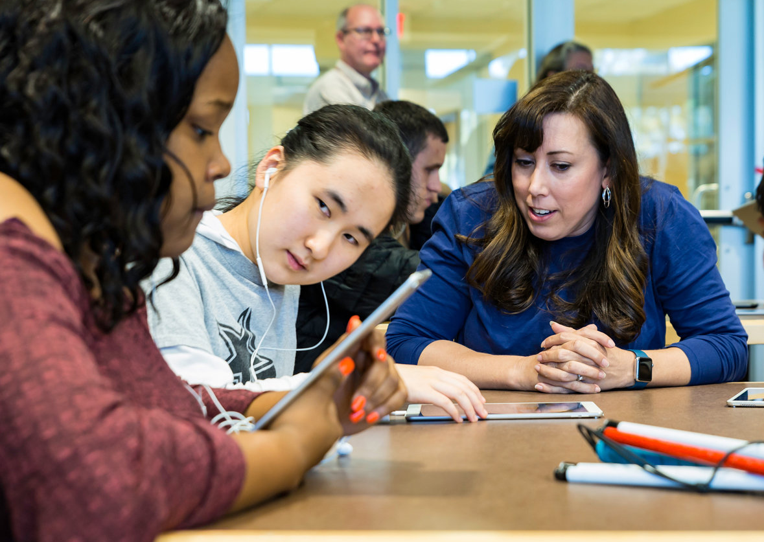
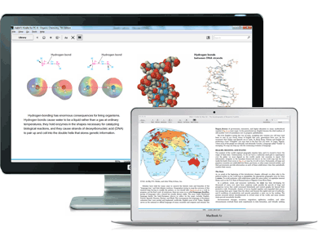
Our Vision
An inclusive tool that helps students share and organize their thinking
Helping teachers work one on one with students in a blended and inclusive classroom
Students working independently at home, on the bus, or at school
Embedded within existing and new digital curriculum

Slide 13
How Mathshare Works
Separate thinking into discrete steps
Dedicated place to explain thinking
Integrated math tools and sketchpad

Slide 14
Get Started
Go to mathshare.benetech.org
Google and Microsoft sign-in optional
Google Classroom and Microsoft Teams Integration
Free for educators, parents, and students.

Slide 15
The Mathshare Dashboard
Notes:
Once logged in you will be brought to your dashboard. The dashboard is where recent sets you’ve created and pre-made sets that are in the Mathshare database appear. It is also where you will create a new problem set. Let’s walk through that now.

Slide 16
The Mathshare Dashboard
Notes:
To add a new problem set you will click on or select the “create a problem set” button.

Slide 17
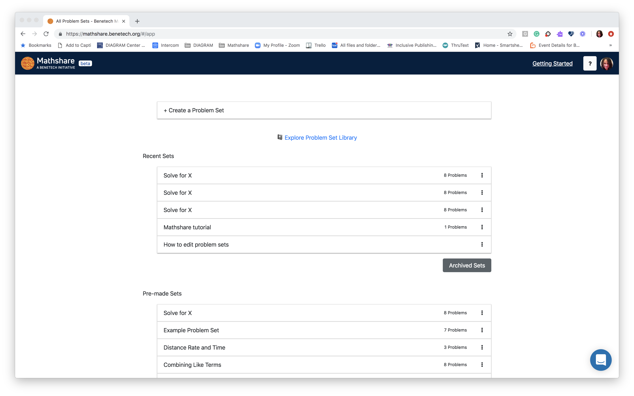
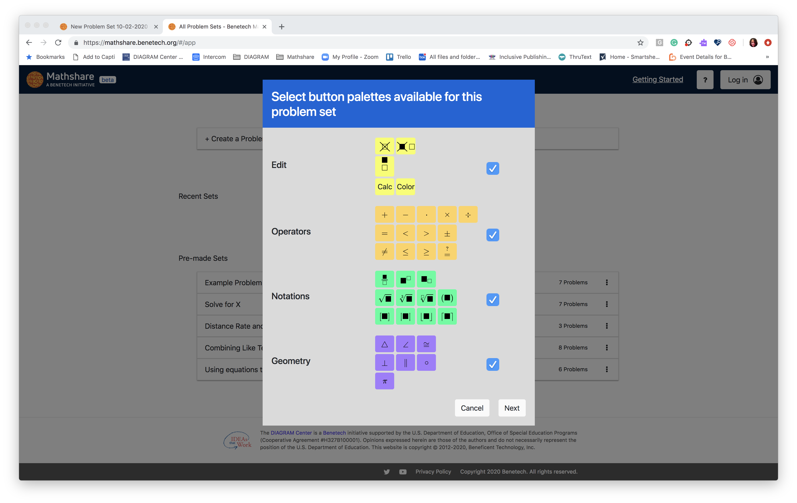
Notes:
Clicking on or selecting the “Create a Problem Set” button opens a pop-up menu which may seem a little intimidating, but don’t worry, I’ll break it down for you.

Slide 18
Notes:
This pop up menu contains all the math function pallets available for your students to use. There is the editing pallet which has buttons that allow your students to use cross outs or calculate simple numerical equations. Then there is the operator pallet with the standard mathematical symbols. Then we have the notation pallet that provides buttons for fractions, exponents and roots. Lastly there is the geometry pallet with buttons for the main geometry operations. If you do not want your student to have access to a pallet simply uncheck the box next to to it and them click on or select the next button. For this demo I will go with the default option of having them all checked and available.

Slide 19
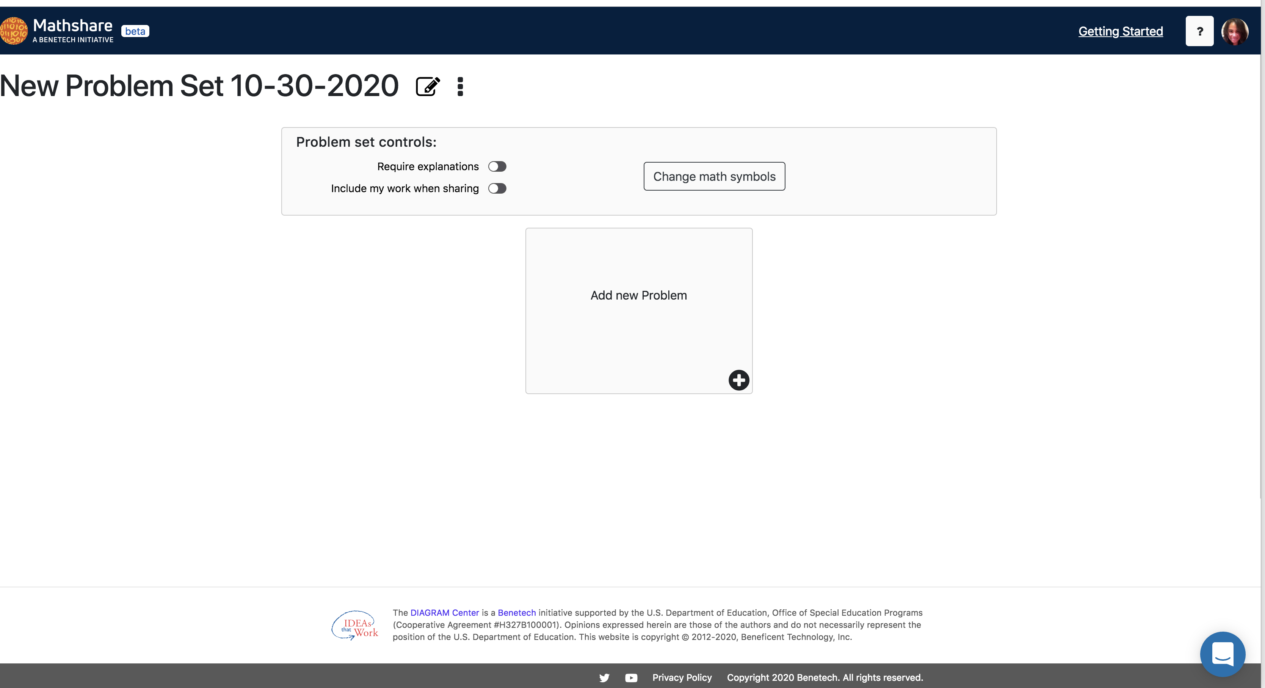
Notes:
Now that you have choses the pallets that will be available you’re ready to create the set. You can give the set a specific name by clicking on or selecting the pencil icon. You can choose if your students will be required to explain their steps and/or if the breakdown of their work will be included when they share it with you by toggling the problem set controls on or off.

Slide 20
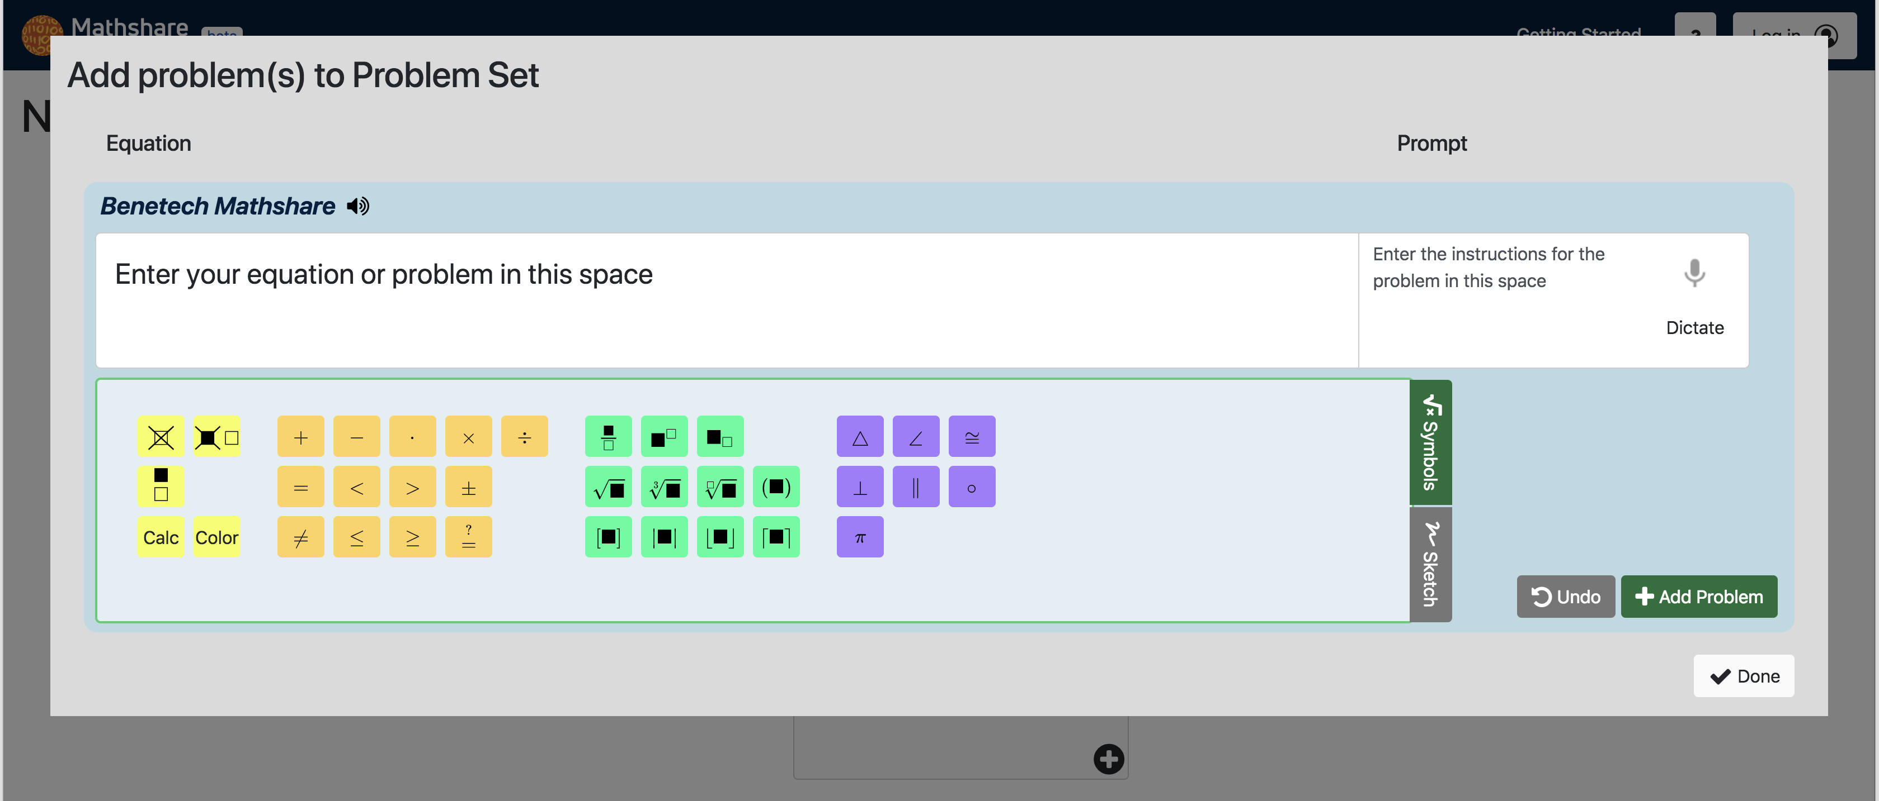
Notes:
You’ll type in the equation you want to add to your set in the in the “equation” field. In the prompt field you can type or select the microphone icon to dictate the instructions to your students.

Slide 21
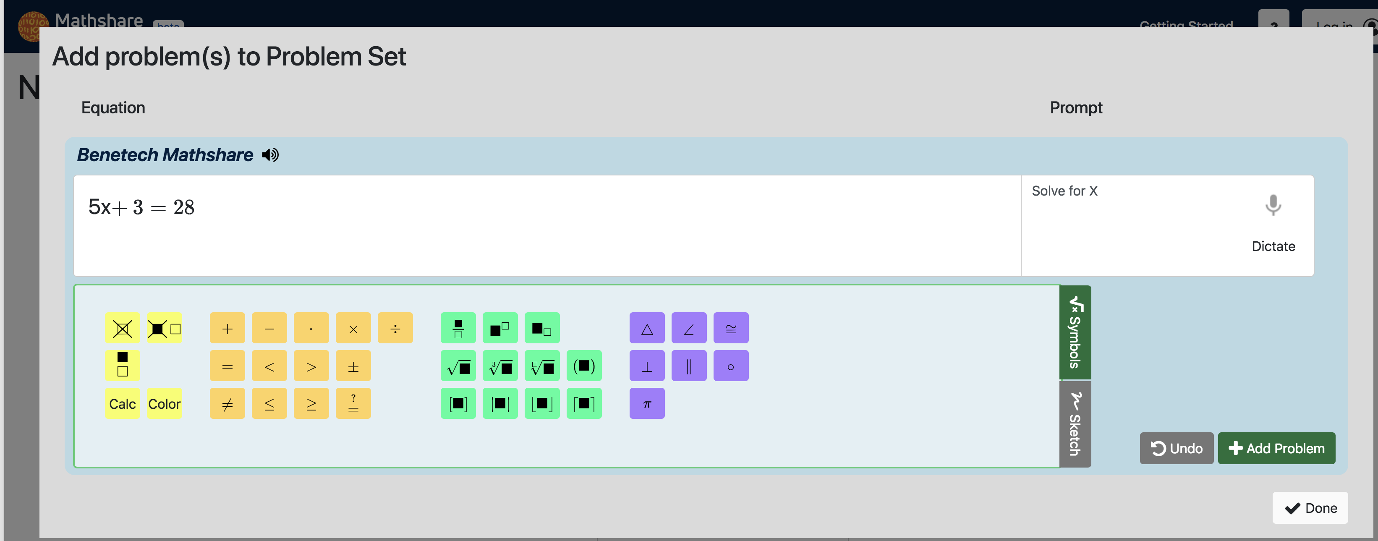
Notes:
Here I have entered in the equation 5x+3=28 and written the prompt “solve for X”. From here I slick on or select “add a problem button to save it to the set.

Slide 22
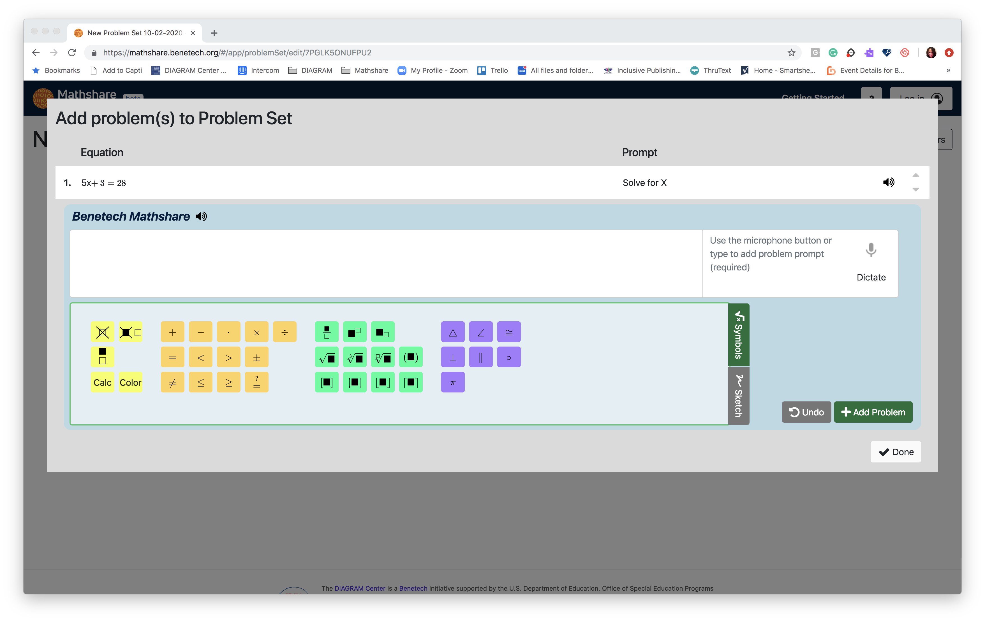
Notes:
Now I can either add additional problems to the set by repeating the steps I just did, or I can click on or select the “done” button to save the full set and go back to the problem set dashboard which is where I can assign the problem.

Slide 23
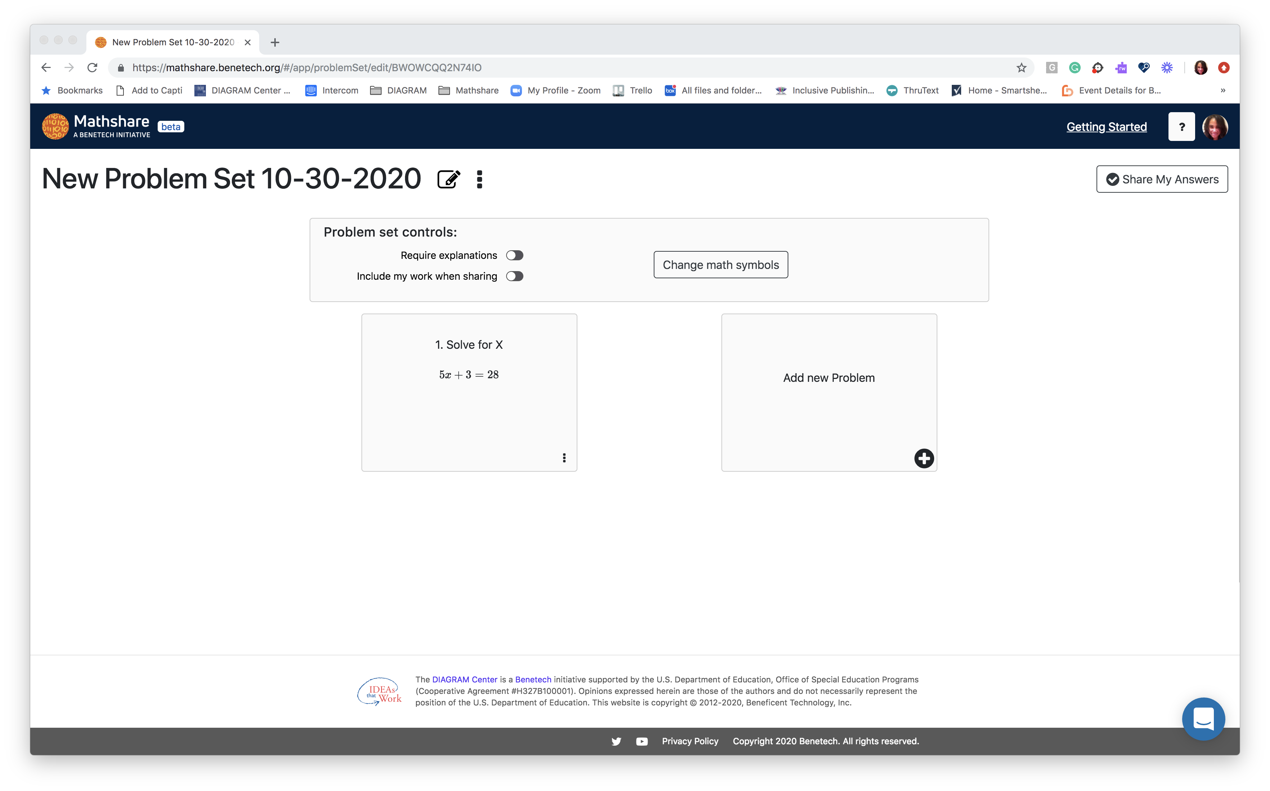
Notes:
And now the problem I created shows up and I’m ready to assign it. Click on or select the 3 dot menu to open the option to share the set,

Slide 24
Assigning a Problem Set
Notes:
Then click on or select “share problem set” to open the options for sharing.

Slide 25
Assigning a Problem Set
Notes:
This will open the “share problem set” menu where you will click or select the Google Classroom button.

Slide 26
Assigning a Problem Set
Notes:
Which Opens the Google classroom interface. Choose the class you wish to assign the problem to from the “choose class” drop down menu

Slide 27
Assigning a Problem Set
Notes:
And then pick create assignment from the “choose action” drop down menu and click on or select the go button to open Google classrooms

Slide 28
Assigning a Problem Set
Notes:
And now the set is assigned to the students in your class, and will show up as assigned in google classroom.

Slide 29
Receiving An Assigned Problem Set
Notes:
You student will then see the assignment in their Google Classroom dashboard. Like any assignment they will click or select it to go to that specific assignment in Google Classrooms.

Slide 30
Notes:
And they will click or select the assignment to start open it in Mathshare

Slide 31
Notes:
Once in Mathshare they can click or select the problem to begin solve it.

Slide 32
Notes:
When the do so it will open the problem that you created as the teacher

Slide 33
Notes:
And the student will go through adding their steps until they are done. They will click or select the finish button to go back to the problem page where they can share their answer.

Slide 34
Notes:
They will click on or select the “share my answers” button to open the Google Classroom interface.

Slide 35
Notes:
They will click on or select the Google classrooms button

Slide 36
Multi-Modal: Story
Students with severe math anxiety can freeze when faced with numbers and complex math problems
Support other skills, like drawing and art, to help find patterns
Notes:
One real-life example is a student who had severe math anxiety and an undiagnosed learning disability. Math was incredibly difficult for her, and when faced with a complex problem she didn’t know where to start. However, when presented with a sketchpad, she was able to draw out the problems, turning the math problem into an art problem and allowing her to fully understand concepts that would have been lost to her otherwise.

Slide 37
Get Involved
Learn More:
Follow Mathshare on YouTube and Twitter
Sign up at mathshare.benetech.org to receive regular updates
Become a tester: https://forms.gle/LZTVdfzHMeif7YoYA
List of accessibility features
YouTube Channel
Help Center
Professional Development Pack

Slide 38
Questions and Answers
Mathshare@Benetech.org
Notes:
I know I threw a lot of information at you so would like to use the last of our time today to answer questions that you might have. Go ahead and type in your questions in the Q&A box and I’ll go through them. As always, thanks for joining us today and feel free to reach out after this with additional questions.

