Slide 1

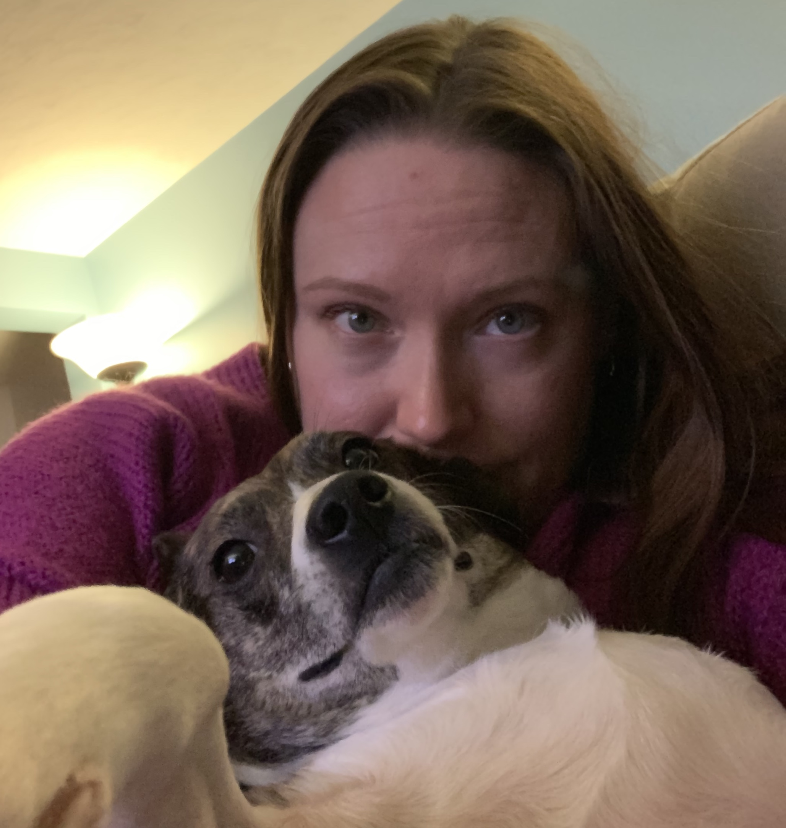
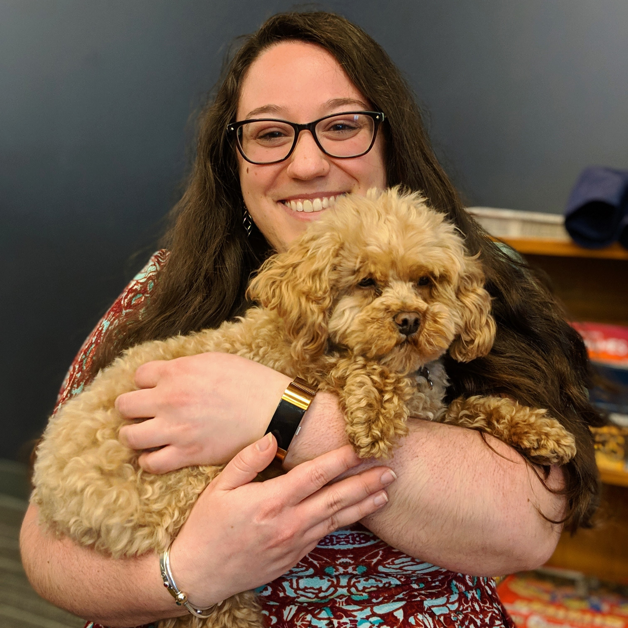
Building an Accessible Culture in Higher Ed
Sarah Ferguson
Program Director for
Digital Accessibility
Esther Brandon
Digital Literacy Specialist

Slide 2
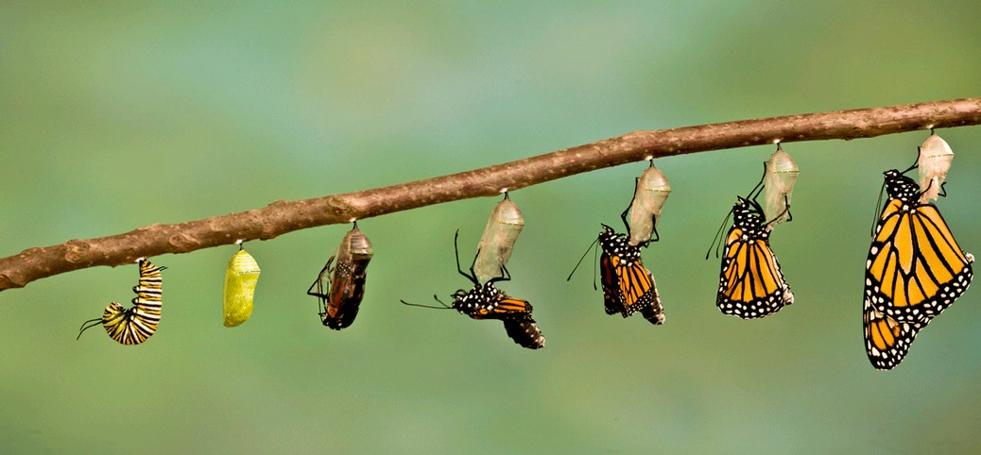
Notice the -ing in the title…we aren’t done yet
Notes:
Transformation…it’s a process

Slide 3
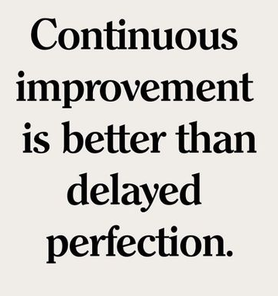
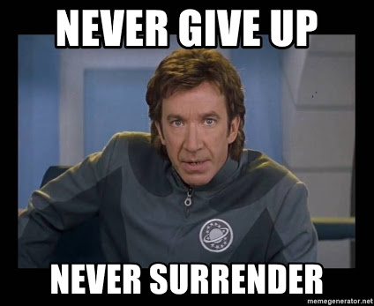
People need time to adjust…keeping chipping away!
-Mark Twain

Slide 4
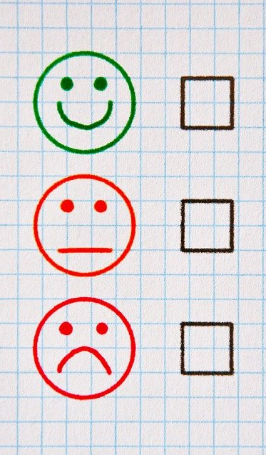
What is the attitude towards accessibility?
Self-Assess
  In your community, do you have:
    Administrative buy-in?
    Faculty buy-in?
    Any underlying hostility, misunderstanding or fear?

Slide 5
Everyone starts somewhere…
Self-Assess
What is your community already doing well?
What do they need to work on?

Slide 6
Everyone starts somewhere…
Self-Assess
What resources do you have?
What resources might you need?
Notes:
We’ve achieved all we have with very limited dedicated resources. This is one of the reasons the next question is so important.

Slide 7
Where are the knowledge gaps?
Self-Assess
  Are they skills-based?
  Are there gaps in understanding?
Notes:
Full understanding of accessibility needs important to students in their work and lives

Slide 8
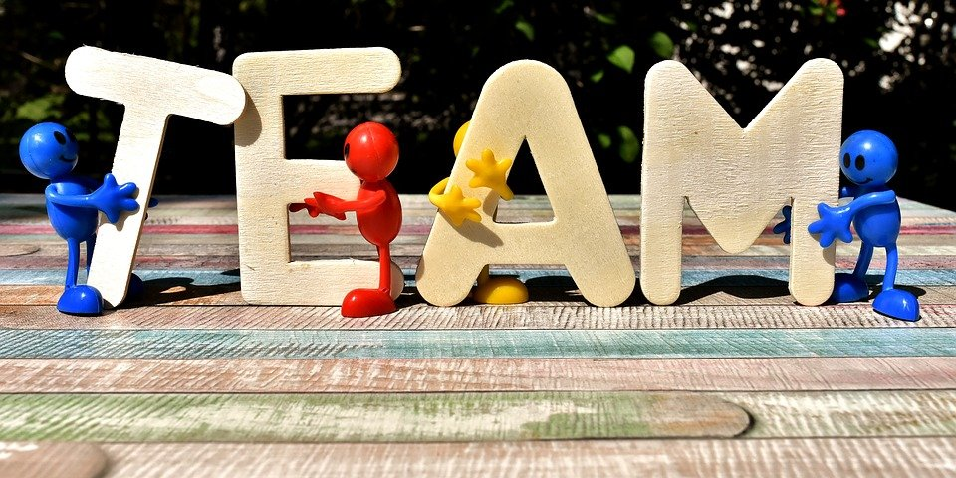
Who are your allies?
Self-Assess
Student Accessibility Support (Accommodations)
Library
Instructional design
ITS
Communications
Media Services (A/V)
Center for Teaching and Learning
Academic advising
Notes:
Treasure trove of resources, advocacy, ideas, positivity to keep you going!

Slide 9
#AccessibilityGoals
Self-Reflect
Self-assessment: Where are you now as a community?
Goals: Where would you like to be?

Slide 10
Increasing awareness & advocacy on parallel tracks
Administrative Support (and Marketing/Communications)
Squad (Team members and allies)
Culture (Community attitude)
Academics (Faculty, Student body, etc.)
Notes:
Culture is also how students with disabilities feel on campus, do they feel welcome?

Slide 11
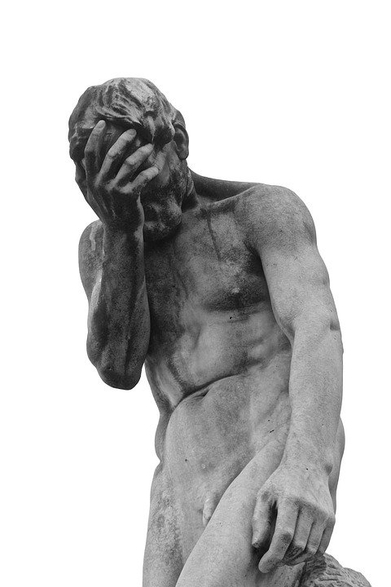
History: what we had
Pre-2015
Administrative Support
Decision to redesign main website
Push to hire Web Accessibility Specialist (WAS)
Squad
Support on campus for hiring WAS:
  Digital comms
  Sr. Assoc. Provost
  Student Accessibility Support (SAS) [Accommodations]
Academics
Student Accessibility Support (SAS)
Culture
Mostly internal at this point

Slide 12
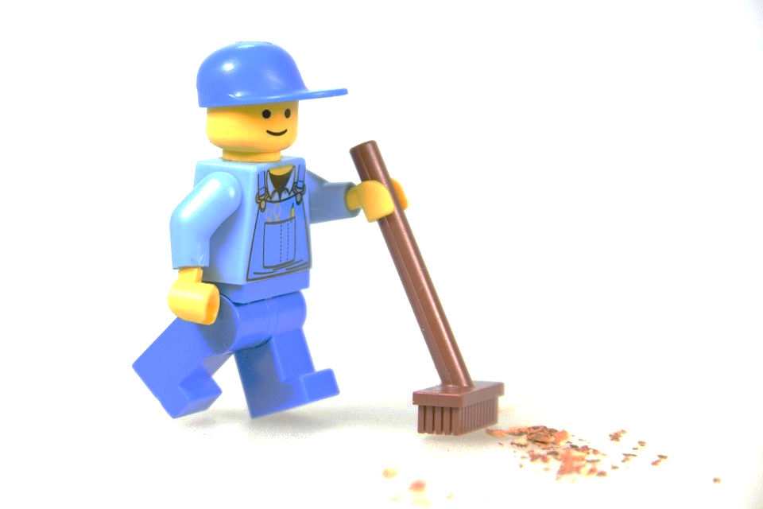
History: tear it down…
2015
Administrative Support
Website redesign underway
Plan for all content to be made accessible during migration
Squad
Web Accessibility Specialist (WAS) hired
Academics
Nothing new!
Culture
Conversations on how to spread awareness begin (WAS & Student Accessibility Support)

Slide 13
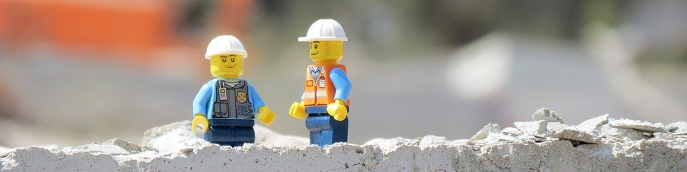
History: rebuild…
2016
Administrative Support
Nothing new!
Squad
Academic Technologist (AT) hired
Academics
AT offers support to faculty
Culture
Building relationships and cultivating advocates and champions

Slide 14
History: increase support
2017
Administrative Support
New Website template goes live
Content being made accessible during migration
Mandatory training for Web Editors in migration phase begins
Squad
Instructional Designer (ID) hired
Conversations about captioning ramp up
Academics
FACET grant for training faculty in making accessible course materials debuts
Culture
Created the Help Desk for Web Accessibility to support the community

Slide 15

History: expansion
2018
Administrative Support
Mandatory training for Web Editors expanded to advanced topics
Movement on Admin buy-in
Squad
SAS specialist hired for grad students
Academics
Student Advocacy ramps up
Library starts to spread awareness around Universal Design for Learning (UDL)
Culture
Same old, same old
Quote by Patti Kelly Ralabate

Slide 16
History: increasing demand for skills
2019
Administrative Support
Training: advanced topics increase
Admin makes a11y a focus – contract rider, facilities plan, $$$, listening to community
Squad
Office of Equal Opportunity created, 504 Coordinator hired
Student Worker x2 hired by WAS
Second Instructional Designer hired
Academics
FACET grant faculty training: applications increase 250%!
Faculty training: welcoming students debuts
Dean of Arts & Sciences calls out for accessible course materials
Culture
Community-wide conversations around accessibility
Transition: Reactive to Proactive model begins

Slide 17
Today: focus on students
2020
Administrative Support
Final phase of migration
Mandatory training for ALL Web Editors (not just undergrad)
Campus-wide a11y committee created
Squad
Program Director position created
Academics
OCR scanners begin roll out on campus
Hybrid Learning Institute, accessible materials
Library materials reviewed for a11y
Culture
Student op-eds
Campus-wide a11y committee created

Slide 18
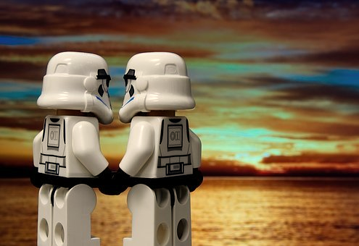
Wishlist
Future
Administrative Support
Staff training mandatory
Digital Accessibility becomes a department w/budget
All digital materials accessible
All buildings/spaces ADA compliant
Squad
WAS position filled
Academics
Faculty Training mandatory
OCR available on all scanners on campus
All course materials accessible
Culture
Everyone feels welcome in the community and are being heard
Running on Proactive model

Slide 19
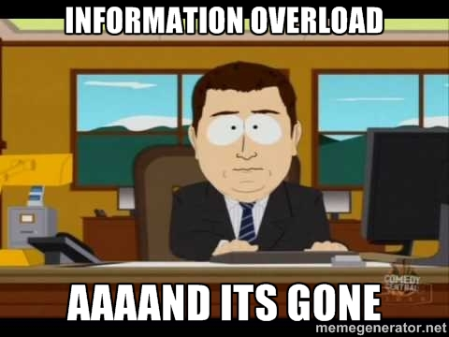
Training Tips #1
Avoid Overload
Don’t cram in too much at once
Chip away at the problem
How can we make this more accessible today than it was yesterday? And repeat.

Slide 20
Training Tips #2
Style & Attitude
  Keep a positive attitude: be a champion, motivate, inspire!
  Maintain some humor: use fun, light-hearted examples when possible
  Find a hook: help attendees relate to accessibility needs:
    How do all learners benefit?
  Make it real: use hands-on demonstrations
    Show and tell, ex: screen reader demos
  Be willing to have one-on-one conversations
Notes:
Help attendees realize what types of accessibility accommodations they use, like curb cuts, elevators, and CCs

Slide 21
Training Tips #3
Know your audience
  Celebrate accessibility achievements
    Administrative policy updates
    Physical building improvements
    Faculty or staff spotlights
  Highlight when advocacy works, esp. student activism
  Use inclusive terms
    Align language with social model
  Remind them: this is not a fad, it’s here, it’s real!
Notes:
Change slide name

Slide 22
Thank you!
Sarah Ferguson Esther Brandon
sferg@brandeis.edu brandone@brandeis.edu
Brandeis.edu/web-accessibility
Notes:
Change slide name

