Slide 1


Accessibility in the Criminal Justice Curriculum
Michael J. Davis, J.D.
Southeastern Oklahoma State University

Slide 2
The Criminal Justice Infrastructure is a Public Service
Under the Americans with Disabilities Act (ADA), people who have disabilities are entitled to the same services law enforcement and the court system provides to anyone else. They may not be excluded or segregated from services, be denied services, or otherwise be treated differently than other people.

Slide 3
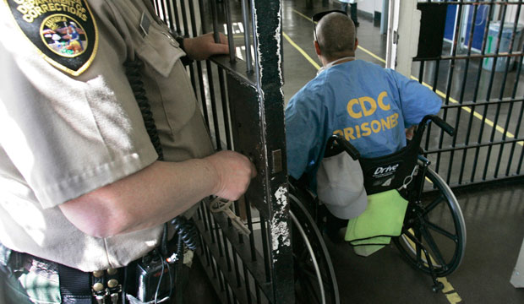
Importance of Including Access Equity in the Criminal Justice Curriculum
Accessibility is often a neglected part of law enforcement training, leaving the space for education of access equity to professional academic programs such as those in postsecondary education, where a majority of Criminal Justice managers and professionals will experience the education.

Slide 4
Unique Importance of Accessibility in Online CJ Curriculum
MUCH higher proportion of students currently employed in law enforcement or corrections.
  Practicing professionals seeking promotion to supervisory capacity.
These classes have a greater emphasis on policy and management.

Slide 5
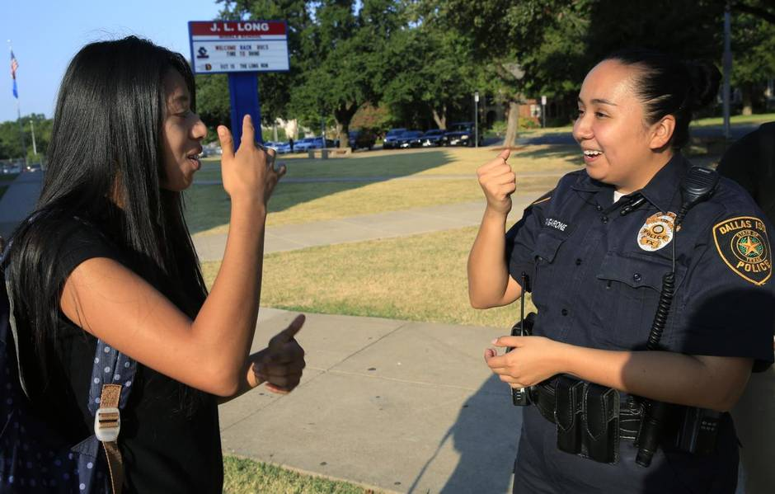
Common/Frequent issues in Accessibility
Title II of the ADA prohibits discrimination against people with disabilities in State and local governments services, programs, and employment. Law enforcement agencies are covered because they are programs of State or local governments, regardless of whether they receive Federal grants or other Federal funds. The ADA affects virtually everything that officers and deputies do, for example:
receiving citizen complaints;
interrogating witnesses;
arresting, booking, and holding suspects;
operating telephone (911) emergency centers;
providing emergency medical services;
enforcing laws;
and other duties.

Slide 6
Classes & Corresponding Curricular Elements
Intro to CJ: Accessible Technology; Judicial ADA Precedent
Corrections: ADAAG Basics; Accessible Transportation
CJ Management: Inclusive Design; LEO Training Programs
Dispatch Mgt: Accessible Technology and 911 Technology

Slide 7
Did you know FCC Regulations Embrace Textable 911?
FCC rules require all wireless carriers and other providers of text messaging applications in the United States to deliver emergency texts to call centers that request them. If a call center requests text-to-911 service, text messaging providers must deliver the service in that area within six months.

Slide 8
Did you know FCC Regulations Embrace Textable 911?
If you attempt to send a text to 911 where the service is not yet available, FCC rules require all wireless carriers and other text messaging providers to send an automatic "bounce-back" message that will advise you to contact emergency services by another means, such as making a voice call or using telecommunications relay service. Bounce-back messages are intended to minimize your risk of mistakenly believing that a text to 911 has been transmitted to an emergency call center when it has not.

Slide 9

App or Handheld Technologies
“PocketTalk” devices for real-time spontaneous translation.
“Hand Talk” translates spoken word into ASL (new version is better).

Slide 10
Access for Law Enforcement Employees
Section 1983 Claims can be brought for inadequate training!
Failure to be disability-inclusive in instructions and interactions especially those that involve waiver of rights: a traffic ticket, consent to search a vehicle, etc.
Even: new lawsuits about crowd control situations & tear gas, etc.

Slide 11
Court Precedent
Roberts v. City of Omaha (2013): ADA applies to arrests.
Williams v. City of New York (2015): ADA applies to investigations.
Deorle v. Rutherford (2001): “when it is or should be apparent that an individual is emotionally disturbed, this information must be considered in determining the reasonableness of force used by police officers…”

Slide 13
Questions?

