Slide 1
Alternate Format Intensive: Alternate Format Production From Student Request to Delivery of Materials

Slide 2
Susan Kelmer
Alternate Format Production Program Manager
University of Colorado Boulder
susan.kelmer@colorado.edu

Slide 3
Today’s Agenda
Housekeeping
10 Modules
2 Overarching Sections
Practice files to be provided
CU Alternate Format Production Manual
Software we will be discussion/demoing

Slide 4
Module 1 - Introduction
Learning Objectives:
Understand the two parts of the alternate media production process:
Administrative
Production
Understand our obligations, and our legal rights, for producing alternate format

Slide 5
What We Are, What We Do
Based on best practices.
Administrative vs. Production.
What an alternate media production facility does and why you should have one.
What are your responsibilities to students?
Acquire and/or produce alternate format materials.
Is this legal?

Slide 6
Module 2 Admin Process –Determining Student Needs
Learning Objectives:
Create a process for student intakes and tracking of requests and type of alternate media needed.
Learn what information you need in order to search for alternate media resources.
Understand how to set up a tracking system for alternate media production.

Slide 7
M2: Who Receives Alternate Format?
Students with print disabilities. What does that mean?
Blind/Low Vision
Physical Impairment
Learning Disability/Reading Disorders

Slide 8
M2: Student Consult/Intake
Meet with students approved for alternate format.
Assess needs.
Assess their knowledge of technology.
Determine format that will work best for them.
Explain your process for alternate format requests.

Slide 9
M2: Types of Alt Format Output
Text-based PDFs
Microsoft Word documents
Microsoft Word documents with enhancements:
Images
MathType
MathML
Braille
Tactile Graphics

Slide 10
M2: How Students Can Request
During initial consult/intake.
Via email.
Via phone.
In Person.
Via database or access system (Accommodate, AIM).

Slide 11
M2: Information Needed From Student
Title of book.
Author
ISBN number
Type of media needed
When alternate media is needed

Slide 12
M2: Production Timeline for Books
Processing of requests should be within two days.
Acknowledging request.
Researching where to get files
Alternate Media should be provided with two weeks, or less, in 95% of cases.

Slide 13
Module 3: Admin Process – Locating Publisher Information and Acquiring Files
Learning Objectives:
Understand how to find complete information for alternate media requests.
Create and follow a process for requesting materials from different types of publishers and databases.
Learn the process for creating files from scanning of a hard copy.

Slide 14
M3: Researching Requested Books
Amazon.com
Complete needed information on student request:
Publisher
Copyright date
Edition

Slide 15
M3: Acquiring Electronic Text
Look for files in current repository.
Request files from publisher, database, or consortium.
Tools:
PublisherLookup.org
AccessText Network
Bookshare
(continued next slide)

Slide 16
M3: Acquiring Electronic Text Cont.
Bibliovault.
Taylor and Francis.
Oxford University Press.
Other publishers not listed (see appendix).
Google as a last resort.
A note about instructor-created materials.

Slide 17
M3: When You Can’t Get Files
Scan hard-copy

Slide 18
Module 4: Admin Process - Tracking
Learning Objectives:
Understand how to create and follow a process for accepting requests for alternate media.
Using best practices, develop a process for storing files, distributing materials for production, performing quality control functions, and distributing completed materials to students.

Slide 19
M4: Tracking of Requests
Spreadsheet (see appendix)
Processing folders/locations for in-progress work.
When files come in:
Folder naming convention
Subfolders
Filenames
(continued on next slide)

Slide 20
M4: Tracking of Requests cont.
Deciding what format to create.
Assigning Text for Production

Slide 21
M4: Assigning Files
Processing folders/locations for in-progress work.
Google doc.

Slide 22
M4: After Files Are Produced/Processed
Quality control.
Preparing and send files to be sent to the student.
Update spreadsheet or other tracking with completion information.
File any hard copies.

Slide 23
Module 5: Admin Process: Non-Textbook Materials
Learning Objectives:
Understand the need and create a method for tracking of smaller work, such as individual articles, power point presentations, and other PDFs faculty may use.
Create a process for production of these smaller pieces on a shortened timeline.
Identify a method for returning completed files to the student.

Slide 24
M5: Non-Textbook Requests
Student can transmit these files any way to you – in person or through email or a portal.
Track these on a separate tab on your spreadsheet; you may need only limited information.
Format of alt media for handouts/small files should always be in Word format.
Turnaround should be 4 days or less.
Transmit finished files via email or pickup.

Slide 25
M6: Production Process - Introduction
Learning Objectives:
Learn how to determine what path production should take from the original document/file to its eventual output.
Understand the difference between the various alternate media options, and what works for different types of students.

Slide 26
M6: What Will Be Produced?
Accessible PDF
Word
Word with Images
Word with Math/MathType
MathML
Braille
Tactile Graphics

Slide 27
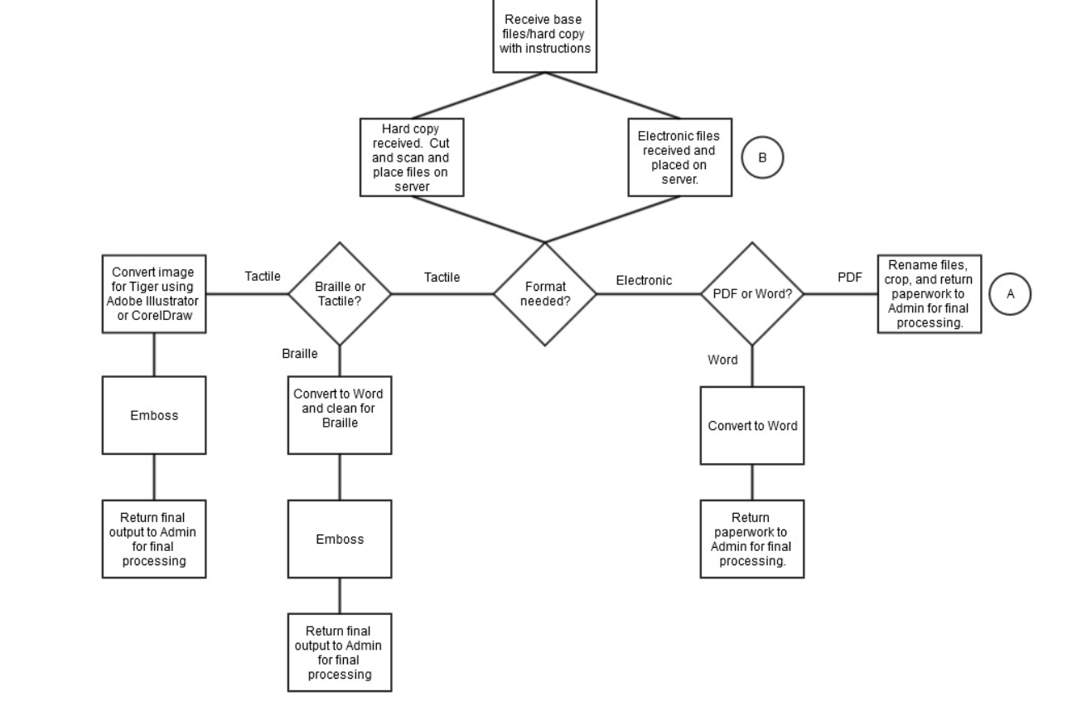
M6: What Format to Produce?
Notes:
This flow chart is also available as a PDF.

Slide 28
Module 7: Production Process – Adobe PDF Processing
Learning Objectives:
Understand how the layout of the PDF determines how it will be processed for use by a student with a print disability.
Learn to use tools in Adobe Acrobat Professional to edit the file appropriately.

Slide 29
M7: Adobe PDF Processing
Does it need to be cropped?
Does it need to be broken into chapters?
Do the individual files need to be renamed?
Do the files need to be combined together?

Slide 30
Module 8: Production Process – Converting PDF to Word/Remediating Word Files
Learning Objectives:
Learn to manipulate an original document to create an editable text-based document.
Understand the key elements required to make a Microsoft Word file accessible for a student using technology to read.
Distinguish the difference between “eye candy” graphics and necessary graphics, and learn how create alternate text to describe them.
Create accessible math in a Word document using MathType.

Slide 31
M8: Production Process – Why and How
Why are we converting to Word?
Optical Character Recognition
Omnipage Professional

Slide 32
M8: Production Process – Editing in Word
Headings and Styles
Page numbers
Footnotes/Notes
Tables
Spelling/Grammar
Bullets and Numbering
Foreign Language Markup
Saving in Appropriate Media Format

Slide 33
M8: Production Process - Graphics
Determination if eye candy, or content.
Placement
Alt-text/description

Slide 34
M8: Production Process – Remediation of Bookshare Files
Locating corroborating information
Breaking into chapters
Page numbers
Repair of index and table of contents

Slide 35
M8: Production Process - MathType
Why MathType?
MathType tutorial from Wiris
Placement of Math
Creating Equations
Shortcuts
Equatio (from TextHelp)

Slide 36
Module 9: Production Process – Other Outputs
Learning Objectives:
Understand three different forms of advanced outputs, and why different output works for different students.
Create a workflow process for fulfilling each of the three advanced outputs.

Slide 37
M9: Production Process – Other Outputs
PDF (save as PDF in Word)
MathML (Word to MathML using MathType)
Braille/Braille-Ready Files (Duxbury)

Slide 38
Module 10: Resources
Alternate Media Consult Form.
Alternate Media Request Form.
Alternate Media Tracking Spreadsheet.
Publisher List.
Recommended Software.
Flow Charts – Admin and Production Processes.
Sample email language.

Slide 39
Susan Kelmer Alternate Format Production Program Manager University of Colorado Boulder susan.kelmer@colorado.edu Location of all files from today’s presentation: http://bit.ly/AlternateFormatIntensive

