Slide 1
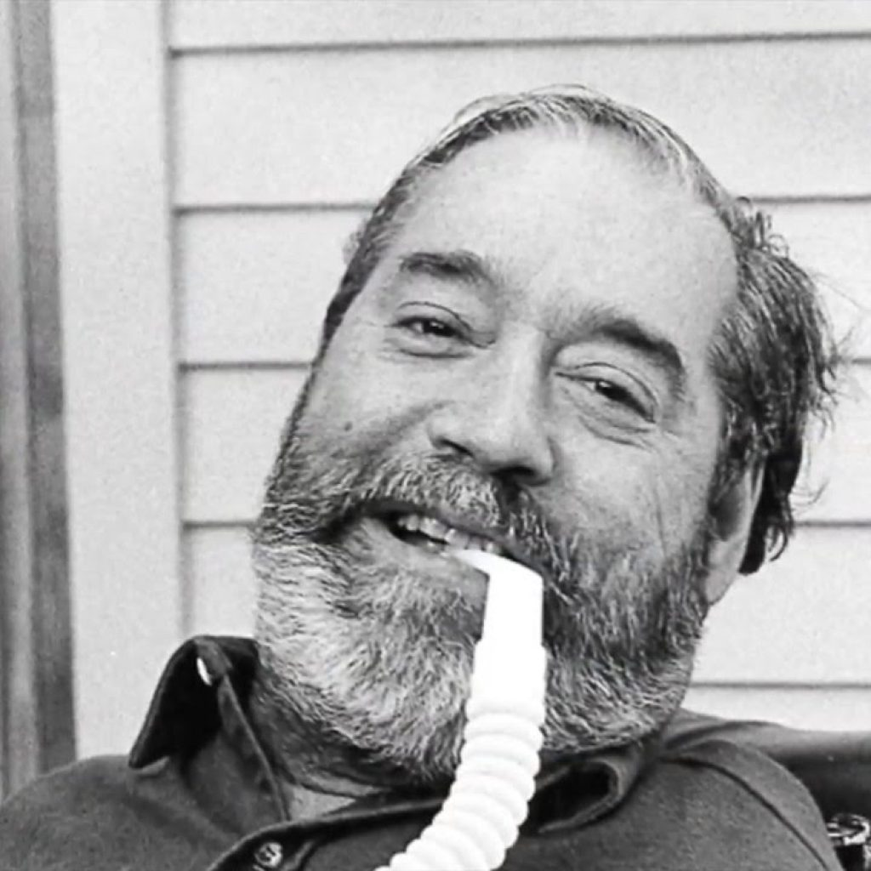
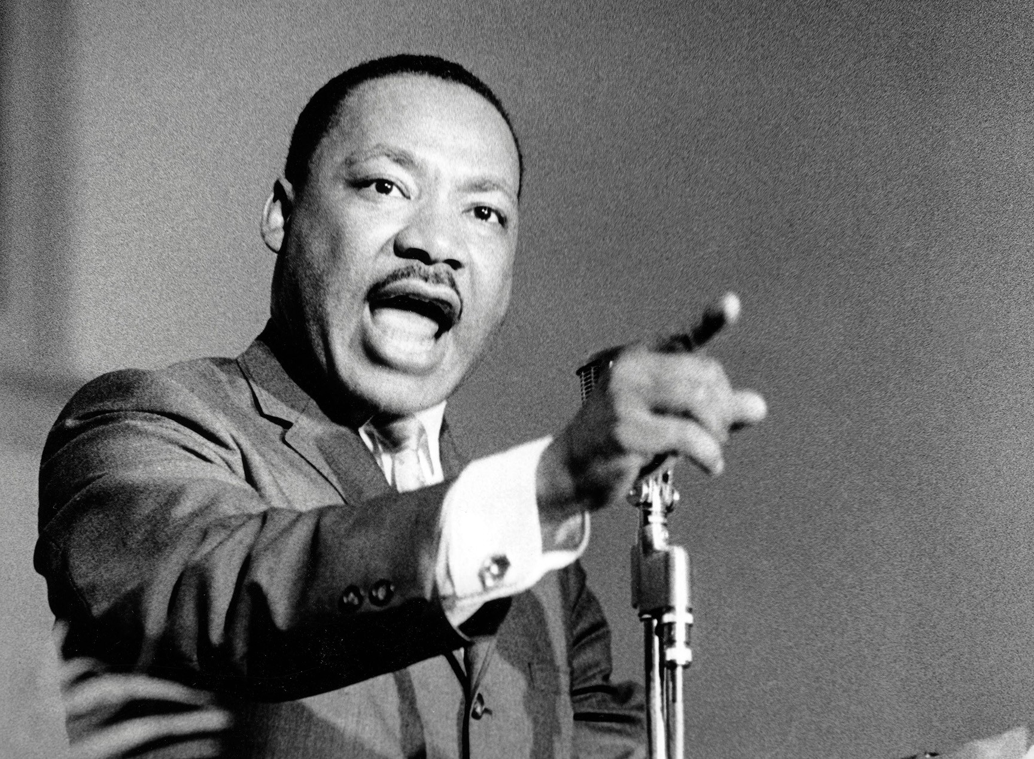
Tips To Empower Professors To Support Students With Disabilities
By
Auston Stamm
Martin Luther King Ed Roberts
Notes:
My name is Auston Stamm and I am the Coordinator of Accessibility and Assistive Technology for Student Disability Services.
I also have mild cerebral palsy and ADHD. Having grown up with a disability I want to shed some light on students with disabilities and how to make the classroom environment more inclusive and accessible for everyone

Slide 2
You Can Empower
You can improve the learning outcomes of your courses for all students
You can be an ally for students with disabilities and create an inclusive classroom environment
You can increase enrollment and diversity on our campus
You can protect your institution and yourself from discrimination lawsuits
Notes:
I hope to hit home these four points

Slide 3
Why Empowerment?
Heart
Mind
Notes:
I’m going to start with Why today. I believe if you know the why you will be more intrinsically motivated to learn about the how and what.
You may be thinking why empowerment? Empowerment is about the process of gaining confidence and strength in controlling one’s life. We want to give our students the tools to pursue what is meaningful to them. I am going to take some time to focus on wny empowering students with disabilities is important and a relevant social justice issue. I will then dive into the how and provide technology and universal design solutions for yoru classroom that can benefit all students
Simon Sinek The Power Of Why: https://www.youtube.com/watch?v=u4ZoJKF_VuA

Slide 4
Disability Awareness
Notes:
I’m going to start with Why today. I believe if you know the why you will be more intrinsically motivated to learn about the how and what.
You may be thinking why empowerment? Empowerment is about the process of gaining confidence and strength in controlling one’s life. We want to give our students the tools to pursue what is meaningful to them. I am going to take some time to focus on wny empowering students with disabilities is important and a relevant social justice issue. I will then dive into the how and provide technology and universal design solutions for yoru classroom that can benefit all students
Simon Sinek The Power Of Why: https://www.youtube.com/watch?v=u4ZoJKF_VuA

Slide 5
The Education Challenge
Chart displayed above, see link in description
Notes:
Link To Education Levels Of People With And Without Disabilities: https://www.bls.gov/opub/ted/2015/people-with-a-disability-less-likely-to-have-completed-a-bachelors-degree.htm
34.6% of people with no disability have a bachelor's degree while only 16.4% of people with a disability
Interesting Journal Article On Students With Invisible Disabilities: https://www.heri.ucla.edu/PDFs/pubs/briefs/HERI_ResearchBrief_Disabilities_2011_April_25v2.pdf

Slide 6
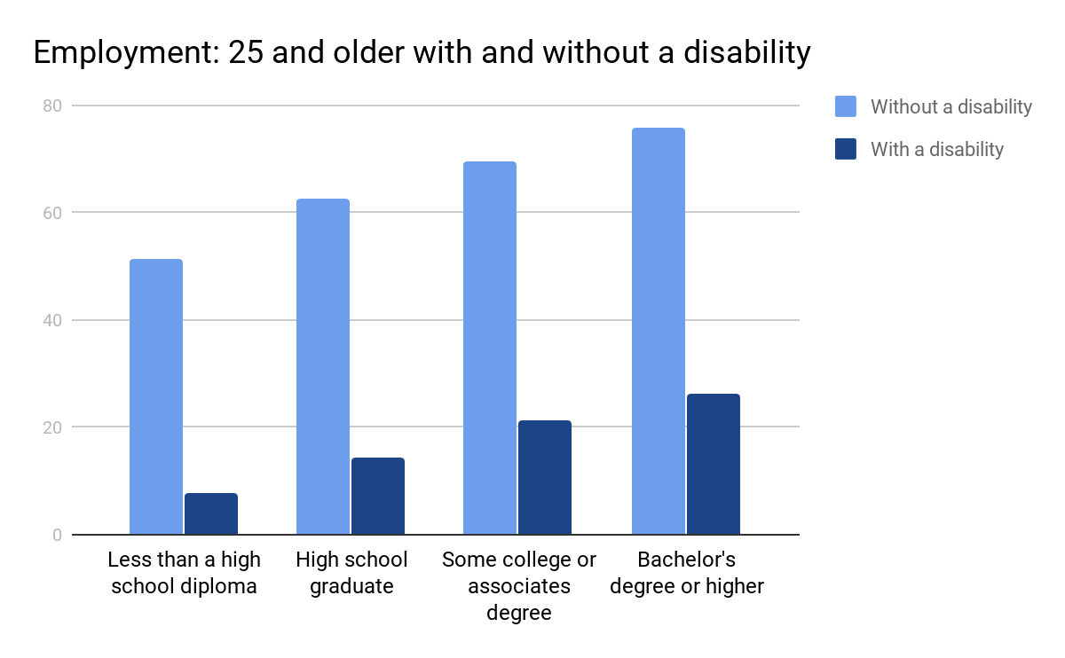
The Employment Challenge
Chart above, see link in description
Notes:
Link To Employment Rates Of People With And Without Disabilities:
https://www.bls.gov/opub/ted/2015/people-with-a-disability-less-likely-to-have-completed-a-bachelors-degree.htm
Harder for people with disabilities to find employment but they have a lot to offer. The third largest market is people with disabilities.
NY Times Article On Benefits Of Hiring People With Disabilities: https://www.nytimes.com/2018/12/27/opinion/disability-rights-employment.html

Slide 7
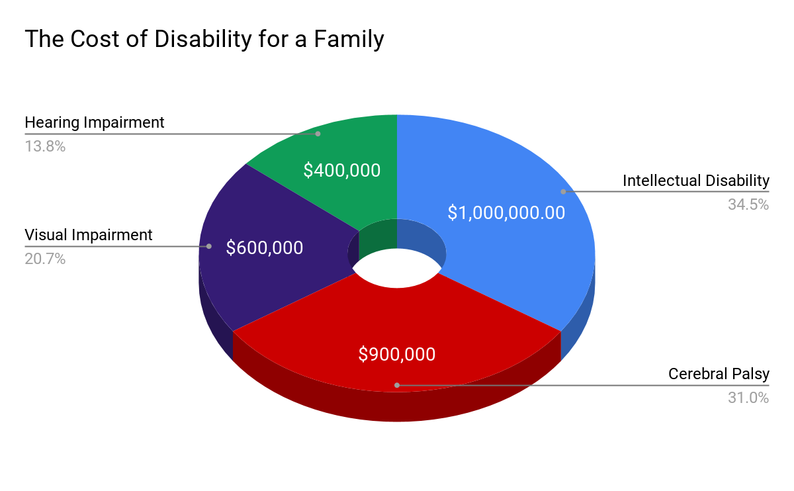
Disability is Expensive
Chart above, see link in description
Notes:
Link To Study Relating To The Cost Of A Disability For A Family: https://www.cerebralpalsy.org/about-cerebral-palsy/costs
Economic status plays a major role in outcomes for people with disabilities.

Slide 8
My Story
Dad, Mom, Me & Dog
Notes:
I have mild cerebral palsy. I was very blessed to have a supportive family and with the economic means to provide the supports I needed to overcome my challenges

Slide 9
Family’s Expenditures
Occupational Therapy
Speech Therapy
Swallowing Therapy
Eye Therapy
Westmark School
Tutoring
Time & Effort
Notes:
Most of these items were not covered by insurance. All these things helped me get to where I am today.
A lot of these supports were not covered by insurance and my parents paid out of pocket for these resources to help me develop
Luncheon Example
OT: Worked on my core strength so that I could sit without resting my body on the table and use a fork/knife
Speech: I had a bad stutter as a child. I had school based and private speech therapy daily for years. CP affects the throat muscles and vocal cords. I remember constantly thinking of synonyms for words in case I stuttered.
Swallowing Therapy: I needed to drink a lot of water when I ate food. My tongue and throat muscles were not strong enough to swallow. I met with a private speech therapist specializing in swallowing and did exercises to strengthen my muscles
Eye Therapy: I had eye therapy to help me with my tracking so I would not jump lines when reading or get confused spatially
Westmark School & Tutoring: I went to a non public school called WestMark that taught me how to read in the fifth grade and helped me maximize by strength by teachin gme how to type and how to make movies
Time & Effort: My Mom was a stay at home Mom. She spent a large amount of her time advocating for me and attending all my IEP meetings

Slide 10
#1 Empowerment Idea
Develop an awareness and understanding of the challenges people with disabilities face in our society

Slide 11
#1 Empowerment Tips
Check out websites dedicated to posting disability articles
Remember that each person has a unique background and lived experience
Try to attend campus events sponsored by Disability Services
Notes:
Please consider attending SDS events!
Disability News Resource: https://www.disabilityscoop.com/

Slide 12
Text To Speech
Notes:
I’m going to start with Why today. I believe if you know the why you will be more intrinsically motivated to learn about the how and what.
You may be thinking why empowerment? Empowerment is about the process of gaining confidence and strength in controlling one’s life. We want to give our students the tools to pursue what is meaningful to them. I am going to take some time to focus on wny empowering students with disabilities is important and a relevant social justice issue. I will then dive into the how and provide technology and universal design solutions for yoru classroom that can benefit all students
Simon Sinek The Power Of Why: https://www.youtube.com/watch?v=u4ZoJKF_VuA

Slide 13
Accessible Textbooks
Students registered with SDS who have difficulty reading can have an accommodation that allows them to access their textbooks electronically
A text to speech program like Kurzweil will read the student their textbooks and allow them to do their highlighting and note taking digitally
Notes:
The assistive technology coordinator (Me) checks each book and makes sure that it is read properly by the software.
It is only for students registered with SDS who have the electronic textbook accommodation
We do have a campus license for Kurzweil

Slide 14
Delivering Accessible Textbooks
It is important to provide the bookstore with your required textbook list as soon as possible
It can take weeks to receive the textbooks from the publisher and longer to remediate the files
Textbooks that contain math or foreign languages may need more time for processing
Notes:
Provide your order to the bookstore ASAP
Text to speech software can have difficulties reading math, old English and foreign languages

Slide 15
Beyond Books
Text to speech programs like Kurzweil can be used to read websites, PDFs and Word Documents
Kurzweil’s can now be used on an iphone to listen and highlight on the go
A campus license of Kurzweil means that the technology is available to all students
Notes:
Provide your order to the bookstore ASAP
Text to speech software can have difficulties reading math, old English and foreign languages

Slide 16
#2 Empowerment Idea
Let your students know the required textbooks as soon as possible
Notes:
This helps students registered with SDS with the electronic textbook accommodation receive the book by the first day of class

Slide 17
#2 Empowerment Tips
Provide the bookstore with your textbook list as soon as possible
Remind your students by sending a message to them through the LMS
If a student talks to you about their accommodations and mentions accessible textbooks refer them to SDS
Notes:
Sending a Moodle message can really be helpful so students know the book is available to purchase
Students like to have more notice because they want to order from other sources sometimes not just the campus bookstore

Slide 18
Kurzweil Activity
Kurzweil Plus Twitter
Notes:
Please follow the directions shown in the next video

Slide 19
#whydisabledpeopledropout
Twitter Bird
Notes:
#whydisabledpeopledropout Link: https://twitter.com/hashtag/whydisabledpeopledropout?ref_src=twsrc%5Egoogle%7Ctwcamp%5Eserp%7Ctwgr%5Ehashtag

Slide 20
#whydisabledpeopledropout Respecting Privacy
Because last semester my professor essentially forced me to publicly disclose my disability to the entire class.
Because professors STILL think that non-technology (no laptop/phone) classrooms are a good idea without considering that those who need accommodations will have to out themselves and justify their use of technology.
Notes:
These are some tweets that I found powerful
It is important to consider how a non-technology ban in the classroom outs those students with disabilities who use technology.
You may want to consider doing periodic checks around the class to see if anyone is misusing their tech vs banning

Slide 21
#whydisabledpeopledropout Respecting Accommodations
Teachers view accommodations as an option and a privilege rather than a legal right they have to give you
Comments from peers in your classes saying: "you don't need extra time/reasonable adjustments, you get better grades than we do. It's not fair."
Notes:
Accommodations are a legal right!
Peers in the classroom sometimes do pass unfair judgements about students who have accommodations. It is important to make clear that accommodations are provided because of a documented disability and are not an advantage

Slide 22
Course Reader
Notes:
I’m going to start with Why today. I believe if you know the why you will be more intrinsically motivated to learn about the how and what.
You may be thinking why empowerment? Empowerment is about the process of gaining confidence and strength in controlling one’s life. We want to give our students the tools to pursue what is meaningful to them. I am going to take some time to focus on wny empowering students with disabilities is important and a relevant social justice issue. I will then dive into the how and provide technology and universal design solutions for yoru classroom that can benefit all students
Simon Sinek The Power Of Why: https://www.youtube.com/watch?v=u4ZoJKF_VuA

Slide 23
The Scoop On Readers
One of the most time consuming jobs I have is creating digital copies of course readers
Text to speech programs are very sensitive to scan quality, highlighting, underlining and additional notes written on the text
It is difficult to find the original material being used in the course reader

Slide 24
#3 Empowerment Idea
Provide a table of contents with the sources you are using for your course reader
Notes:
A good example of a table of contents for a course reader is below
http://w.astro.berkeley.edu/~echiang/rad/table.pdf

Slide 25
#3 Empowerment Tips
Provide the title, author and publisher of each source in the course reader
Consider listing the database you used to find the article
Try to avoid notes, underlining and poor image quality when printing course readers
Notes:
If possible avoid notes, underlining or poor image quality in your course reader

Slide 26
Transition To College
Notes:
I’m going to start with Why today. I believe if you know the why you will be more intrinsically motivated to learn about the how and what.
You may be thinking why empowerment? Empowerment is about the process of gaining confidence and strength in controlling one’s life. We want to give our students the tools to pursue what is meaningful to them. I am going to take some time to focus on wny empowering students with disabilities is important and a relevant social justice issue. I will then dive into the how and provide technology and universal design solutions for yoru classroom that can benefit all students
Simon Sinek The Power Of Why: https://www.youtube.com/watch?v=u4ZoJKF_VuA

Slide 27
The Pillars Of Success
Seeking services from the college disability office and all the other available college services
Forming relationships with professors
Developing support systems with friends, the college disability office, support groups
Learning to be self aware and using that knowledge to overcome challenges
Notes:
Students were asked:
“What advocacy or self-determination skills do you think are absolutely essential to staying in college and getting the supports you need?”
Link To Research Article: https://journals.sagepub.com/doi/10.1177/0885728808317658
A lot of students do not do all of these things. Students with disabilities are saying that these pillars are essential for success in college

Slide 28
The Transition
High School
College
There is a plan (IEP) in place that teachers and school administrators are informed to follow
Adult students must reach out to SDS and their professors to coordinate services
Parents are actively involved in the planning and execution of accommodations
Parents are aware of services only if the student agrees in writing that information can be shared (FERPA)
Students are entitled to an education that meets their individual needs – even if that includes modifying course standards – (IEP)
Students are expected to meet course standards regardless of disability – (No IEP)
Notes:
Our Director Julie Scaff developed this slide to highlight the differences between high school and college. The importance of refined self advocacy skills increase in college but may not be developed in high school. Also in college there are more limits on how course work can be modified.
Resource That Answers Questions For Students About The Transition: https://www2.ed.gov/about/offices/list/ocr/transition.html

Slide 29
Encouraging Self Advocacy
SDS will be providing students with templates to help them start conversations with faculty about their accommodations
Students will have templates for face to face conversations and emails
The templates change based on the student’s comfort disclosing their disability
Notes:
SDS will be providing templates to help encourage students to talk to their professors about their accommodations and learning disability

Slide 30
Sample Script
Hi Professor my name is _____ and I am in your
______ class. Thank you for meeting with me.
Did you receive the SDS email notification outlining the accommodations I have in your class?
I am good at ______ and _______. The accommodations help me with _______.
I would like to discuss _____ from your syllabus and how it relates to my accommodations.
Notes:
This is an accommodations script students can use to practice talking with their professors
Link To Sample Script:http://coastalbend.edu/uploadedFiles/CBC/Content/Student_Services/Counseling/Student%20Disability%20Script(1).pdf

Slide 31
Optional Talking About Disability
I am comfortable speaking about my disability, however I would like to remind you that speaking about my disability puts me in a vulnerable place, so I ask that you approach this topic with compassion.
This is what I feel comfortable sharing about my disability that may aid in your understanding of my accommodations.
Background on the disability:
Possible symptoms:
Possible events that may occur:
How you can help:
Notes:
The student has a choice whether to talk about just their accommodations or to share info on their disability

Slide 32
#4 Empowerment Idea
Always treat any student’s disclosure of their disability with respect and maintain their privacy. If possible try to make a positive comment related to their strengths or express appreciation.
Notes:
Try to talk to a student in a private place like office hours or after class
I’ve had professors mention me consistently when it related to material and it made me feel awkward
I’ve had a professor ask me in front of the class if I take anti-seizure medication? Don’t go into medical questions, it is not appropriate.

Slide 33
#4 Empowerment Tips
Talk to the student in a private setting (after class or office hours) and avoid asking personal questions about their disability
Review important dates/exams with the student and contact SDS if questions arise
Refer students who disclose to SDS
Check for SDS emails with important info
Notes:
Maximize your use of office hours to discuss accommodations with students
Always look to highlight a student’s strengths rather than weaknesses

Slide 34
Accessible Syllabus
Notes:
I’m going to start with Why today. I believe if you know the why you will be more intrinsically motivated to learn about the how and what.
You may be thinking why empowerment? Empowerment is about the process of gaining confidence and strength in controlling one’s life. We want to give our students the tools to pursue what is meaningful to them. I am going to take some time to focus on wny empowering students with disabilities is important and a relevant social justice issue. I will then dive into the how and provide technology and universal design solutions for yoru classroom that can benefit all students
Simon Sinek The Power Of Why: https://www.youtube.com/watch?v=u4ZoJKF_VuA

Slide 35
Syllabus and Course Material
Students have a tendency to lose course materials
Posting materials to Moodle can help students who have a hard time with organization
Notes:
A lot of students lose the syllabus so having it available online is very important

Slide 36
Important Dates
Students need a way to look at important dates and deadlines quickly
An important dates and deadlines page makes it easy for students to see when tests and projects are due
Notes:
Includes all course content: Websites, Videos, Slideshows, Course Materials, Etc.
Try to break down big projects into smaller steps and show when each step is due
Be clear of the exact date/time an assignment is due

Slide 37
Important Dates Example
Week 10: Tuesday, 11/5/19
Lecture
Quiz 3
Turn in outline of final project on 11/9/19 by 5 PM

Slide 38
#5 Empowerment Idea
Post the syllabus and all course materials online through Moodle
Try to include an important dates page

Slide 39
#5 Empowerment Tips
Try to fit all the dates onto one page
Mention the exact time that each assignment is due
Consider making the assignments page available as a separate document

Slide 40
Emails
Notes:
I’m going to start with Why today. I believe if you know the why you will be more intrinsically motivated to learn about the how and what.
You may be thinking why empowerment? Empowerment is about the process of gaining confidence and strength in controlling one’s life. We want to give our students the tools to pursue what is meaningful to them. I am going to take some time to focus on wny empowering students with disabilities is important and a relevant social justice issue. I will then dive into the how and provide technology and universal design solutions for yoru classroom that can benefit all students
Simon Sinek The Power Of Why: https://www.youtube.com/watch?v=u4ZoJKF_VuA

Slide 41
Campus Emails
Sending emails and class communication with text embedded in the message
Images cannot be read by screen readers
Sending both images and text provides two different ways for people to access information

Slide 42
Email Image

Slide 43
Email Text
De La Salle Week: Meet the Brothers event takes place Friday, April 27th 8:30-9:30am
Chat with the brothers over breakfast in Fenlon Hall

Slide 44
#6 Empowerment Idea
Send all emails with text to explain
any images that are attached

Slide 45
#6 Empowerment Tips
Type short summary of important information included in the image
Try to use PDFs over JPEGs with text that is clear and easy to read
Describe a link don’t just say Click Here

Slide 46
Captioning
Notes:
I’m going to start with Why today. I believe if you know the why you will be more intrinsically motivated to learn about the how and what.
You may be thinking why empowerment? Empowerment is about the process of gaining confidence and strength in controlling one’s life. We want to give our students the tools to pursue what is meaningful to them. I am going to take some time to focus on wny empowering students with disabilities is important and a relevant social justice issue. I will then dive into the how and provide technology and universal design solutions for yoru classroom that can benefit all students
Simon Sinek The Power Of Why: https://www.youtube.com/watch?v=u4ZoJKF_VuA

Slide 47
Pacer Center
“The most challenging aspect of modifying classroom policies or practices for students with disabilities is that it requires thought and some prior preparation.”
Notes:
It is very important to take extra time to modify your practices and policies to foster inclusion and accessibility for students.
Benjamin Franklin said, “By failing to prepare, you are preparing to fail” We don’t want to fail our students and that is why it is so great that you are here to learn about accessibility

Slide 48
The Difference
Accommodations
Universal Design
Available to specific students registered with SDS who have a documented disability
Available to all students in the classroom
Meeting a legal standard of access for a specific student by modifying course content
Creating additional ways of accessing the course content and making it available to everyone
Ensuring specific students can participate by providing a support or modification for an assignment
The goal is creating a variety of ways of interacting with the content and assessing the class’s knowledge

Slide 49
Question
When did our government begin to fund curb cuts and handicap parking?
‣1973
Notes:
Occured after Civil Rights Movement

Slide 50
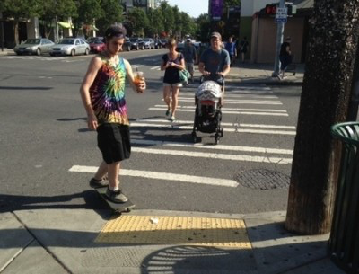
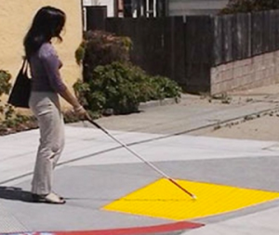
Curb Cuts
Skateboarder and mom with stroller
use curb cut
Woman with cane uses curb cut

Slide 51
Captioning Benefits
Roughly 90 percent of all students who use closed captions find them at least moderately helpful for learning (comprehension, retention)
Studies show captioning can benefit people on the autism spectrum, people with auditory processing disorder & people with ADHD
Notes:
3PlayMedia Benefits Of Captioning: https://www.3playmedia.com/2017/08/18/how-captioned-videos-help-autistic-students/
Gen Z Loves Closed Captioning: https://onezero.medium.com/why-gen-z-loves-closed-captioning-ec4e44b8d02f
A Rising Tide How Closed Captions Can Benefit All Students: https://er.educause.edu/articles/2017/8/a-rising-tide-how-closed-captions-can-benefit-all-students
Benefits Of Audio Description: https://www.automaticsync.com/captionsync/learn/closed-captioning-benefits/

Slide 52
Don’t Make This Captioning Mistake!
Subtitles and closed captioning are different!
Subtitles are selected from the DVD menu, are burned into the video and lack captioning for sound effects
Closed captioning usually is on content from TV (TV Shows, News, Movies), meets the highest standard for accessibility and requires a decoding chip
Notes:
Closed Captioning vs Subtitles: https://www.avsforum.com/forum/24-digital-hi-end-projectors-3-000-usd-msrp/179753-closed-captioning-projectors.html

Slide 53
Projector Tips
Check your projectors to make sure they support closed captioning
Consider connecting your laptop to the projector to play in class DVDs
Computers support closed captioning with built in programs like Apple’s DVD Player or Windows Media Player
Notes:
Closed Captioning vs Subtitles: https://www.avsforum.com/forum/24-digital-hi-end-projectors-3-000-usd-msrp/179753-closed-captioning-projectors.html

Slide 54
Captioning Lawsuits
Netflix was successfully sued to provide closed captioning and audio description
UC Berkeley, MIT and Harvard were all sued for posting free online courses without captioning
Movie theatres are being required to offer closed captioning and audio description
More theatrical performances are being ordered to provide closed captioning
Notes:
Current News Regarding Captioning: https://www.adatitleiii.com/tag/closed-captioning/
Netflix Lawsuit: https://www.3playmedia.com/2015/07/23/nad-v-netflix-ada-lawsuit-requires-closed-captioning-on-streaming-video/
Captions For Theatrical Performances: https://livingwithhearingloss.com/2016/05/10/open-captions-on-broadway/
Harvard, MIT Captioning Lawsuit: https://www.insidehighered.com/news/2019/04/08/mit-and-harvard-fail-get-out-video-captioning-court-case

Slide 55
Captioning Policy
If a student is deaf or hard of hearing in your class all videos/audio must have captioning or transcription
Videos on the institution’s website should have closed captioning
More colleges are providing services or funding for professors to caption materials and advertising captioning for events
Notes:
3PlayMedia Study On Higher EducationCaptioning Guidelines: https://www.3playmedia.com/2017/06/13/do-colleges-have-formal-guidelines-for-closed-captioning/
Universities With Captioning Resources: https://www.3playmedia.com/2017/09/13/5-universities-doing-captioning-right/
Community Colleges With Captioning Policy/Resources: https://www.3playmedia.com/2017/09/19/5-community-colleges-doing-captioning/
Case Study Of Successful College Captioning Programs: https://www.sctechsystem.edu/downloads/web-accessibility/Case-Study-of-Five-Colleges.pdf

Slide 56
#7 Empowerment Idea
Consider providing captioning for all your course media
If a student is hard of hearing or deaf all materials MUST be captioned, videos without captioning cannot be played!
Notes:
Please contact me at abs13@stmarys-ca.edu
You want to submit your captioning requests as far in advance as possible

Slide 57
#7 Empowerment Tips
Look for emails regarding captioning
Consider making audio transcripts available on LMS
Remember to click the CC button!
YouTube and other auto generated captioning is NOT a substitute
Notes:
Look for a CC button on your video player
We can make transcripts of podcasts or radio shows too

Slide 58
Accessible Lecture Tips
Notes:
I’m going to start with Why today. I believe if you know the why you will be more intrinsically motivated to learn about the how and what.
You may be thinking why empowerment? Empowerment is about the process of gaining confidence and strength in controlling one’s life. We want to give our students the tools to pursue what is meaningful to them. I am going to take some time to focus on wny empowering students with disabilities is important and a relevant social justice issue. I will then dive into the how and provide technology and universal design solutions for yoru classroom that can benefit all students
Simon Sinek The Power Of Why: https://www.youtube.com/watch?v=u4ZoJKF_VuA

Slide 59
Helping Hard Of Hearing Students
Students who are hard of hearing generally rely on lip reading
Generally students who are hard of hearing sit up front, which obstructs their view of students in the back of the class
Background noise in the classroom can make hearing difficult at times
Notes:
Journal Article On Hard Of Hearing Students Experiences & Recommendations: https://www.cogitatiopress.com/socialinclusion/article/view/1643/1643

Slide 60
#8 Empowerment Idea
When a student is hard of hearing in your class try to make sure your lips are visible

Slide 61
#8 Empowerment Tips
Avoid speaking with your back turned or while you are looking down at something
Summarize a student’s answers to questions
Try to be mindful of background noise in the environment

Slide 62
Live Captioning
Notes:
I’m going to start with Why today. I believe if you know the why you will be more intrinsically motivated to learn about the how and what.
You may be thinking why empowerment? Empowerment is about the process of gaining confidence and strength in controlling one’s life. We want to give our students the tools to pursue what is meaningful to them. I am going to take some time to focus on wny empowering students with disabilities is important and a relevant social justice issue. I will then dive into the how and provide technology and universal design solutions for yoru classroom that can benefit all students
Simon Sinek The Power Of Why: https://www.youtube.com/watch?v=u4ZoJKF_VuA

Slide 63
Live Captioning Accommodation
Live Captioning is now available for Google Slides and PowerPoint
Google Slides Icon PowerPoint Icon
Notes:
Live captioning does not meet ADA standards
Live Caption App: http://www.livecaptionapp.com/

Slide 64
Activity Time!
Live Caption Icon
Google & Otter.ai have unveiled live captioning apps
Live Caption is another live captioning app. Try it out now! Download “Live Caption” from the App Store or Google Play

Slide 65
Digital Textbooks And Learning Modules
Notes:
I’m going to start with Why today. I believe if you know the why you will be more intrinsically motivated to learn about the how and what.
You may be thinking why empowerment? Empowerment is about the process of gaining confidence and strength in controlling one’s life. We want to give our students the tools to pursue what is meaningful to them. I am going to take some time to focus on wny empowering students with disabilities is important and a relevant social justice issue. I will then dive into the how and provide technology and universal design solutions for yoru classroom that can benefit all students
Simon Sinek The Power Of Why: https://www.youtube.com/watch?v=u4ZoJKF_VuA

Slide 66
Benefits of Digital Textbooks
Easier for students to order and bring because it is digital and stored on their laptop or tablet.
Searching and copying text is a lot faster
Additional online resources to foster learning of key concepts
Some offer text to speech functionality built in
Environmentally friendly
Notes:
The main downside for students is that digital copies cannot be resold
Advantages Of Digital Textbooks: https://www.universities-colleges-schools.com/the-advantages-of-e-textbooks
Consider choosing publishers that offer their textbooks digitally because they can benefit students
Easier for students to bring to class, search textbooks, some offer text to speech functionality and additional online resources

Slide 67
Warning: Online Learning Module
Publishers are making online learning modules like Pearson’s MyLab, Cengage MindTap, McGraw Hill Connect
These learning modules can have varying levels of accessibility
The college is liable if the module is not accessible and it can require a lot of money and time to modify an inaccessible module

Slide 68
What AT Specialists Are Saying
“We have gotten some complaints that online materials may not be accessible, but I don't even know, because we don't even have access to them. The materials are locked down so that we cannot remediate any problems.”
“Our campus just put into effect an Electronic Information Technology policy that will, hopefully, stop a lot of this from happening.”

Slide 69
#9 Empowerment Idea
Ask publishers about the accessibility of their learning modules and digital textbooks

Slide 70
#9 Empowerment Tips
Voluntary Product Accessibility Template (VPAT) are accessibility guidelines of software that you can request
Ask about keyboard navigation and text to speech especially for math and foreign language
Bring accessibility questions to AT Coordinator
Consider implementing a campus wide IET policy focused on accessibility

Slide 71
Assignments
Notes:
I’m going to start with Why today. I believe if you know the why you will be more intrinsically motivated to learn about the how and what.
You may be thinking why empowerment? Empowerment is about the process of gaining confidence and strength in controlling one’s life. We want to give our students the tools to pursue what is meaningful to them. I am going to take some time to focus on wny empowering students with disabilities is important and a relevant social justice issue. I will then dive into the how and provide technology and universal design solutions for yoru classroom that can benefit all students
Simon Sinek The Power Of Why: https://www.youtube.com/watch?v=u4ZoJKF_VuA

Slide 72
A Variety Of Assignments
A lot of classes emphasize a particular way of expressing knowledge like essays or multiple choice questions
It is important to have a variety of assignments encouraging to express their learning in different ways

Slide 73
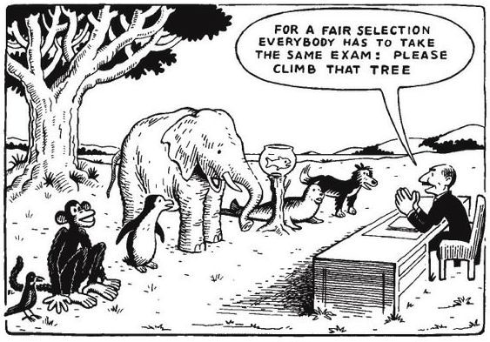
Cartoon
Different animals lined up with a judge saying, “For a fair selection everybody has to take the same exam: please climb that tree.”

Slide 74
Assignment Ideas
Debate
Case Study
Video
Book Review
Theatrical Play
Legal Brief
Poem
Advertisement
Executive Summary
Proposal
Notes:
Alternatives To Traditional Papers: https://citl.indiana.edu/teaching-resources/assessing-student-learning/alternatives-traditional-exams-papers/

Slide 75
#10 Empowerment Idea
Use a wide variety of assignments to allow students to express their learning through different mediums

Slide 76
#10 Empowerment Tips
Try to assign close to equal grading weight to different assignments
Incorporate both traditional and non traditional ways of expressing learning
Be open to assignment modification especially for students with learning disabilities
Notes:
Personal example: Changing art projects to movies

Slide 77
Training Activities
Notes:
I’m going to start with Why today. I believe if you know the why you will be more intrinsically motivated to learn about the how and what.
You may be thinking why empowerment? Empowerment is about the process of gaining confidence and strength in controlling one’s life. We want to give our students the tools to pursue what is meaningful to them. I am going to take some time to focus on wny empowering students with disabilities is important and a relevant social justice issue. I will then dive into the how and provide technology and universal design solutions for yoru classroom that can benefit all students
Simon Sinek The Power Of Why: https://www.youtube.com/watch?v=u4ZoJKF_VuA

Slide 78
Slideshow Activity
Popular slideshow apps include Google Slides or PowerPoint
Provide a sample presentation that has accessibility errors
Guide faculty how to correct the errors and improve accessibility

Slide 79
Alt Text, Labels and Titles
It is important to add alt text or labels to all images in your presentation
Do not use the same title name on multiple slides because it can confuse people using screen readers

Slide 80
Cartoon Example
Different animals lined up with a judge saying, “For a fair selection everybody has to take the same exam: please climb that tree.”

Slide 81
Font, Font Size, Contrast
Choose a font that is easy to read
Ensure it is big enough to be seen even by students in the back
Check the contrast ratio to make sure it is easily readable

Slide 82
Color Contrast Checker, See Notes For Website Link
Notes:
Good checker for contrast accessibility
https://webaim.org/resources/contrastchecker/

Slide 83
Online Accessibility Trainings
The California Community Colleges offer self paced accessibility courses open to anyone
Covering: Microsoft Word, PowerPoint & PDF Accessibility
Kanas Accessibility Resource Network (KSARN) offers online courses focused on accessibility with badging

Slide 84
Student Disability Services
Notes:
I’m going to start with Why today. I believe if you know the why you will be more intrinsically motivated to learn about the how and what.
You may be thinking why empowerment? Empowerment is about the process of gaining confidence and strength in controlling one’s life. We want to give our students the tools to pursue what is meaningful to them. I am going to take some time to focus on wny empowering students with disabilities is important and a relevant social justice issue. I will then dive into the how and provide technology and universal design solutions for yoru classroom that can benefit all students
Simon Sinek The Power Of Why: https://www.youtube.com/watch?v=u4ZoJKF_VuA

Slide 85
Tutorial Videos
Consider creating tutorial videos for students on how to use their assistive technology and complete SDS tasks
YouTube is a great platform
Online videos allow students to get help even when the office is closed
Notes:
SDS Tutorials on YouTube: https://www.youtube.com/channel/UCoqI9ZFrggElRNr0il-_Ubg

Slide 86
Text To Speech For All
Consider promoting text to speech solutions for all students, staff & faculty
Text to speech can be very helpful for student athletes and commuter students who are traveling

Slide 87
Notetaking Express
Notetaking Express makes the student responsible for recording and uploading their own notes
The students receive notes from a professional notetaker within 48 hours
It has provided a significant cost savings over peer notetakers

Slide 88
You Can Do It!
You can improve the learning outcomes of your courses for all students
You can be an ally for students with disabilities and create an inclusive classroom environment
You can increase enrollment and diversity on our campus
You can protect your institution and yourself from discrimination lawsuits
Notes:
I hope to hit home these four points

Slide 89
Auston Stamm Accessibility & Assistive Technology Coordinator Saint Mary’s College CA abs13@stmarys-ca.edu

