Slide 1

Tips for promoting accessible IT campus-wide within the context of a universal design framework
4:30 p.m. | Tips for promoting accessible IT campus-wide within the context of a universal design framework
Sheryl Burgstahler, Director
Accessible Technology Services, UW-IT

Slide 2

Two ATS Centers at UW
        Access Technology Center
          1984–
          To ensure IT procured, developed & used at UW is accessible
          DO-IT Center
          1992–
          Supported with grants
          2007– DO-IT Japan
Disabilities
Opportunities
Internetworking
Technology

Slide 3
Basic approaches
When we are working with faculty, staff, institutions, technology companies, we promote
UNIVERSAL DESIGN (UD)
When we are working with students, we promote
SELF DETERMINATION

Slide 4

Book: Universal Design in Higher Education (UDHE): From Principles to Practice
> 40 authors/co-authors
Harvard Education Press
Email doit@uw.edu to join
the UDHE online community
of practice

Slide 5
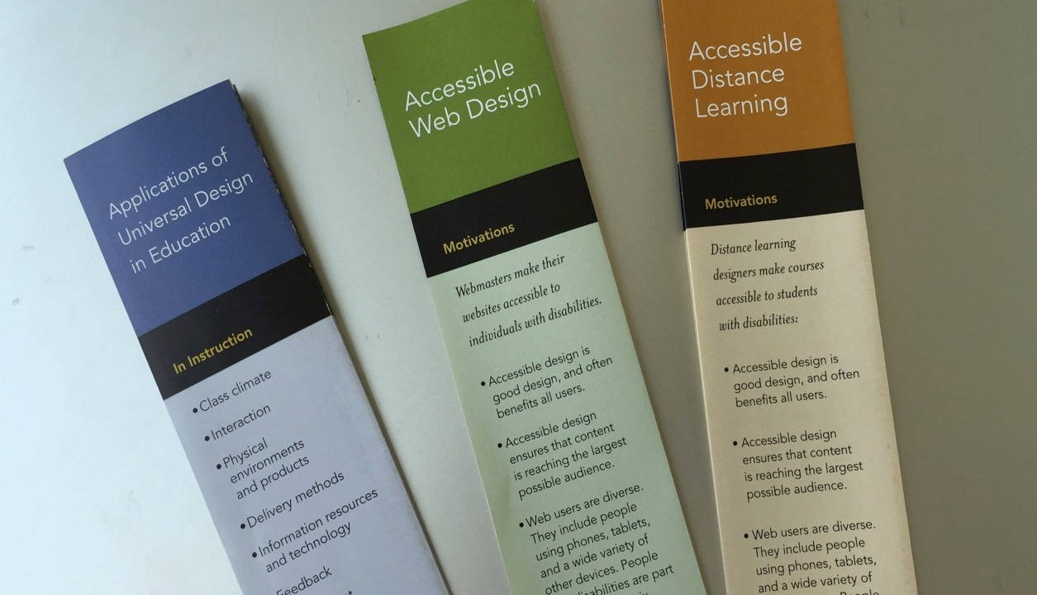

Slide 6
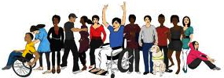
In an “inclusive” environment everyone
  who meets requirements, with or without accommodations, is encouraged to participate
  feels welcome
  is fully engaged in accessible & inclusive activities

Slide 7
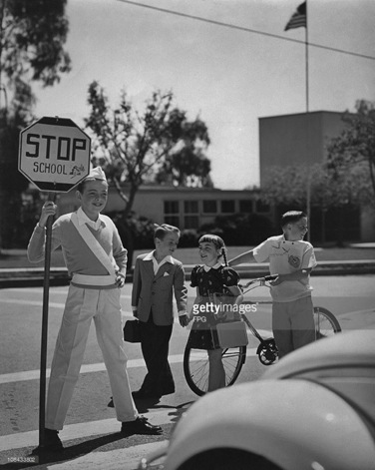

Why exclude groups of people
My quest
to become a
patrol boy
Notes:
Learned that people in charge can get it wrong

Slide 8
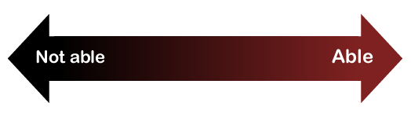
Consider ability on a continuum
understand English, social norms
see
hear
walk
read print
write with pen or pencil
communicate verbally
tune out distraction
learn
manage physical/mental health

Slide 9

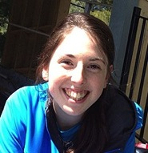
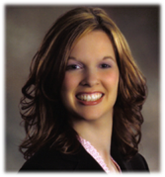
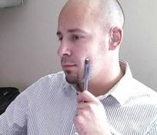
Note
Most disabilities are “invisible”
Fewer than 1/3 of students with disabilities may be reporting them to the disability services office

Slide 10
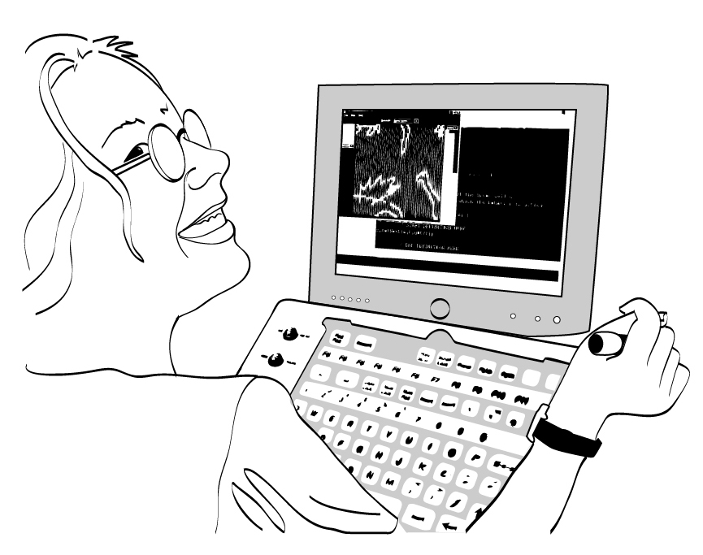
What is the legal basis for access?
Section 504 of the Rehabilitation Act of 1973
The Americans
with Disabilities
Act of 1990 &
its 2008
Amendments
State & local
laws

Slide 11
Most common accommodations for online courses at UW:
Creating accessible documents, mainly reformatting PDF files
Captioning videos

Slide 12
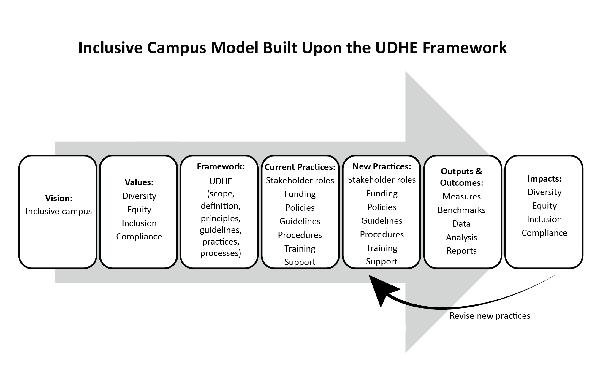
An Inclusive Campus Model

Slide 13
Theoretical & conceptual foundations include:
Social justice view of disability instead of medical/deficit model
Disability as a diversity issue
Instead of an accommodations approach, apply a Universal Design (UD) Framework (which includes accommodations)

Slide 14
UDHE Framework
Scope
Definition
Principles
Guidelines
Process
Practices

Slide 15

Universal design =
  “the design of products & environments to be usable by all people, to the greatest extent possible, without the need for adaptation or specialized design.”
  The Center for Universal Design
  www.design.ncsu.edu/cud

Slide 16
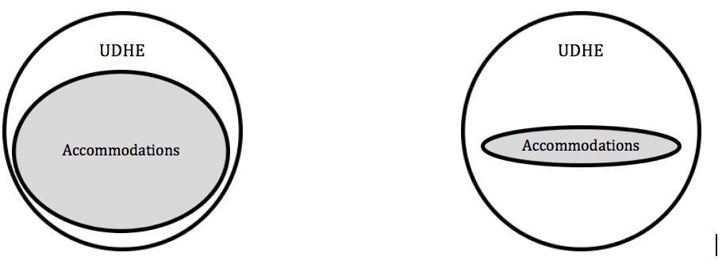
A paradigm shift—
from accommodation-focused to UDHE-focused campus

Slide 17
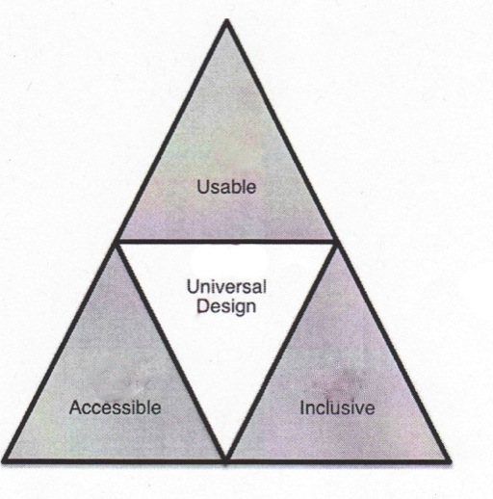
Proactive design terminology
Accessible design
Usable design
Inclusive design
Universal design
Barrier-free design
Design for all

Slide 18
Applications of UD
https://tinyurl.com/y5t799yp

Slide 19
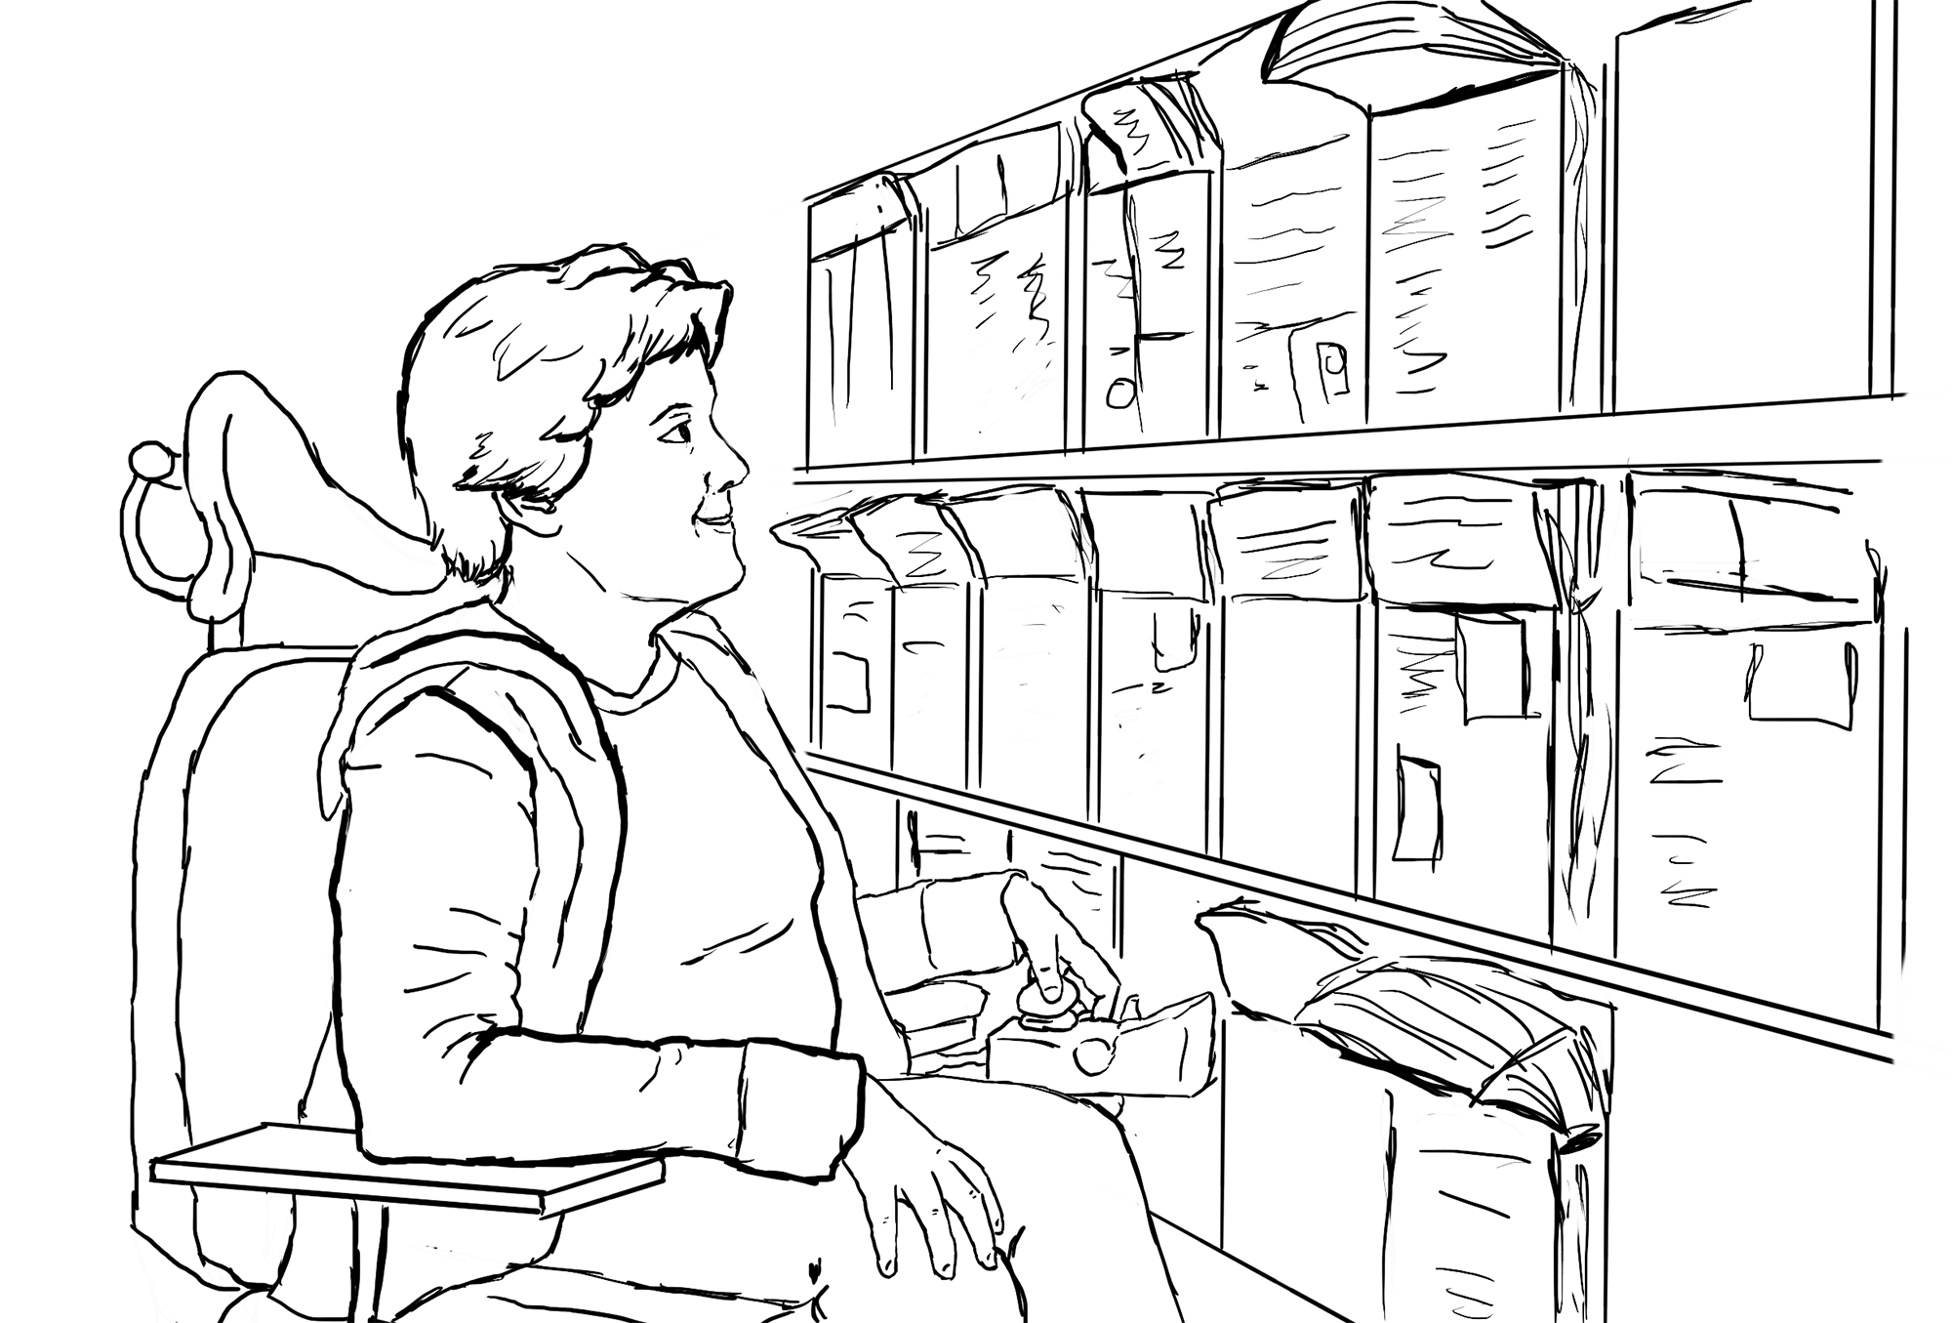
(1) Principles of UD
Equitable use
Flexibility in use
Simple & intuitive use
Perceptible
information
Tolerance for error
Low physical effort
Size & space
for approach & use

Slide 20
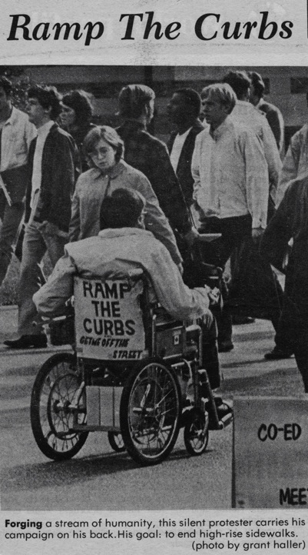
“The Daily”
UW
1970

Slide 21
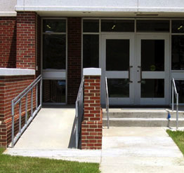
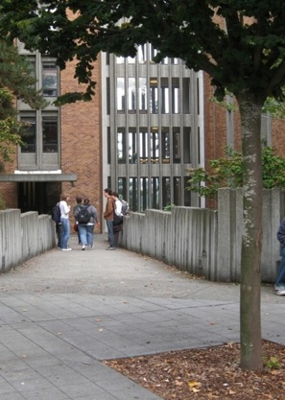
UD provides inclusive access

Slide 22
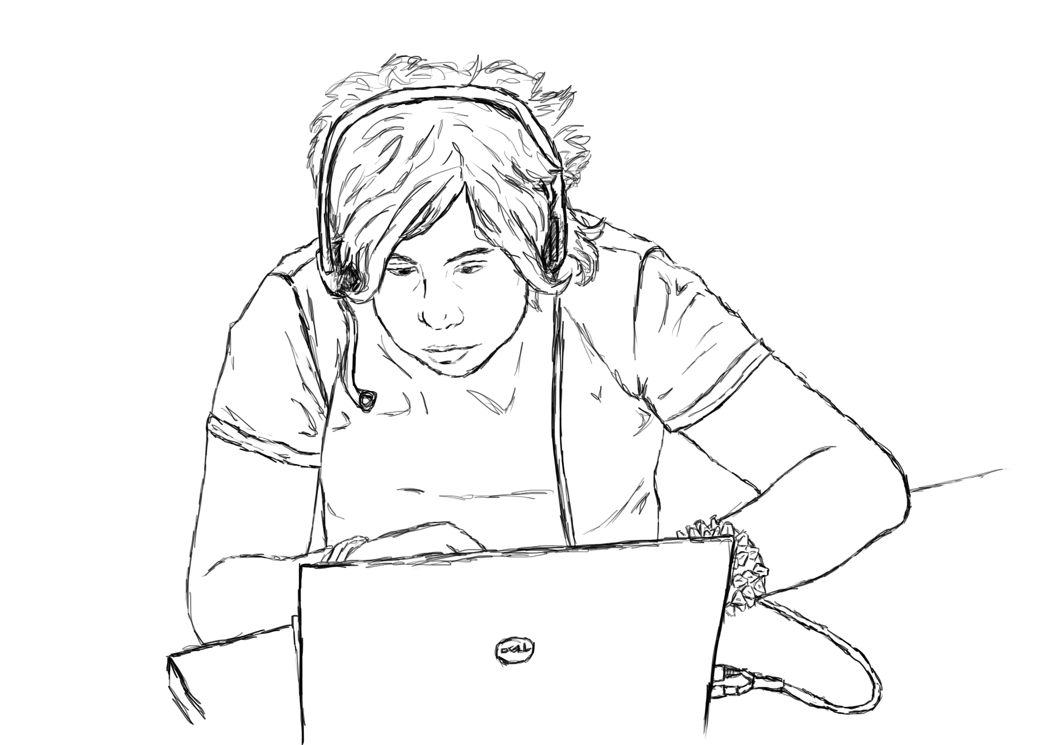
(2) Principles for UD for Learning (UDL)
Offer:
Multiple means of
representation
Multiple means of
engagement
Multiple means of action & expression

Slide 23

“When you plant lettuce,
if it does not grow well, you don't blame the lettuce. You look for reasons it is not doing well.
It may need fertilizer,
or more water,
or less sun...”
-Thích Nhất Hạnh,
Vietnamese
Buddhist Monk

Slide 24
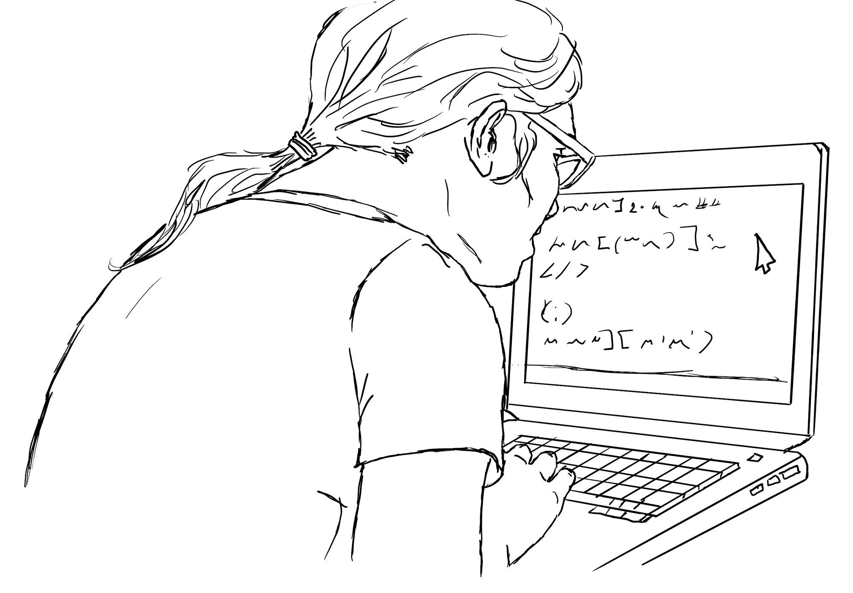
(3) Principles for UD of IT
Underpinning of Web Content Accessibility Guidelines to ensure that digital tools/content is
Perceivable
Operable
Understandable
Robust

Slide 25
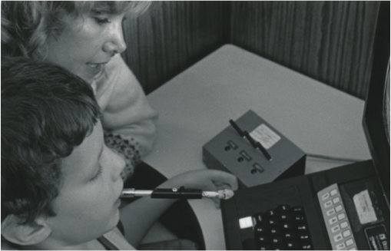
Rodney & the Apple II
6 years old, 1980
No use of hands
& legs
Used mouth wand
Issue: Could not press 2 keys at once
Solution: Switch box to lock shift, control, repeat keys

Slide 26
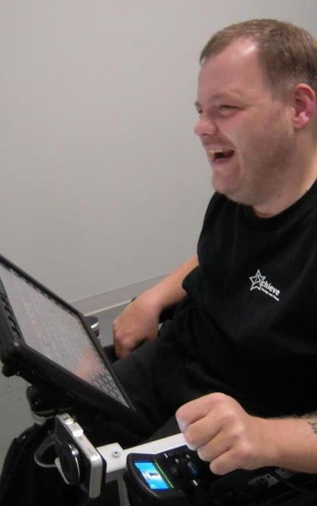
Anthony
AT Specialist
Prentke Romich Co.
grammar/spell checkers
synthesized voice on communication device
touch screen
computer-based environmental control, phone access

Slide 27
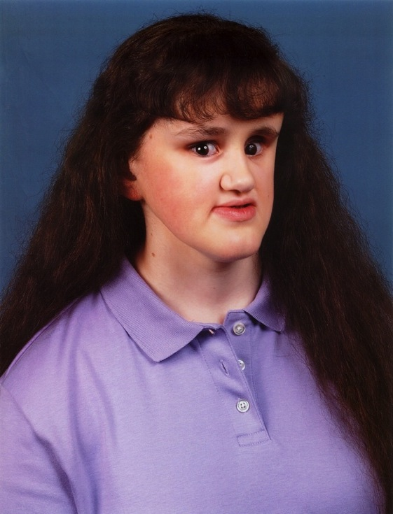
Nicole
BA, Computer Science
Stanford
Google
speech output
Braille translation software
Braille display & printer

Slide 28
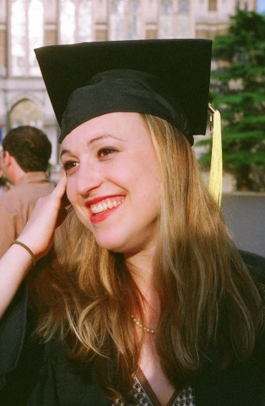
Jessie
BA, Informatics, UW
Manager Web Services
Amazon.com
speech output
speech input
grammar/spell checkers

Slide 29
Accessibility practices that are informed by limitations of assistive technology
Assistive Technology: | Therefore:
May emulate the keyboard, but not the mouse | Design web, software to operate with keyboard alone
Cannot read content presented in images | Provide alternative text
Can tab from link to link | Make links descriptive
Can skip from heading to heading | Structure with hierarchical headings
Cannot accurately transcribe audio | Caption video, transcribe audio

Slide 30
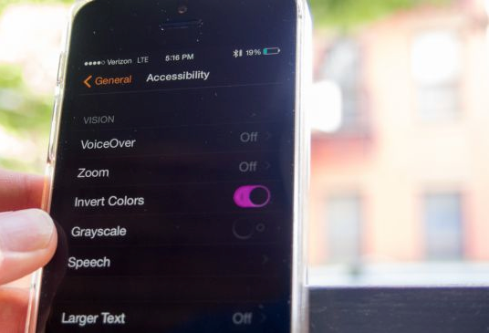
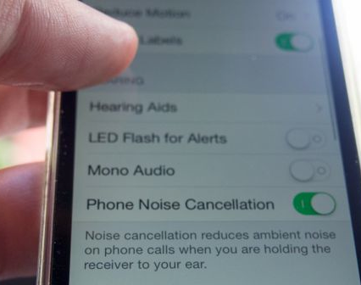
UD of IT
builds in
accessibility
features
ensures compatibility with assistive technology

Slide 31
The first online course at UW
Year: 1995
Instructors: Me & Dr. Norm Coombs
Title: Adaptive Tech. for People with Disabilities
Technology: Email, discussion list, Gopher server, telnet, file transfer protocol
Online materials: In text format
Postal mailed materials: Publications, captioned & audio described VHS videos

Slide 32
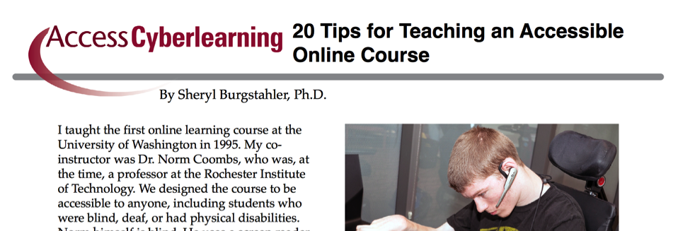
20 tips for teaching an accessible online course
        uw.edu/doit/20-tips-teaching-accessible-online-course

Slide 33
        Websites, documents, images, videos:
Structured headings
Descriptive wording for hyperlinks
PDFs avoided; no scanned images Text descriptions of content in images
Large, bold fonts, uncluttered pages, plain backgrounds
Content & navigation accessible using keyboard alone
Videos captioned; audio transcribed

Slide 34
        Instructional methods:
Address wide range of tech skills
Content presented in multiple ways
Acronyms/jargon spelled out/defined
Instructions & expectations clear
Feedback on parts & corrective opportunities provided
Options for communicating/collaborating
Options for demonstrating learning

Slide 35
Examples of UD

Slide 36
        UD is an attitude, a framework, a goal, & a process—UD:
        values diversity, equity, & inclusion
        promotes best practices & does not lower standards
        is proactive & can be implemented incrementally
        benefits everyone
        minimizes the need for accommodations

Slide 37
The Inclusive Campus Model

Slide 38
Apply the Model to accessible IT
Vision: IT procured, developed, used is accessible
Values: Diversity, equity, inclusion, compliance
Framework: UDHE’s scope, definition, principles, guidelines, practices, processes
Current practices: Stakeholder roles, funding, policies, guidelines, procedures, training, support
New practices: Stakeholder roles, funding, policies, guidelines, procedures, training, support
Outputs & outcomes: Measures, benchmarks, data, analysis, reports
Impacts: Increased alignment with vision & values

Slide 39
UW leadership
  IT Accessibility Coordinator
  IT Accessibility Team (ATS)
  IT Accessibility Task Force
  IT Accessibility
  Liaisons

Slide 40
Policy, guidelines, checklists…
UW’s IT Accessibility Guidelines:
Purpose
Definition
Scope
Standards—Web Content Accessibility Guidelines (WCAG) 2.0 Level AA
Progress & Plan
Resources

Slide 41

Sample of UW approaches 1/2
Promote accessibility within context of UD & inclusive campus
Model IT accessibility compliance after IT security compliance efforts
Build on existing policies, procedures, & job/unit assignments.
Undertake efforts that are both
  reactive & proactive
  top-down & bottom-up

Slide 42
Sample of UW approaches 2/2
  Assign specific roles to individuals, groups
  Integrate training, activities within those sponsored by other campus units
  Search for internal funds to:
    offer incentives (e.g., videos, PDFs)
    purchase tools (e.g., Site Improve, Ally, SensusAccess)
  Benefit from external funding
  Post resources, engage online

Slide 43
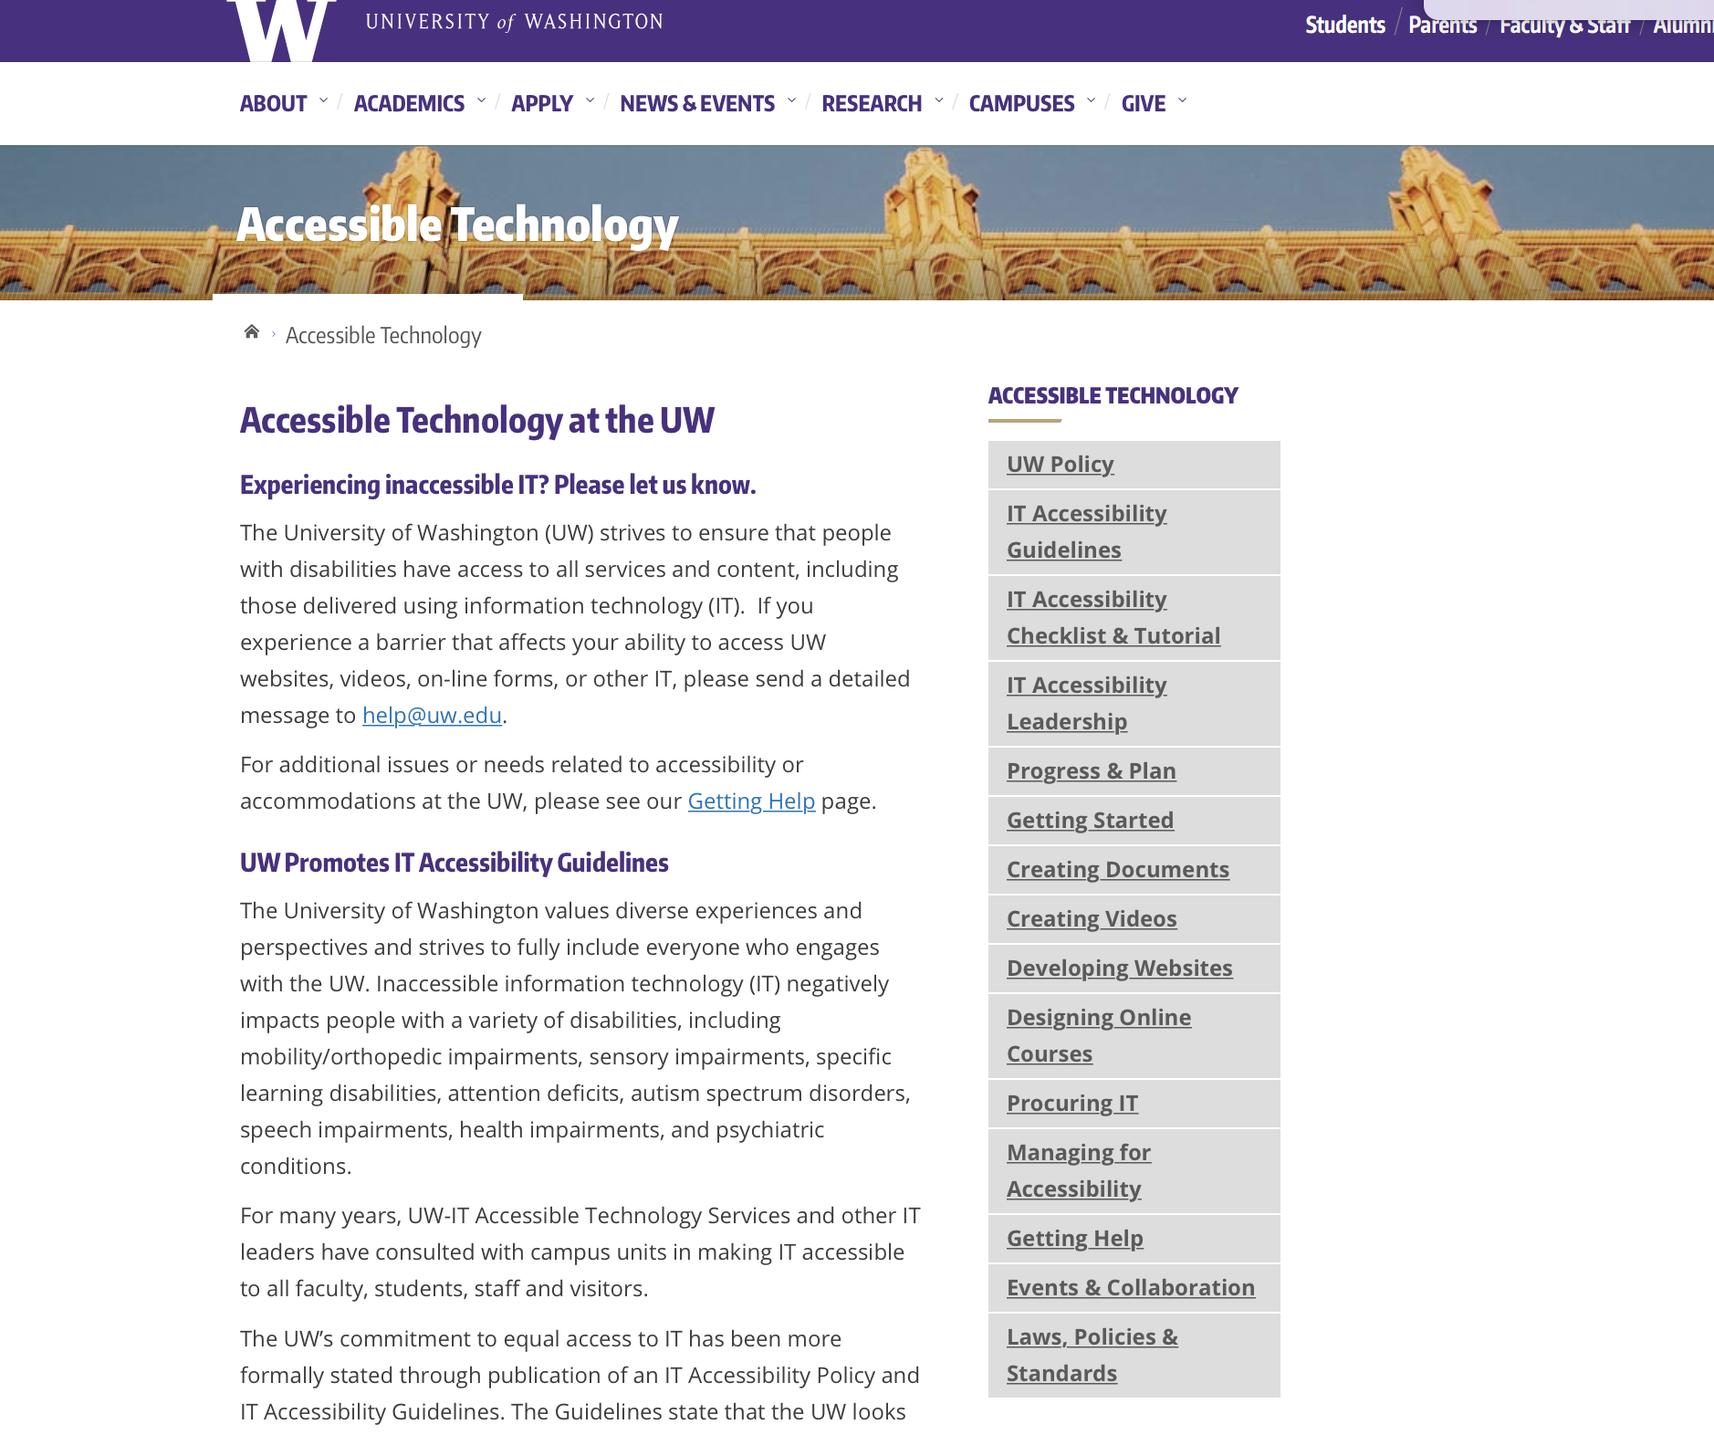
Accessible Technology website
Notes:
Terrill

Slide 44


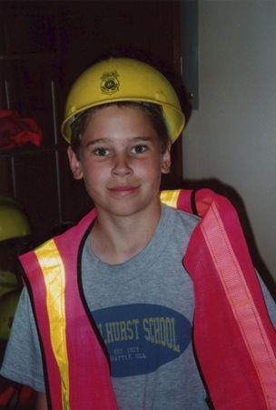
Inclusiveness: What can we learn from my quest to become a patrol boy?

Slide 45
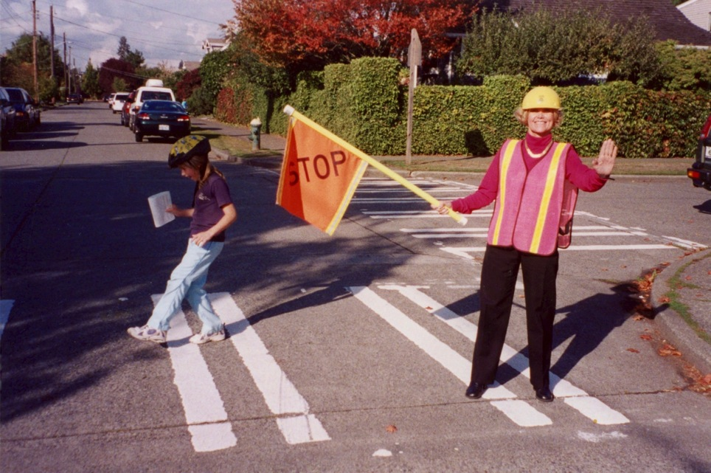
Notes:
Things may take longer than we would like
We are running a marathon, not a sprint

