Slide 1



Teaching Accessibility:
Case studies of courses that include accessibility topics in their curricula
Terrill Thompson
University of Washington
Korey Singleton
George Mason University
Shadi Abou-Zahra
World Wide Web Consortium (W3C)

Slide 2

Teach Access
Teach Access is a unique collaboration between academia, industry, and advocates for people with disabilities, formed to address the urgent need to enhance the skills of higher education students as they learn to design and develop mobile and desktop technologies. The goal is to ensure that future technologies are “born accessible,” by proliferating fundamental skills and concepts of accessible technology design and development in mainstream design, computer science, and other related disciplines.
The project was founded in 2015 by companies including Adobe, Facebook, Google, HP, Intuit, LinkedIn, Microsoft, The Paciello Group, and Verizon Media (originally Yahoo), in partnership with several universities.
https://teachaccess.org

Slide 3
“Who Teaches Accessibility?: A Survey of U.S. Computing Faculty”
RIT: Kristen Shinohara,
UW: Saba Kawas,
Amy Ko
Richard Ladner
2018 Proceedings of the 49th ACM Technical Symposium on Computer Science Education, pp. 197-202.
faculty.washington.edu/ajko/papers/Shinohara2018AccessComputingSurvey.pdf

Slide 4
Research questions
Who is teaching accessibility?
What barriers do faculty see to teaching accessibility?
What factors predict who is teaching accessibility?
+ What resources do you need?

Slide 5
Survey sample
Faculty at 4-year universities & colleges
  Computer Science
  Information Science
  Other interdisciplinary computing departments
Major accredited programs identified:
  Wikipedia
  Computing Research Association
  iSchool Caucus charter list for Information Schools

Slide 6
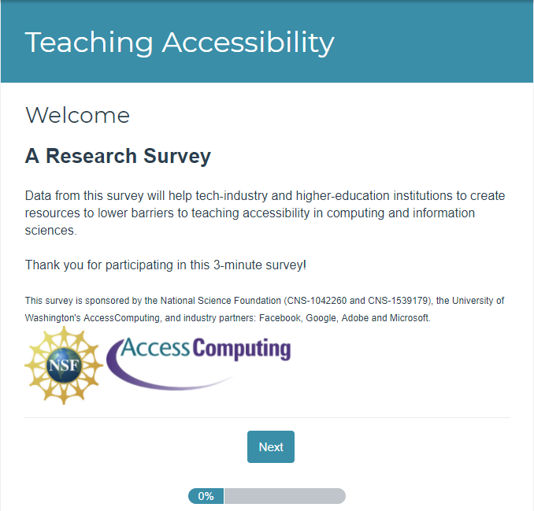
Survey launches & response rate
SurveyGizmo, 3 launches
Emails with link to survey to
14,176 faculty
from 352 institutions
Response rate: 13%

Slide 7
1: Who is teaching accessibility?
20% of respondents
More females
More likely to know someone with a disability
More likely to think it is part of computing
Most common area of expertise: Human-Computer Interaction
17% have a disability

Slide 8
1: Learning objectives
Understand technology barriers
Understand design concepts
Engage diverse populations
Evaluate web accessibility standards & heuristics
Develop accessible web technologies
Employ design techniques
Understand Legal regulations (Section 508, ADA)
Understand Models of disability
Employ accessibility-focused technical languages & tools

Slide 9
2: Challenges to incorporating accessibility
Not core part of curriculum
Don’t know enough to teach it
No appropriate textbook
Lack of students & administrator awareness
Lack of support for topics addressing real challenges for disabled
Difficulty engaging students
Lack of demand in industry
Difficult to recruit people with disabilities

Slide 10
2: What do faculty need?
Help with connections to people with disabilities to interact with 1-1 &/or bring into classroom
Tools, technologies, guidelines, problem examples
Curricular samples for specific courses
Training & other opportunities to gain expertise

Slide 11
2: We need…
“Appropriate lesson plans for different classes (algorithms, theory, intro programming). This should be taught across the CS curriculum, not just in a specialty topics course. But, I feel that students & faculty feel that “it is not directly related to the curriculum” & so they don’t incorporate it.”
-Survey comment

Slide 12
Case Studies

Slide 13
Example 1

Slide 14
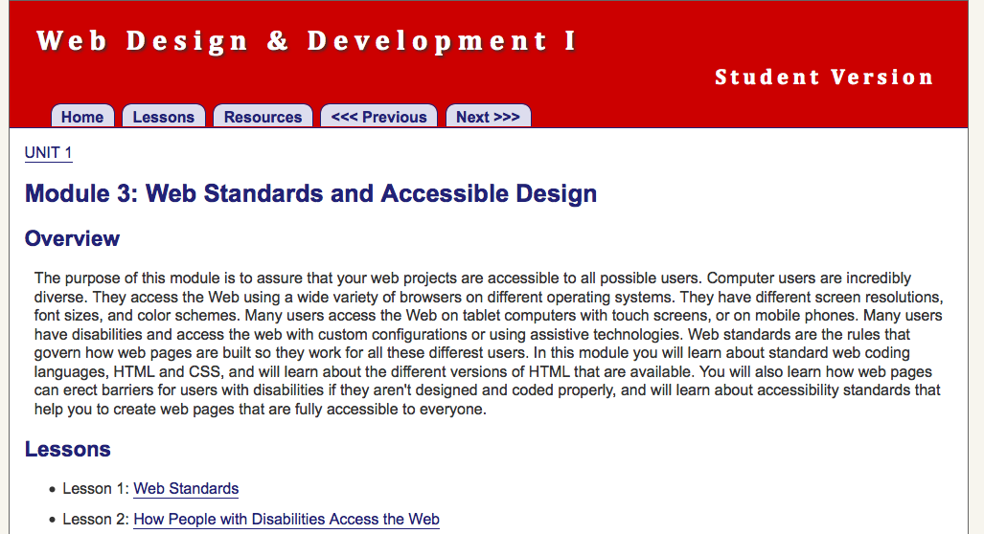
Web Design & Development I Course Curriculum (WebD2)
uw.edu/accesscomputing/webd2

Slide 15
Teaching Respect for Diversity while Teaching Coding
There is no technology without users
Each user is different
When learning to code, students should actively consider their users, including user differences
All this diversity provides technology teachers with a great opportunity!

Slide 16
WebD2 Features
Teaches standards-based & accessible web design
Is platform & vendor-neutral
(teaches concepts, not specific tools)
Standards-based, accessible design is taught early as a core design principle, & reinforced throughout the course
For assignments students must use valid code & conform to accessibility standards

Slide 17
Course Outline
Designing & Planning Web Pages
Creating Content & Structure with HTML
Formatting Web Pages with Style Sheets
Graphics
Scripting
Quality Control
Website Management & Authoring Tools
Client Website / Final Project

Slide 18
Example 2
https://info343-au16.github.io/

Slide 19
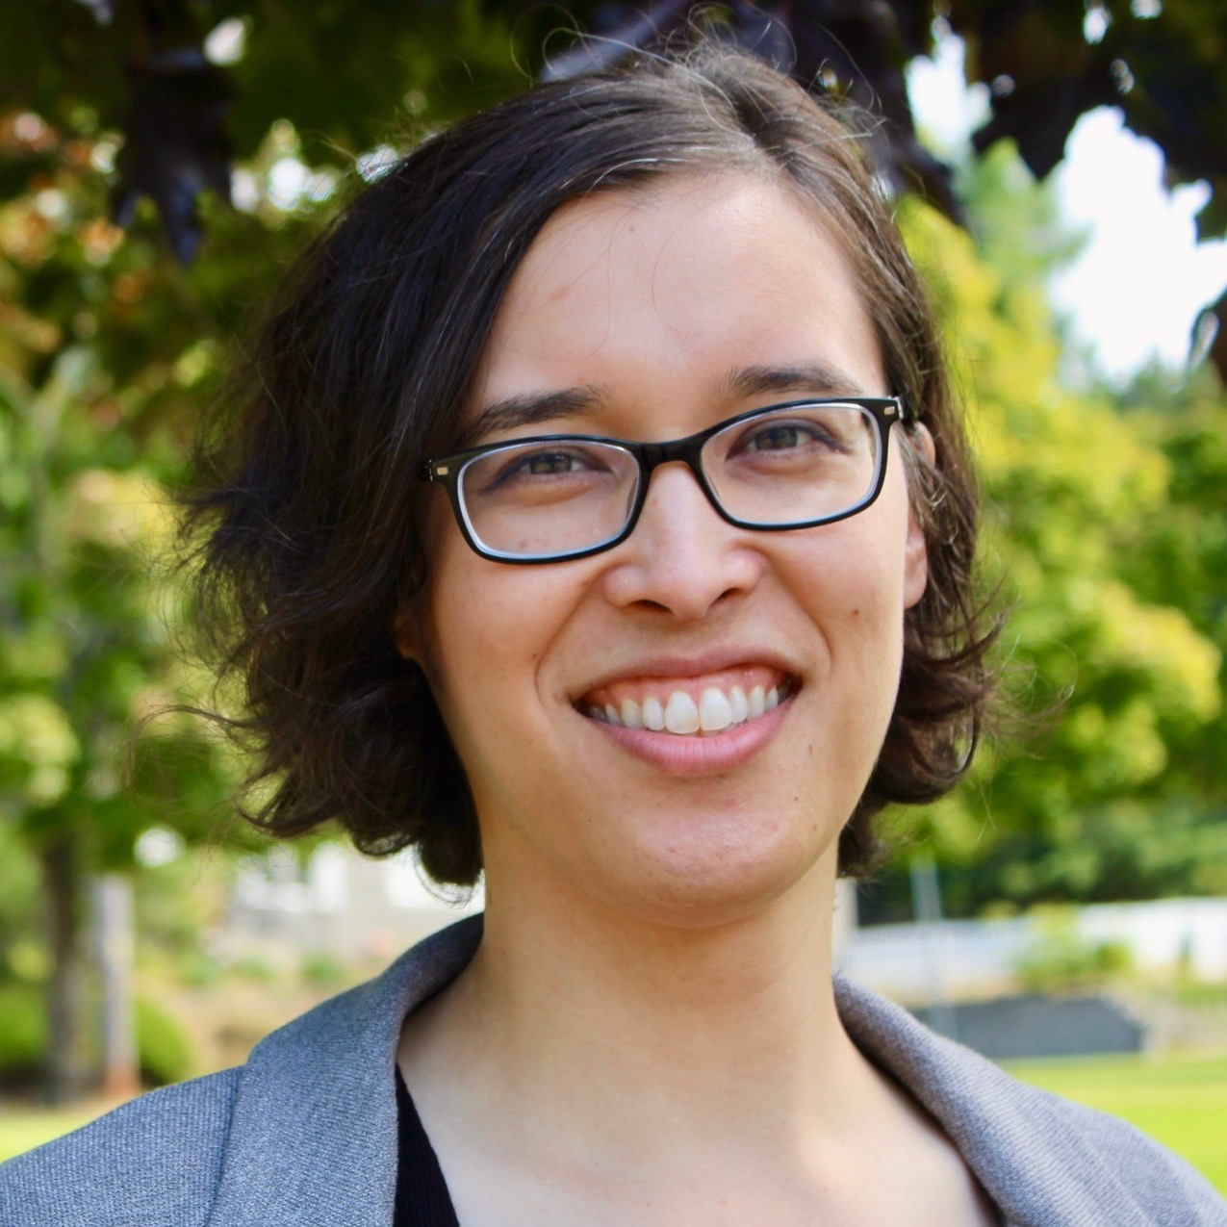



INFO 343
“Hey guys, interested in incorporating accessibility into INFO 343?”
“Sure!”
Notes:
INFO 343 = Client-side Web Development
Dr. Amy Ko initiates

Slide 20
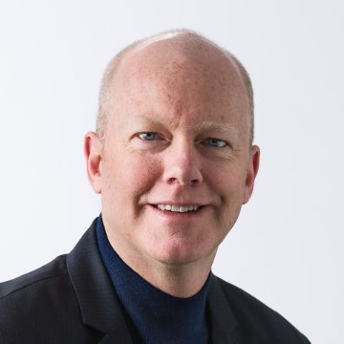
Accessibility Basics
“Hey Terrill, can you teach these three about web accessibility basics?”
“Sure!”

Slide 21
Critical parts and standards
“Here are the most critical parts of the most critical standards”
“We could redesign our overview of markup to cover these…”

Slide 22
Testing?
“Who wants to commit to doing this?”
“I will! I’m teaching a summer course where I can test it out.
Notes:
Dr. Joel Ross volunteers to take the lead

Slide 23
Check in
“How’s the summer course planning going?”
“Good! I was just about to revise the lesson this week.”

Slide 24
Check in again
“How did the lesson go?”
“It was much better than the last version; more engagement, especially with screen readers.”

Slide 25
Review
“Have you guys seen Joel’s new accessibility lesson?”
“No. How’d it go Joel? Can I use it?”
“Sure, here’s the link.”

Slide 26

280 web developers per year now know accessibility basics.
Notes:
One year later…

Slide 27
From the INFO 343 Course Description:
“This course will teach you the skills and techniques necessary for creating sophisticated and accessible interactive web applications. It focuses on the client-side languages, tools, and libraries that professionals use to build the web sites you use every day. We will learn not only the basic syntax and mechanics of web development, but also the best practices that separate professional developers from amateurs.”

Slide 28
EDIT 526: Web Accessibility and Design
AHG 2019 – Teaching Accessibility: Case studies of courses that include accessibility topics in their curricula
Assistive Technology Initiative (ATI)
  Korey Singleton, ATI Manager

Slide 29
EDIT 526: Web Accessibility & Design
3-credit, 7-week summer course (8-weeks in previous years)
Session Description:
  Develops understanding of principles of universal web design. Students apply this understanding by designing and developing accessible web site using web authoring tools.
Course Description on Web: https://cehd.gmu.edu/courses/EDIT-526/
Target Audience:
  Course is geared towards students enrolled in CEHD’s graduate e-learning certificate and Masters programs;
  Undergrads starting in Summer 2020 as part of new Learning Design program

Slide 30
EDIT 526
Course Schedule
Week | Topic | Assessment
1 | Overview of web accessibility, usability, disability, and AT AT Simulation Activities | Simulation Lab Report
2 | Disability Laws & Guidelines Document Accessibility (Word, PPT, PDF/3cr) | Creating an Accessible Word, PPT, & PDF document
3 | Testing Websites & Software Apps
4 | Testing Websites & Software Apps | Testing a Website for Accessibility
5 | Designing Websites HTML Basics | Create a Practice Web Page
6 | Complex HTML Elements and CSS | Complex Images, Tables, Forms, Basic CSS
7 | Complex HTML Elements and CSS cont. ARIA Accessible Video
8 | Final Project | Create an accessible instructional product using HTML & CSS
Course built around 8 asynchronous modules. Each incorporates readings, video (lecture/demo), discussion, and assessments).
3 synchronous sessions to support hands-on activities and discussion
6 assignments and final project (Build an accessible website using HTML & CSS)
60+ knowledge checks

Slide 31
Sample Resources – Intro to Web Accessibility
Intro to Web Accessibility
  WebAIM – Intro to Web Accessibility
  W3C – Intro to Web Accessibility
  UW – Accessible Web Design (Video)
How Individuals with Disabilities are Impacted on the Web
  WebAIM – Visual, Auditory, Motor, Cognitive
  W3C – Web Accessibility Perspectives (Video)

Slide 32
Sample Resources – Hands-On
Web Accessibility Testing
  Easy Checks – A First Review of Accessibility
  Colour Contrast Analyser
  WAVE, ANDI
Technology Supports (AT, video, etc.)
  Jaws/NVDA, Built-in accessibility tools, YouTube

Slide 33
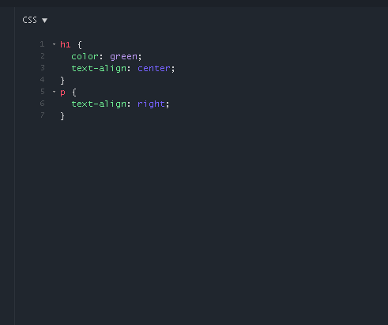
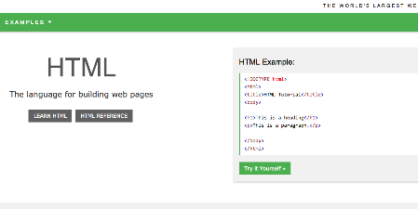
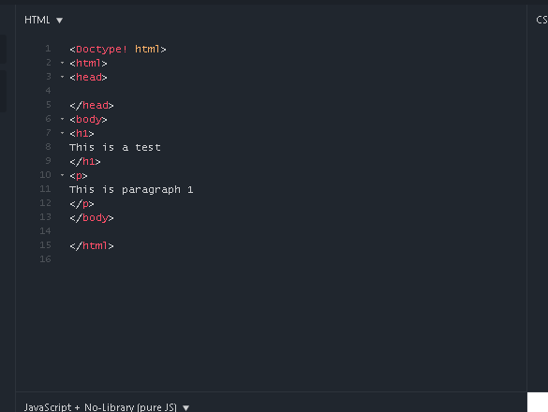
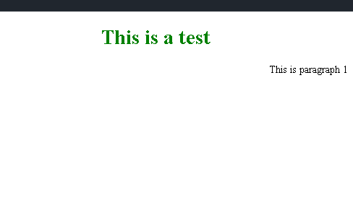
Sample Resources – Hands-On cont…
Web Design & Accessibility (Coding)
  jsfiddle.net (HTML & CSS)
  Textbook – Recommended, not required
  W3Schools.com – HTML5, CSS

Slide 34
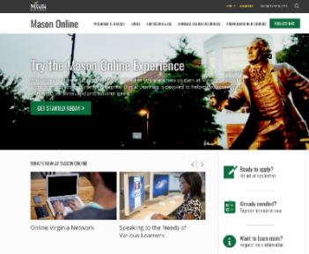
Impact (since 2015)
Course has served as an incubator of sorts…
Student Training – 94 students, 5 faculty
  Instructional Technology Masters & eLearning Certificate Programs (Elective)
  Assistive Technology Masters & Certificate Programs (Elective)
  Modules shared with faculty
    CEHD/AT (2)
    CHSS/Digital History
    Volgenau/Systems Analysis & Design
    Volgenau/Intro to Computing
Faculty/Staff Training – 50+ faculty
  Office of Digital Learning (modules used for accessibility training)
    SOUPR – 8-week faculty cohort (voluntary)
    OCDI – 1-yr ID supported development (funded)

Slide 35
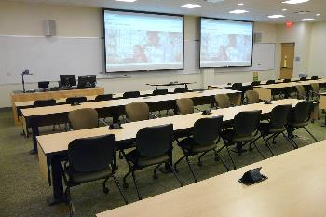
Impact (since 2015) cont.
Staff (Testing)
  Office of Digital Learning
    LMS tools (e.g., Padlet, Supplemental applications, H5P)
  Learning Spaces Design Team
    GUI Interface for instructor workstations

Slide 36
Contact Us
Assistive Technology Initiative
  Aquia Building, Rm. 238
  Mail Stop: 6A11
  Phone: 703-993-4329
  Email: ati@gmu.edu
  ATI Website: http://ati.gmu.edu

Slide 37

Teaching Accessibility
with Resources from WAI
Shadi Abou-Zahra, World Wide Web Consortium (W3C)
W3C Accessibility Strategy and Technology Specialist
@sabouzah
Copyright © 2019 W3C (MIT, ERCIM, Keio, Beihang)

Slide 38

About WAI
W3C Web Accessibility Initiative (WAI) works on:
Ensuring accessibility support in W3C technologies
Creating guidelines for web and digital accessibility
Developing methods for conformance evaluation
Providing resources for education and training
Ensuring harmonized and coordinated standards
Copyright © 2019 W3C (MIT, ERCIM, Keio, Beihang)

Slide 39
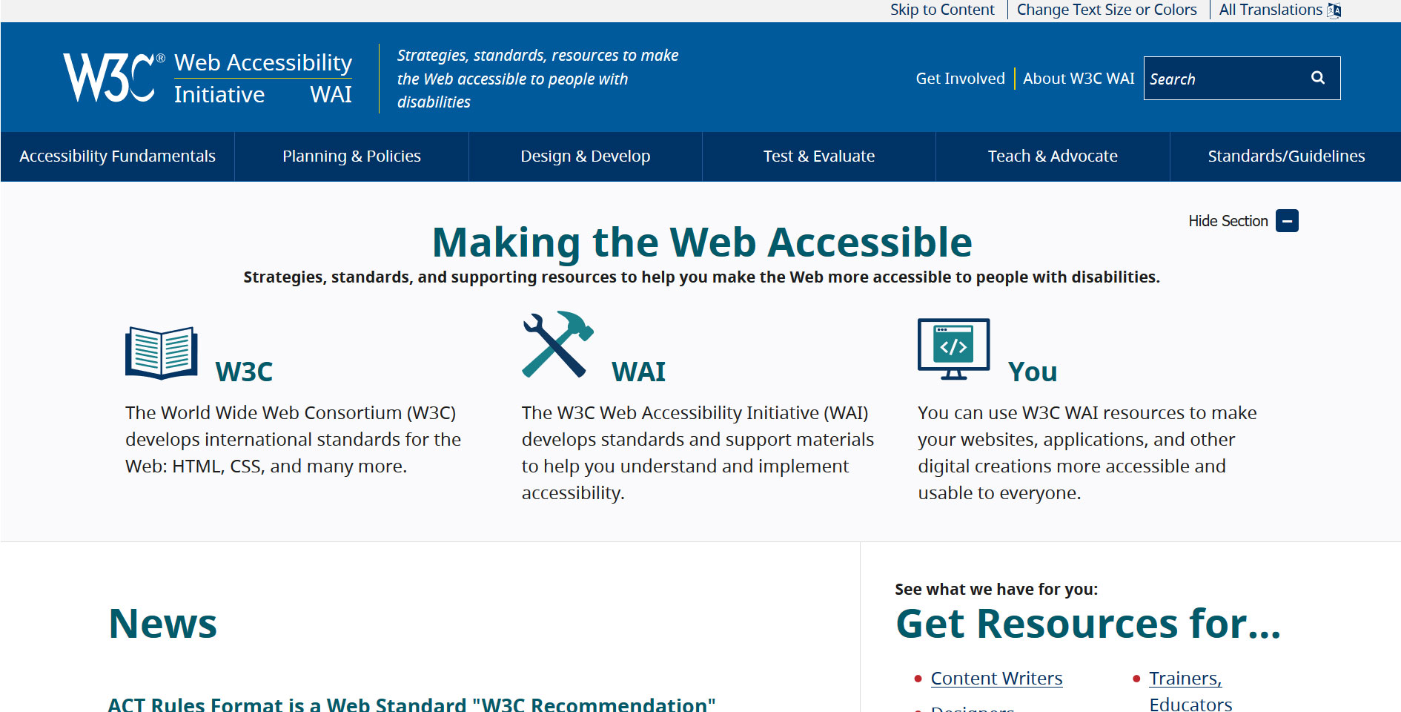
WAI Website
w3.org/WAI
Copyright © 2019 W3C (MIT, ERCIM, Keio, Beihang)

Slide 40
Perspectives Videos
Web Accessibility Perspectives short videos:
Series of 10 videos, each of less than 1 minute
Each video shows one “feature” of accessibility
Describes the broader benefits for everyone
Provides further reading and guideline references
Copyright © 2019 W3C (MIT, ERCIM, Keio, Beihang)

Slide 41
Getting Started Tips
Tips for Getting Started with Web Accessibility:
Tips for Writing
  Titles, Heading, link text, instructions, text, …
Tips for Designing
  Colors, navigation, feedback, viewports, …
Tips for Developing
  Form controls, markup structure, coding, …
Copyright © 2019 W3C (MIT, ERCIM, Keio, Beihang)

Slide 42
WAI Tutorials
Web Accessibility Tutorials:
Page Structure
Menus
Images
Tables
Forms
Carousels
Copyright © 2019 W3C (MIT, ERCIM, Keio, Beihang)

Slide 43
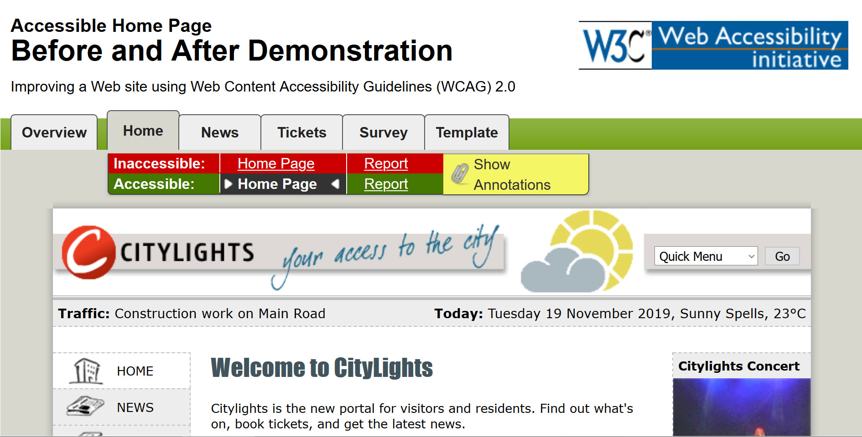
Before & After Demo
Copyright © 2019 W3C (MIT, ERCIM, Keio, Beihang)

Slide 44
Easy Checks
Easy Checks – A First Review of Web Accessibility:
Page titles
Text alternatives
Headings
Contrast ratio
Resize text
Keyboard
…
Copyright © 2019 W3C (MIT, ERCIM, Keio, Beihang)

Slide 45
Several More…
w3.org/WAI
Copyright © 2019 W3C (MIT, ERCIM, Keio, Beihang)

Slide 46
New: WAI Curricula
Role-based and modular curricula to support:
Integrating accessibility into mainstream courses
Developing courses specifically on accessibility
Comparing and selecting from course offerings
Creating contracts and request for proposal (RFP)
Copyright © 2019 W3C (MIT, ERCIM, Keio, Beihang)

Slide 47
Curricula Outline
 | Developer | Designer | Author | Tester | Manager
Level 1 | Introduction to Web Accessibility
Level 2 | TBD | TBD | TBD | TBD | TBD
Level 3 | TBD | TBD | TBD | TBD | TBD
Copyright © 2019 W3C (MIT, ERCIM, Keio, Beihang)

Slide 48
First Curriculum
Curriculum “Introduction to Web Accessibility”:
What is Web Accessibility
People and Digital Technology
Business Case and Benefits
Principles, Standards, and Checks
Getting Started with Accessibility
Copyright © 2019 W3C (MIT, ERCIM, Keio, Beihang)

Slide 49
Soon: Free Course
W3Cx Course “Introduction to Web Accessibility”:
Free online course built on WAI Curriculum
Developed in cooperation with the UNESCO
Featuring a selection of international experts
Approximately 20 hours effort over 5 weeks
All course materials will be freely available
Expected to launch first run in early 2020
Copyright © 2019 W3C (MIT, ERCIM, Keio, Beihang)

Slide 50
Get Involved
Several ways to get involved with WAI:
Explore, use, and promote the materials
Send us your feedback and comments
  Information provided on each page
Actively participate in working groups
  May require W3C membership (depends)
  Usually start with lighter involvement form
Copyright © 2019 W3C (MIT, ERCIM, Keio, Beihang)

Slide 51

Thank You
w3.org/WAI
Shadi Abou-Zahra
w3.org/people/shadi
shadi@w3.org
@sabouzah
Copyright © 2019 W3C (MIT, ERCIM, Keio, Beihang)

