Slide 1
An ID’s Approach to Accessibility – Lessons Learned
An Instructional Design Approach to Accessibility – Lessons Learned
Justin Tumelaire
Notes:
Introduce ourselves here as non-ADA experts

Slide 2
Agenda
accessibility and its relationship to your institution
Instructional Design and Delivery (IDD) in context
how accessibility fits into the IDD development process
how ensuring accessibility affects cost and schedule
addressing challenges associated with non-compliant learning content

Slide 3
Discussion
What are some of the things that your institution currently does to support the delivery of accessible content?
What are some of the challenges that your institution has encountered when trying to deliver accessible content?

Slide 4
What is Cengage’s IDD Team?
Instructional Design and Delivery (IDD) delivers unique end-to-end outcome-based academic services that integrates technology, content, and design to support institutions’ goals.
IDD partners with:
  For-profit, private career, trades, etc.
  Not-for-profit, traditional colleges and universities
  Community colleges and online college systems
  Cengage product teams

Slide 5
Roles
Project Teams
  Project Manager
  Lead ID
  Educational Technologist
  Copyeditor
Accessibility ID
Learning Center of Excellence
  Director of UDL and Accessible Technology
  Accessibility/UDL Specialist

Slide 6
Phases of a Project
Scoping | Pre-Launch | Launch | Development and Production | Project Close
Work with sales to identify the scope of work for the project. Accessibility IDs (designated IDs) support scoping—fill out Scoping Gap Analysis and handoff docs for accessibility. | Create design prototype Run design summit, get customer feedback Update docs & plan Accessibility IDs evaluate all content and fill out the Full Gap Analysis for accessibility, answer questions about design. | Confirm and go over detailed schedule and design prototype with stakeholders ID shows design prototype to the customer and talks about how accessibility will be addressed in the solution. | Create deliverables using decisions from design prototype IDs design deliverables to meet accessibility requirements. Accessibility IDs answer questions. | Discuss lessons learned Send any updated materials to the Product Team IDs discuss lessons learned and content updated for accessibility

Slide 7
Our Sphere of Influence:
Student-facing Office docs or PDFs we include or content we write has:
  Screen-readability
  Appropriate color contrast
  Appropriate reading order
  Descriptive links
  Accessible form functions
Images in editable files (test bank questions, PPTs, lectures) have:
  Appropriate alt text
  No text in the images
Videos, including those in a platform, have:
  Closed captioning
  Transcripts
  * We will check much more than this in scoping, to ensure that the customer knows, and we design for, what we cannot change (by including alternate activities etc.)

Slide 8
Scoping Gap Analysis
Expanded Gap Analysis to include both content and accessibility
Review a sample of the content for the project (based on project size)
Determine where content lacks accessibility
  Effort
  Cost
  Schedule
Focus on the content that aligns to learning objectives

Slide 9
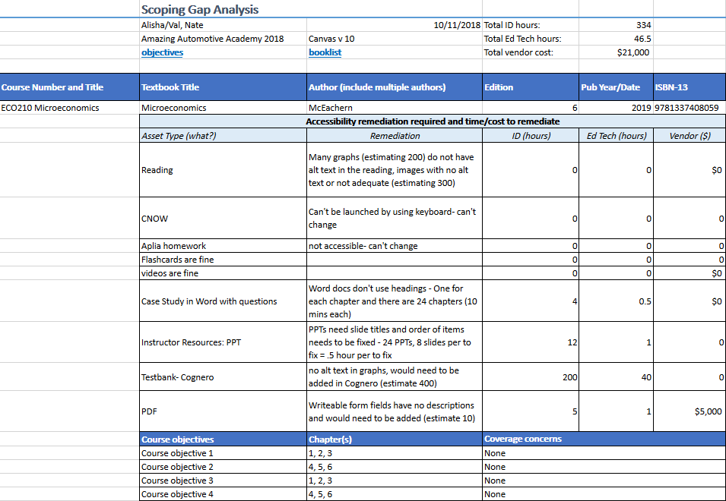
Scoping Gap Analysis (Example Spreadsheet)

Slide 10
Full Gap Analysis
Pre-launch: Full Gap Analysis
  All courses are considered
  Confirm there are no major deviations from scoping
Prototyping and Development:
  Full Gap Analysis informs design – make sure that design reflects the accessibility decisions
  Log newly uncovered accessibility issues to the Full Gap Analysis as they are uncovered
Project Close:
  Send updated files to Product

Slide 11
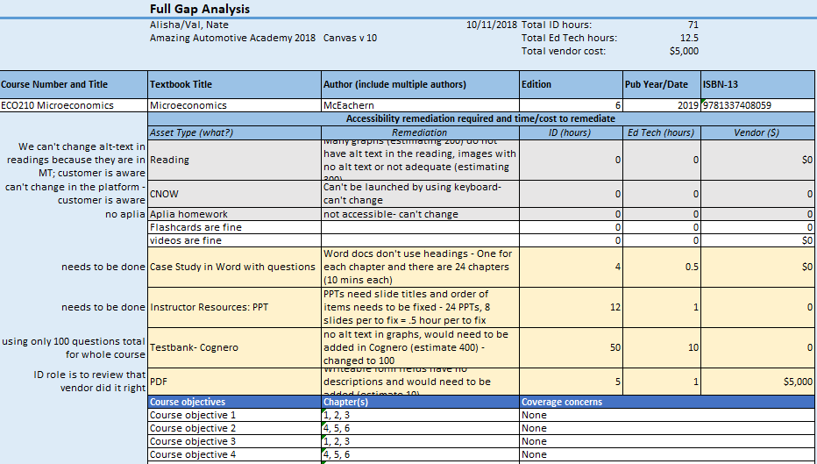
Full Gap Analysis (Example Spreadsheet)

Slide 12
Discussion, Part 2
What have you learned in this presentation that you can implement at your institution?
What suggestions do you have for improving our process?

Slide 13
lQuestions?

