Slide 1
Writing Effective Alternative Text for Educational Content: Best Practices for Reducing Cognitive Load
Presented by Valerie Morrison, Ph.D.
Research by K. James Monroe

Slide 2
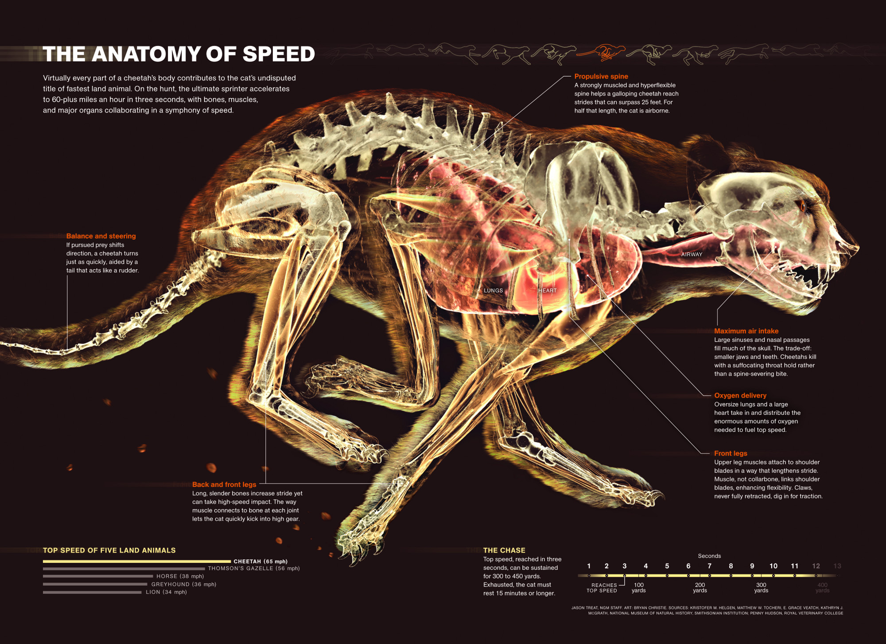
Presentation Goals
My Work with Alternative Text
Concept of Cognitive Load
Examples of STEM Content
Notes:
1. My Work with Alternative Text
Describe the work I do in making accessible content. Examine factors to consider when approaching the art of image description.
2. The Concept of Cognitive Load
Explore the concepts of Cognitive Load and Auditory Fatigue as they relate to STEM image description.
3. Examples of STEM Content
Review a range of specific examples of STEM images and how to write effective alt text, providing several templates for you to follow for different types of graphics.

Slide 3
Alternative Text

Slide 4
CIDI’s Products and Services include: E-Text, Braille, Captioning and Described Media, Assistive Technology Demos and Evaluations, ICT Accessibility Trainings and Website Evaluations

Slide 5
E-Text Products and Services
Accessible PDF
Microsoft Word DOC
EPUB
DAISY
HTML
Accessible Math
Enhanced Tagged PDF
PowerPoint

Slide 6
Who Needs Alt Text?
Individuals who are blind, or experience color blindness or low vision
Individuals with learning disabilities such as dyslexia, dyscalculia, dysgraphia, or ADHD
Individuals with head injuries, trauma, or cognitive disabilities
Auditory learners
Aging population
Everyone

Slide 7
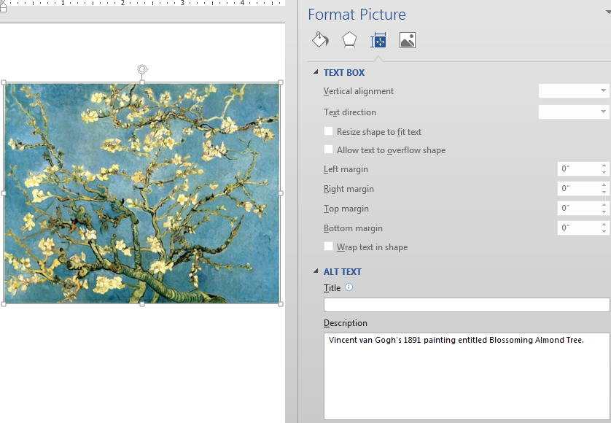
Adding Alt Text
Right-click on the image.
Choose Format Picture.
Select the Layout Properties icon.
Click on the Alt Text link.
Type in the description field.
Use proper capitalization, grammar, and spacing.
Do not include any hard line breaks.

Slide 8
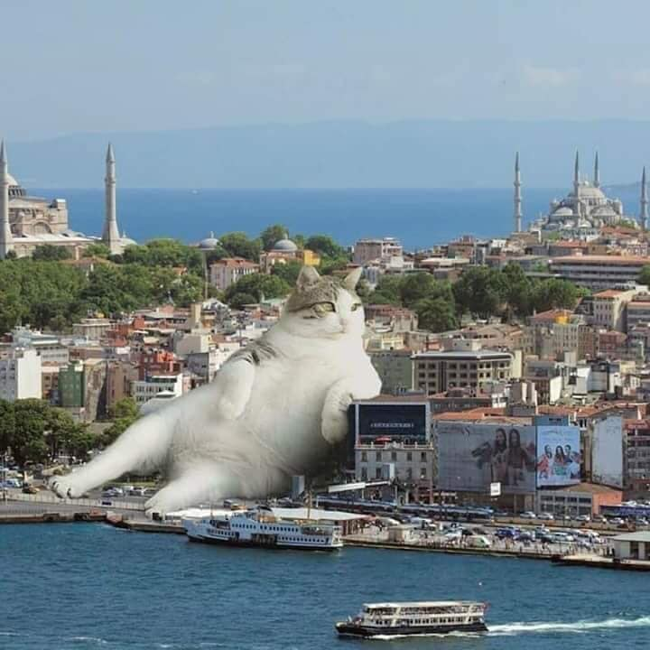
How to Start
First summarize what you see in one general informative sentence.
Keep your description neutral and informative.
Use proper grammar, spelling and punctuation.
Avoid acronyms and symbols.

Slide 9
When to Stop
Best practice is 125 characters, or the length of a Tweet.
The default setting for JAWS screen reading software pauses after 250 characters.
However, depending on purpose or audience, alt text can get quite long.

Slide 10
Cognitive Load
Notes:
Define Cognitive Load
Define Auditory Fatigue

Slide 11
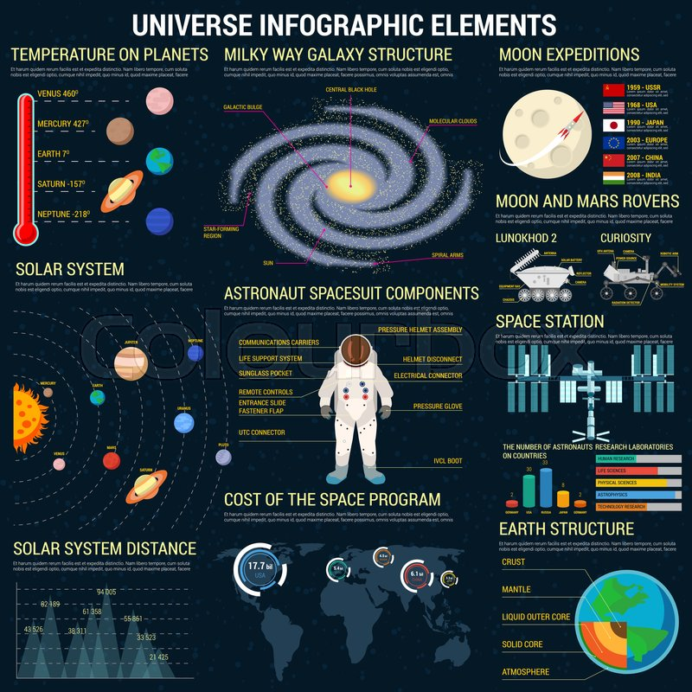
Consider Cognitive Load
Learning is enhanced when you reduce the number of items stored in working memory.
Information is stored in long term memory after it is attended to and then processed by working memory.
Alt text is most effective when it’s as concise as possible and organized efficiently with items grouped for easier mental processing.
Notes:
Example alternative text for this image: An infographic titled "Universe Infographic Elements" that contains information about the temperatures on various planets, a diagram of the solar system including distances between planets, the components of an astronaut's spacesuit, the cost of the space program, the structure of the Milky Way galaxy, Moon expeditions by various countries, the Moon and Mars Rovers diagrams, a rendering of the Space Station, and a diagram of the Earth's structure.

Slide 12
Use Clear and Concise Syntax
Edit for clarity
Simplify word choice
Spell out acronyms or symbols

Slide 13
Organize Information
Work from general to specific
Employ parallel structure
Group like items and describe relationships
Organize information in predictable ways
Notes:
The reason why you want to "work from general to specific" is to provide a schema or framework for the rest of the information to fit into.
Describe images by their similarities first and then provide details about their differences. It helps reduce mental strain to think of two like things together, and then say how they are different.

Slide 14
Provide Multiple Modalities
Provide information in different or additional ways
Transform graphs into tables
Present flow charts as lists

Slide 15
Reduce Redundancies
Avoid repeating what is in a caption or the surrounding text
Edit your description if it becomes wordy
Integrate symbols or labels into your description

Slide 16
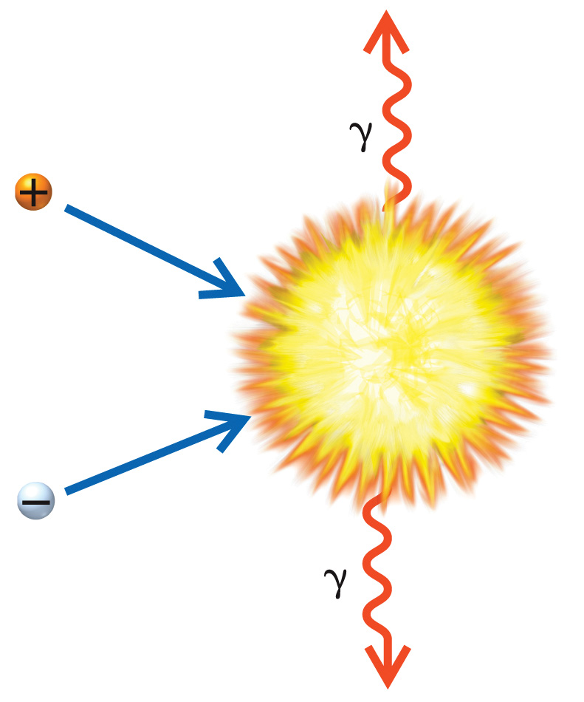
Focus on Meaning
Avoid the common mistake of spending your time describing the appearance of symbols.
Instead, focus on meaning, as that’s the most important information to relay.
Example: In this image, you would want to avoid describing “a ball labeled with a plus sign” and instead you should call it “a positron.” Avoid describing “a squiggly arrow labeled with a weird y” and instead call it “a gamma ray.”
Notes:
Describe meaning not appearance.

Slide 17
The Result?
Reduce simultaneous mental tasks in working memory
Increase ability to focus on new concepts
Eliminate misunderstandings or confusion
Decrease time and energy needed for understanding
Allow for integration of new concepts into a mental model

Slide 18
STEM Examples

Slide 19
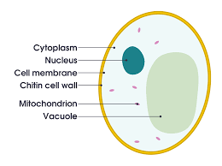
Simple Images
Simple Diagrams can often be summed up in one sentence: A diagram of a cell. The chitin cell wall forms the outer skin of the cell with the cell membrane just inside it, and filling the membrane is cytoplasm in which floats the nucleus, multiple mitochondrion, and a vacuole.
Photographs of people just need a name: Marilyn Monroe.

Slide 20
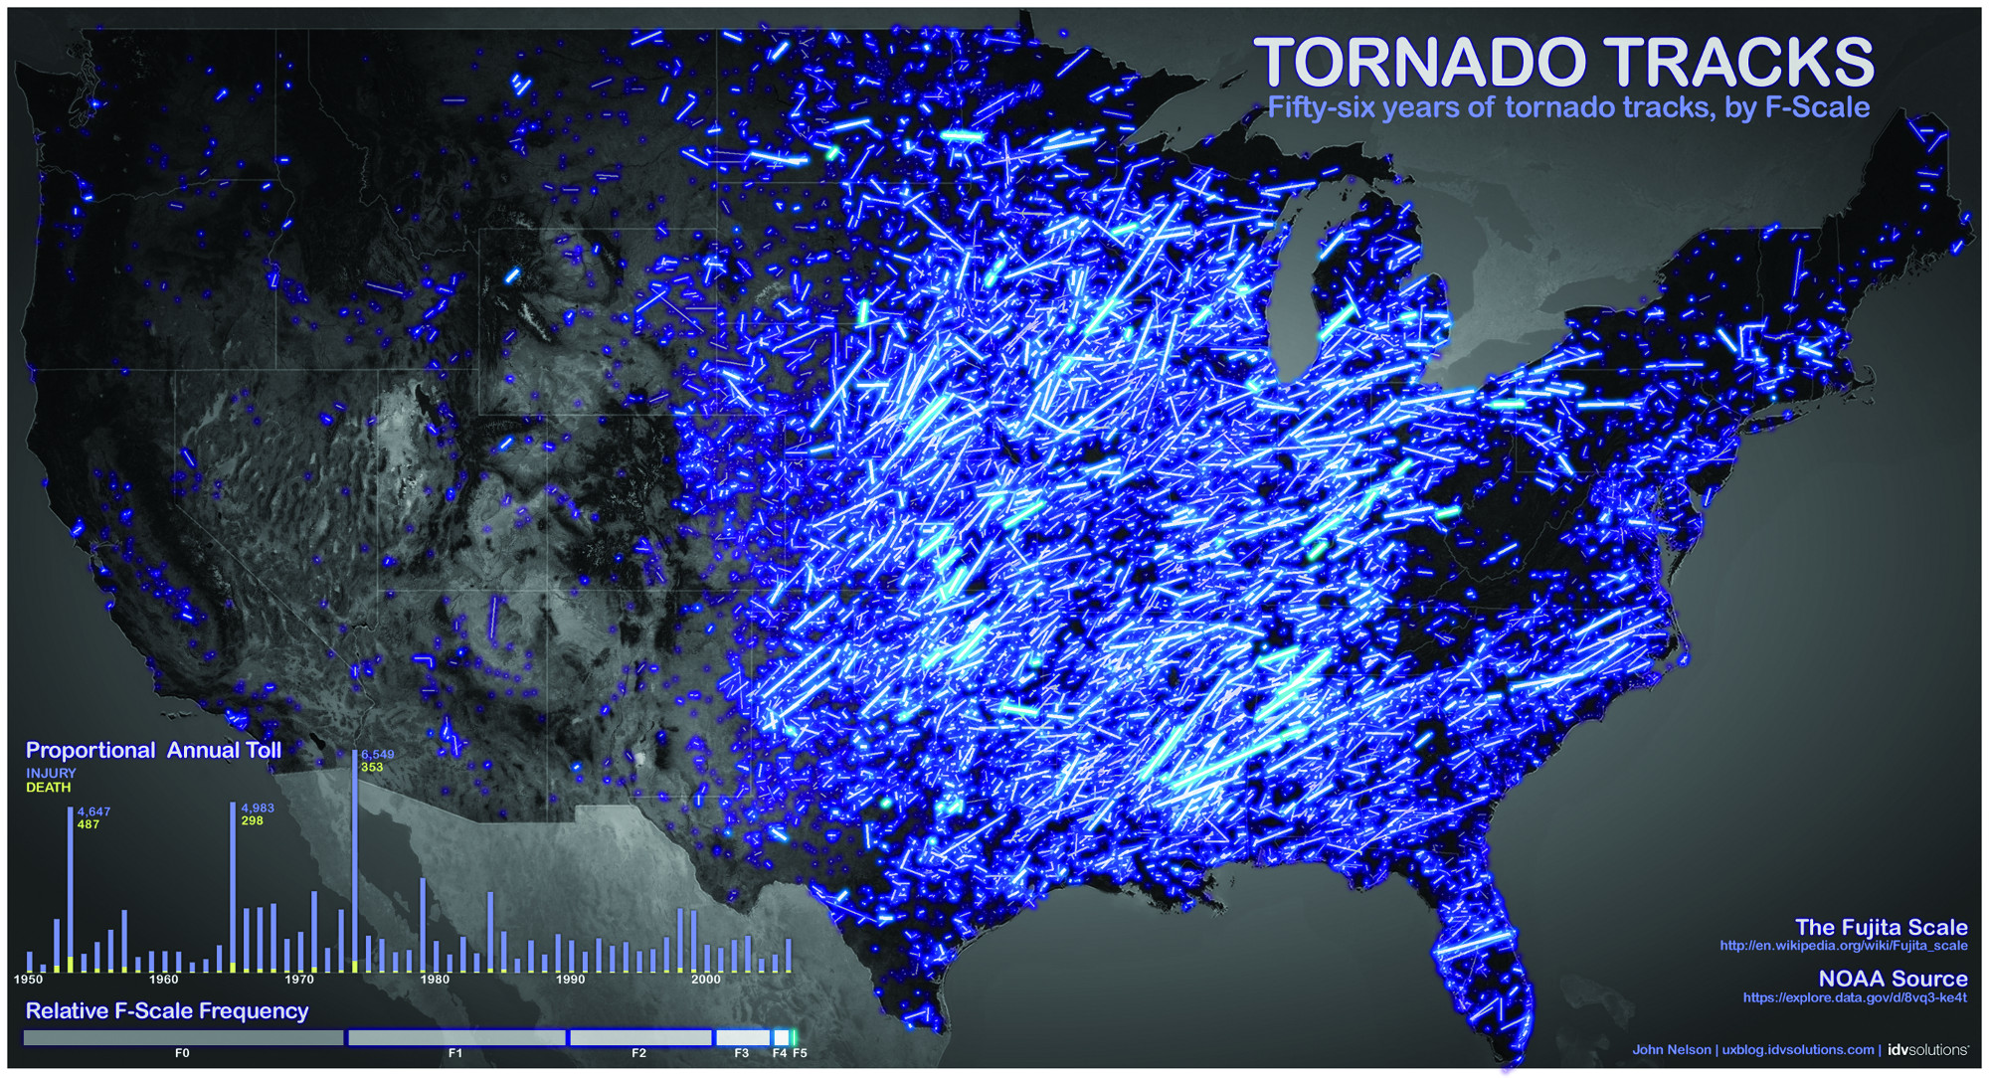
Complex Infographics
Begin by describing the type of image.
Follow up with a general statement to summarize the content.
Work from general to specific, filling in the details as needed.
Notes:
Image description for this example: An infographic titled Tornado Tracks: Fifty-six years of tornado tracks, by F-Scale. The tracks of tornados are shown imposed on a map of the United States in varying shades of blue light to show intensity on the Fujita Scale. A bar graph accompanies the image and measures the proportional annual toll of tornados since 1950 in terms of injuries and deaths that have occurred.

Slide 21
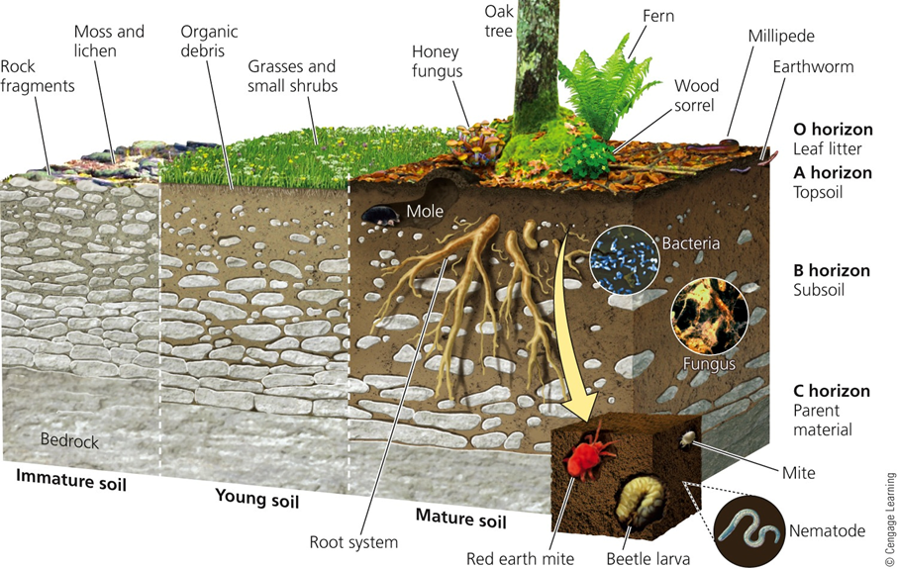
Complex Diagrams
Brief: A diagram showing a cutout of soil formation in three stages: immature, young, and mature.
Complex: A diagram showing a cutout of soil formation in three different stages. Immature soil includes a large layer of bedrock at the bottom, large rocks throughout the rest of the ground, and rock fragments near the surface. Moss and lichen can grow on this soil. Young soil has a smaller layer of bedrock at the bottom, fewer large stones above it, and organic debris near the surface. Grasses and small shrubs can grow on this soil. Mature soil has an even smaller bedrock layer called the C horizon parent material followed by the B horizon subsoil, followed by the A horizon topsoil, and lastly the O horizon leaf litter. Throughout the soil there are root systems, moles, bacteria, fungus, beetle larva, red earth mites, nematodes, and earthworms. On the surface there are honey fungus, oak trees, ferns, wood sorrels, and millipedes.

Slide 22
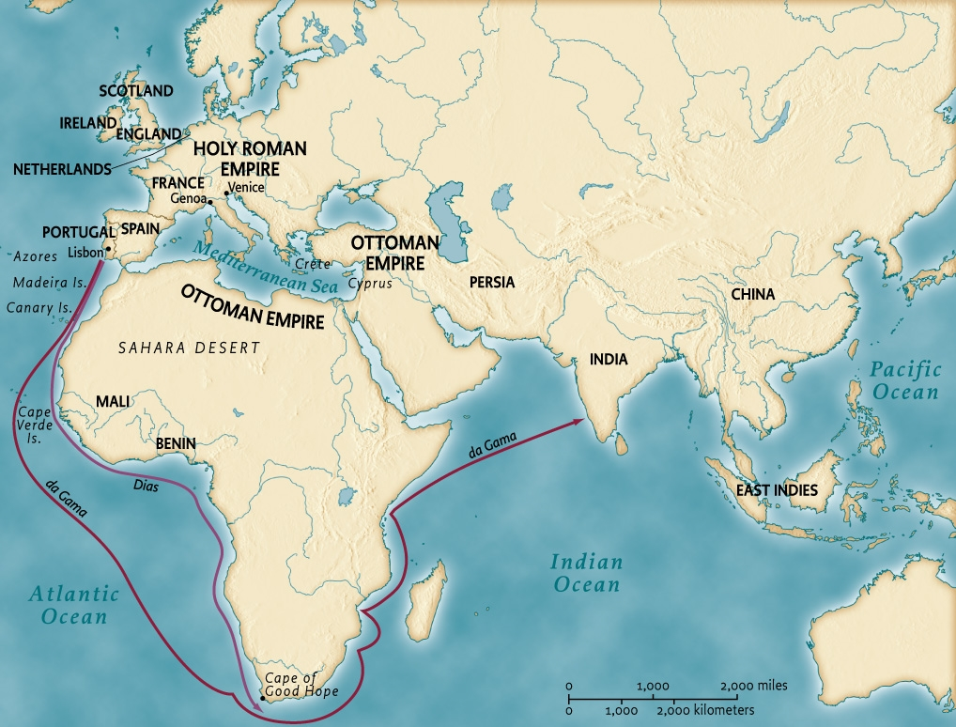
Maps
Describe the areas, regions, and relevant details on the map plus any inset. Often the colors, shapes, or arrows on a map have no significance.
A map of oceanic exploration routes by Dias and de Gama circa 1500, during the reign of the Holy Roman Empire in Europe and the Ottoman Empire in northern Africa and the Middle East. Dias’ route begins in Portugal and hugs the western coast of Africa, ending at the Cape of Good Hope. The route for de Gama also begins in Portugal, goes around the Cape of Good Hope, hugs the eastern coast of Africa, and crosses the Indian Ocean ending in India.
Notes:
Describe only relevant areas, and describe them in proximity to each other.
Relevancy is determined by highlighting, the title or caption, and the legend.

Slide 23
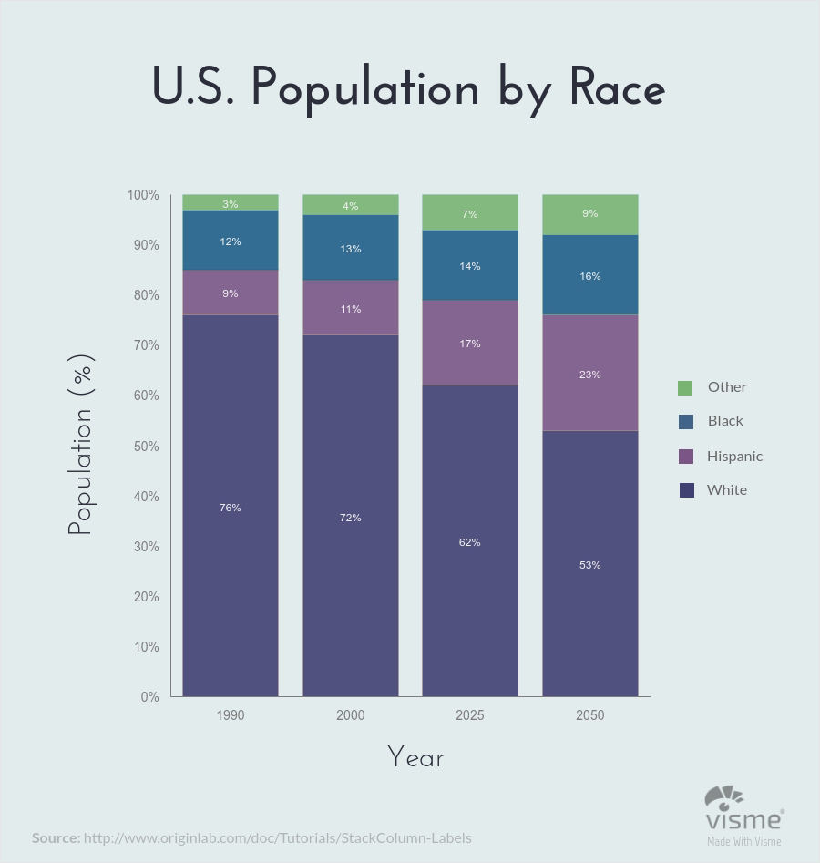
Bar Graphs
Work from general to specific. Begin by naming the type of graph and title. Then describe the horizontal and vertical axes if applicable. Finally, describe the data. A bar graph titled U.S. Population by Race that compares the percentages of Black, Hispanic, White, and Other races in the United States for the years 1990, 2000, projected 2025, and projected 2050. In 1990, there were 76% White, 9% Hispanic, 12% Black, and 3% Other. In 2000, there were…
Notes:
If there are more than 7 categories in a bar graph or pie chart, best practice would be to represent this data as a table or ordered list.
When describing data, either do it consistently by year, or from highest to lowest.

Slide 24
Line Graphs
Include title of graph and X-axis and Y-axis labels and ranges
Summarize trends of lines, not every data point
If every data point is needed, consider converting graph into table format
If there is a steady slope then include the rate of increase or decrease
If there is a noticeable change in slope then describe beginning and end point of that variation

Slide 25
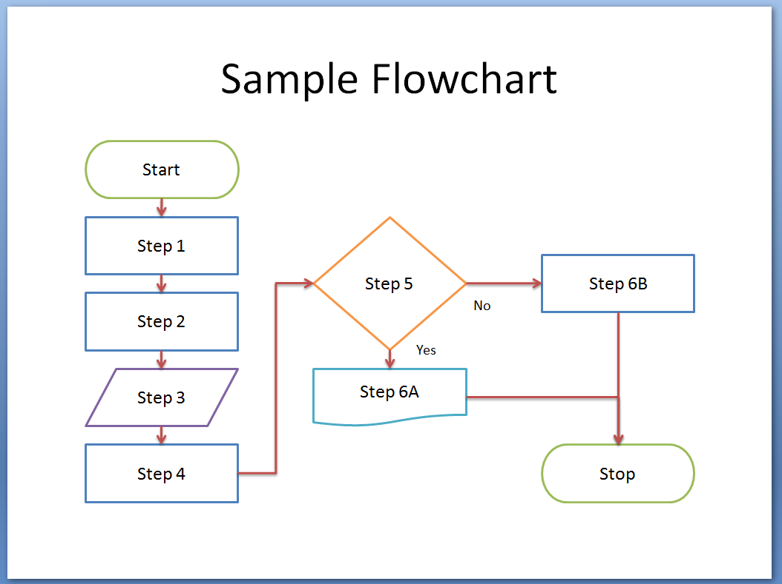
Flow Charts
Often flow charts can be reproduced easily in list format, either as numbered options, or in text form like the example below:
This sample flowchart begins with Start, then Step 1, Step 2, Step 3, Step 4, and Step 5. If yes, proceed from Step 5 to Step 6A and Stop. If no, proceed to Step 6B and Stop.

Slide 26
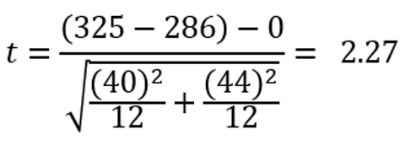
Math and Chemistry Equations
Brief: An equation.
Complex: Begin equation. T equals start fraction left parenthesis 325 minus 286 right parenthesis minus 0 over start root start fraction left parenthesis 40 right parenthesis squared over 12 end fraction plus start fraction left parenthesis 44 right parenthesis squared over 12 end fraction end root end fraction equals 2.27. End equation.
Brief: A chemical equation.
Complex: Begin equation. Gaseous Upper N 2 plus 3 gaseous Upper H 2 yields 2 gaseous Upper N Upper H 3. End equation.
Notes:
MathSpeak and Chemistrian have very different rules
Symbols used by different maths and sciences in different ways
Develop a system that is clear and systematic so student knows what to expect with high volume of equations to process.

Slide 27
Infographics and Tables
Paragraph format removes the ease of comparison, which is the point of an infographic and is readily available to sighted users by means of visual grouping.
Instead, sort the information into a table.
Notes:
This infographic could be translated into a table with five columns with the headings name, category, height, appearance, and weather impact. The row headings should be the names of each cloud type.
Reading the Clouds poster by NASA Wavelength, oercommons.org

Slide 28
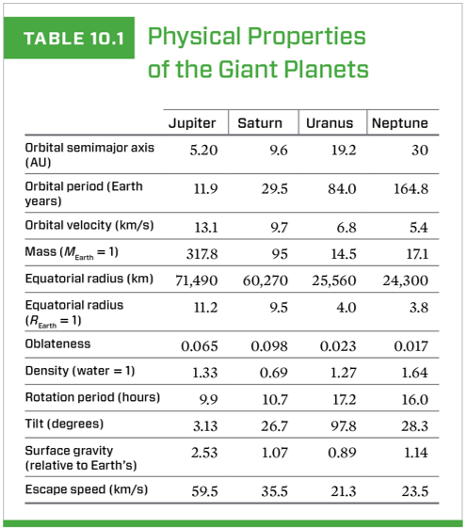
Structural Alt Text for Tables
In addition to adding alt text descriptions for any images or visual content, consider adding structural alt text to summarize your table contents. This gives someone a chance to hear what the table contains before listening to all the data.
Example:
Table 10.1 is titled Physical Properties of the Giant Planets. It has 5 columns and 13 rows. The column headings are Physical Property, Jupiter, Saturn, Uranus, and Neptune.
*Please note that because the first column heading was left blank, we filled it in so that the table would make more sense.

Slide 29
Implied Visual Information
Charts and graphs are visualizations for a reason: to make implications. Leaving out the visual impression leaves out important information.
Graphs should not be described solely by the raw data they offer but rather by what they are communicating.
What is the visual impact of this graph?
What relationships are implied here?
Notes:
A viewer is not usually intended to reflect on each data point but rather to take the image as a whole and interpret it. When we do not facilitate this whole-image ease of interpretation, we are removing meaning.
In this image, you should mention that Georgia has more than double the next highest maternal mortality in the states listed, and you should mention that only half of the 50 states are present on the graph.
Image by K. James Monroe

Slide 30
Questions?

