Slide 1
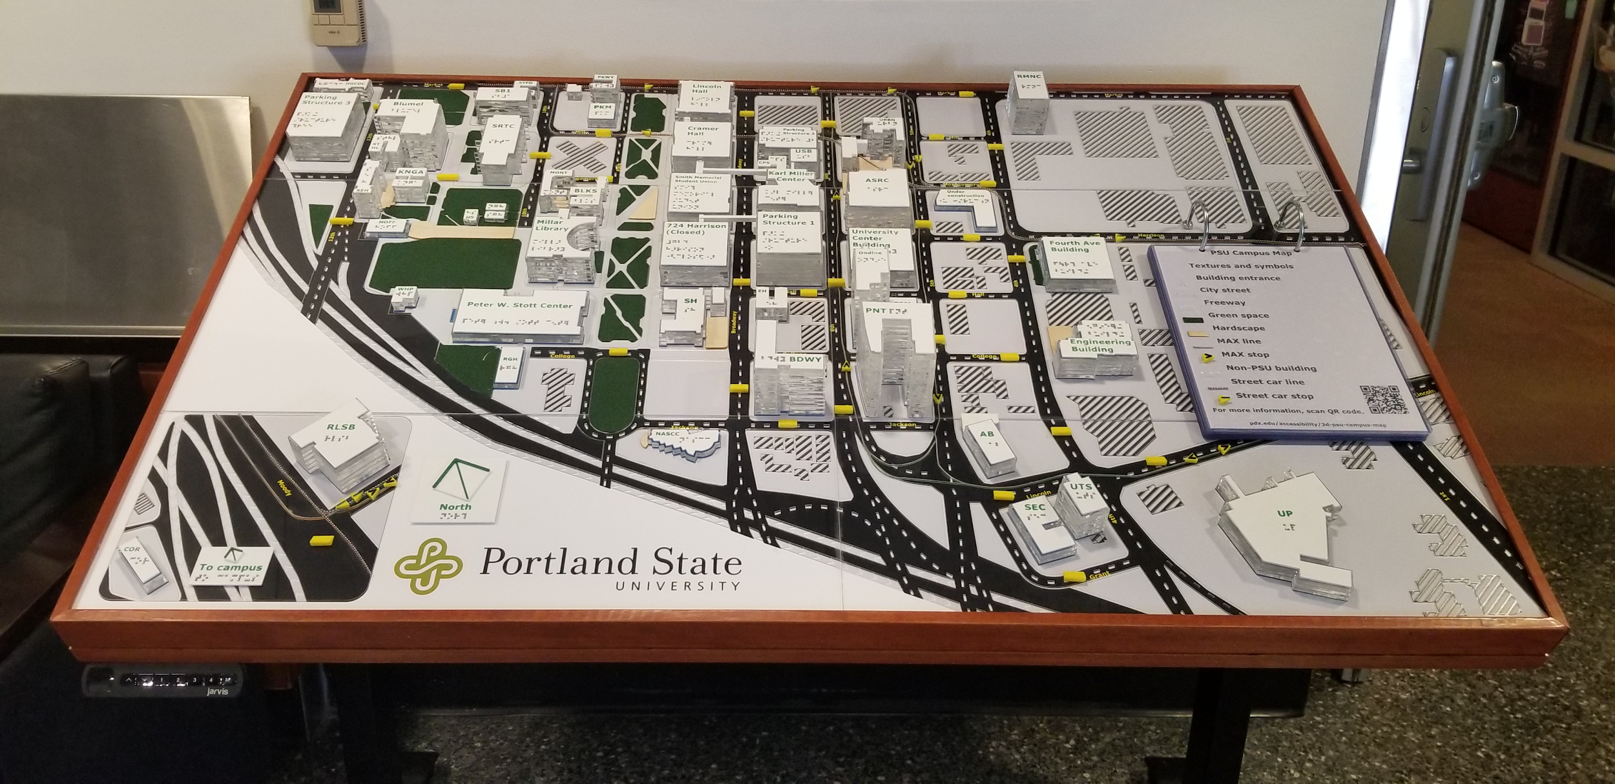
Creating the PSU Tactile Map from One SVG File

Slide 2
Introduction
Michael Cantino, Accessibility Specialist, Portland Community College
Library of Congress certified Braille Transcriber
Research Assistant at Portland State University, studying interactive 3D printed models for BVI students

Slide 3
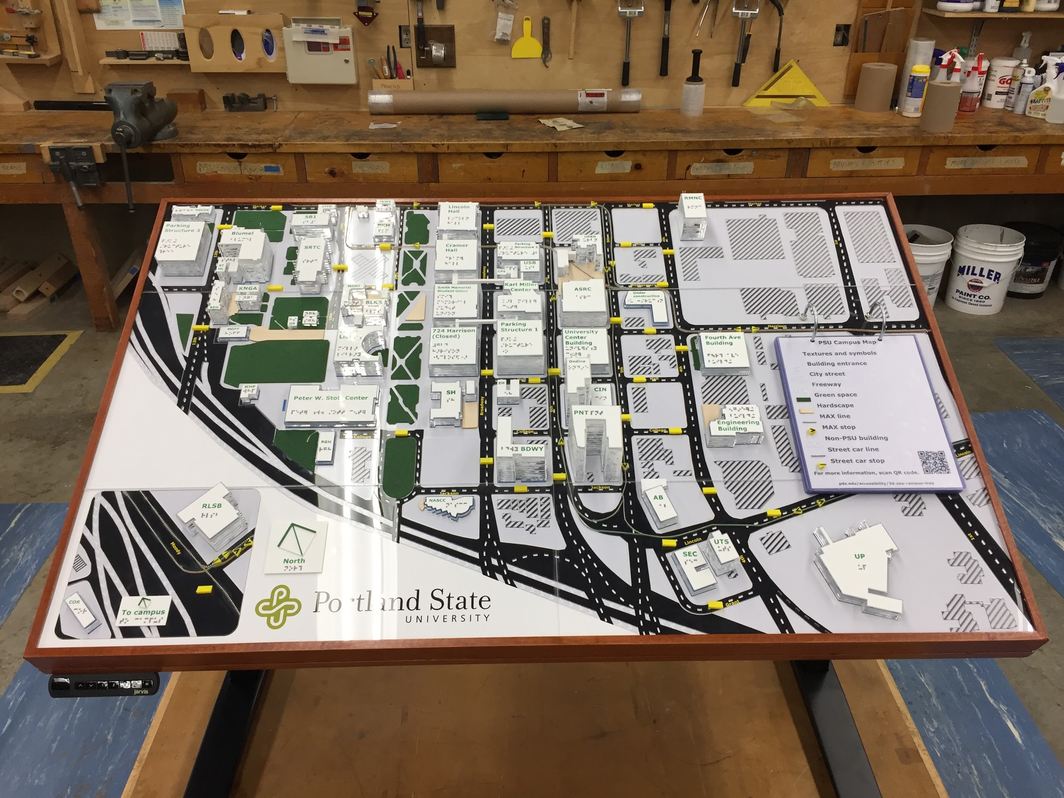
PSU Tactile Map
The Portland State University Tactile Map is approximately 3 feet by 4 feet. Key features include:
Relative height of buildings
High contrast print and braille labels for streets and buildings
Transit stops
Green areas, pedestrian areas, city streets, and freeways
Large print and braille map key with QR code

Slide 4
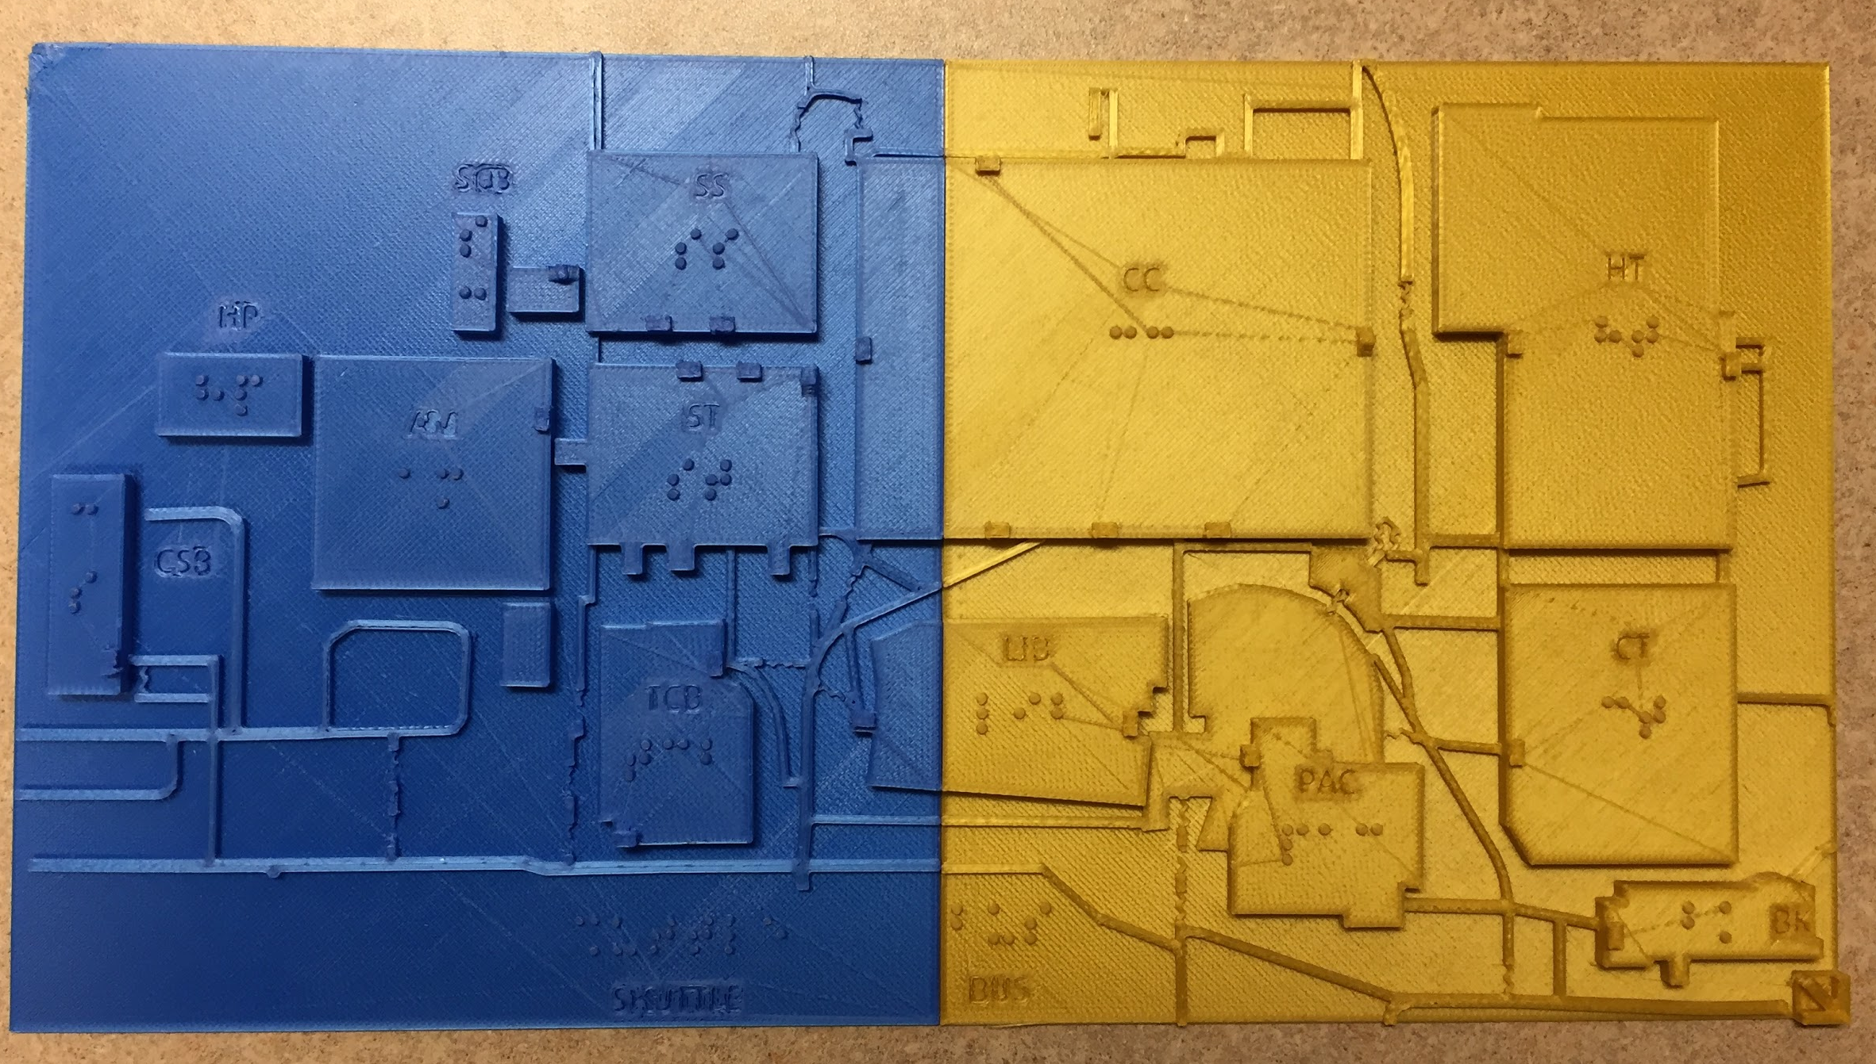
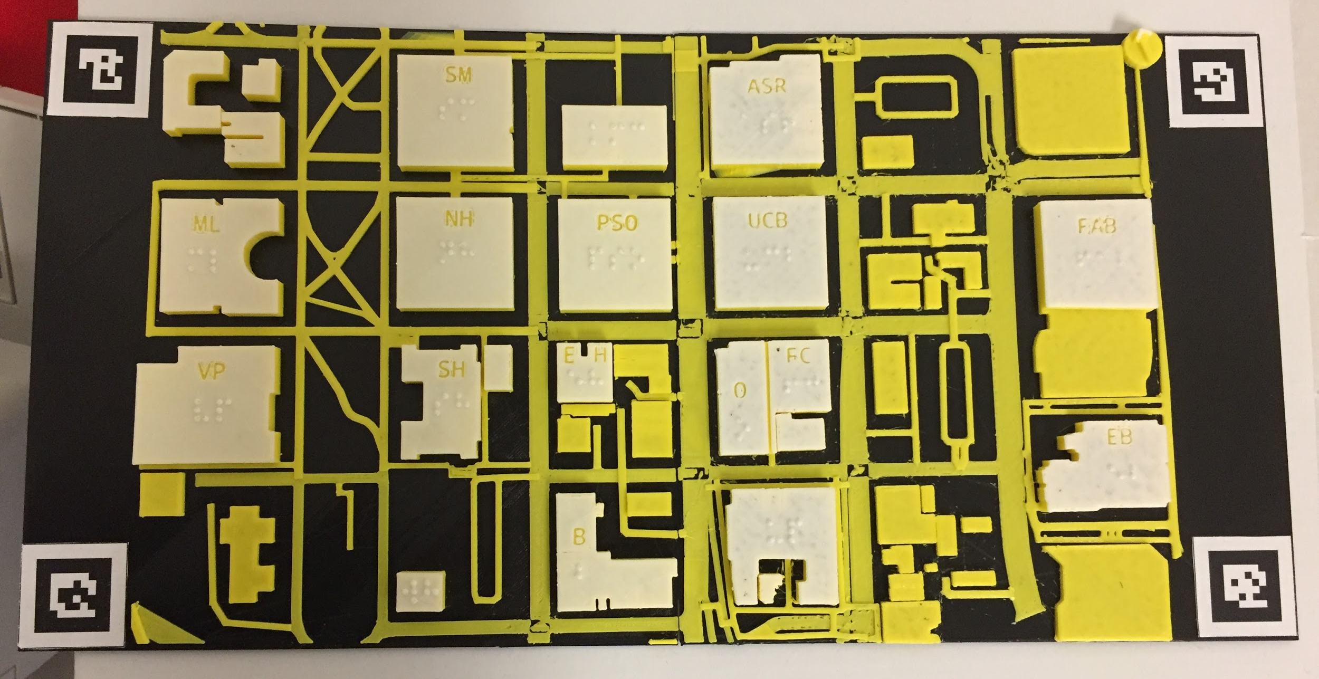
Project Origins
Fall 2017: 3D printed map of Portland Community College Sylvania campus
Spring 2018: 3D printed map of Portland State University created for NSF project
Summer - Fall 2018: Large scale tactile map proposed and intergovernmental agreement established
November 2018: Work on map begins

Slide 5
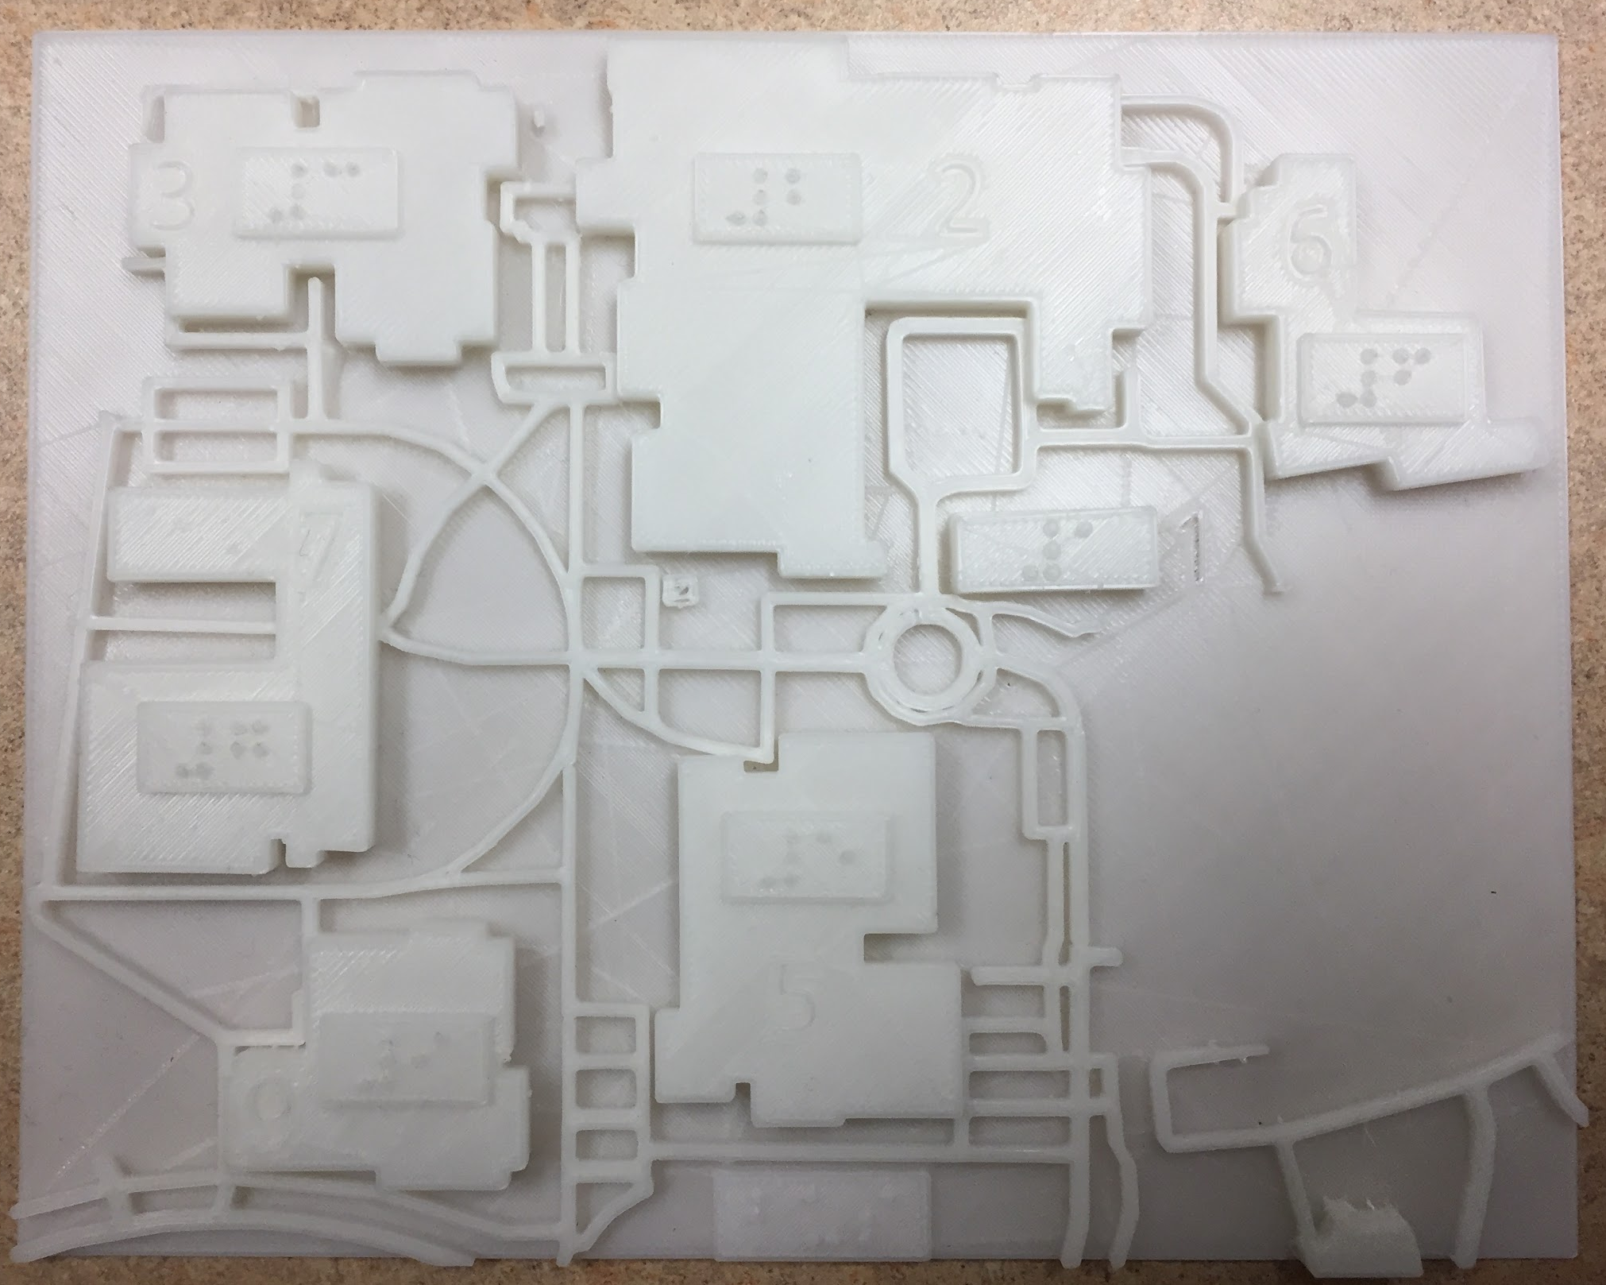
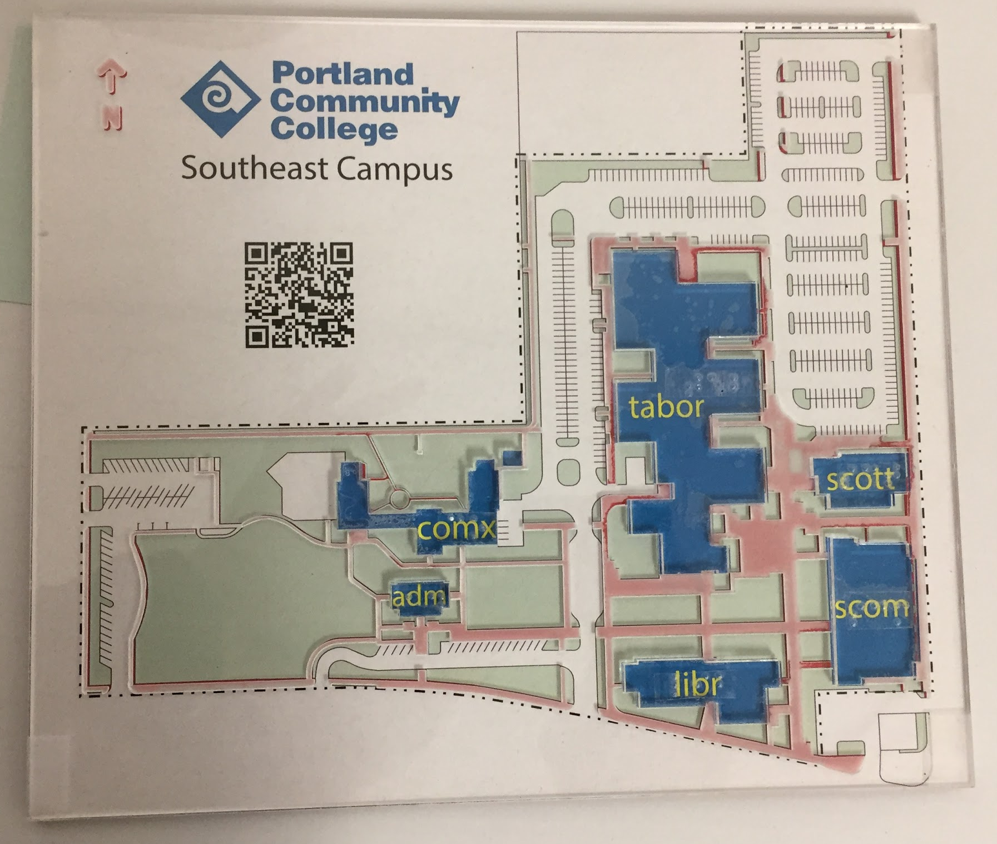
Exploring New Approaches
November 2018
PCC creates 3D printed map of Rock Creek campus.
PCC creates laser cut tactile maps of the Southeast and Cascade campuses using SVG files.
Limits to previous 3D design process prompt exploration of designing with SVG.

Slide 6
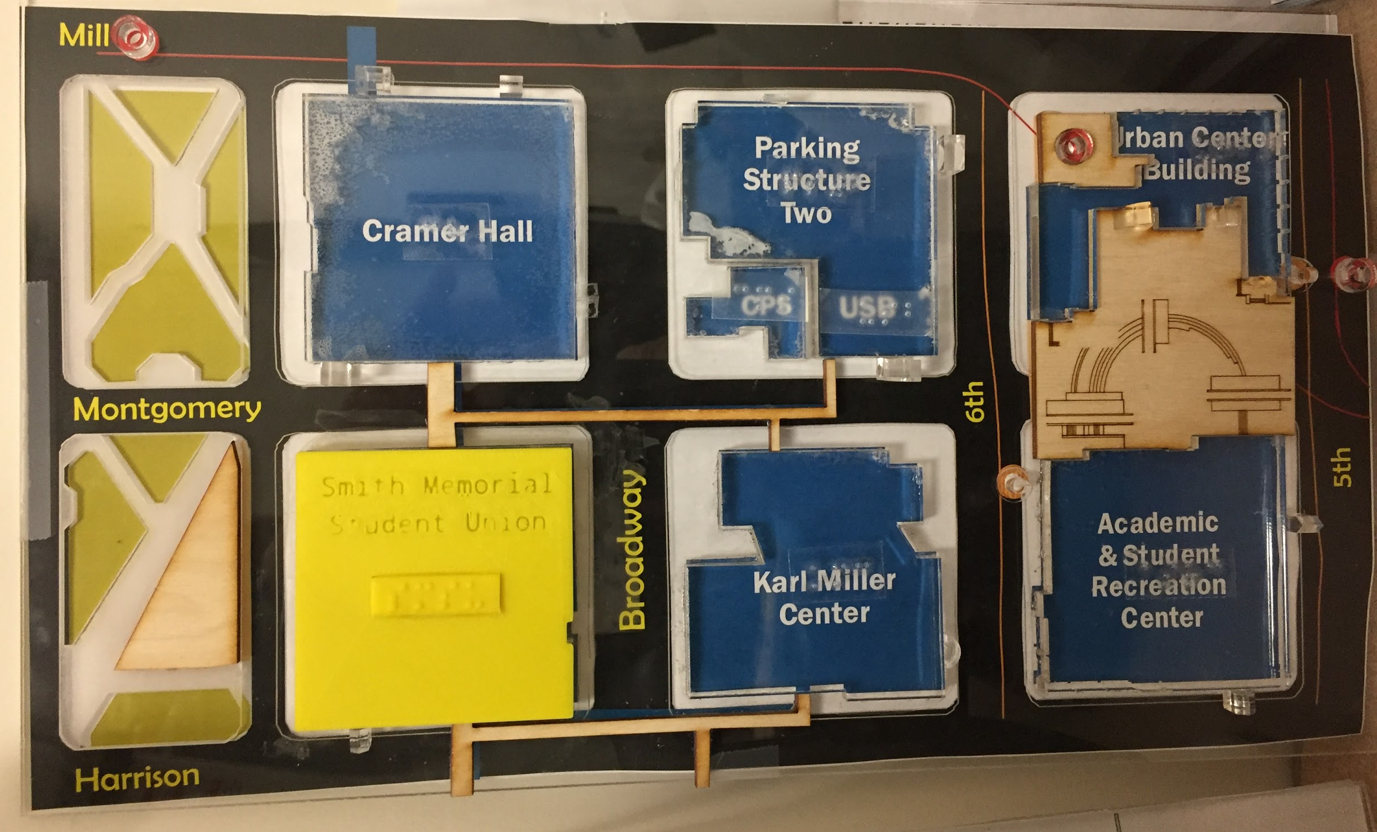
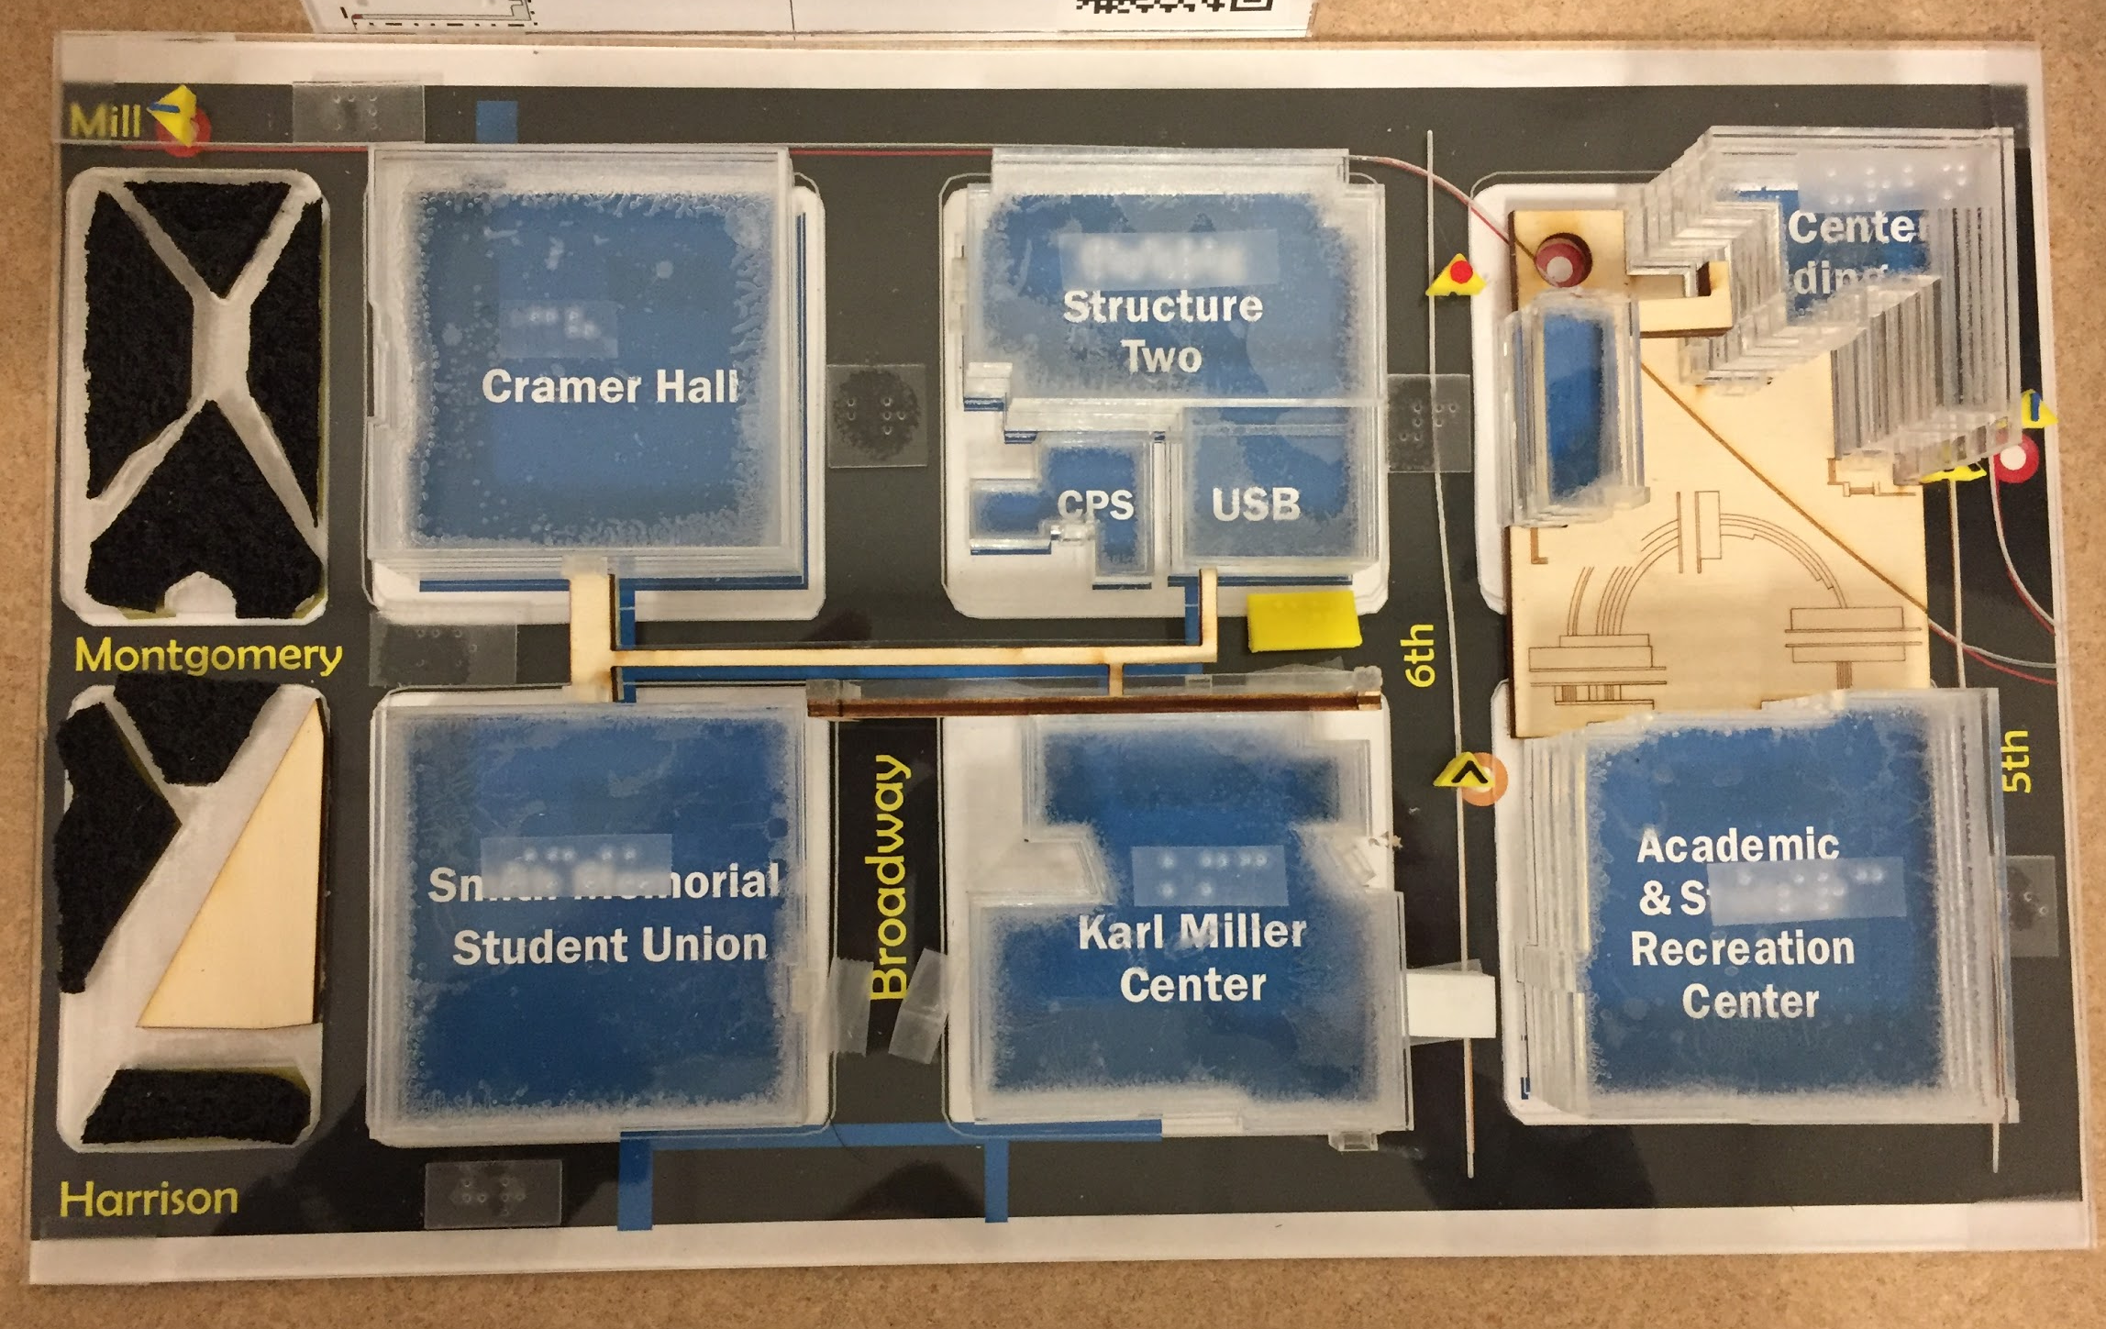
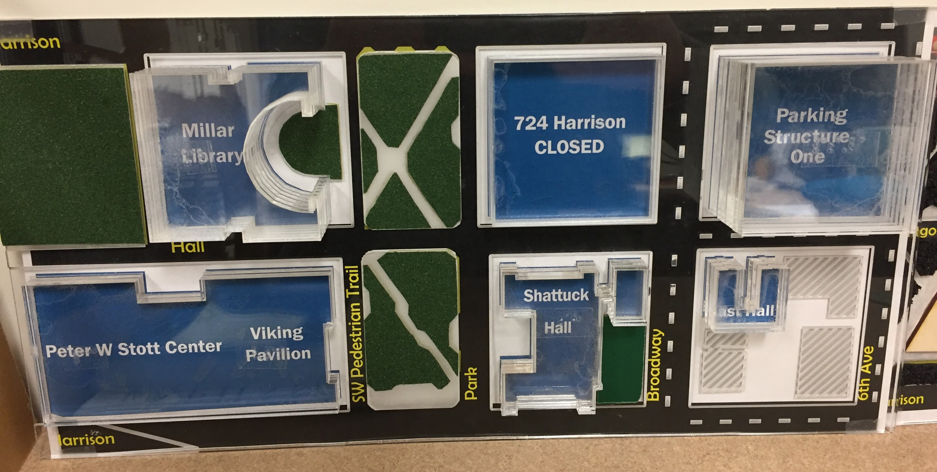
Working with End Users
PCC and PSU were committed to making a map that worked well for their community.
Several end-user feedback sessions were held with PSU students.
Feedback from these sessions was incorporated into map prototypes that were brought back to the users for critique.

Slide 7
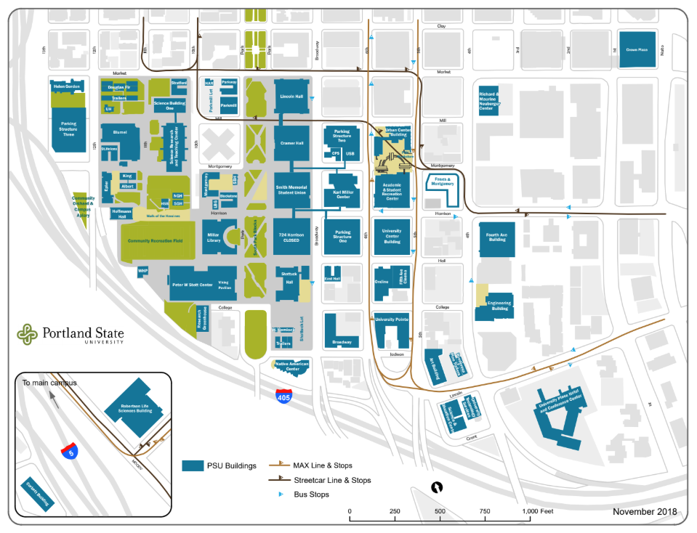
One File to Rule Them All
PSU provided PCC with a PDF of their campus map.
We knew that a variety of elements needed to be included, and we anticipated using a variety of production techniques.
It was decided that one master file would be created to retain consistency across all map elements.

Slide 8
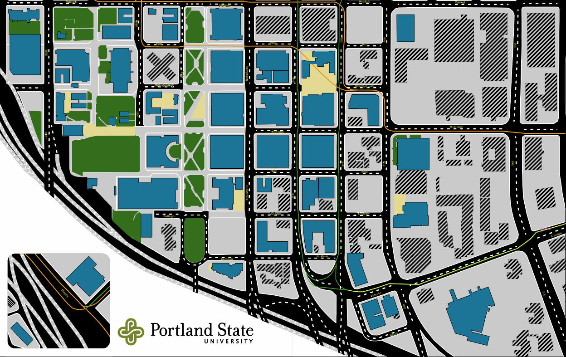
The Master File
Notes:
Lines were adjusted to allow for minimal distance between elements, per BANA tactile graphics guidelines

Slide 9
Working with SVG Files
SVG (Scalable Vector Graphic) files are easy to create, and they can be used for a variety of production methods. Use your SVGs with:
Microcapsule (swell touch) paper
Braille embossers
Vinyl cutters
Laser cutters
3D printers
And more!

Slide 10
Braille Embossers
You can easily emboss your SVG files. Some embossers will even allow you to include ink with your embossed images.
Simply choose your embosser from the list of printers to emboss your graphic.
Some embossers allow you to adjust the height of the raised lines by using different colors. Lighter colors are embossed lower than darker colors.
Notes:
I use ViewPlus embossers.

Slide 11
Vinyl Cutters
Vinyl cutters, like the Silhouette or Cricut, are very easy to use.
The vinyl cutter will cut along the vector lines in your SVG file.
Some vinyl cutters will automatically detect the edges of your image, making it even easier to use.

Slide 12
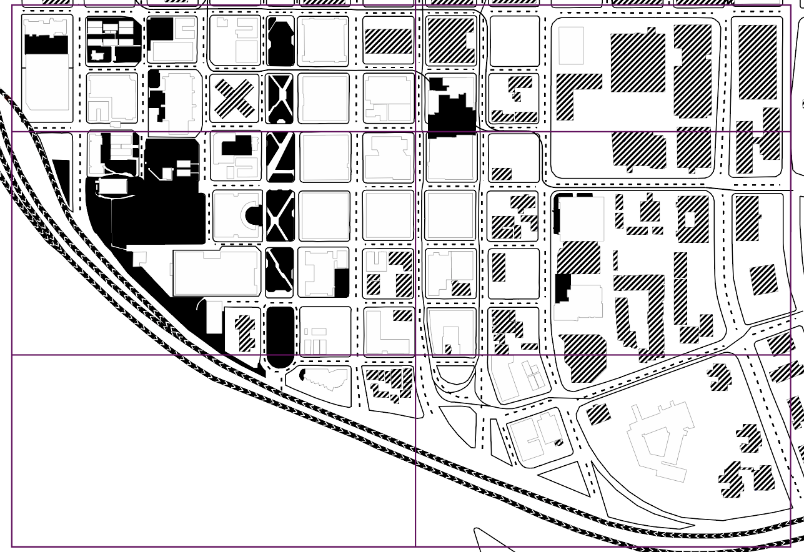
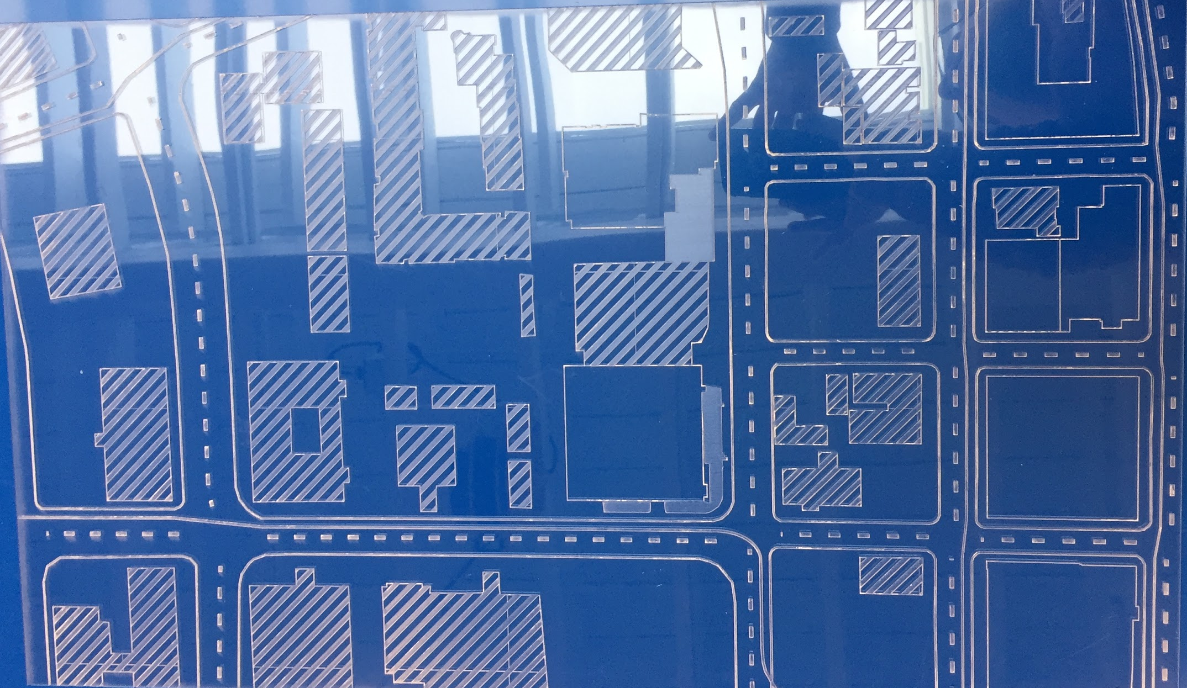
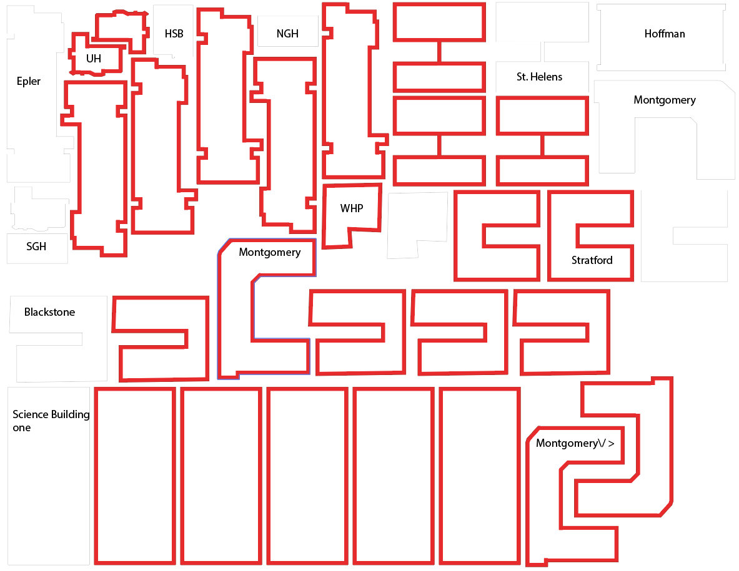
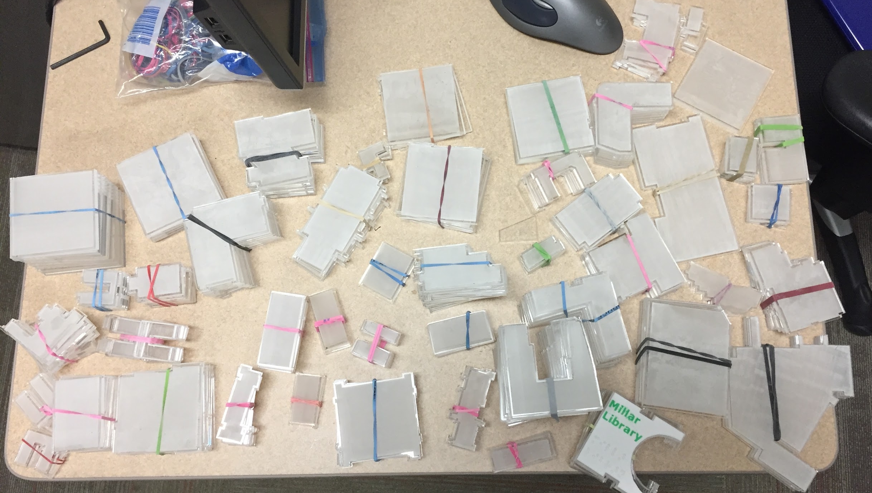
Laser Cutters
Laser cutters are very precise and allow you to use a wide variety of materials.
Laser cutters perform two basic functions: cutting and etching.
Vector lines are cut, and shaded fill areas are etched.
Many laser cutters require specific conventions for color and line weight.

Slide 13
Laser Cutter Specifics
The laser cutter only recognizes a predefined set of colors. The colors in the file must match the predefined colors exactly, or the laser will ignore those areas.
Cut lines needed a line weight of .01pts.
Any shaded area is etched.
Adjust the speed and power to control the depth of your cuts and etches.

Slide 14
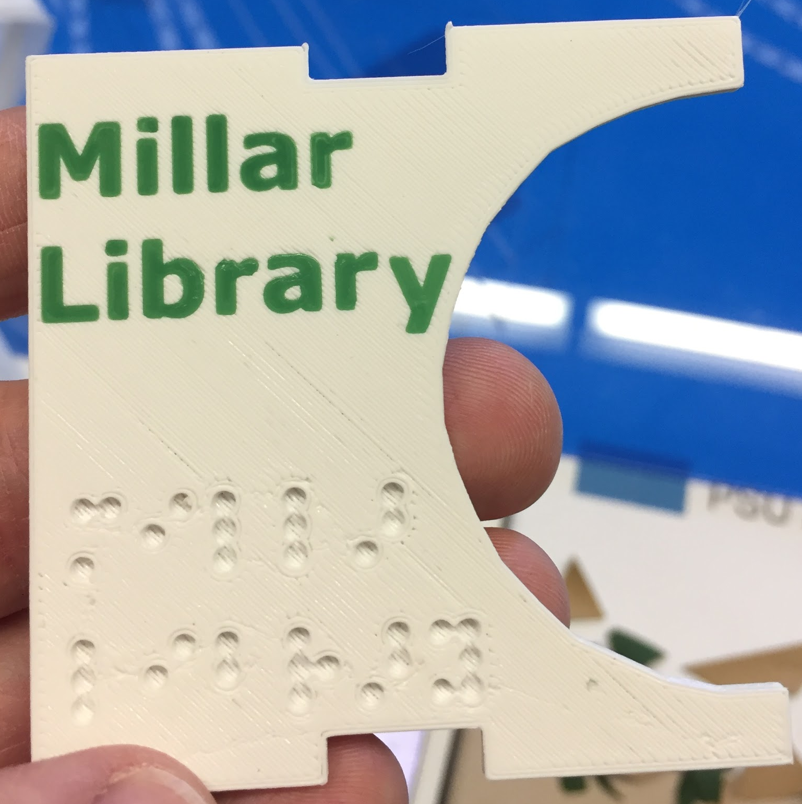
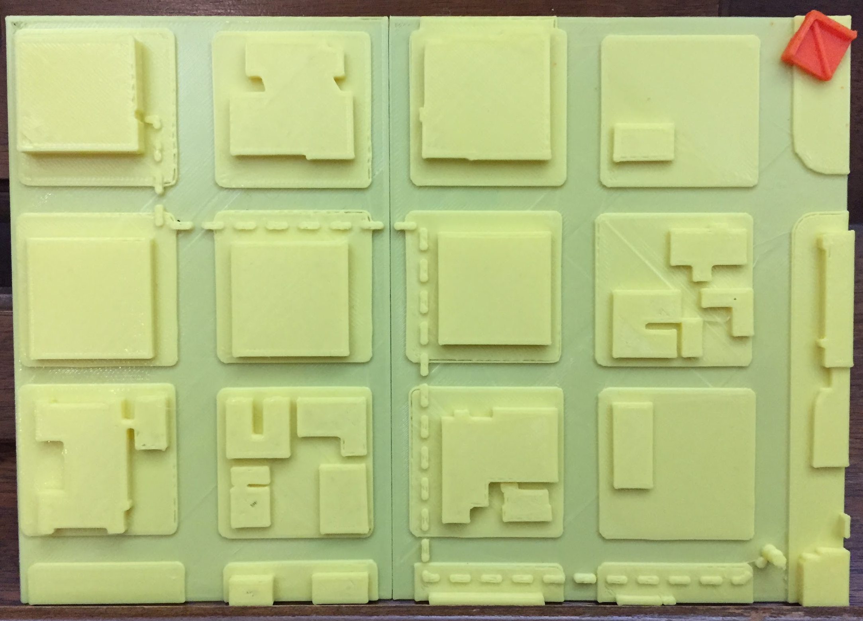
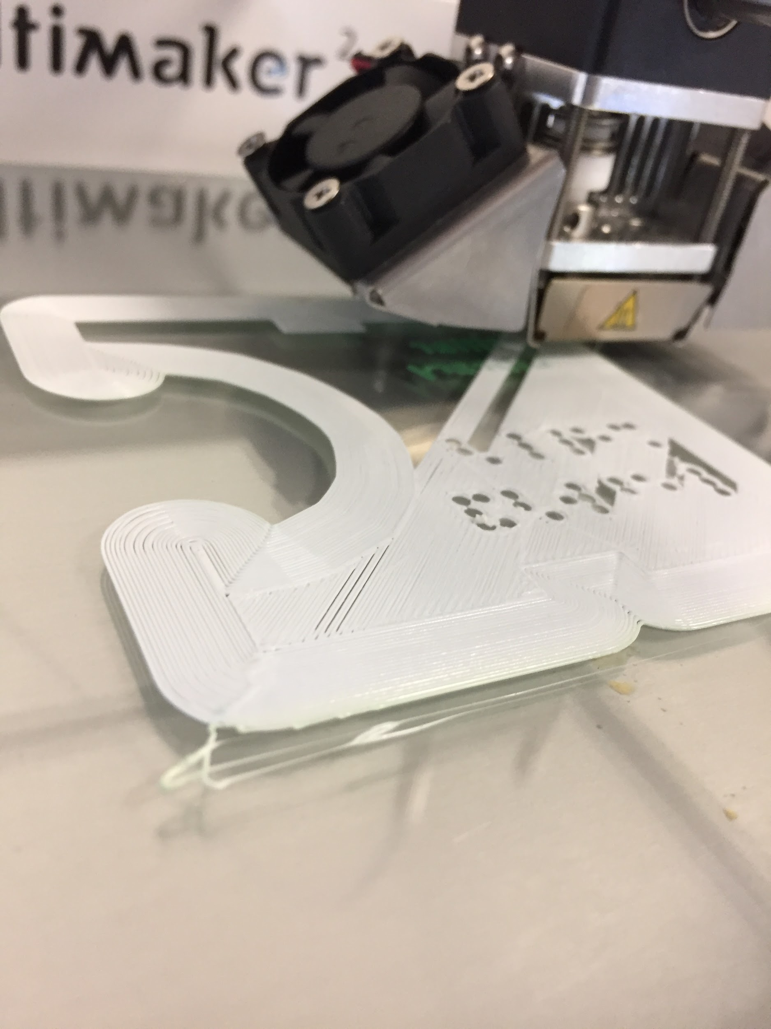
3D Printers
3D printing with SVG files will allow you to easily create 2.5D models.
Some modeling programs, like Tinkercad, will automatically convert your SVGs into 3D printable files.
Other modeling programs require processing to create models, but they offer greater control and customization.

Slide 15
Free Resources
Inkscape: Excellent vector graphics software. Comparable to Adobe Illustrator.
PicSVG: Automatically convert images into SVG files. Very easy to use.
TinkerCAD: Simple, browser based 3D modeling tool
Fusion 360: More complex 3D modeling tool. Free for educators.
Cura: Excellent free slicing software for 3D printing.

Slide 16
Contact
Have questions or looking for additional resources? Please feel free to contact me.
Michael Cantino
Accessibility Specialist
Portland Community College
(971)722-4350
michael.cantino@pcc.edu

