Slide 1


Disabled students, ICT, post compulsory education & employment: In search of new solutions
Sheryl Burgstahler, University of Washington
Dana Kaspi-Tsahor, Open University of Israel
ed-ict.com

Slide 2
The Ed-ICT International Network
To explore the role that ICTs play or could play in creating barriers & mitigating disadvantages that students with disabilities in post-secondary education (PSE) experience
To examine how practices of educators & other stakeholders can craft successful & supportive relationships between learners with disabilities & ICT

Slide 3
Ed-ICT Objectives
Synthesise & compare the available research evidence across the five countries regarding the relationship between students with disabilities, ICTs & PSE
Construct theoretical explanations for why ICTs have not achieved the dramatic reductions in discrimination, disadvantage & exclusion hoped for
Provide new perspectives about potential future solutions regarding how PSE institutions can better use ICTs to remove the ongoing problems of disadvantage & exclusion of students with disabilities.

Slide 4






Ed-ICT- network partners
USA : Sheryl Burgstahler, Hadi Rangin, Dan Comden
University of Washington, Seattle
Canada: Catherine Fichten, Laura King, Alice Havel
Dawson College, Montreal, Quebec
Israel: Tali Heiman, Dorit Olenik-Shemesh, Dana
Kaspi-Tsahor
The Open University of Israel
Germany: Björn Fisseler, Christian Buehler, Markus Deimann
FernUniversität, Hagen
UK: Jane Seale, Chetz Colwell, Tim Coughlan
The Open University, United Kingdom
Notes:
Given the short time, I will not be able to present all (many) new designs that were studied in the meetings from the countries,
but I will briefly present some of what has been introduced. no comparisons, only some of the knowledge regarding new designs that we gained through the project.
USA Seattle symposium (March 2017): New models, frameworks or approaches
Canada- Montreal Symposium (May 2017) :Stakeholders Perspectives
Germany- Hagen Symposium (October 2018): New Practices, Support the Transition to PSE
Israel - Tel-Aviv Symposium (March 2018): In Search of New Designs
UK- London Symposium (June 2019): nd of Project Conference
Professor Jane Seale, Open University, UK
Leader of ED-ICT International Network

Slide 5
The Ed-ICT participants
15 core network partners
20+ local participants
  Disabled students
  Faculty
  Service providers
  Support & advocacy organisations
  Tech companies
  Researchers

Slide 6
Theme 1: Models, Seattle, U.S.
Compare & contrast
the range of models &
frameworks that exist;
Evaluate the potential
of these models &
frameworks to help
develop practices that can, through the use of ICT successfully alleviate disadvantage & exclusion of students with disabilities.

Slide 7
Theme 2: Stakeholder engagement, Montreal, Canada
Who are the stakeholders of disability & ICT related practice in post-secondary education?
How can these stake-holders be effectively engaged in the improvement of practice?

Slide 8
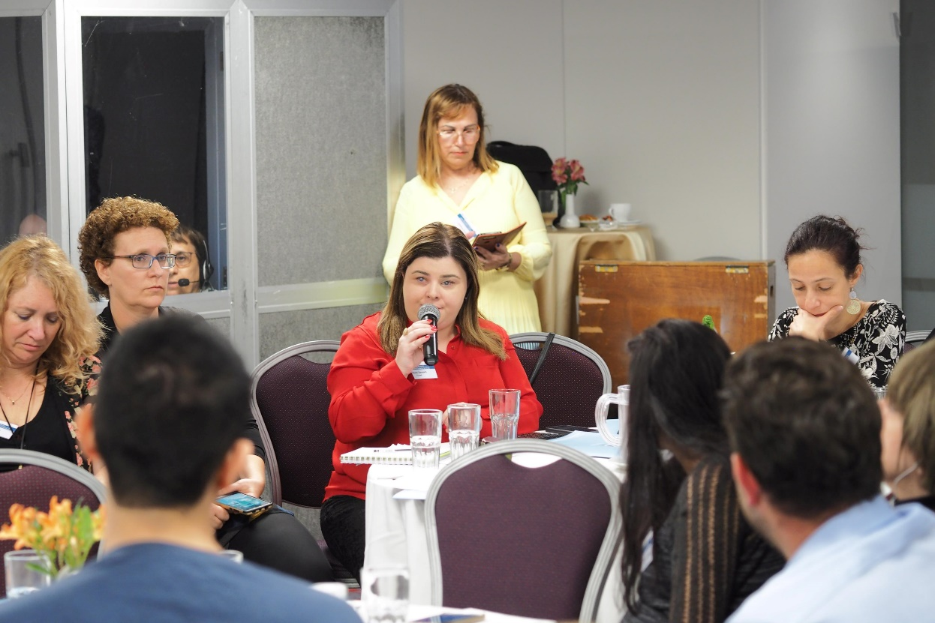
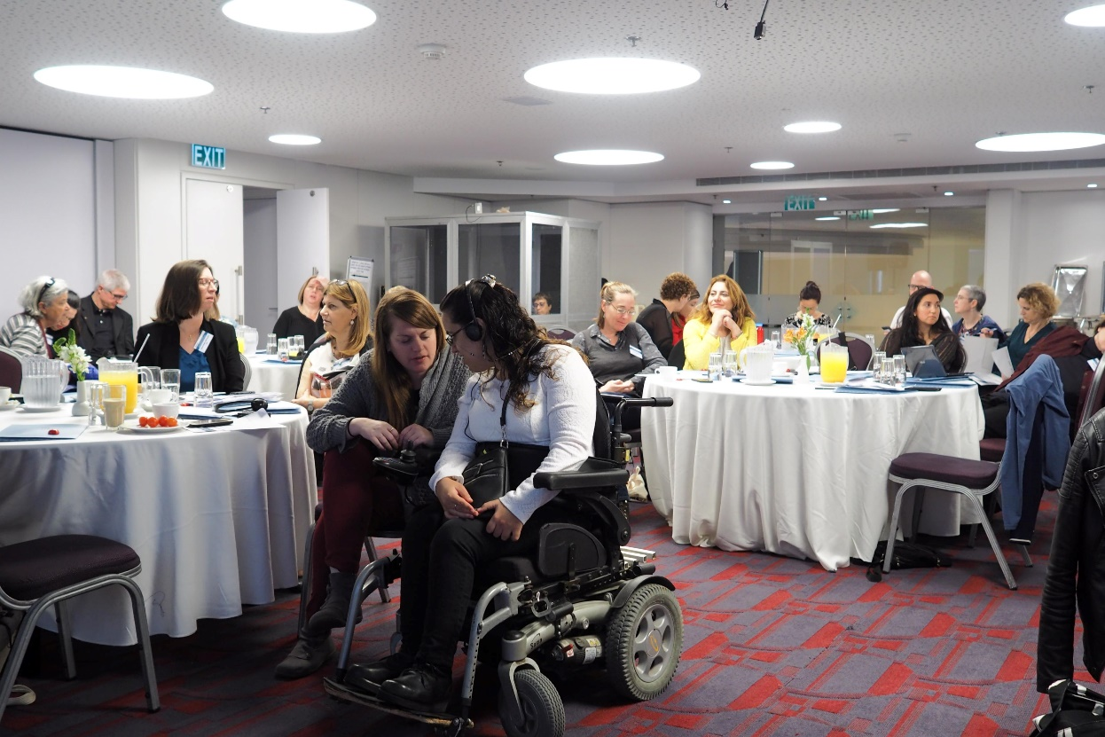
Theme 3: Design.
Tel Aviv, Israel
To what extent can the lack of access to supportive ICTs or inaccessible ICTs be solved by new or better ICT designs?

Slide 9
Theme 4: Transitions, Hagen,
Germany
How can technology
help disabled students
with transitions in the
education system?
What are typical problems
that disabled students
experience with technology
& the accessibility of
technology during transitions?
Who are the different stakeholders involved, & do we need other or different stakeholders?
What role does technology play in the different settings of the education system?

Slide 10
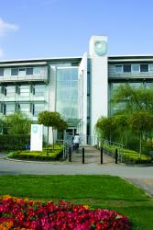
Theme 5: New solutions & opportunities, UK
Debate & evaluate what we
have learned so far
Integrate what we have learnt
with your own research &
practice experiences
Identify, develop & evaluate
new opportunities for research
& practice in the field

Slide 11
The Ed-ICT way: A critical approach
We need to question those things that are ‘taken-for granted’
as truth or fact in
the field in order
to give voice to
new possibilities
& future directions
in both our research
& our practice.

Slide 12
Effective models for
the procurement, development, & use of accessible ICT in post-compulsory education:
Personal Perspectives
Sheryl Burgstahler, UW
Sheryl Burgstahler, University of Washington

Slide 13
Views of disability service provision
“Medical” or “deficit” views lead to accommodation-only approach
“Social” or “social justice views lead to universal design (UD) with accommodations approach

Slide 14
UDHE =
“The design of products & environments in higher education to be usable by all people, to the greatest extent possible, without the need for adaptation or specialized design.”
UDHE
Accommodations
UDHE
Accommodations

Slide 15
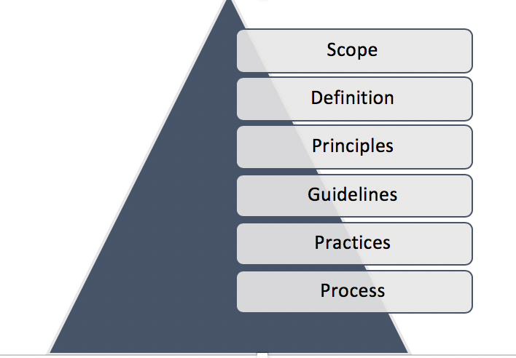
UDHE Framework
Principles:
Universal Design
Universal Design for Learning
Web Content Accessibility Guidelines

Slide 16
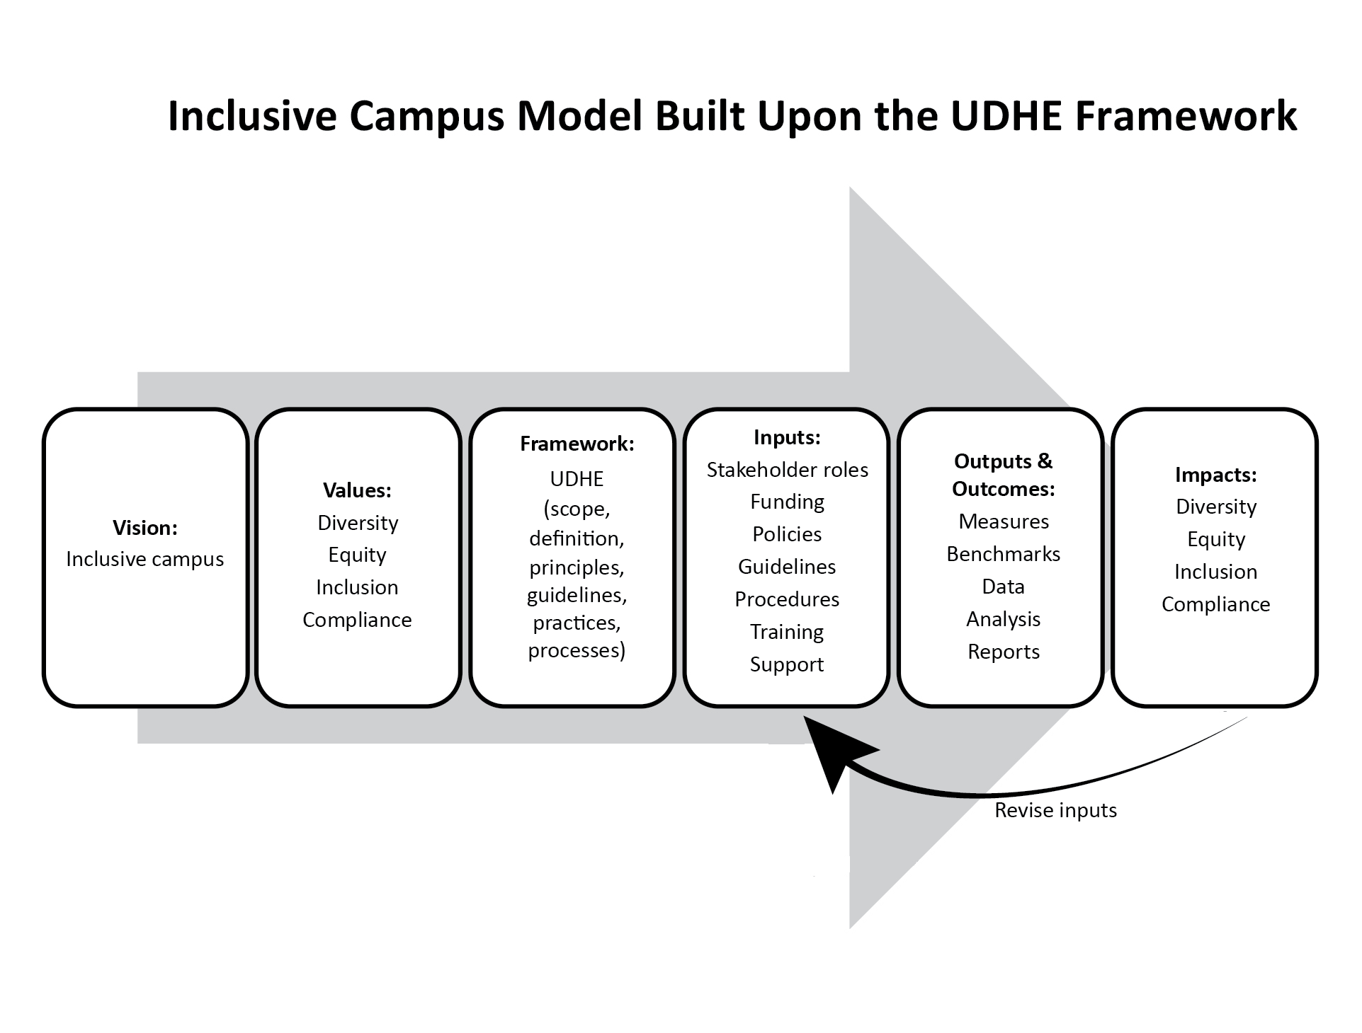
Inclusive Campus Model underpinned by the UDHE Framework

Slide 17
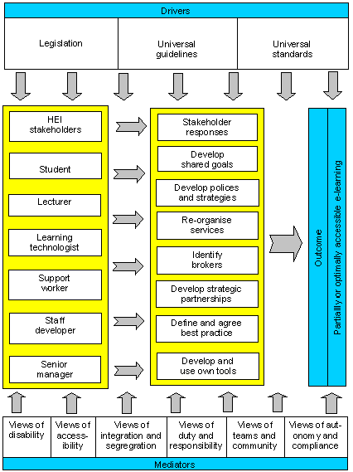
Contextualized Model of Accessibility
Seale, 2006

Slide 18
Consider factors for your campus:
Campus values & culture
Strengths & weaknesses of each model
Views of stakeholder representatives (e.g., on integration & segregation, duty & responsibility, teams & community, autonomy & freedom)
Develop a process to reach a shared vision
Processes for acquiring AT & procurement, development, & use of accessible IT

Slide 19
Consider factors for your campus:
Potential roles of stakeholder groups
Internal/external promoters & resistance
Training & support issues, tailored to specific audiences to promote awareness, increasing knowledge, & procedures
Impact & benchmarks on paradigm shift to more inclusive campus
Strategic partnerships
implementation plans

Slide 20
New designs issues:
What have been studied during the project
Main questions:
Exploring which and how new ICT designs contribute to the needs (academic, social, and physical) of students with disabilities in postsecondary Educational institutions.
Focusing on innovative technologies, future directions, new trends and
challenges for students with disabilities.
Main emphases:
Global viewpoint: What has been studied from the previous symposia regarding new designs across five countries (USA, Canada, Germany, UK & Israel)
Students’ viewpoint : Benefits, difficulties and challenges
Future directions - What next?

Slide 21

New Designs: USA (Washington University UW)
  Provide accommodations for students with disabilities
  Promote accessibility within the context of UD, civil rights, and inclusive campus culture
  Computers with magnifiers and text-to-speech tools in the libraries
  Websites and applications updates
  Pre-pdf for many courses
Undertake efforts that are -
  Reactive and proactive
  Top-down and bottom-up
UW’s Leadership
  IT Accessibility Coordinator
  IT Accessibility Team (ATS)
  IT Accessibility Task Force
  IT Accessibility Associations

Slide 22

New Designs: Canada (French College, Montreal)
  New Designs:
Mobile learning
Cloud computing
MOOCs
Online courses
Webinar
Canadian Software : WordQ, SpeakQ, Thought Q, Word prediction software, Text-to-speech,
Speech recognition, Research tool, Clockwork, Administrative software
  Quebec Software: Antidote, Advanced correction and editing tool, Lexibar
  Past - Student funded directly
  Present - Funding on-campus labs, Read and Write Gold online
  Future trends - Go virtual and create assistive-technology environments
Notes:
MOOCS -Massive Open Online Courses (MOOCs) are free online courses available for anyone.
MOOCs provide an affordable and flexible way to learn new skills, study in various HE institutions, advance career and deliver quality educational experiences at scale.
Webinar - refers to a lecture given on the Internet, live, is a combination of the word Web and Seminar. Some call the Webinar event by other names such as: Internet lecture, Internet conversation, live webcasting, web conferencing and online seminar - the same intention - Webinar

Slide 23

New Designs: Germany (University of Hagen)
Present
Moodle, Late 2017: New website with improved accessibility
  Providing (a lot of) print materials.
  Video captions
  Accessible PDF documents
  Braille & large print version available on individual request
  Videos can be subtitled
Adobe Connect
Various educational technologies, but no focus and knowleddge on
accessibility and needs of students with disabilities.
Focus on compensatory measures.

Slide 24
New Designs: Germany (University of Hagen)
Future trends and challenges:
Info portal for students & staff
Counselling & qualification of teaching staff
Change of examination system with a focus on accommodations
Increase of accessibility of study material & technical infrastructure
Change of procurement processes
Vocational qualification
A need for more accessibility and support for students with disabilities
A need for more disability officers
Focus on digitalisation > window of opportunity
Large scale > diverse needs < standardisation

Slide 25

New Designs: UK (The Open University, UK)
Accessibility considerations in procurement processes
Accessibility testing
Moodle VLE: OU UK has developed this platform which is core in teaching. plugins and fixes for accessibility.
Adobe Connect : Guidance issued to staff and students.
Sense Access : Automatically converts documents into alternative media including audio, eBook and digital braille.
ERA - The Enabling Remote Activity project
  provides practical solutions to the challenges of fieldwork accessibility and provides mobility for impaired students to fully participate in fieldwork learning activities, by using mobile and communications technologies.
  The ERA technology has been used in modules and is available to loan for use.
Notes:
procurement – רכישה השגה
VLE – Virtual Learning Environment סביבת למידה דיגיטלית

Slide 26

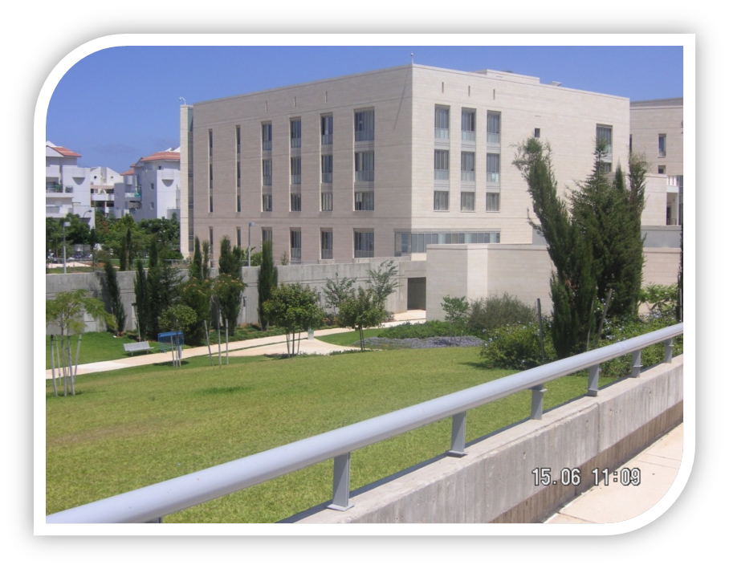
New designs: Israel Open University of Israel (OUI)
  Special standards for HE institutions that requires access to information:
      Accessibility TO Internet services
      Accessibility of Digital Documents
      Accessibility center in every university
Awareness , Obligation , TechniQUES
Notes:
Naturally, I will present a little more information about Israel that is constantly developing new designs and new technologies for people with disabilities, including students

Slide 27
AT for students with disabilities (OUI)
Reading
OCR/Speech Synthesis
Speech Synthesis
Alternative format books (tape, CD)
Writing
Word Processor
Word Prediction
Speech Synthesis
Speech Recognition
Graphic Organizer
Spell Checker
Math
Talking Calculator
Electronic Worksheets
Organization
Personal Data Manager
Computer Flow Charts
Tape Recorder
Free-form Database
Listening
Assistive Listening Device
Tape Recorder
Notes:
OCR - Optical Character Recognition– The computer turns written text and into spoken language.
perfect technology for reading complicated written text.
Computer Flow Charts – Turn ideas into a picture or flow chart, referred to as cognitive mapping, provides a great tool for visual
impaird students who are having trouble outlining or organizing their ideas for presentations or for writing.

Slide 28
Accessible technologies
Facilities in the classrooms
  Portable Closed Circuit Televisions (CCT)
  Laptop
  Magnification software
  Frequency-modulated (FM) system
  Sound amplification system
  Interactive whiteboard (IWB) Special personal computer with special screen and adapted software programs
Facilities for Test typing
  MathType - Software for writing mathematical formulas (https://softfamous.com/mathtype )
  Zoom Text -magnifierreader enlargement program (https://www.zoomtext.com/products/zoomtext ).
  Graf - translation - Text-to-speech
  NVDA (http://nvaccess.org.il )
  Speech-to-text
  Free Voice-to-text software (https://www.speechtexter.com )

Slide 29
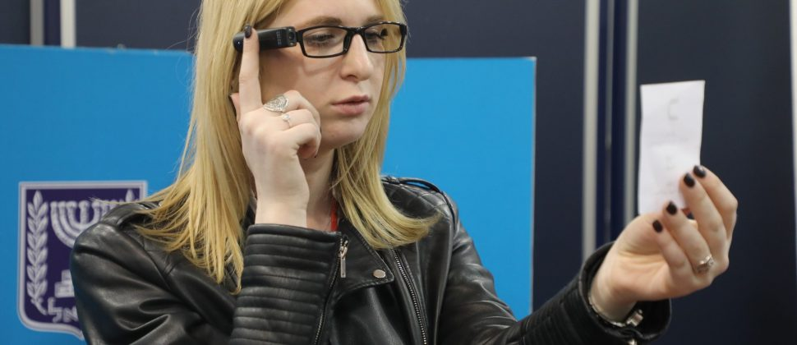
Israel: Advanced, Innovative Technologies and New Designs
  OrCAM MyEye 2.0 (Orcam Technologies, Israel) (https://www.orcam.com/en/myeye2/) -
A wearable assistive technology device, communicates visual information by utilizing a small, intuitive smart camera that is mounted on the eyeglass frames, and connects to a pocket-sized computer. Using advanced technologies, the device converts text and allows blind students to "read" texts that are placed in front of them (numbers, papers), recognizes faces, identifies products and currency.
“Right Hear" - Maps specific environments, using multiple sensors and auditory guidance to inform people with visual
  impaired of their immediate physical surroundings, providing both general factual information (i.e. "This is room 301") and specific instructions (i.e. "three stairs are ahead'). The technology improve the lives of many blind and visually impaired students that confront difficulties in orientation in higher education campuses. (https://right-hear.com).
MAX PROJECT- Translating gloves from sign language to text.
Sesame Phone – The world’s first completely touch-free smartphone, designed by and for people with disabilities.
  With Open Sesame, using the front-facing camera of any Android device, Open Sesame tracks head movement to unlock touch-free texting, social activity, searching the web and much more.
Talkitt - Speech Impairments, that identifiesI speech distortion and translate the words into clear words.
Notes:
Few examples

Slide 30
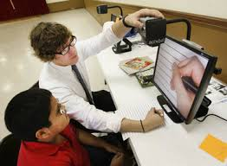
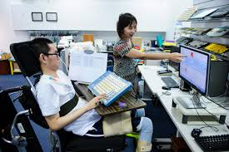
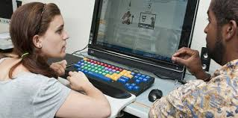
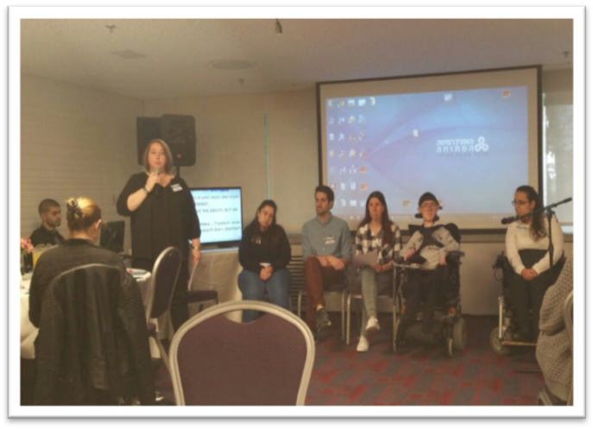
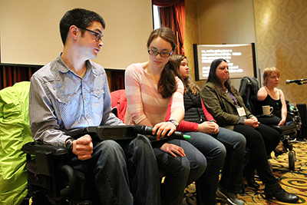
New Designs: Students’ Viewpoint
Notes:
Students Viewpoint regarding new designs: Benefits, difficulties and challenges.
I will present here a summary of (what has been told) the statements made by the Students regarding using,
implementing and coping with new designs in their studies.

Slide 31
New designs: Students’ Viewpoint Benefits
Powerful studying tool – “Technology gives me the ability to progress, to succeed, to express myself and to utilize my potential. Without technology I would not be able to succeed as a university student”.
Independent learning – (e.g. “Screen-reader software that converts the script into audio output, thus allows independent learning for visual impairments.
Emerging sense of empowerment - The power of technology as a mediator of change. The new designs enables students with disabilities to exercise more control over the nature and quality of their university lives – in all aspects: Academic, social and cultural.
Notes:
Powerful studying tools - “Technology gives me the ability to progress by, to succeed, to
express myself and to utilize my potential. Without technology I would not be able to
succeed as a university student”. e.g. - New Software that allow to type math symbols, complicated formulas and draw
graphs in a simple and easy way helps significantly.
Technologies enable independent learning - With a recorded book, I can prepare for the test independently. Summaries of the material and lectures are printed in Braille. The service for the blind helped me buy screen-reader software called 'Jaws' that converts the script into audio output and allows independent learning.
Technologies enable distance learning
Distance learning (from home) enables me to be a full-time student because I have a hard time attending all the lectures due to mobility limitations.
The course site enables me to be at home and still feel part of the classroom. Software systems that allow me to type math symbols, complicated formulas,
participate in class by speaking and do not require typing.
Sense of Equality – e.g.- Visually impaired students reported they felt equal to others while using the internet, but on the other hand, due to inaccessibility issues they still felt they are dependent on others to operate technology. In addition, some technologies (i.e., service bots like SIRI and ALEXA and apps such as Whatsapp, Facebook, Gett, Moovit) help people with physical and cognitive disabilities however not all interfaces are suitable for individuals with motor disabilities because the interfaces do not offer navigation without keyboard.

Slide 32
New designs: Students’ Viewpoint Benefits
Distance learning - enables the student full-time attendance at all lectures, despite mobility limitations
A sense of equity (with the other students)
Developing and promoting the ability to study (to fulfill potential and to gain academic success)
A sense of relevance and belonging

Slide 33
New designs: Students’ Viewpoint - Difficulties
A gap between the new technologies/designs and the abilities/possibilities of students to use them optimally.
Lack of time to learn new (often complicated) technology, parallel to academic demands.
Difficulties related to the format in which digital texts are provided; many new designs are not available on the platform the student is able to use.
Lack of institutional and governmental funding support. Assistive technologies and ICT support are very expensive.
Lack of training, information and difficulty in obtaining relevant services.
Discrepancies between students needs (with various disabilities and without disabilities).
Notes:
Along the 4 symposia students raised the following challenges regarding the integration of new designs.
In addition –
Israel - Lack of technologies which support Hebrew language compared to the variety of ICT in English.
A need to improve the accessibility for ICT resources.
Discrepancies between students with various disabilities and without disabilities (slow studying; achievements; conflicts of interests regarding the different needs).

Slide 34
Students’ Viewpoint: Difficulties and challenges
Lack of knowledge about new upcoming available technologies.
Difficulties attaining accessible technology at the educational institution because of restricted hours.
Problems emerge when updates are installed, or when one software is more developed than another; other difficulties surround technologies that aren't developed enough yet (such as text-to-speech technologies).
Integrating a new technology is “never easygoing”… requires dedication, trial and error, and lots of faith.
100% self-taught. “In every assignment I get to do during the semester I learn by myself something new in the software I use. It takes time and cost valuable energy”.

Slide 35

Questions (that were raised) regarding implementation of new designs
Why new technologies are not fully integrated into higher education institutions (despite existing laws and regulations) ?
If existing technologies are not sufficiently integrated, is there a need of more innovative software?
Do institutions accept their responsibilities and are truly prepared to do what is required.?
Do software developers know enough about the difficulties and challenges of students with disabilities?
Notes:
To the audience….

Slide 36
How students overcome the inaccessibility issues of new appearance of technologies?
Retrieved information from Google and YouTube
Help from: Parents, peers, university personnel and postsecondary access technologists, campus center services for students with disabilities
Computers with access technologies in PCE institutions labs
Computer work stations that are accessible to wheelchair users
Early posting of faculty courses material, to enable students to get alternate format textbooks, and having a national database for scanned content were mentioned
Notes:
PCE= Post compulsory Education

Slide 37
Future expectations
Engagement of all stakeholders in improving practice and implementation of new technologies for students with disabilities. Making PCE institutions digitally accessible requires the collaboration of many stakeholders, including:
  Students with disabilities - should be part of any design development process (not only part of the evaluation Knowledge about accessibility.
  Access technologists and those responsible for services for students with disabilities
  The chief technology officer
  Procurement and purchasing staff
  The academic dean
  The manager of the audio-visual department
Notes:
The symposia emphasized the need of engagement of all stakeholders in improving practice and implementation of new technologies for students
with disabilities. Making PCE and occupational processes digitally accessible requires the collaboration of many stakeholders, including:…..
Students with disabilities should be part of the development process and not only part of the evaluation Knowledge about accessibility and difficulties should be gained as part of the post-secondary education or as a course in their working place

Slide 38
Future expectations
A full adoption of a universal design (UD) perspective
International agreements regarding policies governing digital products, and participation In wide panels related to issues the government should address, serve as facilitators for students.
Coordination of procurement policies BY the need for faculty to put pressure on vendors of digital products (including textbook publishers, to address issues related to copyright.
New designs should become evidence-based (not assumptions/values).
Technological goals should focus on the development of new accessible technologies for all end-users and not only specifically for people with disabilities.
Required from designers - Empathy, accessibility awareness and knowledge about students with disabilities.
New designs should include process of usability testing for students with specific special needs.
A clear communication between all stakeholders, a set of tasks, timelines, and specific roles.
Notes:
Universal Design – "The design of products and environments to be usable by all people, to the greatest extent possible, without the need for adaptation or specialized design" (The Center for Universal Design).
New designs should become evidence-based, (not based only on assumptions and values).

Slide 39
What next ? Future directions and new trends
Mobile technologies -
  Uses of portable devices (laptops, smartphones, and tablets), one of the most promising fields - provides a WIDE range of learning tools, including applications, games, digital books with interactive elements, visual content, camera and browsers.
  A gateway to accessible learning environments, enabling the use of accessible content and exploration of subjects at a personal pace.
  Enabling mobile and flexible learning, with no boundaries of space and time
  Produced in the form of clothing accessories (Jewelry, sunglasses and backpacks), increases students' involvement and motivation to learn, develops innovative learning skills, learning outside the classroom and personalizes learning.
The Internet of Things (IOT) -
  The next technological step in the development of smart objects. A network of physical objects ("things") that incorporate digital components, software and sensors that enable advanced communication between the objects and the ability to collect and exchange information.
  Expected to expand significantly in the coming years in post-secondary institutions. Aims to enable students to receive information from existing objects in the learning environment (e.g., school laboratory, botanical garden). Great potential for making learning systems accessible.
Notes:
Here are few current trends
Mobile technologies can assist students with disabilities and is especially applicable in post-secondary education because most of the students own mobile devices and most of the academic institutions provide free access to wireless networks, which make it inexpensive, convenient and easy to use. To best realize the potential of mobile technology for students with disabilities, one must consider that most of the interface between the user and mobile devices happens through various apps
However, all these virtues and their actual affect on learning for students with special needs, still need to be studies empirically.

Slide 40
What next ? Future directions and new trends
Cloud Computing:
  Enables students to access a variety of online resources, services and tools that do not consume processing and memory resources from their devices.
  High flexibility and savings in computing costs.
  Benefits in the implementation of distance learning programs.
Artificial Intelligence (AI) –
  Educational artificial intelligence may have enormous promising implications for students with disabilities, towards full inclusion and effective study processes.
  In the future, professors will be able to transform learning into an interactive experience through the use of personal AI tutors, helping students with disabilities access lectures at their own pace and with personalized electronic help (Lynch, 2018).

Slide 41
On a personal note
I would like to share with you the story of one of the participants in a student panel in Israel, Jonatan Rothstein, a student with multiple disabilities, who was nominated as an outstanding student in Economics at the OUI, 2018.
In his studies, he use Math Type (Software for writing mathematical formulas), Zoom Text , Graf (Translation software), NVDA -Screen reader.
https://youtu.be/7oZ5uUPxOLw
https://www.youtube.com/watch?v=7oZ5uUPxOLw&feature=youtu.be
“Technology gives me the ability to study, to progress, a way to success, to express myself and to utilize my potential. Without technology I couldn’t achieve my accomplishments through the courses, and frankly, maybe I couldn’t even be a university student…
In high school I took the lowest class of math, and not because I was terrible in math or just lazy… The main reason was that I couldn’t write math by hand or type it on the computer, and I won’t surprise you but it’s quite impossible to study math if you can’t practice it. A few years later, I am a student of economics, with a pair of math courses in my record. Not only that, I am actually disappointed that I finished all of the math courses in my 1st degree because I found it enjoyable in its own way.
What made it possible? Technology”.

Slide 42

Resource: ed-ict.com
Q&A:
Dr. Sheryl Burgstahler sherylb@uw.edu
Dana Kaspi-Tsahor: danakas@openu.ac.il

