Slide 1
Different Role, Same Goal: Creating a Culture that Embraces Accessibility
App.gosoapbox.com 813-189-816
Dr. Jennifer Pederson and Alasha Brito
Notes:
Names, link for the go soap box access code app.gosoapbox.com, 813189816,

Slide 2
Agenda
App.gosoapbox.com
813-189-816
Introductions
Our Journey
Identify where we were At
Identify where we need to Be
Plotting the course from A to B
Future Steps

Slide 3
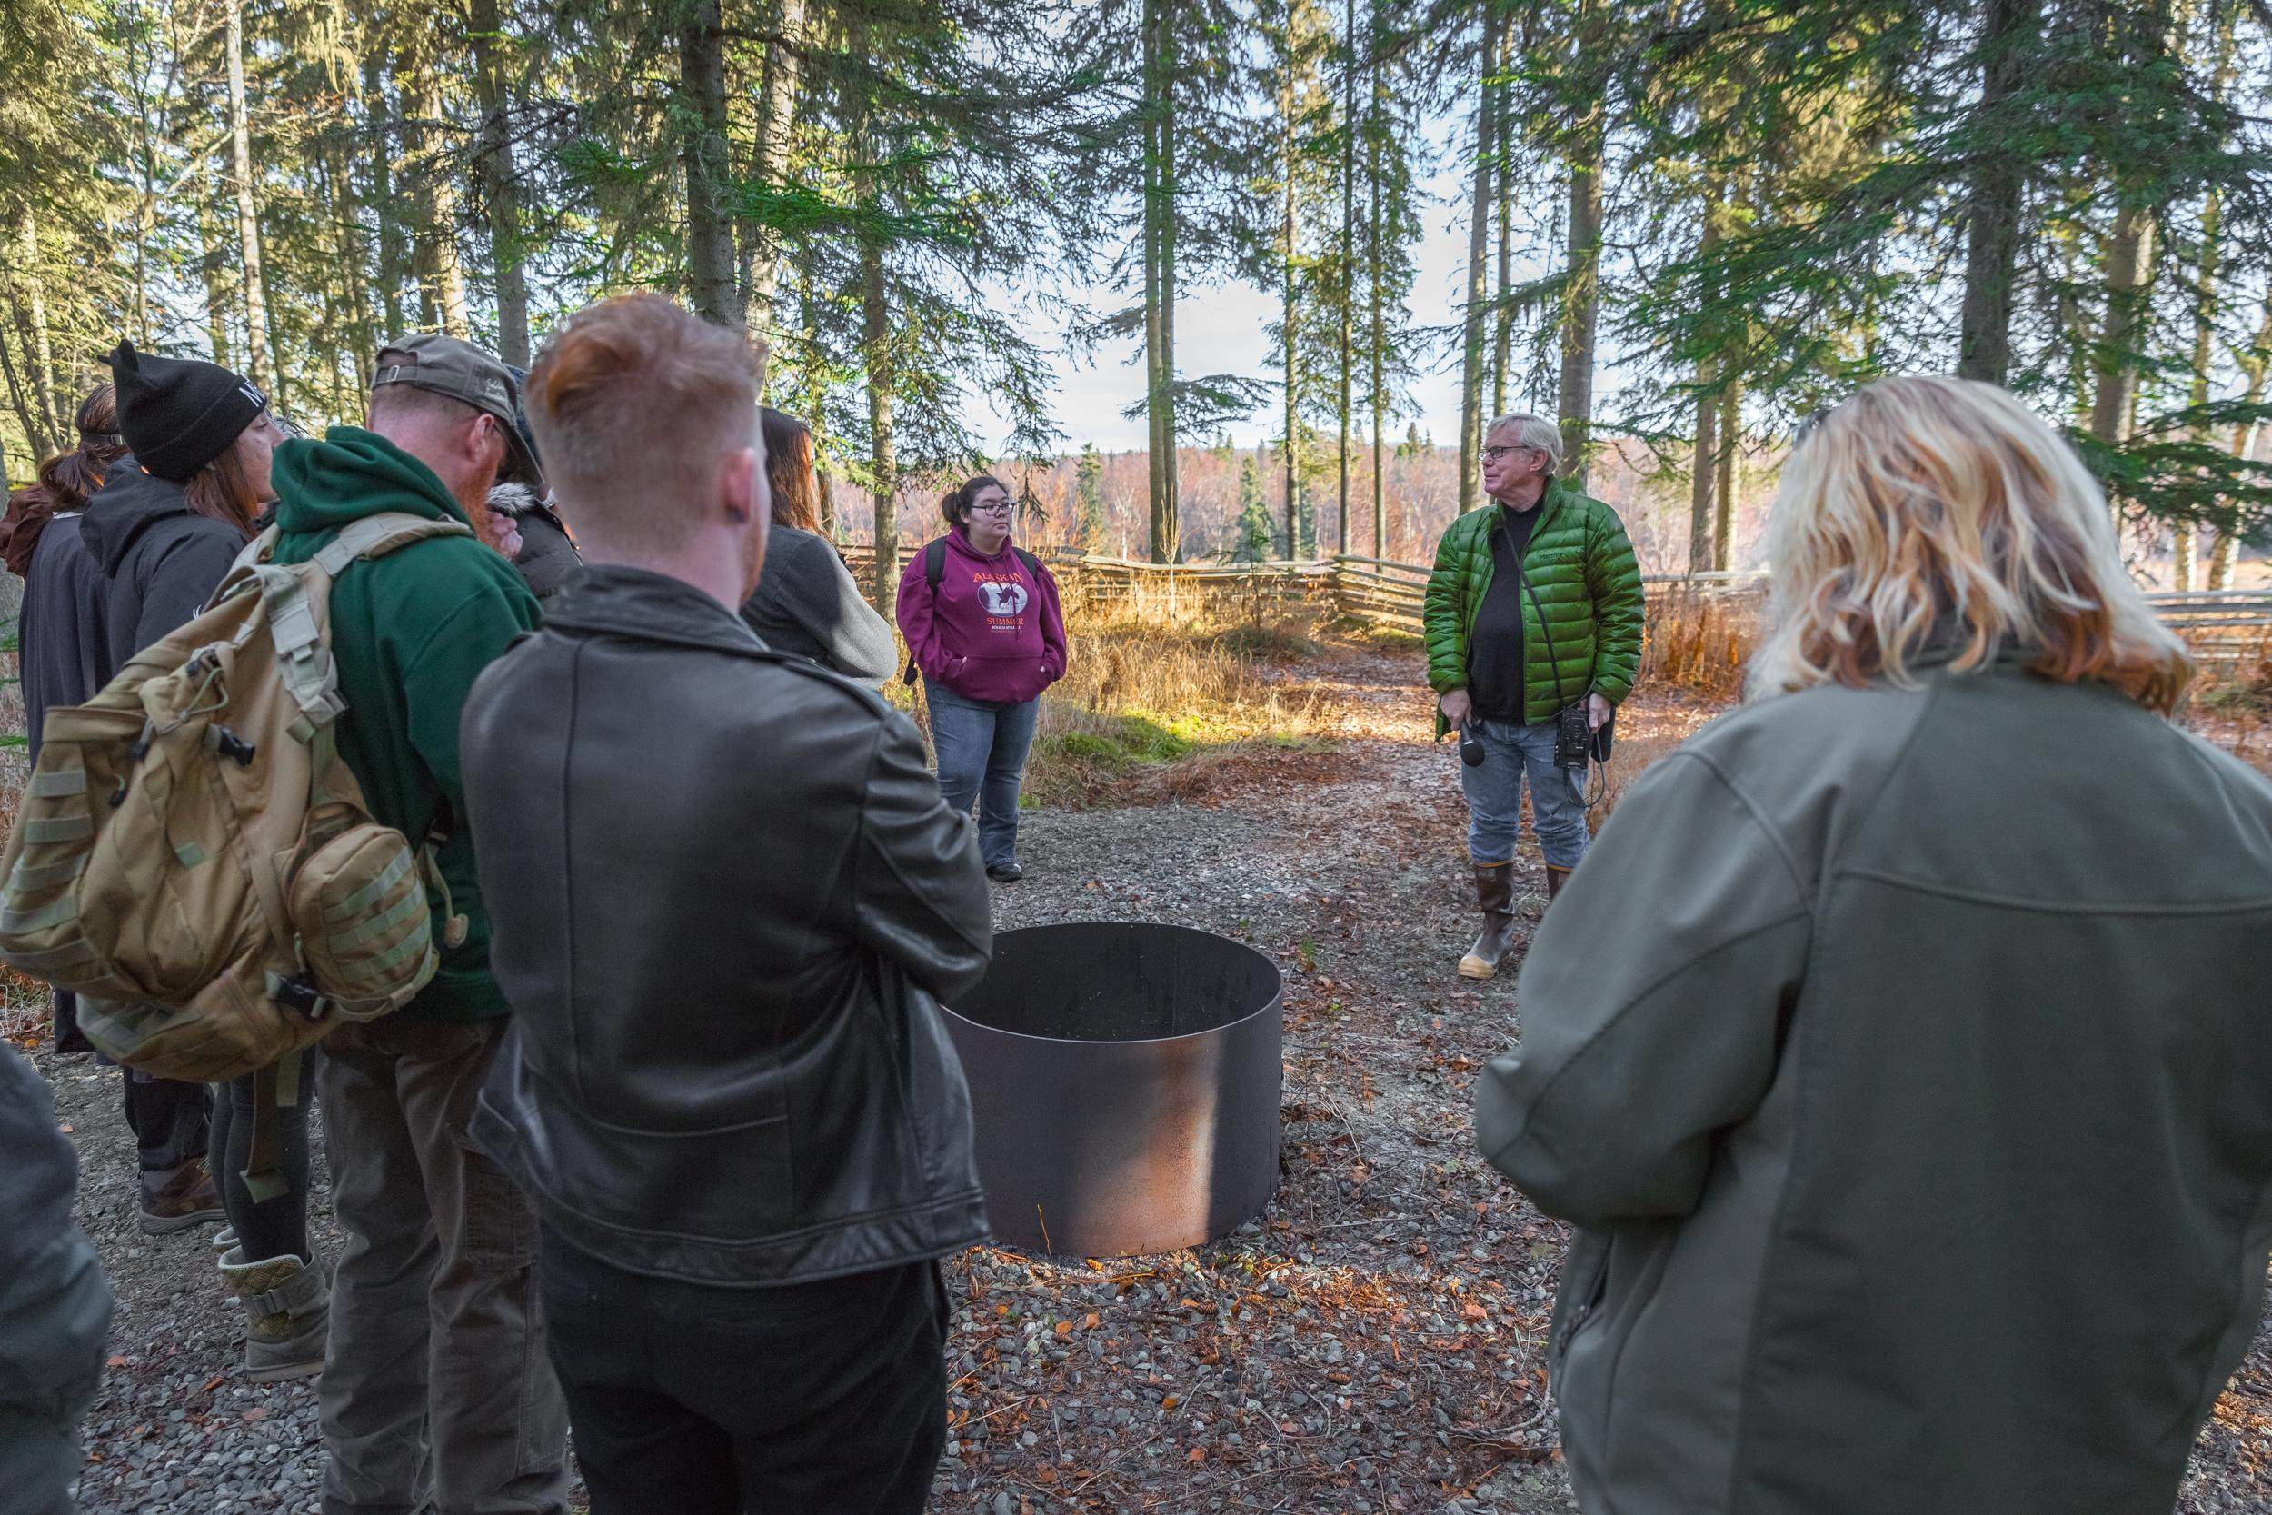
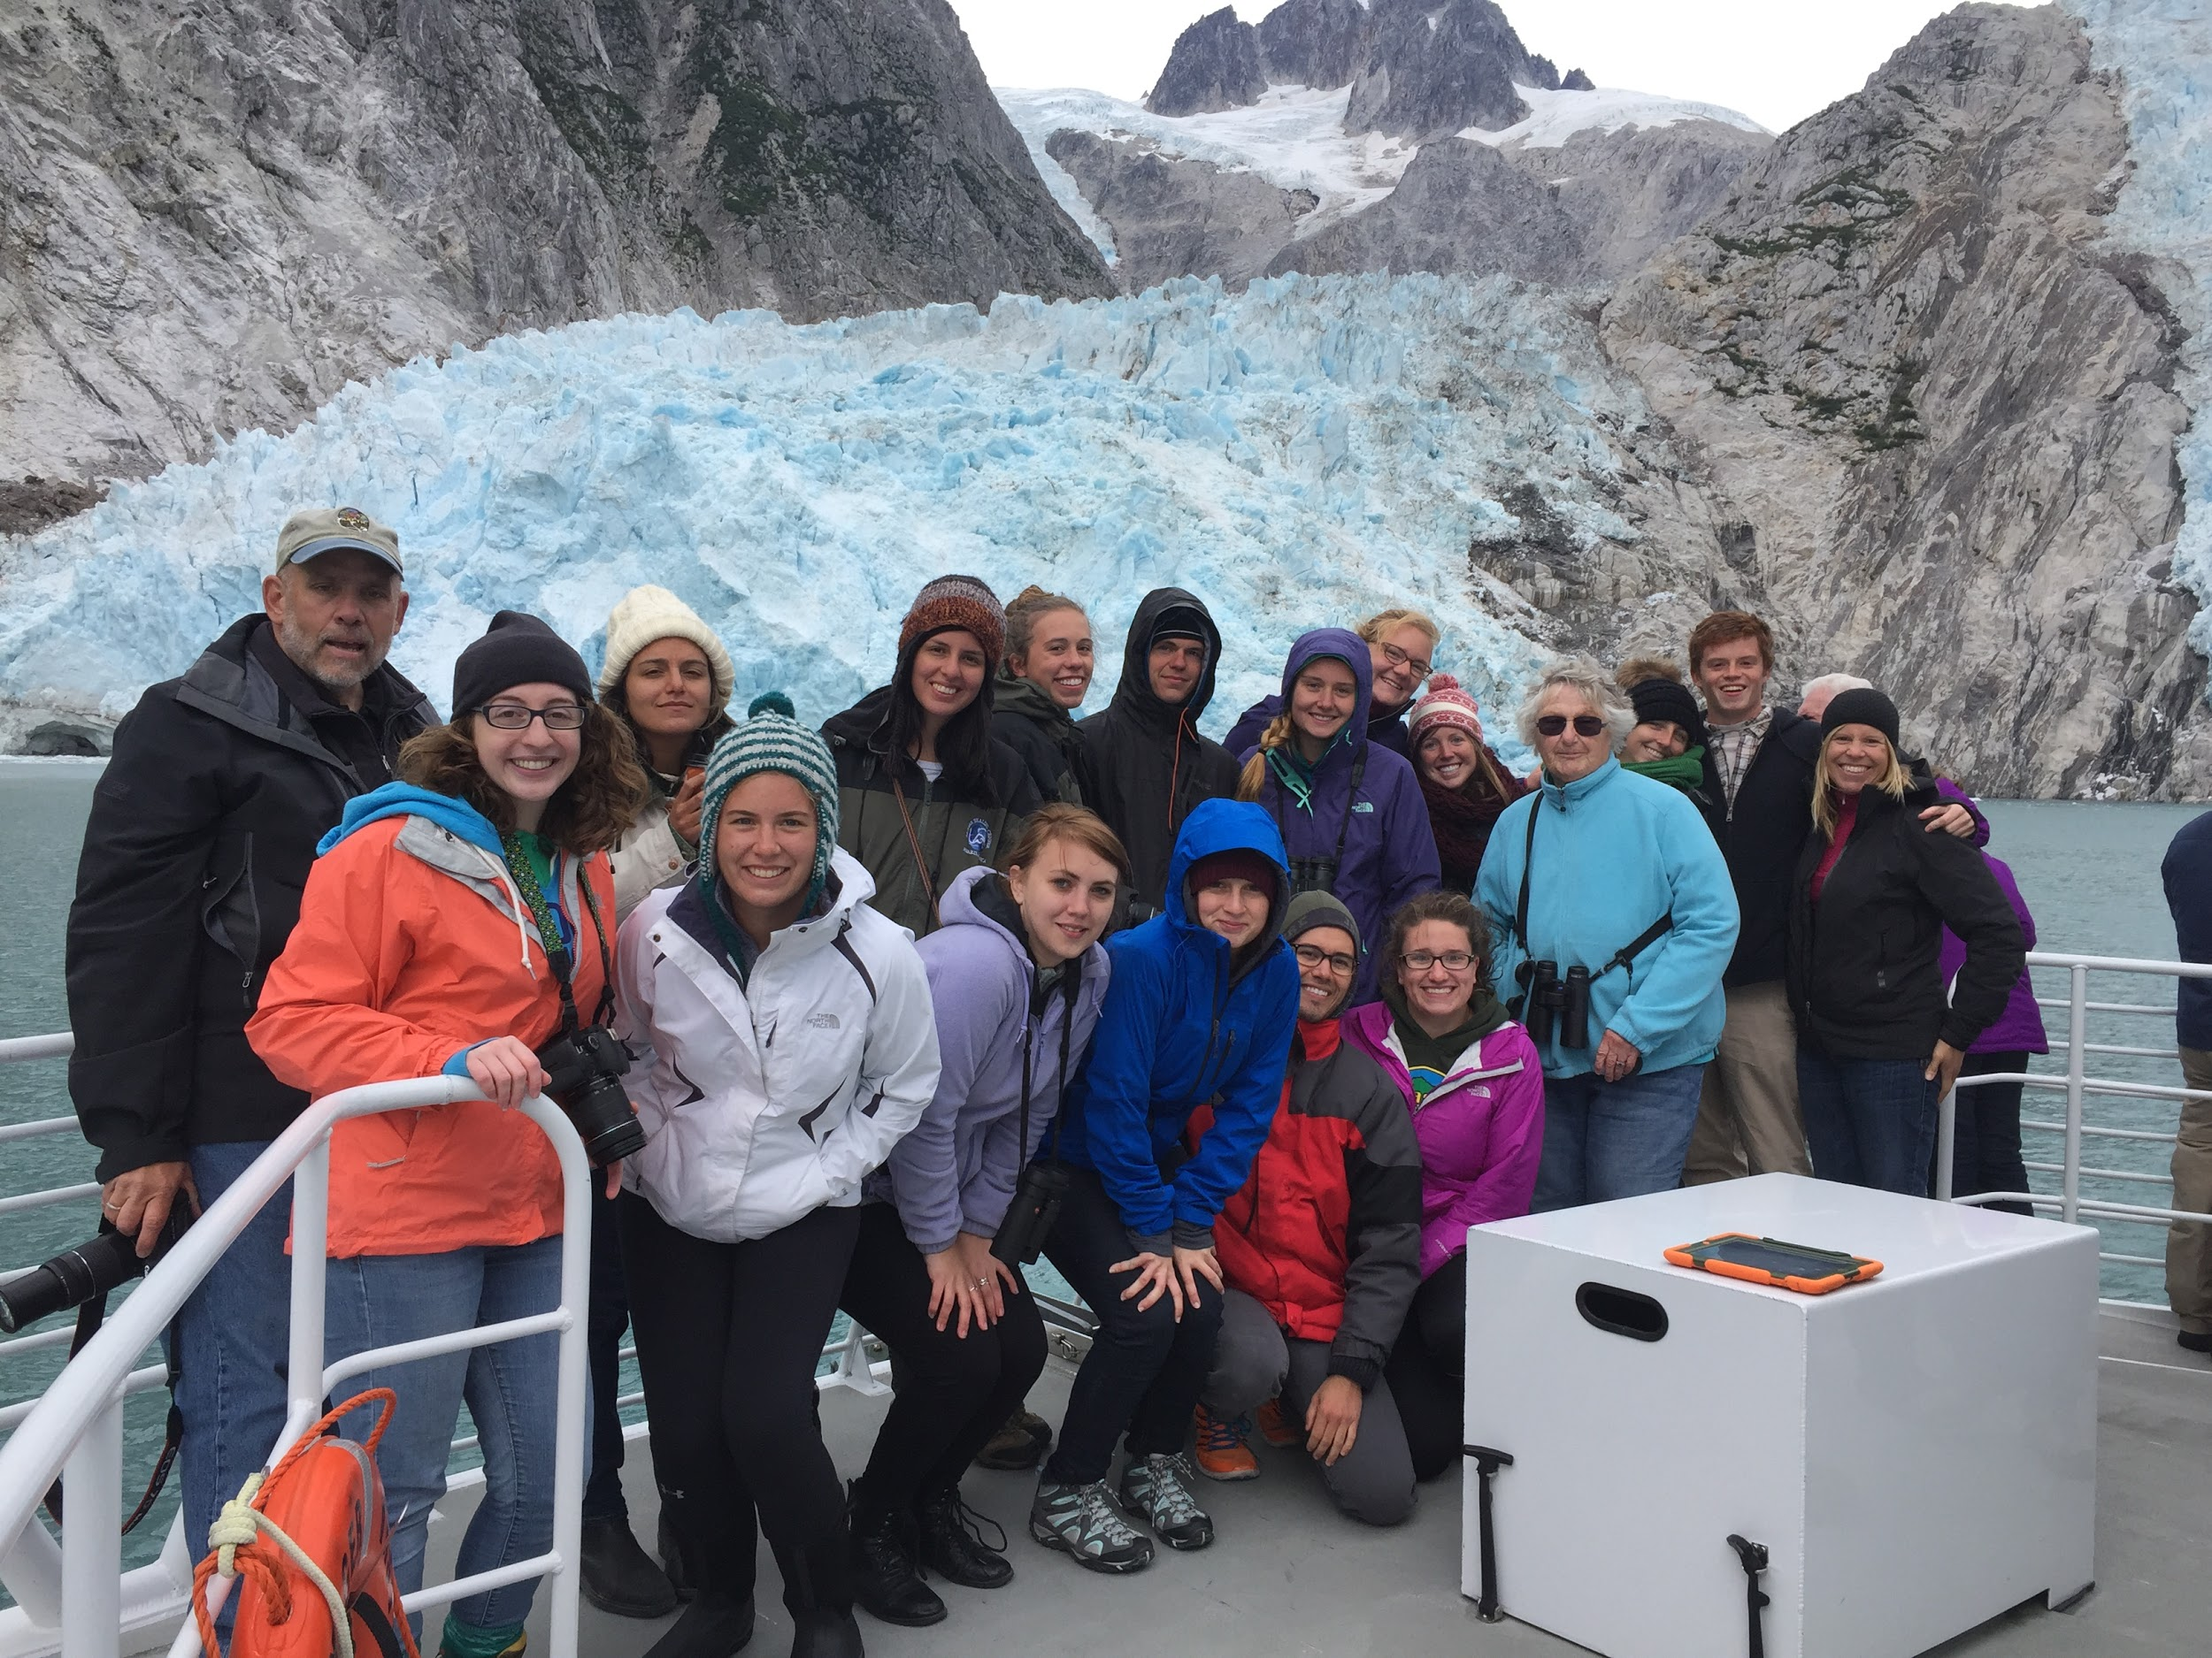
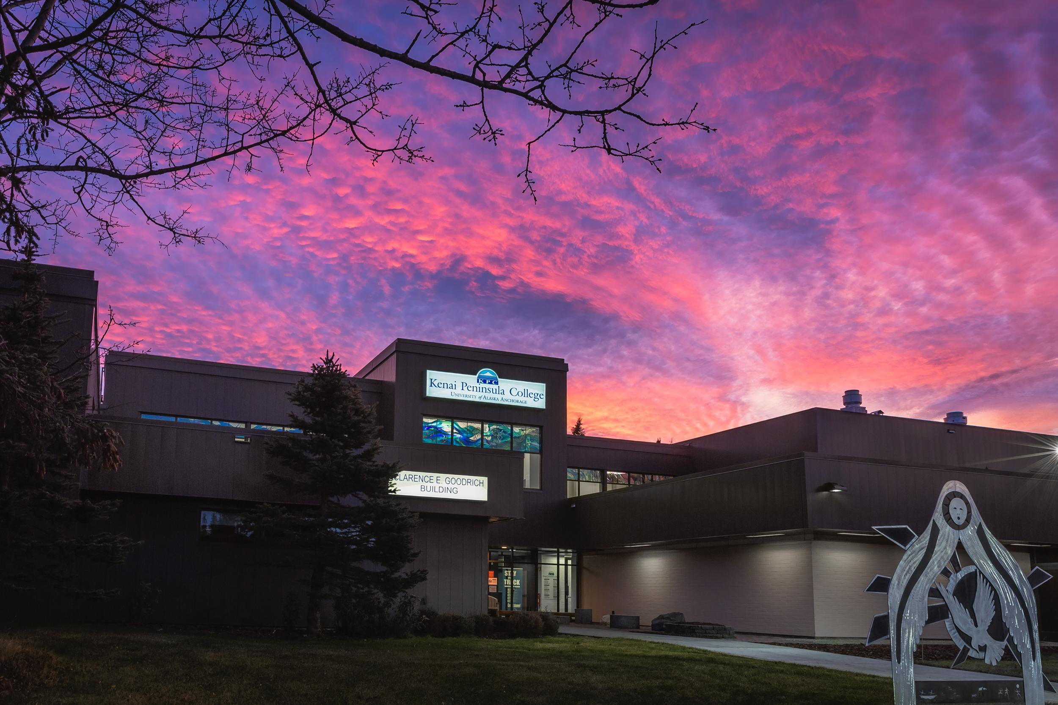
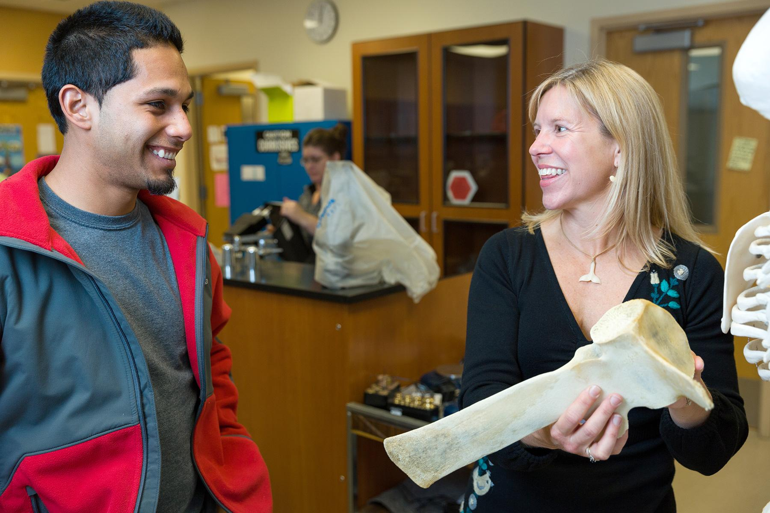
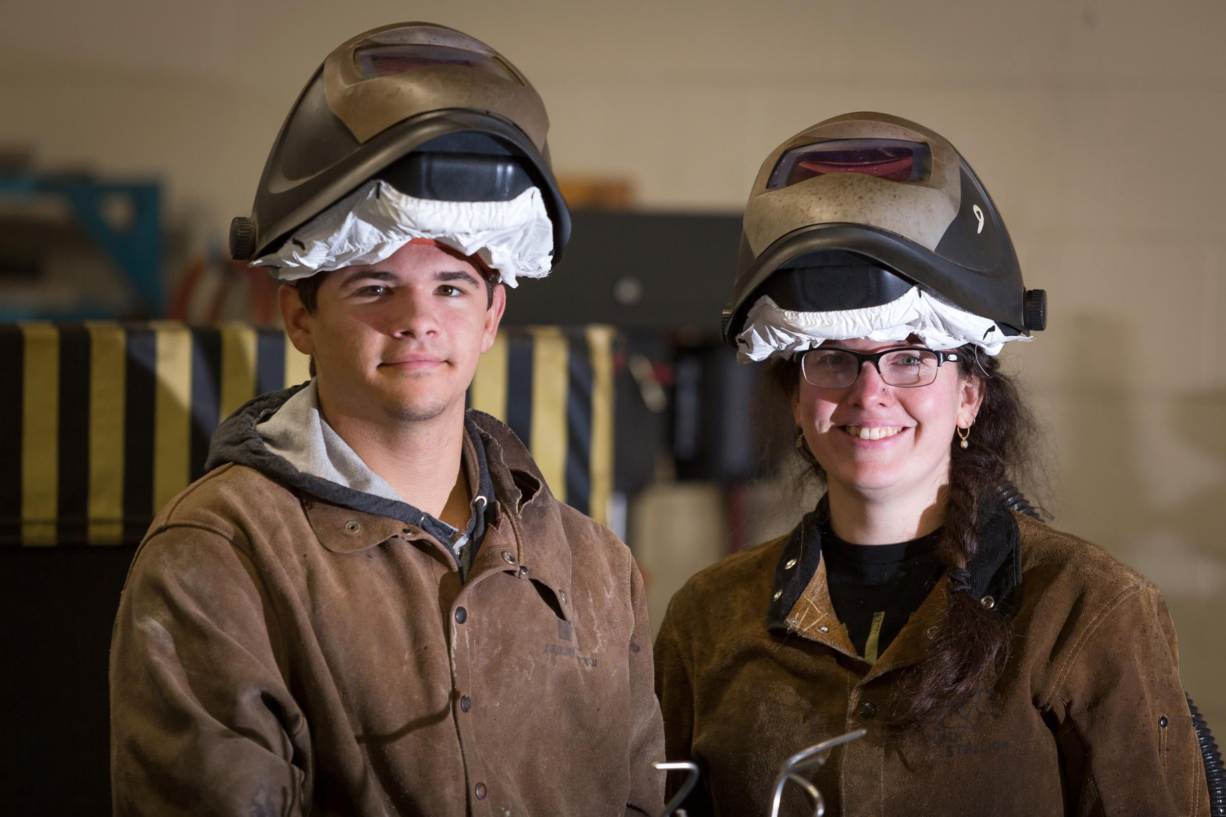
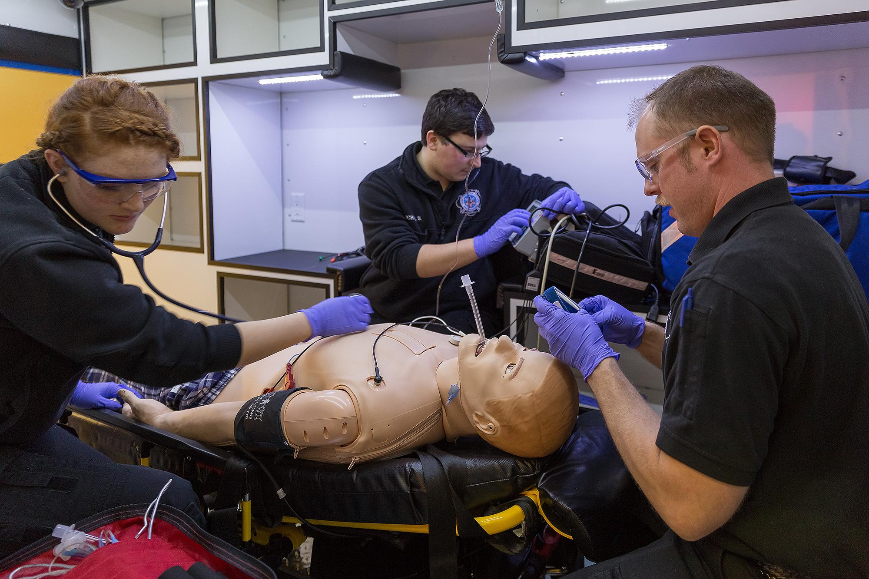
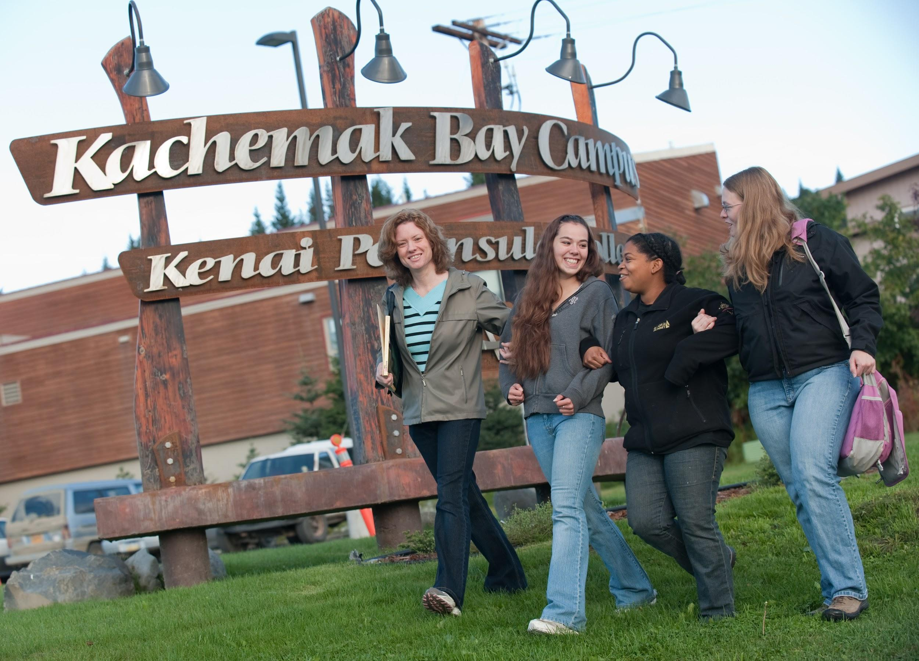
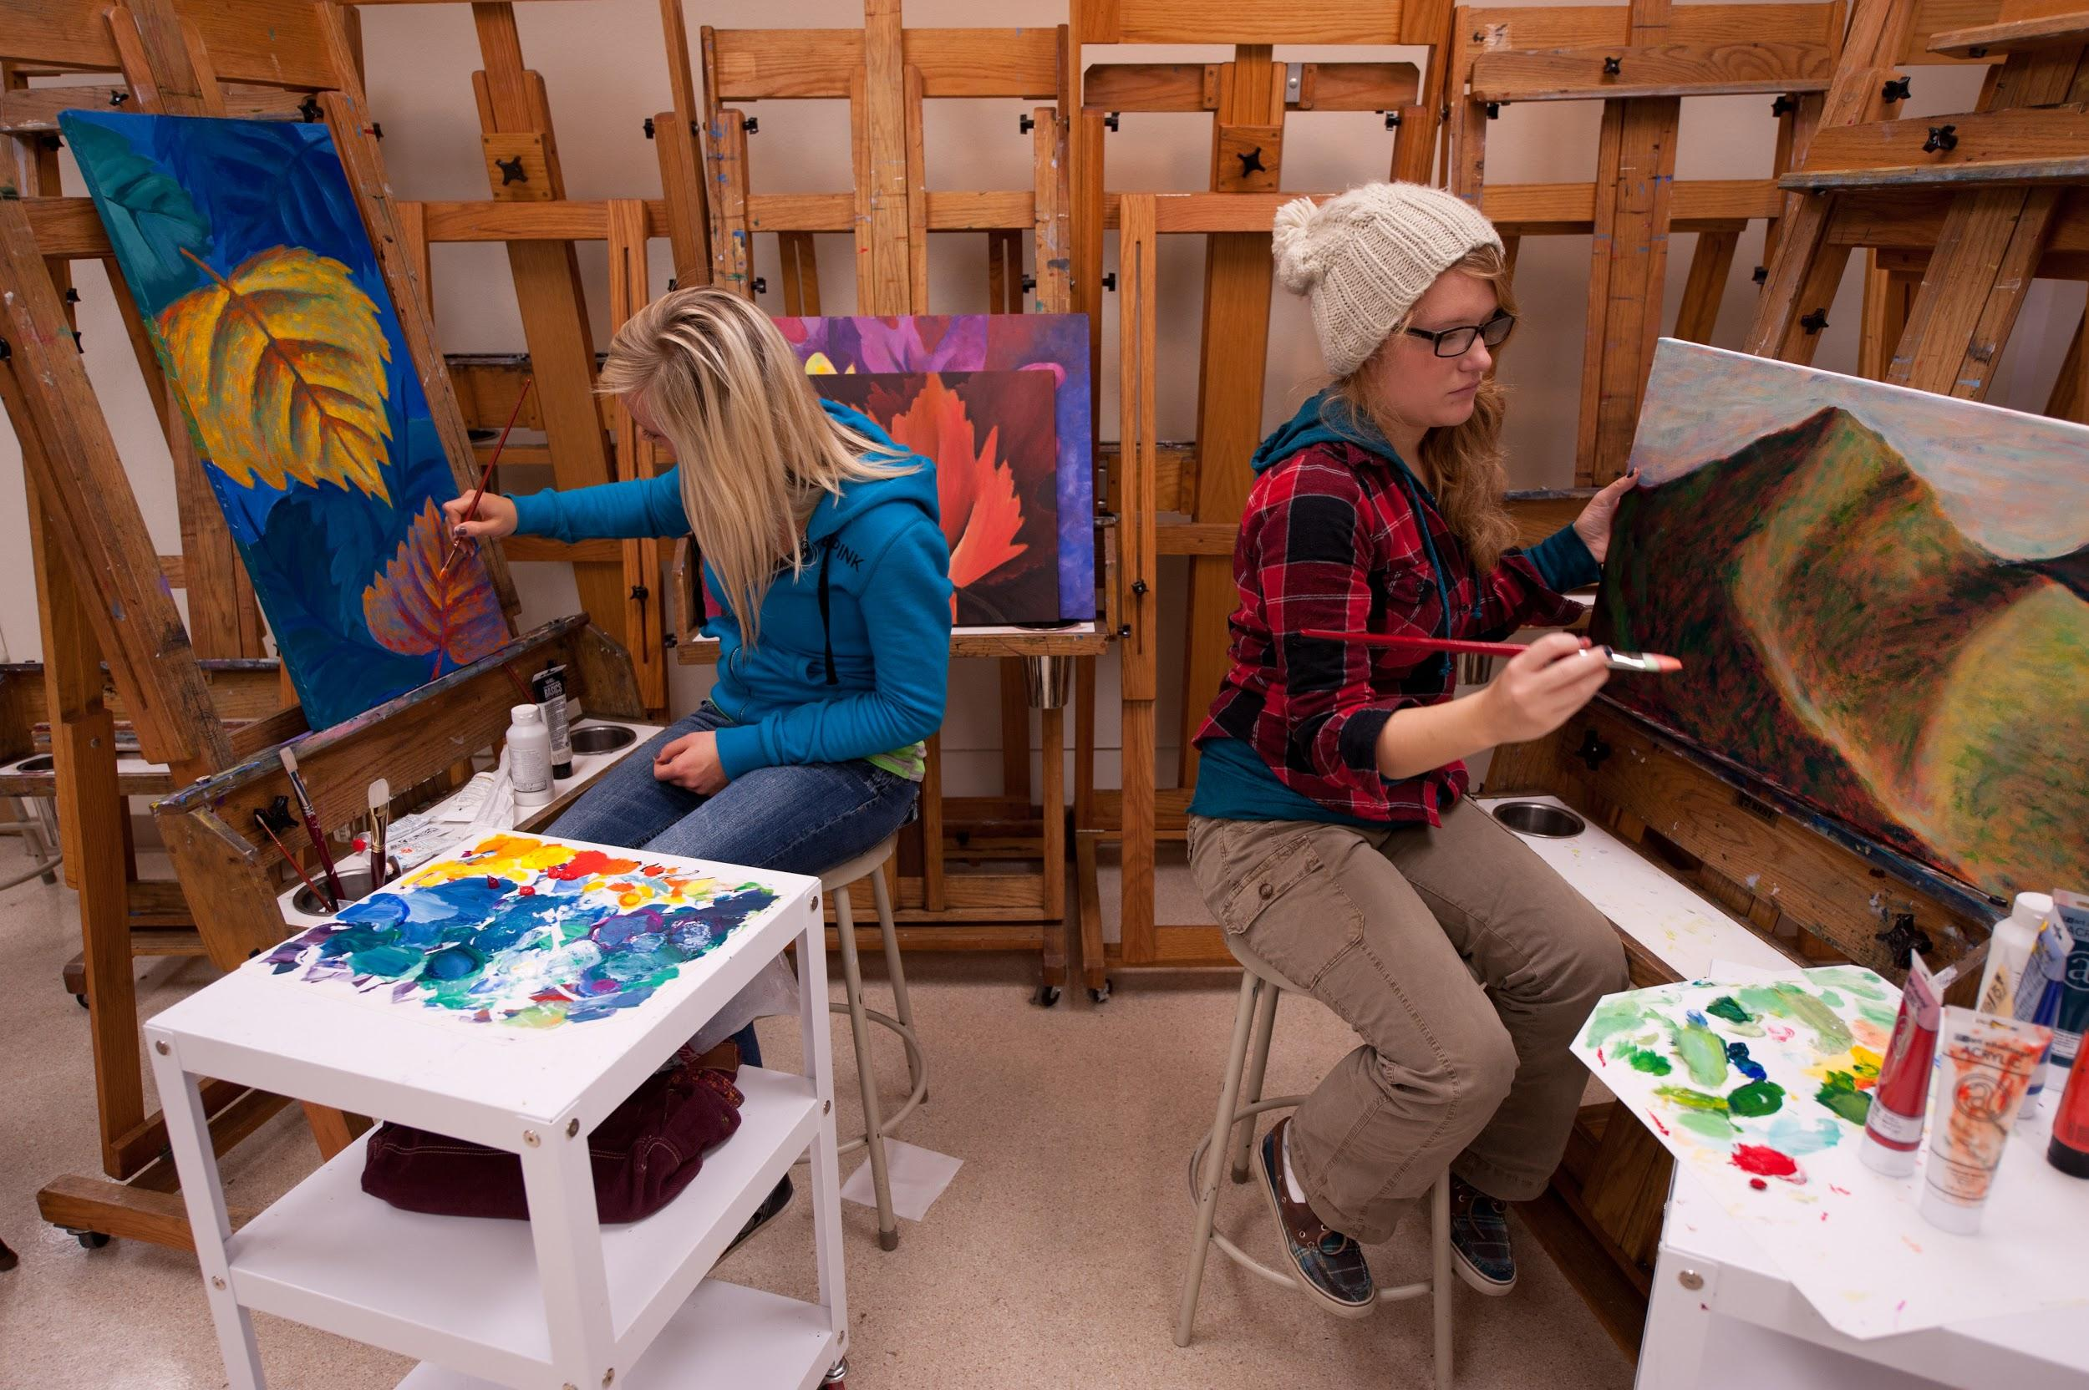
Kenai Peninsula College

Slide 4
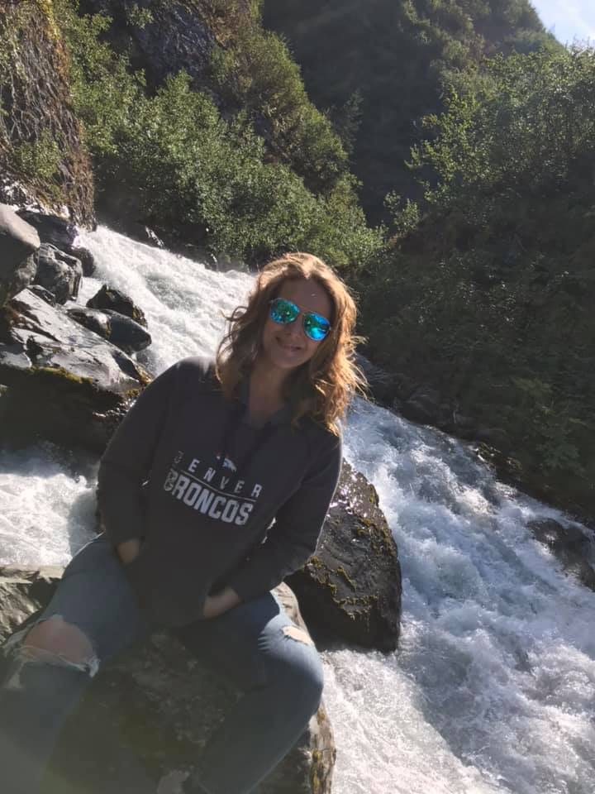
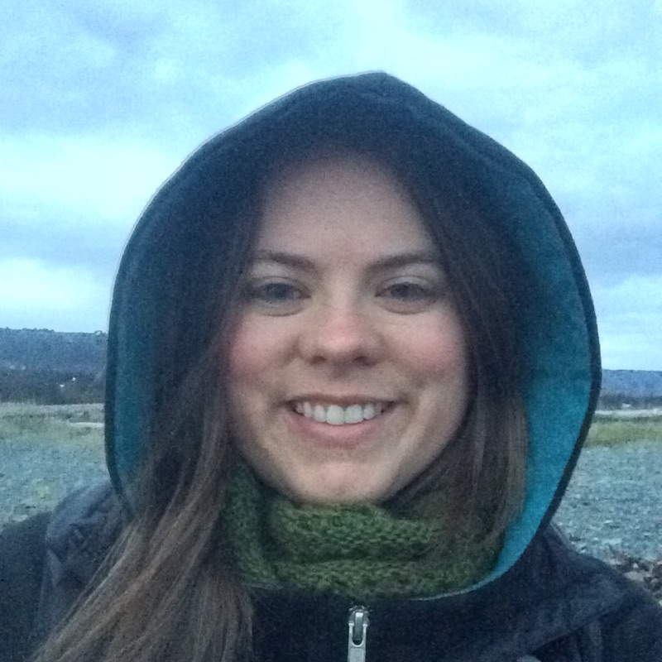
Introductions
Dr. Jennifer Pedersen
Alasha Brito
Notes:
WHO ARE YOU POLL
Culture vs legal compliance-we’ve emerged as leaders and have been invited to conduct trainings across campuses within the greater UA system.

Slide 5
The Journey Begins
Office of Civil Rights Complaint
Voluntary Resolution Agreement

Slide 6
From A to B
Where we were At
Don’t know what we don’t know
KPC Accessibility Committee
Departmental representation
Working groups
Reactive
Where we need to Be
Setting Precedence:
Different Role-Same Goal
ALL positions impact student success
Proactive

Slide 7
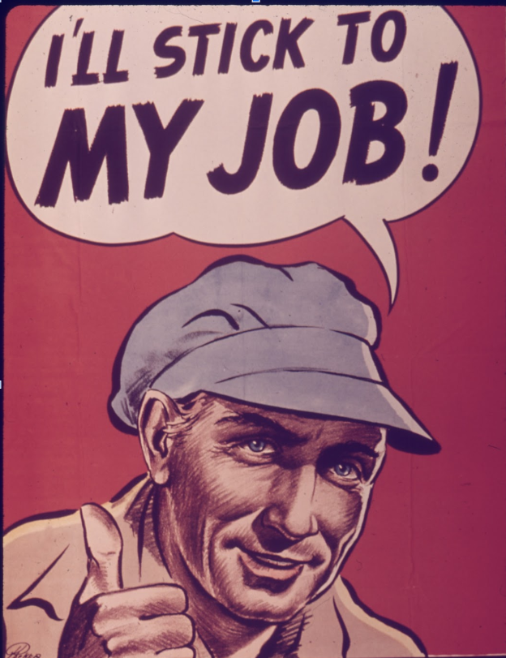
Cultural Change
“It’s not my job”
From Accommodations to Accessibility
Reactive-Proactive
Convocation
Let’s get personal

Slide 8
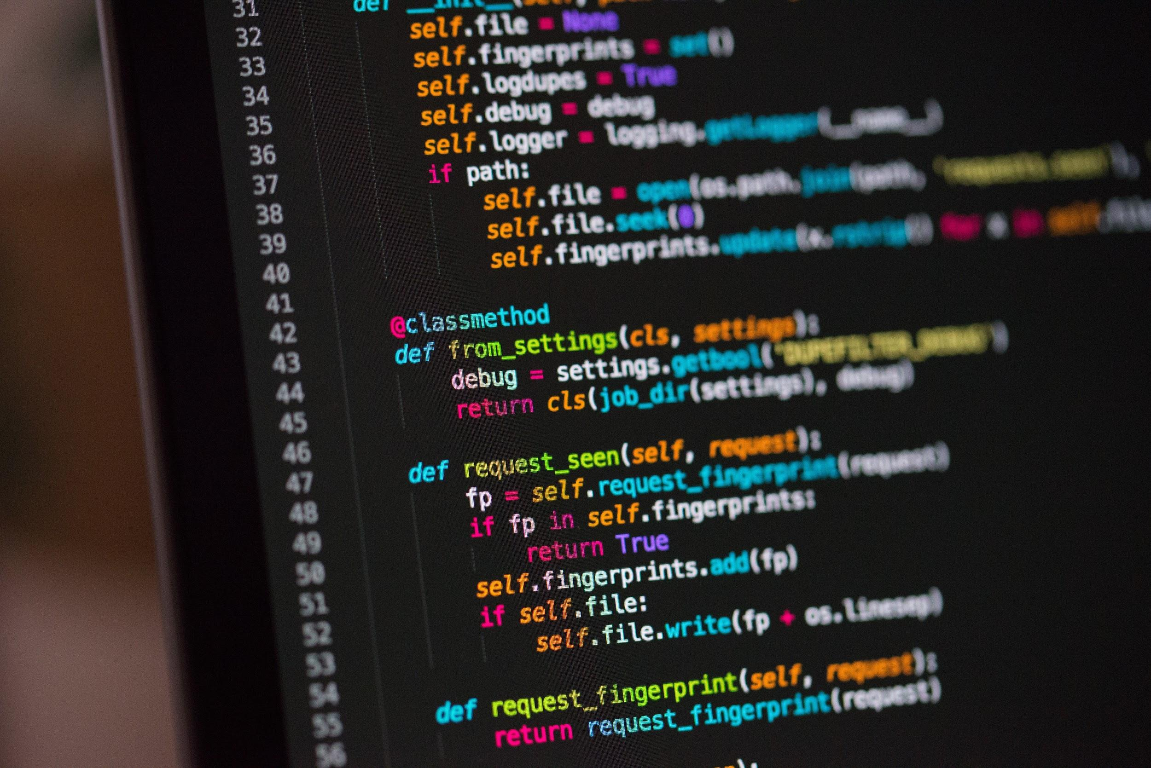
Digital Content [mostly done-image?]
NVDA
Texthelp
Read&Write
EquatIO
Acrobat ProDC
SiteImprove
Shared Drive
PDF forms-HTML
NextGen Web Solutions Dynamic Forms

Slide 9
Training
Month-Topic | # Workshops | # Participants
August-Word | 3 | 33
September-Captioning (Kaltura) | 1 | 4
October-Captioning (YouTube) | 2 | 7
November-PowerPoint | 1 | 4
December-Word | 2 | 6
January-Word | 5 | 27
February-PowerPoint | 2 | 20
March-Excel and PDF | 5 | 40
Barriers
Standards
Source Docs
Built-in Functions
Mouse vs Keyboard
Accessibility Check
PDF/UA
Checklists and Guides
Monthly Accessibility Workshops
Goal: 3x/month

Slide 10
Faculty Highlights
114 videos were processed through 3Play Media resulting in 26 hours and 12 minutes of synchronized closed captioning at 99% accuracy.
All of the lectures are accessible and uploaded into blackboard.
- C. Klamser
“All of my Calculus courses (Math A251, A252, A253, and A221) have been created as fully accessible courses. - C. Kochis
As I'm developing Math 151 in Blackboard, I make sure that all the documents that I post are accessible. - A. Veh
All syllabi are accessible for all my classes, all new content for Math 104 is accessible, and videos and PDFs are being remediated for Math 105. - T. Farrell

Slide 11
Future Steps
Annual Accessibility Awareness Day
New Course Development
Minimum accessibility requirements
Built-in checks
Continued Campus Wide Training
Universal Design
PDF refresher series
Accessibility workshops
Standards
PDF/UA
Accessibility training for website authors
Blackboard Ally
Online Accessibility Portal
Checklists
Guides
Videos

Slide 12
Thank You!
Questions?
Follow up at:
uaa.kpcaccessibility@alaska.edu

Slide 13
Resources We Found Useful
PDF Association
CAST
WebAIM
Accessible Templates for Microsoft Office
Adobe Blog
#a11y
#accessibility
Haben Girma TEDX
Haben Girma’s Website
Deque Webinars

