Slide 1
Document Accessibility, Avoiding Lawsuits and Future Proofing – Tools to be in Compliance
Accessible Document Solutions for the Future

Slide 2
What you will learn today
Lawsuits
What my organization needs to be aware of
What can we do
How to be proactive

Slide 3
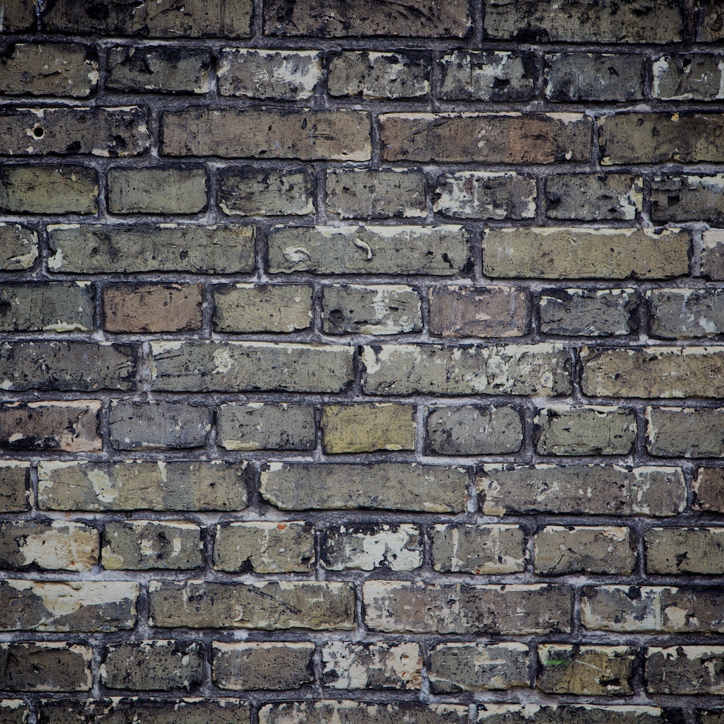
Barriers
Notes:
Paper is a barrier, Reading it to them
What are the formats? Don’t know how to respond to the situation
Client is now having to explain what they need and why

Slide 4
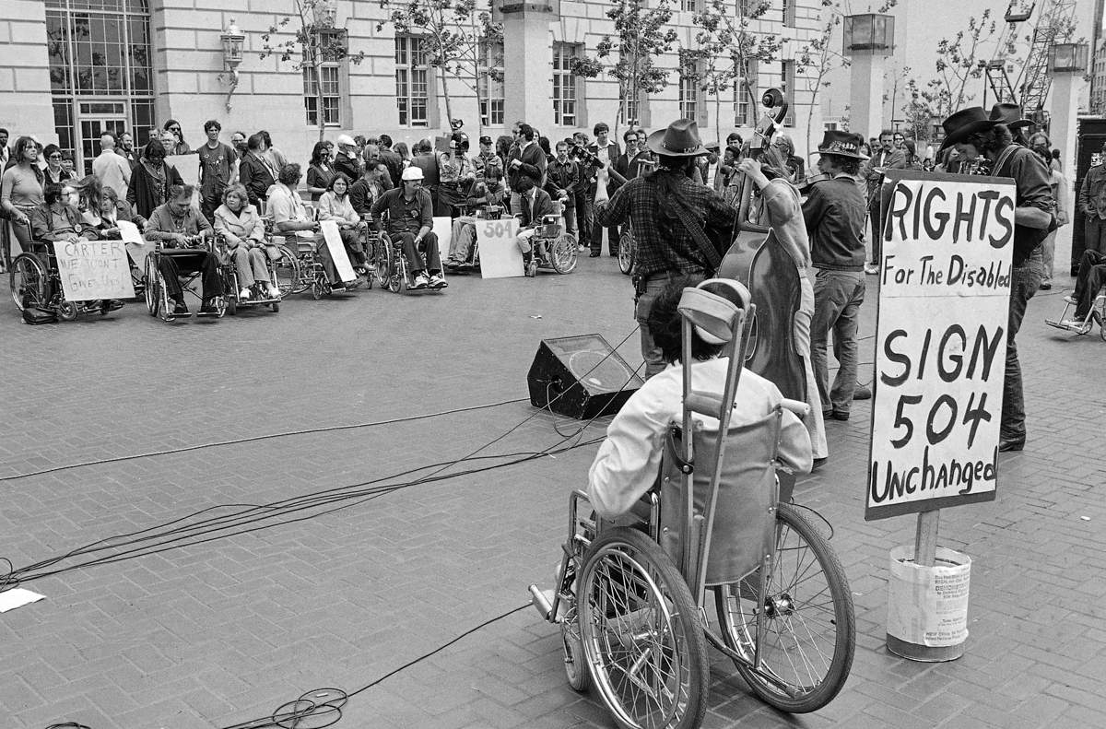

Slide 5
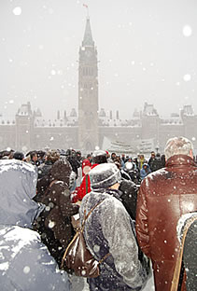
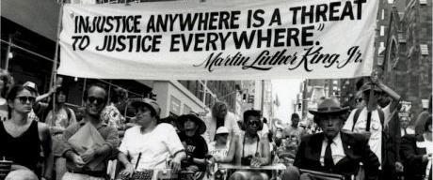
Disability Rights Activism

Slide 6
With the Recent String of Legal Activity
Demand Letters
Lawsuits
“Legal Extortion”

Slide 7
What is happening?
DOJ Lawsuits – (Federal Web)
2015 – 57 lawsuits
2018 - 814
2018 – 2258
2019 – already surpassed 2018 numbers -3400 expected
Most defendants are not winning
Tens of thousands of lawsuits outside of the DOJ
Over 10,000 on ADA title III alone in New York
17020 – 2020
13135 -2019
10136 2018

Slide 8
US Regulations
American Disabilities Act (ADA) - Anti-Discrimination Law – Title III/II
Section 508 RULE for doing business with the US GOV
Federal Employment (501/503)
Federally funded - 504
Affordable Heath Care Act (1557) Health IT
Food and Drug Safety Innovation Act (904)
Telecom Act Section 255
Air Carrier Access Act Airline accessibility DOT rule Title 14 CFR Par 32

Slide 9
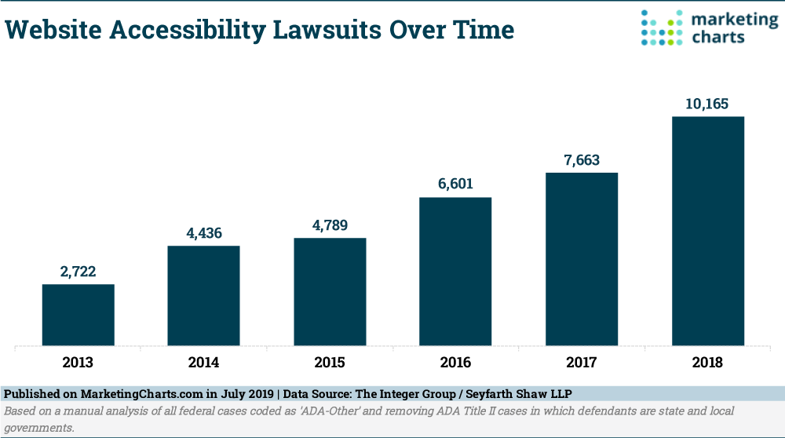

Slide 10
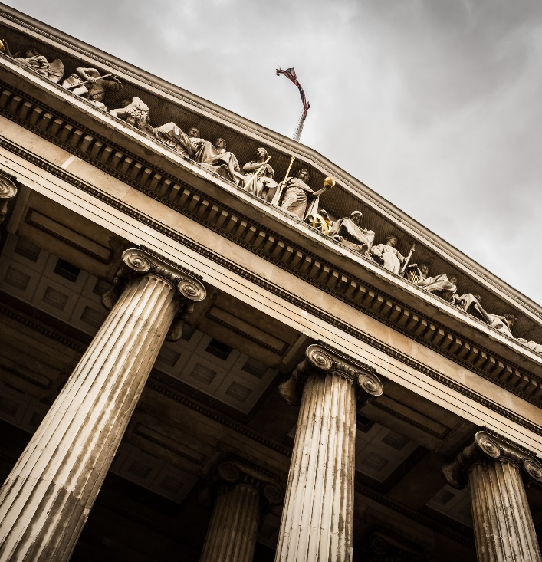
Legal Settlements / Fines - USA
Winn Dixie – over $250K plus legal fees
Verizon - $20 million
Amex – structured settlement
Wells Fargo - $16 million
Target - $6 million
Harvard / MIT – multiple rulings –
$2 million plus
Student Financing – All Student loans must provide
accessible documents
Elections
Hotels
Banks – NY Banks
Notes:
Photo by Sebastian Pichler on Unsplash

Slide 11
CRPD
UN Convention on the Rights of Persons with Disabilities
International law
Canada ratified in March 2010

Slide 12
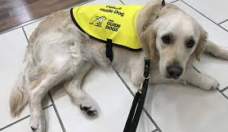
Canadian Regulations
Bill C-81 – Accessible Canada Act
AODA - Accessibilities for Ontarians with Disabilities
AMA - Accessibility for Manitobans Act
The Act – Nova Scotia
Canadian Human Rights Act 1977
Charter of Rights and Freedoms 1982
Omnibus C78

Slide 13
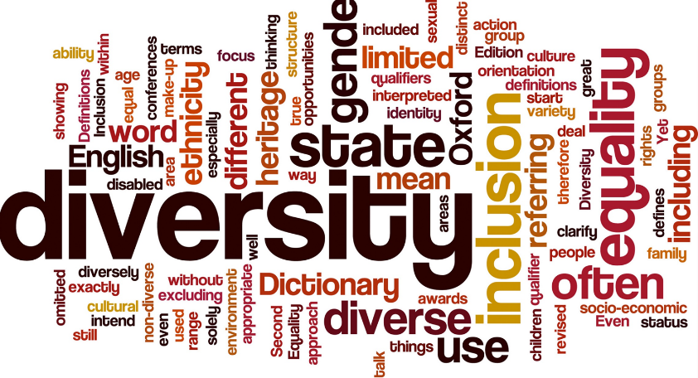
Accessibility Goals
Goals
Be in compliance with evolving regulations on delivering accessible documents to blind, partially sighted and cognitively disabled individuals
Meet the inclusive needs and requests of a large and growing population
Automate and scale the creation of accessible documents in all formats

Slide 14
State of Accessible Documents
My documents are not compliant
High volume documents cannot be done – too costly with current technology – we are manually remediating
I’m ignoring the issue
My documents are compliant – I’ve got a solution
Notes:
So where are your documents today? Do you produce high volume documents? Do you present on the web? Generally we can bucket everything into four buckets “I’m ignoring the issue”, “My documents are not compliant”, “High Volume documents cannot be done so we are remediating or accommodating”. “My documents are compliant and we have a solution”

Slide 15
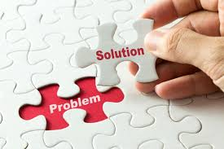
The Problem
Understanding Accessibility Laws and Gaps
Automation or manual effort
Scalability
Expertise
Cost-effectiveness
Security
Lawsuits have timelines

Slide 16
Accessibility Spectrum
Accessibility Compliance: Making Content Accessible to All
Full Self-Sufficiency – Must Do Everything In-House
Will Pick & Choose Based Upon In-House Skills and Available Offerings
Prefer to Outsource as Much as Possible
Where do you fit along this Spectrum?

Slide 17
The Challenge
Making content, educational content, published content, personal and confidential information accessible quickly and easily
Don’t forget your internal HR employees
Providing anyone the ability to make content accessible
Training
Automating
QA & QC
Minimum compliance WCAG 2.0,
WCAG 2.1 soon – lawsuits have started already

Slide 18
Plan
Create a Culture of Inclusion (Accessibility)
Inclusion by design
10X the cost to retrofit – based on dev system background
Build everything with accessibility in mind – good for all
Consider automatic opening doors
Curb ramps
Budget for accessibility

Slide 19
Things to do
Training – train users on remediation and tagging in common office tools. Understand testing
Remediation for back log – set up a plan
Web monitoring – on-going audits
Document Monitoring - on-going audits
High volume correspondence - plan
Preference Management – Alternate formats – braille, large print
QA & QC
Break problem into buckets that technology can address

Slide 20
Use Technology: Get to 100%
Fix Documents at Source?
Yes
Done!
No
Apply Automation “Templates”?
Auto Tagging AI
Desktop Remediation
No
No

Slide 21
Technology
Computer based tagging tools
Heuristic Algorithms
Understanding of PDF / document “guts”
Font exposure
Document structure and positioning
Understanding Print Description Languages

Slide 22
Technology to Human Comparison
Auto Tagging with Post Remediation
Desktop Remediation
Speed
Cheap Labor
Manual Remediation
Cost

Slide 23
Accuracy vs Time
Auto Tagging with Post QA
Manual Remediation
Accuracy
Auto Tagging
Template Tagging
Desk top Auto Tagging
Time

Slide 24
Results
Depending on document quality – Average 30-90% time savings
100’s to 1000’s PDFs per second

Slide 25
Common Issues

Slide 26
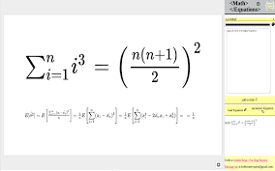
Mathematical / Symbology

Slide 27
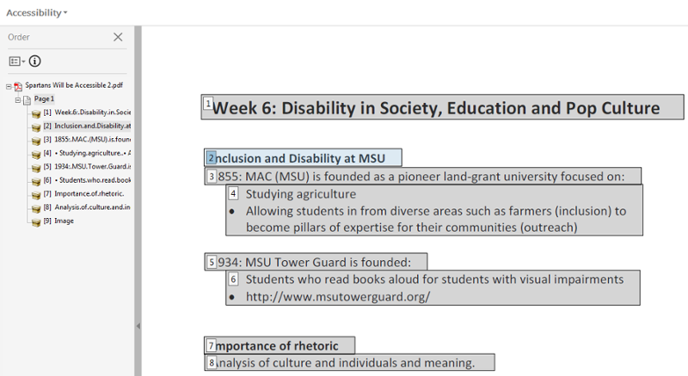
Read Order

Slide 28
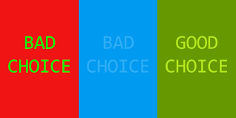
Contrast

Slide 29
Scanned Text

Slide 30
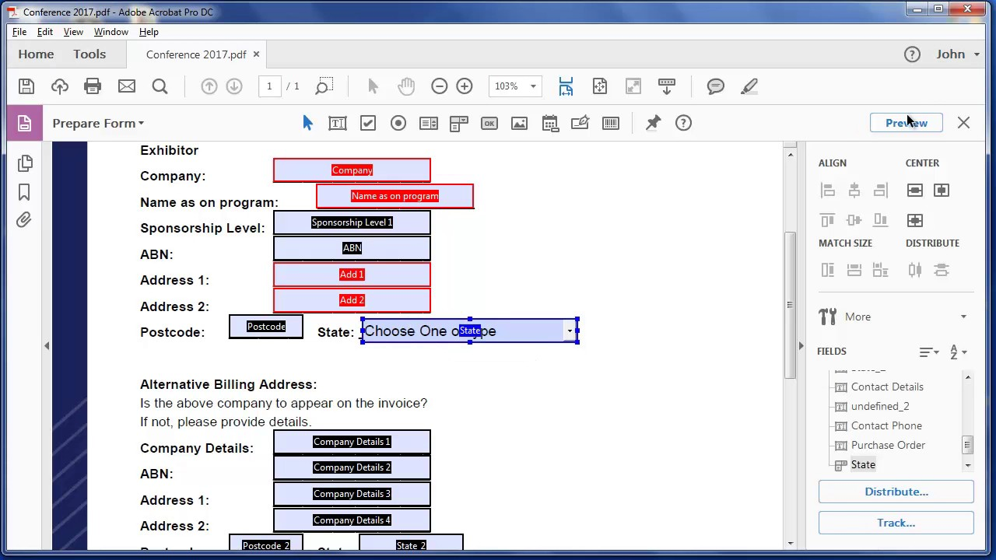
Fillable Forms
Hours of remediation
Very expensive

Slide 31
Tagging documents for accessibility
Graphical user interface
Simplifies setup and configuration with no need for developer resources

Slide 32
Results
Remediation in seconds
100’s to 1000’s PDFs per second
On-the-fly remediation for ePresentment

Slide 33
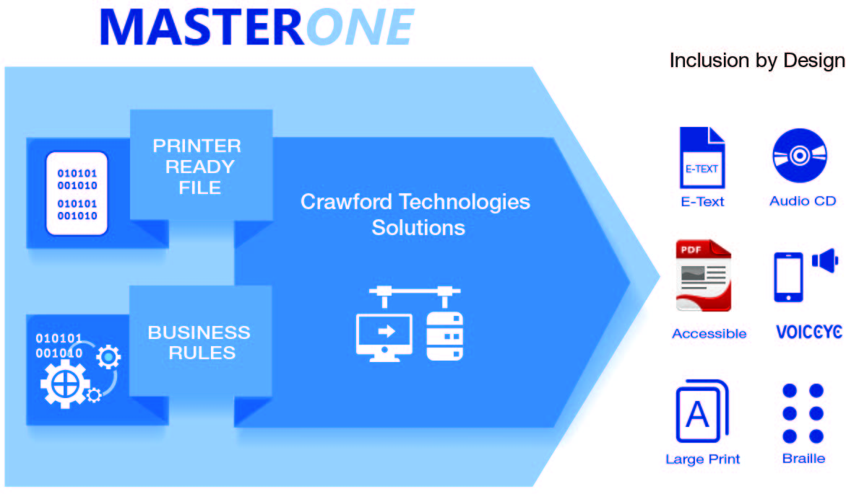
MasterOne Architecture Diagram
Notes:
MasterOne Architecture diagram

Slide 34
Testing – Quality Assurance / Control
Make sure you test your documents/web to be accessible
Conduent is under a huge lawsuit for making The State of California Parks reservation system. Whistle blowers determined that the website was not accessible despite claims for full accessibility.
Don’t leave accessibility testing to the end
Assistive technology
Electronic testing – PAC 3.0, Adobe Acrobat PRO
Physical user testing – using Assistive Technologies
USEABILITY VS ACCESSIBILITY

Slide 35
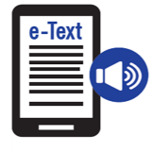
Achieve Accessibility Goals
Comply with global regulations
Mitigate risk
Mitigate cost
Support all formats
Meet customers’ A11y needs
>1 billion people
Right format, channel
Improve CX
Timely and relevant
Automated
On demand
Transactional
Published/Static

Slide 36
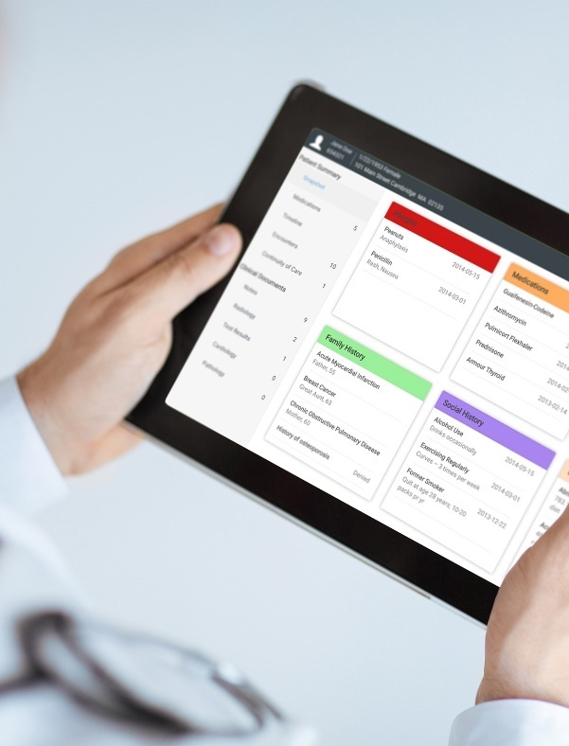
Crawford Technologies
CrawfordTech is a global software company focused on helping enterprises output, digitize and deliver customer communications
Our portfolio and know-how span the intersection of digital output, content management and analytics applications
“The work behind the workflow”
Accessibility
Content Services
Enterprise Output
Software and services provider for accessibility strategies and solutions
Optimizing content distribution strategy and
delivering high-value customer communication archive solutions
Transforming and optimizing workflows for all output processes

Slide 37
Questions?

Slide 38
Learn More
Find us on Facebook, LinkedIn, Twitter and Google+ Visit: www.crawfordtech.com or e-mail: dkoppenhofer@crawfordtech.com
Phone: 630-518-1397

