Slide 1
Add Accessibility to Your Process the Easy-ish Way
James Green
Sr. Director, Visa Accessibility & UX Research
SXSW 2019
March 13, 2019 | Austin, TX

Slide 2

Let’s hear about you.
How familiar is everyone with web accessibility?
What types of roles are in the room?
How many of you already do accessibility or plan to soon?

Slide 3



And a little about me.
Sr. Director, Global Product Design
Visa
Global Accessibility
UX Strategy & User Research
Member, Board of Directors
Knowbility
Board Development Lead
Chair starting January 1, 2020
James Green
Jgreen@visa.com
@thatJamesGreen

Slide 4
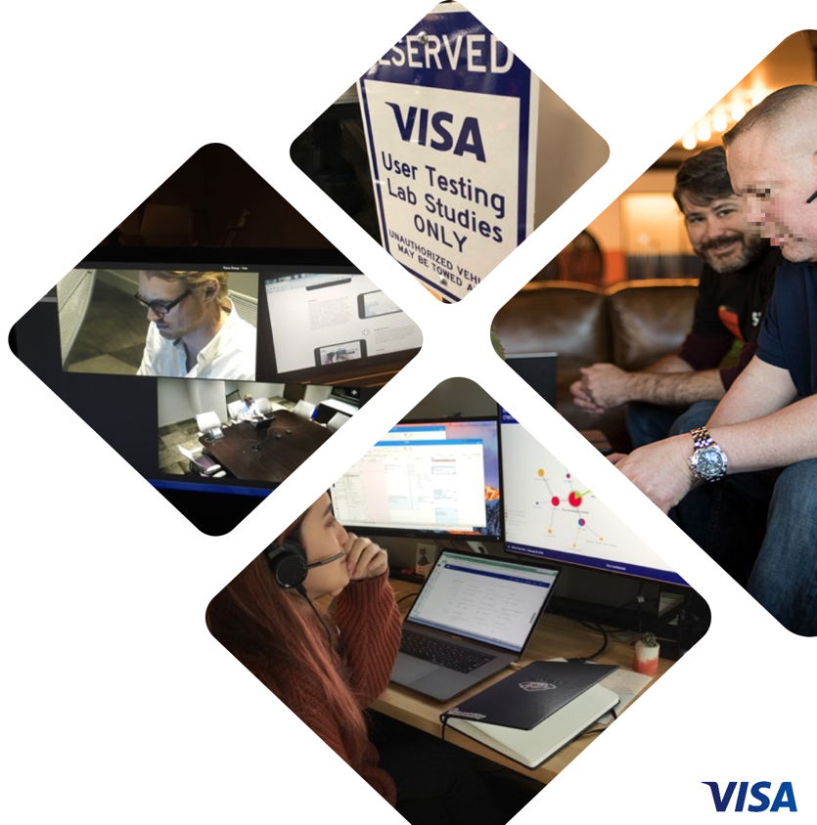
Visa’s Global Design Research Team
Visa has a user testing lab in Austin, TX
1500 sq. ft. 3 Rooms. Rallying point for shifting culture to a user-centric and data-driven mindset.
Growing UX Research Capability
Research capability staffed by a team of nearly 20 professional researchers, working on projects globally.
All kinds of Research for Visa & Partners
Services Include Lab testing, RITE, remote, contextual inquiry, focus groups and workshops, surveys, journey mapping, information architecture, card sorts, tree testing, analytics, & interaction design.

Slide 5
Visa’s Global Accessibility Team
The Visa Accessibility team brings world class knowledge and tools together with support from deep subject matter experts to meet the needs of our staff and stakeholders. They also recommend policy, monitor compliance, and drive growth in Visa’s capabilities.
Knowledge
Support
Governance
Requirements
Tools
Training
New Guidance
Subject Matter Expertise
Testing
Consulting
Program Strategy
Policy
Metrics
Monitoring
Corporate Strategy

Slide 6

What you’re going home with today.
Basics of Accessibility & Who it Helps
An understanding of Assistive Technology
Four reasons to do Accessibility
Basics of the W3C’s WCAG
Why there’s a problem with adoption of WCAG
What Visa did about it
How to evaluate your product or team
How to understand and influence YOUR users
How to get good help and learn more
A start to custom requirements and tests
Heaping platefuls of tips, best practices, and inspiration

Slide 7

What is Accessibility?

Slide 8
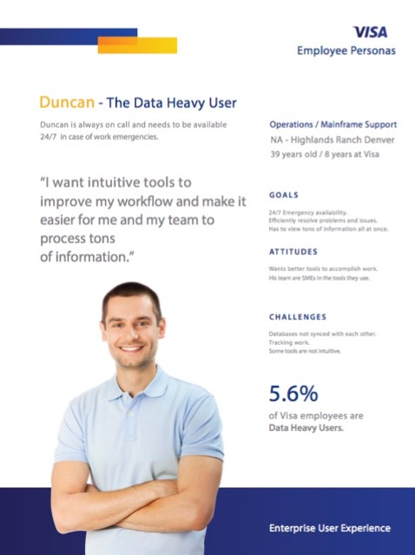
Let’s start with Usability.
Reduce effort for users…
  visual
  mental
  motor
  memory
To make a user interface more…
  efficient
  learnable
  easy
  pleasant
Personas help you understand your users, so you can design for them.

Slide 9
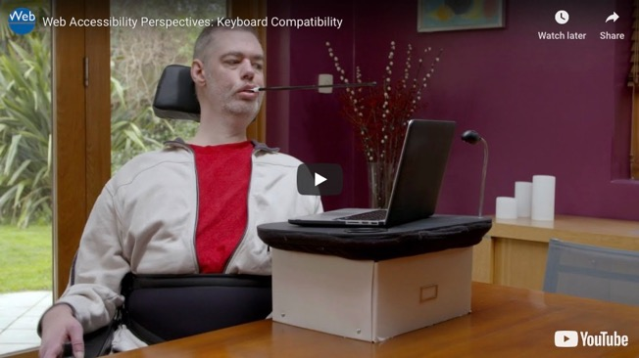
Accessibility is Usability (with more diverse personas).
Reduces effort for users with potentially significant challenges.
Personas help you understand your users with disabilities, because you probably don’t.
Usability often makes things easier, Accessibility often makes things possible.
Design considerations and coding techniques make products inclusive.
Accessibility is often abbreviated A11y because there are eleven letters between the A and Y.
  A C C E S S I B I L I T Y
11 letters
https://www.w3.org/WAI/perspective-videos/keyboard/
Notes:
Usability is the science and art of reducing visual, mental, motor, and memory load on users.
Accessibility is Usability, with a focus on users with disabilities.
Accessibility (abbreviated a11y) simply adds Personas to our list.
The implementation is sometimes different, but the idea is the same: Understand your users, and design for them.
While Usability is often focused on making things easier, Accessibility is often focused on making things possible.

Slide 10
Who does accessibility help?
And how does it work?

Slide 11
Accessibility helps with many user challenges.
Vision
Blindness
Color Blindness
Low Vision
Screen glare / sunlight
Shattered Screen
Cognitive / Neurological
Limited Attention
Memory Loss
Comprehension / Language
Epilepsy
Cognitive Overload
Distracting Environment
When we design accessible products we improve the experience for everyone.
Physical
Limited Mobility
Slow Movement
Limited Dexterity
No mouse
One Handed Mobile Use
Wearing Gloves
Hearing
Deafness
Hearing Loss
Noisy Environments
Audio Muted Situations

Slide 12
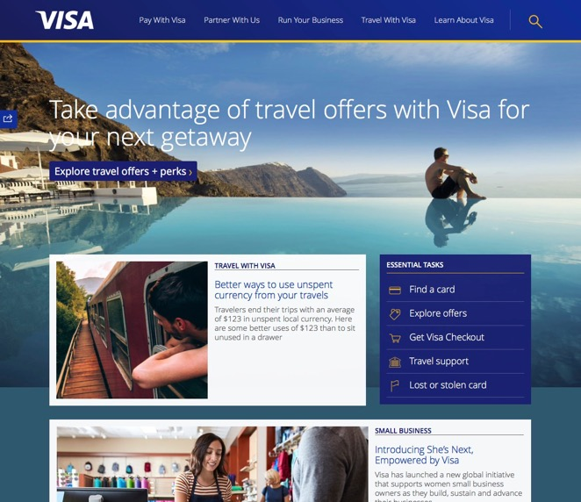
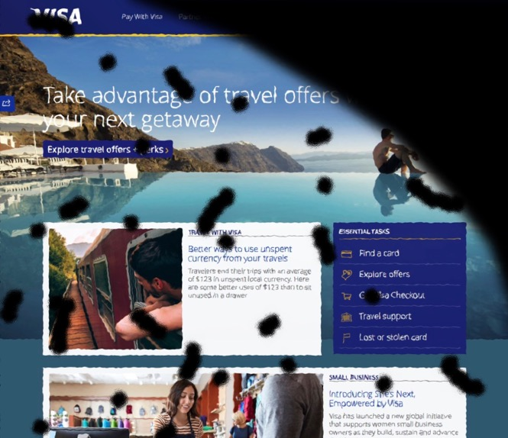
Temporary disabilities can occur at any time.
Clear Vision
Detached Retina

Slide 13
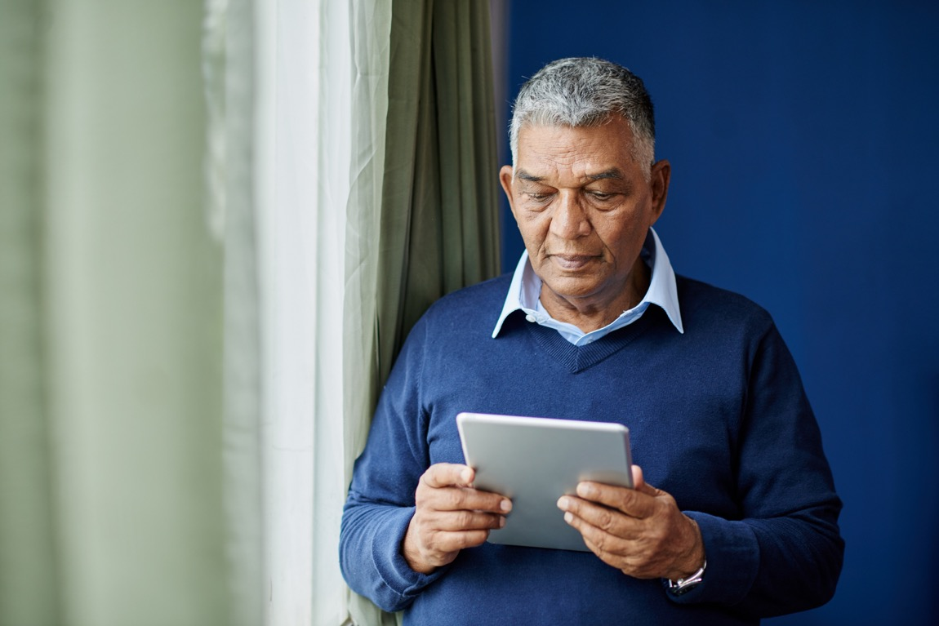
An aging population means more changes in ability.
Vision loss
Hearing loss
Decreased mobility
Cognitive changes
The 65-and-older age group will more than double over the next 40 years, rising from 15% of the US population today to nearly 24%.
Source: https://www.census.gov/content/dam/Census/ library/publications/2015/demo/p25-1143.pdf

Slide 14
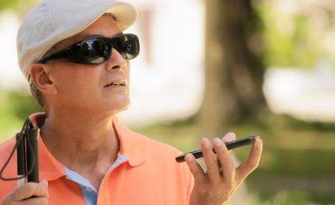



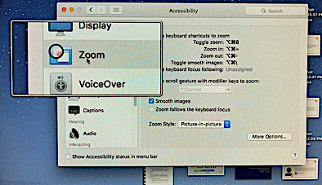
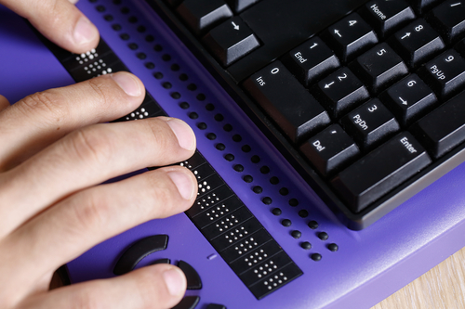

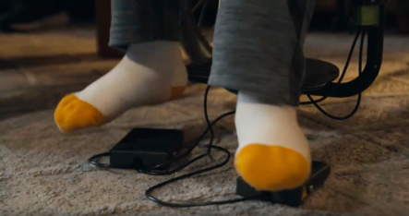
Assistive technology helps users interact w/ digital interfaces.
There is a wide variety of assistive technology supporting many use cases.
Screen Readers
Screen Magnification
Voice Dictation / Control
Refreshable Braille Displays
Closed Captioning
Audio Description
Keyboard Only
Input Devices & Switches

Slide 15
Why do Accessibility?
Here are four really good reasons, in my order of preference.

Slide 16

1. Accessibility is the right thing to do.
Corporate responsibility.
It’s a human right according to the United Nations.
Accessible products are better products.
Inclusive design and accessibility ensure you’re not blocking some people from using your product and fully participating in society.
Notes:
Convention on the Rights of Persons with Disabilities
UN General Assembly 2006

Slide 17

2. The market opportunity for accessible products is huge.
2B People with Disabilities (PWD) worldwide.
3B including their friends and family.
57M PWD in US, more than the entire populations of countries like Spain, Canada, and South Korea.
PWD and their friends and family control $8T in disposable income.
Only 24% of the largest US companies show any interest in accessibility.
Only 4% of the largest US companies have shown measurable effort.
Now is the perfect time to expand into this wide open market!
Source: http://www.rod-group.com/content/rod-research/edit-research-2016-annual-report-global-economics-disability

Slide 18

3. Someone will eventually demand accessibility.
Don’t take the financial and reputational risk.
Customers
Clients
Contracts
Leadership
Competition
Society
Media
Plaintiffs
DOJ

Slide 19

4. Accessibility is the law.
Don’t get fined or sued.
Americans with Disabilities Act (ADA)
Section 508 of the Rehabilitation Act
Accessibility for Ontarians with Disabilities Act (AODA)
European Accessibility Act
Other International laws
Web Accessibility lawsuits on the rise
WCAG 2.0 AA conformance is the standard

Slide 20
What is WCAG and what’s the problem?
(It’s a usability issue…)

Slide 21

WCAG 2.0 is the international accessibility standard.
Technical standard published in December 2008 by W3C.
How to make web content more accessible to people with disabilities.
WCAG 2.1 was published in June 2018.
78 Success Criteria broken into 3 levels (A, AA, AAA).
Goal to meet needs of individuals, organizations, and governments.
Written for governments to adopt as policy, not developers to integrate.

Slide 22

The Web Content Accessibility Guidelines are substantial.
Printed out, the spec plus supporting docs are more than 1200 pages long.
Technology agnostic, often open to interpretation.
Organized with the “end” users of WCAG in mind, i.e. people with disabilities.
Not written or organized for the actual users of WCAG, i.e., designers and developers.
We started with that problem and came up with a solution.

Slide 23
The Problem with adoption.
And how we solved for some challenging personas.

Slide 24
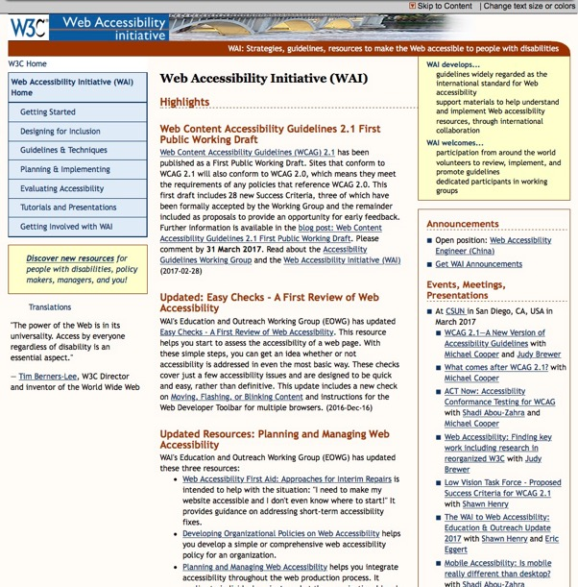
Visa has been doing Accessibility since 2006.
Trained by Knowbility, and working with W3C while they were writing the standard.
Released world’s first WCAG 2.0 AA major commercial website in 2007.
Invited Experts on W3C’s Education and Outreach Working Group.
Visa volunteers helped redesign the Web Accessibility Initiative Website, providing project management, user research, information architecture, and a completely new visual design.
WAI Website August 2005 - June 2018

Slide 25
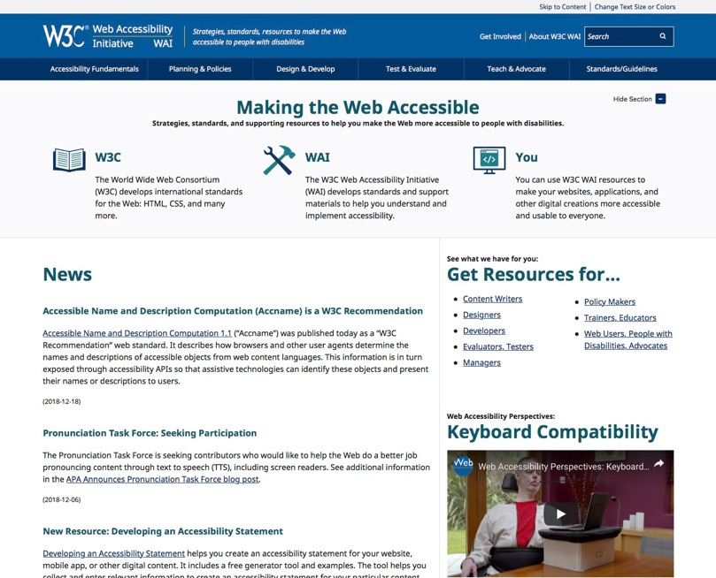
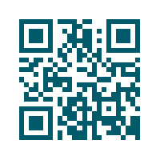
Visit the new Web Accessibility Initiative (WAI) Website.

Slide 26

Understanding our staff and meeting their needs.
Motivation to read 1200 pages lacking.
WCAG requires SME and interpretation.
Aesthetics and comprehensiveness build credibility.
Clear, simple instructions go a long way.
Everyone wants on-demand information.
Developers work at the component level and require code snippets.
QA works at the tool level and requires videos.
A friendly team behind the content helps relieve anxiety about the unknown.

Slide 27
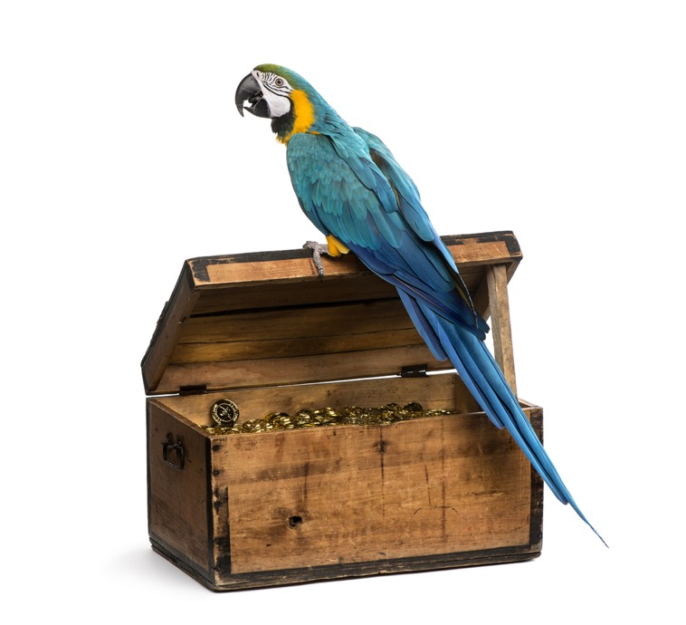
So we translated the WCAG into the VGAR.
Short for Visa’s Global Accessibility Requirements
Technical requirements for web (iOS and Android too)
Mapped directly to WCAG 2.0 AA (2. 1 in progress)
1:1 Requirement to Test Scenarios with how-to videos for every test
90 Minute Training Module
FAQs
Organized by “component” for Designers & Developers and by Testing Tool for QA
Available to all Visa Teams internally at http://accessibility/
“It’s pronounced Vee-Garrr”

Slide 28
What did the VGAR look like?

Slide 29
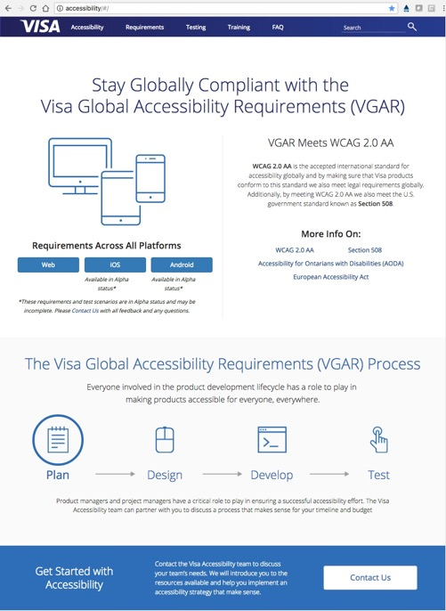
A friendly home page with a friendly team behind it.
The site is meant to look authoritative and approachable.
Everything a team would need to get started is in this one place.
Contacting our team is easy.

Slide 30
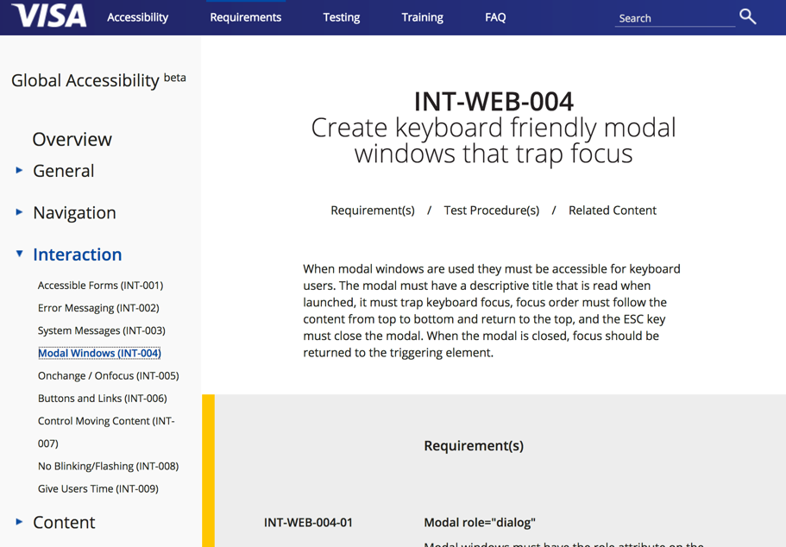
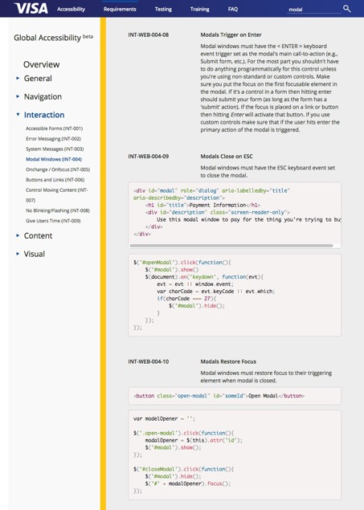
Requirements grouped by component.
Notes:
Demo: http://accessibility/#/

Slide 31
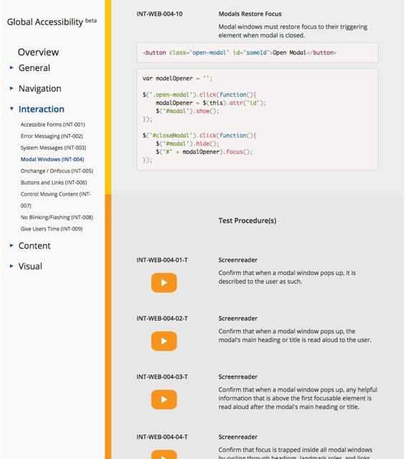
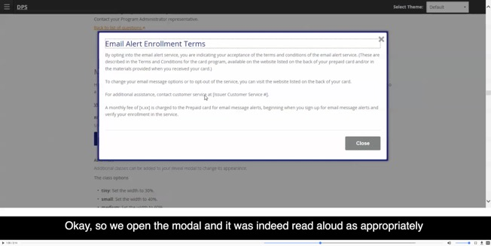
Test cases grouped by test tool with how-to videos.

Slide 32
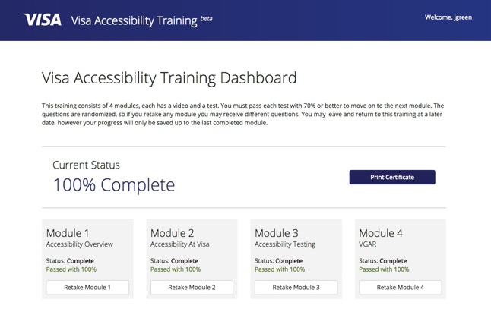
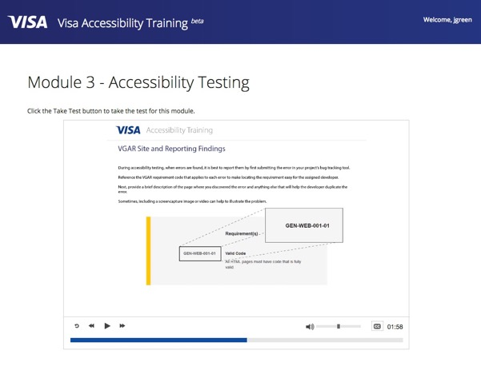
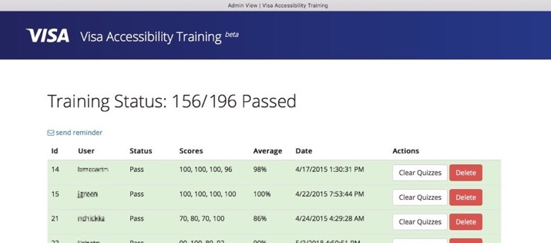
Online Training Module with Reporting.

Slide 33
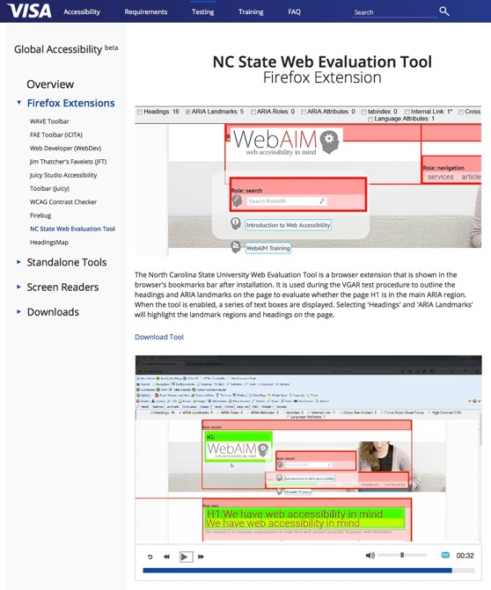
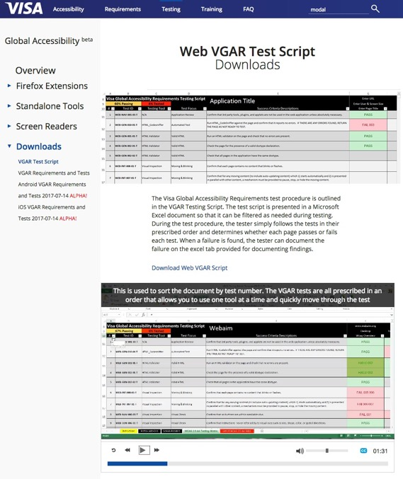
Assistive Technology and other tools to help with QA.
And it gives us a visual readout of where those are on the page.

Slide 34
Things we learned from 5 years of VGAR on our intranet.
It really is a ton of unique and valuable knowledge.
It helps with consistency across the company.
It reduces unnecessary communication between Dev and QA.
The self-service and email support model works in some situations.
External stakeholders love it, but it doesn’t prevent back-and-forth after they audit our products.
Our vendors would use it, but lack access to our intranet.
Colleagues in industry want it.

Slide 35
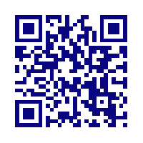
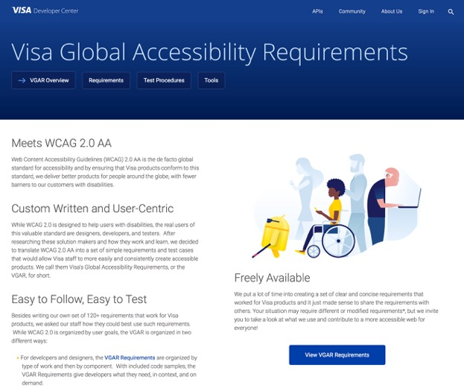
The VGAR’s New Home is Visa Developer Center.
http://developer.visa.com/pages/accessibility

Slide 36
VGAR Next Steps
More Sharing of knowledge:
  Videos for every test scenario and tool
  Additional videos covering relevant topics
  Tools we recommend and develop
Consistent updates to the VGAR
  Feedback from our users
  Updates to laws and standards
Custom sets of requirements as we develop them:
  PDF in draft
  Email (multiple clients) in draft
  Native Mobile (iOS and Android) in Alpha

Slide 37
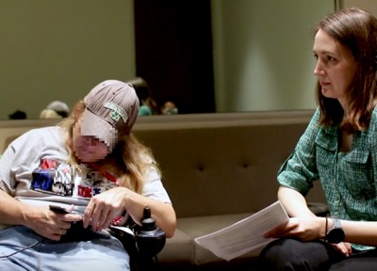
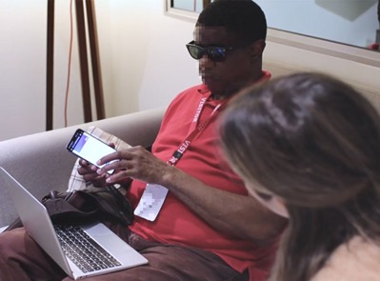
Visa Design System to Help Further Scale Accessibility
Effective and consistent Brand and UX
Efficient, production grade, consumable & configurable code
Designed for inclusivity and easy adoption
  Broad user base considered, following the VGAR
  Tested for accessibility with automated tools and by hand
  Tested in our UX lab by specially trained Research team

Slide 38
Let’s figure out where your team stands.

Slide 39
Evaluate your program to see where you stand…
Stakeholders
Time
Process
Resources
Skills
Leadership
Level of Accessibility of your Product(s)
Leadership Support and Vision
Stakeholders and how much time you have
Process and tools
Resource availability (budget, staff, skills)
Accessibility of your Product(s)

Slide 40
How accessible is your product today?
Stakeholders
Time
Process
Resources
Skills
Leadership
Quick manual testing on key pages to help you see how bad things are.
Automated testing is an easy way to test your whole product. (finds ~30% of issues)
It’s probably going to be bad.
Accessibility of your Product(s)
Notes:
What does your organization produce?
Web applications
Mobile applications
Printed materials
Email and advertising communications
Audio/visual media
Hardware
Software

Slide 41
Where are you with Accessibility Leadership?
Stakeholders
Time
Process
Resources
Skills
Leadership
Authority isn’t enough, you need influence.
Who will lead this effort?
How broad is awareness and support?
Do you have a champion?
Organizational culture controls change.
Long term, securing support from higher up is necessary.
Accessibility of your Product(s)

Slide 42
Do you have the right funding, staff, and skills?
Stakeholders
Time
Process
Resources
Skills
Leadership
Do you have the right skill set on your team?
Do you have enough people?
Do you have the expertise to hire good help?
You need dedicated staff, but it’s a team effort.
Does your team already lack in key areas?
  Communication
  Cooperation
  Discipline
  Motivation
  Quality
  Competence
  Culture
Conduct research to understand what your staff need.
Accessibility of your Product(s)
Notes:
Next, who is responsible for making it happen?
Product management team
Technology group
Design or UX
Legal or Compliance
Undecided
Who does the testing?
Does your organization have a QA team?
Can you hire test resources?
Do you need to engage an agency?
Can your developers test?
Do you have people you can train to test?
Who fixes the issues?
Do you have internal development teams?
Do you need to engage an agency?
Can you hire accessibility engineers?
How do you train your developers?

Slide 43
How will your process and tools need to change?
Stakeholders
Time
Process
Resources
Skills
Leadership
How well does your process work now?
Shift accessibility as far left as possible.
Do you have the tools needed to develop and test accessible code?
What configurations will you support?
Test with QA and users.
How will you be sure that code is accessible?
How will you make sure it stays that way?
How will you claim accessibility to stakeholders?
Accessibility of your Product(s)

Slide 44
What are your Stakeholders’ needs and timeframes?
Stakeholders
Time
Process
Resources
Skills
Leadership
Who are your stakeholders now and later?
Are you under external pressure to do this?
Legal compliance, contracts, sales, or reputation at stake?
Are there hard deadlines?
How long can/will they wait to see progress?
Do they trust you? Are they mad at you?
An educated plan goes a long way. If you back it up.
Accessibility of your Product(s)

Slide 45
Getting to Accessible and staying there.
Expect this to take years.

Slide 46

Understand your users... and then influence them.
Get to know your users.
You are a bringer of bad news and the face of extra work.
Accessibility is unknown and scary.
Have empathy for them and help them build empathy for their users.
Be smart and here to help!
Solve their key problems and they will get on board.

Slide 47
Shift Accessibility Left.
Accessibility doesn’t happen at the end of a project, it starts at the beginning.
It’s not just for the “accessibility person” – it’s every person’s job!
It starts with Product and Leadership showing it’s a priority.
Product
Design
Dev
QA

Slide 48

To get good help you must know a little yourself.
You need an in-house expert to bring on good help.
Procurement: vendors who say they know accessibility probably don’t. Demand working products to test yourself.
Agencies: Most consultancies are for-profit businesses, with their best interests and long term success in mind.
Hiring: test your candidates’ skills – can they find problems AND effectively help you fix them?
Notes:
Personal trainer example

Slide 49
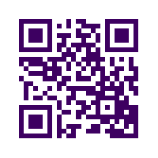
Knowbility is a unique Accessibility non-profit.
20 Years of Community Programs & Advocacy
John Slatin AccessU
OpenAIR
AccessWorks
ATSTAR
World Class Experts & Consulting Services
Accessibility strategy
Testing & Auditing
Usability Testing with People with Disabilities
Training
http://knowbility.org

Slide 50
If you can, write your own requirements and tests.
Start with the VGAR, but you have to base specific requirements on a specific system.
The goal is to create consistency and reduce interpretation discussions that come out of broad requirements like WCAG 2.X.
Evaluate your product(s) and the various UI components and interactions, what accessible solutions can you document as the new rule?
Organize for your users, e.g., requirements by component and tests by tool.
Place it all somewhere central and convenient.
Be ready to keep evolving as your products and technology do.

Slide 51

Lastly, fix your team first.
Accessibility exposes weakness in teams.
Every person has to see accessibility as their job.
Common challenges that raise risk:
  Distributed staff and high turnover
  Leadership sends mixed messages or none
  Overworked staff or unrealistic deadlines
  Poor communication and quality issues
  Inconsistency/lack of discipline in code
  A culture based only on shipping

Slide 52
Accessibility is not extra or a burden or even hard.
It’s just part of your job.
Your job description was incomplete before.
Now you get to do more and for lots of good reasons.
Thank you for your valuable work.

Slide 53
Visa’s Vision Statement:
To be the best way to pay and be paid, for everyone, everywhere.

Slide 54

Questions
accessibility

