Slide 1
HEY, SIRI!
ARE WE THERE YET?
www.3playmedia.com
@3playmedia

Slide 3
AGENDA
Trends in video and a11y
ASR & Captioning
ASR Examples
Synthesized Speech & Audio Description
Examples of synthesized description
Q&A
Notes:
Practice first, “Theory” later.

Slide 4
LOOK AT THE STATS
Notes:
No (but a good starting point for editing).

Slide 5
MORE VIDEO
82%
78%
Is uploaded to the web in 1 month than TV has created in 3 decades.
Of the world’s internet traffic will be video by 2022.
Of people are watching videos online every week.
Notes:
It’s important to note that this may not seem like it makes a big difference in a 7 word sentence, but when you have two sentences, and then a paragraph, and then multiple paragraphs. The errors add up very quickly.

Slide 6
71%
48 MILLION
24 MILLION
Of people with disabilities leave a website immediately if it is not accessible.
Americans are d/Deaf or hard of hearing. That’s 20%!
Americans are Blind or low-vision. That’s 10%!
Notes:
It’s important to note that this may not seem like it makes a big difference in a 7 word sentence, but when you have two sentences, and then a paragraph, and then multiple paragraphs. The errors add up very quickly.

Slide 7
12%
41%
98.6%
Captions increase view time on Facebook videos by 12%.
Of videos are incomprehensible without sound or captions.
Of students find captions helpful for learning.
Notes:
It’s important to note that this may not seem like it makes a big difference in a 7 word sentence, but when you have two sentences, and then a paragraph, and then multiple paragraphs. The errors add up very quickly.

Slide 8
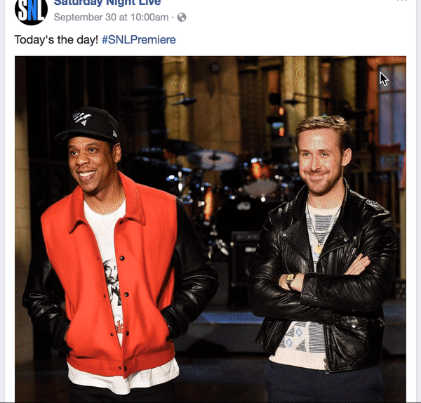
Notes:
Who else hates it when you’re scrolling through Facebook and you come to a video … and it autoplays without sound or captions. I’m in the 80% that hates it, that’s for sure.

Slide 9
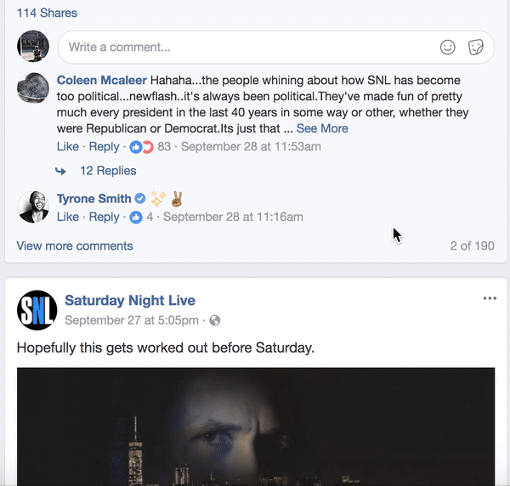
Notes:
Comparatively, this grasps your attention and keeps viewers with the video.

Slide 10
WHAT ARE CAPTIONS?
Time-synchronized text that can be read while watching a video
Usually the CC icon
Originated as FCC mandate for broadcast in the 1980s
Include relevant non-speech elements
Notes:
1)Time-synchronized text that can be read while watching a video
2)Usually the CC icon
3)Originated as FCC mandate for broadcast in the 1980s

Slide 11
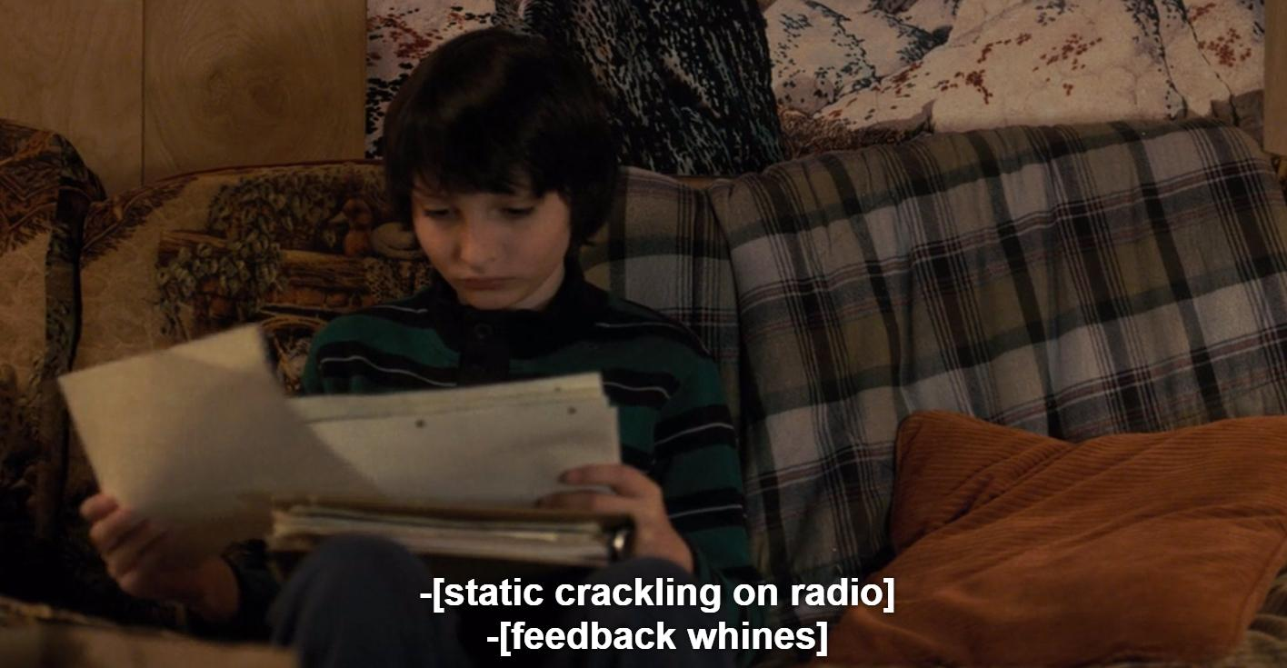
Notes:
Those auditory cues are critical to the plot development. Captions have to include non-speech elements like these.

Slide 12
WHAT IS ASR?
Automatic Speech Recognition
Translates spoken word to text.
Common uses: Siri, Alexa, YouTube auto captions

Slide 13
IS ASR GOOD ENOUGH FOR CAPTIONING?
Notes:
No (but a good starting point for editing).

Slide 14
THE 2019 STATE OF ASR
Annual report to test the current state of ASR. The 2019 report tested six of the most popular ASR technologies:
Speechmatics*
IBM Watson
Google
Microsoft
Temi (Rev)
Trint
*Speechmatics (SMX) is the engine we use in the first step of our captioning process.
Notes:
This is the task, and this is the universe of APIs - not every API, but all of the ones we could get access to.
All testing used real content, and lots of it, reflective of the most common type and volume that we receive at 3Play Media.
In order to gain a clear picture of where we stand, we chose to test content that spans across the industries which best represent our broad customer base and the content type that we receive on a regular basis.
Distinct from academic reports, which focus on one problem domain (good for benchmarking, but not real-world)
Distinct from Rev, which published results on 20 podcasts ~200K words, ~20 hours.
Distinct from some reports on line which tested a single file or two.
AND Distinct from Siri/Alexa, where the speaker is known, the queries are very constrained, and the words are not important (many tasks like that - which may shape your view of AI … so be careful!)

Slide 15
THE DATA
Industry | # of Files | # of Words | Duration (Hours)
Education | 178 | 408277 | 51.4
eLearning | 85 | 121303 | 14.0
E&M | 62 | 68592 | 8.7
Corporate | 37 | 80612 | 9.1
Online Video | 34 | 63782 | 7.1
Market Research | 9 | 15687 | 1.7
Faith | 7 | 6151 | 0.8
Fitness | 6 | 30169 | 3.3
Government | 5 | 8015 | 1.0
Total | 423 | 802588 | 96.9
All testing used real content, and lots of it, reflective of the most common type and volume that we receive at 3Play Media.
In order to gain a clear picture of where we stand, we chose to test content that spans across the industries which best represent our broad customer base and the content type that we receive on a regular basis.
Notes:
WER vs. FER: Speakers, Numbers, grammar fixing, non-speech tokens
WER: was actually 13% (insertions!)
FER was actually 25%.
McNemar - important statistical significance test on every single word (compares the two systems.)
Customer Mappings: Learns from editors corrections

Slide 16
Why is Siri so good, but my captioning sucks?
WHY SIRI IS SO GOOD:
Single Speaker
Constrained Tasks
Clarification
Did you catch my drift?
Close speaker
WHY ASR CAPTIONING IS SO BAD:
Usually multiple speakers
Tasks are open-ended
Background noise, poor audio
Lost frequencies
Most of us don’t speak perfectly
Changing audio conditions
Notes:
WER vs. FER: Speakers, Numbers, grammar fixing, non-speech tokens
WER: was actually 13% (insertions!)
FER was actually 25%.
McNemar - important statistical significance test on every single word (compares the two systems.)
Customer Mappings: Learns from editors corrections

Slide 17
WE EXAMINED...
1. Error Rates
The first test determined that Speechmatics had the lowest overall error rate, with an accuracy of 90.91%. Google and Trint were within 1% of Speechmatics, but both had significantly different error rates from Speechmatics according to the McNemar test.
2. Error Rates Including Punctuation, Capitalization, and other Formatting
Speechmatics paired with our custom mapping model performed the best compared with the other speech engines, at an accuracy rate of 77.88%, followed closely by Trint.
Notes:
WER vs. FER: Speakers, Numbers, grammar fixing, non-speech tokens
WER: was actually 13% (insertions!)
FER was actually 25%.
McNemar - important statistical significance test on every single word (compares the two systems.)
Customer Mappings: Learns from editors corrections

Slide 18
WER vs. FER
Word Error Rate (WER) is the % of word errors in a file.
Industry research often references WER, which does not accurately depict the experience of the viewer.
Formatted Error Rate (FER) is the % of word errors when we include punctuation, grammar, speaker ID, non-speech elements, capitalization, etc.
This is the experienced accuracy rate.

Slide 19
Common causes of
ASR errors
Word Errors (WER) | Formatting Errors (FER)
Multiple Speakers | Speaker Labels
Overlapping Speech | Punctuation
Background Noise | Grammar
Poor Audio Quality | Numbers
False Starts | Relevant non-speech elements
Acoustic Errors | No [INAUDIBLE] tags
Notes:
As Roger touched on earlier in the presentation, when it comes to captioning accuracy, it’s important to consider both Formatted Error Rate (FER) and Word Error Rate (WER).
The examples listed on the screen are common causes of asr errors. Word errors are when the word is incorrect. Formatting errors are those errors that relate to formatting elements such as punctuation, grammar, speaker identification, non-speech elements, capitalization, and other notations are taken into account. You were able to identify both types of errors in the ASR example that I just played.

Slide 20
CHALLENGES (not being addressed by current tech or research in NLP/ASR)
Punctuation
(?!)
Multiple Speakers
Overlapping Speech
Background Noise
Speaker Labels
Numbers
#
False Starts
Non-Speech Elements
Acoustic Errors
Notes:
Punctuation: While NLP has some ability to insert periods and (more limitedly) commas, there has been very little exploration into inserting quotations, parentheses, question marks, etc. The ability to do so is not currently represented in ASR/NLP models. This is an easy task for a human.
Multiple speakers: ASR has limited capabilities to switch models when multiple speakers are present. This is an easy task for a human.
Overlapping speech: While humans have evolved to understand multiple speakers at once, ASR has not.
Background noise: While humans can often pull out a speaker amidst background noise or poor audio quality, ASR methods struggle immensely with this.
Speaker Labels: ASR has limited means to identify different speakers and appropriately label speaker changes. Humans manage this easily.
Numbers: ASR will transcribe the words spoken instead of the numerical notation (i.e., November eighteenth nineteen ninety vs. 11/18/1990). NLP post-processing algorithms have some success with this task, but do not deal well with ambiguities. Humans easily accomplish this.
False starts/clean read transcription: ASR can train on removing word insertions like “um,” but it cannot identify mis-speaks and false starts. Humans adapt and can easily identify the misspoken words.
Captioning relevant non-speech elements: ASR has no methods for tagging sound effects or identifying relevance. Humans can do this easily, and understand context to identify relevance. For example: keys jangling in someone’s pocket while they’re walking down the street is not relevant; keys jangling behind a door in a horror movie is relevant.
Acoustic errors: Some of the most common word errors are acoustic errors that humans would never make. For example, “mixture” could be incorrectly transcribed as “makeshift.”
Key function words: ASR often fails on critical words like “can” and “can’t.” This can vastly alter the meaning of a sentence. Humans rely on context to choose the correct function word, even in the presence of very difficult audio.

Slide 21
ASR Example
Place your screenshot here
Audience Question ✋
What are some of the errors you notice in this example?
Notes:
I’m going to play an example of a transcript generated by ASR. I want everyone to take a listen and note any errors you hear.
[Play]
Is anyone willing to share what errors they noticed?
Right. These are examples of where ASR technology typically fails. While a lot of the errors sound similar, they are completely incorrect. A human wouldn’t make those errors, because they’re able to understand and consider context.

Slide 22
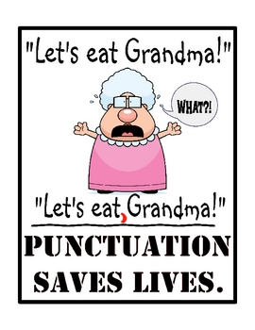
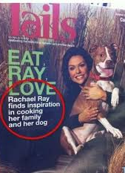
Formatting Errors
Incorrect punctuation can change the meaning of language tremendously.
Notes:
To better understand formatting errors and their importance, I have a few more examples.
Punctuation and capitalization are crucial to relaying the correct message. Incorrect punctuation can also make it difficult to comprehend a file – for example – following along or knowing who is speaking. For these reasons, it is important to measure accuracy rates which include punctuation as a factor… I bet grandma agrees!

Slide 23
Function Words
“I can’t attend the meeting.”
vs.
“I can attend the meeting.”
This example indicates a very common ASR error. Although seemingly small, the meaning is completely reversed.
Notes:
Function words are another area where ASR usually fails. This example indicates a very common ASR error. This type of error typically occurs with the presence of background noise, or if the speaker deemphasizes the second syllable of the keyword “can’t.” It is really important to note here, however, that although a seemingly small mistake, the meaning is completely reversed. It is very rare for a human – especially a trained editor – to make such an error, as they will use the context to determine the correct meaning, even in cases of background noise that may have been responsible for the ASR failure.
These are the types of errors that a human wouldn’t make because they can consider context clues and reason logically

Slide 24
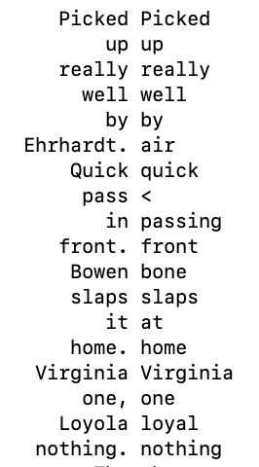
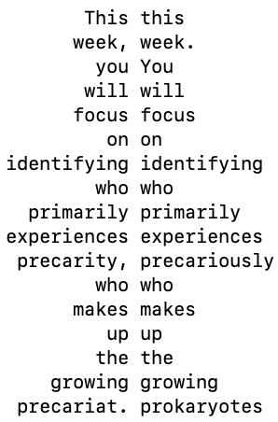
Complex Vocabulary
These examples of names and complex vocabulary require human expertise & knowledge. In each case, the truth is on the left, and the ASR is on the right.
Notes:
These are several examples from the actual test. They tend to focus on names and complex vocabulary which really do require human expertise/knowledge.
In each case, the truth is on the left, and the ASR is on the right:
You can see there are a lot of errors - both word errors as well as formatting errors.

Slide 25
“Much of Harvard’s online content is either not captioned or is inaccurately or unintelligibly captioned, making it inaccessible for individuals who are deaf or hard of hearing.”
Notes:
On February 5, 2015, the National Association of the Deaf (NAD) filed a class-action lawsuit against Massachusetts Institute of Technology (MIT) and Harvard University.
Harvard was accused of violating both the Americans with Disabilities Act (ADA) and Section 504 of the Rehabilitation Act for failing to provide accurate and comprehensive captioning for online educational content including online lectures, courses, and podcasts.
The lawsuit noted, “Much of Harvard’s online content is either not captioned or is inaccurately or unintelligibly captioned, making it inaccessible for individuals who are deaf or hard of hearing.”
It’s important to know that these “inaccurate” captions were from ASR technology.
So this really speaks to the importance of having accurate captions, and how this technology just isn’t there yet on its own.

Slide 26
WHAT THIS MEANS FOR YOU
While technology continues to improve, there is still a significant leap to real accuracy from even the best speech recognition engines, making humans a crucial part of creating accurate captions.

Slide 27
TAKEAWAYS
ASR has definitely improved of late.
We are confident that we are using the best available technology for our problem.
There are a few competitors that are worth watching for improvements to ASR.
ASR is not close to being sufficient to solve our problem.
Notes:
When we started in 2010 overall FER of 40%
DNNs came on-line since then and have definitely improved things.
Using data to update the ASR models is helpful
ASR helps our captioners focus on the higher-level intelligence tasks, leading to higher quality.

Slide 28
WHAT’S NEXT?
Download full 2019 ASR report
Webinars
Blog content and eBooks
Video A11y Certification Course
www.3playmedia.com/resources/industry-studies

Slide 29
THANKS!
Questions?
Find us:
Booth 27!
@3PlayMedia
elisa@3playmedia.com

