Slide 1
Writing Good Alt Text
Accessing Higher Ground, 2019
Robert Beach and Gaeir Dietrich

Slide 2
Presenters
Gaeir Dietrich
Access Specialist
Consultant
gaeird@gmail.com
408-996-6047
Robert Lee Beach
Assistive Technology Specialist
Kansas City Kansas Community College
rbeach@kckcc.edu
913-288-7671

Slide 3
Graphics. What to do?
Web pages, DE courses, online documents
Alt text
In books
Possibly alt text
Generally preferred
Possibly insert the caption
Preferred by some students so that the caption does not interrupt reading

Slide 4
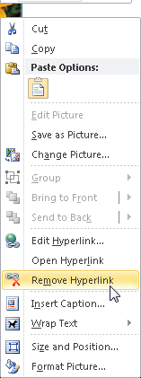
Be Aware: Hyperlinks
Graphics copied from the Internet sometimes retain their hyperlink and can cause issues
To remove the hyperlink in Office, right click on graphic and choose “Remove Hyperlink” or use the link tools in other programs

Slide 5
Be Aware: Graphics Inline
Graphics work best when they are placed “inline” with text
Other programs are not sure where to place graphics that are not inline
If you want to “wrap” text around the graphic, use columns for side by side
If you use graphics in Word that are not inline, check the reading order when converting PDF

Slide 6
As Specific Accommodations
When working with a particular student, ask his/her preferences.
Some students do not want the graphics included in the document at all.
Some students will have a reader describe graphics.
Some students will want either the embedded caption or alt text on the graphic.

Slide 7
I have the graphic, now what?
First figure out the purpose of the graphic.
What is the intent of the graphic?
What does the graphic convey?
What specific information does the graphic communicate?
How much is the purpose of the graphic informational? How much decoration?

Slide 8
Describing Graphics
When determining the purpose, always consider the context in which the graphic is being shown.
The same graphic may have a different purpose in a different context.
Sometimes decoration
Sometimes informational
Sometimes an entirely different point

Slide 9
How Do I Decide??
Does the student need to do something with the graphic or understand something from it?
Informational
Is the graphic simply entertaining or “pretty”?
Decoration

Slide 10
Decoration
Does it even need to be described?
If yes, how much? Usually very little.
If graphic is simply decoration
Word New version: decorative checkbox
Word Old version: brief description
PDF: set as “background”—mark as decorative element
Web: quote-quote “”
Canvas: decorative checkbox

Slide 11
Informational
If information is being conveyed, then consider…
What is the information being presented in the graphic?
Is that information already conveyed in the text?
How can I describe the graphic in as few words as possible?
Focus on “What is it?”

Slide 12
Illustrative
Does the graphic summarize or condense something described in the text?
May be informational; may be decorative
Depends on whether the graphic adds / summarizes information or simply illustrates exactly what the text describes
May be a visual summary of written passages

Slide 13
Testing
Tests using graphics as part of the testing material need special handling.
Beware of a simple description giving away the answer.
May need a longer description based on what the graphic looks like.

Slide 14
What Do I Say?*
Be objective
Stick to the facts, do not interpret
Be brief
The shorter the better
Be descriptive
Use words that convey clear meaning
Be logical
Use a sequence or structure
Be accurate
Make sure the information you give matches the book/site
* A Picture Is Worth 300 Words: Writing Visual Descriptions For An Art Museum Web Site by Adam Alonzo

Slide 15
In Most Cases…
Do not need to say “picture of,” “photo of,” “painting of”…
Screen reader will announce “graphic” or “image”
If there is a content-specific reason to identify the format, then go ahead
Art history, e.g., may differentiate between line drawing, painting, photo, etc.
May note schematic, diagram, map, etc.

Slide 16
Text in Graphics
If graphic contains important (i.e., text that is meant to be read for meaning), include the text in the alt text
A logo, for example, may contain a “tag line” in addition to the name
Include all text
A street scene may include signs which are not important
Do not need to include such text

Slide 17
No Single Right Way
There is not only one way to describe graphics.
Just remember…
Keep context in mind
Ask yourself: Is this something the person really needs to hear?

Slide 18
Exercise Photo 1
In a book about exercise, this photo appears at the beginning of a chapter on nutrition:

Slide 19
Possible Alt Text Photo 1
The photo is decorative.
It is simply illustrating the theme of the book.
Keep the description simple:
People biking
Cyclists
If you really want more…
3 people cycling along a river
Notes:
Gaeir: tell story about the over-described graphic

Slide 20
Exercise Photo 2
In the same textbook, the graphic below is included next to boxed text about the benefits of strength training.

Slide 21
Possible Alt Text Photo 2
This graphic is purely decorative.
Since this graphic is essentially “eye candy,” it is a good example of when a null tag might be useful on the web or the decorative checkbox in Word or Canvas.
If you do want to describe, keep it very short: “Smiley face lifting weights.”
Notes:
Robert: Several ways can do; any of them could be right

Slide 22
Logo Example 1
Kansas City Kansas Community College
Presents an Evening of Jazz
Come join us for two hours of wonderful jazz by the lake. …

Slide 23
Possible Alt Text Logo 1
The logo is mostly decorative, somewhat informational.
Logo is branding, but is essentially decorative from the user’s viewpoint.
Keep it simple; first time include all text.
Kansas City Kansas Community College logo, Making Life Better
KCKCC logo or college logo

Slide 24
Logo Example 2
In marketing your business, the design of a logo can make a big impression or can be a waste of money. The logo needs to be attractive but not dominate other information presented along with the logo. In the example below, what catches your attention?

Slide 25
Possible Alt Text Logo 2
The logo is informational.
In this case, the same logo is a specific example and requires a more lengthy description.
Focus on what the student needs to know:
Interlocking blue K and red C block letters on left with the words “Making Life Better” in red italics above the college name in black italics, blocked and underlined with a blue line.
Notes:
Robert: two opposite interns
Gaeir: When a graphic is part of an exercise, a lengthier description is required.

Slide 26
Blood Pressure Example 1
Proper positioning of the cuff, stethoscope and arm are important to accurate blood pressure readings. The arm should be relaxed and straight, resting on a flat surface. The cuff should be positioned just above the elbow. The stethoscope should be positioned over the brachial artery at the bend of the elbow. See the example for proper technique.

Slide 27
Possible Alt Text Example 1
The graphic is decorative.
The graphic is illustrative of what has been described in the text, and no further description is needed.
Keep the alt text simple:
Taking blood pressure

Slide 28
Blood Pressure Example 2
Proper positioning of the cuff, stethoscope, and arm are important to accurate blood pressure readings. See the example below for a demonstration of correct technique.

Slide 29
Possible Alt Text Example 2
The graphic is informational.
Since the photo illustrates a particular procedure, it would require a longer description because the description is not already present in the text.

Slide 30
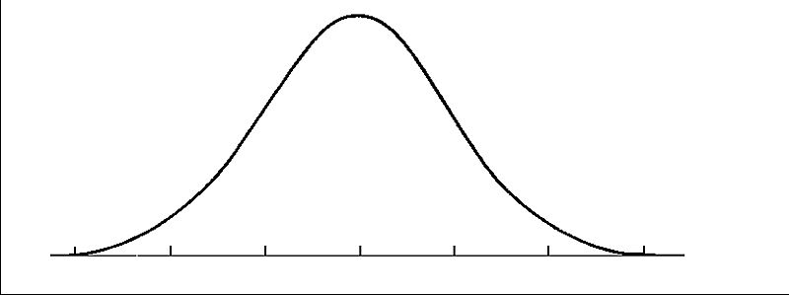
Math Example 1
The graph of a Gaussian function is a characteristic symmetric “bell curve” shape that quickly falls off towards plus/minus infinity.

Slide 31
Possible Alt Text Math Example
The graphic is informational.
The graph illustrates what a bell curve is.
Alt text could be “A bell curve.”
However…what if the student does not know what a bell curve is?!?

Slide 32
When More Is Needed
Sometimes even a long description will not really convey the information in the graphic.
The alt text will not be sufficient for a student’s needs.
Tactile graphics to the rescue!

Slide 33
What Are Tactile Graphics?
A tactile graphic is a tactile representation of the content conveyed by a graphic.
Tactile graphics are not simply “copies” but are new conceptualizations of the information being conveyed.
They convey the same information in a totally different form.
Notes:
Gaeir: stylized representation of the information that needs to be conveyed

Slide 34
Tactile Graphics Session
For more, we will be presenting on tactile graphics in another session!
Feel Good about Your Tactile Graphics
Wednesday, November 20, 3:30 p.m.
Westminster 2

Slide 35
Other Resources
NCAM
http://ncam.wgbh.org/
Description for Assessment
https://www.wgbh.org/foundation/guidelines-for-describing-images-for-assessments
W3C WAI
https://www.w3.org/WAI/tutorials/images/decision-tree/
WebAIM
http://webaim.org/techniques/images/

Slide 36
Credits
A Picture is Worth 300 Words
CSUN proceedings 2001 by Adam Alonzo
Blood Pressure photo
Photo Credit blood pressure check image by .shock from Fotolia.com

Slide 37
Thank you!
Robert Beach
rbeach@kckcc.edu
913-288-7671
Gaeir Dietrich
gaeird@gmail.com
408-472-3146

